Slide 1
Types and Access Control for Cross-Domain Security in Flash
Aseem Rastogi
University of Maryland, College Park
Avik Chaudhuri Rob Johnson
Adobe Systems Stony Brook University

Slide 2
Flash: Ubiquitous on Web
and many more …

Slide 3
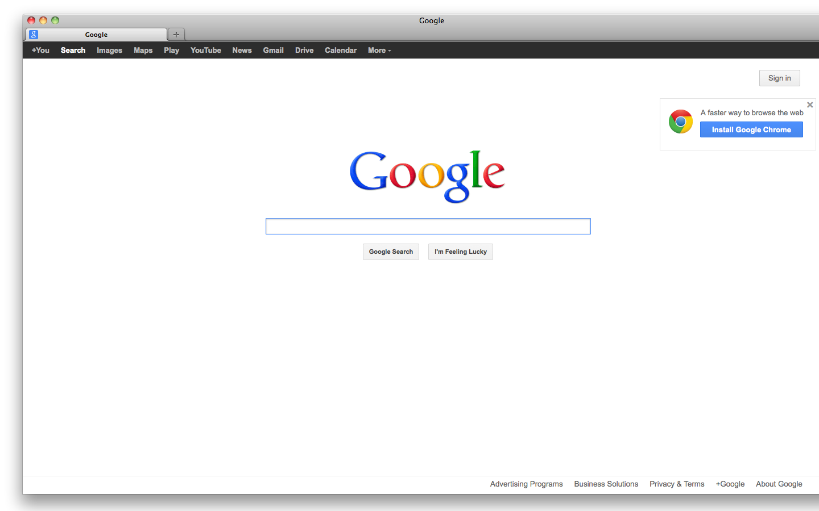
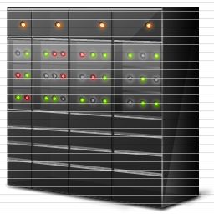
The Big Picture
Web browser
A₁
A₂
A₃
B₁
B₂
SWFs
http://www.a.com
C₁
C₂
Web servers
Flash Player
http://www.b.com

Slide 4
Flash Security Model
Controls interaction between swfs, web browser, and servers
Configured by trust policies
Runtime access control checks to enforce trust policies

Slide 5
Security Model – Trust Relationships
A₁
A₂
A₃
Complex asymmetric trust relationships
✗
✗
✗
B₁
✗
B₂
http://www.a.com
C₁
C₂
Flash Player
http://www.b.com

Slide 6
Problems
No formal specification of the Flash Security Model !
The security guarantees of the model are unclear
Programmers cannot reason about security of swfs

Slide 7
Our Contributions
Security model formalization
First formal specification of Flash Security Model
Well Typed programs cannot violate data integrity invariants
Prevents Cross Site Scripting and other injection attacks too !
Show inadequacy of the model
Example programs that violate data integrity property
Type System to enforce data integrity
Security extension to the Flash static type system
Strong Threat Model: The attacker’s code need not be well-typed

Slide 8
This Talk
Introduction to Flash Security Model
Example programs that violate data integrity
Overview of the security type system
Conclusion

Slide 9
This Talk
Introduction to Flash Security Model
Example programs that violate data integrity
Overview of the security type system
Conclusion

Slide 10
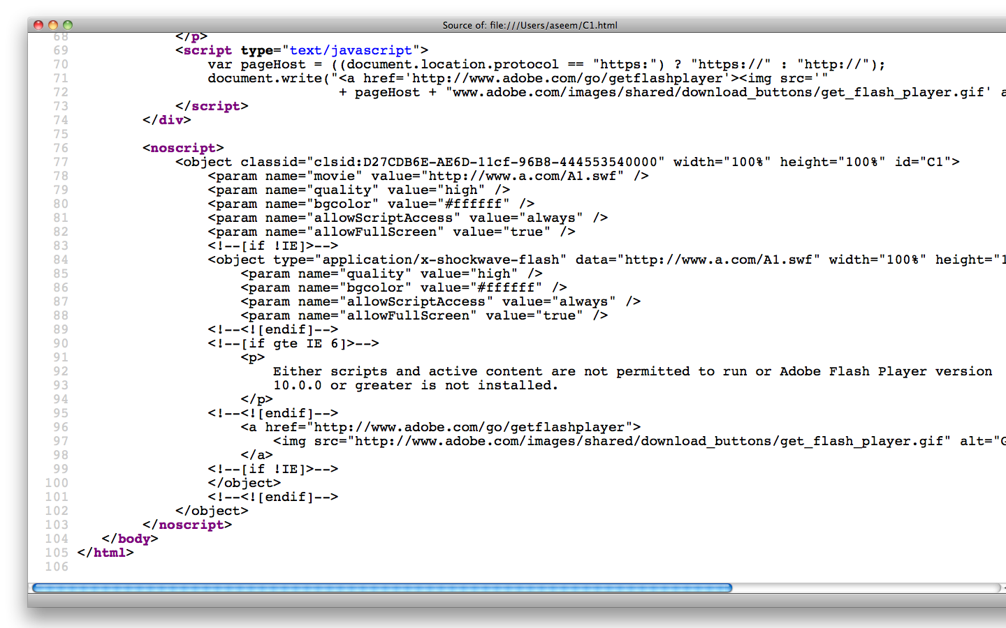
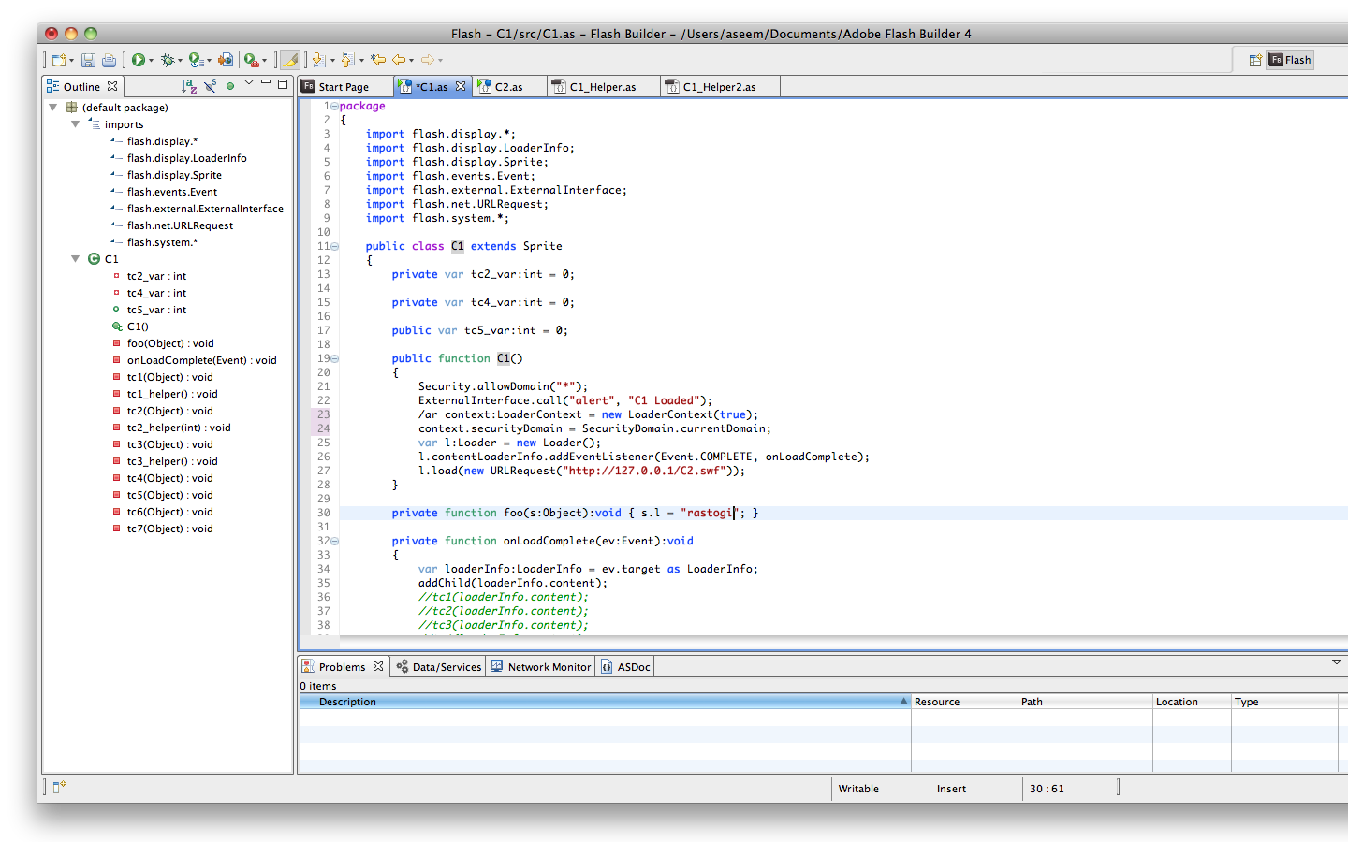
Flash Applications
A₁
A₁
ActionScript Compiler
ActionScript Code
A₁
http://www.a.com
HTML Code

Slide 11
Flash API
Rich API. SWFs can:
load other swfs from same/different domain
access data and functions of other swfs
manipulate HTML DOM
do network communication
Security Model:
Provides access control API
Enforced by Flash Player

Slide 12
Same Origin Policy
Domain Based Sandboxes
A₁
A₂
A₃
Different from JavaScript
Freely communicate within a sandbox
✗
✗
B₁
B₂
No cross-communication by default
✗
C₁
C₂
Flash Player

Slide 13
Extensions to Same Origin Policy
SWFs can grant access permissions to swfs from other domains
A₁
A₂
A₃
B₁: allowDomain(“A”);
✗
B₁
B₂
C₂: allowDomain(“B”);
✗
C₁
C₂
Flash Player

Slide 14
Content Loading vs. Import Loading
Import Loaded
A₁
http://www.a.com
B₁
B₂
Content Loaded
http://www.b.com
Flash Player

Slide 15
Security Model Formalization
Model APIs for swf loading
in a core calculus with functions and objects
Model trust assumptions
Different from actual Flash API: static vs. dynamic
Semantics for:
swf loading
swf execution
runtime access control checks
More details in the paper !

Slide 16
This Talk
Introduction to Flash Security Model
Example programs that violate data integrity
Overview of the security type system
Conclusion

Slide 17
Threat Model
The attacker owns some web domains
Writes swfs and hosts them
the swfs can do all that is allowed by the language
Victim does not trust the attacker
but the attacker trusts the victim - allowDomain(victim)
The attacker’s and victim’s swfs may load one another
Flash runtime contains victim’s and attacker’s swfs executing together
Attacker’s goal: violate data integrity invariants of victim’s swfs

Slide 18
Example - 1
v = [ s_fn = fun(x) { /* transfer $100 to account x */; ret 0; } ]
a = [ v_swf = load(v), f = v_swf.s_fn(a_acc) ]
✔
Executes in a separate sandbox
Direct cross scripting
prevented by Flash runtime
Recall: Victim does not trust the attacker

Slide 19
Example - 2
v = [ s_fn = fun(x) { /* transfer $100 to account x */; ret 0; },
a_swf = load(a), f = a_swf.f’(s_fn) ]
a = [ f’ = fun(g) { g(a_acc); } ]
Allowed by Flash runtime
Indirect cross scripting allowed by Flash runtime
Violation of Data Integrity
Recall: Attacker trusts the victim
✗

Slide 20
This Talk
Introduction to Flash Security Model
Example programs that violate data integrity
Overview of the security type system
Conclusion

Slide 21
Security Labels on Types
Add labels S (set of domains) to the types
Invariant: A term t with type τ_{S} should evaluate to a value that comes from one of the domains in S

Slide 22
Static Type System
If a term with type τ_{S} flows to a context that expects a term of type σ_{T} then
Label checks in addition to the usual subtyping checks
For higher order types, check all parts of the types
S
τ <: σ and
T

Slide 23
Example – 2 Revisited
v = [ s_fn = fun(x) { /* transfer $100 to account x */; ret 0; },
a_swf = load(a), f = a_swf.f’(s_fn) ]
a = [ f’ = fun(g) { g(a_acc); } ]

Slide 24
Example – 2 Revisited
v = [ s_fn = fun(x) { /* transfer $100 to account x */; ret 0; },
a_swf = load(a), f = a_swf.f’(s_fn) ]
a = [ f’ = fun(g) { g(a_acc); } ]
s_fn: (int_{{d}} int_{{d}})_{{d}}
d is victim’s domain

Slide 25
Example – 2 Revisited
v = [ s_fn = fun(x) { /* transfer $100 to account x */; ret 0; },
a_swf = load(a), f = a_swf.f’(s_fn) ]
a = [ f’ = fun(g) { g(a_acc); } ]
s_fn: (int_{{d}} int_{{d}})_{{d}}
Γ(a.f’) = ((int_{D} int_{D})_{D} int_{D})_{D}
d is victim’s domain
D is set of all domains

Slide 26
Example – 2 Revisited
v = [ s_fn = fun(x) { /* transfer $100 to account x */; ret 0; },
a_swf = load(a), f = a_swf.f’(s_fn) ]
a = [ f’ = fun(g) { g(a_acc); } ]
s_fn: (int_{{d}} int_{{d}})_{{d}}
Γ(a.f’) = ((int_{D} int_{D})_{D} int_{D})_{D}
Type Check: (int_{{d}} int_{{d}})_{{d}} <: (int_{D} int_{D})_{D}
d is victim’s domain
D is set of all domains

Slide 27
Example – 2 Revisited
v = [ s_fn = fun(x) { /* transfer $100 to account x */; ret 0; },
a_swf = load(a), f = a_swf.f’(s_fn) ]
a = [ f’ = fun(g) { g(a_acc); } ]
(int_{{d}} int_{{d}})_{{d}} <: (int_{D} int_{D})_{D}

Slide 28
Example – 2 Revisited
v = [ s_fn = fun(x) { /* transfer $100 to account x */; ret 0; },
a_swf = load(a), f = a_swf.f’(s_fn) ]
a = [ f’ = fun(g) { g(a_acc); } ]
(int_{{d}} int_{{d}}) <: (int_{D} int_{D}) {d} D
(int_{{d}} int_{{d}})_{{d}} <: (int_{D} int_{D})_{D}
✔

Slide 29
Example – 2 Revisited
v = [ s_fn = fun(x) { /* transfer $100 to account x */; ret 0; },
a_swf = load(a), f = a_swf.f’(s_fn) ]
a = [ f’ = fun(g) { g(a_acc); } ]
int_{D} <: int_{{d}} int_{{d}} <: int_{D}
(int_{{d}} int_{{d}}) <: (int_{D} int_{D}) {d} D
(int_{{d}} int_{{d}})_{{d}} <: (int_{D} int_{D})_{D}
✔

Slide 30
Example – 2 Revisited
v = [ s_fn = fun(x) { /* transfer $100 to account x */; ret 0; },
a_swf = load(a), f = a_swf.f’(s_fn) ]
a = [ f’ = fun(g) { g(a_acc); } ]
int <: int D {d}
int_{D} <: int_{{d}} int_{{d}} <: int_{D}
(int_{{d}} int_{{d}}) <: (int_{D} int_{D}) {d} D
(int_{{d}} int_{{d}})_{{d}} <: (int_{D} int_{D})_{D}
Victim’s code fails to type check
✗
Data integrity violation is flagged at compile time
✔

Slide 31
Type System Properties
Soundness: Well-typed programs do not violate data integrity invariants
Attacker code need not be well-typed security labels wise
victim can enforce data integrity all by himself
Prevents Cross Site Scripting attacks
More details in the paper !

Slide 32
Contributions
First formal specification of the Flash Security Model
Demonstrate inadequacy of the model
example data integrity violation attacks
Security extension to Flash static type system
flags data integrity violations at compile time
stronger threat model: the attacker’s code need not be well-typed security labels wise

