Slide 1
What is OAuth and Why?

Slide 2
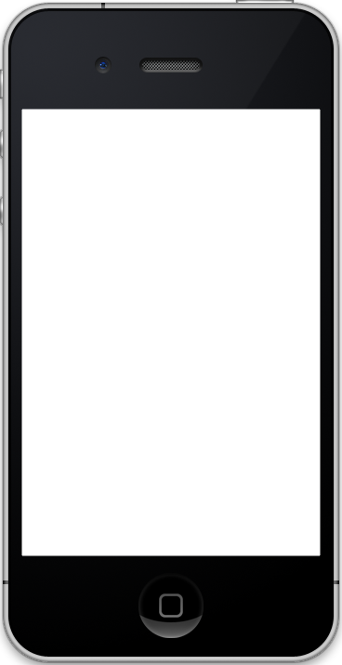
Twitter
(or other service)
App
User

Slide 3
How OAuth Works

Slide 4
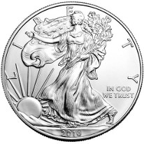
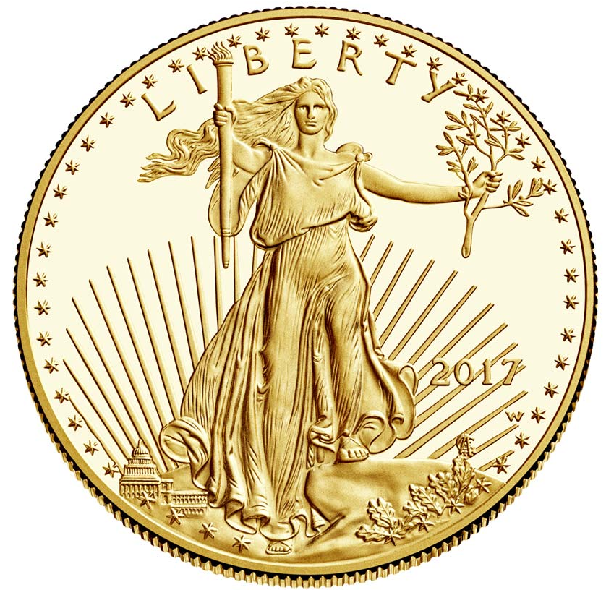
Request Token
Access Token
Used to authorize someone to
Access your account
Used to actually do stuff with
Your account

Slide 5
Twitter
(or other service)
3rd Party App
(like an app you write)
User

Slide 6
Twitter
(or other service)
User Installs App
3rd Party App
(like an app you write)
User

Slide 7
Twitter
(or other service)
3rd Party App
(like an app you write)
User
App requests access to user’s Twitter

Slide 8
Twitter
(or other service)
User Says “OK!”
3rd Party App
(like an app you write)
User

Slide 9
Twitter
(or other service)
App asks for request token
3rd Party App
(like an app you write)
User

Slide 10
Twitter
(or other service)
Twitter sends token
3rd Party App
(like an app you write)
User

Slide 11
Twitter
(or other service)
3rd Party App
(like an app you write)
User
App sends token to user to authorize

Slide 12
Twitter
(or other service)
User tells Twitter to authoirze token
3rd Party App
(like an app you write)
User

Slide 13
Twitter
(or other service)
Twitter sends user authorized token
3rd Party App
(like an app you write)
User

Slide 14
Twitter
(or other service)
3rd Party App
(like an app you write)
User
User sends authorized token to app

Slide 15
Twitter
(or other service)
3rd Party App
(like an app you write)
User

Slide 16
Twitter
(or other service)
App sends request token and asks for authorization token
3rd Party App
(like an app you write)
User

Slide 17
Twitter
(or other service)
3rd Party App
(like an app you write)
User

Slide 18
Twitter
(or other service)
3rd Party App
(like an app you write)
User

