Slide 1


Toward Improved Aeromechanics Simulations Using Recent
Advancements in Scientific Computing
Qi Hu, Nail A. Gumerov,
Ramani Duraiswami
Institute for Advanced Computer Studies and Department of Computer Science
Monica Syal,
J. Gordon Leishman
Alfred Gessow Rotorcraft Center and Department of Aerospace Engineering
University of Maryland
College Park, MD
Presented at the 67th Annual Forum of the American Helicopter Society,
Virginia Beach, VA, 3–5 May 2011
Sponsored by AFOSR, Flow Interactions & Control Program
Contract Monitor: Douglas Smith
Notes:
Good morning,
Today I will be on behalf of our team, to present how recent advancements in scientific computing to improve the aeromechanics simulations. This work is supervised by prof. Gumerov, Duraiswami and leishman.

Slide 2
100x+ “faster” is “fundamentally different”
David B. Kirk, Chief Scientist, NVIDIA
Notes:
The key idea of this work is to speedup the computation as much as possible such that we can run large scale simulations with millions of particles and vortex elements in acceptable time. We hope to get computation results over coffee, but NOT over nights!

Slide 3
Outline
Motivation
  Vortex element method
  Particle motion simulations
Brute force algorithm accelerations
  Graphics processing units (GPU)
  Performance
Algorithmic accelerations
  Fast multipole methods (FMM)
Fast algorithms on GPUs
  FMM on GPU
  Fast data structures
  Performance and error analysis
Conclusion
Notes:
The outline of this presentation is as following:
First motivation,
Next, we will present the brute force algorithm accelerations.
Then, we will introduce the algorithm acceleration: fast multipole method.
After that, we describe our FMM implementation on GPU.
Finally, we conclude this work.

Slide 4
Motivation

Slide 5
Motivation – Aeromechanical Simulations
High fidelity comprehensive analysis required for aeromechanics
  Aeroacoustics
  Aeroelasticity
  Vibrations
  Complex turbulent flows
  Many more
Particularly, we are interested with rotorcraft brownout simulations, which include
  Flow simulations using free vortex method
  Dust cloud dynamics in vortical flows via Lagrangian methods
  These simulations are very time consuming and we are looking for accelerations using high performance computing and algorithmic advances
Notes:
In many fields of aeromechanics, such as Aeroacoustics, complex turbulent flow, it is required to perform high fidelity analysis, which are computationally expensive.
Particularly, in our group, we are targeting at the rotorcraft brownout simulations.
When solve the system on large number of particles and vortex elements using these method, the total computations are very time consuming. Our goal here is to accelerate such kind of computations by using both high performance computing techniques and algorithmic advances such that the run time can be reduced substantially.

Slide 6
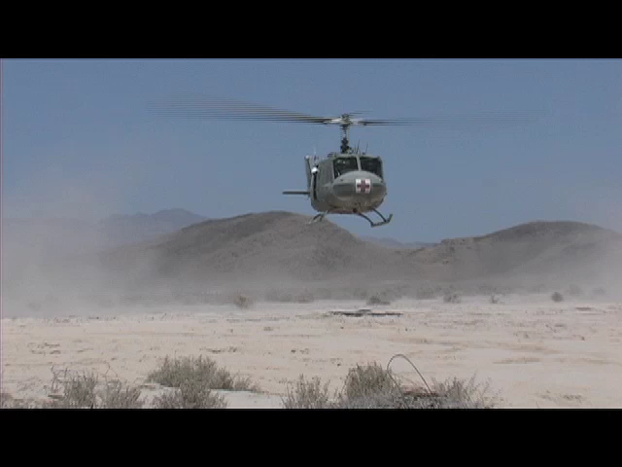
Motivation – Problem of Brownout
Video courtesy OADS
Brownout is a safety of flight issue and cause of many mishaps
Loss of ground visibility for the pilot as well as vection illusions
Modeling dust cloud helps understand the scope of the problem and possible means of mitigation:
  By rotor design
  By flight-path management
Notes:
First of all, lets watch one video of the generated dust clouds when a helicopter is landing on the desert terrain. From this video, you could imagine that the pilot can not see any nearby objects which may provide necessary outside visual reference for landing safely. In fact, many civilian and military rotorcraft accidents are caused by the brownout.
It is known several factors which affect the probability and severity of brownout:
1. Rotor design
2. Soil composition
3. approach speed and angle
Therefore, modeling of these dust clouds is important to help understand the scope of the problem and possible means of mitigation

Slide 7
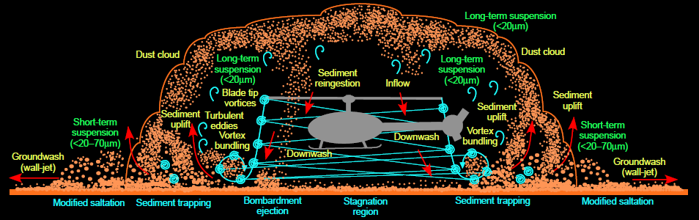
Challenges in Dust Cloud Modeling
Flow field is complicated and many vortex elements are needed to model the flow correctly
Physics of two-phase particulate flows is complex and different mechanisms of particle-flow interaction can be important
A large number of particles is needed for Lagrangian methods
Many time steps are needed to provide reliable computations
Notes:
The figure shows a general schematic of the brownout problem, which essentially is a dual phase and multi-disciplinary problem.
The flow field here is very complicated and many factors, such as vortex stretching, vortex bundling, have to be considered. The complexity of the problem gets aggravated by the presence of dust particles.
Modeling of billions of particles poses a big computational challenge for each time step and also many time steps are required for the realistic simulation.

Slide 8
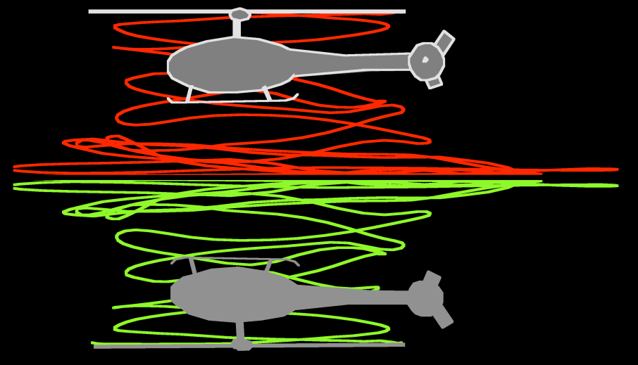


Free-Vortex Method
Z
q
y
Blade, N
ψ
Straight line segment
l
approximation
ζ
r
Real flow
Ω
l
+1
Γ
p
x
Blade, N-1
Ground
v
Lagrangian
l
+2
h
markers
Image flow
Γ
Curved vortex
v
filament
Induced velocity from
element of vortex trailed
by blade N-1
Velocity field
Smoothing kernel
“viscous core”
Vortex center dynamics
N² interactions
(all to all)
Notes:
In present study the flow field is modeled using the free vortex methodology. Ground plane is simulated by using an image rotor system.
The Lagrangian markers are convected using the convection equation, which is obtained from the equations describing an inviscid and incompressible flow.
The discretized convection equations are then solved using finite differences.
The velocity field is obtained by solving the Biot–Savart law. To maintain the stability, we also include the smoothing kernel for some cases.
Assume there are total N vortex elements, then to update the vorticity, N^2 interactions have to be conducted, which result in the quadratic complexity.

Slide 9
Particle Dynamics
Force on particle
Particle position
Particle velocity
Fluid velocity field
N vortex elements act on M particles:
Total number of interactions NM
Notes:
For the particle dynamics, at each time step, the particle velocities are updated according to the Newton second law. Due to each vortex element has influence on each particle, so if you have M particles, the total computation complexity for the particle updating is O(NM) at each time step.
For the details of the modeling methodology, I recommend to attend the other talks of our group, or consult our group director professor Leishman.

Slide 10
Technical Barriers and Solutions
Computation is expensive for real simulations:
  Millions of particles and vortex elements involved with O(N²+NM) cost per time step
  Many time steps for realistic simulations
Ways to achieve efficiency:
  Acceleration of brute force computations
    Multiple CPU cores
    CPU distributed clusters
    Graphics processors (GPUs)
    Heterogeneous CPU/GPU architectures
  Algorithmic acceleration
    Fast multipole methods (FMM)
  Use both
Notes:
Hence, the big technique challenge is that, computation is very expensive for realistic simulations.
In this work, the way to solve this computation challenge consists mainly three parts:

Slide 11
Brute Force Acceleration
Notes:
This section describe our first way to accelerate the computation.
First way to accelerate the computation is to use parallel processing for brute force acceleration

Slide 12
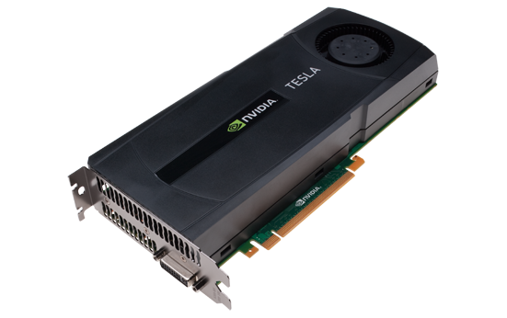
A Quick Introduction to the GPU
  Graphics processing unit (GPU) is a highly parallel, multithreaded, many-core processor with high computation power and memory bandwidth
  GPU is designed for single instruction multiple data (SIMD) computation; more transistors for processing rather than data caching and flow control
A few cores
Hundreds cores
Control
ALU
ALU
ALU
ALU
Cache
NVIDIA Tesla C2050:
1.25 Tflops single
0.52 Tflops double
448 cores
DRAM
DRAM
CPU
GPU
Notes:
Control and cache become very small!

Slide 13
Is It Expensive?
  Any PC has GPU which probably performs faster than the CPU
  GPUs with Teraflops performance are used in game stations
  Tens of millions of GPUs are produced each year
  Price for 1 good GPU in range $200-500
  Prices for the most advanced NVIDIA GPUs for general purpose computing (e.g. Tesla C2050) are in the range $1K-$2K
  Modern research supercomputer with several GPUs can be purchased for a few thousand dollars
  GPUs provide the best Gflops/$ ratio
  They also provide the best Gflops/watt
Notes:
Current No.1 Super computer, TianHe 1A by China, is equipped with the latest NVIDIA fermi GPU M2050.

Slide 14
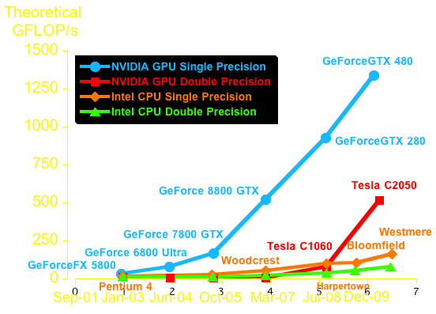
Floating-Point Operations for CPU and GPU
Notes:
Driven by the insatiable gaming market demand for realtime, high-definition 3D graphics, the computation power of GPU hardware evolves substantially each year. By comparing with latest CPU chips, the theoretical peak performance of the current highend NVIDIA GPU is much higher than the popular multicore CPUs in terms of both single and double precision computation.

Slide 15
Is It Easy to Program A GPU ?
For inexperienced GPU programmers
  Matlab Parallel Computing Toolbox
For FORTRAN Programmers: FLAGON
  Middleware to program GPU from FORTRAN
  Relatively easy to incorporate to existing codes
  Developed by the authors at UMD
  Free (available online)
For advanced users
  CUDA: a C-like programming language
  Math libraries are available
  Custom functions can be implemented
  Requires careful memory management
  Free (available online)
Local memory
~50 kB
GPU global
memory
~1-4 GB
Host memory
~4-128 GB
Notes:
Programming GPU is hard before because it requires deep knowledges of computer graphics and its pipelines. But since recently, generous purpose computation on gpu becomes popular in scientific computing society, a lot of softwares are developed to ease the use of GPU. Hence, programming GPU becomes much easier.
In our group, the authors also developed a middleware software FLGAON to incorporate GPU codes into existing Fortran code. It is easy to use. Flagon is a open source software and free to download from sourceforge. Just google FLGAON GPU, you can find the link.
Basic linear algebra subroutines and fast fourier transfer librarys are available.
GPU has a hierarchical memory architecture. Their sizes and accessing speeds are quite different. The key idea of efficient CUDA programming is how to make balance between the memory size and speed. Also it is important that CUDA is free online.

Slide 16
University of Maryland
UMD is one of the NVIDIA world excellence centers for the GPU programming
  Courses on GPU programming
  PCs equipped with GPUs
  CPU/GPU heterogeneous cluster at Institute of Advance Computer Study (UMIACS)
Notes:
Within the computer science department, we have both graduate and undergraduate level courses on GPU programming. And lots of PCs in our labs are equipped highend GPUs. In a addition, the Institute of Advanced Computer Study has a highend CPU/GPU heterogeneous cluster, which is accessible to many researchers.

Slide 17
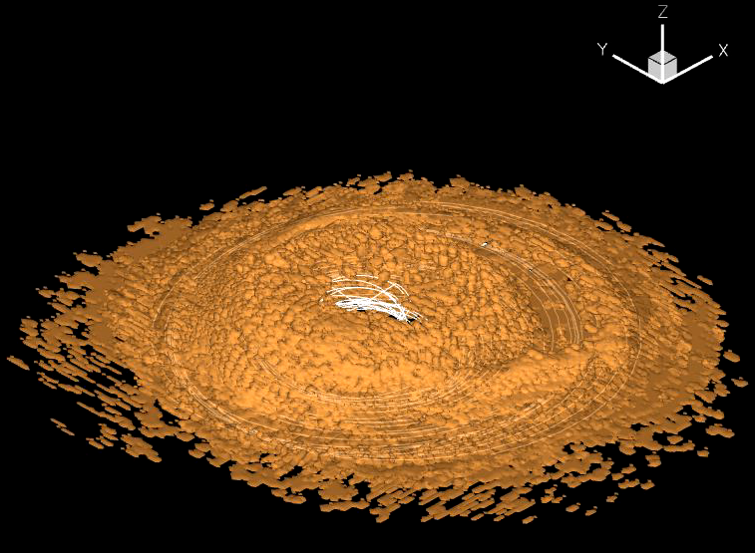
Acceleration via GPUs
Existing brute force brownout simulations
  At least 20 times speedup for double precision
  At least 250 times speedup for single precision
  Total time for landing simulation:
CPU (8 cores): 45.1 hours
GPU : 4.1 hours
Notes:
Our first result is on the speedup of the most time consuming part in the existing calculation for brownout.
The 10 times difference not 20 times is due to computation overheads.
This acceleration is realized by distributing the computation tasks among GPU cores.
For single precision, we can achieve up 250 times and double 20 times. For double precision, there is no difference between the CPU and GPU.
Below are the snapshots on two different time steps obtained from our simulation. CPU and GPU use both double precision.

Slide 18
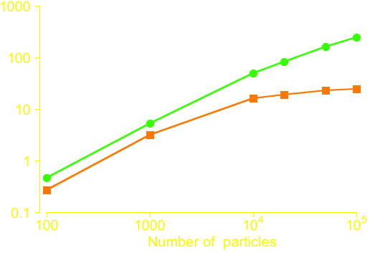
Direct Parallelism for Simulations
Wake induced velocities
  computation expensive (quadratic)
  easy to parallel the brute force calculations
  incorporate CUDA codes into current FORTRAN codes by FLAGON
For small number of particles, GPU implementation not efficient because of computational over-heads involved
For large number of particles, single precision 10 times faster than double precision
Acceleration, X
Single precision
Double precision
Notes:
Going into the details, we are timing the functions to compute wake induced velocities, which are implemented on GPU and CPU.
In our performance test, we run these two implementations on different number of particles. The speedup is summarized in the following figure.
One thing to note is that: GPU is not good at small size problems. Only when the computation dominate the overall performance, we can have good speedup. For small size problems, other things, like the CPU-GPU data transfering, some overhead and latency may be the most part of the wall clock time. Hence, in that case, we wont expect good speedup by using GPU.

Slide 19
Algorithmic Acceleration

Slide 20
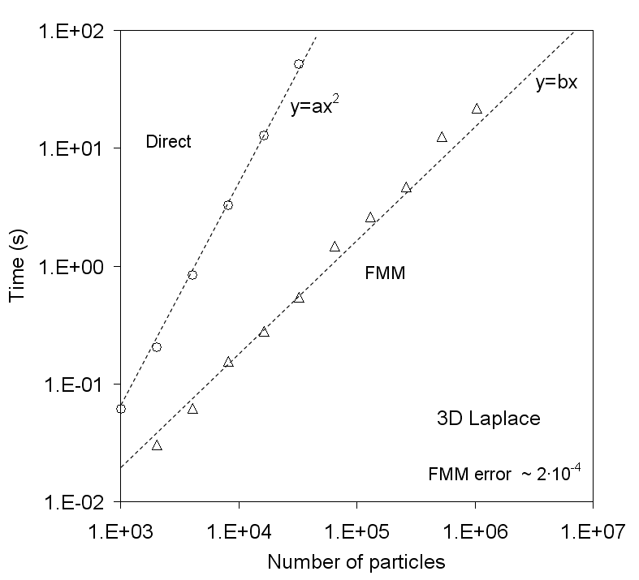
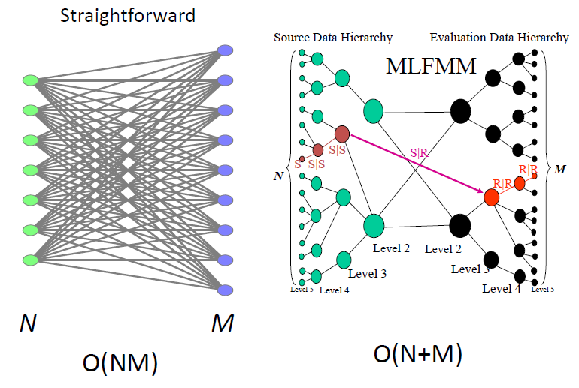
Fast Multipole Method
FMM introduced by Rokhlin and Greengard (1987), hundreds of publications since then
Achieves dense NxM matrix-vector multiplication for special kernels in O(N+M) time and memory cost
Based on the idea that the far field of a group of singularities (vortices) can be represented compactly via multipole expansions
Uses hierarchical data structures
Notes:
It is known that each vortex element has influence on each particle. Hence, we have O(NM) computation complexity if we use the direct method, which is shown on the left figure. But, ppl from fluid mechanics already known that, the influence of the group of far field vortex elements can be approximately replaced by a single vortex element. FMM puts this idea in a rigorous mathematical framework can achieve machine precision or other required precisions.
The way to approximate with required precisions is realized by the hierarchical data structure and multipole and local expansions. Using Fast multipole methods, we can reduce this computation cost to linear.

Slide 21
Algorithmic and Hardware Acceleration

Slide 22
FMM on GPU
Pioneering work by Gumerov and Duraiswami 2007 with many papers since
  Showed that the peculiarities of GPU architecture affect the FMM algorithm
  1 million N-body interaction computed for 1 second in single precision
  Bottleneck: FMM data structures are relatively slow and take time exceeding the FMM run time
  Did not implement the vortex element method
Our new results:
  Fast data structures on GPU (very important for dynamic problems)
  Vector kernels for the vortex element method
  Problem sizes on a single GPU extended to tens of millions particles
  Double precision computations
Notes:
Previously, the data structure construction time only takes a small part of the overall time. But when the FMM is implemented on GPU, its run time is reduced substantially hence that data structure construction time become dominant computation part. This is not acceptable for the dynamic problems.
In this work, we developed a novel data structure which can be constructed on GPU in parallel.

Slide 23
Acceleration of the FMM Data Structure on GPU
Our new algorithm constructs the FMM data structures on GPU for millions of particles for times of the order of 0.1 s opposed to 2-10 s required for CPU.
This provides very substantial computational savings for dynamic problems, where particle positions change and the data structure should be regenerated each time step.
Depth of the FMM octree (levels)

Slide 24
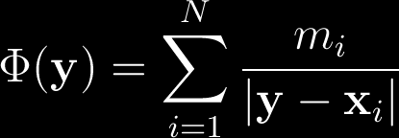
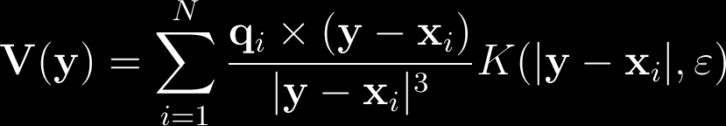

FMM for 3D Vector Kernel (Vortex Elements)
The Baseline FMM on GPU in previous implementation computes the scalar kernel (1/r)
To obtain the Biot-Savart 3D vector kernel, we need to apply the baseline FMM three times and compute the gradients
is the smoothing kernel (viscous core) with support ε.
Notes:
The smoothing kernel is used to reduce the singularity of the kernel function so that the stability can be preserved. Different smoothing kernels are implemented and tested.

Slide 25
FMM for Biot–Savart Vector Kernel
Our algorithm demonstrates that the full FMM computation time is even less than doubled baseline FMM running time (not tripled)
Time (sec)
Number of vortex elements
Notes:
Again, the philosophy of GPU programming is that computation is cheap but memory accessing is relative expensive. Hence, we optimized our code by techniques such as memory coeallescing and minimize the global memory accessing such that the extra computations can be performed for free.

Slide 26
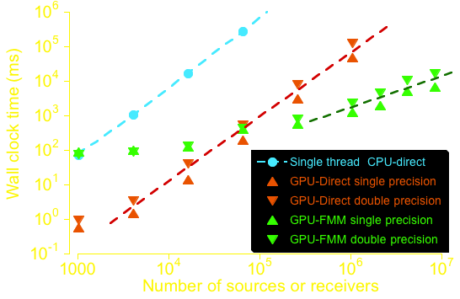
Overall Performance Test
Double precision computation of 10 million particle interaction takes about 16 seconds and single precision takes 7 seconds per time step

Slide 27
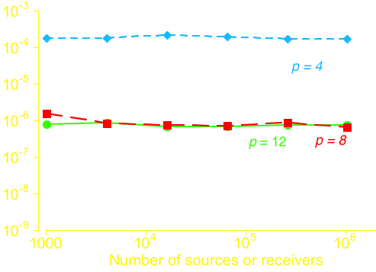
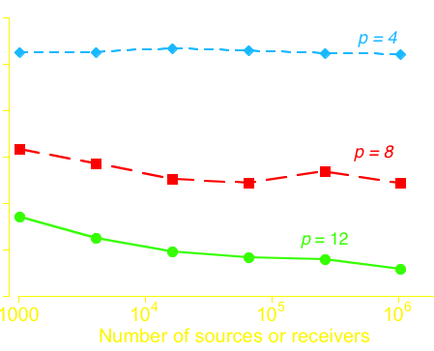
Error Analysis
Relative error in L₂-norm for different multipole expansion truncation numbers and problem sizes
The total number of multipoles in a single expansion is
Error
Single precision
Double precision
Error
Number of Vortex Elements
Number of Vortex Elements
Notes:
P is the truncation number, which determines the accuracy of FMM. Generally speaking, larger p, means we use more multipoles to expand the kernel functions, hence give better accuracy.
For the single precision, due to the round off errors and the number of bits to represent mantisa, 10^-6 already hit its accuracy limit.

Slide 28
Conclusions
The capability of improved high fidelity aeromechanics very large simulations demonstrated
Accelerated vortex particle computations on GPUs performed
GPU based FMM data structures with very small cost enable the FMM application for dynamic problems
The acceptable accuracy of FMM on GPU is shown with both single and double precision
The ability to achieve very large simulations in acceptable time has been demonstrated

Slide 29
Questions?
100x+ “faster” is “fundamentally different”
David B. Kirk, Chief Scientist, NVIDIA

Slide 30
Backup slides

Slide 31
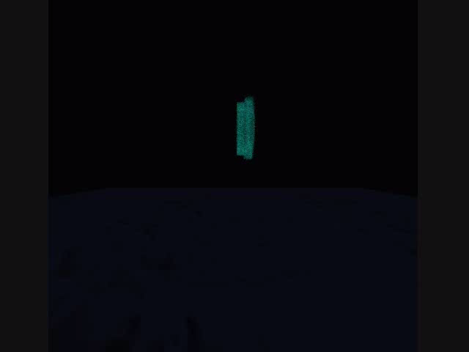
Two vortex rings interaction demo
Two vortex rings move at the same direction
Two vortex rings collision

Slide 32
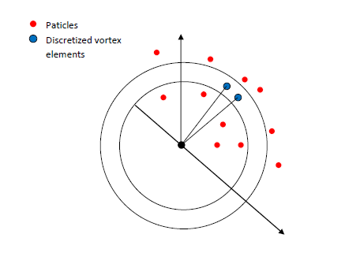
FMM testing
Run a single vortex ring movement to test FMM
16384 discretized ring elements and 32768 particles

Slide 33
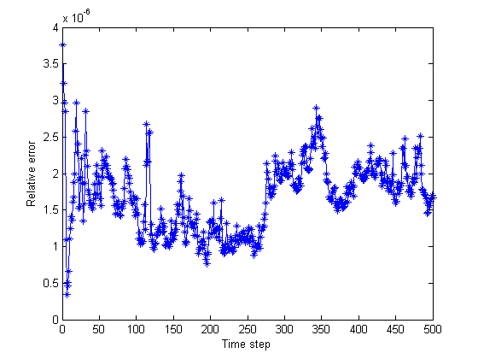
FMM testing
Compute relative errors by comparing with CPU results for every time step
Run for 500 time steps with acceptable error
10^(-6)

Slide 34
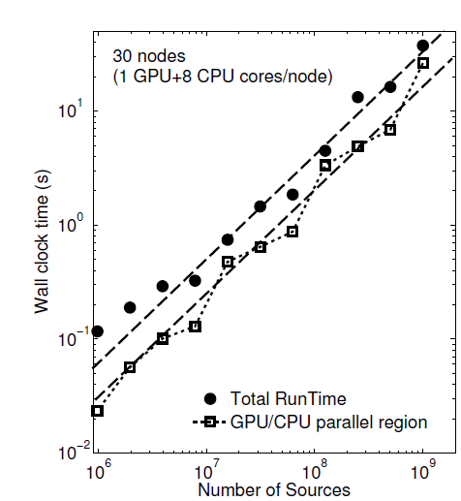
Extending the algorithm to clusters
Practical simulations may require billions of particles/vortices
Recently we developed heterogeneous algorithm that scales well on the cluster of CPU/GPU nodes
Our current result: One billion of vortices in 30s on clusters of 30 nodes
expected to be significantly improved both in terms of number of particles and computation time

Slide 35
Toward Improved Aeromechanics Simulations Using Recent
Advancements in Scientific Computing
Qi Hu, Nail A. Gumerov,
Ramani Duraiswami
Institute for Advanced Computer Studies and Department of Computer Science
Monica Syal,
J. Gordon Leishman
Alfred Gessow Rotorcraft Center and Department of Aerospace Engineering
University of Maryland
College Park, MD
Sponsored by AFOSR
Contract Monitor Douglas Smith

Slide 36
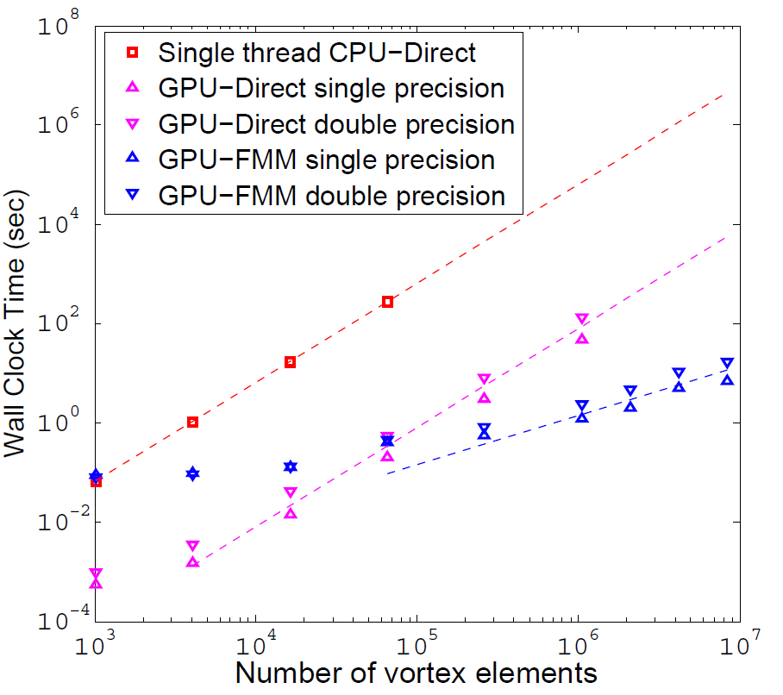
Overall Performance Test
Double precision
computation
Full interaction of
10 million particles
in about 16 seconds
(Single precision in
7 seconds)
Larger fonts for titles, legend and labels. X-axis title: Number of Vortex elements. Also put time in seconds, not milliseconds.

Slide 37
Algorithmic Acceleration - FMM
4 cores of CPU via OMP
Notes:
In this graph, we the performance of our FMM implementation on CPU using openMP. Clearly, the direct method shows the quadratic complexity while the FMM shows the linear cost.

Slide 38
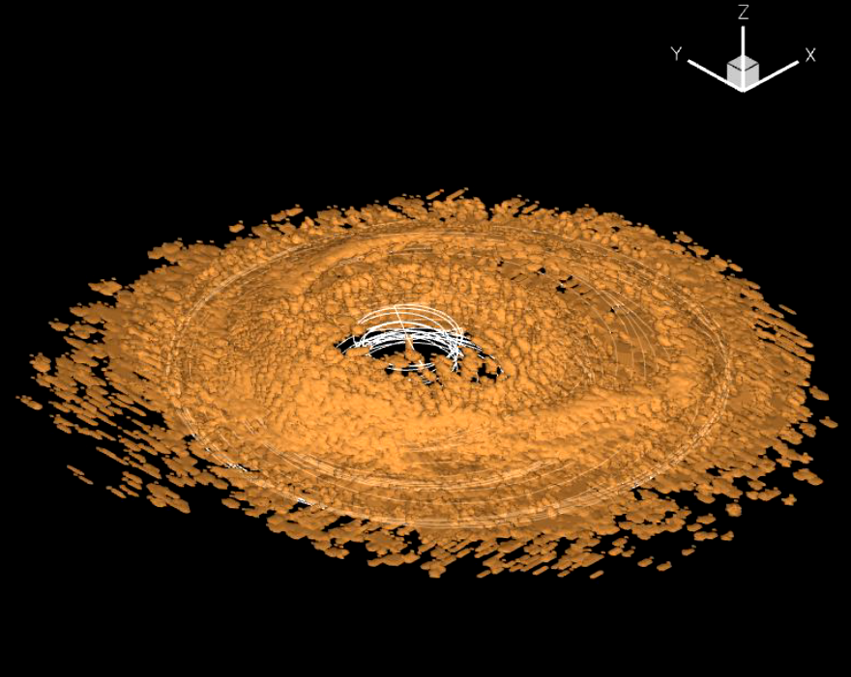
Acceleration via GPUs
Existing brute force brownout simulations
  At least 20 times speedup for double precision
  At least 250 times speedup for single precision
  Total time for landing simulation:
CPU (8 cores): 45.1 hours
GPU : 4.1 hours
Notes:
Our first result is on the speedup of the most time consuming part in the existing calculation for brownout.
This acceleration is realized by distributing the computation tasks among GPU cores.
For single precision, we can achieve up 250 times and double 20 times. For double precision, there is no difference between the CPU and GPU.
Below are the snapshots on two different time steps obtained from our simulation. CPU and GPU use both double precision.

