Slide 1
Scalable Distributed Fast Multipole Methods
Qi Hu, Nail A. Gumerov, Ramani Duraiswami
Institute for Advanced Computer Studies
Department of Computer Science
University of Maryland, College Park, MD
Notes:
All these work are collaborate with my supervisor prof. Duraiswami, Gumerov.

Slide 2
Previous work
FMM algorithm for GPUs
Gumerov and Duraiswami (2008) explored the FMM algorithm for GPU
Yokota, et al. (2009) presented FMM on the GPU cluster
FMM algorithm for distributed systems
Greengard and Gropp (1990) discussed parallelzing FMM
Ying, et al. (2003): the parallel version of kernel independent FMM
Lashuk, et al. (2009) presented kernel independent adaptive FMM on heterogeneous architectures
Cruz, et al. (2010): the PetFMM library
Hu, et al. (2011): the heterogeneous FMM algorithm
Yokota, et al. (2011): using FMM to simulate turbulence on 4096 GPUs

Slide 3
Issues with previous results
Communication data structures: local essential tree
Bottleneck
No details of implementation
Especially, our previous work Hu, et al. (2011):
The L|L translations are not fully distributed
Very large data transfer overheads

Slide 4
Contributions
Efficient salable communication management data structures
Classify the spatial boxes
Determine boxes for internode exchange on GPU
Only communicate necessary data
Small amount of communication data
Fully distribute the all parts of FMM among all the nodes
Extremely fast parallel algorithms for FMM data structures
Complexity O(N) and much faster than evaluation steps
Suitable for dynamics problems

Slide 5
Motivation: Brownout
Complicated phenomena involving interaction between rotorcraft wake, ground, and dust particles
Causes accidents due to poor visibility and damage to helicopters
Understanding can lead to mitigation strategies
Lagrangian (vortex element) methods to compute the flow
Fast evaluation of the fields at particle locations
Need for fast evaluation of all pairwise 3D interactions

Slide 6
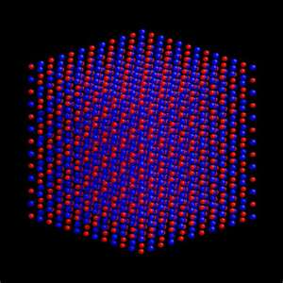
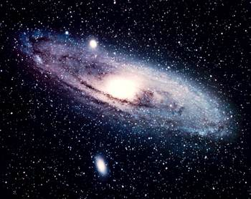
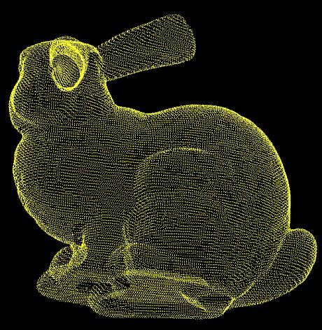
Motivation
Many other applications require fast evaluation of pairwise interactions with 3D Laplacian kernel and its derivatives
Astrophysics
(gravity potential
and forces)
Molecular Dynamics
(Coulomb potential
and forces)
wissrech.ins.uni-bonn.de
Micro and Nanofluidics
(complex channel Stokes flows)
Imaging and Graphics (high quality RBF interpolation)
Much More!

Slide 7
Introduction to fast multipole methods
Problem: compute matrix-vector product of some kernels
Linear computation and memory cost O(N+M) with any accuracy
Divide the sum to the far field and near field terms
Direct kernel evaluations for the near field
Approximations of the far field sum via the multipole expansions of the kernel function and spatial data structures (octree for 3D)

Slide 8
Introduction to the fast multipole method
The local and multipole expansions of the Laplace kernel at the center with the truncation number p
Expansions regions are validated by well separated pairs realized using spatial boxes of octree (hierarchical data structures)
Translations of expansion coefficients
Multipole to multipole translations (M|M)
Multipole to local translations (M|L)
Local to local translations (L|L)
r^{n}Y_{nm} local spherical
basis functions
r ^{−(n+1)}Y_{nm} multipole spherical
basis functions

Slide 9
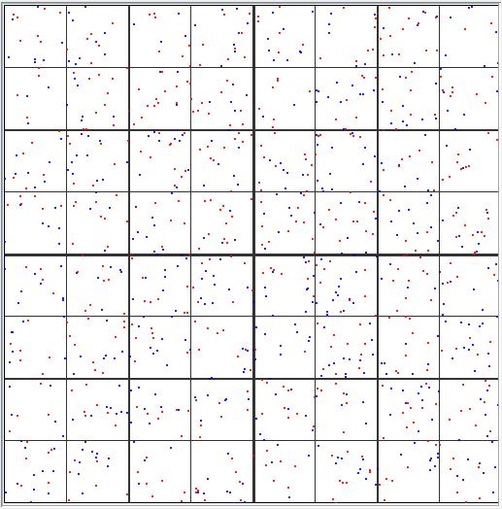
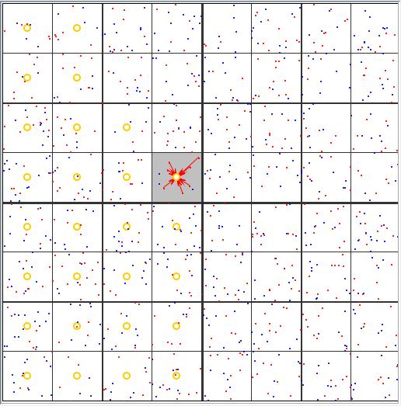
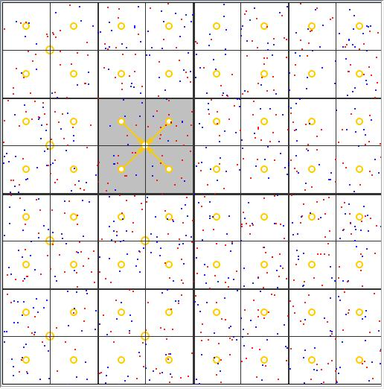
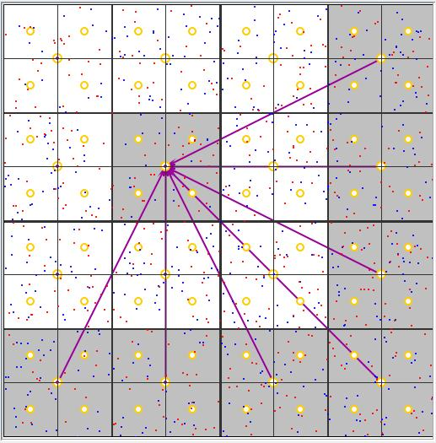
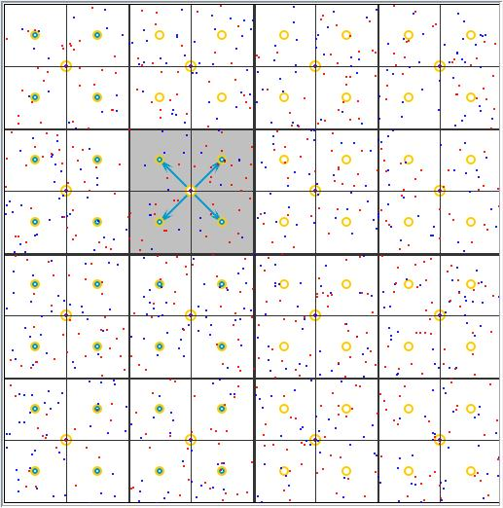
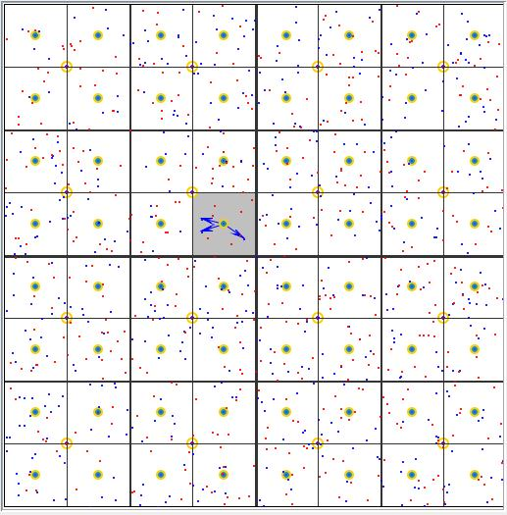
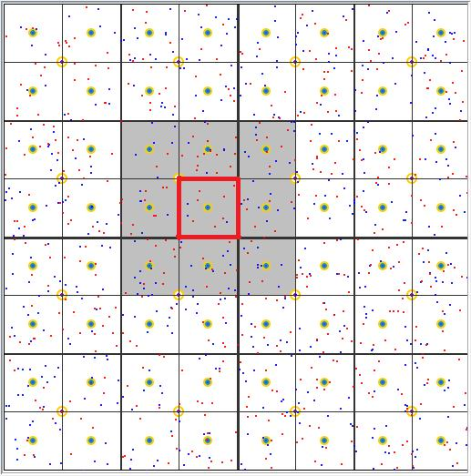
FMM flow chart
Build data structures
Initial M-expansions
Upward M|M translations
Downward M|L, L|L translations
L-expansions
Local direct sum (P2P) and final summation
From Java animation of FMM by Y. Wang M.S. Thesis, UMD 2005

Slide 10
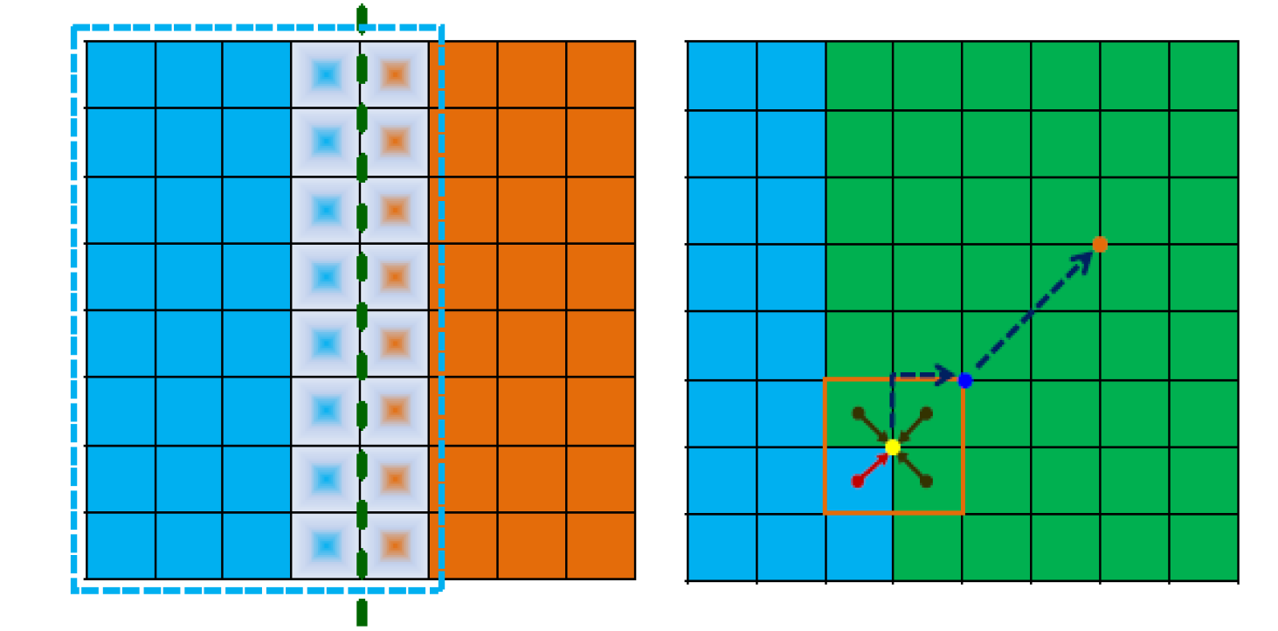
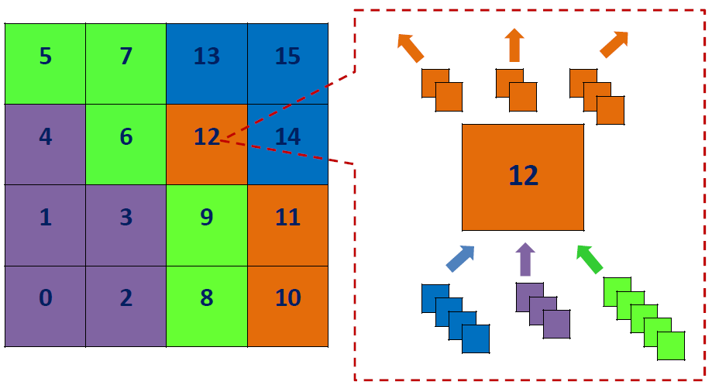
Issues with distributed algorithms
Halo regions
Incomplete translations

Slide 11
Solutions
Distribute the entire computing domain based on the global workload balance
Classify the spatial boxes into 5 categories
Need to calculate box types efficiently
No interruptions on kernel evaluations
A single communication to exchange data of halo regions
Master-slave model
Small overheads
All other computations are performed independently
Fully distributed

Slide 12
Heterogeneous architecture
openMP
Main
Memory
GPU
GPU
CPU
core
CPU
core
CPU
core
CPU
core
PCI-e
MPI
openMP
Main
Memory
GPU
GPU
CPU
core
CPU
core
CPU
core
CPU
core
PCI-e
MPI
InfiniBand
Notes:
Here is the typical architecture of a heterogeneous computing node

Slide 13
Mapping the FMM on CPU/GPU architecture
GPU is a highly parallel, multithreaded, many-core processor
Good for repetitive operations on multiple data (SIMD)
CPUs are good for complex tasks with
Complicated data structures, such as FMM M|L translation stencils, with complicated patterns of memory access
CPU-GPU communications expensive
Profile FMM and determine which parts of FMM go where
Hundreds of cores
DRAM
GPU
A few cores
Control
ALU
ALU
ALU
ALU
Cache
DRAM
CPU

Slide 14
FMM on the GPU
Look at implementation of Gumerov & Duraiswami (2008)
M2L translation cost: 29%; GPU speedup 1.6x
Local direct sum: 66.1%; GPU speedup 90.1x
Profiling data suggests
Perform translations on the CPU: multicore parallelization and large cache provides comparable or better performance
GPU computes local direct sum (P2P) and particle related work: SIMD

Slide 15
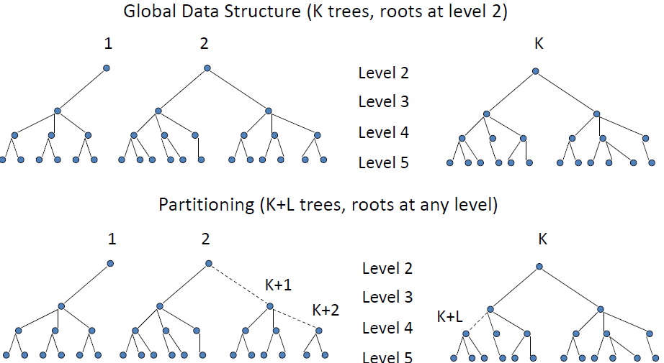
Workload distribution
A forest of trees
Workload balance

Slide 16
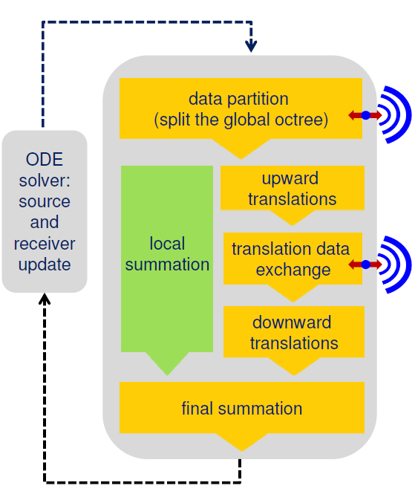
The distributed FMM algorithm on a single node

Slide 17
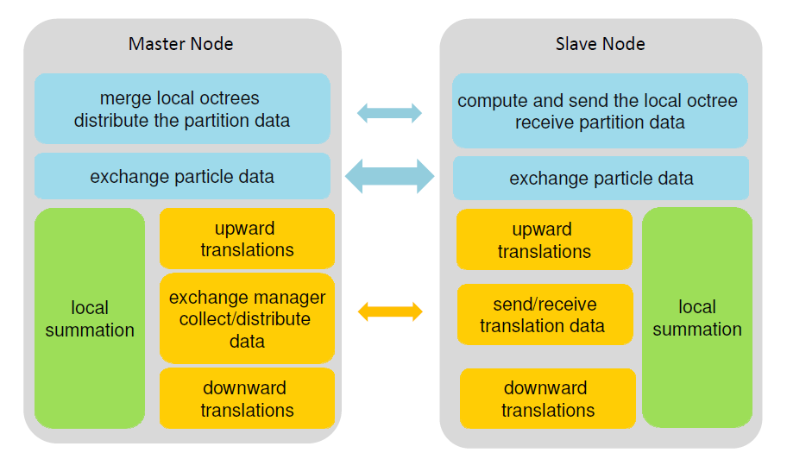
The distributed algorithm on multiple nodes

Slide 18
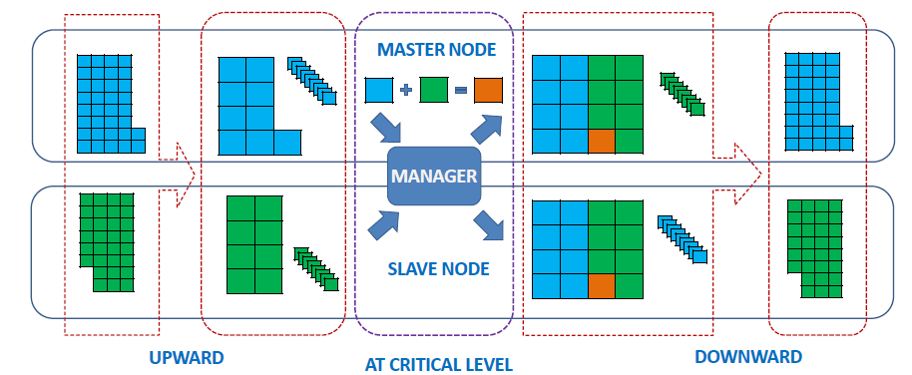
A 2D example

Slide 19
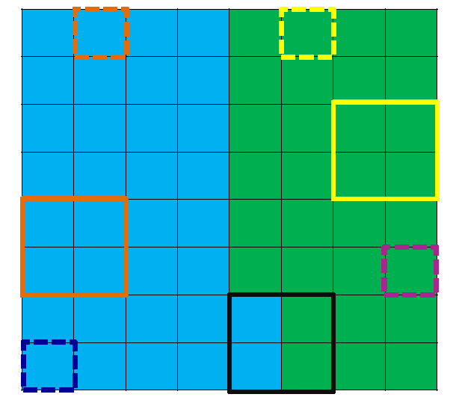
Box types
Five types: root, import, export, domestic, other
Each node computes its box types on GPUs with other FMM data structures
Very small overhead
A 2D example
Notes:
Dashed line means box at level 3. solid line means box at level 2.
As the green region,
Yellow boxes are export boxes
Orange boxes are import boxes
Purple box is domestic box
Blue box is other box
Black box is root box

Slide 20
Communication overhead
Depend on the input data distribution
It is proportional to
the number of computing node P
the number of boxes in the boundary (halo) regions
Assume the uniform distribution
Cost:

Slide 21
Comments on implementations
Other FMM data structures (interaction lists) and heterogeneous implementations
Using the heterogeneous algorithms in Hu, et al. (2011)
All data structures passed to the kernel evaluation engine are compact, i.e. no empty box related structures
The data manager is on the master node and implemented on CPU
Its workload is small
No noticeable gain of its GPU implementation

Slide 22
Weak scalability
Compare with Hu et al. (2011)
Reduce both the overheads and kernel evaluations
Fix 8M per node and run tests on 1 ~ 16 nodes
The depth of the octree determines the overhead
The particle density determines the parallel region timing

Slide 23
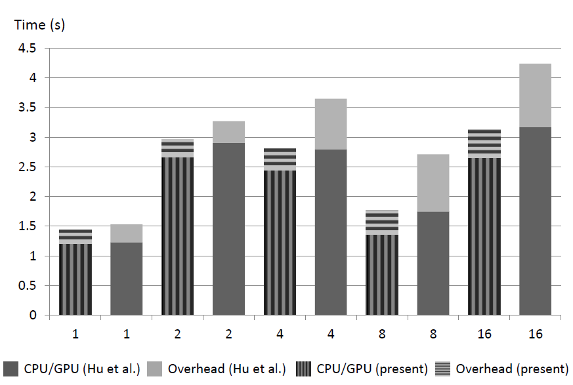
Weak scalability

Slide 24
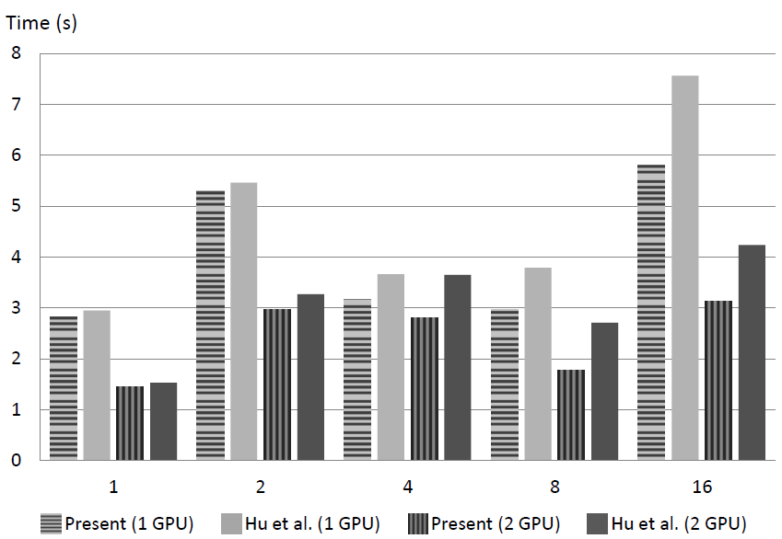
Weak scalability

Slide 25
Strong scalability
Fix the problem size to be 8M particles
Run tests on 1 ~ 16 nodes
Direct sum dominates the computation cost
Unless GPU is fully occupied algorithm does not achieve strong scalability
Can choose number of GPUs on a node according to size
Compare with Hu et al. (2011)

Slide 26
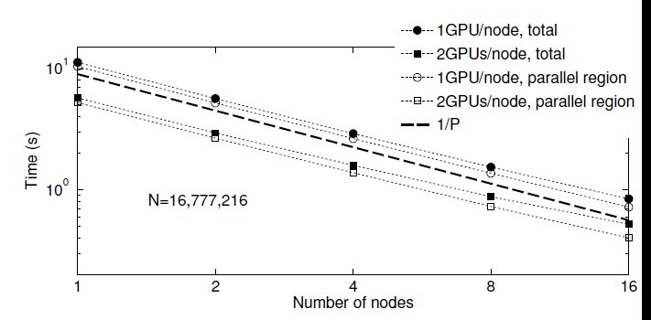
Strong scalability

Slide 27
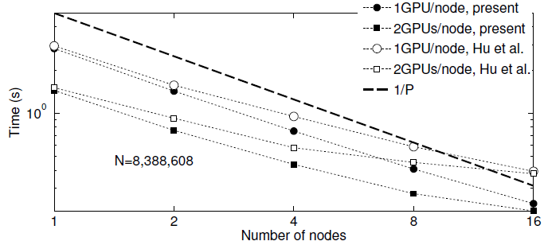
Strong scalability

Slide 28
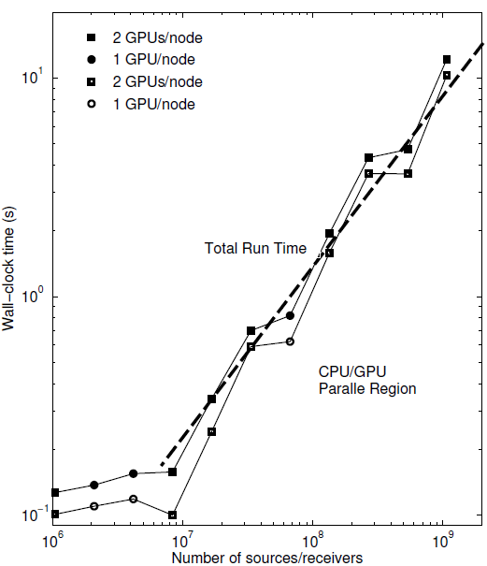
The billion size test case
Using all 32 Chimera nodes and 64 GPUs
2³⁰ ~1.07 billion particles potential computation in 12.2 s vs 21.6 s in Hu et al. (2011)
32 M per node
Each node:
Dual quad-core Intel Nehalem
5560 2.8 GHz processors
24 GB of RAM
Two Tesla C1060 GPU

Slide 29
Performance count
 | HPCC 2012 | SC’11 | SC’10
Paper | Hu et al. 2012 | Hu et al. 2011 | Hamada and Nitadori, 2010
Algorithm | FMM | FMM | Tree code
Problem size | 1,073,741,824 | 1,073,741,824 | 3,278,982,596
Flops count | 39.7 TFlops on 64 GPUs, 32 nodes | 38 TFlops on 64 GPUs, 32 nodes | 190 TFlops on 576 GPUs, 144 nodes
GPU | Tesla C1060: 1.296 GHz 240 cores | Tesla C1060: 1.296 GHz 240 cores | GTX 295 1.242 GHz 2 x 240 cores
 | 620 GFlops/GPU | 593 GFlops/GPU | 329 GFlops/GPU

Slide 30
Conclusion
Fast communication management data structures
Handle non-uniform distribution
Parallel granularity: spatial boxes
Small overheads
Much improved scalability and performance
The capability of computing million or billion size problems on a single workstation or a middle size cluster
Developed code will be used in solvers for many large scale problems in aeromechanics, astrophysics, molecular dynamics, etc.

Slide 31
Questions?
Acknowledgments

