Slide 1
Scalable Fast Multipole Methods on Distributed Heterogeneous Architecture
Qi Hu, Nail A. Gumerov, Ramani Duraiswami
Institute for Advanced Computer Studies
Department of Computer Science
University of Maryland, College Park, MD
Notes:
All these work are collaborate with my supervisor prof. Duraiswami, Gumerov.

Slide 2
Previous work
FMM on distributed systems
Greengard and Gropp (1990) discussed parallelizing FMM
Ying, et al. (2003): the parallel version of kernel independent FMM
FMM on GPUs
Gumerov and Duraiswami (2008) explored the FMM algorithm for GPU
Yokota, et al. (2009) presented FMM on the GPU cluster
Other impressive results use the benefits of architecture tuning on the networks of multi-core processors or GPUs
Hamada, et al. (2009, 2010): the Golden Bell Prize SC’09
Lashuk, et al. (2009) presented kernel independent adaptive FMM on heterogeneous architectures
Chandramowlishwaran, et al. (2010): optimizations for multi-core clusters
Cruz, et al. (2010): the PetFMM library
Notes:
The previous includes FMM parallel algorithm on distributed architectures. Recently, many research works are on the FMM GPU implementations.
There are also other impressive works on the different FMM algorithms with different optimization or tuning strategies, for different hardware platforms.

Slide 3
Issues with previous results
FMM algorithm implementations demonstrated scalability in restricted range
Scalability was shown for less accurate tree-codes
Papers did not address issue of the re-computation of neighbor lists at each step
Important for dynamic problems that we are interested in
Did not use both the CPU and GPU which occur together in modern architectures
Notes:
However, the FMM algorithm’s scalability is only demonstrated in a restricted range.
The data structures are treated as outside component with heavy overheads.
And the FMM parallelism between CPU and GPU are not explored i.e. the system is not best utilized, especially for the heterogeneous architecture.

Slide 4
Contributions
Efficient scalable parallel FMM algorithms
Use both multi-core CPUs and GPUs
First scalable FMM algorithm on heterogeneous clusters or GPUs
Best timing for a single workstation
Extremely fast parallel algorithms for FMM data structures
Complexity O(N) and much faster than evaluation steps
Suitable for dynamics problems
Algorithms achieve 38 Tflops on 32 nodes (64 GPUs)
Demonstrate strong and weak scalability
Best scalability per GPU (>600 Gflops/GPU)
FMM with billion particles on a midsized cluster

Slide 5
Motivation: Brownout
Complicated phenomena involving interaction between rotorcraft wake, ground, and dust particles
Causes accidents due to poor visibility and damage to helicopters
Understanding can lead to mitigation strategies
Lagrangian (vortex element) methods to compute the flow
Fast evaluation of the fields at particle locations
Need for fast evaluation of all pairwise 3D interactions
Notes:
The motivation of our research is from the brownout problem. Basically, we want to simulate the dust dynamics when a rotorcraft is landing on a dust land. These three pics show the different dust cloud caused by different rotorcrafts.
Such problem involves complicated interactions between rotorcraft wake, ground and dust particles.

Slide 6
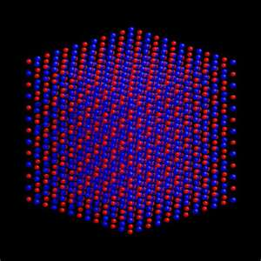
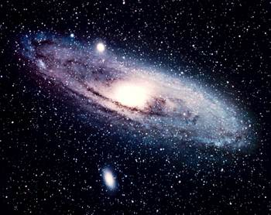
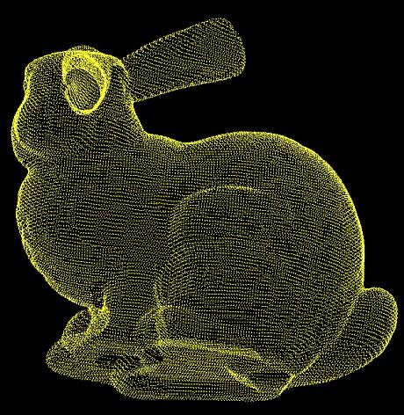
Motivation
Many other applications require fast evaluation of pairwise interactions with 3D Laplacian kernel and its derivatives
Astrophysics
(gravity potential
and forces)
Molecular Dynamics
(Coulomb potential
and forces)
wissrech.ins.uni-bonn.de
Micro and Nanofluidics
(complex channel Stokes flows)
Imaging and Graphics (high quality RBF interpolation)
Much More!
Notes:
We collaborate with the leading group from umd’s aero mechanics engineer dept. We use the vortex method for flow simulation and a large number of particles for realistic dust cloud dynamic simulation.
The model we use requires the computation of nbody problems. For example, the velocity field is updated by this following equation.

Slide 7
Introduction to fast multipole methods
Problem: compute matrix-vector product of some kernels
Linear computation and memory cost O(N+M) with any accuracy
Divide the sum to the far field and near field terms
Direct kernel evaluations for the near field
Approximations of the far field sum via the multipole expansions of the kernel function and spatial data structures (octree for 3D)
Notes:
What is the key idea of FMM in short?
In nbody problems, it is known the influence of the group of far field objects can be approximately replaced by a single object. FMM puts this idea in a rigorous mathematical framework can achieve machine precision or other required precisions.
For the previous shown sum, we can divide it into two terms: the first is for far field interaction, and the second term is for near field interaction. This far field approximation is realized by the hierarchical data structure and multipole and local expansions. Later, we will explain how this approximation can reduce the overall complexity.
Using Fast multipole methods, we can reduce this computation cost to linear. The key is the hierarchical data structure.

Slide 8
Introduction to the fast multipole method
The local and multipole expansions of the Laplace kernel at the center with the truncation number p
Expansions regions are validated by well separated pairs realized using spatial boxes of octree (hierarchical data structures)
Translations of expansion coefficients
Multipole to multipole translations (M|M)
Multipole to local translations (M|L)
Local to local translations (L|L)
r^{n}Y_{nm} local spherical
basis functions
r ^{−(n+1)}Y_{nm} multipole spherical
basis functions
Notes:
The trick of reducing computation cost is because of the factorizations of the kernel function such that we can separate source and receiver. For the laplace green function, 1/r, we can expand it at some spatial center x* by using the local or multipole spherical basis functions. Here this p is the truncation number which controls the accuracy of the expansions.
However such expansions are not global and only valid for certain regions. In FMM, ……
Once, we expand the kernel functions at all spatial centers, we have to translate them upward and downward in the context of octrees. Such translations used in FMM algorithms can be divided into MM ML and LL translations.

Slide 9
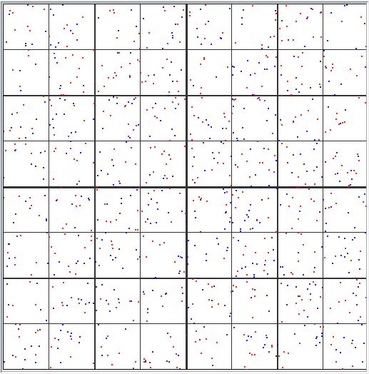
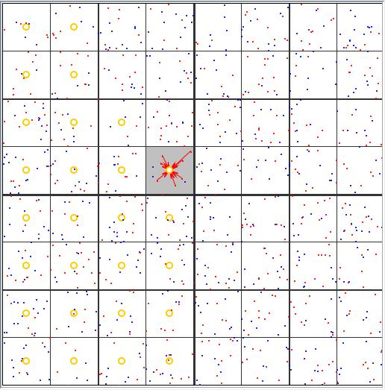
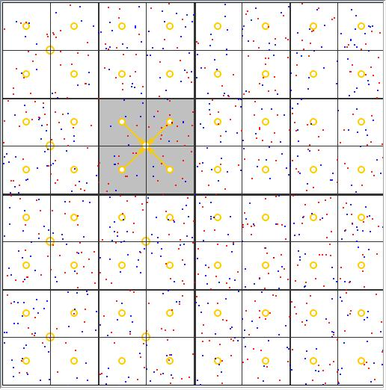
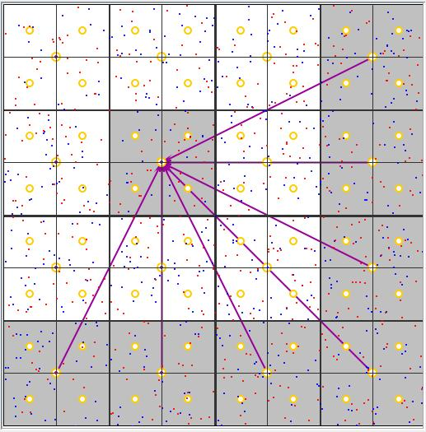
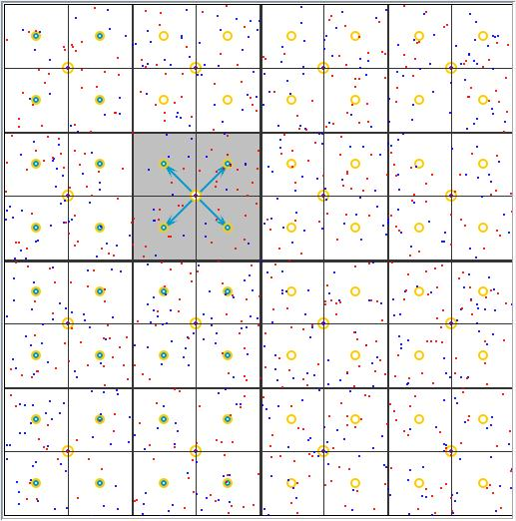
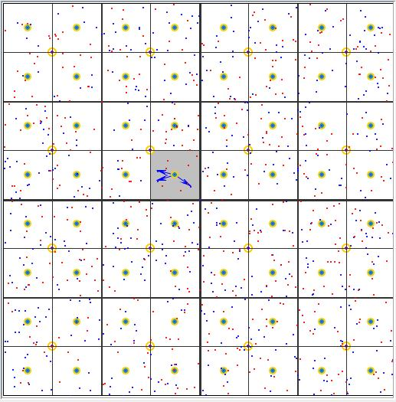
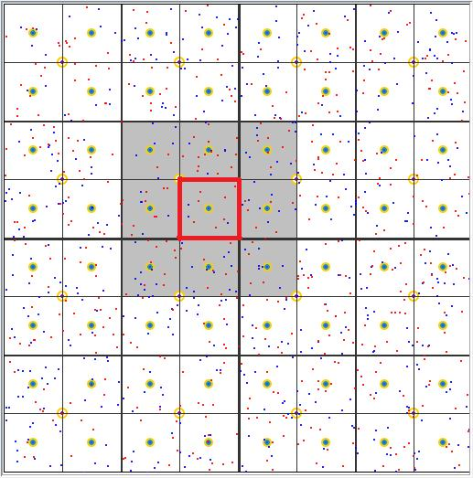
FMM flow chart
Build data structures
Initial M-expansions
Upward M|M translations
Downward M|L, L|L translations
L-expansions
Local direct sum (P2P) and final summation
From Java animation of FMM by Y. Wang M.S. Thesis, UMD 2005
Notes:
Of course, we can perform single level FMM, but this only reduce the complexity to N^{4/3} if we have N source and receiver points.
To save computation more, we perform the grouping and translation hierarchically, i.e., we use the multi-level FMM. The steps are summarized as the following.

Slide 10
Novel parallel algorithm for FMM data structures
Data structures for assigning points to boxes, find neighbor lists, retaining only non empty boxes
Usual procedures use a sort, and have O(N log N) cost
Present: parallelizable on the GPU and has O(N) cost
Modified parallel counting sort with linear cost
Histograms: counters of particles inside spatial boxes
Parallel scan: perform reduction operations
Costs significantly below cost of FMM step
Data structures passed to the kernel evaluation engine are compact, i.e. no empty box related structures
Notes:
As mentioned before, the data structures includes assign points to the boxes, construct neighbors and very important: we need to skip all the empty boxes.
Traditional ways of the data structure constructions use the nlog n sorting algorithm and searching to address the non-empty boxes. However, in FMM, we don’t need so accurate particle location sort since we only concern particle order in terms of their mortron indices but we don’t care how they appear within a certain box. Hence we modify the counting sort such that it can be parallelly executed in linear time. The searching operation can not be implemented efficiently on current GPU architecture. However, with the histogram, which is nothing but a counter to keep a box’s particle number, and parallel scan, we can address all the nonempty boxes.
Even though the histogram consume large memory, it is only in the data structure construction time, and does not appear to the kernel evaluation engine. Data structures passed to the evaluation engine are compact, which means no empty box related structures are kept

Slide 11
Performance
FMM data structures on the GPU for millions of particles in 0.1 s as opposed to 2-10 s required for CPU.
Substantial computational savings for dynamic problems, where particle positions change and data structure need to be regenerated ay each time step
Depth of the FMM octree (levels)
Notes:
Here is the one summary slide to show our data structure performance.
The experiment is running on the NVIDIA gtx 480 and the Intel Nelham 2.8G hz quadcore cpu. Firstly, We keep the size of the data points, I mean the both source and receiver, to be 1 million and vary the maximal level to compare the CPU and GPU performance. Here the CPU is only single threaded and no vectorized operations. This figure summarized the speedups we got. You can see we can save this construction time upto 100 times.
Generally speaking, our GPU parallel algorithms computes all these data structures for millions of particles in the order of 0.1 seconds. However, on CPU, it requires about 2 -10 seconds.
Such substantial savings make our implementation suitable to compute dynamic problems. Or else, the sequential data structure construction will be the dominant computation cost or at least be a large non neglectable part of the cost.

Slide 12
Heterogeneous architecture
openMP
Main
Memory
GPU
GPU
CPU
core
CPU
core
CPU
core
CPU
core
PCI-e
MPI
openMP
Main
Memory
GPU
GPU
CPU
core
CPU
core
CPU
core
CPU
core
PCI-e
MPI
InfiniBand
Notes:
Here is the typical architecture of a heterogeneous computing node

Slide 13
Mapping the FMM on CPU/GPU architecture
GPU is a highly parallel, multithreaded, many-core processor
Good for repetitive operations on multiple data (SIMD)
CPUs are good for complex tasks with
Complicated data structures, such as FMM M|L translation stencils, with complicated patterns of memory access
CPU-GPU communications expensive
Profile FMM and determine which parts of FMM go where
Hundreds of cores
DRAM
GPU
A few cores
Control
ALU
ALU
ALU
ALU
Cache
DRAM
CPU
Notes:
GPU has hundreds of computation cores but Control and cache become very small!
GPU is better for the repetitive computations on multiple data like the SIMD model.
However for the CPU with large cache but limited computation core, its more efficient for operations where the memory access dominating tasks.
Also remember the communication between CPU and GPU is expensive we should minimize the data transfer.
Now we know the hardware’s specialties, next we need to profile and analyze FMM to determine which can determines which part of FMM algorithm should go which hardware.

Slide 14
FMM on the GPU
Look at implementation of Gumerov & Duraiswami (2008)
M2L translation cost: 29%; GPU speedup 1.6x
Local direct sum: 66.1%; GPU speedup 90.1x
Profiling data suggests
Perform translations on the CPU: multicore parallelization and large cache provides comparable or better performance
GPU computes local direct sum (P2P) and particle related work: SIMD
Notes:
By Amdahl's law, such profiling data suggest that instead use GPU or CPU alone, we should use the heterogeneous architectures.

Slide 15
Single node algorithm
GPU work
CPU work
ODE
solver:
source
receiver
update
particle positions, source strength
data structure (octree and neighbors)
source M-expansions
translation stencils
local direct sum (P2P)
upward M|M
downward M|L L|L
receiver L-expansions
final sum of far-field and near-field interactions
time
loop
Notes:
In this slide, we will show our single node heterogeneous algorithm.
Boxes of blue color represents GPU work while red boxes are for CPU work.
Lets assume that we have an ODE solver which use our FMM algorithm to update each time step’s source and receiver data, which shown in the purple color.
Firstly, this outside FMM solver pass the particle positions and source strength to our single node algorithm. Next, we compute all needed data structures, such as data point sorting and neighbor construction, in parallel on GPU as described in previous section. After that, we will divide the work to two parts and process them in parallel.
Firstly, GPU computes the source s-expansions. CPU compute the translation stencils. After all of them are done, we let GPU first copy all these S-coefficients from device, GPU’s global memory to the host CPU’s main memory. Then, GPU continue its work to process the local direct sum while CPU takes the S-coefficients and translation stencils to compute the upward SS translation, then downward SR and RR translations. This step is the most time consuming part among all the algorithm. We also want to find a optimal level, such that, these two big computation, i.e. local direct sum and translations workload can be balanced. We call these overlapped region here as the parallel region.
After we finish the parallel region, the CPU will copy all the translated R-coefficients to the GPU’s global memory. The GPU further take these receiver’s position and strength to compute the R-expansions and consolidate with the corresponding translated coefficients. Finally, it sums up the local direct sum and far field approximated sum. In the very end, it resort all these sums to the original input order and copy to CPU’s main memory. Note that, this reorder doesn’t take extra time since we stored an inverse map when we sort all the receivers. Reorder here is just like copy data to different addresses.

Slide 16
Advantages
CPU and GPU are tasked with their most efficient jobs
Faster translations: CPU code can be better optimized using complex translation stencil data structures
High accuracy, double precision, CPU translation without much cost penalty
Faster local direct sum: many cores on GPU; same kernel evaluation but on multiple data (SIMD)
The CPU is not idle during the GPU computations
Easy visualization: all particle in GPU
Smaller data transfer between the CPU and GPU
Notes:
Cpu and GPU are tasked with their most efficient work. CPU performs the complex translations and take advantages of large cache and GPU performs the direct sum best use its many computation cores. We keep both CPU and GPU running during the evaluation stage, which makes the whole system be the best used.
Since we use CPU to process the translation, we could use double precision without much cost penalty. High accuracy translations will make our final sum more accurate. However, to achieve the same thing, using GPU will take substantial extra time.
Because all the data are on GPU’s global memory, it is easy to dump all of them to the rendering pipelines and show their visualization directly on the screen.
The last advantages is that this algorithm only transfer necessary data between CPU and GPU which minimizes the data exchange overhead.

Slide 17
GPU Visualization and Steering
Notes:
Here is an example we use the GPU to visualize the FMM computation results.

Slide 18
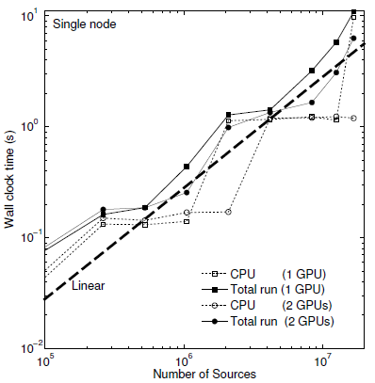
Single node tests
Dual quad-core Intel Nehalem
5560 2.8 GHz processors
24 GB of RAM
Two Tesla C1060 GPU
Notes:
Firstly, we show that our profiling of single node test on different size of problems.
We run the nbody test from 1 million points upto 16 million points. Here the source and receivers are different and there are uniform distributed.
The CPU wall clock time is the time of CPU translation. The C/G parallel region means the elapsed time of the translation and local direct sum parallel region. Because the software limitation, we can not measure the local direct sum accurately. But this parallel region time can tell us some useful information.
If parallel region time > CPU wall time, that means the local direct sum is the dominant cost term. Otherwise, the CPU translation will be the dominant cost. If the translation is dominant, then there is only small difference between 1 GPU and 2GPU since GPU are only used to compute data structure and local sum. However, if local sum dominates, the 2 GPU will speedup the overall computation.
Another note is that In the translation part, gradient computation only happens at the consolidation in the very end, it is actually quite cheap. If the translation dominates the cost, then there is a little difference between the force and potential computation. Also, the optimal maximal level for force and potential might be different.
This table show the timing of the best settings. We can compute 1 million points nbody in 0.24s and 8 million in 1.52 second for potential. These are best timings among the published results so far for a single work station.
This figure shows the overall complexity of our implementation. Generally, its complexity scales as linear. The step function like curve is because of the maximal level change.

Slide 19
Dividing the FMM algorithm on different nodes
Divide domain and assign each piece to separate nodes (work regions)
Use linearity of translations and spatial decomposition property of FMM to perform algorithm correctly
Node 1
Node 3
target box
Node 0
Node 2
Notes:
There are many approaches to extend the computation from single node to multiple nodes. Here in our implementation, the parallel version is based on the FMM spatial decomposition property and linearity of the translation operators.
We continuous assign the spatial boxes to each node. You see here the node IDs are in the Z-order. Now assume we have sources in the green and orange regions. We can perform the translation separately and sum all the coefficients at the end to get the complete data.

Slide 20
The algorithm flow chart
Node K
Master collects receiver boxes and distributes work regions (work balance)
Assigns particle data according to assigned work regions
M|M for local non-empty receiver boxes while M|L and L|L for global non-empty receiver boxes
L-coefficients efficiently sent to master node in binary tree order
positions, etc.
ODE
solver:
source
receiver
update
data structure (receivers)
merge
data structure (sources)
assign particles to nodes
single heterogeneous
node algorithm
exchange final L-expansions
final sum
Notes:
The multiple node algorithm is shown in the following flow chart. Assume we have two nodes here Node A is in yellow and Node B is in Green. Note that the case with more nodes are the same as the two nodes’ case.
As the single node algorithm, we have an ODE solver which updates the source and receiver on each computing node. They provide the inputs and collect outputs from our FMM algorithm.
Initially, the solver passes all the particle positions and source strength to the FMM module. Next, each node independently computes its own receiver information at maximal level. Then all these receiver octree infomations from all nodes will be collected by the master node. The master node then split the job to achieve the work balance and send the distributed work region information to each node. This step is called merge receiver octree here, which involves MPI communications among the nodes.
After all nodes obtain the global work load distribution information, they repack their own particle data and send the corresponding data to other nodes accordingly. This packing also involves the neighbor computation, since correct local direct sum requires data not only in the allocated work region but also in its boundary layers. This redistribution step will exchange a lot of data, particle related via MPI.
After this data redistribution, we apply the single node algorithm to the input data. Note that, in this case, we translate the coefficients to all the global non-empty receiver boxes but not only local non-empty receiver boxes. After all the nodes obtain the final R-expansions. They send to the master node in a binary tree order, which can fully uitilize the infiniband property to maximize the communication throughput. This tree exchange scheme also performs the merging R-coefficients from level to level.
Once the master node get coefficients, it broadcasts them to all the computing nodes. In the end, each node consolidate its receiver’s R coefficients with the global translated coefficients and output the final sum.

Slide 21
Scalability issues
M|M and M|L translations are distributed among all nodes
Local direct sums are not repeated
L|L translations are repeated
Normally, M|L translations takes 90% overall time and L|L translation costs are negligible
Amdahl’s Law: affects overall performance when P is large
Still efficient for small clusters (1~64 nodes)
Current fully scalable algorithm performs distributed L|L translation
Further divides boxes into four categories
Much better solution is using our recent new multiple node data structures and algorithms
Hu et al., submitted
Notes:
As for the scalability discussion of the multiple node algorithm, we mentioned before that:
S|S S|R are amortized. So are the local direct sums since each node is only in charge of certain allocated region by the master node.
However, the R|R translation is not amortized because we process the receiver boxes globally. The reasons why do this are …….

Slide 22
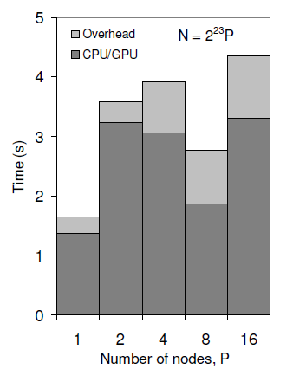
Weak scalability
Fix 8M per node
Run tests on 1 ~ 16 nodes
The depth of the octree determines the overhead
The particle density determines the parallel region timing
Notes:
To test the so called strong and weak scalability, we run the same test of 8M particles on 1,2,4,8 and 16 nodes and compare their time profiles.
Firstly we fix 8M particles per node, which means the problem size is from 8M to 128M. We also use 2GPUs per node. The left figure shows the parallel region time and overhead, which is mainly MPI communications. The ideal case should be all bars have the same height. But in our implementation, because the particle density and the maximal level change which has an effect on the CUDA thread blocks, the time varies. You can see that the over head for 1 and 2 nodes are similar while 4,8,16 are similar. This is because the maximal level change. However, for the same particle density case, 1 &8, 2 and 16, we can see the parallel region times are almost the same.

Slide 23
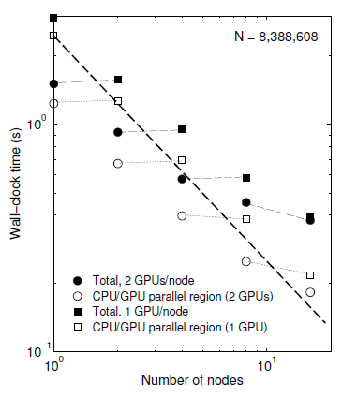
Strong scalability
Fix the problem size to be 8M particles
Run tests on 1 ~ 16 nodes
Direct sum dominates the computation cost
Unless GPU is fully occupied algorithm does not achieve strong scalability
Can choose number of GPUs on a node according to size
Notes:
For the strong scalability, we fix the problem size to be 8M and run it on from 1 up to 16 nodes by using 1 or 2 GPUs. The right figure shows the time profiling. Since the direct sum dominates the overall cost, when we increase the number of GPU from 1 to 2, our computation drops almost by half. Ideally, the regression line of the same category dots should parallel to this black dash line. But due to the overheads, our implementation didn’t show the perfectly weak scalability.

Slide 24
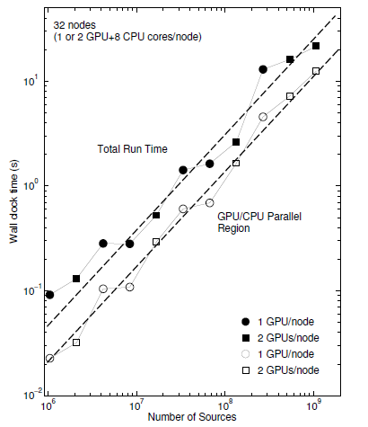
The billion size test case
Using all 32 Chimera nodes and 64 GPUs
2³⁰ ~1.07 billion particles potential computation in 21.6 s
32 M per node
Each node:
Dual quad-core Intel Nehalem
5560 2.8 GHz processors
24 GB of RAM
Two Tesla C1060 GPU
Notes:
The very last experiment of our heterogeneous algorithm is to hit billion size problem on our local cluster. Basically, we fix the number of nodes to be 32 and run the test as large as possible.
Here we exclude the data partition time and only include our best setting time. You can see from this figure our algorithm , both the wall clock time and the parallel region, shows the linear complexity as we increase the problem size from 1M to 1 Billion. And for the potential kernel, our algorithm could process such 1Billion nbody calculation in 21.6 seconds. However, our new multiple node data structures and algorithm can reduce the overhead due to MPI exchanging such that this timing decreases by 35%.

Slide 25
Performance count
 | SC’11 | SC’10 | SC’09
Paper | Hu et al. 2011 | Hamada and Nitadori, 2010 | Hamada, et al. 2009
Algorithm | FMM | Tree code | Tree code
Problem size | 1,073,741,824 | 3,278,982,596 | 1,608,044,129
Flops count | 38 TFlops on 64 GPUs, 32 nodes | 190 TFlops on 576 GPUs, 144 nodes | 42.15 TFlops on 256 GPUs, 128 nodes
GPU | Tesla C1060: 1.296 GHz 240 cores | GTX 295 1.242 GHz 2 x 240 cores | GeForce 8800 GTS: 1.200 GHz 96 cores
342 TFlops
on 576 GPUs
Notes:
Finally, in this table, we summarize the FMM GPU implementations presented at recent supercomputing conferences. Our paper is the first one to develop efficiently heterogeneous FMM algorithms. By comparing with the previous works, our approach can achieve better flops counts. According to our weak scalability, we can extend our 38TFlops to 342TFlops if we have 576GPUs. Again, our new algorithm with new data structures can further improve such performance count.

Slide 26
Conclusion
Heterogeneous scalable (CPU/GPU) FMM for single nodes and clusters.
Scalability of the algorithm is tested and satisfactory results are obtained for midsize heterogeneous clusters
Novel algorithm for FMM data structures on GPUs
Fixes a bottleneck for large dynamic problems
Developed code will be used in solvers for many large scale problems in aeromechanics, astrophysics, molecular dynamics, etc.

Slide 27
Questions?
Acknowledgments

Slide 28
Backup Slides

Slide 29
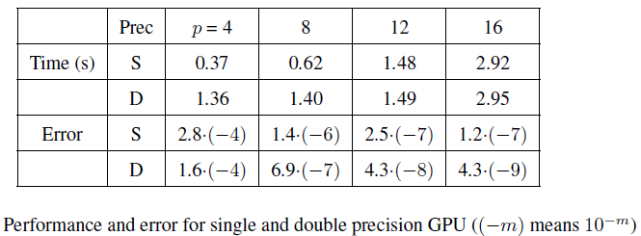
Accuracy test
Test performed for potential kernel
NVIDIA Tesla C2050 GPU accelerator with 3 GB
Intel Xeon E5504 processor at 2.00 GHz with 6GB RAM
Notes:
To test the accuracy, we run the test on a better card tesla C2050 which are capable of better double precision computations. However the CPU of that work station is not so powerful, only has 2.00 GHz of quad core with 6GB memory.
We fixed the problem size to be 1 million and vary the truncation numbers from 4 up to 16.
Form the error rows, you can see that the overall accuracies are improved by increasing the value of truncation number. However, for single precision, from 12 to 16, we don’t get much better accuracy. This is because, for the single precision, there 23 bits to store the significant part, which corresponds to 7 digits in decimal. Hence, the best relative error we can expect is 10^-7. In contrast, when we move from single precision to double, the relative error does improve.

Slide 30
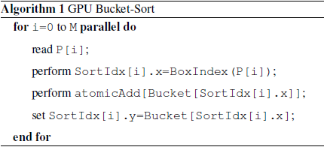
Bucket-sort on GPU
Source/receiver data points array
Each data point i has a 2D vector
Each box j has a counter
Parallel scan
The rank of data point j:
Notes:
The first thing of data structure is to rearrange the input source and receiver data points according to their spacial order, which means we need to sort them. Tradition sort of the data points requires O(n log n) time. However, in FMM, we don’t need that so accurate sort since we only care the order in terms of morton index. Within a box, the data points appearing order is irrelevant to the correctness of the overall algorithms. Hence, we develop such linear Bucket sort algorithm on GPU.
Say we have source and receiver data points array P, then we assign an 2D vector to each data points. Its first entry stores its box index and the second entry stores its rank within that box. Also each box j has a counter Bucket[j].
Here is our GPU bucket-sort algorithm.
The Bucket array here is one histogram. We use the CUDA atomic function to increase that counter. This atomic function guarantees that when multiple threads access this counter, they will increase the value one by one without race conditions. One may argue that this will make the sort sequential, however, since number of boxes are much larger than the active threads in the CUDA swarp, only few conflicts happens according to our experiments.
After we perform this linear sorting algorithm, we run a parallel scan on that bucket array. Then we obtain the rank of data point i by this equation here.

Slide 31
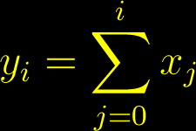
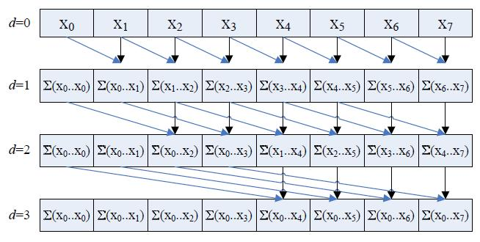
Parallel scan operation
An array
Compute , where
Notes:
Another important approach in our parallel data structure is the parallel scan.
It is defined as: given a array x, we want to compute another array y, where its ith entry is the sum of x from 0 to i.
this figure shows a naïve way to parallel compute the scan values..
In fact, such parallel scan has been developed for many years and several efficient implementations can be found in literature. Here in our FMM algorithm, we import an high efficient CUDA parallel scan primitive to our implementation to process the reduction operations on histograms.

