Slide 1
Group theory exercise

Slide 2
Group
A group
Consists
Set $S$
Operation $⋅$ $:S×S→S$
Identity-element
Properties
Closure $x,y∈ S⇒ x⋅y∈S$
Identity $∃ e∈S : x∈S⇒ e⋅x=x$ (we use e to denote the identity element)
Associativity $x,y,z∈ S⇒ \left(x⋅y\right)⋅z⇒x⋅(y⋅z)$
Inverse: $x∈S⇒∃ y∈S :x⋅y=e$
Extra property
Commutativity: $x,y∈ S⇒ x⋅y=y⋅x$

Slide 3
Uniqueness of multiplication
For every group $G$ and $x,y,z∈G$ , if $x⋅y=x⋅z$ then $y=z$
Proof
$x⋅y=x⋅z$
$x^{−1}⋅\left(x⋅y\right)=x^{−1}⋅\left(x⋅z\right)$
${(x}^{−1}⋅x)⋅y ={(x}^{−1}⋅x)⋅z$ (associativity)
$1⋅y =1⋅z$ (inverse)
$y=z$ (identity)

Slide 4
Sampling games
For any group G, for any $x∈ G$, the following two games are indistinguishable
$$w$$
$$r∈G$$
$$w$$
$$r∈G$$
$$w←r$$
$$w←x⋅r$$
Follows that For every group $G$ and $x,y,z∈G$ , $x⋅y=x⋅z$ then $y=z$

Slide 5
Inverse of product
For every group $G$ and $a,b∈G, {\left(ab\right)}^{−1}=b^{−1}{⋅ a}^{−1}$
Proof:
$\left(ab\right)⋅\left(b^{−1} a^{−1}\right)$
$a⋅\left(b⋅ b^{−1}\right)⋅a^{−1}$ (associativity)
$a⋅1⋅a^{−1}$ (inverse)
$a⋅a^{−1}$ (neutral)
1 (inverse)

Slide 6
Public-key cryptography

Slide 7
Topics in public cryptography for today
Key-exchange
Public-key encryption

Slide 8
Key-exchange
When Alice and Bob want to exchange keys
Adversary should learn no information about the keys

Slide 9
Key-exchange
$$k$$
$$k$$
$$F_{key−exchange}$$
$$|k|$$
$≔$ secure channel

Slide 10
Merkle puzzle
“Key-exchange” protocol published in 1978
Alice effort small
Bob’s effort $O\left(1\right)$
Adversary’s effort $O(n)$
Gap in effort between Bob and adversary

Slide 11
Merkle puzzle
Puzzle
Easy to produce, some difficulty to solve
Solving the puzzle produces an identifier and a key
Sending the identifier does not help solve the puzzles
Algorithm for key-exchange
Alice creates n puzzles with different identifiers and sends them to Bob
Bob solves one of them and sends the resulting identifier to Alice
Alice and Bob uses the key for the one that Bob solved.

Slide 12
Diffie-Hellman assumption
Group G
Generator g
${{(g}^{y})}^{x}={{(g}^{x})}^{y}$
The following two games are indistinguishable
$$x,y∈_{R}G$$
$$x,y∈_{R}G$$
$$(a,b,c)$$
$$a←g^{x}$$
$$≈$$
$$(a,b,c)$$
$$a←g^{x}$$
$$b←g^{y}$$
$$b←g^{y}$$
$$c←g^{xy}$$
$$c∈_{R}G$$

Slide 13
Security of DH-Key exchange
Need a group $G$ such that
Generator g
${{∀x,y∈G : (g}^{y})}^{x}={{(g}^{x})}^{y}$
Diffie-Hellman assumption holds
Assumption
Adversary will not tamper with communication
Channel is authenticated between Alice and Bob

Slide 14
Diffie-Hellman key-exchange
$x∈_{R}G$
$$g^{x}$$
y $∈_{R}G$
$$g^{y}$$
$k= {(g^{y})}^{x} =g^{xy}$
$k= {(g^{x})}^{y} =g^{xy}$

Slide 15
Security of Diffie-Hellman key-exchange
$x∈_{R}G$
$$k$$
$$k$$
y $∈_{R}G$
$$k←g^{xy}$$
$$g^{x},g^{y}, |k|$$

Slide 16
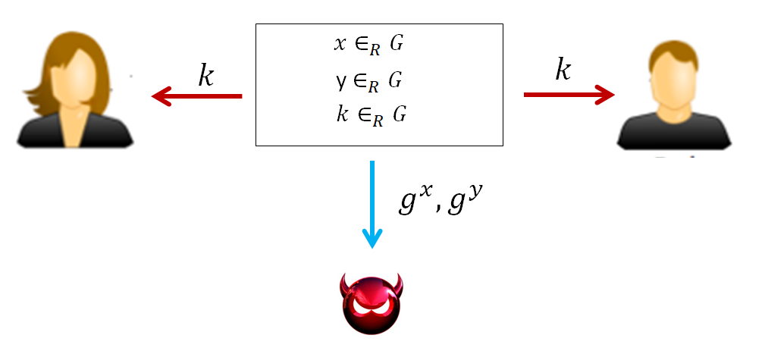
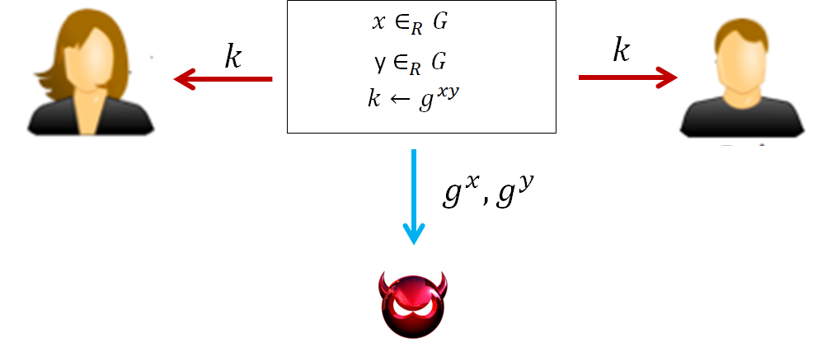
Security of Diffie-Hellman key-exchange
$$≈$$
$≔$ secure channel

Slide 17
Insecurity against man-in-the-middle adversary
$$g^{x}$$
$$g^{\overline{x}}$$
$x∈_{R}G$
$\overline{x}∈_{R}G$
y $∈_{R}G$
$\overline{y}∈_{R}G$
$$g^{\overline{y}}$$
$$g^{y}$$
$k_{1}= g^{x\overline{y}}$
$k_{1}= g^{x\overline{y}}$
$k_{2}= g^{\overline{x}y}$
$k_{2}= g^{\overline{x}y}$

Slide 18
Public key-encryption
How can people send encrypted messages to google, steam, your bank, even though they have never exchanged secret keys with those companies?
Public-key encryption allows you to do it
Public key is revealed publicly so that everyone can encrypt messages
Secret key is kept hidden and only the owner is allowed is able to decrypt the ciphertext

Slide 19
Public-key encryption
The Gen algorithm takes security parameter $1^{s}$ and outputs both a secret key and a public key
The encrypt algorithm takes a public key $pk$ and a message $m$ and outputs a ciphertext $c$
The decrypt algorithm takes a secret key $sk$ and a ciphertext $c$ and outputs the message m

Slide 20
Formal definition
$Gen\left(1^{s}\right)→(sk,pk)$
$Enc_{pk}\left(m\right)→c$ where $m∈M, c∈C$
$Dec_{sk}\left(c\right)→m$ where $m∈M, c∈C$
Correctness:
$Pr[{Dec}_{sk}\left(Enc_{pk}\left(m\right)\right) =m | \left(sk,pk\right)←Gen\left(1^{s}\right)]=1$

Slide 21
Chosen-plaintext security
$$pk$$
$$pk$$
$$\left(sk,pk\right)←Gen(1^{s})$$
$$\left(sk,pk\right)←Gen(1^{s})$$
$$m_{0},m_{1}$$
$$m_{0},m_{1}$$
c
$$c←Enc_{pk}(m_{0})$$
c
$$c←Enc_{pk}(m_{1})$$
$$≈$$
m
m
$$c←Enc_{pk}(m)$$
$$c←Enc_{pk}(m)$$
c
c
Repeat as many times as the distinguisher wants
Repeat as many times as the distinguisher wants
$$G_{0}$$
$$G_{1}$$

Slide 22
Multi-message indistinguishability
p$k$
p$k$
$$\left(sk,pk\right)←Gen(1^{s})$$
$$\left(sk,pk\right)←Gen(1^{s})$$
$$m_{0}^{1},…,m_{0}^{n}$$
$$m_{0}^{1},…,m_{0}^{n}$$
$$m_{1}^{1},…,m_{1}^{n}$$
$$c^{i}←Enc_{pk}(m_{0})$$
$$m_{1}^{1},…,m_{1}^{n}$$
$$c^{i}←Enc_{pk}(m_{1})$$
$$≈$$
$$c←c^{1},…,c^{n}$$
$$c←c^{1},…,c^{n}$$
$$c$$
$$c$$
$$G_{0}$$
$$G_{1}$$

Slide 23
Security relationship
Multi-message security of public-key encryption $=>$ CPA-security of public-key
Reason: public-key encryption allows adversary to encrypt any message of his choice

Slide 24
Validation oracles / error oracles
When encrypting message using public-key encryption, it might be that the website sends you an error if the message is not valid.
Homomorphic properties of certain encryption schemes
$Enc_{pk}(m_{1}) ∗ Enc_{pk}(m_{2}) = {Enc}_{pk}(m_{1}+m_{2})$

Slide 25
Validation oracle attack using homomorphism
$M = \left\{x | x mod 3=0, x<n\right\}∪\left\{x | x mod 3=1, x<n\right\}$
$$Dec_{sk}\left(Enc_{pk}\left(x\right)∗Enc_{pk}\left(1\right)\right)∈M ⇔$$
$$Dec_{sk}\left(Enc_{pk}\left(x+1\right)\right)∈M ⇔$$
$$x mod 3=0$$

Slide 26
Require CCA-security
Distinguisher loses automatically if $c = c′$
$$pk$$
$$pk$$
$$\left(sk,pk\right)←Gen(1^{s})$$
$$\left(sk,pk\right)←Gen(1^{s})$$
$$m_{0},m_{1}$$
$$m_{0},m_{1}$$
c
$$c←Enc(m_{0})$$
$$c←Enc(m_{1})$$
c
$$c′$$
$$c′$$
m
$$m←Dec(c′)$$
m
$$m←Dec(c′)$$
Repeat as many times as the distinguisher wants
Repeat as many times as the distinguisher wants
$$G_{0}$$
$$G_{0}$$

Slide 27
Key-encapsulation
Why not use public-key encryption to encrypt long messages?
Public-key encryption is hundreds to thousand of times slower than private key-encryption
Key-encapsulation attempts to combine the properties of a public key encryption with the speed of private key-encryption

Slide 28
Key-encapsulation (hybrid-encryption)
$Gen,Enc_{pk},Dec_{sk}$ is a public-key encryption
$Enc_{k},Dec_{k}$ is a private key encryption
$$k∈_{R}{\left\{0,1\right\}}^{n}$$
$$m$$
$$(c_{1},c_{2})$$
$$(c_{1},c_{2})$$
$$k←Dec_{sk}(c_{1})$$
$$m$$
$$c_{1}←Enc_{pk}(k)$$
$$c_{2}←Enc_{k}(m)$$
$$m←Dec_{k}(c_{2})$$
$$Enc$$

Slide 29
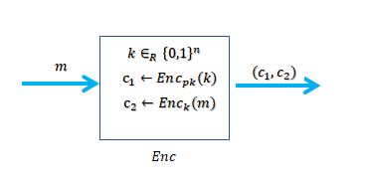
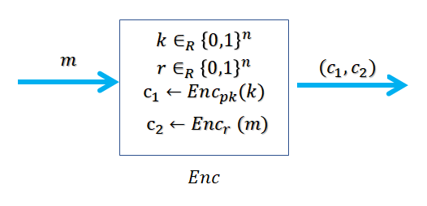
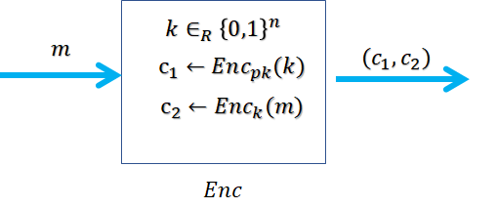
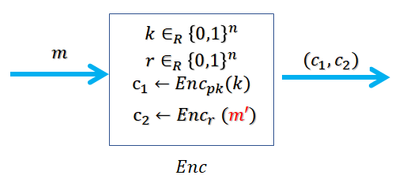
Security of key-encapsulation
$$≈$$
$$k∈_{R}{\left\{0,1\right\}}^{n}$$
$$≈$$
$$m$$
$$(c_{1},c_{2})$$
$$c_{1}←Enc_{pk}(k)$$
$$c_{2}←Enc_{k}(m′)$$
$$Enc$$

Slide 30
El-Gamal public-key encryption
Group G
$|G| = q$
Generator $g$
$Gen\left(1^{s}\right)$
${x∈}_{R} G$
$h=g^{x}$
$sk←x$
$pk←(G,q,g,h)$

Slide 31
El-Gamal encryption/ decryption
$$pk=(G,q,g,h)$$
$$m$$
$$m$$
$$y∈_{R}G$$
$$c$$
$$d←{\left(g^{y}\right)}^{x}=g^{xy}$$
$$m$$
$$(g^{y},c^{′})$$
$$m$$
$$c←(g^{y},h^{y}⋅m)$$
$$h^{y}=g^{xy}$$
$$m←\frac{c^{′}}{h^{y}}$$
$$Enc$$
$$Dec$$

Slide 32
Sampling games
For any group G, for any $x∈ G$, the following two games are indistinguishable
$$w$$
$$r∈G$$
$$w$$
$$r∈G$$
$$w←r$$
$$w←x⋅r$$
Follows that For every group $G$ and $x,y,z∈G$ , $x⋅y=x⋅z$ then $y=z$

Slide 33
Security of El-Gamal
$$pk=(G,q,g,h)$$
$$pk=(G,q,g,h)$$
$m_{0}$
$$m$$
$$m$$
$$y∈_{R}G$$
$$c$$
$$≈$$
$$m$$
$${r∈}_{R}G$$
$$c$$
$$c←(g^{y},h^{y}⋅m_{0})$$
$$c←(g^{y},r⋅m_{0})$$
$$Enc$$
$$Enc$$
$$pk=(G,q,g,h)$$
$$pk=(G,q,g,h)$$
$$m_{1}$$
$$m$$
$${r∈}_{R}G$$
$$c$$
$$m_{1}$$
$$≈$$
$$y∈_{R}G$$
$$c$$
$$c←(g^{y},r⋅m_{1})$$
$$c←(g^{y},h^{y}⋅m_{1})$$
$$Enc$$
$$Enc$$

