Slide 1
Introduction to Data Science
John P Dickerson
Prem Saggar
Lecture #11 – 10/3/2018
CMSC320
Mondays & Wednesdays
2:00pm – 3:15pm

Slide 2
Announcements
Mini-Project #2 is out!
It is linked to from ELMS; also available at: https://github.com/umddb/cmsc320-fall2018/tree/master/project2
Deliverable is a .ipynb file submitted to ELMS
Due date is Friday, October 19th, 2018.

Slide 3
Today’s Lecture
Data collection
Data processing
Exploratory analysis
&
Data viz
Analysis, hypothesis testing, & ML
Insight & Policy Decision

Slide 4
Exploratory Data Analysis
Seen so far:
Manipulations that prepare datasets into tidy form
Join tables and compute summaries
Form relationships between different entities
EDA is the last step before Big Time Statistics and ML™:
Want to quickly “get a feel” for the data through summary statistics, visualization, et cetera
Spot nuances like skew, how distributed the data is, trends, how pairs of variables interact, problems
Suggests which Stats/ML assumptions to make and approaches to take

Slide 5
Last Week’s lesson
Having a really big sample does not assure you of an accurate result.
It may assure you of a really solid, really bad (inaccurate) result.
Not all randomness is create equal when it comes to random sampling of a population:
Ask why data are missing! MCAR, MAR, MNAR.
Ask how the data were collected.

Slide 6
Today’s lesson: Summary Statistics
Part of descriptive statistics, used to summarize data:
Convey lots of information with extreme simplicity
Descriptive statistics for a variable:
Measures of location: mean, median, mode
Measure of dispersion: variance, standard deviation
Measuring correlation of two variables:
Understanding correlation
Measuring correlation
Scatter plots and regression
Thanks to William Green (NYU Stern IOMS) and Hector Corrada Bravo (UMD)

Slide 7
Measures of Location
These are 30 hours of average defect data on sets of circuit boards. Roughly what is the typical value?
1.45 1.65 1.50 2.25 1.65 1.60 2.30 2.20 2.70 1.70 2.35 1.70 1.90 1.45 1.40 2.60 2.05 1.70 1.05 2.35 1.90 1.55 1.95 1.60 2.05 2.05 1.70 2.30 1.30 2.35
Location and central tendency
There exists a distribution of values
We are interested in the “center” of the distribution
Two measures are the sample mean and the sample median
They look similar, and measure the same thing
They differ systematically (and predictably) when the data are not symmetric
[WG]

Slide 8
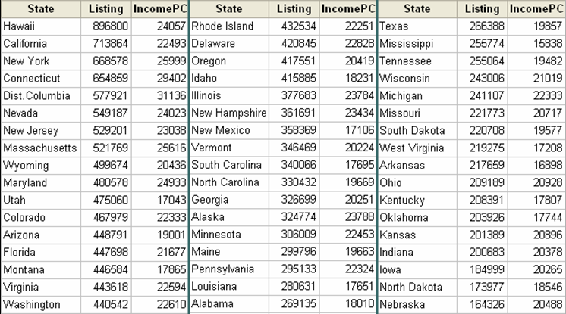
The mean Of aggregate data
Average list price:
1/51 ($898,800 + $713,864 + … + $164,326) = $369,687
[WG]

Slide 9
Averaging Averages?
Hawaii’s average listing = $896,800
Hawaii’s population = 1,275,194
Illinois’ average listing = $377,683
Illinois’ population = 12,763,371
Illinois and Hawaii each get an equal weight of 1/51 = .019607 when the mean is computed.
Looks like Hawaii is getting too much influence …
[WG]

Slide 10
Weighted Average
New average is $409,234 compared to $369,687 without weights, an error of 11%
Sometimes an unequal weighting of the observations is necessary
State population data: http://www.factmonster.com/ipka/A0004986.html

Slide 11
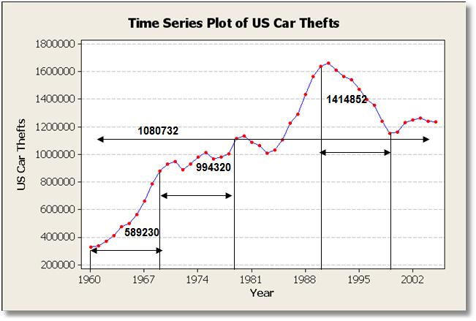
Averages & Time Series
Averaging trending time series is usually not helpful
Mean changes completely depending on time interval
What about periodic time series data ??????????
Ask yourself:
Does the mean over the entire observation period mean anything?
Does it estimate anything meaningful?

Slide 12
The Sample Median
Median:
Sort the data
Take the middle point*
Odd number:
Central observation: Med[1,2,4,6,8,9,17]
Even number:
Midpoint between the two central observations Med[1,2,4,6,8,9,14,17] = (6+8)/2=7
* CMSC351 will show you how to find the median in linear time!

Slide 13
What is the center?
The mean and median measure the central tendency of data
Generally, the center of of a dataset is a point in its range that is close to the data.
Close? Need a distance metric between two points x and x₂
We’ve talked about some already!
Absolute deviation: | x₁ – x₂ |
Squared deviation: (x₁ – x₂)²
We’ll define the center based on these metrics

Slide 14
Dataset for this part
53,940 measurements of diamonds
More info: https://en.wikipedia.org/wiki/Diamond_(gemstone)#Gemological_characteristics

Slide 15
The Mean Revisited
Define a center point μ based on some function of the distance from each data point to that center point
Residual sum of squares (RSS) for a point μ:
So what should our estimate of the “center” of this dataset be, based on the RSS metric?
?????????????

Slide 16
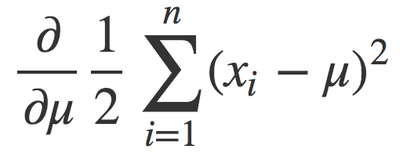
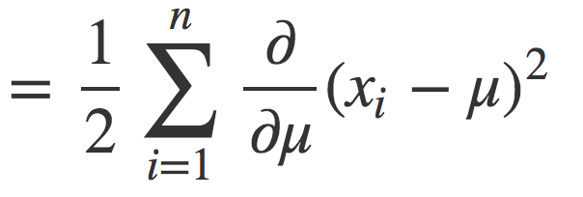
The mean Revisited
Want the point μ that minimizes the RSS ??????????
Find the derivative of RSS and set it to zero, solve for μ!

Slide 17
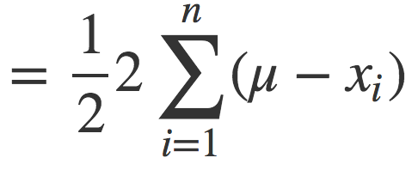
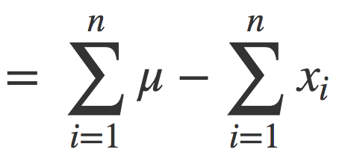
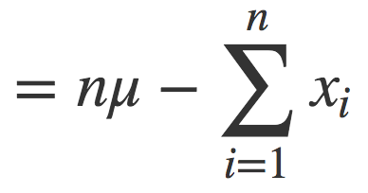
The mean revisited

Slide 18
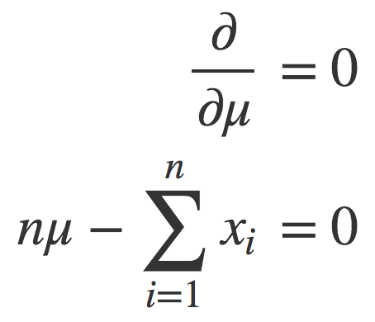
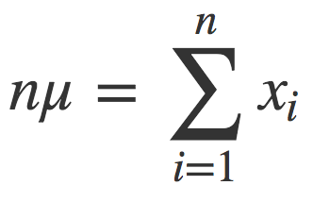
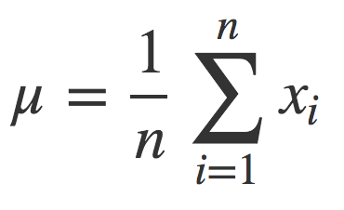
The mean revisited
Set the derivative to zero and solve for μ:
The mean is the point μ that minimizes the RSS for a dataset.

Slide 19
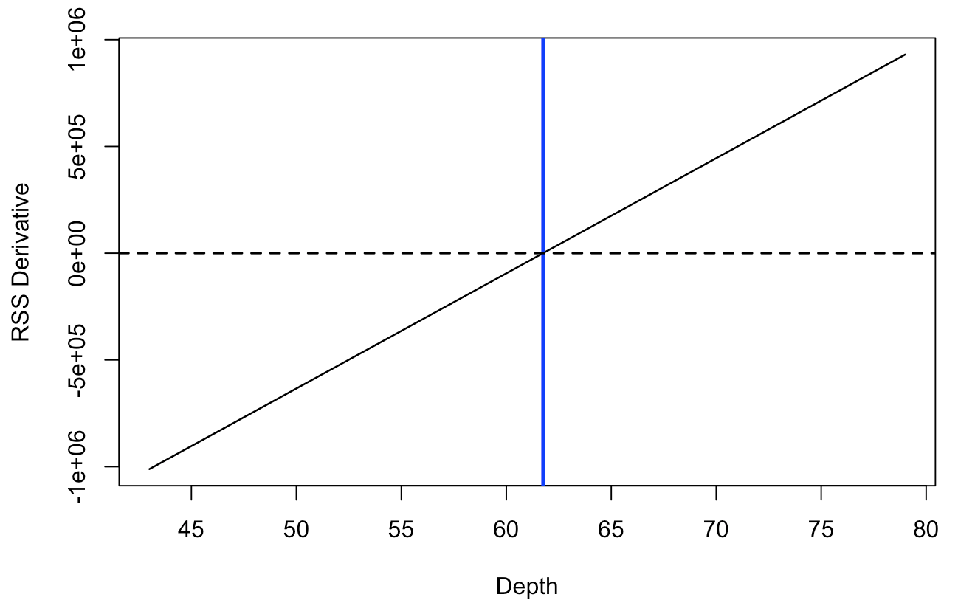
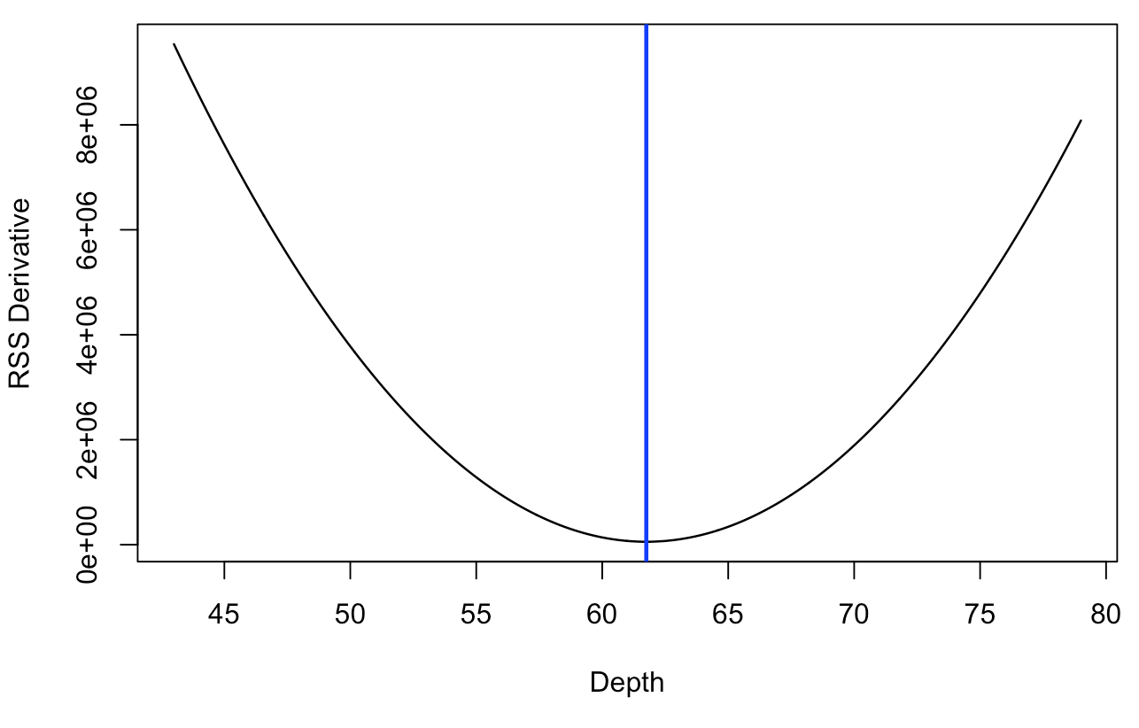
The mean revisited
What about a weighted average ???????
The mean is the point μ that minimizes the RSS for a dataset.

Slide 20
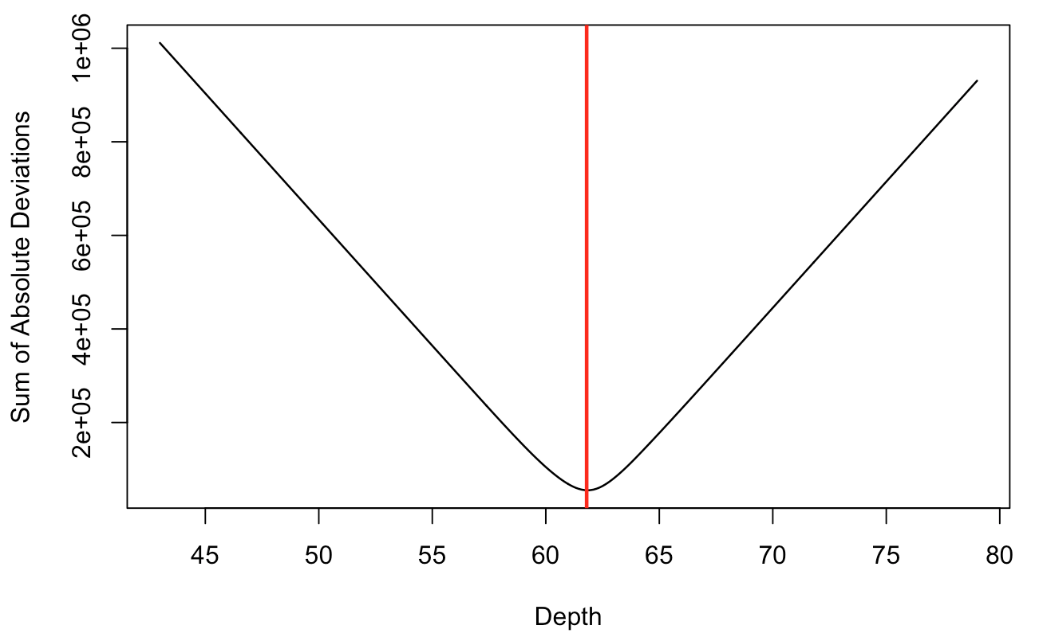
The median revisited
Define a center point m based on some function of the distance from each data point to that center point
The median m minimizes the sum of absolute differences:

Slide 21
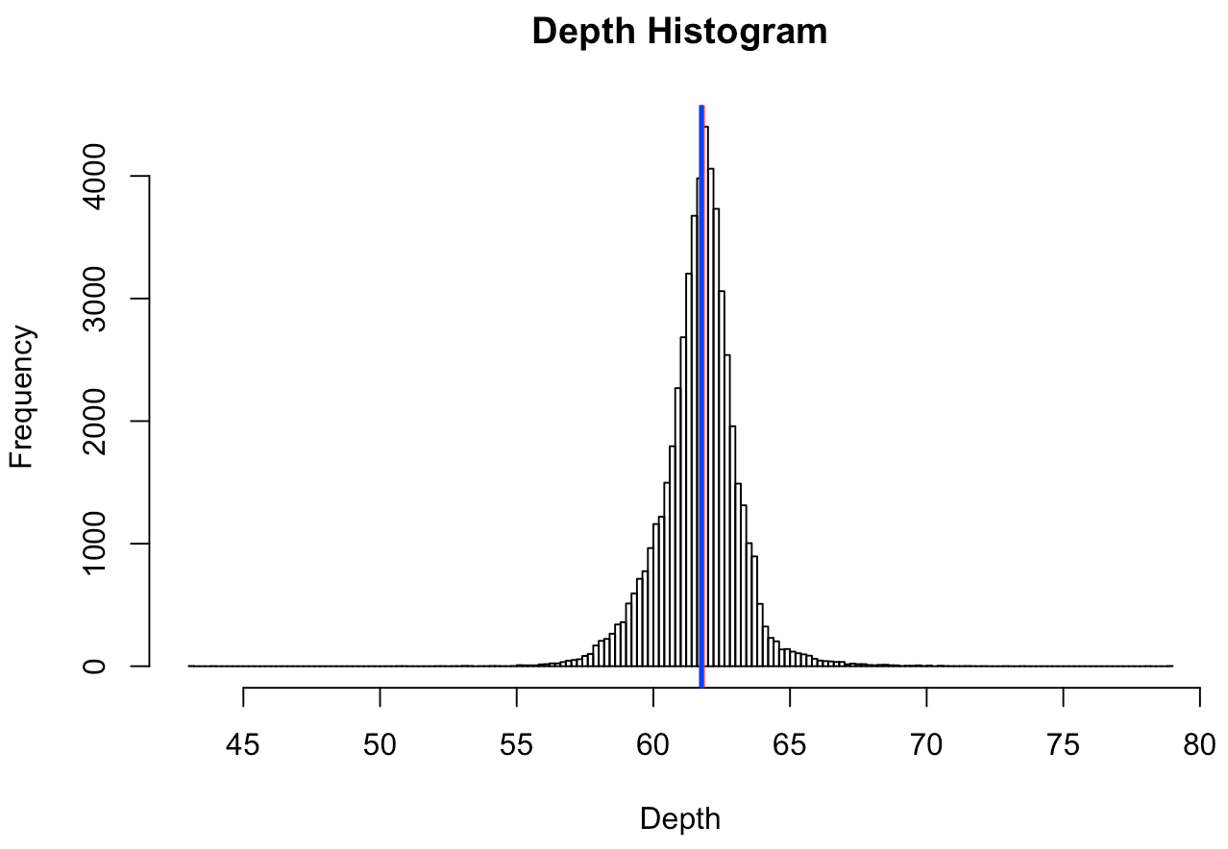
Mean != Median

Slide 22
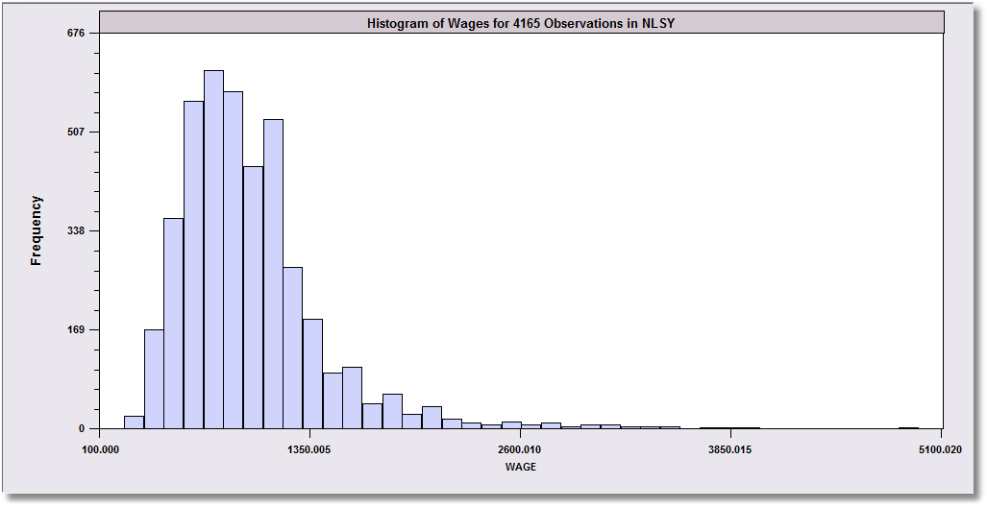
Skewed Data
Monthly Earnings N = 595, Median = 800 Mean = 883
These data are skewed to the right.
Median
Mean
The mean will exceed the median when the distribution is skewed to the right.
Skewness is in the direction of the long tail

Slide 23
SKewness
Extreme observations distort means but not medians.
Outlying observations distort the mean:
Med [1,2,4,6,8,9,17] = 6
Mean[1,2,4,6,8,9,17] = 6.714
Med [1,2,4,6,8,9,17000] = 6 (still)
Mean[1,2,4,6,8,9,17000] = 2432.8 (!)
Typically occurs when there are some outlying observations, such as in cross sections of income or wealth and/or when the sample is not very large.

Slide 24
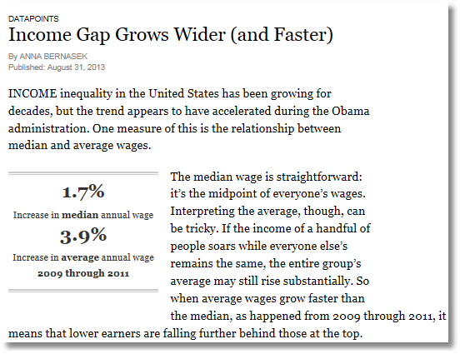

Slide 25
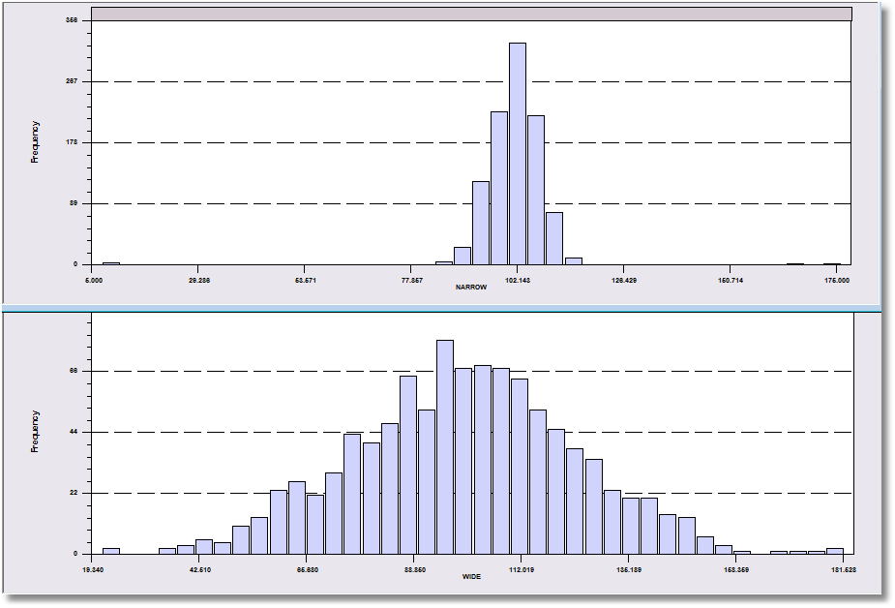
More Information Needed!
Both data sets have a mean of about 100.

Slide 26
Dispersion of the Observations
30 hours of average defect data on sets of circuit boards.
1.45 1.65 1.50 2.25 1.65 1.60 2.30 2.20 2.70 1.70 2.35 1.70 1.90 1.45 1.40 2.60 2.05 1.70 1.05 2.35 1.90 1.55 1.95 1.60 2.05 2.05 1.70 2.30 1.30 2.35
We quantify the variation of the values around the mean.
Note the range is from 1.05 to 2.70. This gives an idea where the data lie.
The mean plus a measure of the variation do the same job.

Slide 27
Range as a Measure of Dispersion
Problems ????????
These two data sets both have 1,000 observations that range from about 10 to about 180.

Slide 28
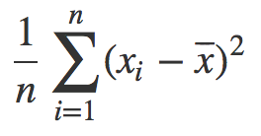
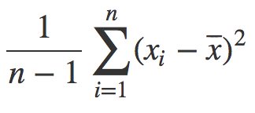
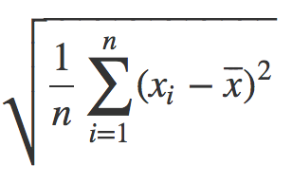
Variance & STDEV: Measures of dispersion
Variance = s_{X}² =
Standard deviation = s_{X} =
The variance is commonly used statistic for spread
What are the units of the variance ??????????
Standard deviation “fixes this,” can be used as an interpretable unit of measurement
or
Why n-1? http://nebula.deanza.edu/~bloom/math10/m10divideby_nminus1.pdf

Slide 29
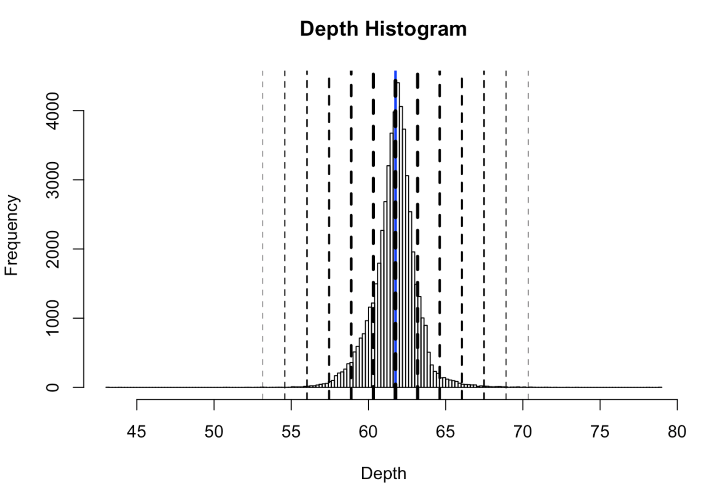

Slide 30
Using “standard deviations from the mean” as a unit
SDs | Proportion | Interpretation
1 | 0.68 | 68% of the data is within ± 1 sds
2 | 0.95 | 95% of the data is within ± 2 sds
3 | 0.9973 | 99.73% of the data is within ± 3 sds
4 | 0.999937 | 99.9937% of the data is within ± 4 sds
5 | 0.9999994 | 99.999943% of the data is within ± 5 sds
6 | 1 | 99.9999998% of the data is within ± 6 sds

Slide 31
Pairs of data Points?

Slide 32
Correlation
Variables Y and X vary together
Causality vs. correlation: Does movement in X “cause” movement in Y in some metaphysical sense?
Correlation
Simultaneous movement through a statistical relationship
Simultaneous variation “induced” by the variation of a common third effect

Slide 33
House Prices & Per Capita Income

Slide 34
Scatter Plot Suggests Positive Correlation

Slide 35
Linear Regression Measures Correlation
Regression Line: Listing = a + b IncomePC

Slide 36
Correlation Is Not Causation
Price and income seem to be positively correlated.
Does a rise in income cause a rise in gas prices ??????????????
US gasoline prices, 1953-2004, plotted against per-capita US income

Slide 37
A Hidden Relationship
Not positively “related” to each other; both positively related to “time.”

Slide 38
“Related” ...?
Want to capture: some variable X varies in the same direction and at the same scale as some other variable Y
What happens if:
X varies in the opposite direction as Y ????????
X varies in the same direction as Y ????????
What are the units of the covariance ????????
Pearson’s correlation coefficient is unitless in [-1,+1]:

Slide 39
Correlation
r_{Income,Listing} = +0.591

Slide 40
Correlations
r = 0.0
r = +1.0
r = +0.5

Slide 41
Correlation is not causation!!!
 | 2000 | 2001 | 2002 | 2003 | 2004 | 2005 | 2006 | 2007 | 2008 | 2009
Divorce rate in Maine Divorces per 1000 people (US Census) | 5 | 4.7 | 4.6 | 4.4 | 4.3 | 4.1 | 4.2 | 4.2 | 4.2 | 4.1
Per capita consumption of margarine (US) Pounds (USDA) | 8.2 | 7 | 6.5 | 5.3 | 5.2 | 4 | 4.6 | 4.5 | 4.2 | 3.7
r=0.993
?????????
http://tylervigen.com/spurious-correlations

Slide 42
Just to drive the point home …

Slide 43
Transformations

Slide 44
Transformations
So, you’ve figured out that your data are:
Skewed
Have vastly different ranges across datasets and/or different units
What do you do?
Transform the variables to:
ease the validity and interpretation of data analyses
change or ease the type of Stat/ML models you can use

Slide 45
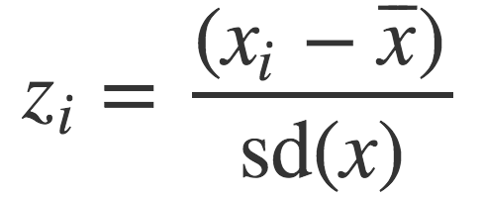
Centering And Scaling
Transform your data into a unitless scale
Put data into “standard deviations from the mean” units
This is called standardizing a variable, into standard units
Given data points x = x₁, x₂, ..., x_{n}:
Translates x into a scaled and centered variable z
What is the mean of z ??????????
What is the standard deviation of z ??????????
Notes:
Mean of z = 0
Stdev of z = 1

Slide 46
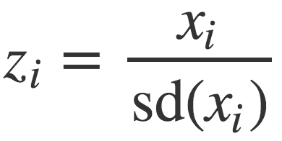
Centering or Scaling
Maybe you just want to center the data:
What is the mean of z ??????????
What is the standard deviation of z ??????????
Maybe you just want to scale the data:
What is the mean of z ??????????
What is the standard deviation of z ??????????

Slide 47
Discrete to continuous variables
Some models only work on continuous numeric data
Convert a binary variable to a number ???????????
health_insurance = {“yes”, “no”} → {1, 0}
Why not {-1, +1} or {-10, +14}?
0/1 encoding lets us say things like “if a person has healthcare then their income increases by $X.”
Might need {-1,+1} for certain ML algorithms (e.g., SVM)

Slide 48
Discrete to continuous variables
What about non-binary variables?
My main transportation is a {BMW, Bicycle, Hovercraft}
One option: { BMW → 1, Bicycle → 2, Hovercraft → 3 }
Problems ??????????
One-hot encoding: convert a categorical variable with N values into a N-bit vector:
BMW → [1, 0, 0]; Bicycle → [0, 1, 0]; Hovercraft → [0, 0, 1]
# Converts dtype=category to one-hot-encoded cols
cols = [‘my_transportation’]
df = df.get_dummies( columns = cols )

Slide 49
Continuous to discrete variables
Do doctors prescribe a certain medication to older kids more often? Is there a difference in wage based on age?
Pick a discrete set of bins, then put values into the bins
Equal-length bins:
Bins have an equal-length range and skewed membership
Good/Bad ????????
Equal-sized bins:
Bins have variable-length ranges but equal membership
Good/Bad ????????

Slide 50
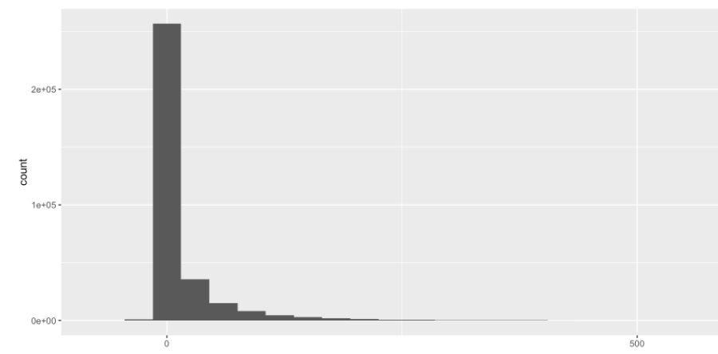
Skewed Data
Skewed data often arises in multiplicative processes:
Some points float around 1, but one unlucky draw → 0
Logarithmic transforms reduce skew:
If values are all positive, apply log₂ transform
If some values are negative:
Shift all values so they are positive, apply log₂
Signed log: sign(x) * log₂( |x| + 1)

Slide 51
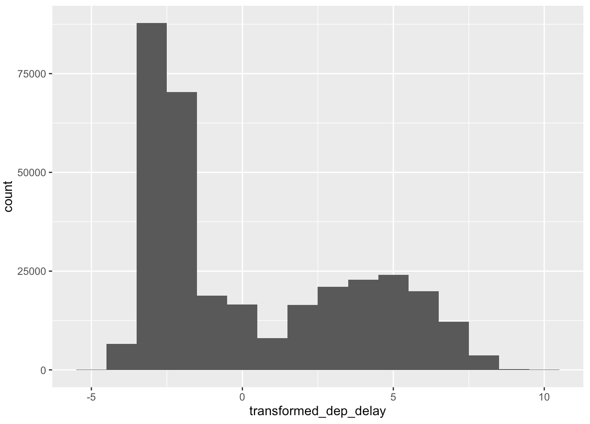
Skewed Data
log₂ transform on airline takeoff delays

Slide 52
Next Class: Visualization, Graphs, & Networks

