Slide 1
Standard deviations and probability of the population mean

Slide 2
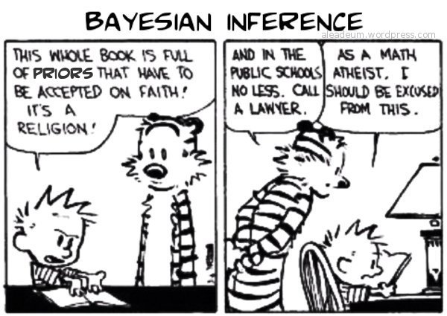
Bayesian Inferencing

Slide 3
Thomas Bayes

Slide 4
Basic Probabilities
The probability of something occurring is the number of ways that thing can occur divided by the total number of things that can occur.
Say you flip a “fair” coin. What’s the probability of heads?
Ways you can have heads = 1
Total possible outcomes = 2
Probability of heads = P(h) = ½ = 50%

Slide 5
Conditional Probabilities
Conditional probabilities: If I know something ahead of time (or before), then what is the probability of event x? Conditional probabilities are calculated just like basic probabilities. What is P(drawing an Ace from a full deck) = 4/52. Ok. After drawing that ace what are probabilities of getting an Ace again? P(Ace|Ace) = 3/51. This is read what is the probability of getting an Ace given=| we’ve pulled one already. I.e., P(A|B) = The probability of A given B has already occurred.
Conditionals = adjust all possibilities

Slide 6
Joint Probabilities
What is probability of pulling an Ace of (Hearts or Diamonds)?
P(Ace) = P(a) 4/52
P(Hearts or Diamonds) = P(hd) =13*2/52 = 26/52 = ½
P(a and hd) = 4/52 * ½ = 4/104 = 2/52
We calculate this in our heads but are actually doing some quick multiplication.
Joint = multiply

Slide 7
Marginal Probabilities
What is P of pulling any heart or diamond?
P(heart) = 13/52
P(diamond) = 13/52
P(any red) = P(heart) + P(diamond)
Marginal = add

Slide 9
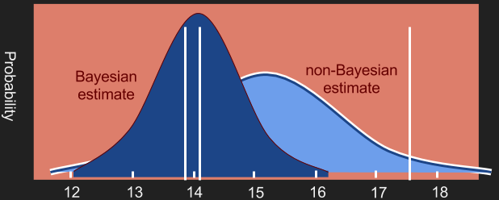
Bayes Theorem

Slide 10
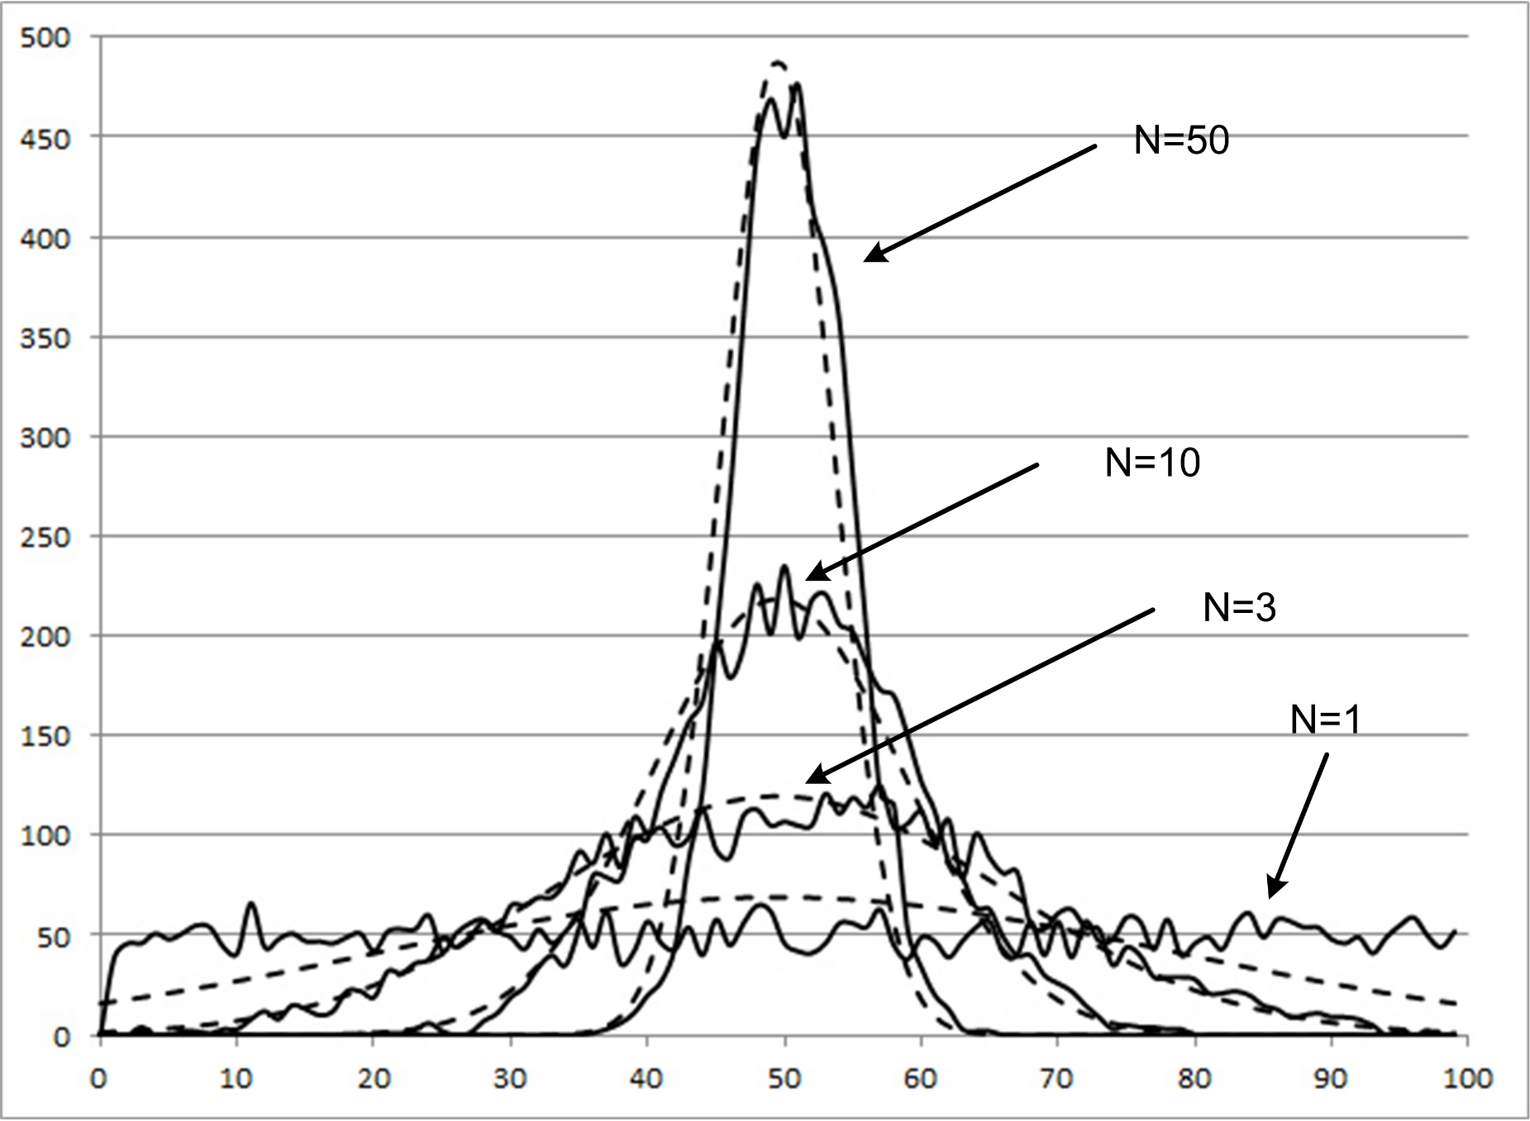

Slide 11
Standard deviations and probability of the population mean

Slide 12
Type I & Type II errors

Slide 13
Some examples
The average time it takes to find Waldo at Comic Con by a random group of people over age 6 is 7 minutes. We surveyed 30 random people over age six and they found Waldo in an average time of 5 minutes. Who is right?
Null hypo = mean = 7
New hypo = mean = 5. N = 30, calculated sdev = 2.08, Z-Score = -.96
Z-table look up gives = .33*2 → p = 66%. So there’s a 66% chance that the population mean is in this range. Margin of error = 5+-.36 66% confidence. Should we reject?

Slide 14
Time permitting in class examples with Waldo

