Slide 1
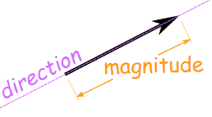

Slide 2
How do we find the best linear regression line?

Slide 3
How do we find the best linear regression line with multiple variables?

Slide 4
Partial Differential Equations!

Slide 5
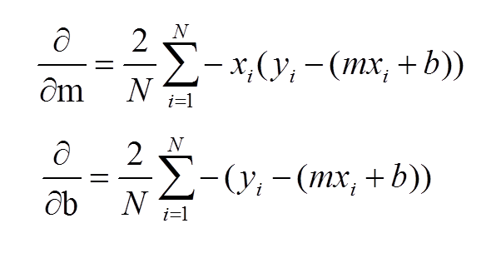
Revisit SSE
Both are basic applications of the chain rule ☺

Slide 6
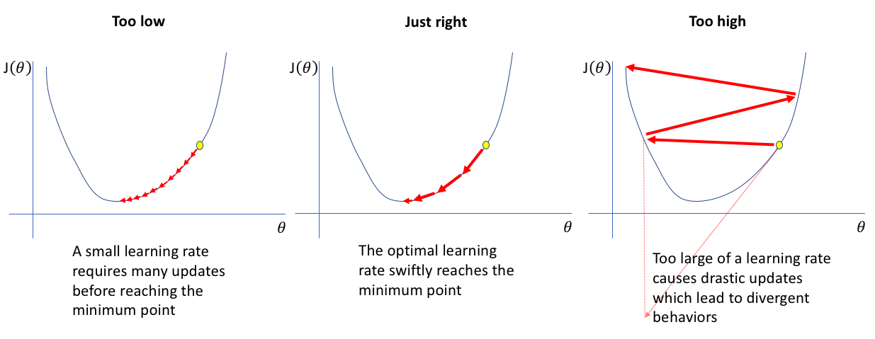
Gradient Descent
Gradient descent is an optimization algorithm for finding the minimum of a function. To find a local minimum of a function using gradient descent, one takes steps proportional to the negative of the gradient of the function at the current point. These steps are governed by a learning rate.

Slide 7
Learning Rate
How do we set the learning rate?

Slide 8
Excel example

Slide 9
Java Example!

Slide 10
Python Example

Slide 11
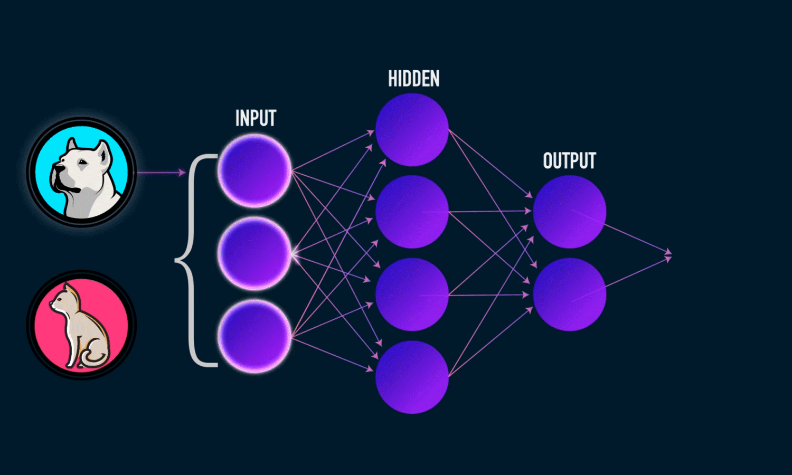
Gradient Descent Applications
Multi-variable Regression

