Slide 1
Introduction to
Data Science
John P Dickerson
Lecture #29 – 12/10/2018
CMSC320
Mondays & Wednesdays
2:00pm – 3:15pm

Slide 2
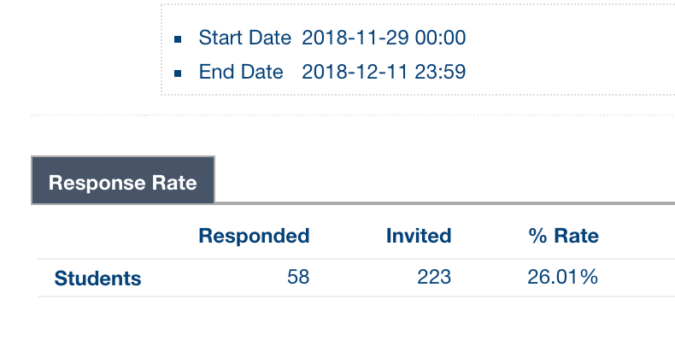
Announcements
Please fill out course evaluations!
https://courseevalum.umd.edu
Last day to fill them out is tomorrow.

Slide 3
Grades & Final Tutorials
Project 4 is being graded as we speak, should be up in the next day or two
Generally, people did very well!
Remember to:
Submit via ELMS the URL for the GitHub Page for your group’s final tutorial
Fill in on the Google Doc your project title, URL, group members, and data source(s)

Slide 4
Increasing Access to organs through Market Design & optimization
John P Dickerson
University of Maryland
CMSC320 – Last Lecture
December 10, 2018

Slide 5
Markets come in many forms …
… some of which don’t conform to conventional notions of markets …
… and some in which money may play little or no role.
– excerpt from Who Gets What – and Why
Notes:
Markets and marketplaces come in many forms …
… some of which don’t conform to conventional notions of markets …
… and some in which money may play little or no role.

Slide 6












Matching markets
In matching problems, prices do not do all – or any – of the work
Agents are paired with other (groups of) agents, transactions, or contracts
Workers to firms
Children to schools
Residents to hospitals
Patients to donors
Advertisements to viewers
Riders to rideshare drivers

Slide 7




Uncertainty
Does a matched edge truly exist?
How valuable is a match?
Will a better match arrive in the future?
F
?
W

Slide 8

Competition
Rival matching markets compete over the same agents
How does this affect global social welfare?
How to differentiate?

Slide 9




Match Cadence
FREQUENCY
How quickly do new edges form?
How frequently does a market clear?
Is clearing centralized or decentralized?
Can agents reenter the market?
?
?
?
?

Slide 10
Use data & optimization –
alongside human domain expertise – to learn matching policies
Strong theoretical underpinnings provide design guidance &
runtime guarantees

Slide 11
This talk
Four dimensions of matching market design:
  Managing short-term uncertainty
  Balancing equity & efficiency
  Combining human input and optimization
  Incentives & mechanism design
(Each is supported by my work with local and nationwide kidney exchanges)
Also, some open problems!
Covers recent and ongoing work – talk to me for details!
Publications: jpdickerson.com/pubs.html

Slide 12
Kidney Exchange

Slide 13
Kidney transplantation
US waitlist: about 100,000
  35,587 added in 2017
4,044 people died while waiting
14,022 people received a kidney
from the deceased donor waitlist
5,794 people received a kidney from a living donor
  Some through kidney exchanges!
  This talk: experience with UNOS national kidney exchange (and some data from the NHS NLDKSS)
Demand
Supply
[Roth et al. 2004]
Notes:
United Kingdom National Health Service National Living Donor Kidney Sharing Schemes

Slide 14
Tried-and-true: Deceased-Donor Allocation
Online bipartite matching problem:
Set of patients is known (roughly) in advance
Organs arrive and must be dispatched quickly
Constraints:
Locality: organs only stay good for 24 hours
Blood type, tissue type, etc.
Who gets the organ? Prioritization based on:
Age?
QALY maximization?
Quality of match?
Time on the waiting list?

Slide 15




Kidney exchange
Wife
Husband
D₁ P₁
Donors
Patients
D₂ P₂
Brother
Brother
(2- and 3-cycles, all surgeries performed simultaneously)

Slide 16
Non-directed donors & chains
[Rees et al. 2009]
NDD
D1
D2
D3
…
Pay it forward
P1
P2
P3
Not executed simultaneously, so no length cap required based on logistic concerns …
… but in practice edges fail, so some finite cap is used!

Slide 17
Real-world impact
Kidney exchange is only a decade young, but already accounts for >12% of living donations in the United States
Now a worldwide phenomenon (AU, CA, IL, PT, TR, UK, …)
(Slowly) moving toward organized international exchange
Extensive experience with, e.g., the United Network for Organ Sharing (UNOS) US nationwide kidney exchange!
155+ transplant centers (roughly 69% of the US)
Completely autonomous biweekly match runs
Only automated exchange in the US

Slide 18
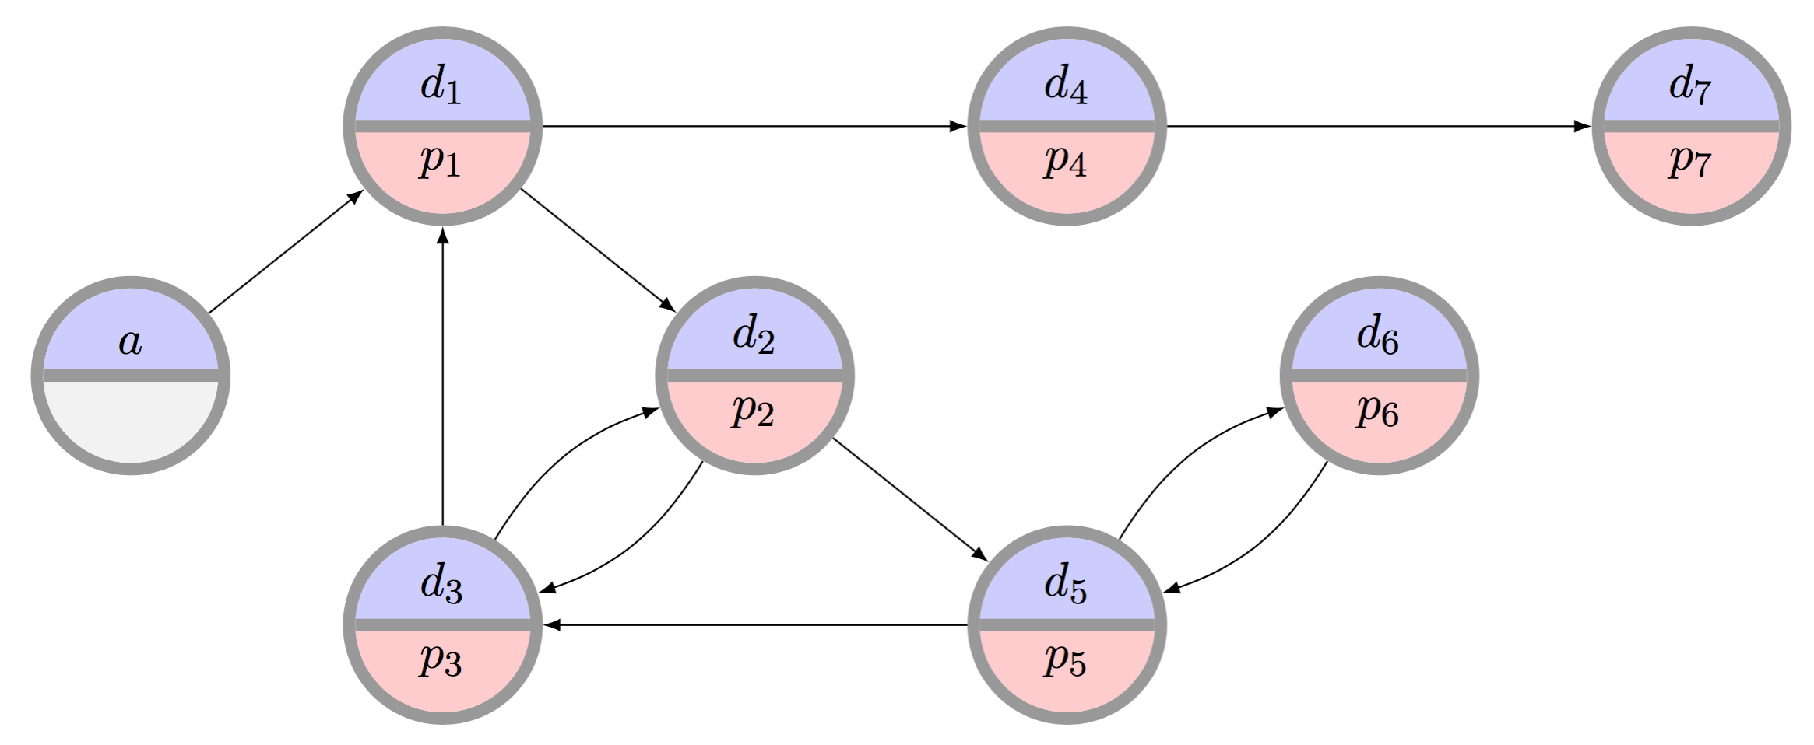
The clearing problem
The clearing problem is to find the “best” disjoint set of cycles of length at most L, and chains
  Typically, 2 ≤ L ≤ 5 for kidneys (e.g., L=3 at UNOS)
  NP-hard (for L>2) in theory, really hard in practice
[Glorie et al. 2014,
Anderson et al. 2015,
Plaut et al. 2016,
Dickerson et al. 2016 ...]
[Abraham et al. 07, Biro et al. 09]

Slide 19
A Simple Integer program
(“Best” = max weight, myopic matching)
[Roth et al. 04, 05,
Abraham et al. 07]
Binary variable x_{c} for each feasible cycle or chain c
Maximize
u(M) = Σ w_{c} x_{c}
Subject to
Σ_{c : i in c} x_{c} ≤ 1 for each vertex i
“Simple” …?

Slide 20
The Big Problem
What is “best”?
Maximize matches right now or over time?
Maximize transplants or matches?
Prioritization schemes (i.e. fairness)?
Modeling choices?
Incentives? Ethics? Legality?
Optimization can handle this, but may be inflexible in hard-to-understand ways (for humans)
Want humans in the loop at a high level
(and then CS/Opt handles the implementation)

Slide 21
Managing short-term uncertainty
[EC-13, EC-15, EC-16, Management Science 18, AAAI-19]
With A. Blum, N. Haghtalab, D. Manlove, D. McElfresh, B. Plaut, A. Procaccia, T. Sandholm, A. Sharma, J. Trimble

Slide 22
Matched ≠ Transplanted
Only around 10-15% of UNOS matched structures result in an actual transplant
Similarly low % in other exchanges [ATC 2013]
Many reasons for this. How to handle?
One way: encode probability of transplantation rather than just feasibility
for individuals, cycles, chains, and full matchings

Slide 23
Discounted clearing problem
(“Best” = max expected cardinality | limited recourse)
Find matching M* with highest discounted utility
3
Maximum cardinality
Maximum expected transplants
0.1
0.1
0.9
1
2
0.9

Slide 24


Solving this new problem
Theorem:
In a sparse random graph model, for any failure probability p, w.h.p. there exists a matching that is “linearly better” than any max-cardinality matching
Practice: Solved via branch-and-price
  One binary decision variable per cycle/chain
  Upper-bounding is now NP-hard
  Pricing problem is (empirically) much easier
Maybe this is a good idea …

Slide 25
UNOS
2010-2014
Oct. 2010
Late 2014
Under discussion for implementation at UNOS

Slide 26
Pre-match edge testing
Idea: perform a small amount of costly testing before a match run to test for (non)existence of edges
E.g., more extensive medical testing, donor interviews, surgeon interviews, …
Cast as a stochastic matching problem:
Given a graph G(V,E), choose subset of edges S such that:
|M(S)| ≥ (1-ε) |M(E)|
Need: “sparse” S, where every vertex has O(1) incident tested edges

Slide 27
UNOS Data
At p=0.5, one edge test per vertex → +21% OPT
Even 1 or 2 extra tests would result in a huge lift

Slide 28
In theory and practice, we’re helping the global bottom line by considering post-match failure …
… But can this hurt some individuals?

Slide 29
Balancing Fairness and efficiency
[AAMAS-14, AAAI-15, AAAI-18, Invited to AIJ, u.r. 2018]
With D. McElfresh, A. Procaccia and T. Sandholm

Slide 30
Sensitization In Kidney Transplantation
Highly-sensitized patients: unlikely to be compatible with a random donor
Deceased donor waitlist: 17%
Kidney exchanges: much higher (60%+)
“Easy to match” patients
“Hard to match” patients

Slide 31
Price of fairness
Efficiency vs. fairness:
Utilitarian objectives may favor certain classes at the expense of marginalizing others
Fair objectives may sacrifice efficiency in the name of egalitarianism
Price of fairness: relative system efficiency loss under a fair allocation
Very applicable to kidney exchange!
[Bertismas, Farias, Trichakis 2011]
[Caragiannis et al. 2009]

Slide 32
Contradictory goals
Earlier, we saw failure-aware matching results in tremendous gains in #expected transplants
Gain comes at a price – may further marginalize hard-to-match patients because:
  Highly-sensitized patients tend to be matched in chains
  Highly-sensitized patients may have higher failure rates (in, e.g., APD data, not in UNOS data)

Slide 33
Beats efficient deterministic
UNOS runs, weighted fairness, constant probability of failure (x-axis), increase in expected transplants over deterministic matching (y-axis)

Slide 34
Fairness vs. efficiency can be balanced in theory and in practice in a static model …
… But how should we match over time?

Slide 35
Learning to match in a dynamic environment
[AAAI-12, AAAI-15, NIPS-15 MLHC, w.p. 2018]
With M. Curry, D. McElfresh, C. Moy, A. Procaccia, and T. Sandholm

Slide 36
Dynamic kidney exchange
Kidney exchange is a naturally dynamic event
Can be described by the evolution of its graph
Additions, removals of edges and vertices
Vertex Removal | Edge Removal | Vertex/Edge Add
Transplant, this exchange | Matched, positive crossmatch | Normal entrance
Transplant, deceased donor waitlist | Matched, candidate refuses donor
Transplant, other exchange ("sniped") | Matched, donor refuses candidate
Death or illness | Pregnancy, sickness changes HLA
Altruist runs out of patience
Bridge donor reneges
How should we balance matching now versus waiting to match?

Slide 37
FutureMatch: Learning to match in dynamic environments
Offline (run once or periodically)
Domain expert describes overall goal
Take historical data and policy input to learn a weight function w for match quality
Take historical data and create a graph generator with edge weights set by w
Using this generator and a realistic exchange simulator, learn potentials for graph elements as a function of the exchange dynamics
Online (run every match)
Combine w and potentials to form new edge weights on real input graphs
Solve maximum weighted matching and return match

Slide 38


Experimental results & Impact
We show it is possible to:
Increase overall #transplants a lot at a (much) smaller decrease in #marginalized transplants
Increase #marginalized transplants a lot at no or very low decrease in overall #transplants
Increase both #transplants and #marginalized
Sweet spot depends on distribution:
Luckily, we can generate – and learn from – realistic families of graphs!
Presented at Supercomputing
Tied with IBM Watson
FutureMatch now used for policy recommendations at UNOS

Slide 39
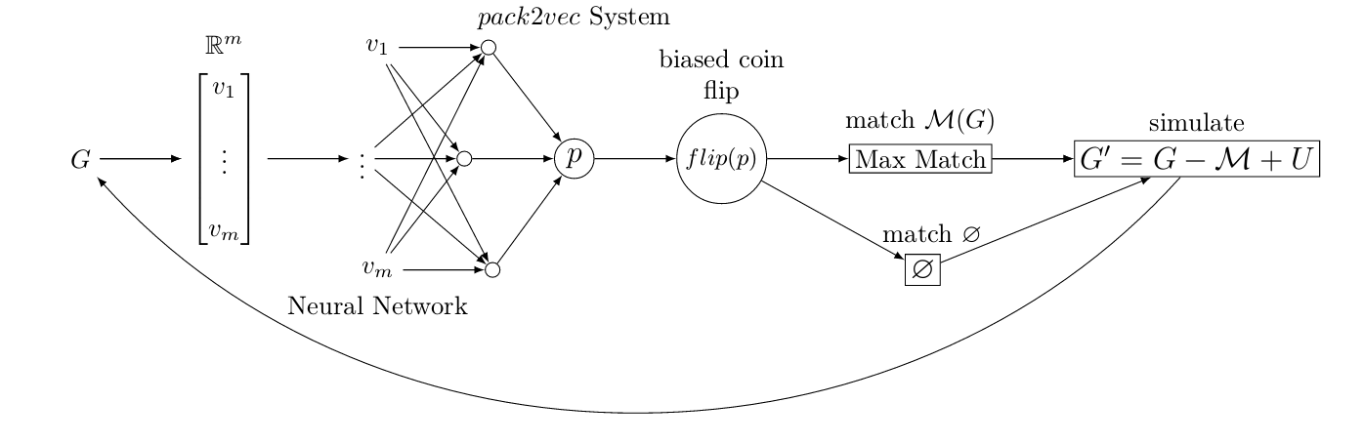
Learning & Dynamic Kidney exchange
2
3
5
4
1
  Embed current compatibility graph into fixed-dimensional space
  Neural network uses those vectors to learn appropriate policy
  Flip a biased coin
  If heads: find and match maximum cardinality matching
  Simulate kidney exchange environment and grow the graph

Slide 40
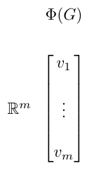
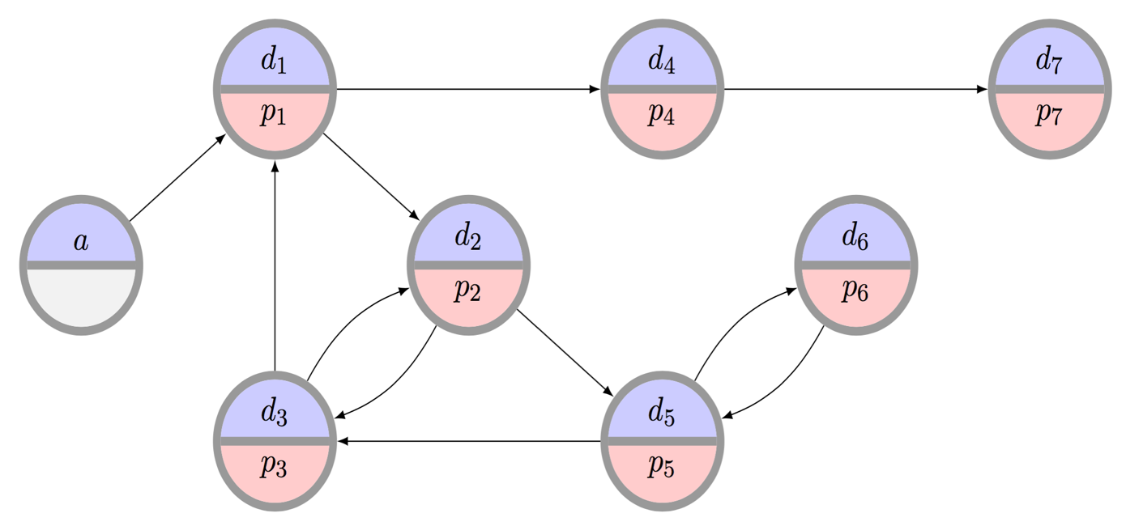
1. embedding
Neural networks generally take a fixed-sized vector as input
Our state space: graphs of any size
Need: embed the graph as a vector and still maintain certain properties, such as node neighborhood structure. We use random walks to do so [Li, Campbell, Caceres 2017]
Use random walk on a carefully selected initial distribution to capture temporal changes in probability distribution
Encode distance between pairs of probability distributions
Empirically, this approach can distinguish between, e.g., Erdős–Rényi and Stochastic Block Model graphs

Slide 41
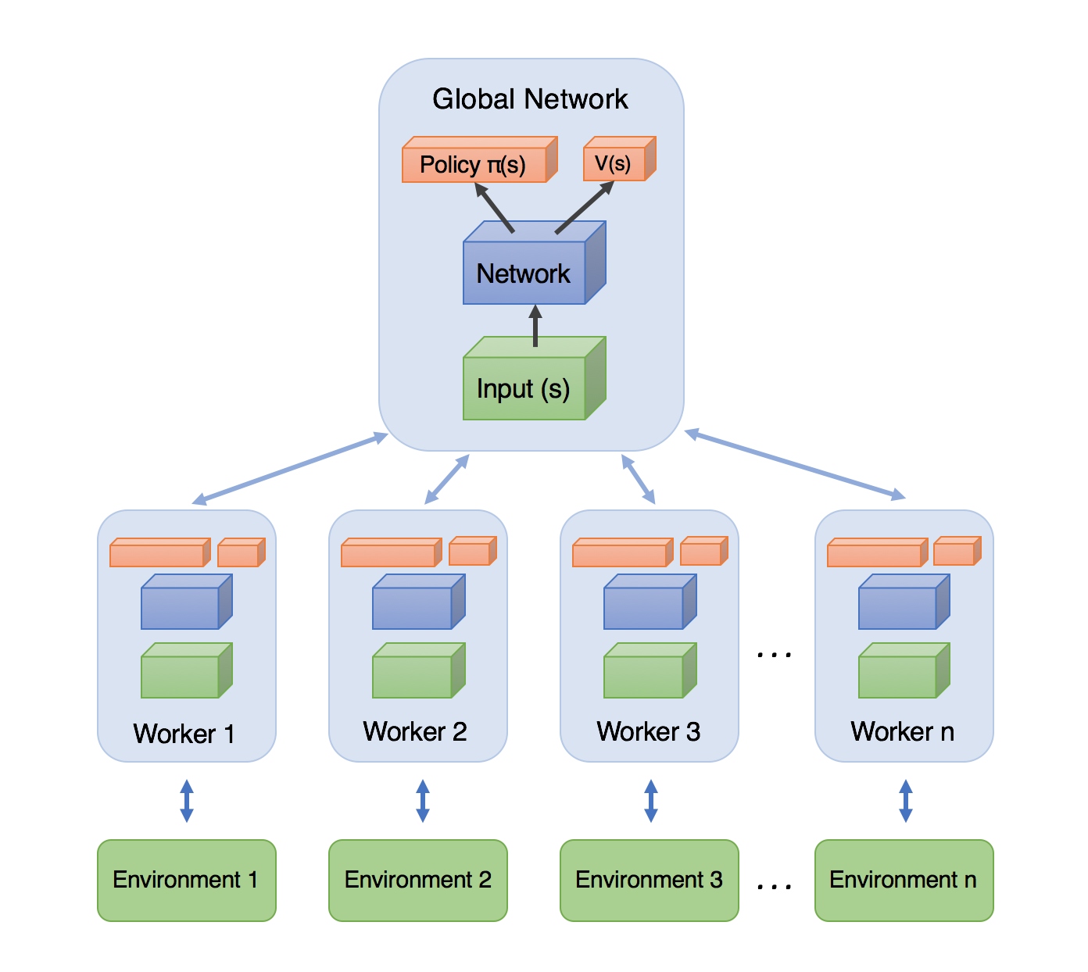
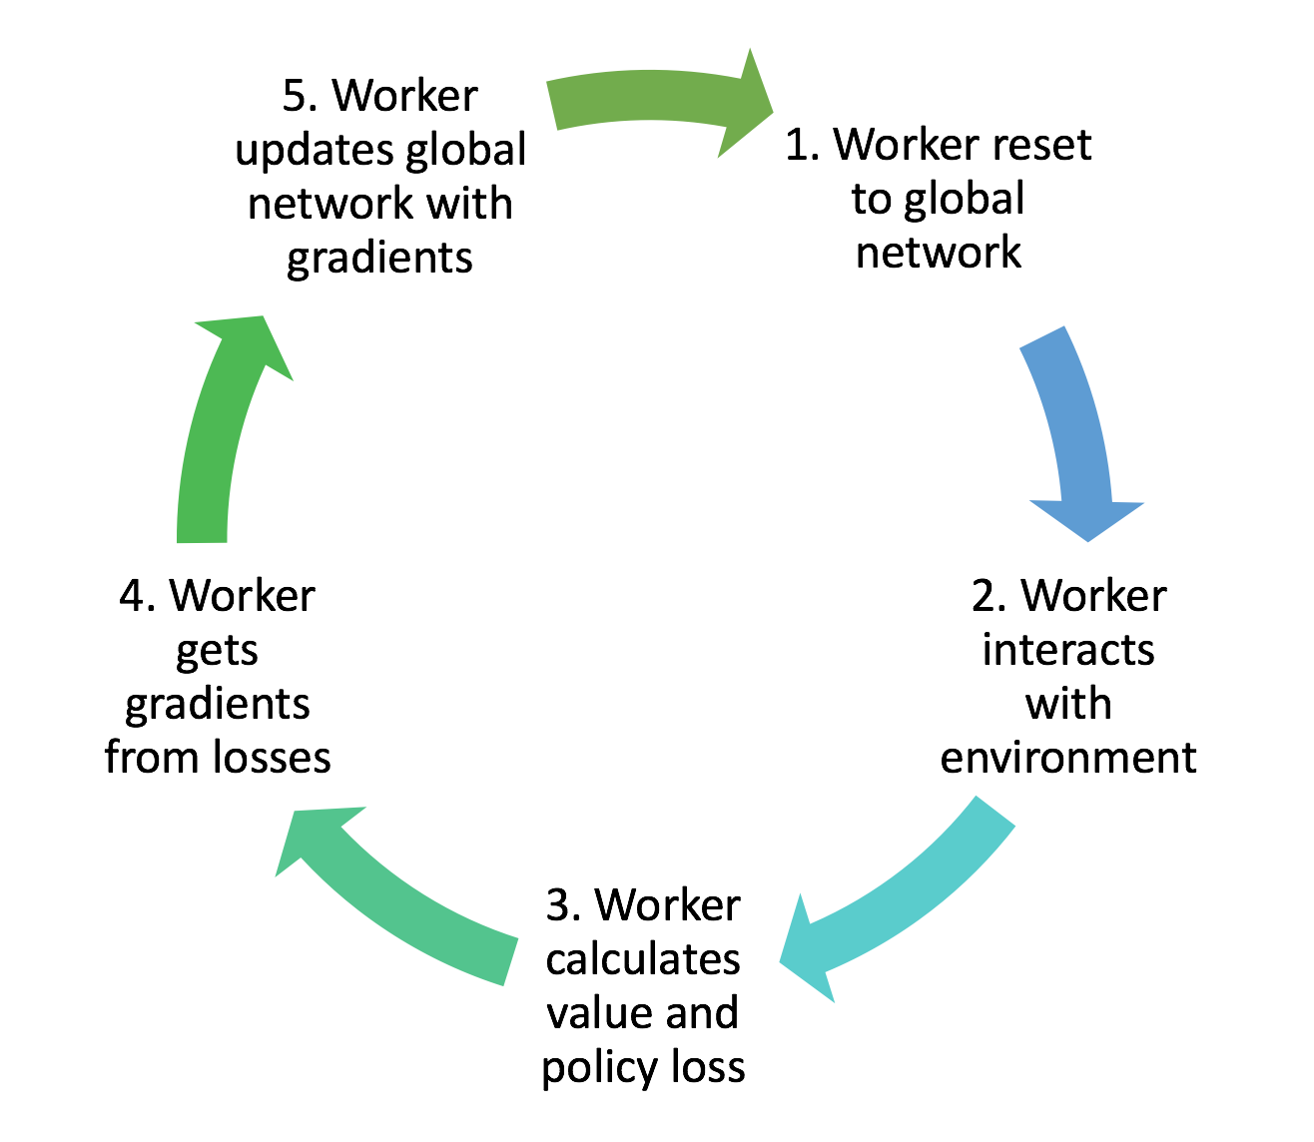
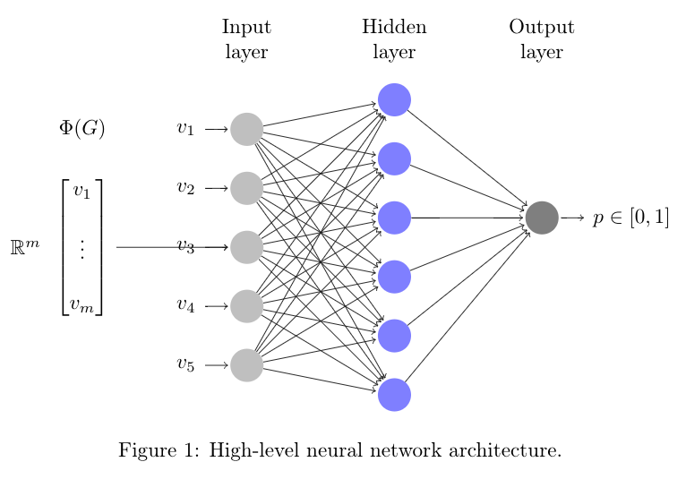
2. Embedding to Neural Net
Feed an embedded graph into, e.g., a neural network to output a learned probability for our biased coin flip
(Currently, using an adaptation of Asynchronous Advantage Actor-Critic (A3C) method [Mnih 2016])

Slide 42


3. Biased Coin Flip w/Learned
Probability
1
MAX MATCH
0
MATCH NOTHING (wait)
4. MAX Matching (The clearing problem)—or not

Slide 43
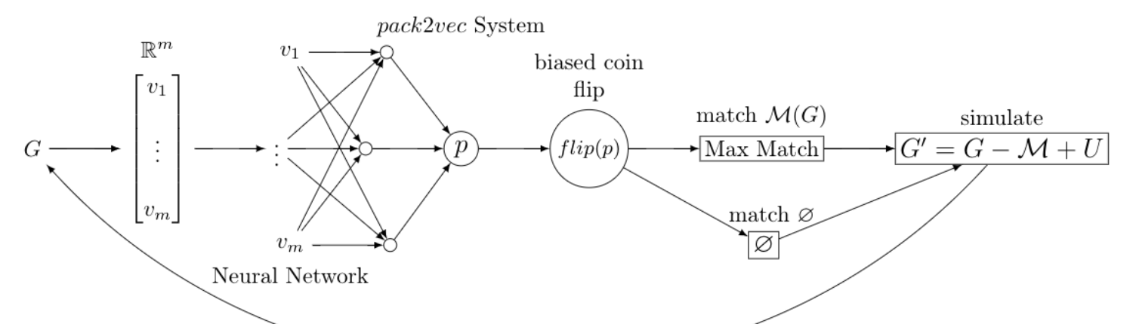
5. Kidney Exchange simulation – Changing the Input graph
To train the neural network, we must be able to simulate kidney exchange (graphs). We use several evolution models.
Homogeneous Erdős–Rényi graphs [Akbarpour et al. 2017+]
Heterogeneous Erdős–Rényi graphs [Ashlagi et al. 2013+]
Real data from the UNOS exchange
(Real data from other exchanges?)
5

Slide 44
Early results
We replicate results from prior theory papers:
In some models, dynamic matching helps
In some models, dynamic matching does not help
Still iterating on:
Neural net structure
Action space (binary coin flip vs. multiple match types)
Learning method (A3C vs. DQN vs. more standard methods)
But …
Seems promising. Can learn matching policies beyond simply batching for T time periods; can realize gains over greedy.
Policies depend on graph structure.

Slide 45
Competition Within, and between, Kidney Exchanges
[AAAI-15, AMMA-15, IJCAI-18, w.p. 2018]
With S. Das, N. Gupta, C. Hajaj, A. Hassidim, Z. Li, T. Sandholm, and D. Sarne

Slide 46
Managing Incentives
Clearinghouse cares about global welfare:
  How many patients received kidneys (over time)?
Transplant centers care about their individual welfare:
  How many of my own patients received kidneys?
Patient-donor pairs care about their individual welfare:
  Did I receive a kidney?
  (Most work considers just clearinghouse and centers)

Slide 47
Private vs Global Matching

Slide 48
0%

Slide 49
Race to the bottom
In the US, there are multiple competing exchanges:
UNOS, NKR, APD, …
Single-center “centralized exchanges”
What about international exchange?
EU COST Action to investigate connection of exchanges
Fragmenting the market results in:
Higher short-term failure rates
Fewer matching opportunities
Higher (aka greedier, “myopic”) match speed
Overall efficiency loss (in theory, simulation, and reality)

Slide 51















Questions?
More information:
http://jpdickerson.com
Code:
/JohnDickerson/KidneyExchange
Joint work with:
Funding & support:
NDSEG
Fellowship
Facebook
Fellowship

Slide 53
Backup slides
John P Dickerson

Slide 54
The Cutting Edge

Slide 55
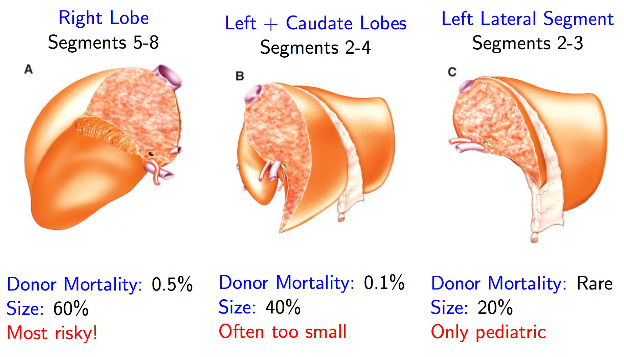
Moving beyond kidneys: Livers
[Ergin, Sönmez, Ünver w.p. 2015]
Similar matching problem (mathematically)
Right lobe is biggest but riskiest; exchange may reduce right lobe usage and increase transplants
[Sönmez 2014]

Slide 56

Moving beyond kidneys: Multi-Organ Exchange
[Dickerson Sandholm AAAI-14, JAIR-17]
Chains are great! [Anderson et al. 2015, Ashlagi et al. 2014, Rees et al. 2009]
Kidney transplants are “easy” and popular:
  Many altruistic donors
Liver transplants: higher mortality, morbidity:
  (Essentially) no altruistic donors
P1
P2
P3
P4
…
Kidney
A
Kidney
Liver
Kidney
D1
D2
D3
D4

Slide 57
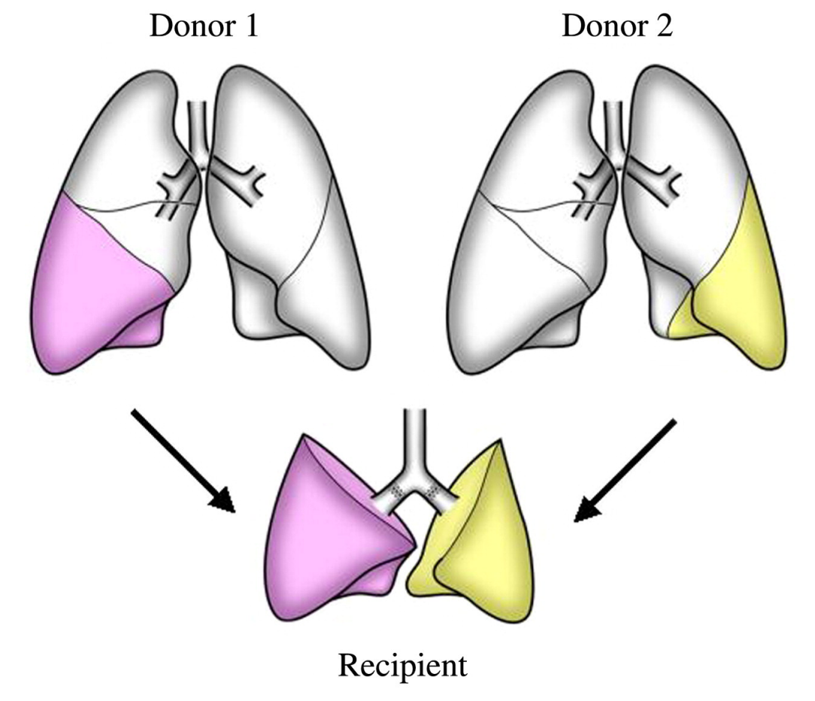
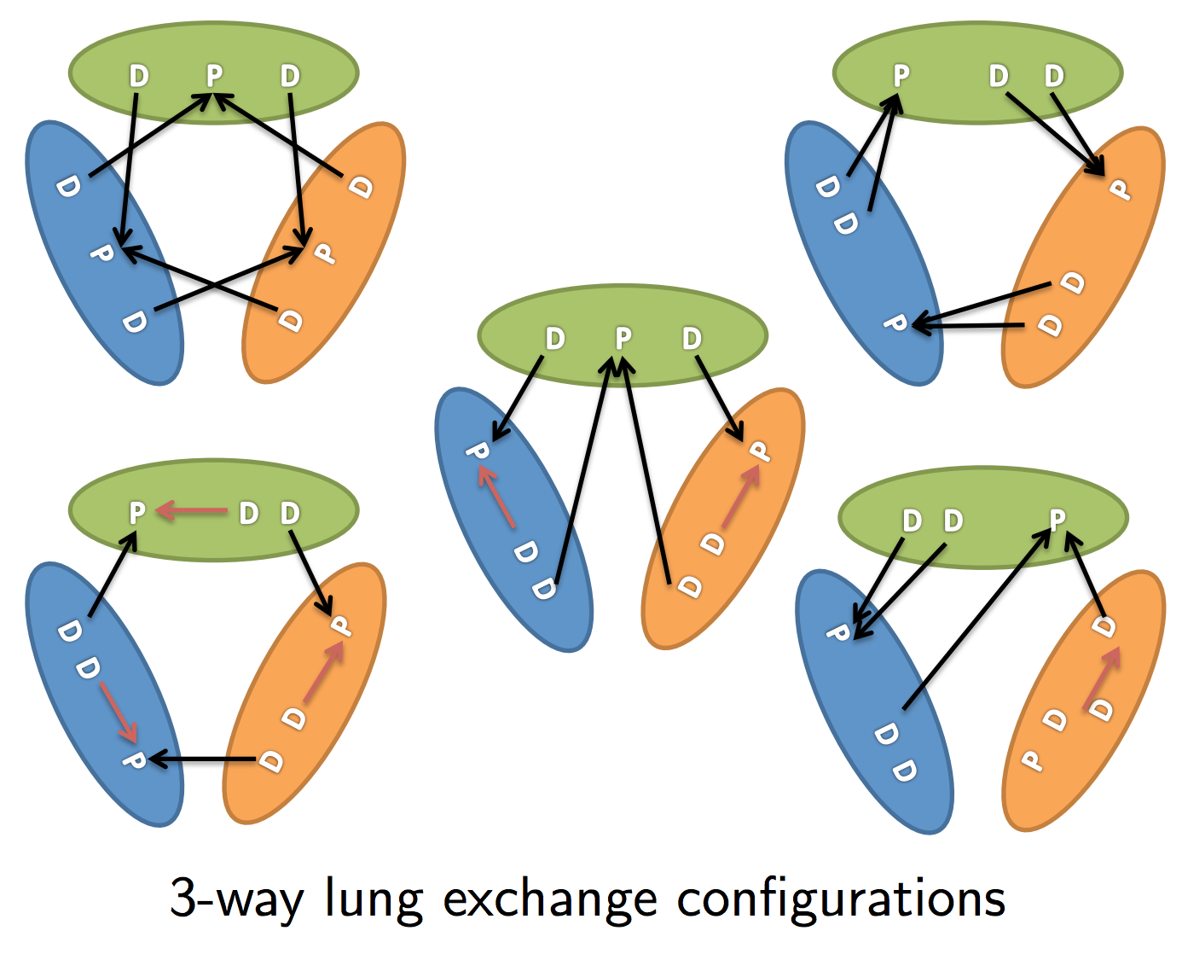
Moving beyond kidneys: Lungs
[Ergin, Sönmez, Ünver w.p. 2014]
Fundamentally different matching problem
  Two donors needed
[Date et al. 2005; Sönmez 2014]
(Compare to the single configuration for a “3-cycle” in kidney exchange.)

Slide 58
Failure-aware model
Compatibility graph G
Edge (v_{i}, v_{j}) if v_{i}’s donor can donate to v_{j}’s patient
Weight w_{e} on each edge e
Success probability q_{e} for each edge e
Discounted utility of cycle c
u(c) = ∑w_{e} • ∏q_{e}
Value of successful cycle
Probability of success

Slide 59
Failure-aware model
Discounted utility of a k-chain c
Cannot simply “reweight by failure probability”
Utility of a match M: u(M) = ∑ u(c)
Exactly first i transplants
Chain executes in entirety

Slide 60
Incrementally solving very large IPs
#Decision variables grows linearly with #cycles and #chains in the pool
Millions, billions of variables
Too large to fit in memory
Branch-and-price incrementally brings variables into a reduced model [Barnhart et al. 1998]
Solves the “pricing problem” – each variable gets a real-valued price
Positive price → resp. constraint in full model violated
No positive price cycles → optimality at this node

Slide 61
Considering only “good” chains
Theorem:
Given a chain c, any extension c’ will not be needed in an optimal solution if the infinite extension has non-positive value.
Optimistic future value of infinite extension
Donation to waitlist
Discounted utility of current chain
Pessimistic sum of LP dual values in model

Slide 62
G(n, t(n), p): random graph with
n patient-donor pairs
t(n) altruistic donors
Probability Θ(1/n) of incoming edges
Constant transplant success probability q
Theorem
For all q∈ (0,1) and α, β > 0, given a large G(n, αn, β/n), w.h.p. there exists some matching M’ s.t. for every maximum cardinality matching M,
u_{q}(M’) ≥ u_{q}(M) + Ω(n)

Slide 63
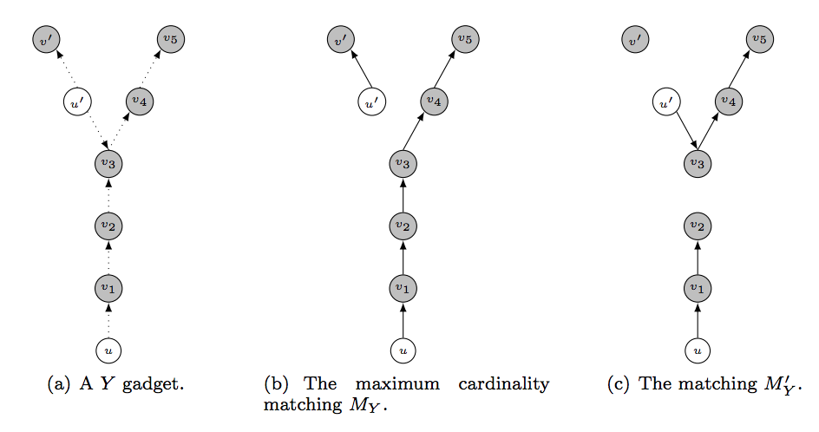
Brief intuition: Counting Y-gadgets
For every structure X of constant size, w.h.p. can find Ω(n) structures isomorphic to X and isolated from the rest of the graph
Label them (alt vs. pair): flip weighted coins, constant fraction are labeled correctly → constant × Ω(n) = Ω(n)
Direct the edges: flip 50/50 coins, constant fraction are entirely directed correctly → constant × Ω(n) = Ω(n)

Slide 64


Under the “most stringent” fairness rule:
Theorem
Assume “reasonable” level of sensitization and “reasonable” distribution of blood types. Then, almost surely as n → ∞,
(And this is achieved using cycles of length at most 3.)

Slide 65
Linear efficiency loss
Sublinear loss
Notes:
Under- and self-demanded pairs are white, over-demanded pairs are gray, and reciprocal pairs are black.
Regular edges appear in the efficient matching, while dashed edges represent 3-cycles from the efficient matching that may be disturbed via fair matching.

Slide 66
Better static optimization methods
Recall two main methods for solving big IPs for kidney exchange:
  Branch-and-price = B&B + column generation
  Constraint generation
Many different ways to do these:
  E.g., how do I solve the pricing problem?
  E.g., which constraints should I add to the model?
Big runtime changes [Anderson et al. PNAS-2015, Glorie et al. MSOM-2014]

Slide 67
Basic Edge formulation
[Abraham et al. 07]
Binary variable x_{ij} for each edge from i to j
Maximize
u(M) = Σ w_{ij} x_{ij}
Subject to
Σ_{j} x_{ij} = Σ_{j} x_{ji} for each vertex i
Σ_{j} x_{ij} ≤ 1 for each vertex i
Σ_{1≤k≤L} x_{i(k)i(k+1)} ≤ L-1 for paths i(1)…i(L+1)
(no path of length L that doesn’t end where it started – cycle cap)
Flow constraint

Slide 68
State of the art for edge formulation
[Anderson et al. PNAS-2015]
Builds on the prize-collecting traveling salesperson problem [Balas Networks-89]
  PC-TSP: visit each city (patient-donor pair) exactly once, but with the additional option to pay some penalty to skip a city (penalized for leaving pairs unmatched)
They maintain decision variables for all cycles of length at most L, but build chains in the final solution from decision variables associated with individual edges
Then, an exponential number of constraints could be required to prevent the solver from including chains of length greater than K; these are generated incrementally until optimality is proved.
  Leverage cut generation from PC-TSP literature to provide stronger (i.e. tighter) IP formulation

Slide 69
Best Edge Formulation
[Anderson et al. 15]
A
Ck
C3
If: flow into v from a chain
Then: at least as much flow across cuts from {A}
A
C1
V
A
C2
…
Notes:
If there is flow into V, then for every way V can be cut off from NDDs, there must be at least as much flow over that cut.

Slide 70
Review: Cycle formulation
Objective = maximum cardinality
Binary variable x_{c} for each cycle/chain c of length at most L
Maximize
Σ |c|x_{c}
Subject to
Σ_{c : i in c} x_{c} ≤ 1 for each vertex i

Slide 71
DFS to solve pricing problem
[Abraham et al. PNAS-2015]
Pricing problem:
  Optimal dual solution π* to reduced model
  Find non-basic variables with positive price (for a maximization problem)
    0 < weight of cycle – sum of duals in π* of constituent vertices
First approach [Abraham et al. EC-2007] explicitly prices all feasible cycles and chains through a DFS
  Can speed this up in various ways, but proving no positive price cycles exist still takes time poly in chain/cycle cap = bad for even reasonable caps

Slide 72
The Right Idea
Idea: solve structured optimization problem that implicitly prices variables
Price: w_{c} – Σ_{v in c} δ_{v} = Σ_{e in c} w_{e} – Σ_{v in c} δ_{v} = Σ_{(u,v) in c} [w_{(u,v)} – δ_{v}]
Take G, create G’ s.t. all edges e = (u,v) are reweighted r_{(u,v)} = δ_{v} – w_{(u,v)}
  Positive price cycles in G = negative weight cycles in G’
Bellman-Ford finds shortest paths
  Undefined in graphs with negative weight
  Adapt B-F to prevent internal looping during the traversal
    Shortest path is NP-hard (reduce from Hamiltonian path:
      Set edge weights to -1, given edge (u,v) in E, ask if shortest path from u to v is weight 1-|V| → visits each vertex exactly once
    We only need some short path (or proof that no negative cycle exists)
  Now pricing runs in time O(|V||E|cap²)

Slide 73
Loop Blocking Must Be During Traversal
P5
0
A
0
P1
0
P2
0
-1
-2
0
P6
0
P7
0
P8
P4
P3
0
(cycle cap = 3, chain cap = 6)

Slide 74
Experimental results
Note: Anderson et al.’s algorithm (CG-TSP) is very strong for uncapped aka “infinite-length” chains, but a chain cap is often imposed in practice

