Slide 1
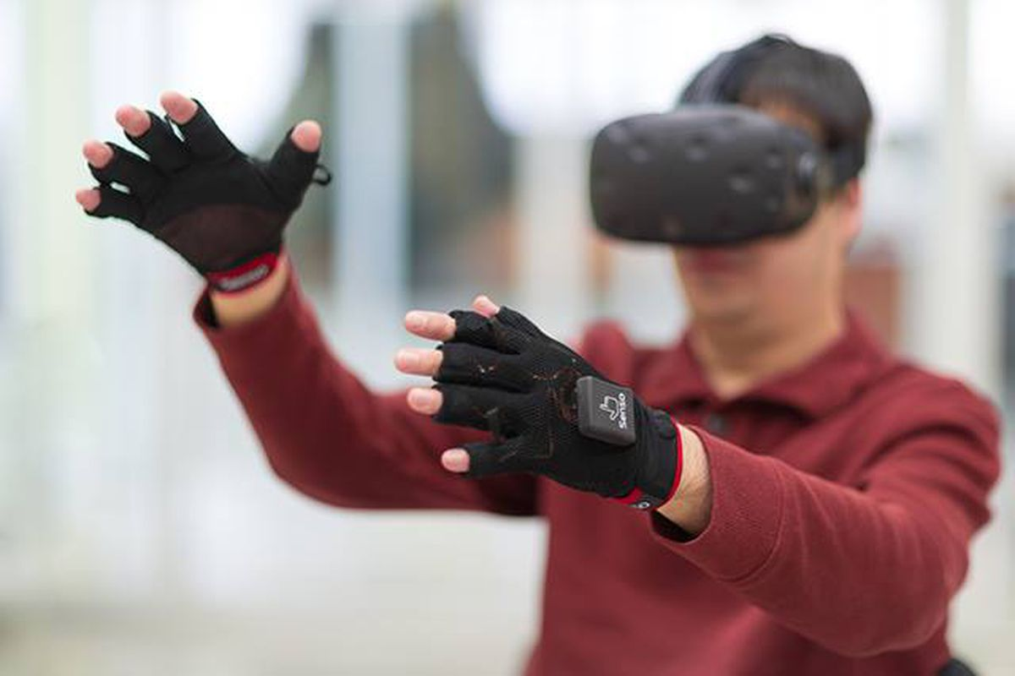
Wireless and Mobile Systems
for the IoT
CMSC 818W : Fall 2019
Conclusion
Nirupam Roy
M-W 2:00-3:15pm
CSI 1122

Slide 2
IoT

Slide 3
IoT

Slide 4
Thanks for being such an
amazing group of students…
Please be like that forever
and keeeeeep learning!!

Slide 5
Project pitch (20% of the project)
Location: CSI 1122 (this classroom)
Time: 1:30pm – 3:30pm
Each team will get 5 minutes to speak.

Slide 6
Project pitch

Slide 7
Project pitch (20% of the project)
Location: CSI 1122 (this classroom)
Time: 1:30pm – 3:30pm
Each team will get 5 minutes to speak.
Format of the pitch: None
-- Convince the class that you have worked on an
excellent project.
-- Feel free to use any media/prop
-- Generally focusing on the broader impacts of
the project and your concrete achievements
helps.

Slide 8
Project evaluation
Inherently subjective. We will try to make it as objective as possible.
Will use your project proposal as a guideline about the scope of the project.
We know life is uncertain, so are projects. Please justify challenges/roadblocks you have faced.
According to the score board so far, you are doing great. Feel confident and use the rest of the time wisely.

