Slide 1
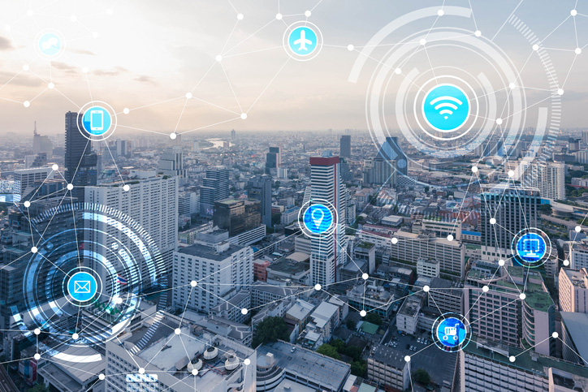
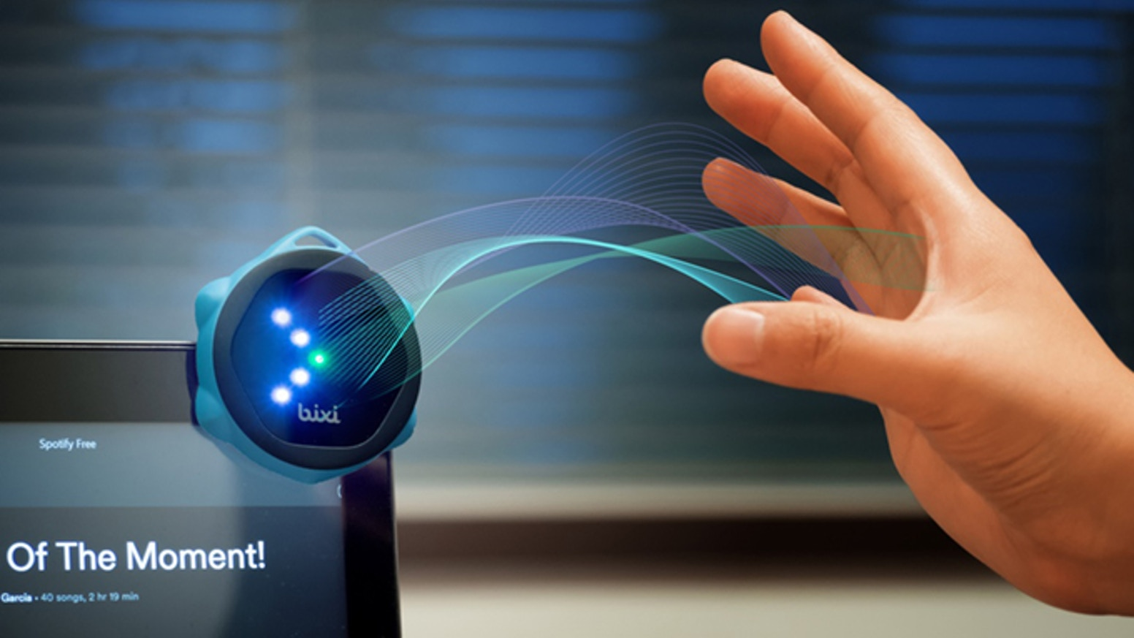
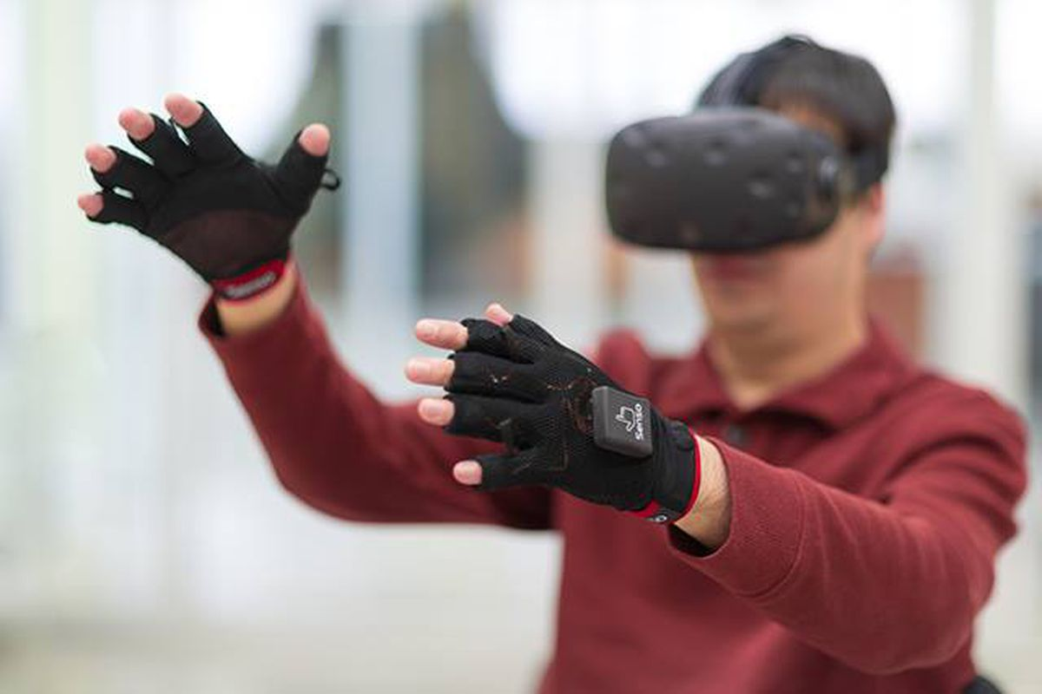
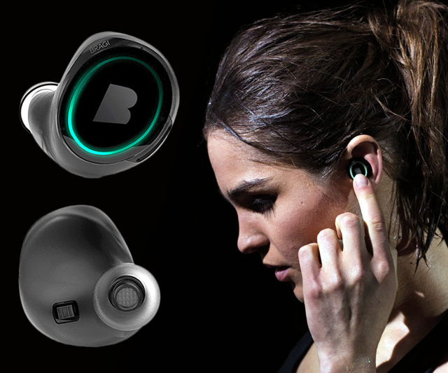
Wireless and Mobile Systems
for the IoT
CMSC 818W : Fall 2019
Lecture 2.3: Viterbi Algorithm
Nirupam Roy
M-W 2:00-3:15pm
CSI 1122

Slide 2
Problems solved by HMM
1) Likelihood:
Determine the likelihood of an observation sequence.
2) Decoding:
Given an observation sequence, determine the best sequence of hidden states.
[Viterbi algorithm]
[Forward-backward algorithm]
[Baum-Welch algorithm]
3) Learning:
Given an observation sequence and a sequence of states, learn the HMM parameters:
i) Transition probabilities
ii) Emission probabilities

Slide 3
Problems solved by HMM
1) Likelihood:
Determine the likelihood of an observation sequence.
2) Decoding:
Given an observation sequence, determine the best sequence of hidden states.
[Viterbi algorithm]
[Forward-backward algorithm]
[Baum-Welch algorithm]
3) Learning:
Given an observation sequence and a sequence of states, learn the HMM parameters:
i) Transition probabilities
ii) Emission probabilities

Slide 4
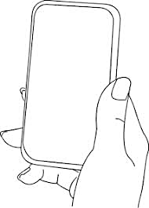
A simple gesture recognition example
States:
Observations:
No
Call
Call
Near
Far
Notes:
http://www.davidsbatista.net/assets/documents/posts/2017-11-11-hmm_viterbi_mini_example.pdf

Slide 5
A simple gesture recognition example
Start
End
St
No
Call
Call
Near
Far
Near
Far

Slide 6
A simple gesture recognition example
 | Call | NoCall | End
Start | 0.7 | 0.3 | 0
Call | 0.2 | 0.7 | 0.1
NoCall | 0.7 | 0.2 | 0.1
 | St | Near | Far
Start | 1 | 0 | 0
Call | 0 | 0.7 | 0.3
NoCall | 0 | 0.4 | 0.6
State transition
probabilities
Emission
probabilities

Slide 7
A simple gesture recognition example
Emission states are: Near, Far, Far
What is the hidden state sequence?

Slide 8
A simple gesture recognition example
i = 1 2 3
Call
Call
Call
Start
End
No
Call
No
Call
No
Call
St
Near
Far
Far

Slide 9
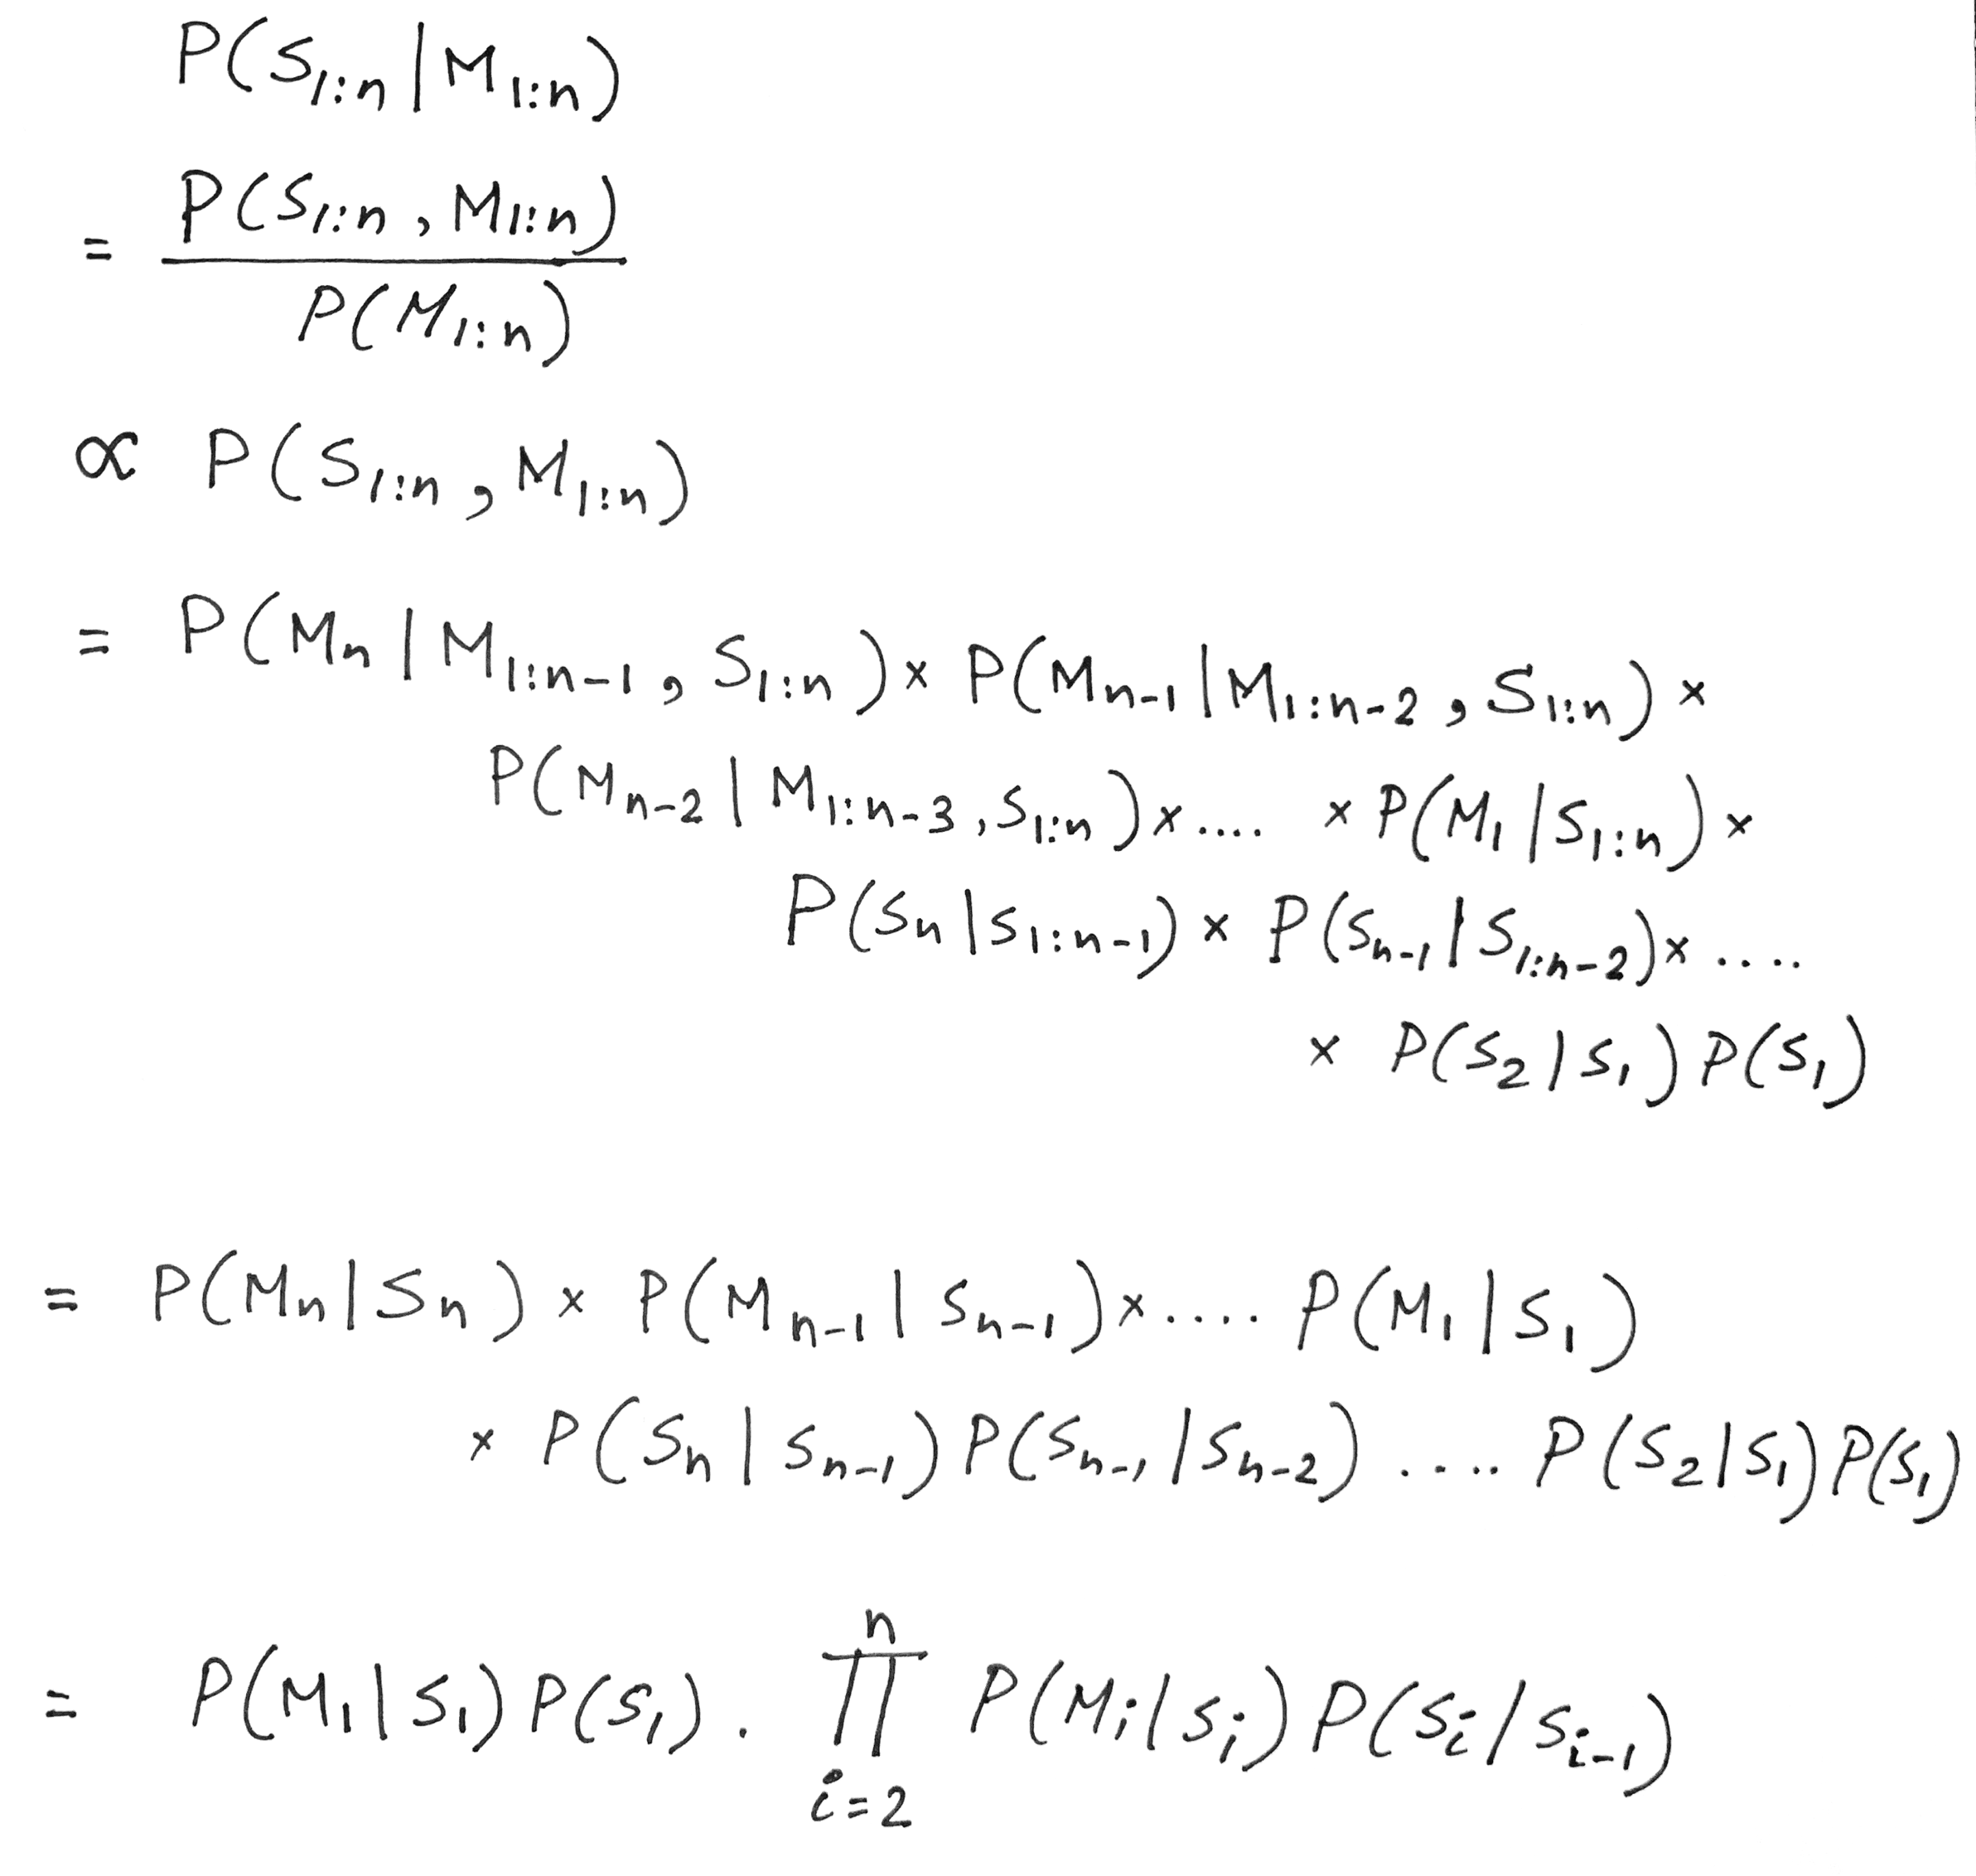
Hidden Markov Model: Definition

Slide 10
A simple gesture recognition example
Save two parameters per iteration, per state:
Recursion
$$Initialize, δ0\left(Start\right)=1$$
$$S=\{Start, Call, NoCall, End\}$$
$$ω=\{St, Near, Far\}$$
[Ref] http://www.davidsbatista.net/assets/documents/posts/2017-11-11-hmm_viterbi_mini_example.pdf

Slide 11
A simple gesture recognition example
i = 1 2 3
Call
Call
Call
Start
End
No
Call
No
Call
No
Call
St
Near
Far
Far

Slide 12
A simple gesture recognition example
i = 1
 | Call | NoCall | End
Start | 0.7 | 0.3 | 0
Call | 0.2 | 0.7 | 0.1
NoCall | 0.7 | 0.2 | 0.1
Call
State transition probabilities
Start
$$δ0\left(Start\right)=1$$
 | St | Near | Far
Start | 1 | 0 | 0
Call | 0 | 0.7 | 0.3
NoCall | 0 | 0.4 | 0.6
No
Call
St
Near
Emission probabilities

Slide 13
A simple gesture recognition example
i = 1 2
Call
Call
Start
No
Call
No
Call
Near
Far

Slide 14
A simple gesture recognition example
i = 1 2 3
Call
Call
Call
Start
End
No
Call
No
Call
No
Call
Near
Far
Far

Slide 15
A simple gesture recognition example
i = 1 2 3
Call
Call
Call
Start
End
No
Call
No
Call
No
Call
Near
Far
Far

Slide 16
A simple gesture recognition example
i = 1 2 3
Call
Call
Call
Start
End
No
Call
No
Call
No
Call
Near
Far
Far

Slide 17
A simple gesture recognition example
i = 1 2 3
Call
Call
Call
Start
End
No
Call
No
Call
No
Call
Viterbi sequence: < Call, Call, NoCall >
P( <Call, Call, NoCall > | <Near, Far, Far>) = 0.0012348
Near
Far
Far

Slide 18
An Application of HMM and Viterbi Algorithm
Ref: https://www.ri.cmu.edu/pub_files/pub3/yang_jie_1994_1/yang_jie_1994_1.pdf

Slide 19
An Application of HMM and Viterbi Algorithm
Approach:
1) Define meaningful gestures
2) Describe each gesture in terms of an HMM
3) Collect base data
4) Find parameters of the HMM through base data
5) Estimate gestures with the HMM model

Slide 20
Course project ideas on gesture/motion
1. Head gesture using eSense smart earpods.
2. Whole body pose inferencing using eSense earpods.
3. I am an earpod and I can tell your eating behavior

