Slide 1
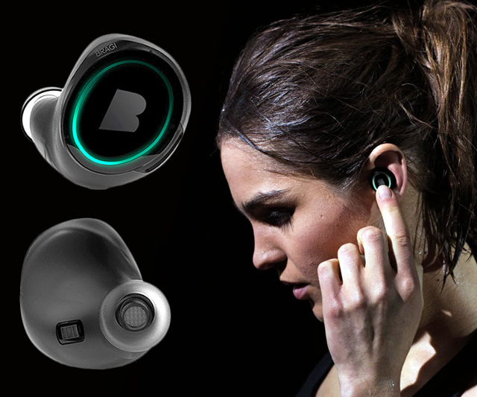
Wireless and Mobile Systems
for the IoT
CMSC 818W : Fall 2019
Lecture 3.3: Sensor Array (Part 2)
Nirupam Roy
M-W 2:00-3:15pm
CSI 1122

Slide 2
Superimposition of sinusoids
$$sin⁡(2πft)$$
$$d$$
$$sin⁡(2πft+2πd/λ)$$

Slide 3
Superimposition of sinusoids
Signal amplified
(perfect constructive interference)
$$sin⁡(2πft)$$
$$d=λ/2$$
$$\sin\left(2πft+\frac{2πd}{λ}\right)$$
= $\sin\left(2πft+π\right)$
= $− sin\left(2πft\right)$
Signal nullified
Signal nullified

Slide 4
Superimposition of sinusoids: Gain
Amplitude gain due to the array structure
Distance from the center of the array
$$−λ/4$$
$$0$$
$$λ/4$$
$$d=λ/2$$
Constant phase difference of $\frac{2πd}{λ}$

Slide 5
Beamforming in 2D space

Slide 6
Beamforming in 2D space
$$d$$

Slide 7
Beamforming in 2D space
$$φ$$
$$d$$

Slide 8
Beamforming in 2D space
Phase difference between these two paths
$$φ$$
$$d$$

Slide 9
Near vs Far Field
Assume far-field (planar wave model) when the receiver/transmitter are (2L²/ λ) distance apart.

Slide 10
Beamforming in 2D space
Approximation for ‘far field’
$$φ$$
$$?$$
$$d$$

Slide 11
Beamforming in 2D space
Approximation for ‘far field’
$$φ$$
$d sin$($φ$)
$$?$$
$$φ$$
$$d$$

Slide 12
Beamforming in 2D space
Approximation for ‘far field’
$$φ$$
Along this line
$d sin$($φ$)
$$φ$$
$$d$$
Combined signal = $\sin\left(2πft\right) + \sin\left(2πft+ \frac{2π d sin (φ)}{λ}\right)$
= $e^{j\left(2πft\right)}{ }+e^{j\left(2πft+ \frac{2π d sin(φ)}{λ}\right)}{ }$

Slide 13
Beamforming in 2D space
Approximation for ‘far field’
Parameters: d, $φ$, $λ$ (or f)
Does the gain depend on the distance from the array?
$$φ$$
Along this line
$d sin$($φ$)
$$φ$$
$$d$$
Combined signal = $\sin\left(2πft\right) + \sin\left(2πft+ \frac{2π d sin (φ)}{λ}\right)$
= $e^{j\left(2πft\right)}{ }+e^{j\left(2πft+ \frac{2π d sin(φ)}{λ}\right)}{ }$

Slide 14
Beamforming in 2D space
$$φ$$
$$d$$

Slide 15
Beamforming in 2D space
$$φ$$
$$d$$
+
Combined signal
= $e^{j\left(2πft\right)}{ }+e^{j\left(2πft + \frac{2π d sin(φ)}{λ}\right)}{ }$

Slide 16
Beamforming in 2D space
Directional gain of an array

Slide 17
Beamforming in 2D space

Slide 18
Uniform Linear Array (ULA)

Slide 19
Beamforming in 2D space
$d sin$($φ$)
$$E1$$
$$E2$$
$$E3$$
$$E4$$
…
N elements
$$d$$
$$d$$
$$d$$
Interelement distance = d

Slide 20
Beamforming in 2D space
$3d sin$($φ$)
$2d sin$($φ$)
$d sin$($φ$)
$$E1$$
$$E2$$
$$E3$$
$$E4$$
…
N elements
$$d$$
$$d$$
$$d$$
Interelement distance = d

Slide 21
Beamforming in 2D space
$3d sin$($φ$)
$2d sin$($φ$)
$d sin$($φ$)
$$E1$$
$$E2$$
$$E3$$
$$E4$$
…
N elements
$$d$$
$$d$$
$$d$$
Path difference with n^{th} element:
$\left(n−1\right)d sin$($φ$)
Phase difference with n^{th} element:
$\left(n−1\right)d sin$($φ$) 2Π/λ

Slide 22
$3d cos$($φ$)
$2d sin$($φ$)
Beamforming in 2D space
$d sin$($φ$)
$$φ$$
$$E1$$
$$E2$$
$$E3$$
$$E4$$
…
N elements
$$d$$
$$d$$
$$d$$
Path difference with n^{th} element:
$\left(n−1\right)d sin$($φ$)
Phase difference with n^{th} element:
$\left(n−1\right)d sin$($φ$) 2Π/λ
Original signal:
$e^{j\left(2πft\right)}{ }$
Combined signal:

Slide 23
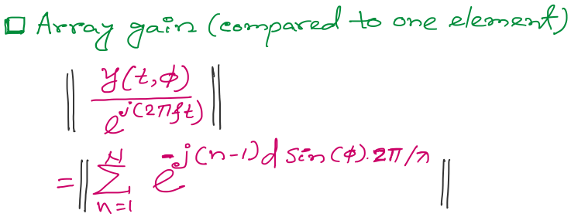
Beamforming in 2D space
Notes:
http://www.waves.utoronto.ca/prof/svhum/ece422/notes/15-arrays2.pdf

Slide 24
Beamforming in 2D space
Notes:
http://www.waves.utoronto.ca/prof/svhum/ece422/notes/15-arrays2.pdf

Slide 25
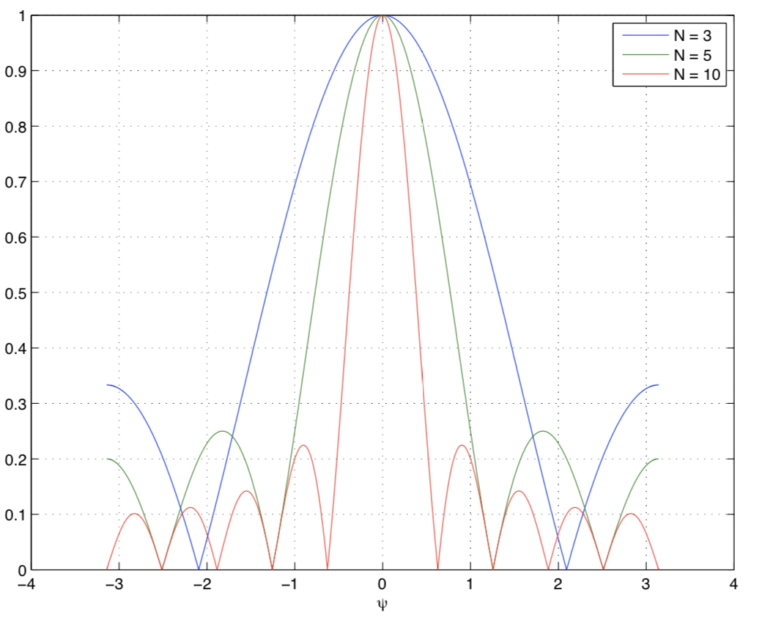
Beamforming in 2D space
Gain
-90 -60 -30 0 30 60 90
Angle
Notes:
http://www.waves.utoronto.ca/prof/svhum/ece422/notes/15-arrays2.pdf

Slide 26
Beamforming in 2D space
Notes:
http://www.waves.utoronto.ca/prof/svhum/ece422/notes/15-arrays2.pdf

Slide 27
Beamforming in 2D space: Broadside vs. Endfire

Slide 28
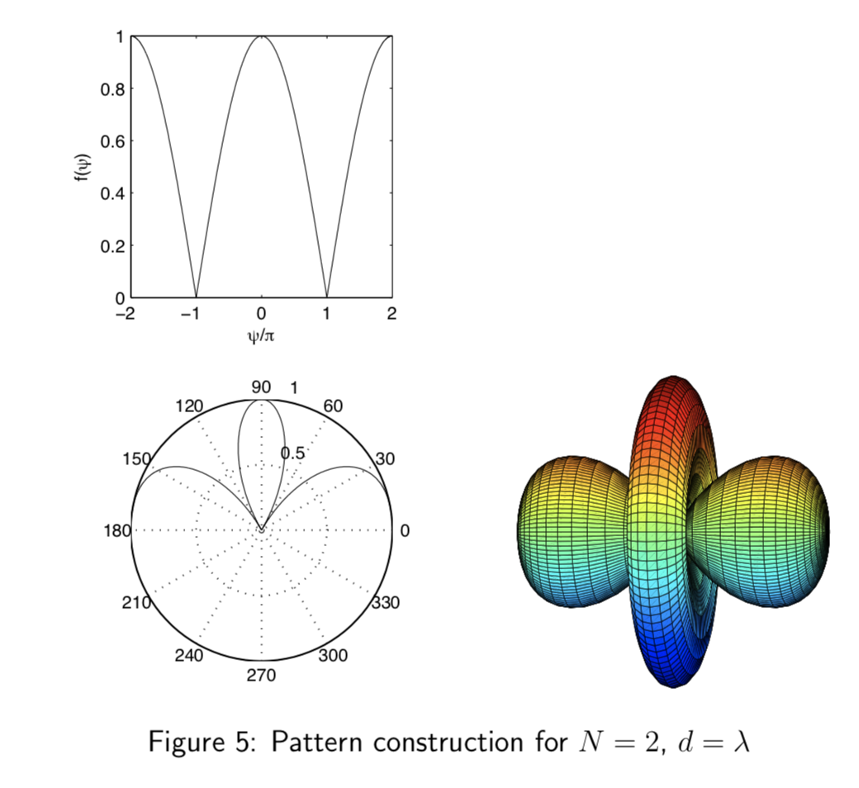
Beamforming in 2D space
Notes:
http://www.waves.utoronto.ca/prof/svhum/ece422/notes/15-arrays2.pdf

Slide 29
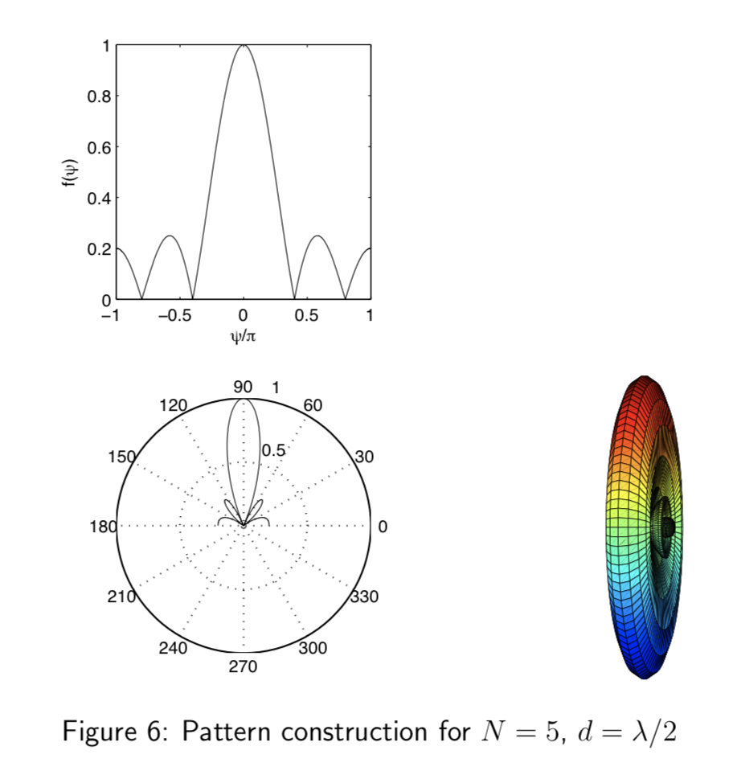
Beamforming in 2D space
Notes:
http://www.waves.utoronto.ca/prof/svhum/ece422/notes/15-arrays2.pdf

Slide 30
Beamforming in 2D space

Slide 31
Beam-steering
Delay-sum beamformer or Phased array
Notes:
http://www.waves.utoronto.ca/prof/svhum/ece422/notes/15-arrays2.pdf

Slide 32
Beam-steering
Delay-sum beamformer or Phased array
Add additional phase:
-$\left(n−1\right)d sin$(𝚹_{s}) 2Π/λ
Notes:
http://www.waves.utoronto.ca/prof/svhum/ece422/notes/15-arrays2.pdf

Slide 33
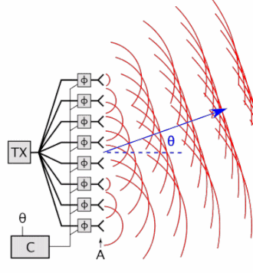
Beam-steering
Delay-sum beamformer or Phased array
Notes:
http://www.waves.utoronto.ca/prof/svhum/ece422/notes/15-arrays2.pdf

Slide 34
Angle-of-Arrival (AoA)
or
Direction-of-Arrival (DoA)

Slide 35
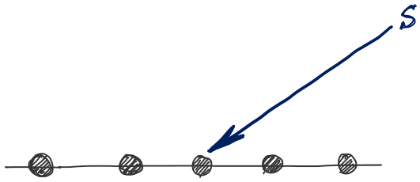
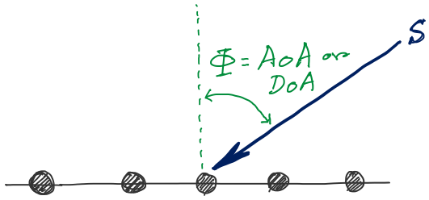
DoA Estimation
d
d
d
d
Notes:
http://www.waves.utoronto.ca/prof/svhum/ece422/notes/15-arrays2.pdf

Slide 36
DoA Estimation
$3d sin$($φ$)
$2d sin$($φ$)
$d sin$($φ$)
$$E1$$
$$E2$$
$$E3$$
$$E4$$
…
N elements
$$d$$
$$d$$
$$d$$
Interelement distance = d

Slide 37
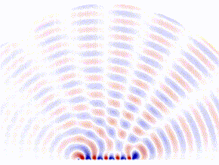
DoA Estimation: Beam-scanning
Scan the region with a steerable beam of the phased array.
DoA of the signal will show maximum received power.

Slide 38
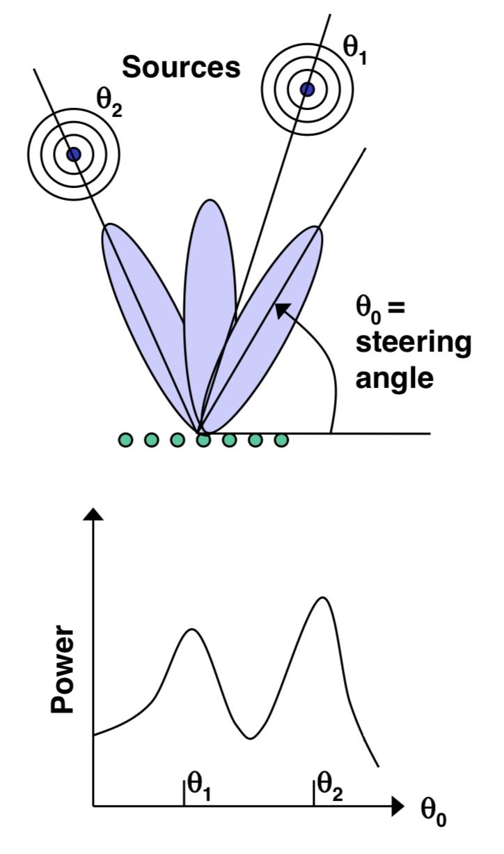
DoA Estimation: Beam-scanning

Slide 39
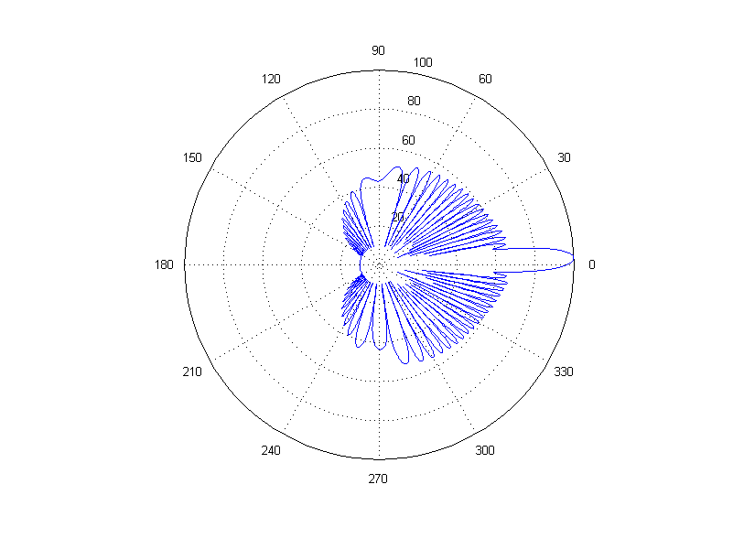
DoA Estimation: Beam-scanning
Number of elements = 30, wave length = 10cm, distance between elements = 6.5 cm
Notes:
http://www.waves.utoronto.ca/prof/svhum/ece422/notes/15-arrays2.pdf

Slide 40
Delay-sum DoA estimation

Slide 41
DoA Estimation: Delay-sum
Notes:
http://www.waves.utoronto.ca/prof/svhum/ece422/notes/15-arrays2.pdf

Slide 42
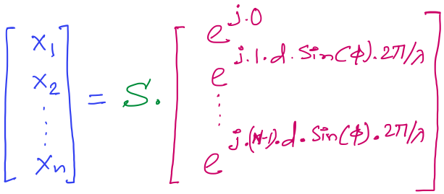
DoA Estimation: Delay-sum
Received signals in all elements:
Steering vector
Notes:
http://www.waves.utoronto.ca/prof/svhum/ece422/notes/15-arrays2.pdf

Slide 43
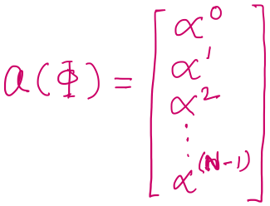
DoA Estimation: Delay-sum
Received signals in all elements:
Notes:
http://www.waves.utoronto.ca/prof/svhum/ece422/notes/15-arrays2.pdf

Slide 44
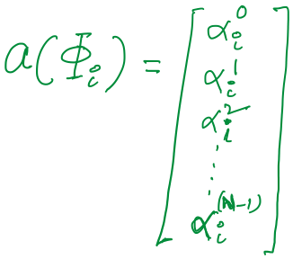
DoA Estimation: Delay-sum

Slide 45
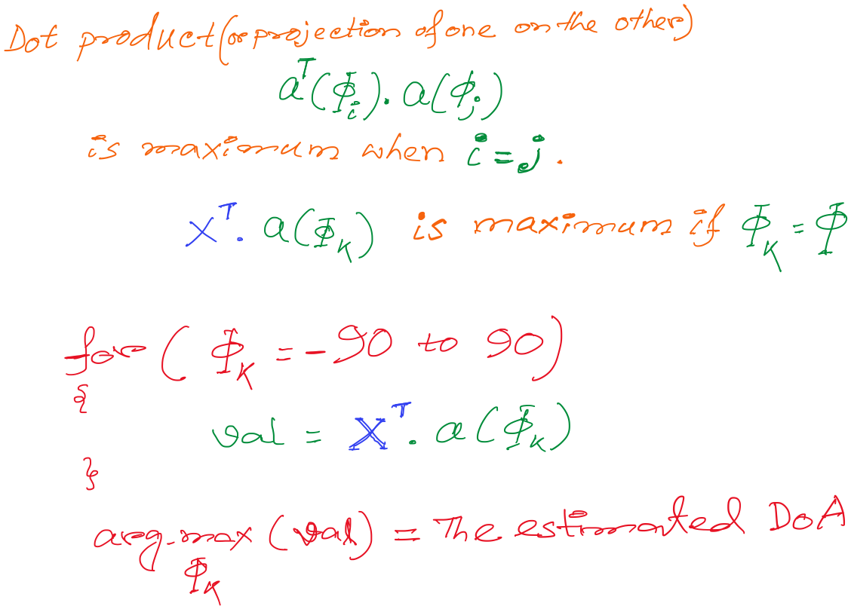
DoA Estimation: Delay-sum
How is this a “delay -sum” ?

Slide 46
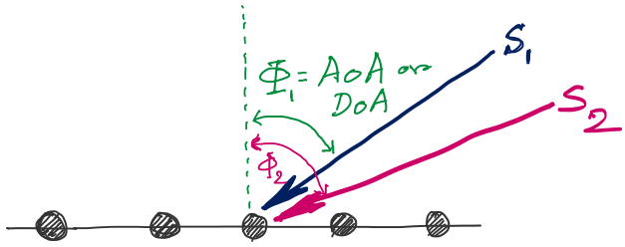
DoA Estimation
d
d
d
d
Notes:
http://www.waves.utoronto.ca/prof/svhum/ece422/notes/15-arrays2.pdf

Slide 47
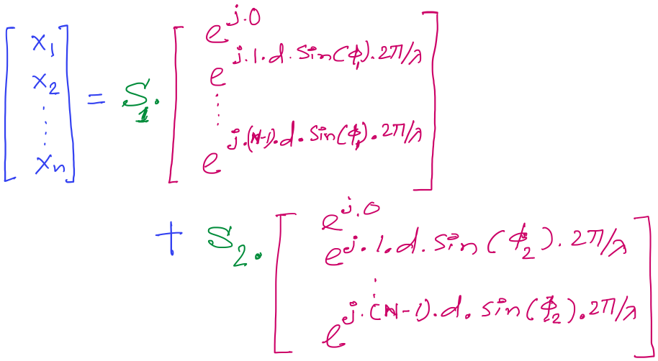
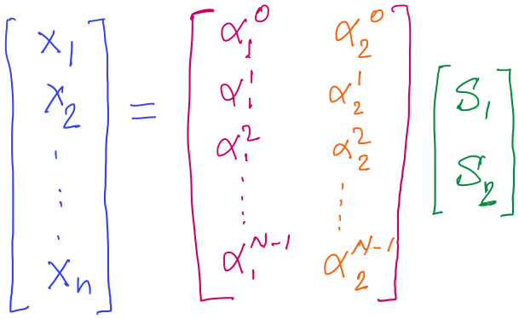
DoA Estimation

Slide 48
DoA Estimation
Mx1
Steering matrix

Slide 49
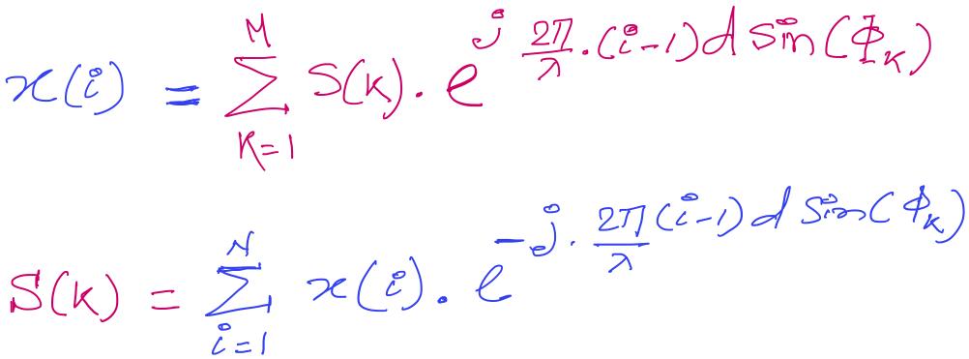
DoA Estimation

Slide 50
Discrete Fourier Transform
$$\sum_{n=0}^{N−1}{x(n)e^{−j\frac{2π}{N}.m.n}}$$
DFT:
z(m) =
$$\sum_{m=0}^{N−1}{z(m)e^{j\frac{2π}{N}.m.n}}$$
IDFT:
x(n) =

Slide 51
Discrete Fourier Transform
Frequency domain coefficients
$$e^{j0}$$
$$e^{j0.\frac{2π}{N}}$$
$$e^{j0.\frac{m.2π}{N}}$$
$$e^{j0.\frac{(N−1).2π}{N}}$$
$$e^{j0}$$
$$e^{j1.\frac{2π}{N}}$$
$$e^{j1.\frac{m.2π}{N}}$$
$$e^{j1.\frac{(N−1).2π}{N}}$$
+
$$e^{j2.\frac{2π}{N}}$$
+
$$e^{j2.\frac{m.2π}{N}}$$
+
$$e^{j2.\frac{(N−1).2π}{N}}$$
Z₀
$$e^{j0}$$
Z₁
…
Z_{m}
…
Z_{N-1}
…
…
…
…
$$e^{j(N−1).\frac{2π}{N}}$$
$$e^{j(N−1).\frac{m.2π}{N}}$$
$$e^{j(N−1).\frac{(N−1).2π}{N}}$$
$$e^{j0}$$
x[0]
x[1]
=
X =
x[2]
Time domain samples
…
x[N-1]

Slide 52
DoA Estimation : Classical FFT approach

Slide 53
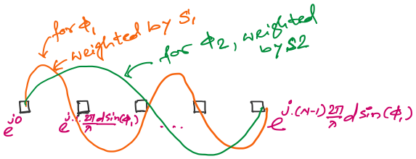
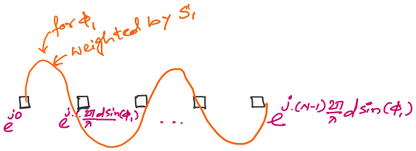
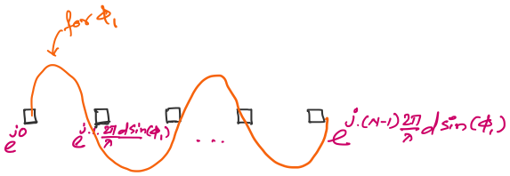
DoA Estimation : Classical FFT approach

Slide 54
DoA Estimation : Classical FFT approach

Slide 55
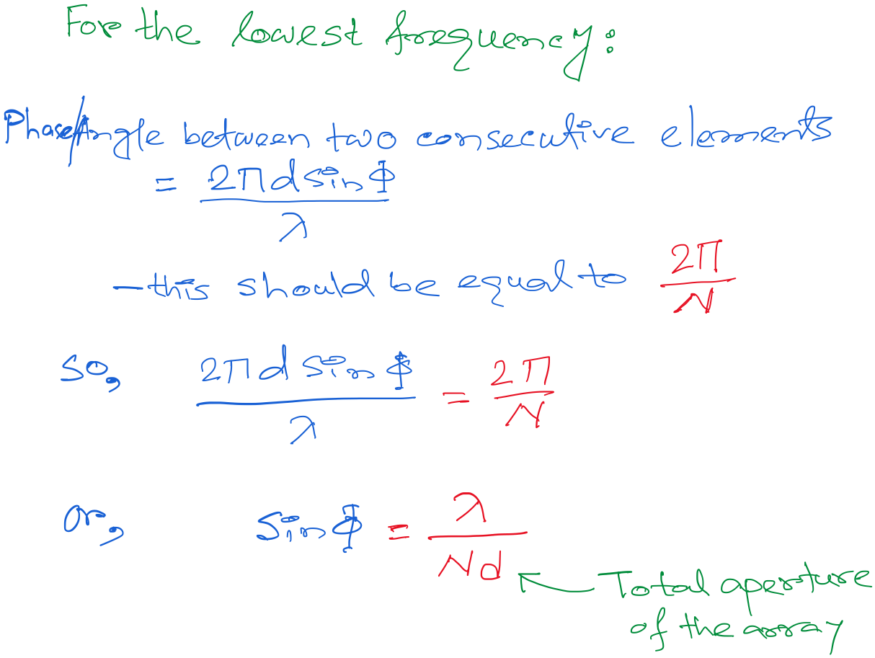
DoA Estimation : Classical FFT approach: Resolution

Slide 56
DoA Estimation : Classical FFT approach
What is the minimum and maximum value of the inter-element distance (d)?
d
d
d
d

Slide 57
DoA Estimation : Classical FFT approach

Slide 58
DoA Estimation : Classical FFT approach
Matlab demo

Slide 59
A Subspace-based DoA Estimation Algorithm: MUSIC (Multiple Signal Classification)

Slide 60
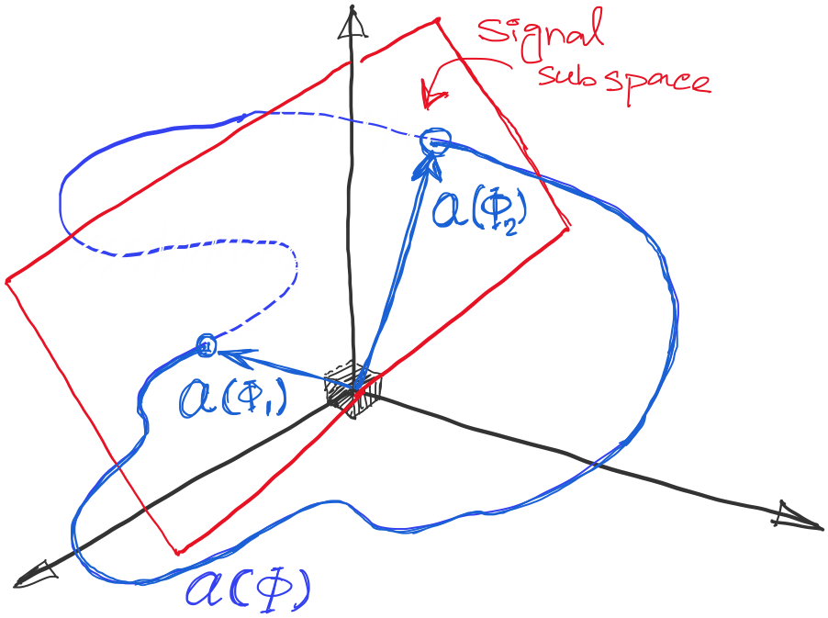
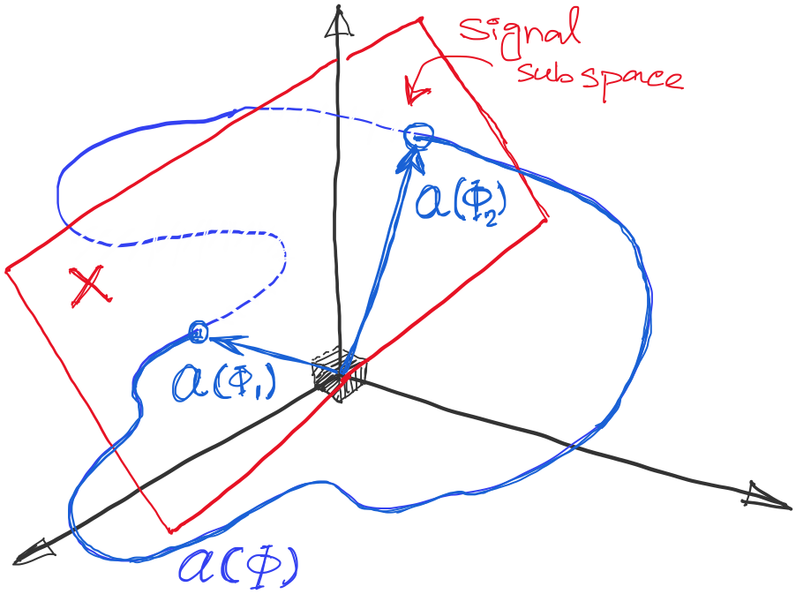
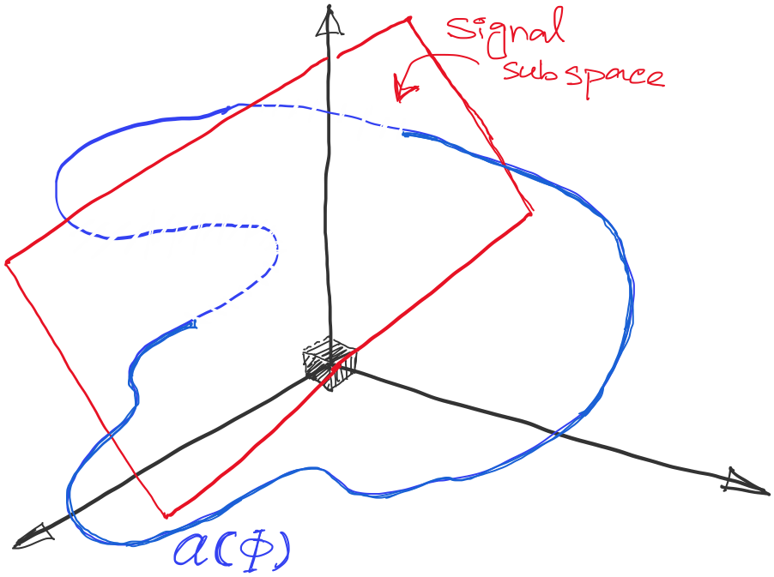
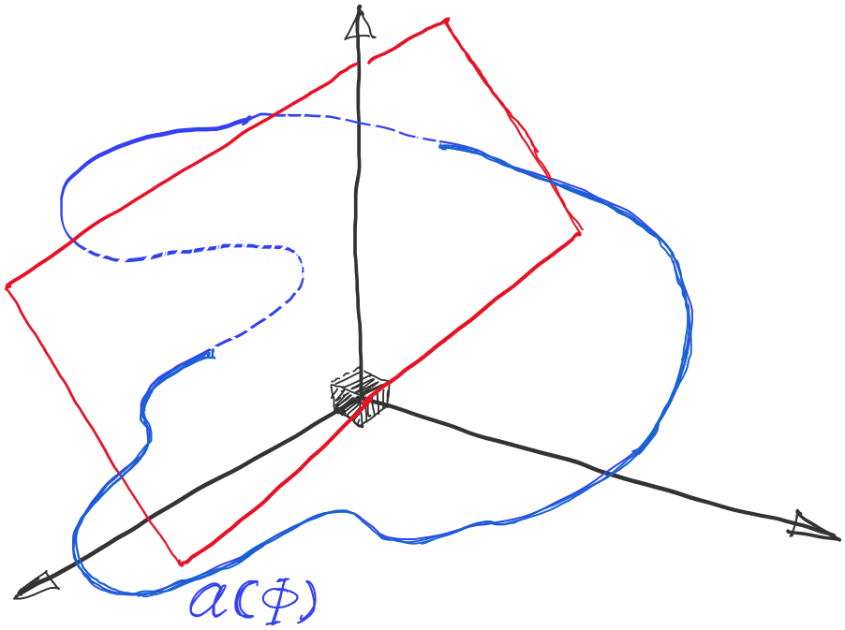
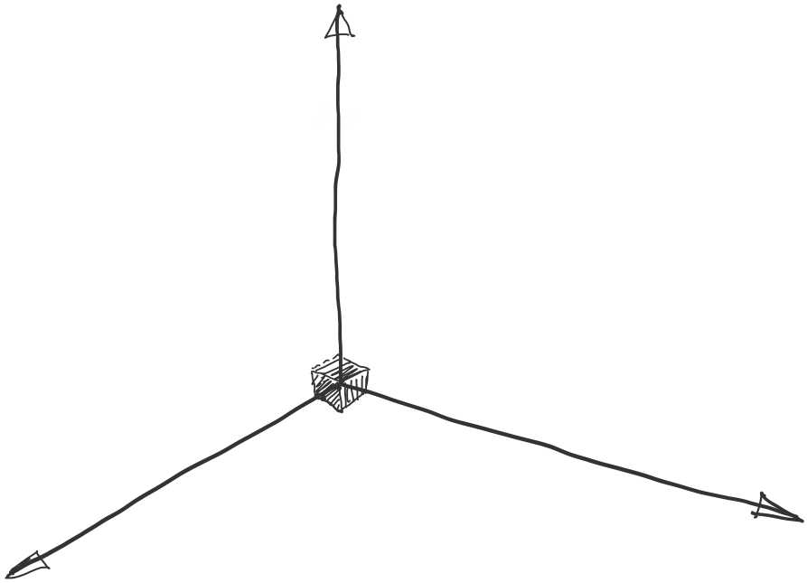
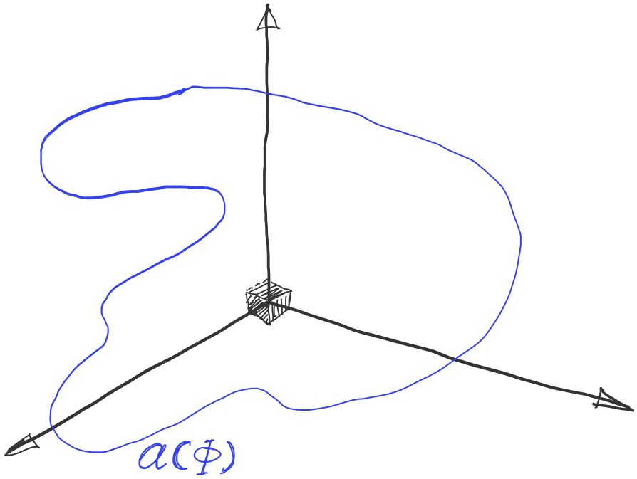
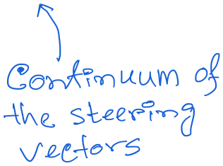
DoA Estimation: MUSIC Algorithm

Slide 61
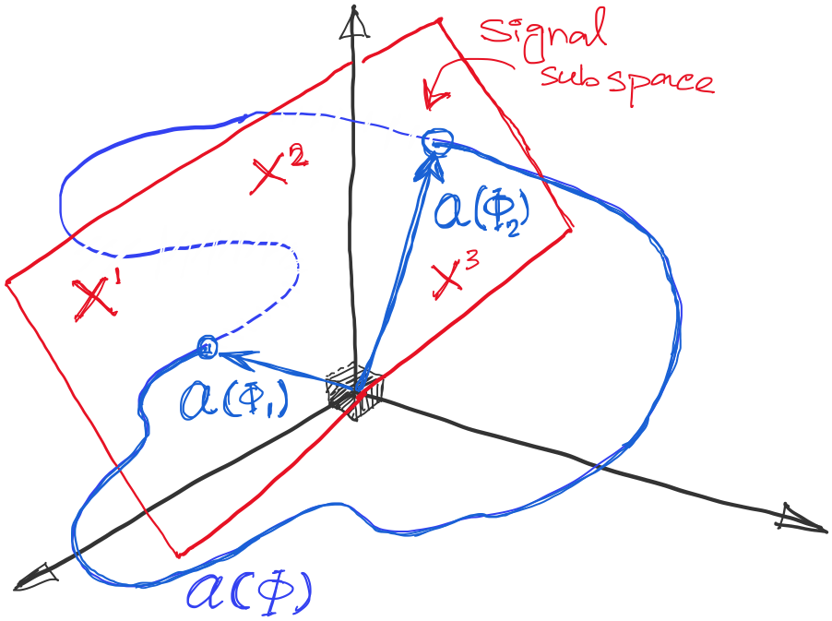
DoA Estimation: MUSIC Algorithm

Slide 62
DoA Estimation: MUSIC Algorithm
Mx1
Steering matrix

Slide 63
DoA Estimation: MUSIC Algorithm

Slide 64
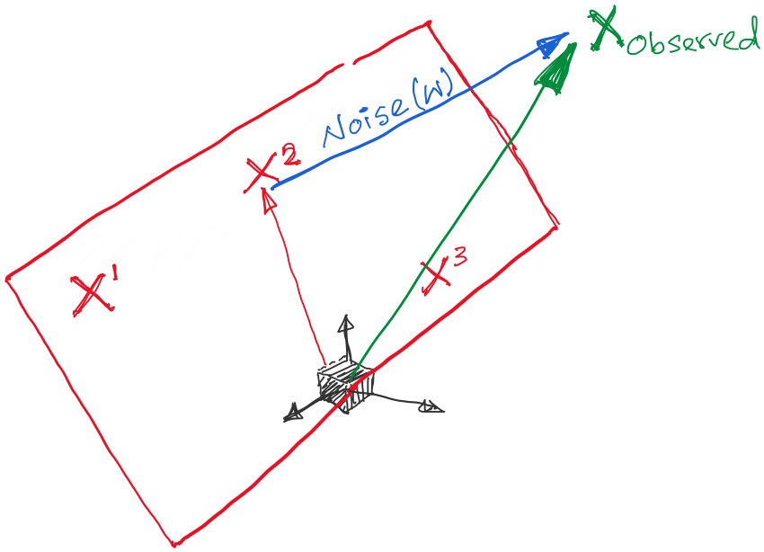
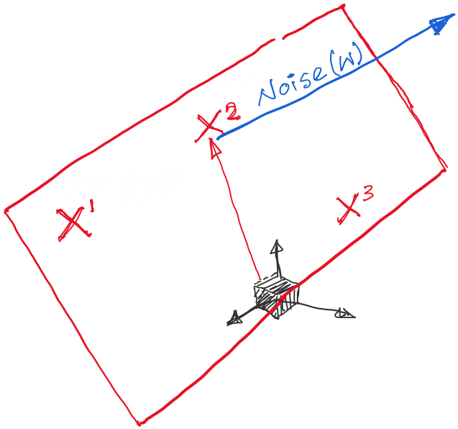
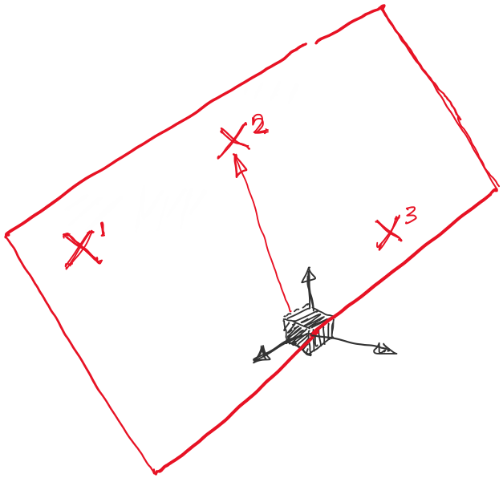
DoA Estimation: MUSIC Algorithm

Slide 65
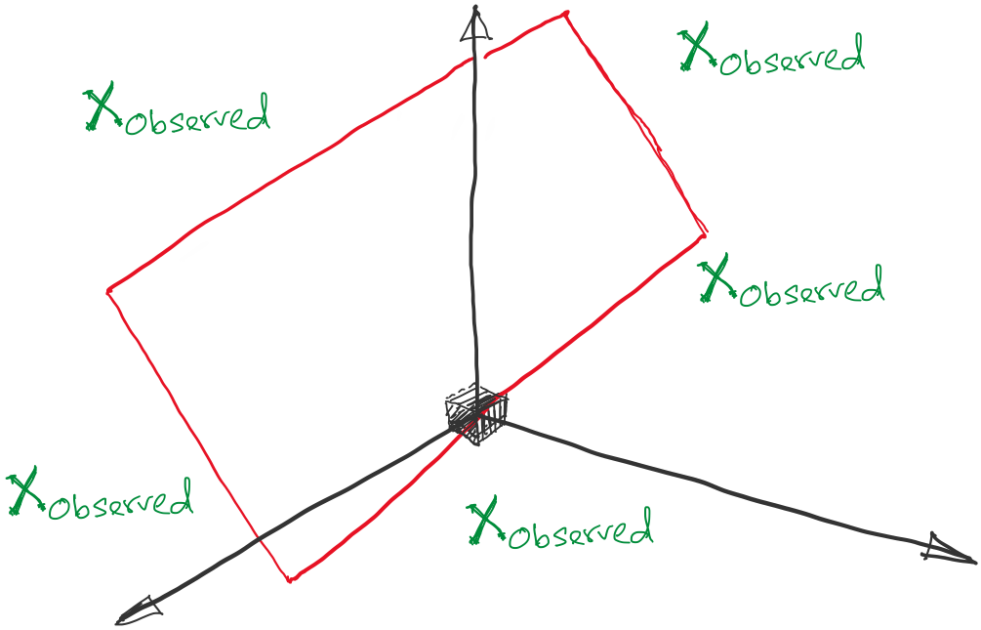
DoA Estimation: MUSIC Algorithm

Slide 66
DoA Estimation: MUSIC Algorithm

Slide 67
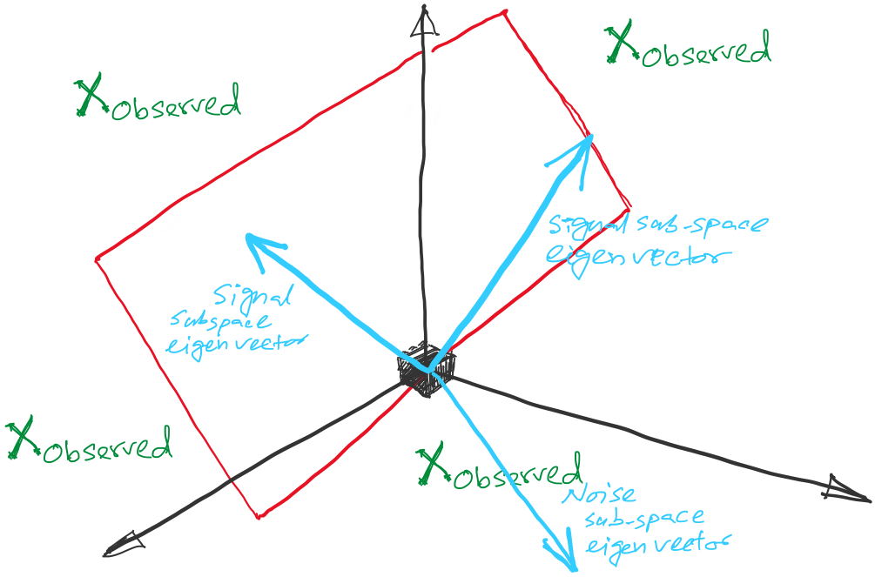
DoA Estimation: MUSIC Algorithm

Slide 68
DoA Estimation: MUSIC Algorithm

Slide 69
DoA Estimation: MUSIC Algorithm

Slide 70
DoA Estimation: MUSIC Algorithm

Slide 71
DoA Estimation: MUSIC Algorithm

Slide 72
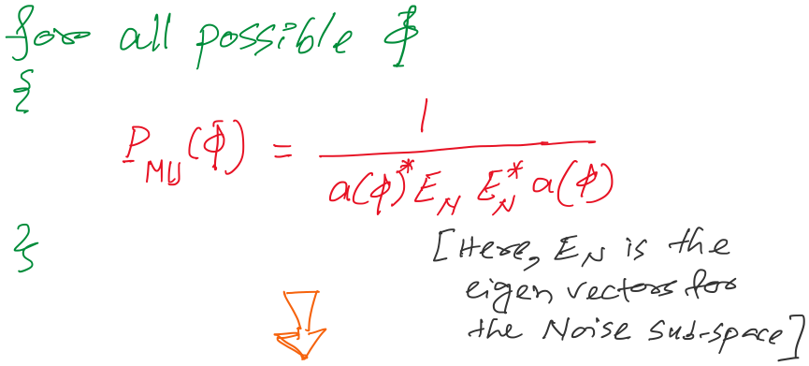
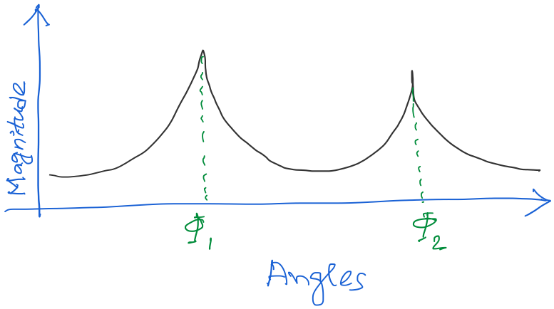
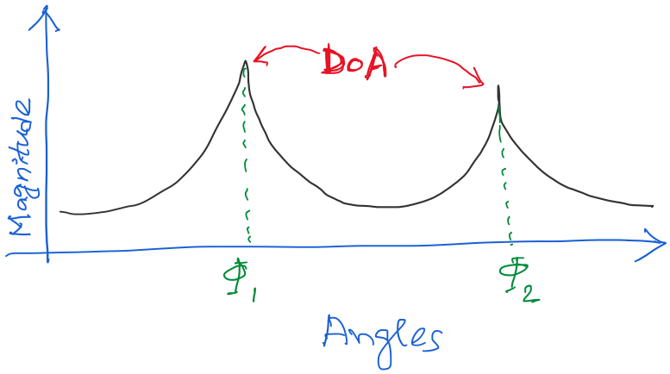
DoA Estimation: MUSIC Algorithm
A signal subspace method for DoA
estimation
What happens if number of
signals sources (M) are more than the number of sensors (N) ?

