Slide 1

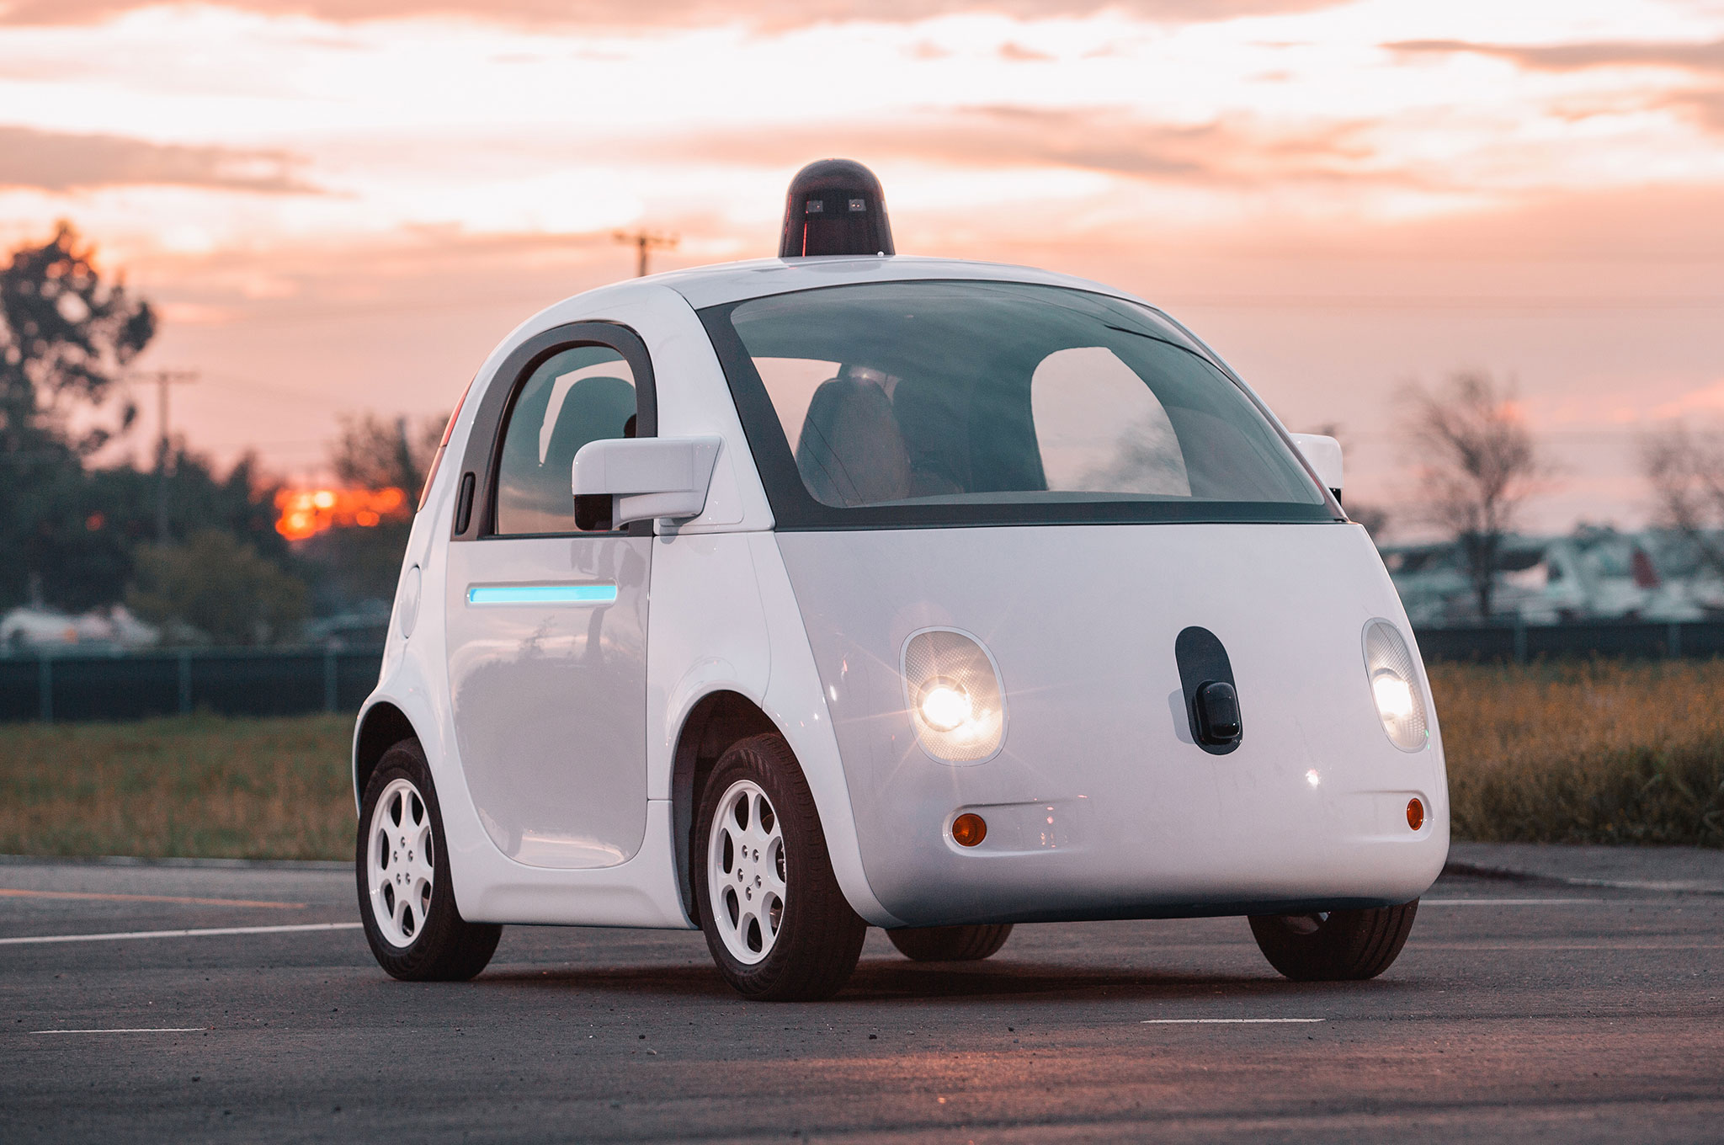




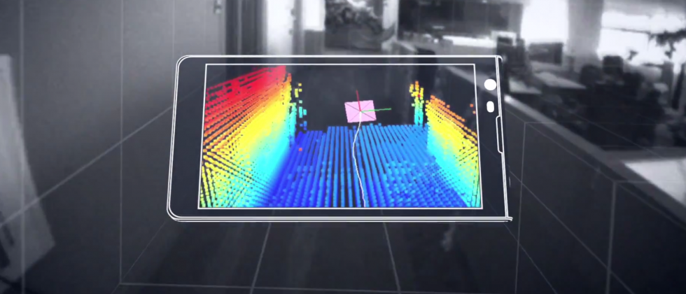

Wireless and Mobile Systems
for the IoT
CMSC 818W : Fall 2019
Lecture 4.1: Wireless Networks for the IoT
Nirupam Roy
M-W 2:00-3:15pm
CSI 1122

Slide 2
Beamforming is everywhere

Slide 3
Generalizing
the Sensor Array
Concept

Slide 4
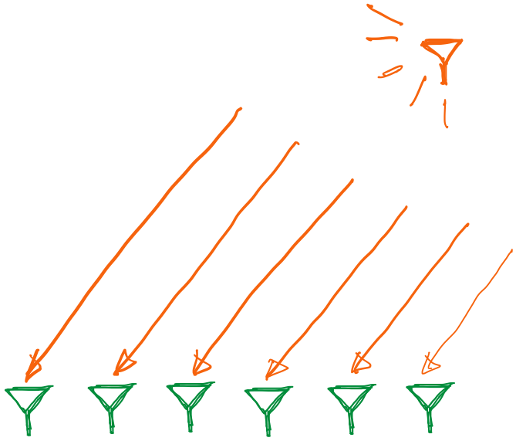
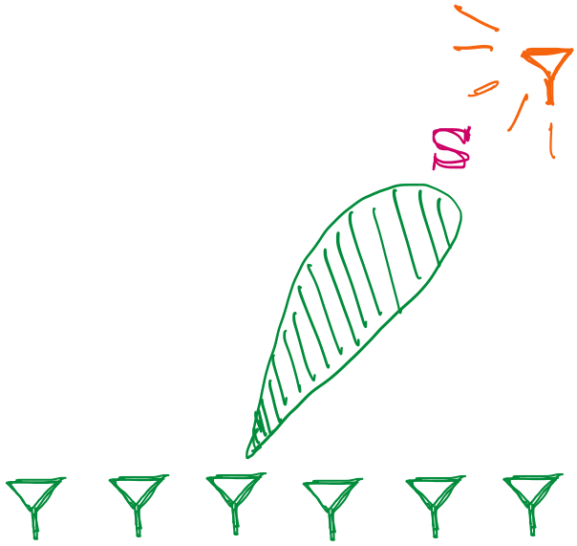
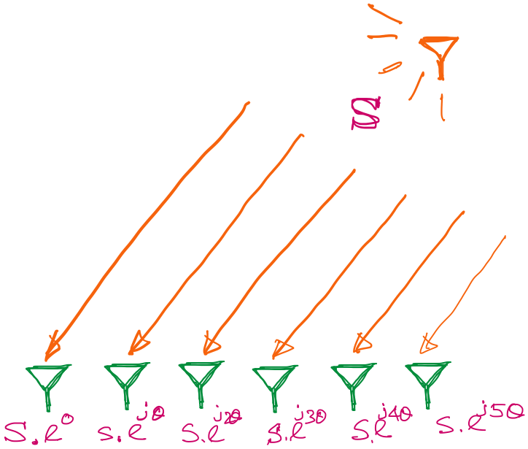
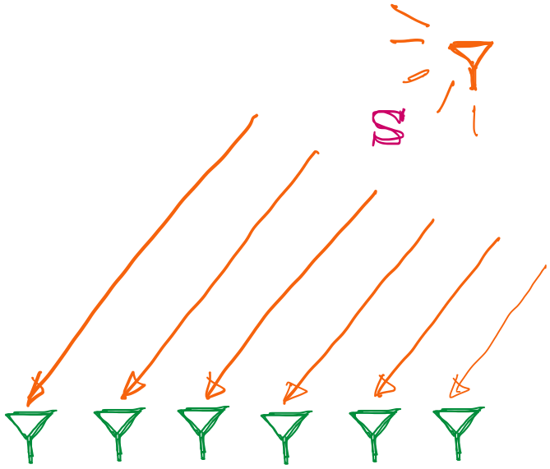
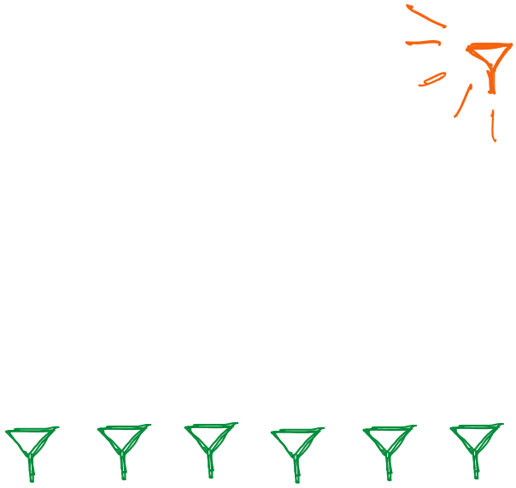
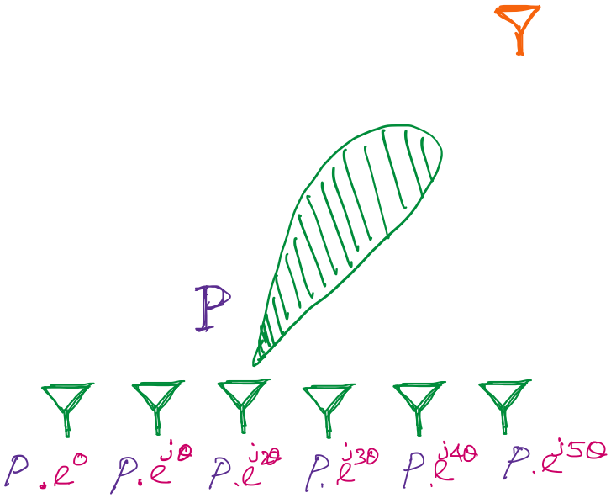

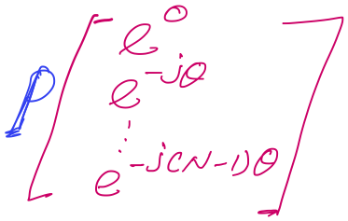
Generalizing the Beamforming Concept
Phased Array
Notes:
https://www.analog.com/en/analog-dialogue/articles/massive-mimo-and-beamforming-the-signal-processing-behind-the-5g-buzzwords.html#

Slide 5
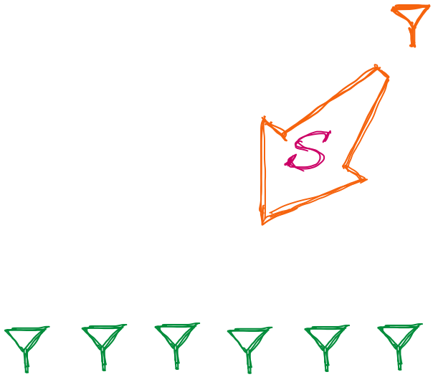
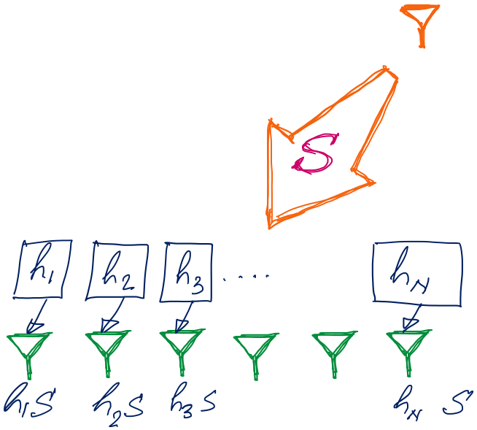
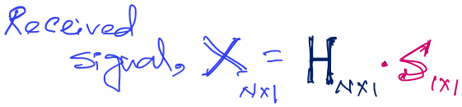
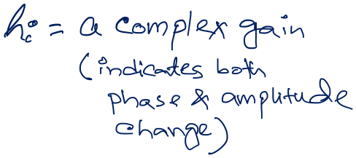

Generalizing the Beamforming Concept
If we know transmit signal ‘S’, then we can calculate the channel ‘H’ at the array.
And if ‘H’ is known then…

Slide 6
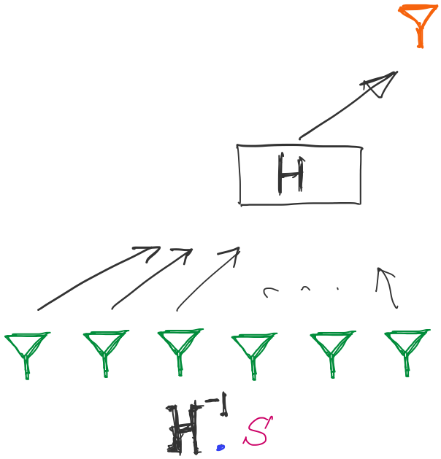

Generalizing the Beamforming Concept

Slide 7
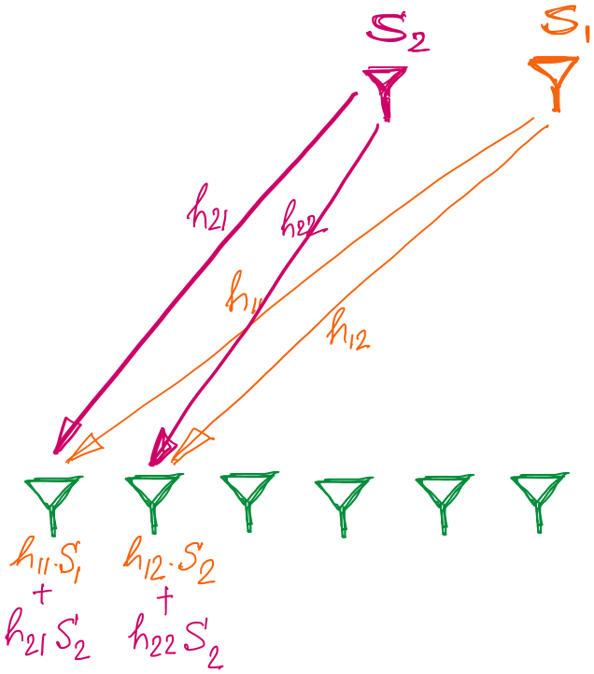
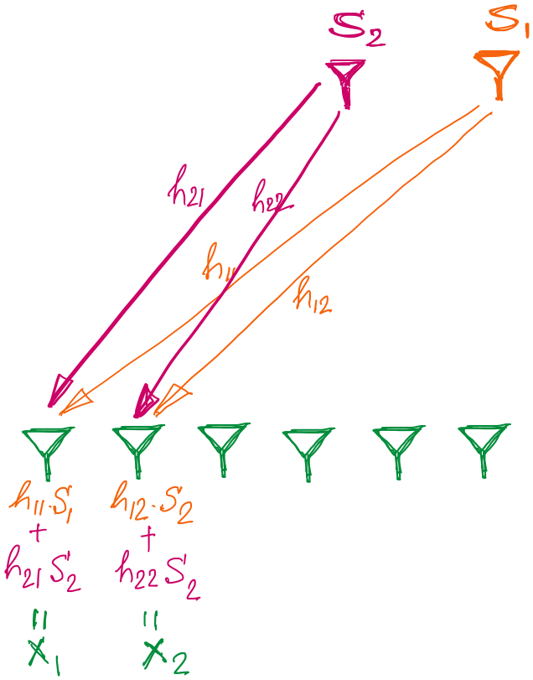
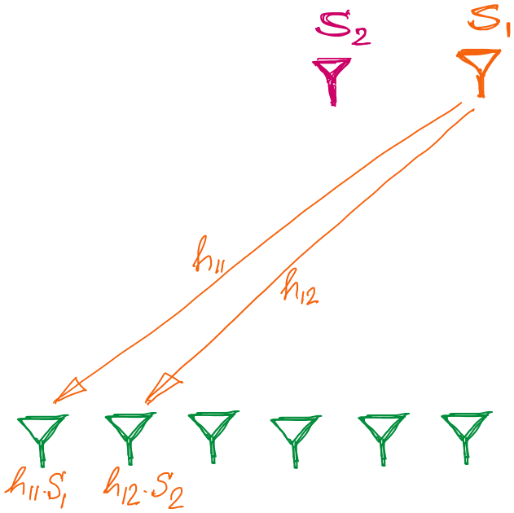
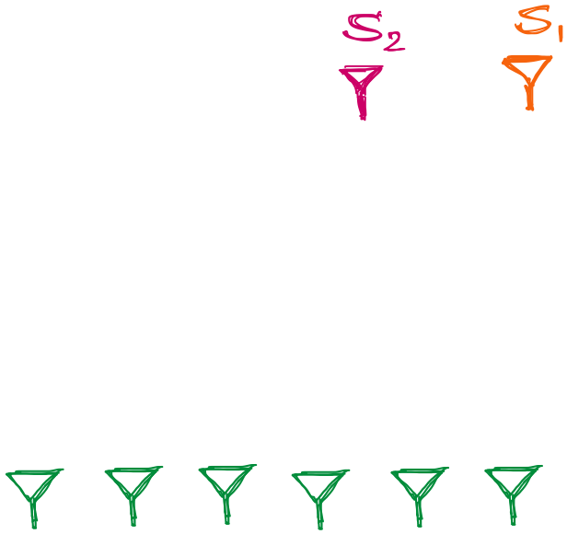
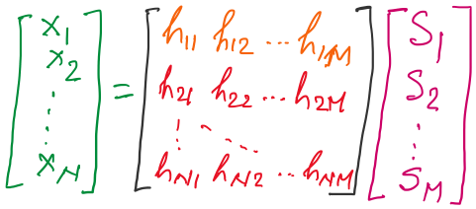
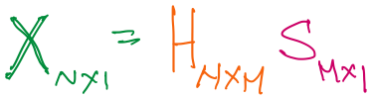
Generalizing the Beamforming Concept

Slide 8
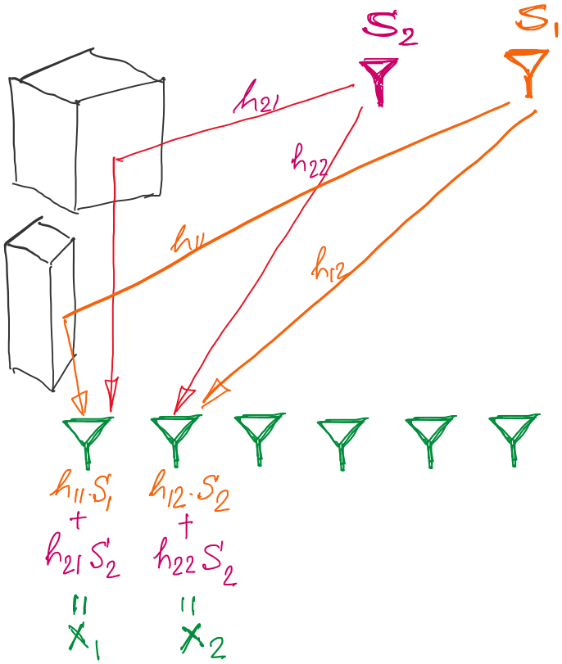
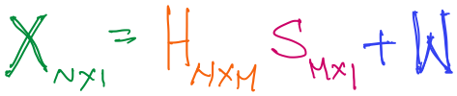
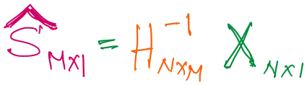
Generalizing the Beamforming Concept

Slide 9
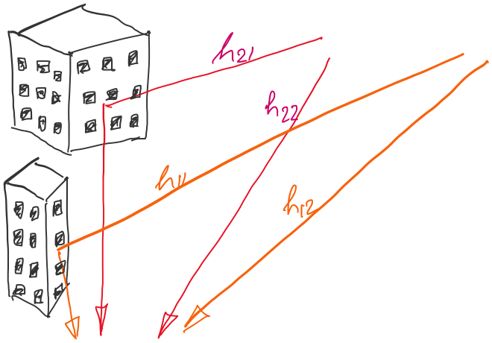
Generalizing the Beamforming Concept
MIMO
5G Massive MIMO

Slide 10
MIMO

Slide 11
MIMO

Slide 12
[Ref] https://twitter.com/lavellenetworks/status/1070315894751006720

Slide 13
Huge bandwidth
[Ref] https://twitter.com/lavellenetworks/status/1070315894751006720

Slide 14
5G spectrum

Slide 16
Huge bandwidth
Channel
sharing
[Ref] https://twitter.com/lavellenetworks/status/1070315894751006720

Slide 17
Huge bandwidth
Channel
sharing
Massive
MIMO
Orthogonal
Frequency
Efficient
coding
[Ref] https://twitter.com/lavellenetworks/status/1070315894751006720

Slide 18
ZTE, and Facebook have demonstrated Massive MIMO systems
with as many as 96 to 128 antennas.
Cisco estimates that by 2020 - when 5G is set to roll out to a mainstream audience –
there will be 5.5 billion mobile users around the world, each consuming 20GB of data per month.

Slide 19
Communication:
A generalized view

Slide 20
Sending/Receiving agreed set of symbols

Slide 21
Sending/Receiving agreed set of symbols
What is the computer’s version of this?

Slide 22
Recall: what can we change in a wave
Depth imaging
…
SONAR
(detection)
Gesture
Finding distance using waves
(Ranging)
Speed
Amplitude
Frequency
Phase

Slide 23
Modulation
Modulation
Speed
Amplitude
Frequency
Phase
(AM)
(FM)
(PM)

Slide 24
Modulation schemes

Slide 25
Data bits
1
1
0
1
1
0
0
1
0
0
1
0
1
0
1
0
…
Notes:
https://www.tutorialspoint.com/analog_communication/analog_communication_angle_modulation.htm

Slide 26
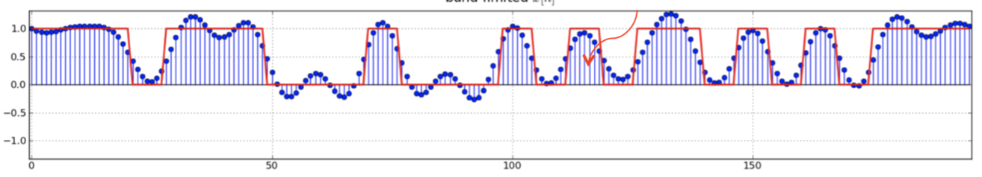
Data bits
1
1
0
1
1
0
0
1
0
0
1
0
1
0
1
0
…
Baseband signal
Notes:
https://www.tutorialspoint.com/analog_communication/analog_communication_angle_modulation.htm

Slide 27

Baseband vs Passband
$$e^{j2πf1t}$$
Amplitude
Time

Slide 28
Baseband vs Passband
$$e^{j2πf1t}$$
Baseband signal
Amplitude
FFT
Amplitude
Time
Frequency

Slide 29
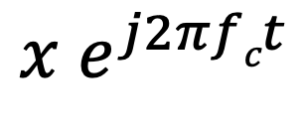

Baseband vs Passband
$$e^{j2πf1t}$$
Baseband signal
Amplitude
FFT
Amplitude
Time
Frequency
$$e^{j2πf1t}$$
$${x e}^{j2πfct}$$
Amplitude
2
4
6
8
Frequency (kHz)

Slide 30
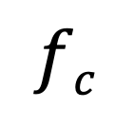
Baseband vs Passband
$$e^{j2πf1t}$$
Baseband signal
Amplitude
FFT
Amplitude
Up-conversion: Converting the baseband signal to the passband signal
Time
Frequency
$$e^{j2πf1t}$$
$${x e}^{j2πfct}$$
Passband signal
$${fc}^{ }$$
Carrier
frequency
Amplitude
FFT
Amplitude
2
4
6
8
Frequency (kHz)
Frequency

Slide 31
Baseband vs Passband
Amplitude
Transmit
2
4
6
8
Frequency (kHz)

Slide 32
Baseband vs Passband
Amplitude
Transmit
Receive
2
4
6
8
Frequency (kHz)

Slide 33
Baseband vs Passband
Amplitude
Transmit
Receive
Down-conversion
2
4
6
8
Frequency (kHz)
Amplitude
Time

Slide 34
Baseband vs Passband
Amplitude
Transmit
Receive
Down-conversion
Why do we need passband signal?
2
4
6
8
Frequency (kHz)
Amplitude
Time

Slide 35
Baseband vs Passband
Spectrum sharing for multiple simultaneous communication
Amplitude

Slide 36
Baseband vs Passband
Spectrum sharing for multiple simultaneous communication
Antenna size ∝ wavelength
Higher frequency requires smaller antenna
Amplitude
Amplitude

Slide 37
Modulation schemes
QAM

Slide 38
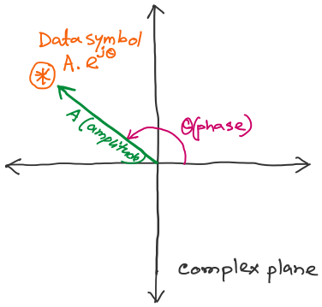
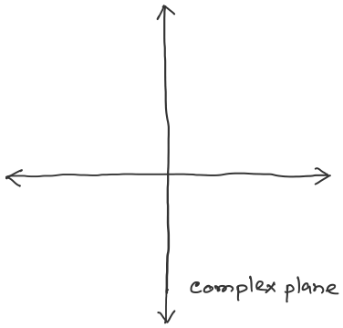
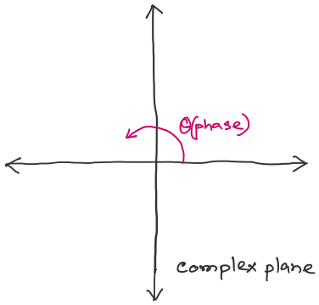
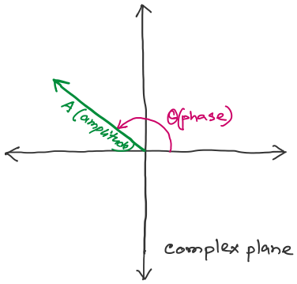
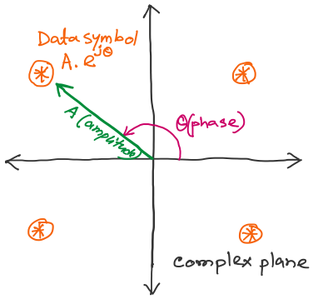
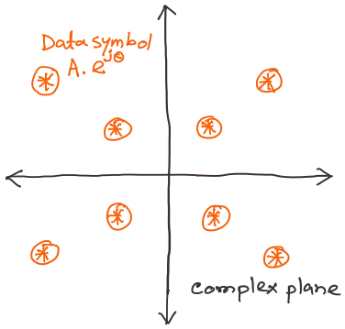
QAM: Quadrature amplitude modulation
Each symbol is assigned to a sequence of bit string (e.g., 00, 01, 10, or 11)

Slide 39
Additive White Gaussian Noise
BPSK: 1 bit per symbol
16 QAM: 4 bits per symbol

Slide 40





SNR: Signal-To-Noise Ratio
$$SNR=\frac{Received Signal Power}{Noise Power at RX}$$
  High SNR – easier to extract signal from noise (a “good thing”)
  Low SNR – hard to extract signal from noise ( a “bad thing”)
$$+$$
$$=$$
Bits:
0
1
0
0
$$+$$
$$=$$
Bits:
0
1
0
0

Slide 41
Capacity of Wireless Channel
Given SNR, what is maximum rate that we can achieve?
  Shannon Capacity Theorem:
$$Capacity=Bandwidth×\log_{2}\left(1+SNR\right)$$

Slide 42
QAM: Quadrature amplitude modulation
Each symbol is assigned to a sequence of bit string (e.g., 00, 01, 10, or 11)

Slide 43
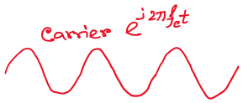
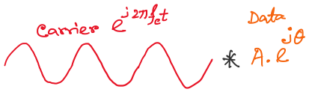
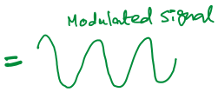


QAM: Quadrature amplitude modulation

Slide 44
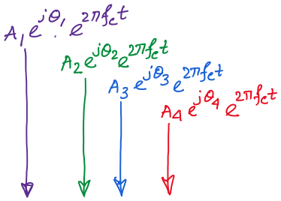
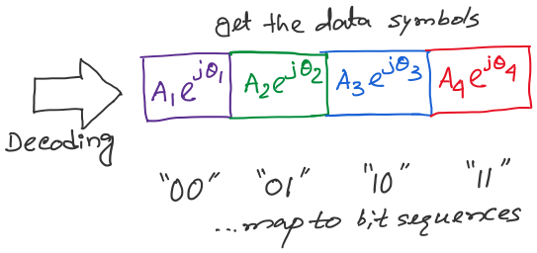
QAM: Quadrature amplitude modulation
Symbol1
Symbol2
Symbol3
Symbol4

Slide 45
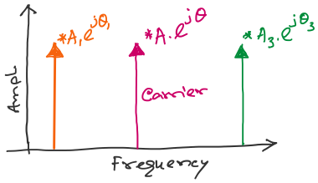
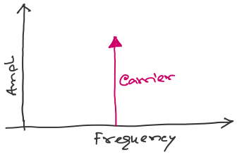

QAM: Quadrature amplitude modulation

Slide 46
Channel sharing

Slide 47
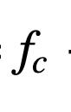
Multicarrier modulation
Carrier
frequency
Amplitude
Frequency
Bandwidth

Slide 48
Multicarrier modulation
Carriers
1
2
3
Amplitude
Frequency

Slide 49
Multicarrier modulation
Carriers
1
2
3
Amplitude
Frequency
Bandpass filter
and
demodulate

Slide 50
Multicarrier modulation
1
2
Amplitude
Frequency

Slide 51
Amplitude
Time
Symbol1
Symbol2
Symbol3
Symbol4

Slide 52
Amplitude
Frequency
Time
Symbol1
Symbol2
Symbol3
Symbol4

Slide 53
Multicarrier modulation: Effect of the symbol length
Symbol1

Slide 54
Multicarrier modulation: Effect of the symbol length
Multiplication with a rectangle function
Symbol1

Slide 55
Multicarrier modulation: Effect of the symbol length
Multiplication with a rectangle function
Symbol1
Time domain:
(Time series with multiple frequencies) X (rect function)
Frequency domain:
FFT(Time series with multiple frequencies) X FFT(rect function)
*
= (Frequency co-efficients) DFT(rect function)

Slide 56
Multicarrier modulation: Effect of the symbol length
1
2
Amplitude
How does the rect function look in the frequency domain?
Frequency
Effect of the data pulses = convolution of the
“DFT(rectangle function)”
with the carriers

Slide 57
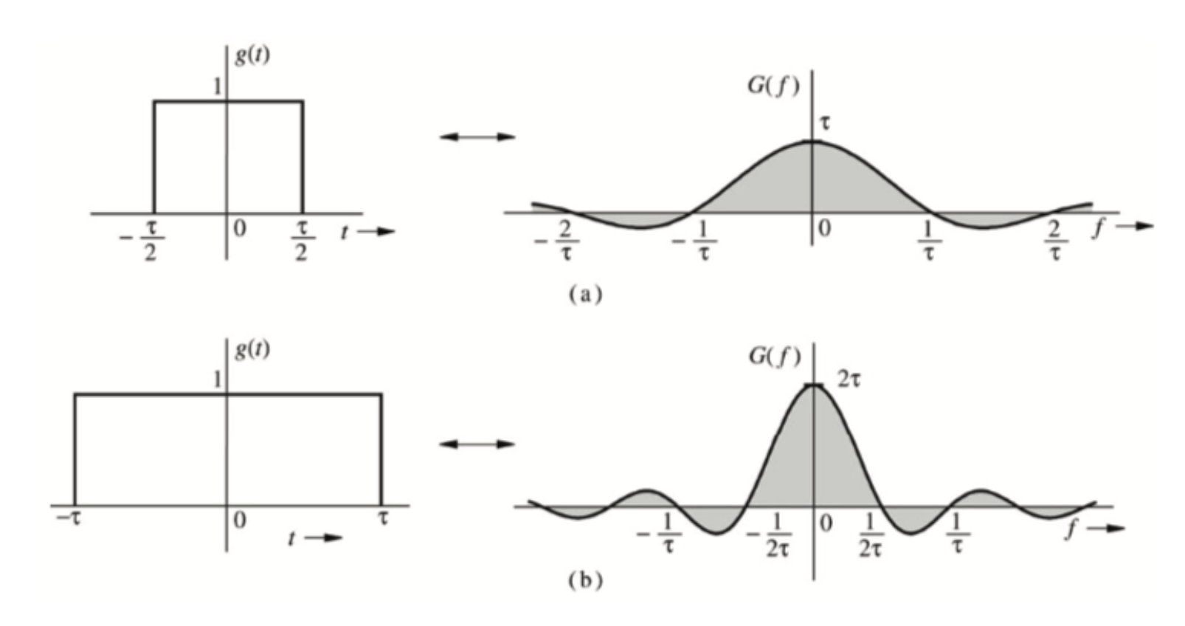
DFT of the rect function

Slide 58
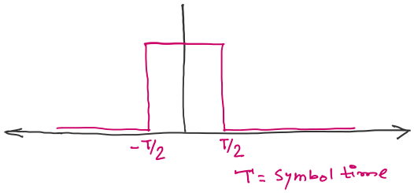
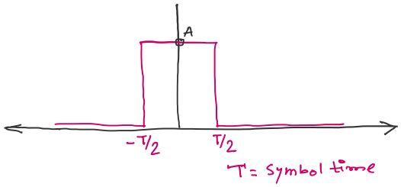

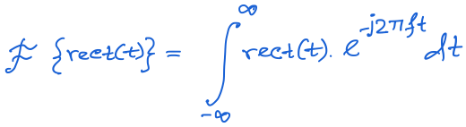
DFT of the rect function

Slide 59
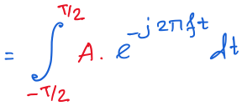
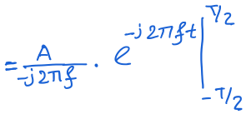


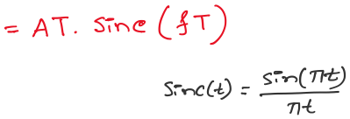

Slide 62
Multicarrier modulation
1
2
Amplitude
Frequency

Slide 63
Multicarrier modulation
1
2
Amplitude
Frequency

Slide 64
Multicarrier modulation
Orthogonal carriers frequencies
1
2
OFDM
(Orthogonal Frequency-Division Multiplexing)
Amplitude
Frequency

Slide 65
OFDM (Orthogonal Frequency-Division Multiplexing)

Slide 66
OFDM (Orthogonal Frequency-Division Multiplexing)
subcarriers

Slide 68





Slide 70
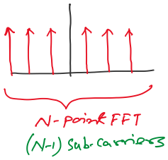

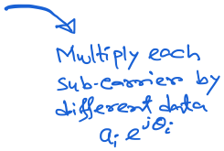






Slide 71
Frequency Division Multiple Access

Slide 72
Time Division Multiple Access
Frequency Division Multiple Access

Slide 73
Time Division Multiple Access
Frequency Division Multiple Access
Code Division Multiple Access

Slide 74
Code Division Multiple Access

Slide 75
CDMA Concept: Matlab code

Slide 76
Sharing Channel Over Space
(Exploring multiple antennas)

Slide 77


SISO
SIMO
MISO

Slide 78
MIMO

Slide 79


Slide 80
For N antennas, H is NxN matrix. i.e., O(N³) operations.
Noise
amplification

Slide 81


Slide 82







Slide 83


Slide 84


Slide 85


Slide 96
What is Massive-MIMO ?

Slide 97
Massive-MIMO
[Ref] http://the-mobile-network.com/2015/09/5gic-the-launch-the-goals-the-research-the-project/

