Slide 1
Coupling of Fluids and Solids

Slide 2
Review - Boundary Conditions
From the divergence theorem,
We calculate pressure to satisfy the N-S incompressibility condition:

Slide 3
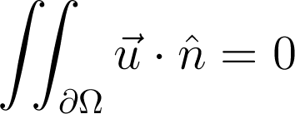
Review - Boundary Conditions
The equation
intuitively means the amount of fluid moving into a domain equals the amount of fluid moving out.

Slide 4
Review - Boundary Conditions
Hence, at solid boundaries
The velocity of the fluid must match the velocity of the solid with respect to the normal direction to the solid

Slide 5
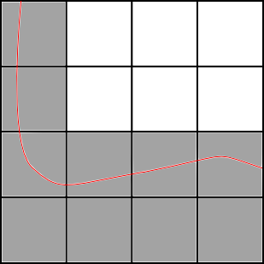
More on Boundary Conditions
Original method
Label cells as either solid or fluid
Change linear system for pressure to compensate

Slide 6
More on Boundary Conditions
Original method
Label cells as either solid or fluid
Change linear system for pressure to compensate
Disadvantages:
Blocky artifacts in simulation
Effects of fluid on solid are too coarse

Slide 7
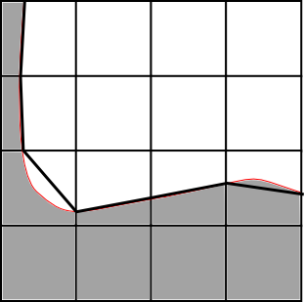
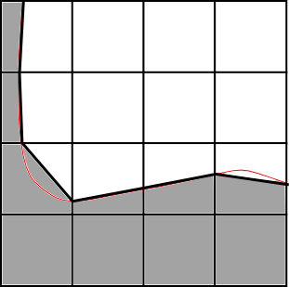
More on Boundary Conditions
Alternate method "cut-cell"
Compute a discretized version of
Change linear system for pressure to compensate

Slide 8
More on Boundary Conditions
Alternate method "cut-cell"
Compute a discretized version of
Change linear system for pressure to compensate
Disadvantages:
Cannot handle really thin solids
Cannot handle solids less than a single grid cell

Slide 9
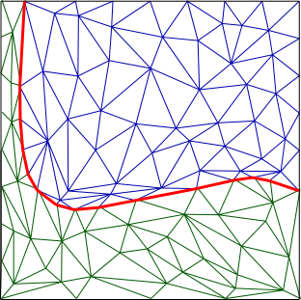
More on Boundary Conditions
Method for coupling with solids:
Tetrahedral decomposition

Slide 10
More on Boundary Conditions
Method for coupling with solids:
Tetrahedral decomposition
Disadvantages:
Must remesh each timestep
Mesh should capture small fluid features (turbulence)

Slide 11
Extracting Force From Fluid Sim
Rigid bodies:

Slide 12
Extracting Force From Fluid Sim
Rigid bodies:
Intuitively: The net force on the solid is the sum of the fluid pressure pushing against the solid

Slide 13
Extracting Force From Fluid Sim
Rigid bodies:
Intuitively: The net force on the solid is the sum of the fluid pressure pushing against the solid
Torque is defined similarly

Slide 14
Simple Coupling
Advect fluid and update solid positions

Slide 15
Simple Coupling
Advect fluid and update solid positions
Add non-coupled forces to all velocities

Slide 16
Simple Coupling
Advect fluid and update solid positions
Add non-coupled forces to all velocities
Compute pressure to maintain incompressibility, use current solid velocities

Slide 17
Simple Coupling
Advect fluid and update solid positions
Add non-coupled forces to all velocities
Compute pressure to maintain incompressibility, use current solid velocities
Update solid velocities from fluid forces

Slide 18
More advanced: IBM
Simple idea (Immersed Boundary Method):
- Consider entire simulation domain during pressure computation
- Use resulting grid-velocities at boundaries for solid

Slide 19
More advanced: IBM
Simple idea (Immersed Boundary Method):
- Consider entire simulation domain during pressure computation
- Use resulting grid-velocities at boundaries for solid
Problems:
- Numerical Dissipation at interface
- Doesn't quite accurately handle complex boundaries

Slide 20
Coupling Deformable Objects
General idea presented by Chentanez et al. at SIGGRAPH in 2006.
Main idea:
- Make sure that pressure and solid velocities each satisfy constituent equations:
Fluid Incompressibility:
Deformable Solid:

Slide 21
Maintaining Solid Constituency
We want to know the node velocity at
From constituent equation:

Slide 22
Maintaining Solid Constituency
Using the trapezoid and euler integration:

Slide 23
Maintaining Solid Constituency
Using the trapezoid and euler integration:
Or, in other words:

Slide 24
Maintaining Solid Constituency
To approximate non-linear stiffness:
Where is the jacobian of the elastic force at

Slide 25
Maintaining Solid Constituency
Now we can rewrite the constituent equation in
terms of , , and :

Slide 26
Maintaining Solid Constituency
The force from the fluid is simply the pressure at the solid node points.

Slide 27
Maintaining Solid Constituency
The force from the fluid is simply the pressure at the solid node points.
We need to map the fluid pressure to the solid using the (sparse) matrix J:

Slide 28
Maintaining Solid Constituency
Hence the final equation for maintaining our solid is:

Slide 29
Maintaining Fluid Constituency
All we need to maintain is incompressibility:

Slide 30
Maintaining Fluid Constituency
All we need to maintain is incompressibility:
Which means fluid in matches fluid out:

Slide 31
Maintaining Fluid Constituency
From the fluid, the pressure must result in zero divergence.

Slide 32
Maintaining Fluid Constituency
From the fluid, the pressure must result in zero divergence.
For intermediate fluid velocity ,
Such that

Slide 33
Maintaining Fluid Constituency
With a little arithmetic:
Which implies:

Slide 34
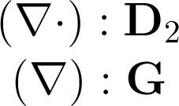
Maintaining Fluid Constituency
Using finite differences, we can map both gradient and divergence to matrices:

Slide 35
Maintaining Fluid Constituency
From the solid, if it doesn't occupy an area, it is replaced by fluid.

Slide 36
Maintaining Fluid Constituency
From the solid, if it doesn't occupy an area, it is replaced by fluid.
Hence, we can calculate the divergence from the node velocities:

Slide 37
Maintaining Fluid Constituency
With the solid, we have:
We compute the divergence free velocity by:

Slide 38
Coupling Deformable Objects
Finally, we are given the following system:
Where

Slide 39
Coupling Deformable Objects
Finally, we are given the following system:
Notes:
This is a (very) sparse system.

Slide 40
Coupling Deformable Objects
Finally, we are given the following system:
Notes:
This is a (very) sparse system.
Chentantez et al. solve it using a bi-conjugate stabilized method with incomplete Cholesky preconditioner

Slide 41
References
Fluid Simulation for Computer Graphics
by Robert Bridson
Nuttapong Chentanez, Tolga G. Goktekin, Bryan E. Feldman, and James F. O'Brien. "Simultaneous Coupling of Fluids and Deformable Bodies". In ACM SIGGRAPH/Eurographics Symposium on Computer Animation, pages 83–89, August 2006.

Slide 42
Questions?

