Slide 1
Motion Planning for SpaceCraft
Andrew Best UNC Chapel Hill

Slide 2
Introduction
Discuss problems and concepts specific to motion planning in space
Motion planning background
Specific challenges to space
Path planners
Planetary Orbital Environment and Deep Space

Slide 3
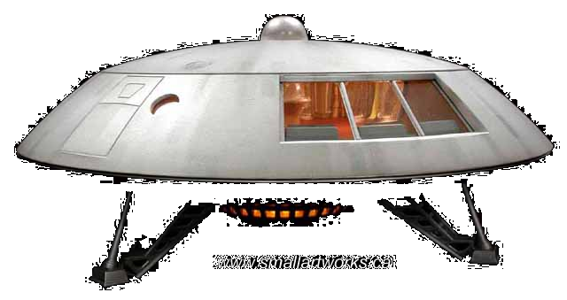
Motivation
Space travel is the future of human civilization
Satellite networks power critical technologies
Long missions will require effective and trustworthy autopilot
Motion planning in space is difficult
Space travel is expensive
Cost to Low Earth Orbit ~$9000 / kg
RP-1 .81 kg/l
$7290 per liter waste ($630)
Notes:
Our planet is increasing crowded and decreasingly capable of sustaining life, we need to travel the starts
.
Space travel is REALLY expensive. Cost to LEO is $9000 per kg (averaged from Wikipedia)
RP-1 has a density of .81 kg/l meaning each wasted liter due to bad planning costs roughly $720
or… for liquid hydrogen $630
either way, it is very costly to mess this up, because these costs assume we can get more fuel to the ships

Slide 4
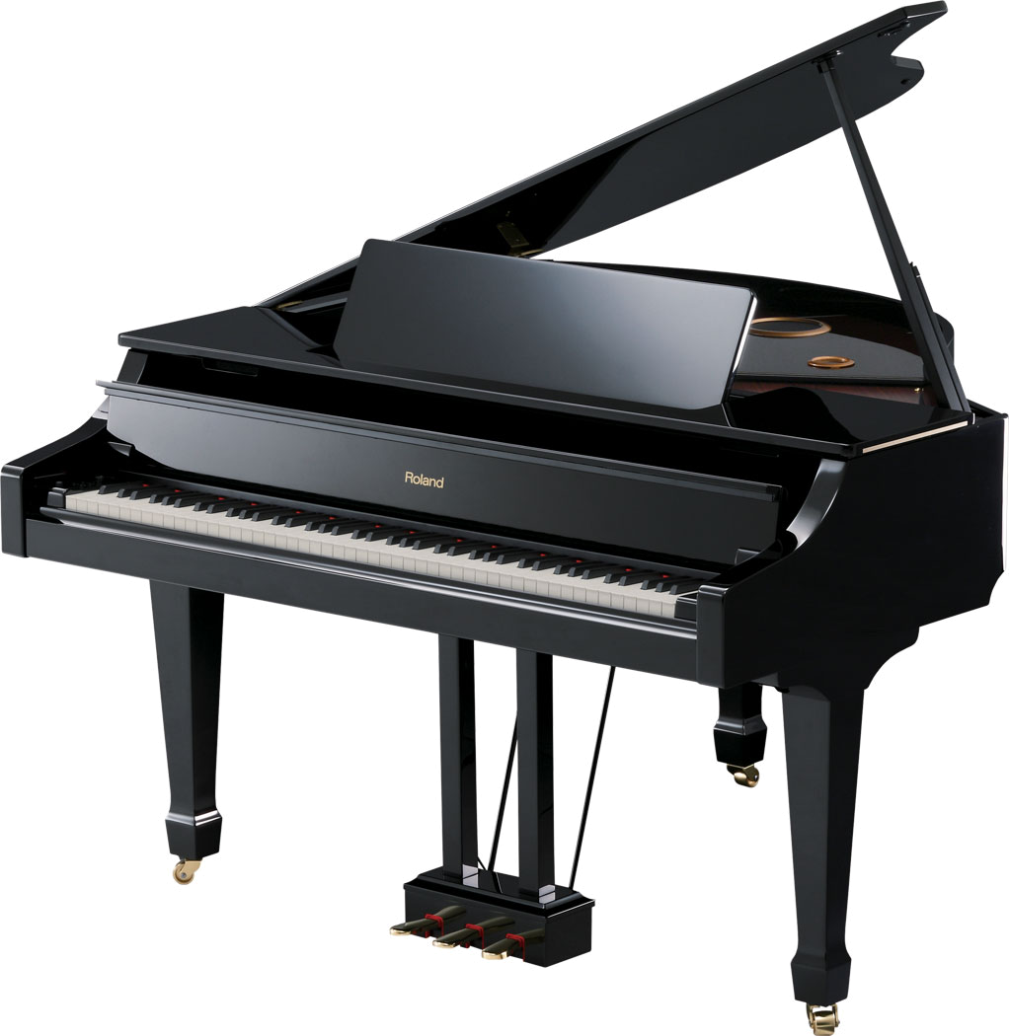
Motion Planning
Wiki: process of breaking down a desired movement task into discrete motions that satisfy movement constraints and possibly optimize some aspect of the movement.
common constraints:
Collision-free
kinematics
Dynamics (external system forces)

Slide 5
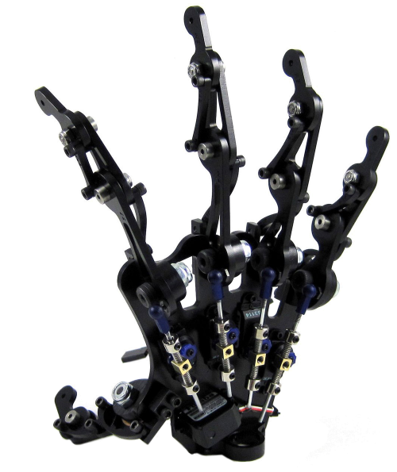
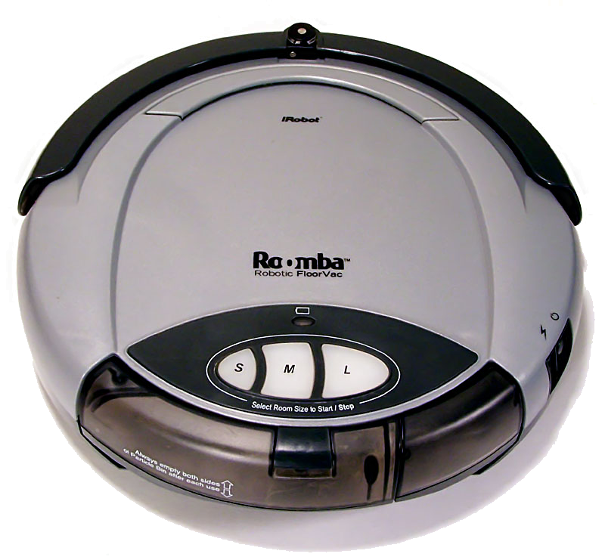
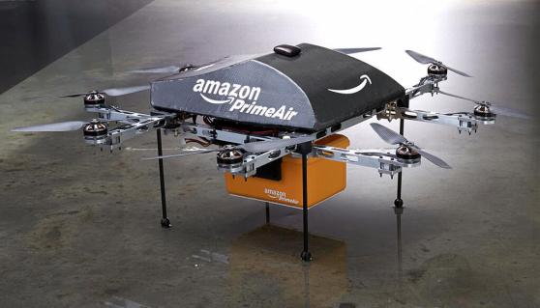
Motion Planning problems
Manipulators
N-rotors (4,8, etc)
Roomba
Surgical Robots

Slide 6
Motion Planning problems
Bipeds
Autonomous Cars
https://www.youtube.com/watch?v=8h_W-KtQics
18:00 – 23:00
https://www.youtube.com/watch?v=bnv5JP8gL_k
07:00 – 13:00

Slide 7
General Abstraction
s = ($α_{0},a_{1},…,a_{n}$) configuration of robot in the world
$S$ set of all states, $t_{i}$ timestep i, ${s(t}_{i})$ state at $t_{i}$
Kinematics: state evolution given control inputs
Path is set of all intermediate states between $s\left(t_{0}\right)$ and $s(T)$
Notes:
Given some s which represents a vector of the configuration parameters (sufficient parameters to get a complete picture of the system state)
Some discrete timestep t_i and state s_i
the “path” is the set of all intermediate states the agent / robot/ actor will pass through from t0 to T

Slide 8
Methods to Compute a Path
PRM – Probabilstic Roadmap
Gradient Decent
RRT – Randomly-Exploring Rapid Tree
Notes:
Here I will give a SHORT overview of these three techniques

Slide 9
Planning in Space: 2 cases
Planning in space divided into two environments
Deep-Space
No state- dependent forces in open loop
Reduces to double integrator control problem
ODE like our ballistics
Planetary Orbital Environment POE
Strong dynamic forces
Search For Passive Relative Orbits, Active Relative Orbits, or reconfigurations
Notes:
Passive relative orbit – maintain position constraints without open-loop control
ARO - maintain constraints WITH open-loop control
Reconfiguration – search for optimal paths from ARO to PRO or ARO to ARO

Slide 10
Planning in Space: 2 cases
Additional POE Complications
Linear thrust produces curved trajectories
Thrust changes eccentricity of orbit as well as moving spacecraft along path
Additional Terminology:
Controllability: For any two configurations $s_{1}, s_{2}$, there exists a time interval T and set of inputs to the control equations so that $s_{1}$ is the initial configuration and $s_{2}$ is the final.
Notes:
[Caltech motion planning paper] - controllability
Passive relative orbit – maintain position constraints without open-loop control
ARO - maintain constraints WITH open-loop control
Reconfiguration – search for optimal paths from ARO to PRO or ARO to ARO

Slide 11
Distinction: planning in space
Motion planning tends to assume no drift
State evolution is only dependent on control inputs and kinematic
Momentum is neglected from state to state
Motion planning is symmetric
Undirected graphs can be used to represent configuration spaces
Notes:
Now, it gets complicated, spacecraft have drift
[stanford drift paper]

Slide 12
Distinction: planning in space
Spacecraft have drift!
Three key features:
Asymmetric state evolution functions
Inevitable collision state sets
For some states, no evolution exists s.t. $v=0$
Mathematically:
$x\left[t+1\right]=Ax\left[t\right]+Bu\left[t\right]+c$
$x\left[t\right]∈$ configuration space
$u\left[t\right]∈$ control space
Called LQDMP (Linear Quadratic DMP)
Notes:
Now, it gets complicated, spacecraft have drift
schmerling linear affine drift dynamics
For some states, it is not possible to stop v = 0
A is state Dynamics
B is kinematics
U is control inputs
Linear-Quadratic Dynamic Motion Planning

Slide 13
Distinction: planning in space
Generally not optimizing time/path length
Balancing a complex cost function of time + energy cost
Additional constraints:
Sun exposure
Solar Pressure forces
Plume and glint avoidance
Not all directions are equivalent
Cost functions for given motions vary by dynamics

Slide 14
Formation Flying
Used to control multiple spacecraft performing a single mission
Additional constraints on fuel consumption and balance
6N DOF problem
Generally reduced by leader-follower algorithms
One craft is master, plans in POE frame
Others are followers, plan in master-relative frame

Slide 15
Planning in Space: 2 cases
Formation Flying Passive Relative Orbit
https://www.youtube.com/watch?v=b3y_NaMIymI
Notes:
Passive relative orbit – maintain position constraints without open-loop control
ARO - maintain constraints WITH open-loop control
Reconfiguration – search for optimal paths from ARO to PRO or ARO to ARO

Slide 16
Motion Planner examples
FMT*
Fast-Marching Trees
Single-Query algorithm
Greedy RRT based on arbitrary cost function
Step 1:
Optimal next node (ignore collisions)
Step 2:
Connect collision free neighbors
Notes:
[Fmt Stanford paper]
Few things to note. Tree expands outward, nodes can be connected by a distance over a neighbor radius.
Look for optimatal (ignore collisions), then check best, store it if no collide

Slide 17
Motion Planner examples
DFMT*
Dynamic Fast Marching Trees
Principal difference: neighborhood locality is now defined by differential constraints, not simply Euclidian distance
More expensive, not realtime, but functional
Notes:
[Fmt Stanford paper]
Few things to note. Tree expands outward, nodes can be connected by a distance over a neighbor radius.
Look for optimatal (ignore collisions), then check best, store it if no collide

Slide 18
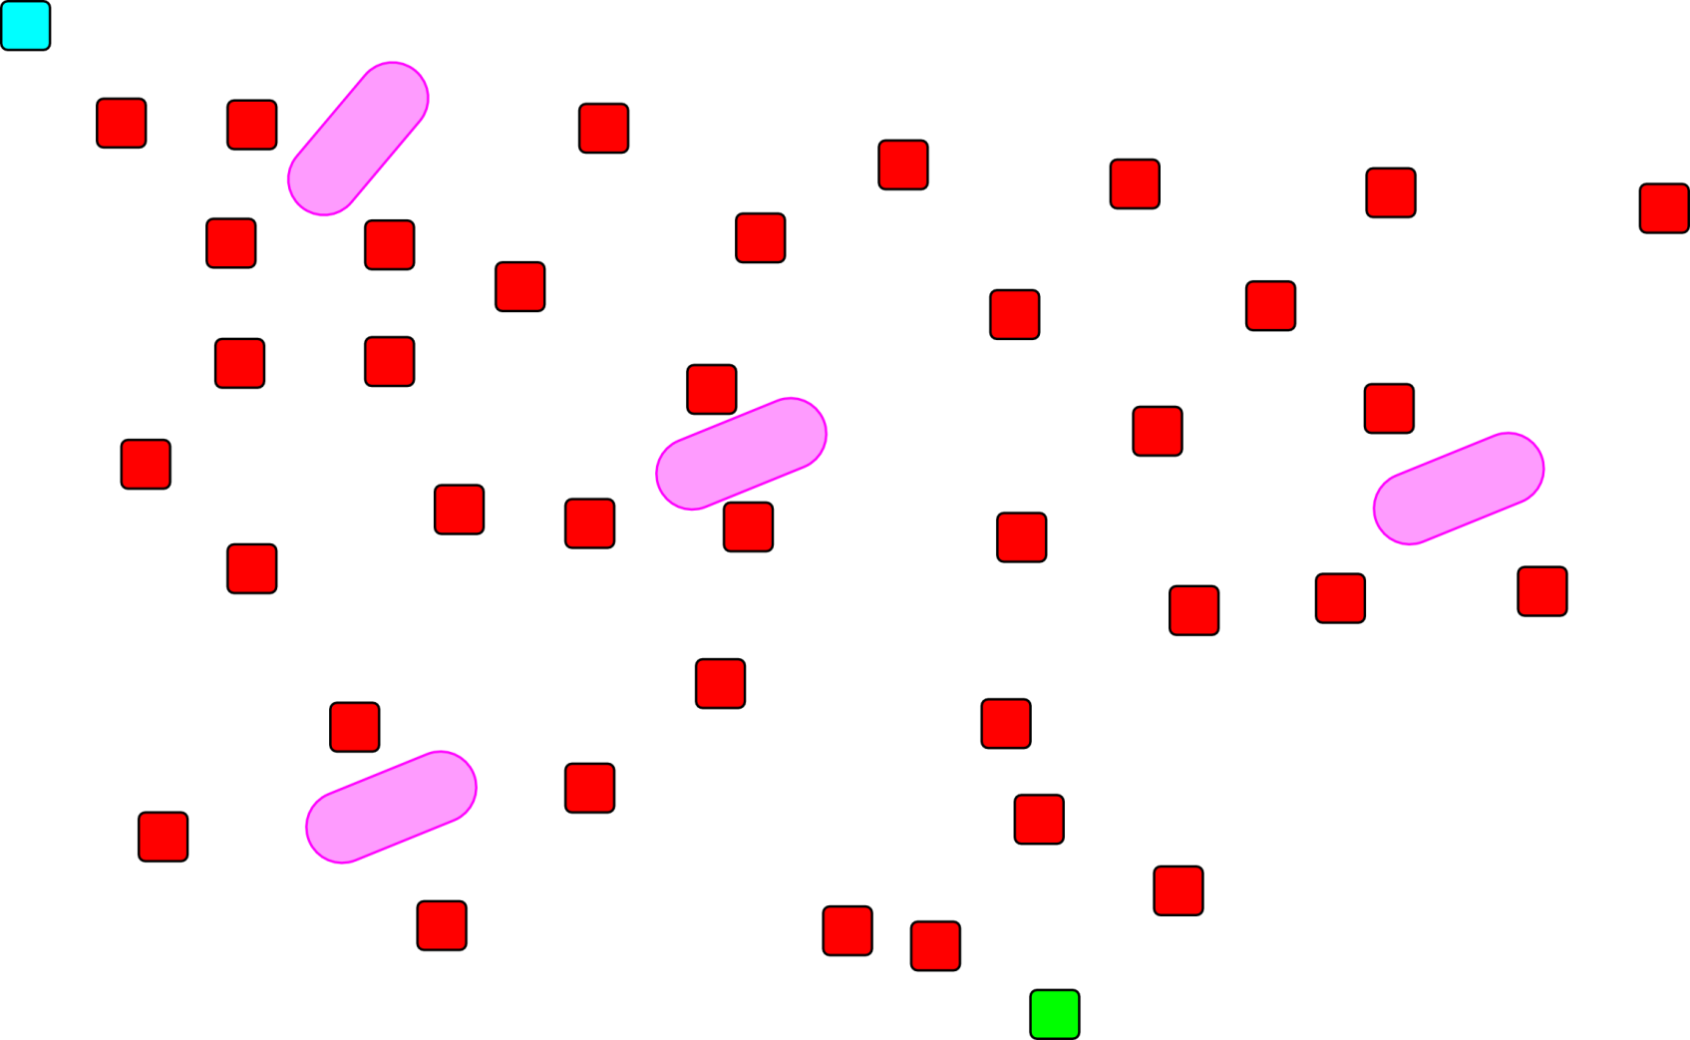
Motion Planner Examples
RRT
Notes:
2d cross section of a search space

Slide 19
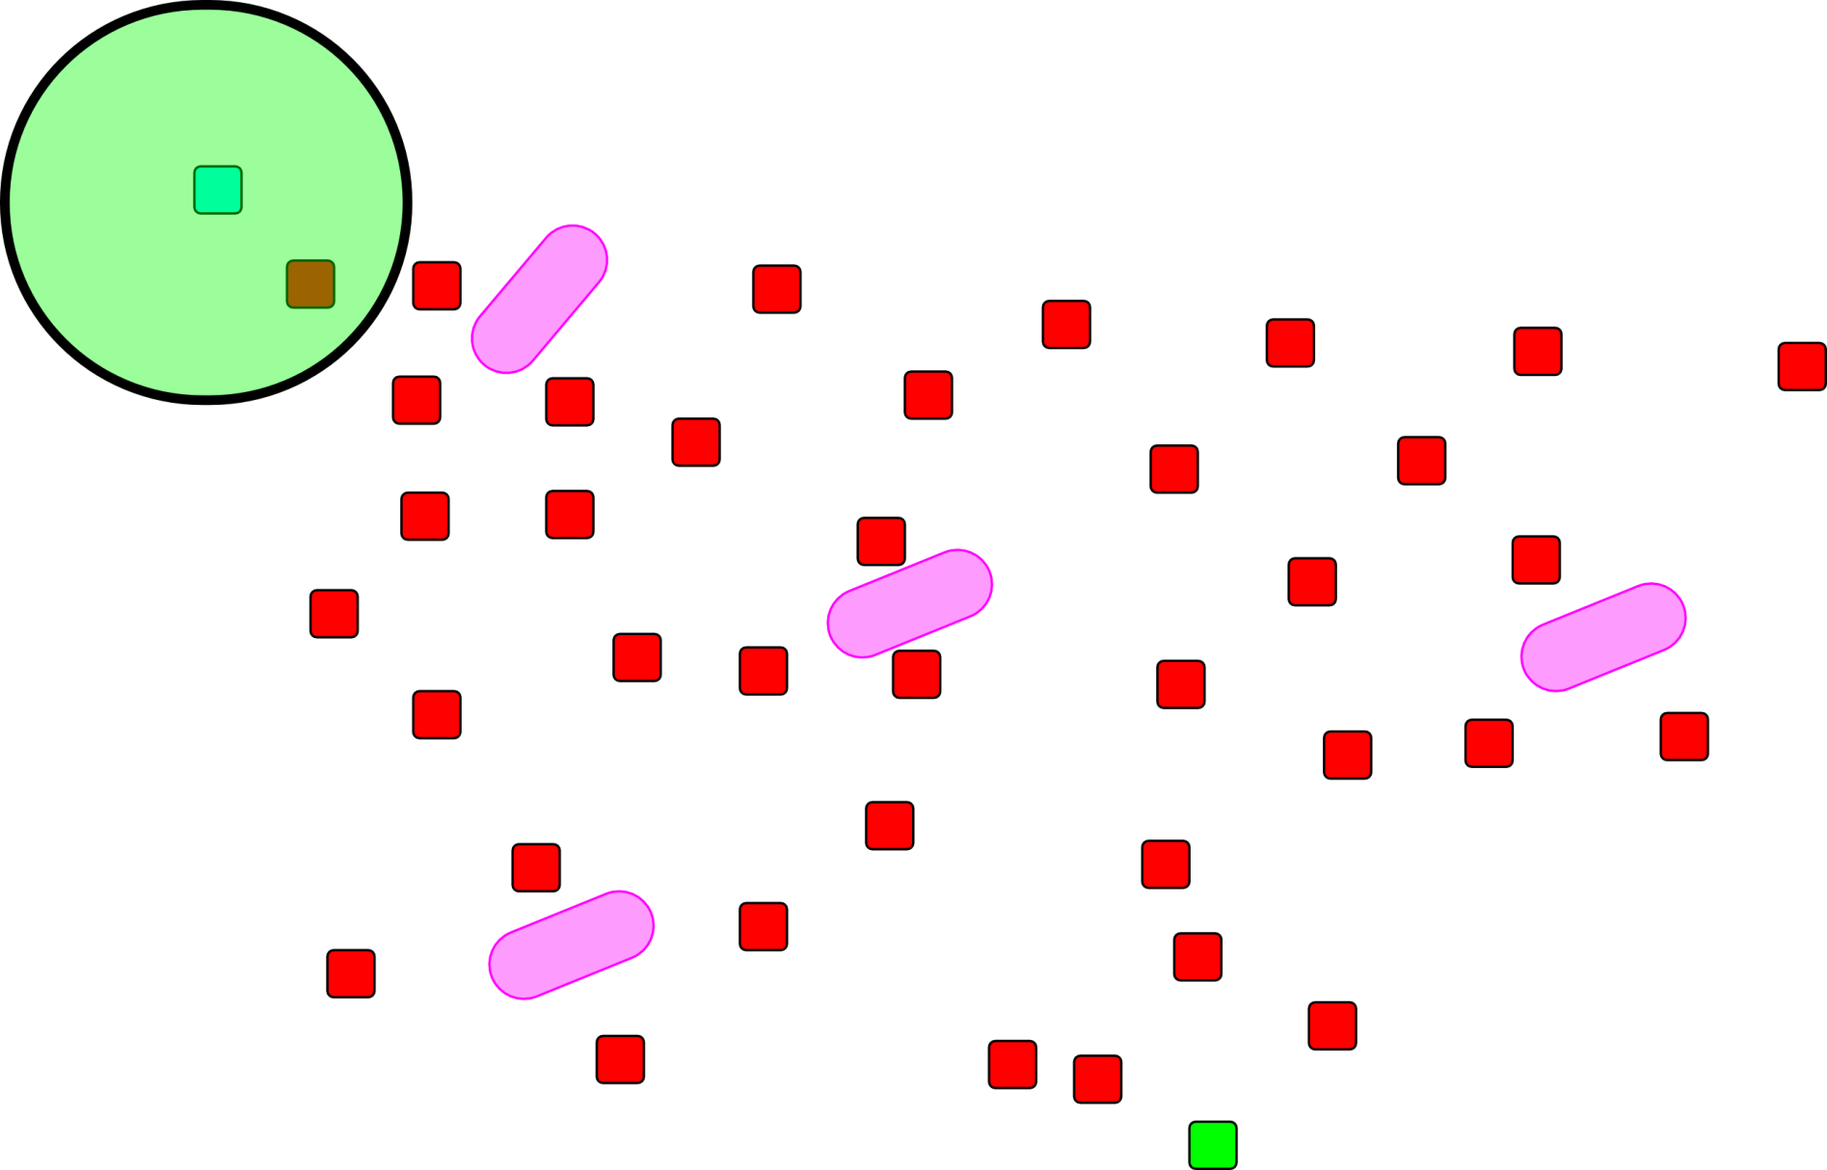
Motion Planner Examples
RRT
Notes:
2d cross section of a search space

Slide 20
Motion Planner Examples
RRT
Notes:
2d cross section of a search space

Slide 21
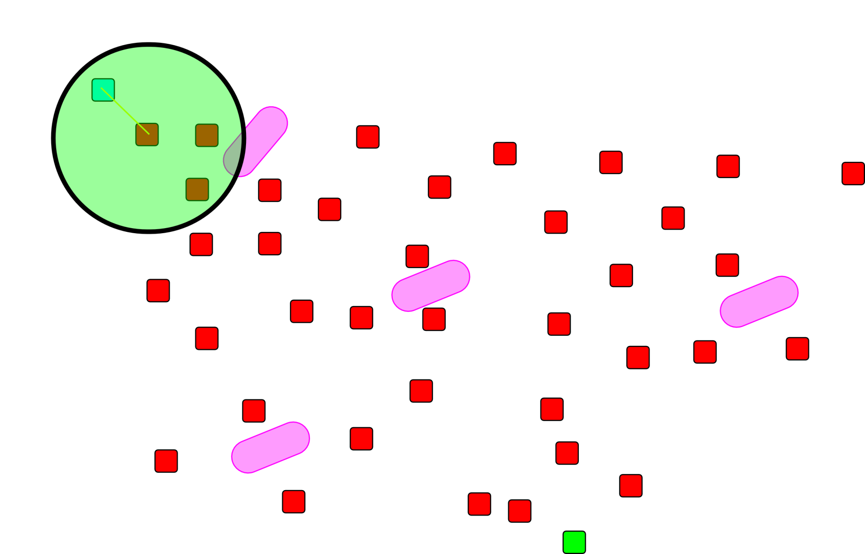
Motion Planner Examples
RRT
Notes:
2d cross section of a search space

Slide 22
Motion Planner Examples
RRT
Notes:
2d cross section of a search space

Slide 23
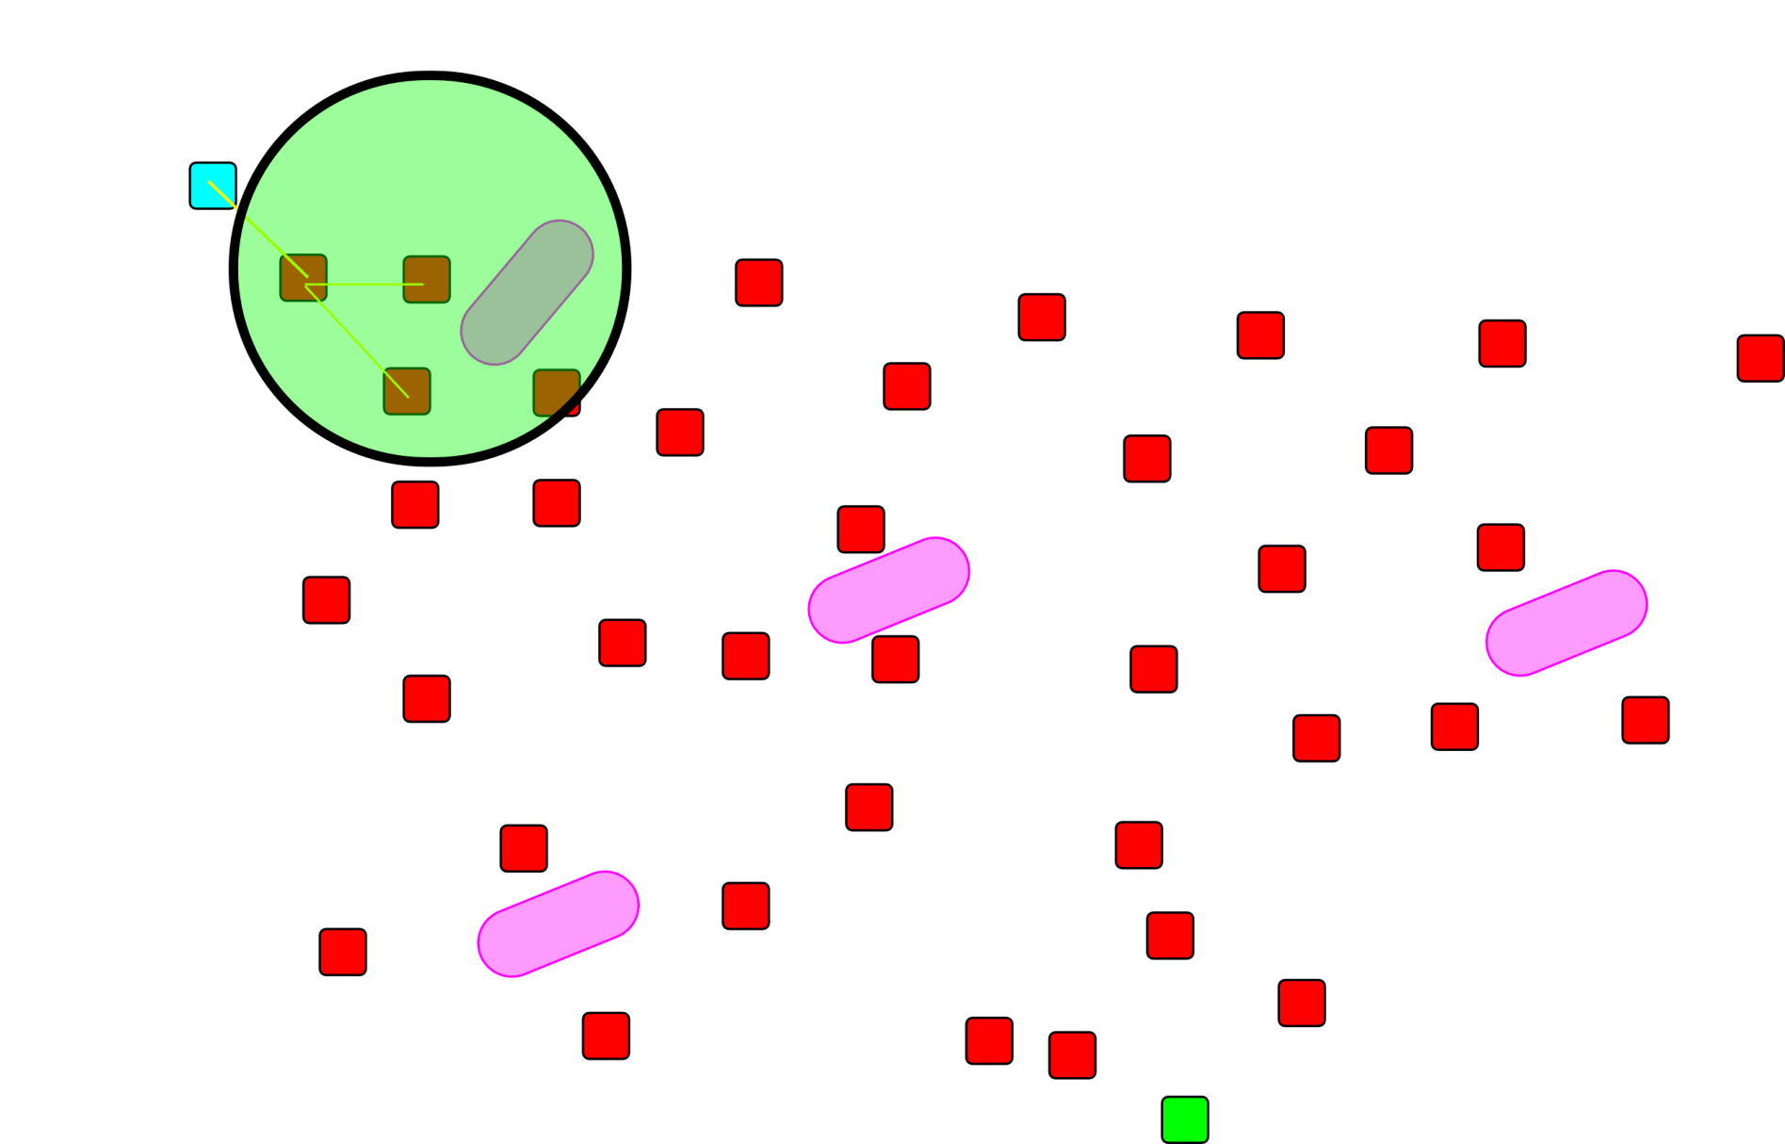
Motion Planner Examples
RRT
Notes:
2d cross section of a search space

Slide 24
Motion Planner Examples
RRT
Notes:
2d cross section of a search space

Slide 25
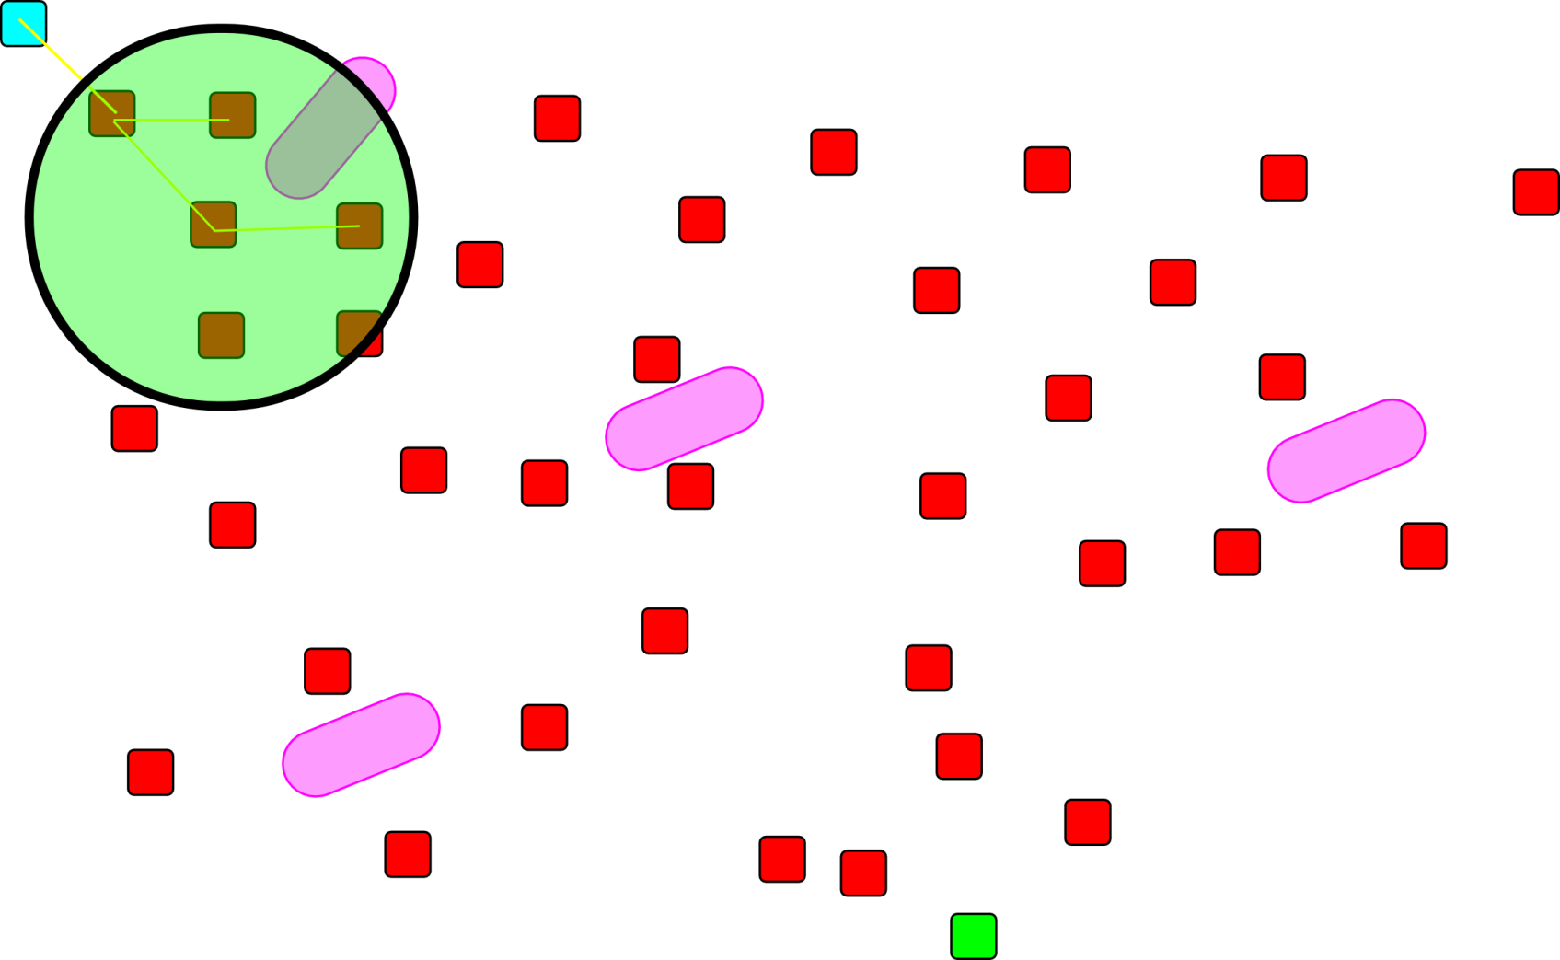
Motion Planner Examples
RRT
Notes:
2d cross section of a search space

Slide 26
Motion Planner Examples
RRT
Notes:
2d cross section of a search space

Slide 27
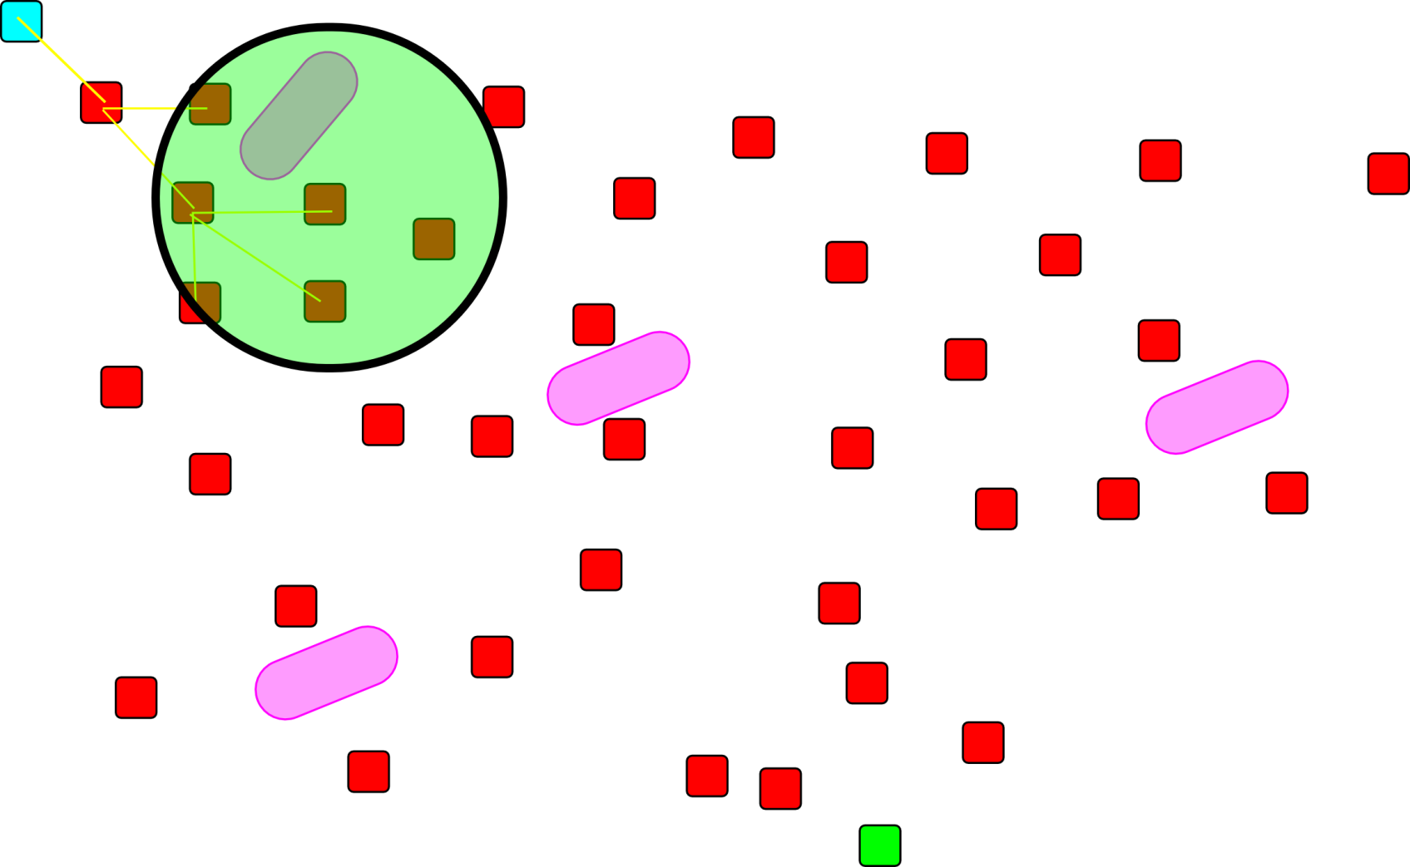
Motion Planner Examples
RRT
Notes:
2d cross section of a search space

Slide 28
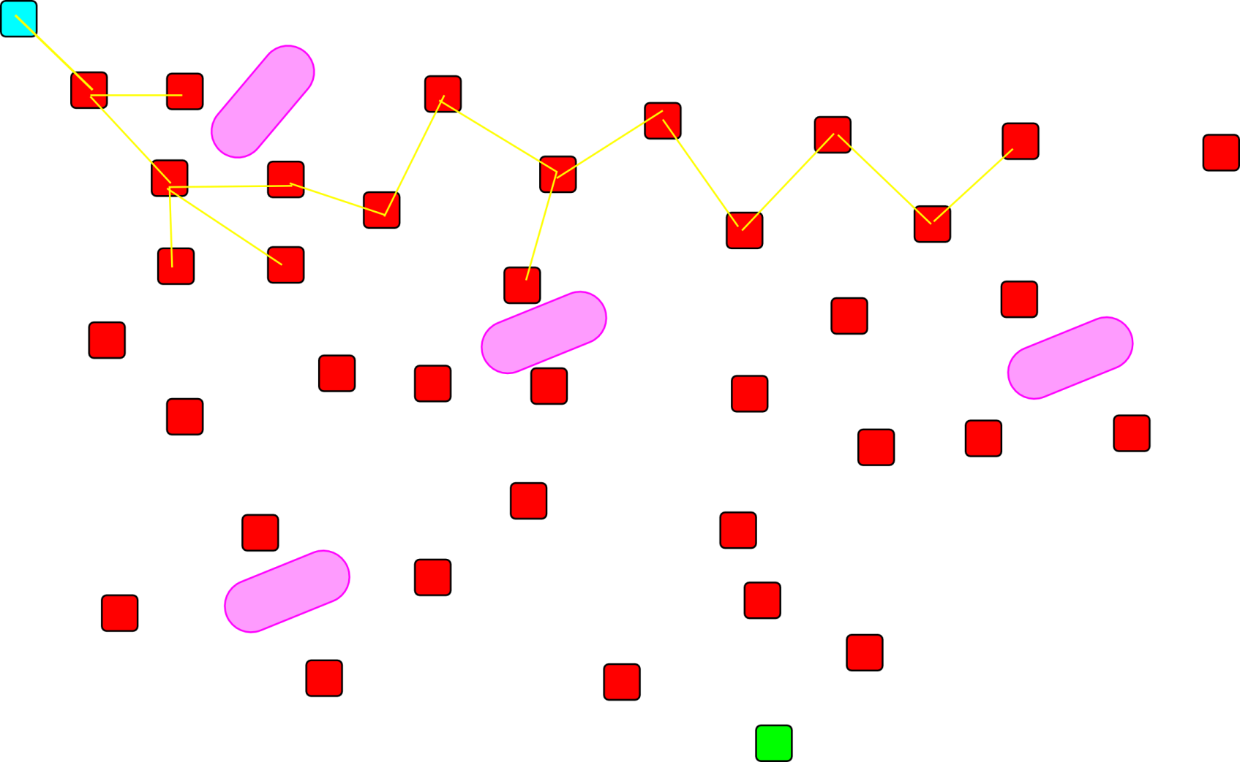
Motion Planner Examples
RRT
Notes:
2d cross section of a search space

Slide 29
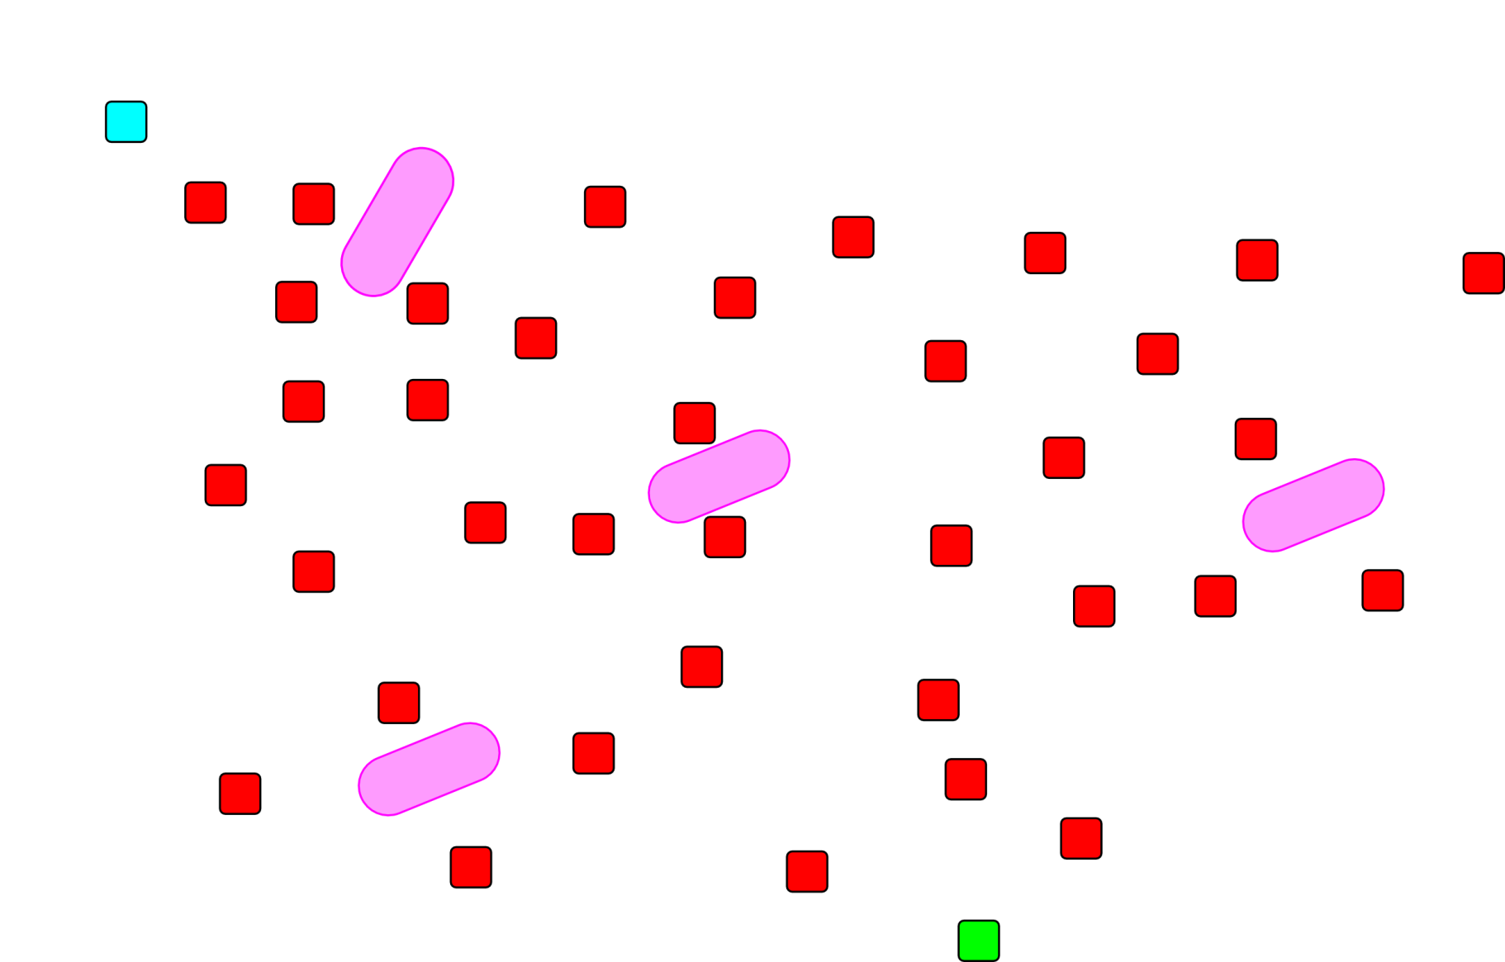
Motion Planner Examples
DFMT*
Notes:
2d cross section of a search space

Slide 30
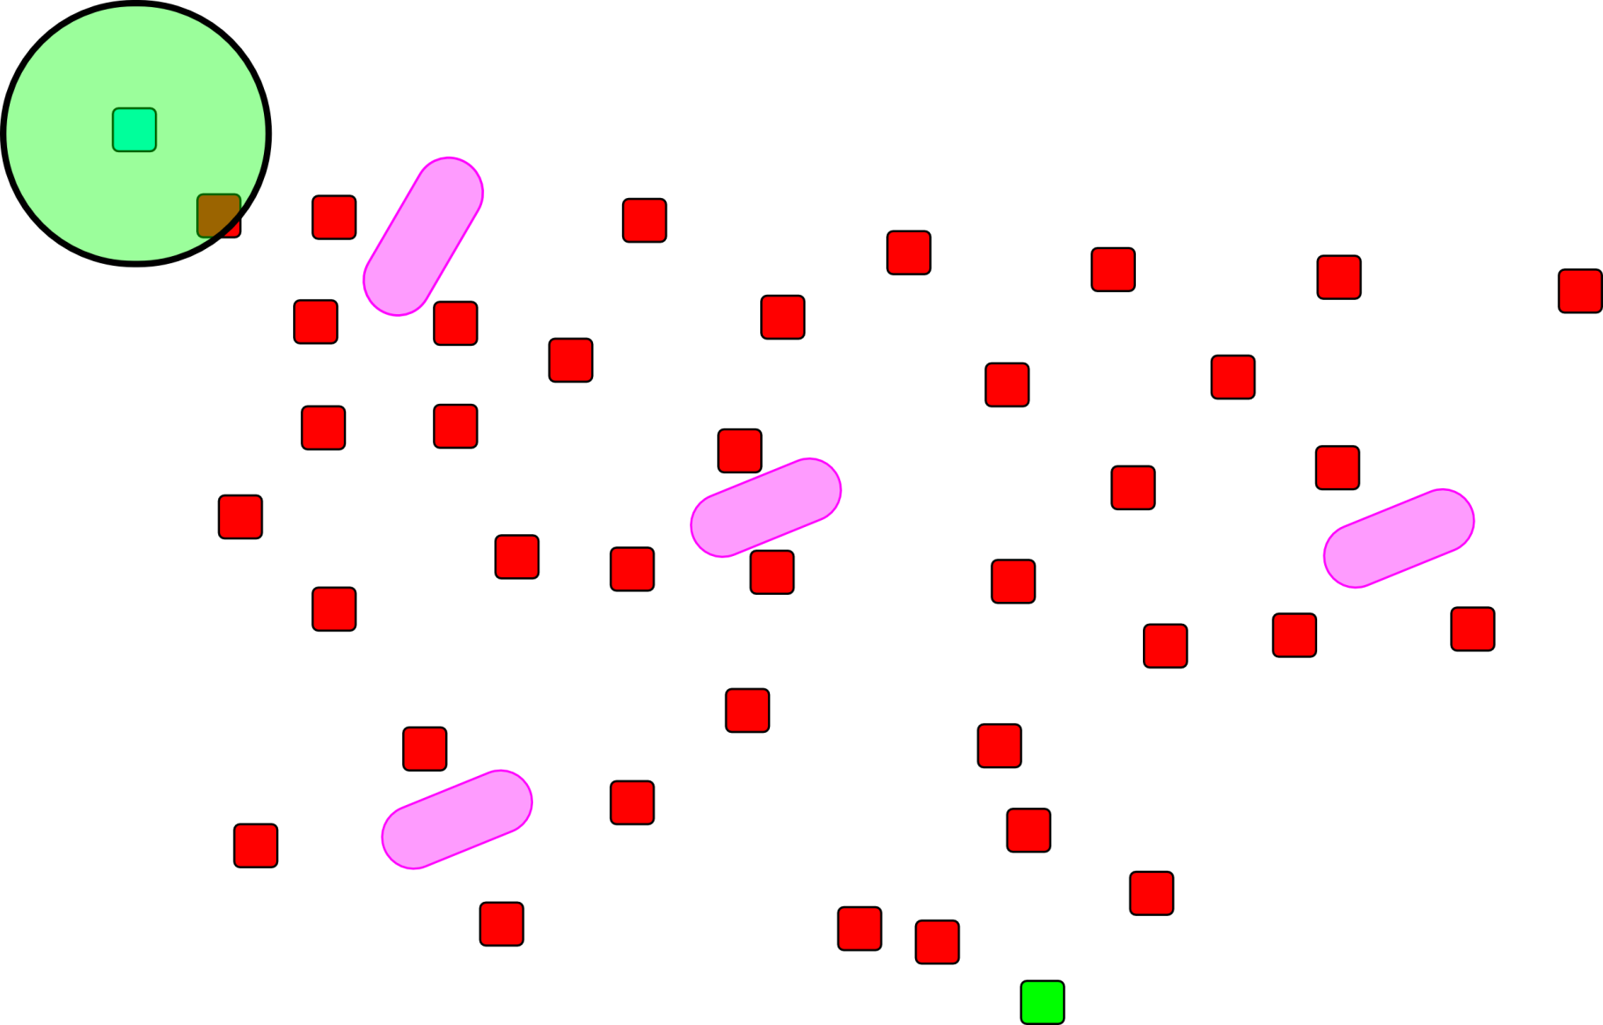
Motion Planner Examples
DFMT*
Notes:
2d cross section of a search space

Slide 31
Motion Planner Examples
DFMT*
Notes:
2d cross section of a search space

Slide 32
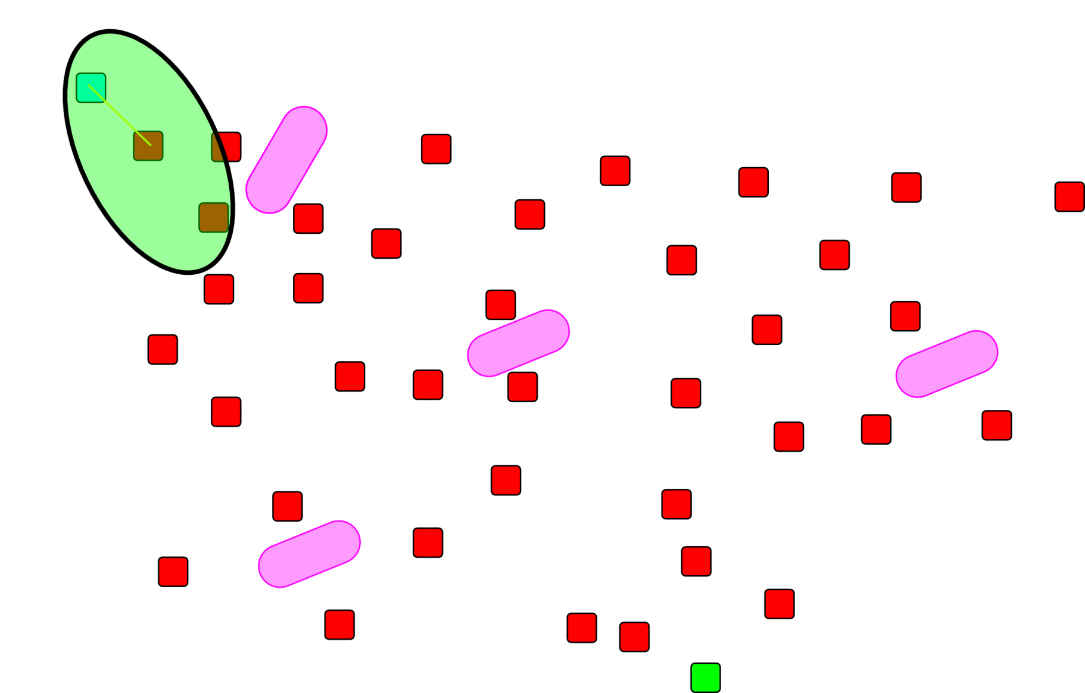
Motion Planner Examples
DFMT*
Notes:
2d cross section of a search space

Slide 33
Motion Planner Examples
DFMT*
Notes:
2d cross section of a search space

Slide 34
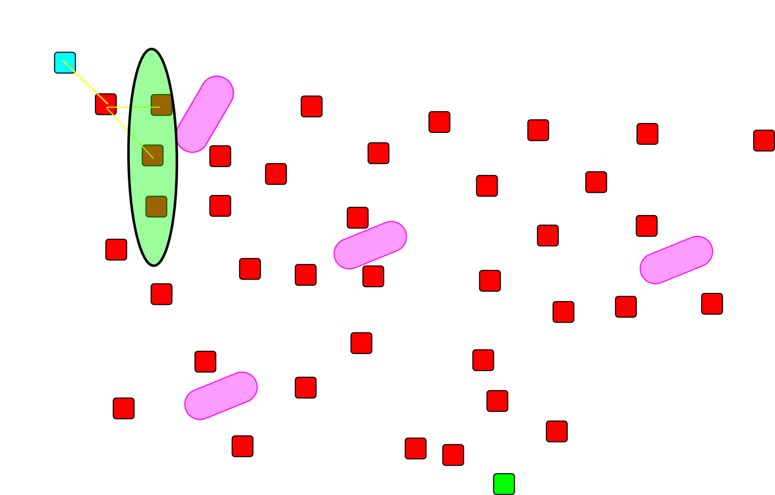
Motion Planner Examples
DFMT*
Notes:
2d cross section of a search space

Slide 35
Motion Planner Examples
DFMT*
Notes:
2d cross section of a search space

Slide 36
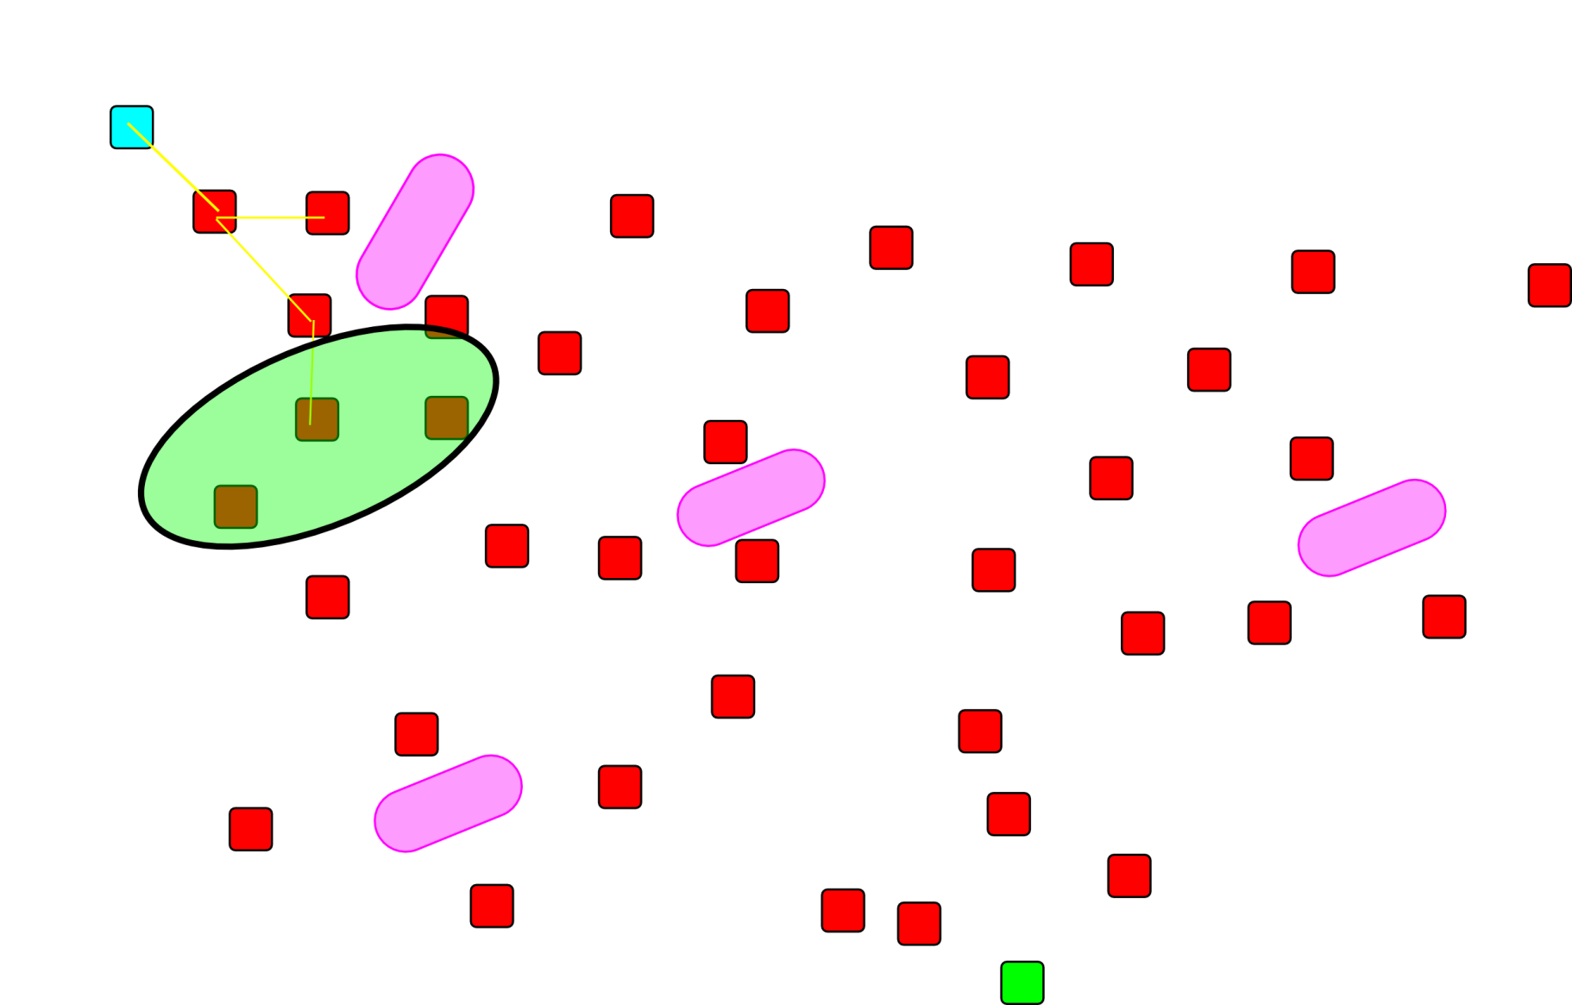
Motion Planner Examples
DFMT*
Notes:
2d cross section of a search space

Slide 37
Motion Planner Examples
DFMT*
Notes:
2d cross section of a search space

Slide 38
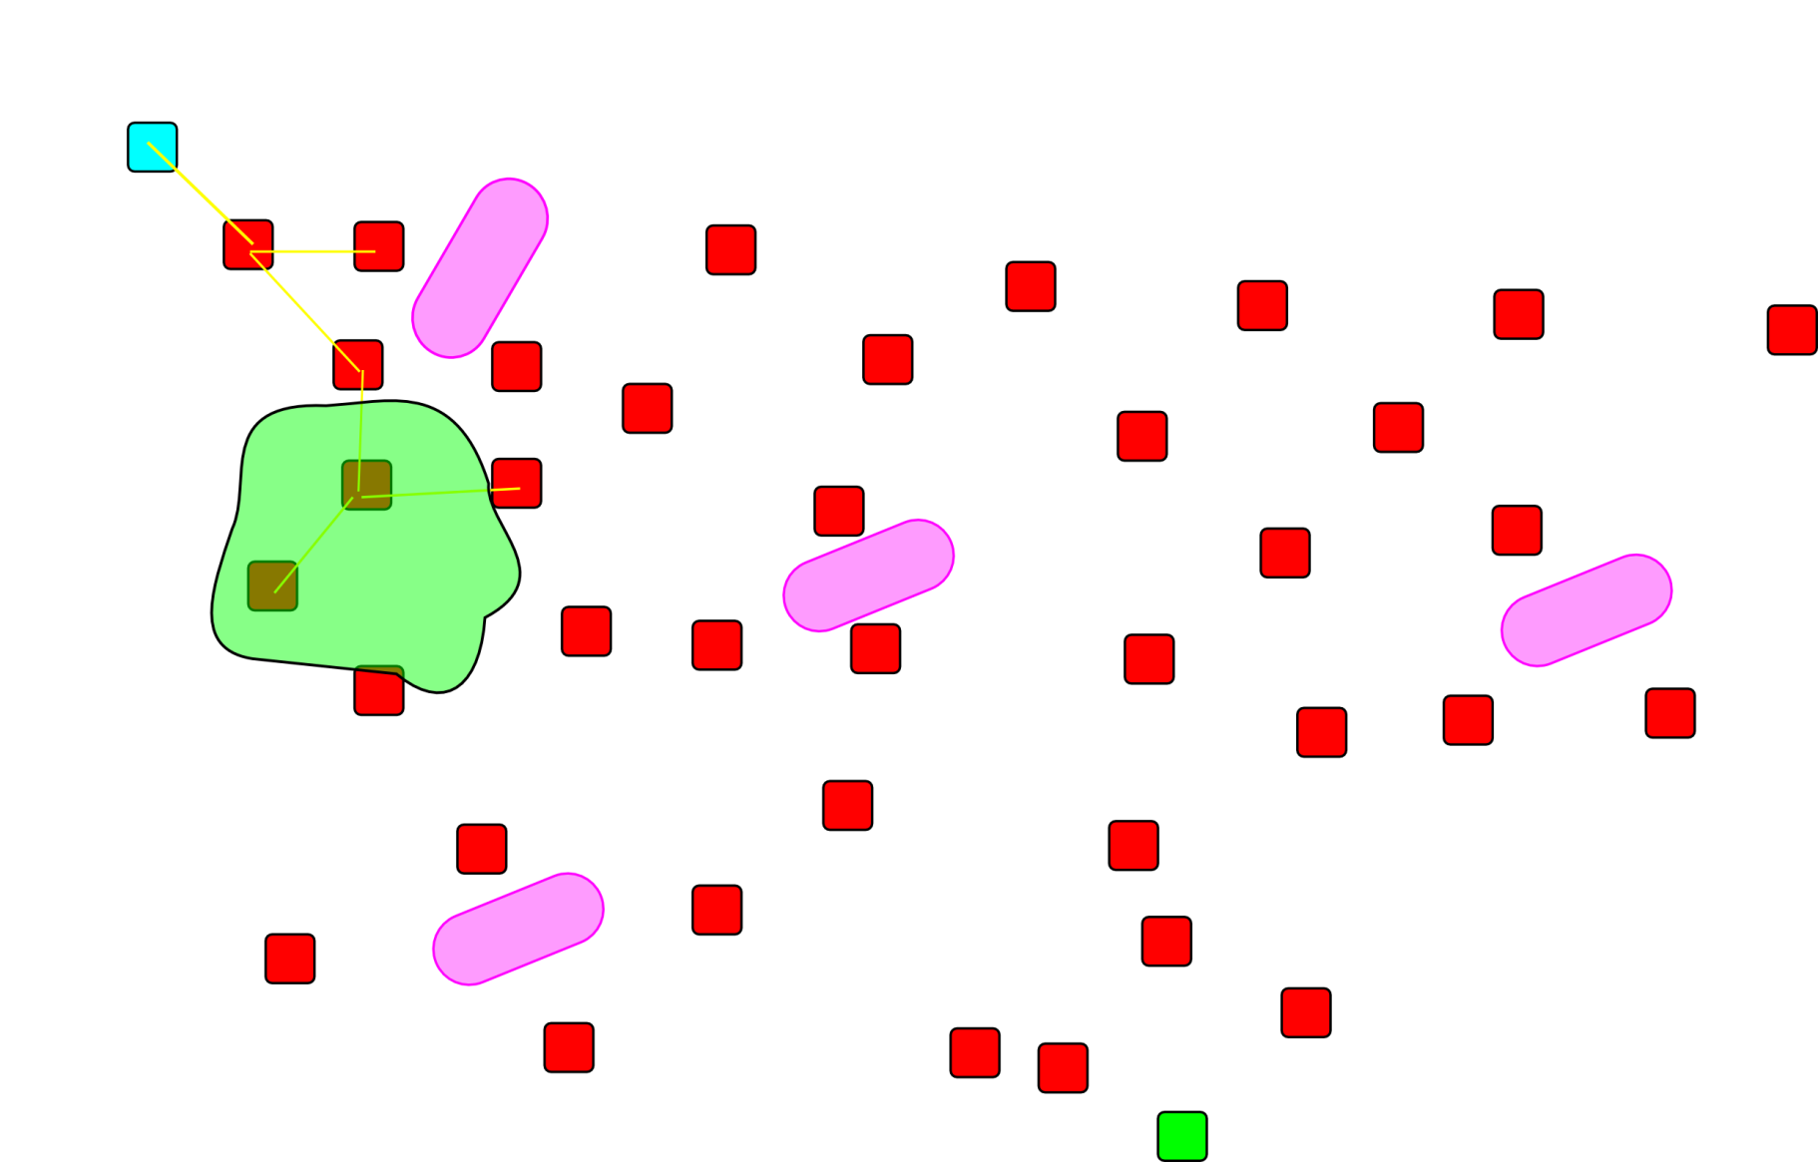
Motion Planner Examples
DFMT*
Notes:
2d cross section of a search space

Slide 39
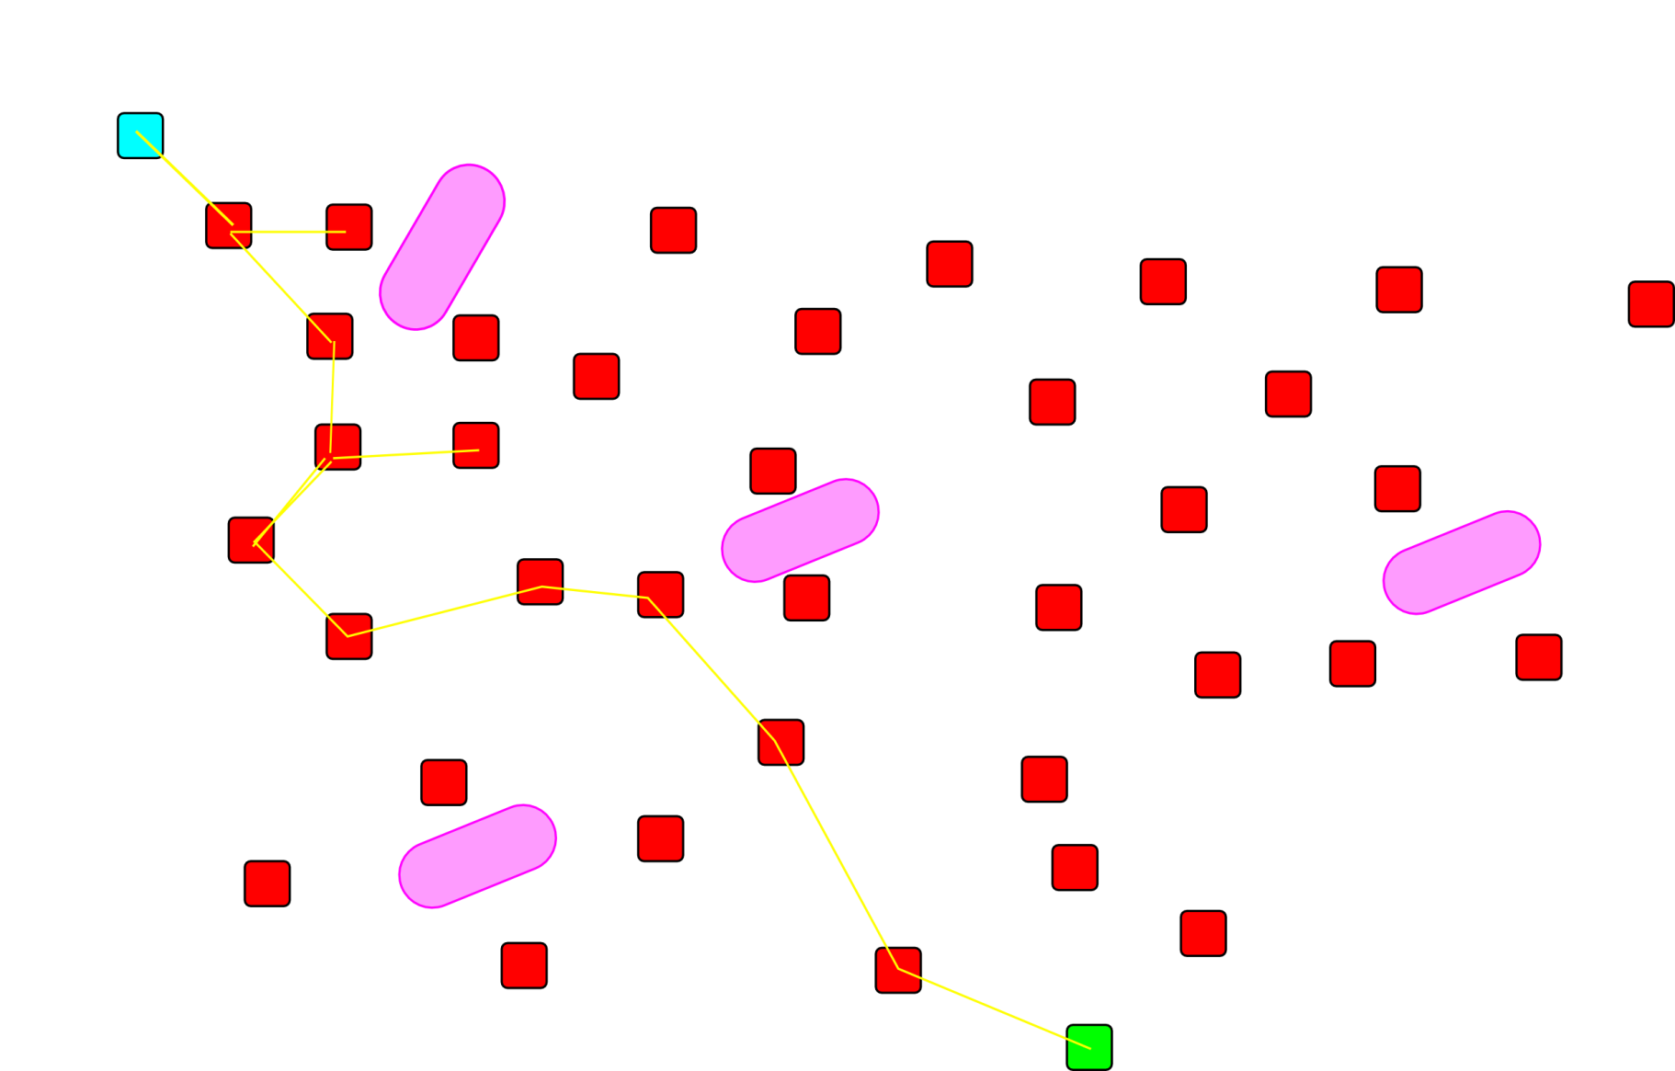
Motion Planner Examples
DFMT*
Notes:
2d cross section of a search space

Slide 40
Motion Planner examples
Potential Field Method
Like gradient decent, but using the superposition of dynamic forces as potential fields
Theoretically applied in continuous and discrete control scenarios
Relies on a vector $λ$ of free parameters to be arbitrarily defined reflecting the impact of the dynamic constraints
Notes:
http://eprints.gla.ac.uk/6/1/McInnes,_C._53__2004.pdf?origin=publication_detail
Continuous and discrete do not mean what they do in simulation. Discrete means boost and coast functions.

Slide 41
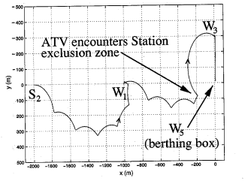
Motion Planner examples
Potential Field Method
Paths computed by potential field
method

Slide 42
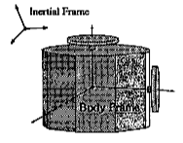
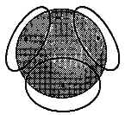
Motion Planner examples
Geometric Reduction Planning
Plans on a reduced constraint set
Adapts computed path to dynamically feasible path
Can be run in real-time
Caveat: Paths computed in reduced set are not always dynamically feasible
Provably sub-optimal
Notes:
“2-shot planner”
Not unlike crowd simulation, run un a reduced complexity system, then adapt to the dynamic system once a path is computed.
We take a complex satellite with reaction wheels for example, and reduce it to a spheroid, so as to simplify our computation. We can then detect and respond to errors caused by the rotational dynamics.

Slide 43
DS motion Planning DEMO
https://www.youtube.com/watch?v=4a3eY5siRRk
11:00 -
Notes:
Exampe of deep space manoever

Slide 44
Rendezvous Demo
https://www.youtube.com/watch?v=2C_GHIHbUyQ
Notes:
Pro transfer orbit

Slide 45
Conclusions
Motion planning for spacecraft uses algorithms and techniques common to many dynamical systems
Straightforward to compute plans, if you can accurately describe the dynamics (which we have a very limited capacity to do)
Few real-time methods exist, but work is continuing in this area by preprocessing
Deep space motion planning is much easier that Planetary Orbital Environment, but only theoretical presently

Slide 46
Future Work
Motion planning for extended constraints
Solar Pressure
Sun exposure optimization
Formation Flying Guidance optimization
Real-time methods
Better dynamics approximation / understanding
Hardware tests of formation control

Slide 47
KSP Demo
Rendezvous and docking in KSP http://youtu.be/aHlSmepxx-o
Notes:
Kerbal Space Program is a popular space sim with linnear affine dynamics and simplified well defined dynamics

Slide 48
KSP Demo
Rondezvous and docking in KSP
http://youtu.be/YXMYzTEH4cQ
Notes:
Kerbal Space Program is a popular space sim with linnear affine dynamics and simplified well defined dynamics

Slide 49
Thank you
Questions?

