Slide 1
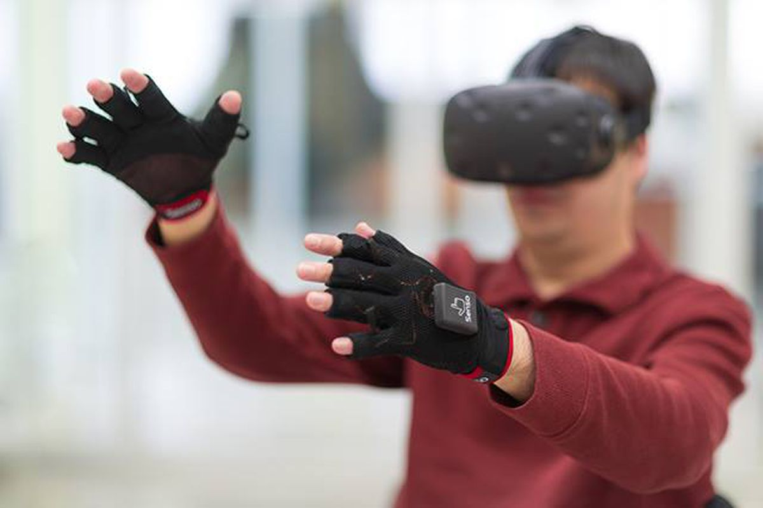
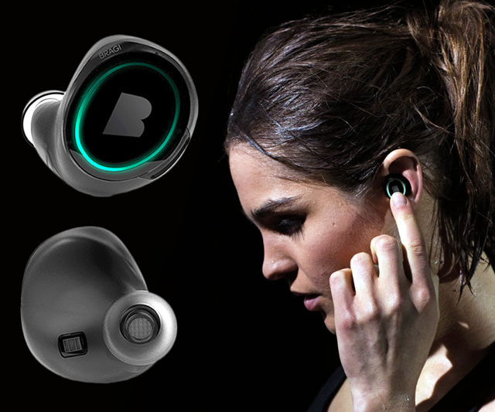
Wireless and Mobile Systems
for the IoT
CMSC 818W : Fall 2020
Lecture 1.3: Mathematical Foundations
for Signal Analysis (Part 2)
Nirupam Roy
M-W 2:00-3:15pm
Online

Slide 2
This Zoom session is being recorded.

Slide 3
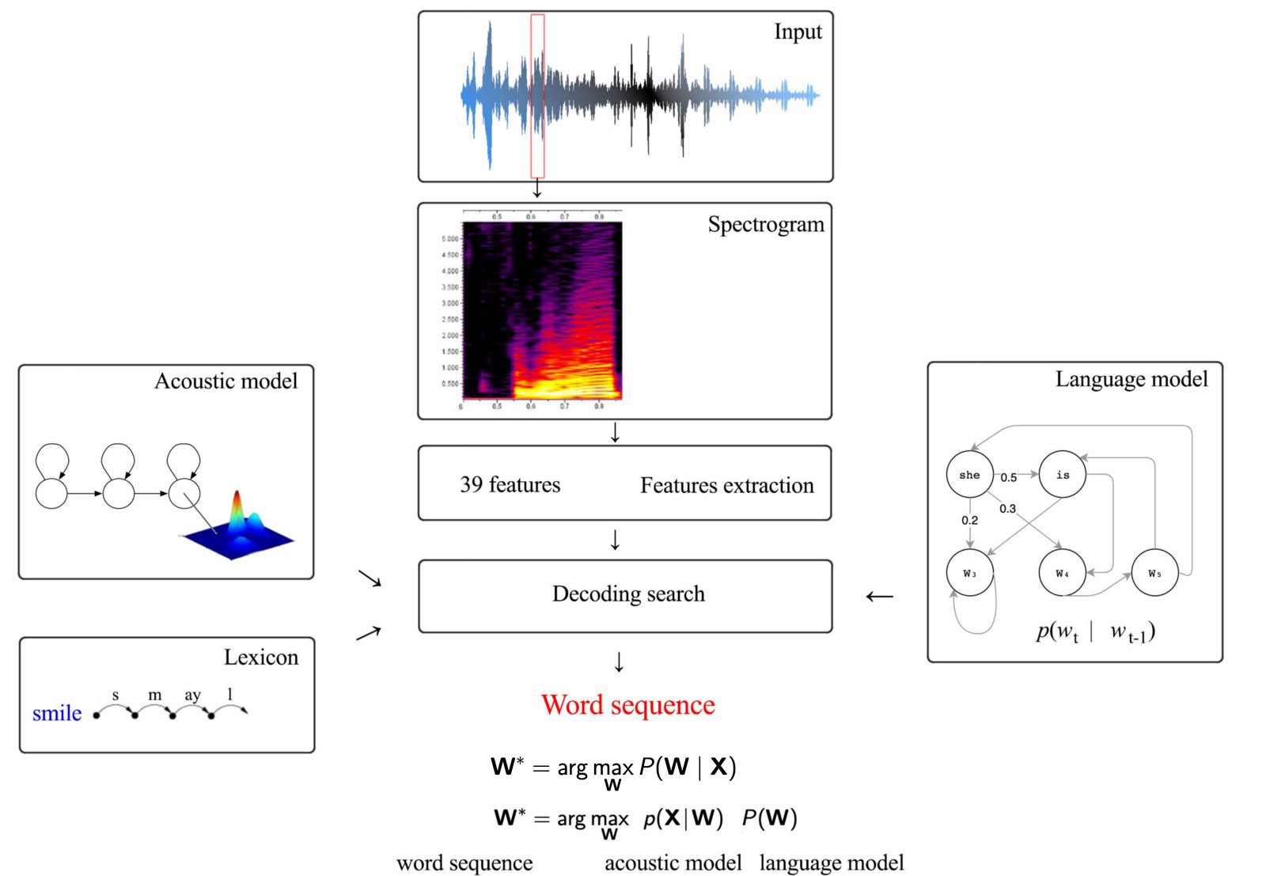
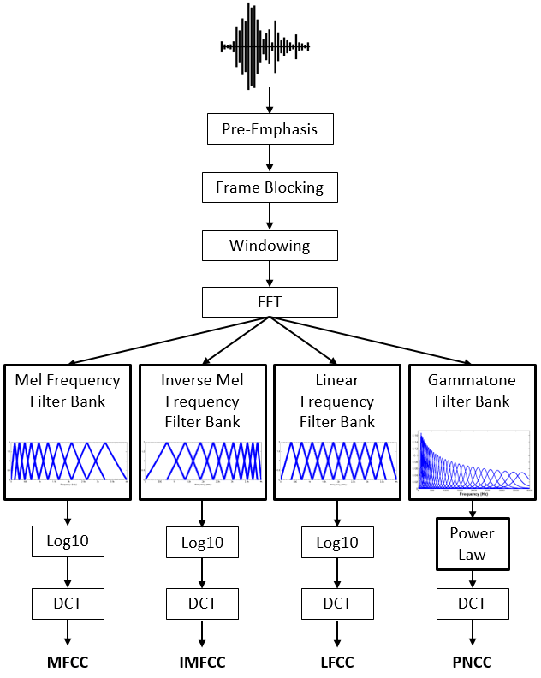
Why learn about Frequency domain?

Slide 4
Why learn about Frequency domain?

Slide 5
Why learn about Frequency domain?

Slide 6
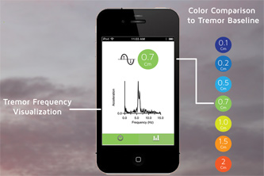
Why learn about Frequency domain?

Slide 7
Time Domain and Frequency Domain
Fourier Transform
$$ej 2π4t$$
FFT
Amplitude
0
2
4
6
8
Frequency (Hz)
Time domain
Frequency domain
FFT = Fast Fourier Transform
IFFT = Inverse Fast Fourier Transform

Slide 8
Time Domain and Frequency Domain
Fourier Transform
FFT
$$\cos\left(2π4t\right)$$
Amplitude
$$ej 2πft$$
$$+$$
$$e_j 2πft$$
$$=$$
2
-6
-4
-2
0
2
4
6
8
Frequency (Hz)
Time domain
Frequency domain
FFT = Fast Fourier Transform
IFFT = Inverse Fast Fourier Transform

Slide 9
Matlab demo
function fft_test()
freq = 200;
sampleRate = 1000;
time_ticks = 0:1/sampleRate:1;
realSignal = sin(2*pi*freq*time_ticks);
plot_fft(realSignal, sampleRate);
complexSignal = exp(j*2*pi*freq*time_ticks);
plot_fft(complexSignal, sampleRate);
end

Slide 10
Calculating
Discrete Fourier Transform (DFT)

Slide 11
Discrete Fourier Transform
…
0
1
2
3
4
5
6
N-1
Sample number
X = [ ]
x[0], x[1], x[2], x[3], x[4], … x[N-1]

Slide 12
Discrete Fourier Transform
…
0
1
2
3
4
5
6
N-1
Sample number
X = [ ]
x[0], x[1], x[2], x[3], x[4], … x[N-1]

Slide 13
Discrete Fourier Transform
…
0
1
2
3
4
5
6
N-1
Sample number
$$e^{j2.\frac{2π}{N}}$$
$$e^{j1.\frac{2π}{N}}$$
$$\frac{2π}{N}$$
$$e^{j0.\frac{2π}{N}}$$
$$e^{j(N−1).\frac{2π}{N}}$$

Slide 14
Discrete Fourier Transform
…
0
1
2
3
4
5
6
N-1
Sample number
= [ ]
Freq f₁
$$e^{j0.\frac{2π}{N}},$$
$e^{j1.\frac{2π}{N}}$,
$$e^{j2.\frac{2π}{N}},$$
…
$${,e}^{j(N−1).\frac{2π}{N}}$$
$$e^{j2.\frac{2π}{N}}$$
$$e^{j1.\frac{2π}{N}}$$
$$\frac{2π}{N}$$
$$e^{j0.\frac{2π}{N}}$$
$$e^{j(N−1).\frac{2π}{N}}$$

Slide 15
Discrete Fourier Transform
…
0
1
2
3
4
5
6
N-1
Sample number
$$e^{j1.\frac{2.2π}{N}}$$
$$\frac{2.2π}{N}$$
$$e^{j0.\frac{2.2π}{N}}$$
$$e^{j(N−1).\frac{2.2π}{N}}$$

Slide 16
Discrete Fourier Transform
…
0
1
2
3
4
5
6
N-1
Sample number
= [ ]
Freq f₂
$$e^{j0.\frac{2.2π}{N}},$$
$e^{j1.\frac{2.2π}{N}}$,
$$e^{j2.\frac{2.2π}{N}},$$
…
$${,e}^{j(N−1).\frac{2.2π}{N}}$$
$$e^{j1.\frac{2.2π}{N}}$$
$$\frac{2.2π}{N}$$
$$e^{j0.\frac{2.2π}{N}}$$
$$e^{j(N−1).\frac{2.2π}{N}}$$

Slide 17
Discrete Fourier Transform
…
0
1
2
3
4
5
6
N-1
Sample number
What is the MINIMUM number of cycles
observable in this model?

Slide 18
Discrete Fourier Transform
…
0
1
2
3
4
5
6
N-1
Sample number
$$0$$

Slide 19
Discrete Fourier Transform
…
0
1
2
3
4
5
6
N-1
Sample number
= [ ]
Freq f₀
$$e^{j0},$$
$e^{j0}$,
$$e^{j0},$$
…
$${,e}^{j0}$$
$$0$$

Slide 20
Discrete Fourier Transform
…
0
1
2
3
4
5
6
N-1
Sample number
= [ ]
Freq f₁
$$e^{j0.\frac{2π}{N}},$$
$e^{j1.\frac{2π}{N}}$,
$$e^{j2.\frac{2π}{N}},$$
…
$${,e}^{j(N−1).\frac{2π}{N}}$$
$$e^{j2.\frac{2π}{N}}$$
$$e^{j1.\frac{2π}{N}}$$
$$\frac{2π}{N}$$
$$e^{j0.\frac{2π}{N}}$$
$$e^{j(N−1).\frac{2π}{N}}$$

Slide 21
Discrete Fourier Transform
…
0
1
2
3
4
5
6
N-1
Sample number
What is the MAXIMUM number of cycles
observable in this model?

Slide 22
Discrete Fourier Transform
…
0
1
2
3
4
5
6
N-1
Sample number
What happens when the ball rotates exactly N times?
$$0$$
We can uniquely observe up to (N-1) number of cycles.

Slide 23
Discrete Fourier Transform
Freq f₀
n=0
$$e^{j0}$$
n=1
$$e^{j0}$$
n=2
$$e^{j0}$$
…
…
n=N-1
$$e^{j0}$$

Slide 24
Discrete Fourier Transform
Number of cycles
…
…
Freq f₀
Freq f₁
Freq f_{m}
Freq f_{N-1}
n=0
$$e^{j0}$$
n=1
$$e^{j0}$$
Sample number
n=2
$$e^{j0}$$
…
…
n=N-1
$$e^{j0}$$

Slide 25
Discrete Fourier Transform
Number of cycles
…
…
Freq f₀
Freq f₁
Freq f_{m}
Freq f_{N-1}
n=0
$$e^{j0}$$
$$e^{j0.\frac{2π}{N}}$$
$$e^{j0.\frac{m.2π}{N}}$$
$$e^{j0.\frac{(N−1).2π}{N}}$$
n=1
$$e^{j0}$$
$$e^{j1.\frac{2π}{N}}$$
$$e^{j1.\frac{m.2π}{N}}$$
$$e^{j1.\frac{(N−1).2π}{N}}$$
Sample number
…
…
$$e^{j2.\frac{(N−1).2π}{N}}$$
$$e^{j2.\frac{2π}{N}}$$
$$e^{j2.\frac{m.2π}{N}}$$
n=2
$$e^{j0}$$
…
…
…
…
…
$$e^{j(N−1).\frac{2π}{N}}$$
$$e^{j(N−1).\frac{m.2π}{N}}$$
$$e^{j(N−1).\frac{(N−1).2π}{N}}$$
n=N-1
$$e^{j0}$$

Slide 26
Discrete Fourier Transform
$$e^{j0}$$
$$e^{j0.\frac{2π}{N}}$$
$$e^{j0.\frac{m.2π}{N}}$$
$$e^{j0.\frac{(N−1).2π}{N}}$$
$$e^{j0}$$
$$e^{j1.\frac{2π}{N}}$$
$$e^{j1.\frac{m.2π}{N}}$$
$$e^{j1.\frac{(N−1).2π}{N}}$$
+
$$e^{j2.\frac{2π}{N}}$$
+
$$e^{j2.\frac{m.2π}{N}}$$
+
$$e^{j2.\frac{(N−1).2π}{N}}$$
Z₀
$$e^{j0}$$
Z₁
…
Z_{m}
…
Z_{N-1}
…
…
…
…
$$e^{j(N−1).\frac{2π}{N}}$$
$$e^{j(N−1).\frac{m.2π}{N}}$$
$$e^{j(N−1).\frac{(N−1).2π}{N}}$$
$$e^{j0}$$

Slide 27
Discrete Fourier Transform
$$e^{j0}$$
$$e^{j0.\frac{2π}{N}}$$
$$e^{j0.\frac{m.2π}{N}}$$
$$e^{j0.\frac{(N−1).2π}{N}}$$
$$e^{j0}$$
$$e^{j1.\frac{2π}{N}}$$
$$e^{j1.\frac{m.2π}{N}}$$
$$e^{j1.\frac{(N−1).2π}{N}}$$
+
$$e^{j2.\frac{2π}{N}}$$
+
$$e^{j2.\frac{m.2π}{N}}$$
+
$$e^{j2.\frac{(N−1).2π}{N}}$$
Z₀
$$e^{j0}$$
Z₁
…
Z_{m}
…
Z_{N-1}
…
…
…
…
$$e^{j(N−1).\frac{2π}{N}}$$
$$e^{j(N−1).\frac{m.2π}{N}}$$
$$e^{j(N−1).\frac{(N−1).2π}{N}}$$
$$e^{j0}$$

Slide 28
Discrete Fourier Transform
$$e^{j0}$$
$$e^{j0.\frac{2π}{N}}$$
$$e^{j0.\frac{m.2π}{N}}$$
$$e^{j0.\frac{(N−1).2π}{N}}$$
$$e^{j0}$$
$$e^{j1.\frac{2π}{N}}$$
$$e^{j1.\frac{m.2π}{N}}$$
$$e^{j1.\frac{(N−1).2π}{N}}$$
+
$$e^{j2.\frac{2π}{N}}$$
+
$$e^{j2.\frac{m.2π}{N}}$$
+
$$e^{j2.\frac{(N−1).2π}{N}}$$
Z₀
$$e^{j0}$$
Z₁
…
Z_{m}
…
Z_{N-1}
…
…
…
…
$$e^{j(N−1).\frac{2π}{N}}$$
$$e^{j(N−1).\frac{m.2π}{N}}$$
$$e^{j(N−1).\frac{(N−1).2π}{N}}$$
$$e^{j0}$$
=
…
0
1
2
3
4
5
6
N-1
Sample number

Slide 29
Discrete Fourier Transform
Frequency domain coefficients
$$e^{j0}$$
$$e^{j0.\frac{2π}{N}}$$
$$e^{j0.\frac{m.2π}{N}}$$
$$e^{j0.\frac{(N−1).2π}{N}}$$
$$e^{j0}$$
$$e^{j1.\frac{2π}{N}}$$
$$e^{j1.\frac{m.2π}{N}}$$
$$e^{j1.\frac{(N−1).2π}{N}}$$
+
$$e^{j2.\frac{2π}{N}}$$
+
$$e^{j2.\frac{m.2π}{N}}$$
+
$$e^{j2.\frac{(N−1).2π}{N}}$$
Z₀
$$e^{j0}$$
Z₁
…
Z_{m}
…
Z_{N-1}
…
…
…
…
$$e^{j(N−1).\frac{2π}{N}}$$
$$e^{j(N−1).\frac{m.2π}{N}}$$
$$e^{j(N−1).\frac{(N−1).2π}{N}}$$
$$e^{j0}$$
x[0]
x[1]
=
X =
x[2]
Time domain samples
…
x[N-1]

Slide 30
Discrete Fourier Transform
_{F}
…
DFT matrix,
=
f₀
f₁
…
f_{m}
f_{N-1}

Slide 31
Discrete Fourier Transform
_{F}
…
DFT matrix,
=
f₀
f₁
…
f_{m}
f_{N-1}
_{Z}
Z₀
Fourier coefficients,
=
Z₁
…
Z_{m}
…
Z_{N-1}

Slide 32
Discrete Fourier Transform
_{F}
…
DFT matrix,
=
f₀
f₁
…
f_{m}
f_{N-1}
_{Z}
Z₀
x[0]
X =
Fourier coefficients,
=
Z₁
Time series,
…
x[1]
Z_{m}
x[2]
…
…
Z_{N-1}
x[N-1]

Slide 33
Discrete Fourier Transform
_{X}
_{F}
_{Z}
=
_{X}
_{Z}
_{F}⁻¹
=
_{H}
_{X}
_{Z}
_{F}
=

Slide 34
Discrete Fourier Transform
_{X}
_{F}
_{Z}
=
_{X}
_{Z}
_{F}⁻¹
=
_{H}
_{X}
_{Z}
_{F}
=
*
f₀
*
f₁
…
*
f_{m}
…
*
f_{N-1}

Slide 35
Discrete Fourier Transform
_{X}
_{F}
_{Z}
=
IDFT
_{X}
_{Z}
_{F}⁻¹
=
DFT
_{H}
_{X}
_{Z}
_{F}
=
*
f₀
x[0]
Z₀
*
Z₁
f₁
x[1]
…
=
…
*
x[2]
Z_{m}
f_{m}
…
…
…
Z_{N-1}
*
x[N-1]
f_{N-1}

Slide 36
Discrete Fourier Transform
$$\sum_{n=0}^{N−1}{x(n)e^{−j\frac{2π}{N}.m.n}}$$
DFT:
z(m) =
$$\sum_{m=0}^{N−1}{z(m)e^{j\frac{2π}{N}.m.n}}$$
IDFT:
x(n) =

Slide 37
Preserving energy in time and frequency domain

Slide 38
Preserving energy in time and frequency domain
Is IDFT( DFT(x) ) = x ?

Slide 39
Preserving energy in time and frequency domain
Is IDFT( DFT(x) ) = x ?
*
_{X ?}
_{X}
_{F F}
=
*
_{N.X}
_{X}
_{F F}
=
_{F}
$$\frac{1}{\sqrt{N}}$$
…
DFT matrix,
=
f₀
f₁
…
f_{m}
f_{N-1}

Slide 40
Discrete Fourier Transform
$$\sum_{n=0}^{N−1}{x(n)e^{−j\frac{2π}{N}.m.n}}$$
z(m) =
$$\frac{1}{\sqrt{N}}$$
DFT:
$$\sum_{m=0}^{N−1}{z(m)e^{j\frac{2π}{N}.m.n}}$$
x(n) =
$$\frac{1}{\sqrt{N}}$$
IDFT:

Slide 41
Plotting
DFT spectrum

Slide 42
Plotting the DFT spectrum
Magnitude
|z_{m}|
m = 0
1
2
3
4
…
Frequency
N-2
N-1

Slide 43
Plotting the DFT spectrum
Magnitude
|z_{m}|
m = 0
1
2
3
4
…
Frequency
N-2
N-1
Phase
⦨ z_{m}
m = 0
1
2
3
4
…
Frequency
N-2
N-1

Slide 44
The Curious Case of “Negative frequency”
$$\frac{(N−1)2π}{N}=2π−\frac{2π}{N}$$
$$\frac{2π}{N}$$
$$\frac{2π}{N}$$
$$\frac{(N−1)2π}{N}=2π−\frac{2π}{N}$$
Positive rotation with $\frac{2π}{N}$ radian angle per step
Negative rotation with $\frac{2π}{N}$ radian angle per step

Slide 45
The Curious Case of “Negative frequency”
m = 0
1
2
3
4
…
Frequency
N-2
N-1
+
+
+
-
-
-

Slide 46
The Curious Case of “Negative frequency”
-4
-3
-2
-1
m = 0
1
2
3
4
Frequency

Slide 47
The Curious Case of “Negative frequency”
Magnitude
|z_{m}|
-4
-3
-2
-1
m = 0
1
2
3
4
Frequency
Real signal’s magnitude spectrum is symmetric.
Why?

Slide 48
The Curious Case of “Negative frequency”
Magnitude
|z_{m}|
-4
-3
-2
-1
m = 0
1
2
3
4
Frequency
Complex signal’s magnitude spectrum may or may not be symmetric.
Why?

Slide 49
Estimating the real-world frequencies
Sampling frequency = f_{s} (i.e., f_{s} samples per second)
Slowest frequency ($\frac{2π}{N}$ radians per step) = N samples per rotation
= (N/ f_{s}) seconds per rotation
Therefore, the slowest frequency = (f_{s} /N) Hz
Higher frequencies are integer multiple of (f_{s} /N) Hz
0, $\frac{\text{f}\text{s}}{N}\text{, }\frac{\text{2}\text{f}\text{s}}{N}$ , $\frac{\text{3}\text{f}\text{s}}{N}$ , $\frac{\text{4}\text{f}\text{s}}{N}$, … , , $\frac{\text{(}\text{N}\text{−1)}\text{f}\text{s}}{N}$

Slide 50
The resolution and the highest frequency
Magnitude/Phase of z_{m}
-4
-3
-2
-1
m = 0
1
2
3
4
Frequency
Resolution
= minimum observable frequency difference =
$\frac{\text{f}\text{s}}{N}$
What if the actual frequency falls in between two frequency bins?

Slide 51
Extras

Slide 52
A quick (and incomplete) review of
Linear Algebra Basics for reference
(Not covered in class)

Slide 53
Properties of a linear function f(x)

Slide 54
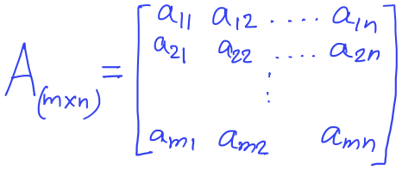
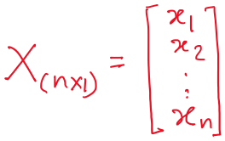
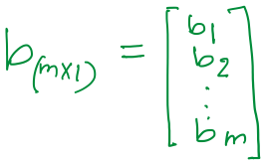
System of linear equation

Slide 55
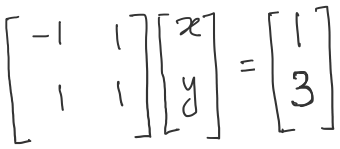
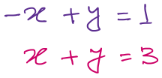
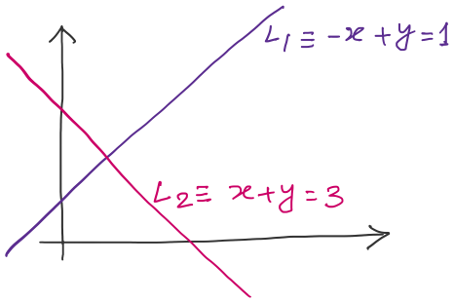
Row view
Solution, x=1, y=2

Slide 56
Column view

Slide 57
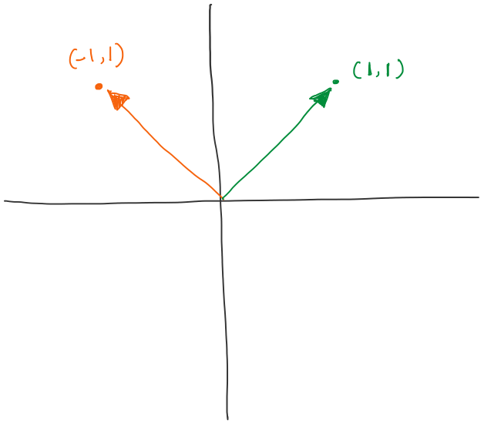
Column view

Slide 58
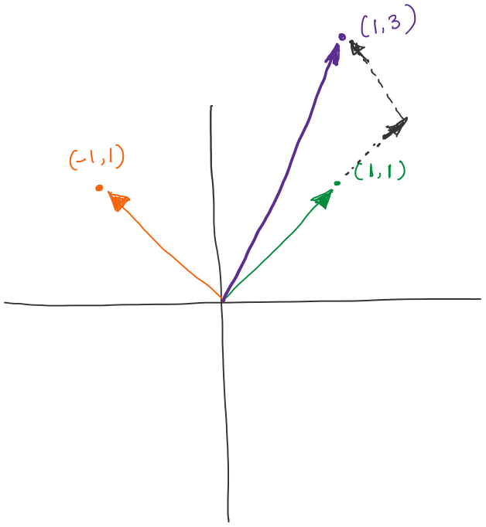
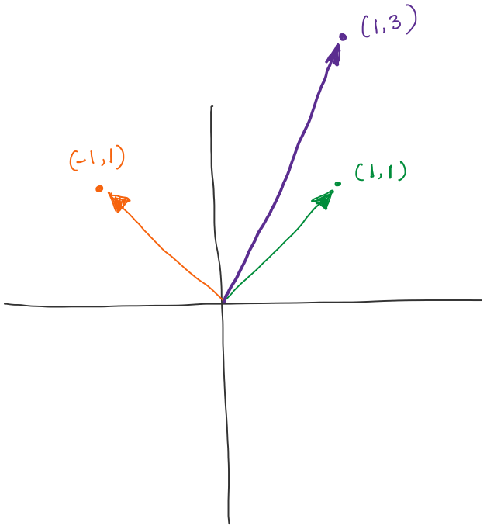
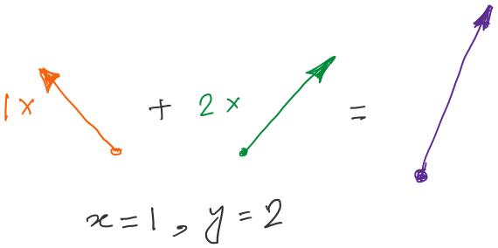
Column view
What is the solution space or the set of all candidate solutions?
Ans: All linear combinations of the columns
of the matrix A_{(m x n)}

Slide 59
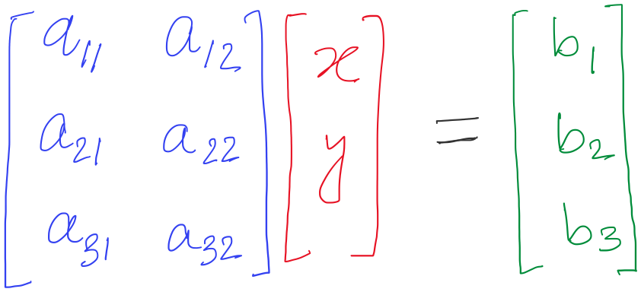
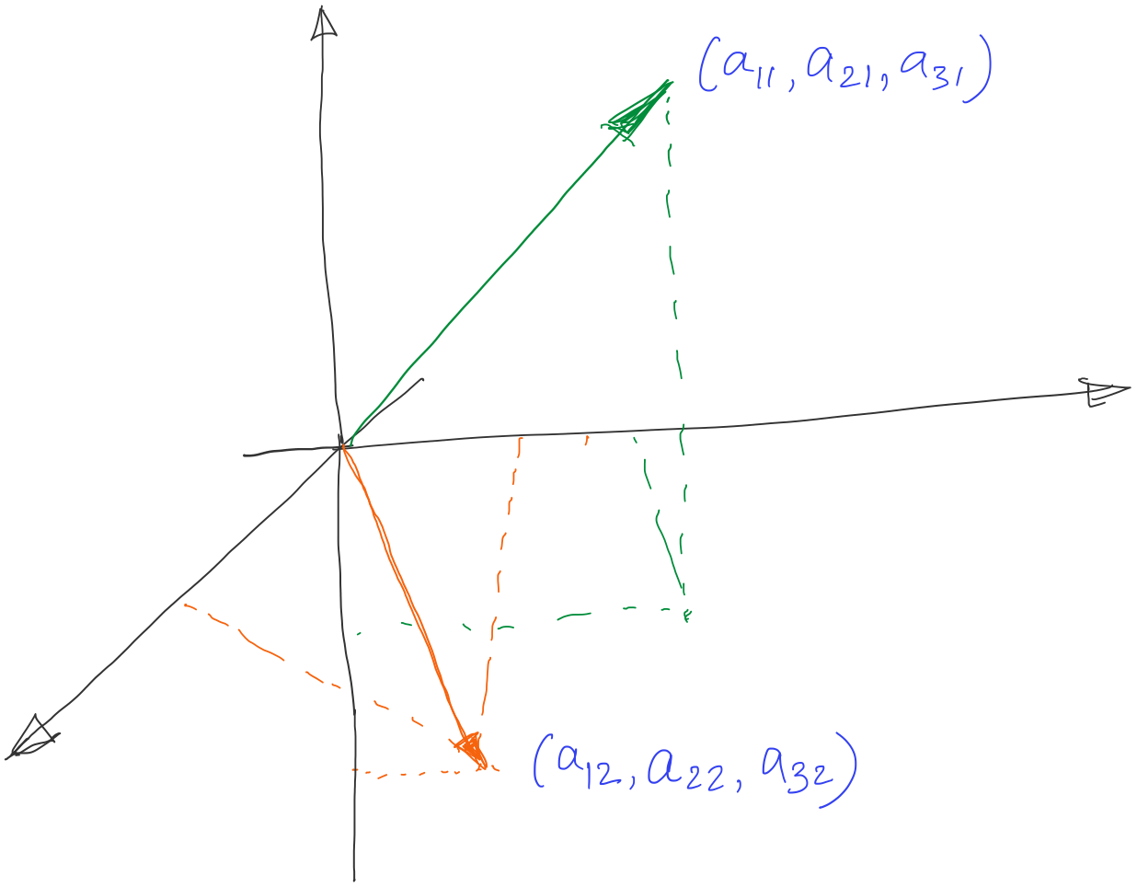
Column space

Slide 60
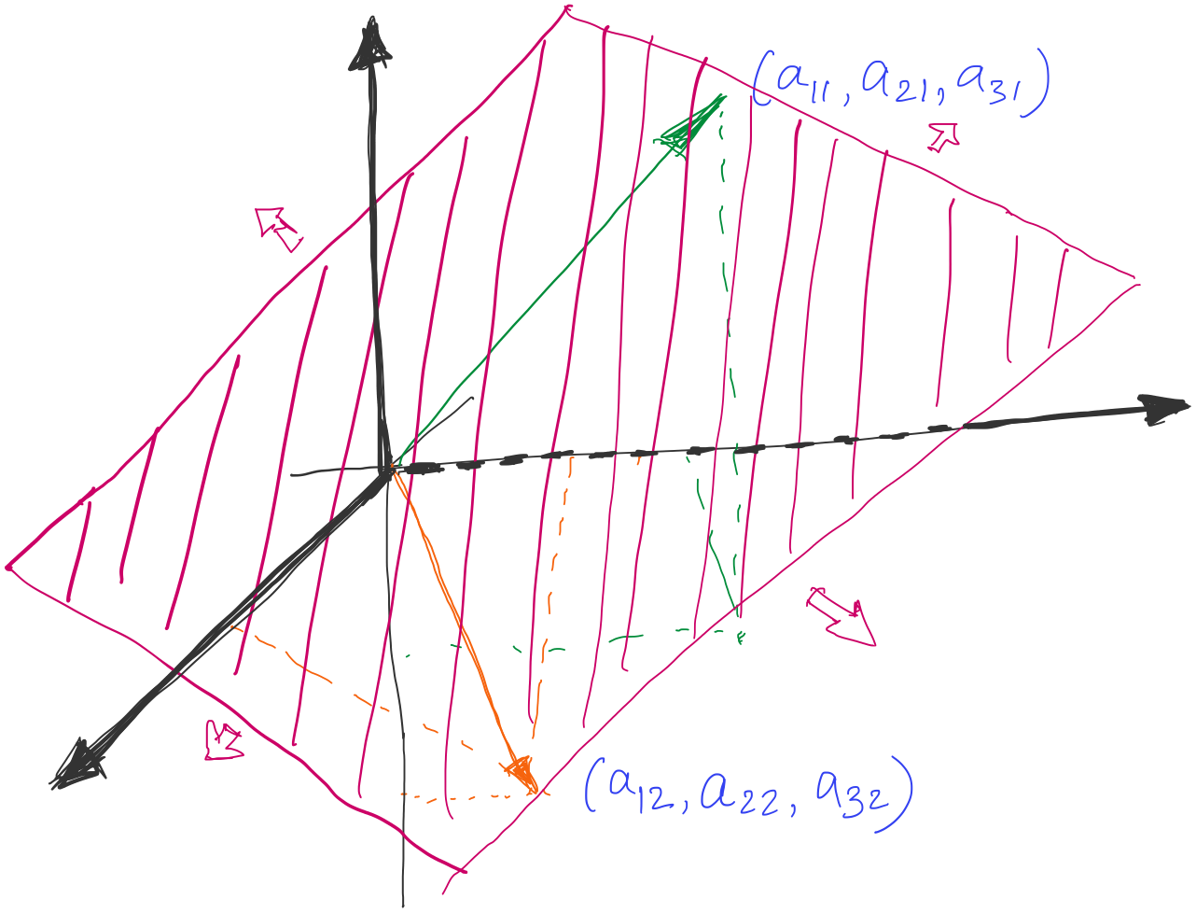
Column space
Solution space, spanned by the columns of the matrix A
( b vector should lie in this space )

Slide 61
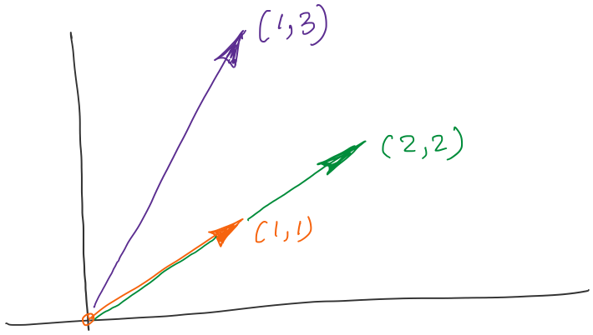
What if the vectors are aligned?
What is column rank of the matrix?
A column is a linear combination of other columns
i.e., the columns are not independent

Slide 62
Approximate solution

Slide 63
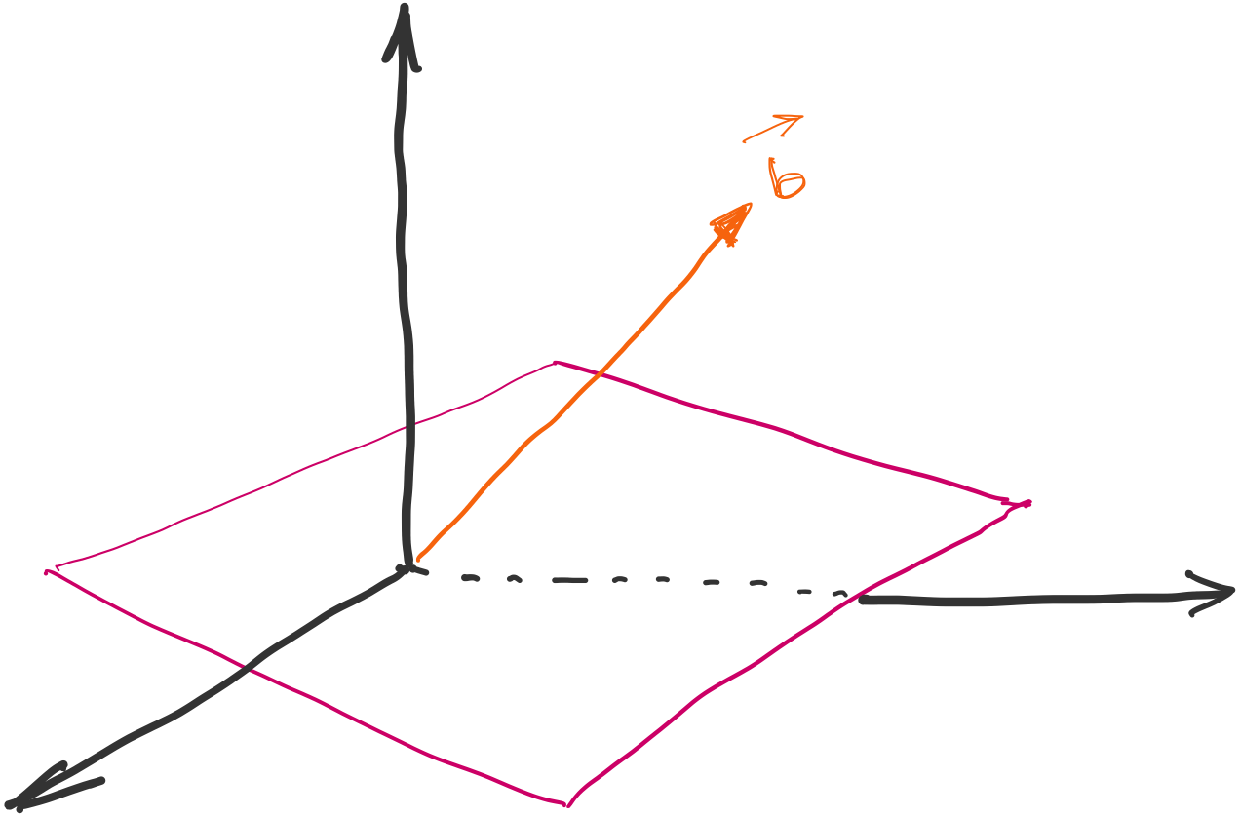
Approximate solution

Slide 64
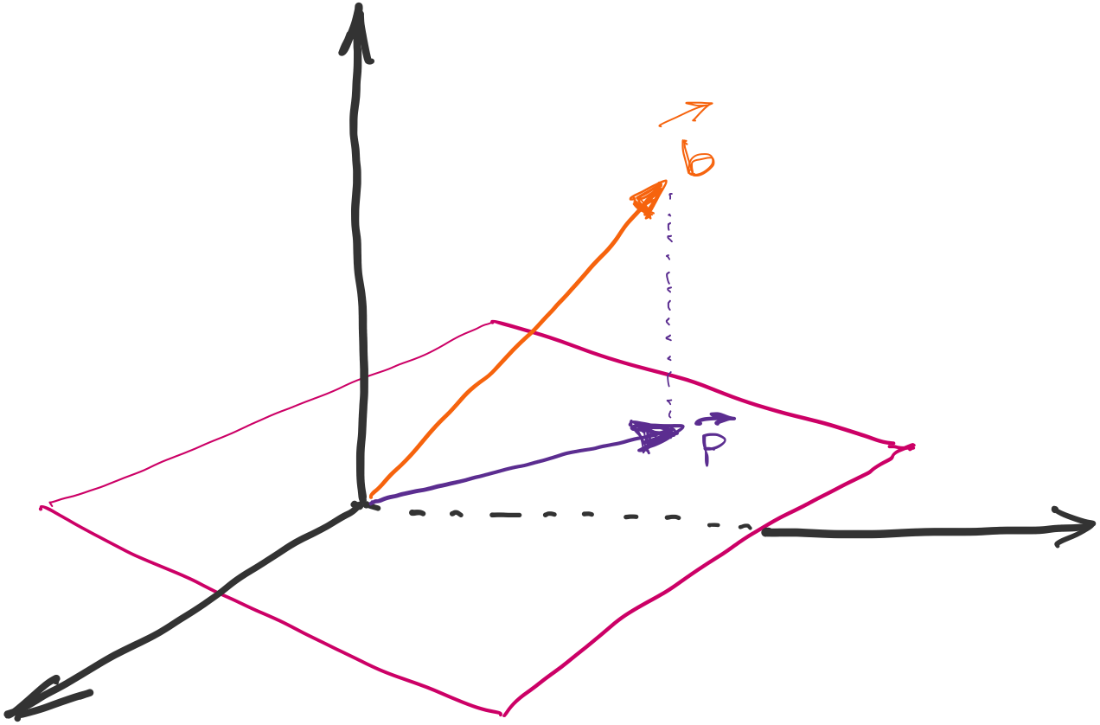
Approximate solution

Slide 65
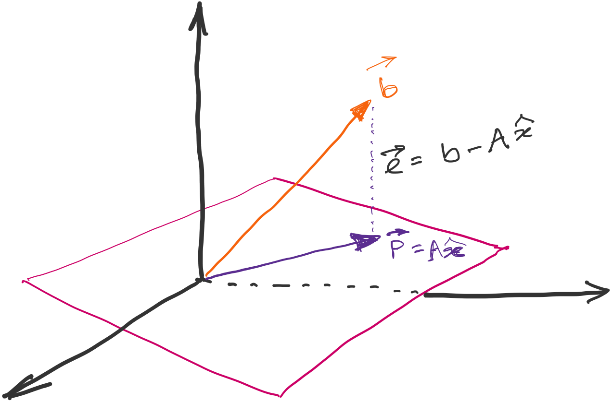
Approximate solution
Error e is orthogonal to the plane for optimal solution
Projection of the vector b on the solution plane
Two vectors a & b are orthogonal when their
dot product (a^{T} b) is zero.

Slide 66
Approximate solution

Slide 67
Approximate solution
Projection matrix

