Slide 1
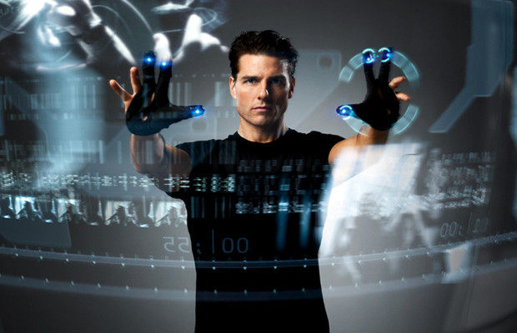

I am a Smartwatch and I can
Track my User’s Arm
CMSC 818W : Fall 2020
Nirupam Roy

Slide 2
Understanding human arm motion
How is the arm moving?
What is the meaning of this motion?

Slide 3
Gesture Recognition
What is the meaning of this motion?

Slide 4
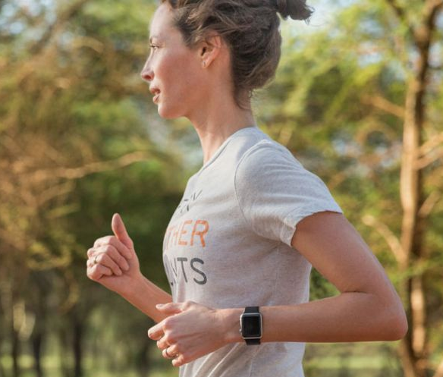


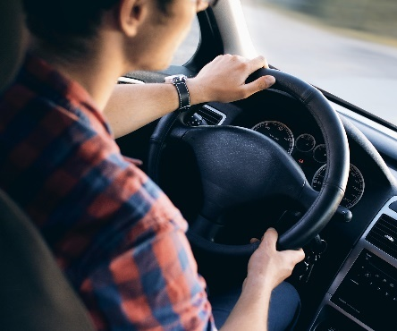
Gesture Recognition
Running
Smoking
Drinking
Driving

Slide 5
Gesture Recognition
Running
Smoking
Drinking
Driving

Slide 6
Posture Tracking
Gesture Recognition
How is the arm moving?
What is the meaning of this motion?

Slide 7
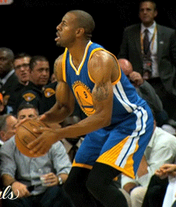
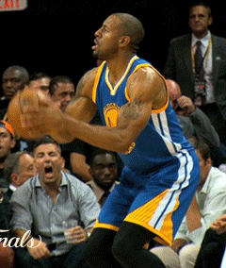
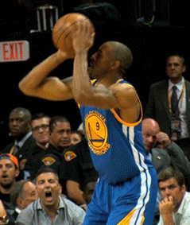
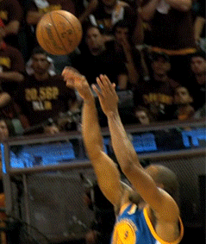
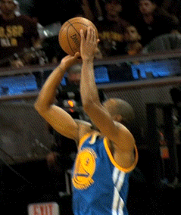
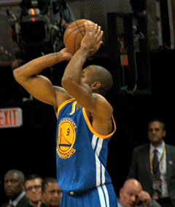

Slide 8
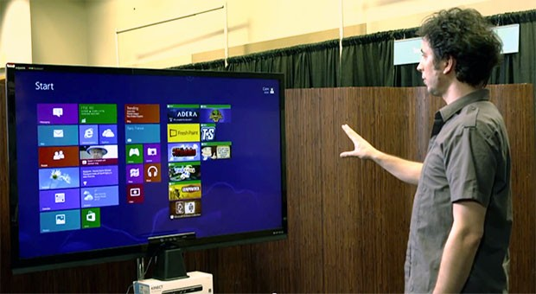
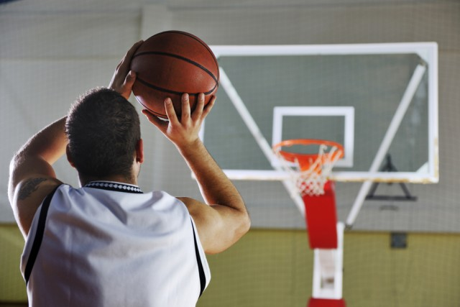
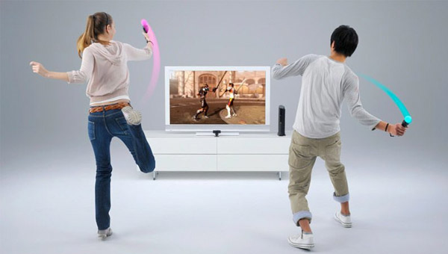

Arm Posture Tracking - Applications
Natural User Interface
Sports Analytics
Can we track arm postures with a smartwatch alone?
Motion Gaming
Healthcare

Slide 9
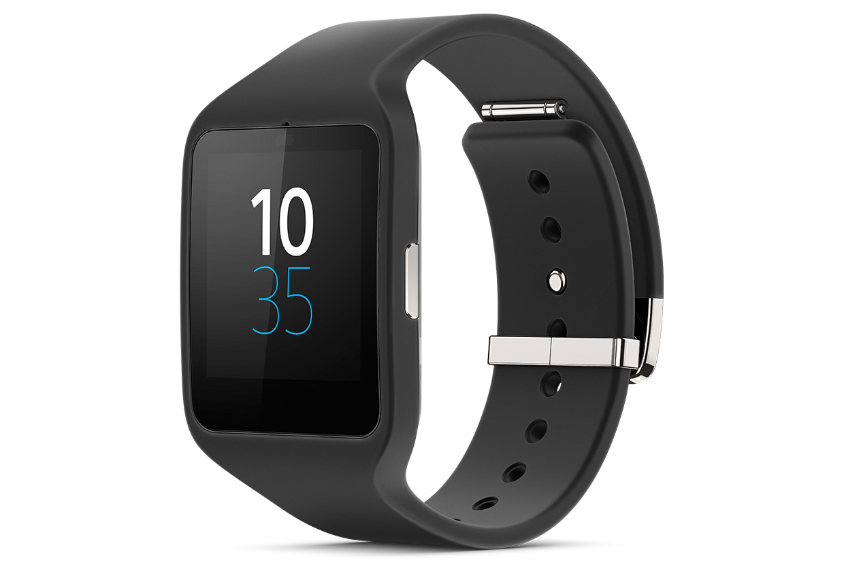
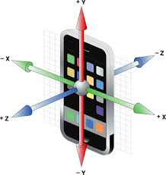
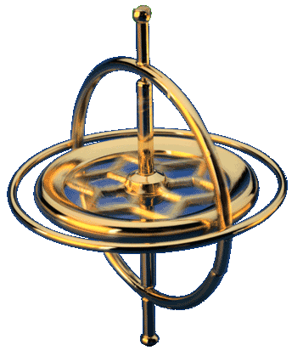
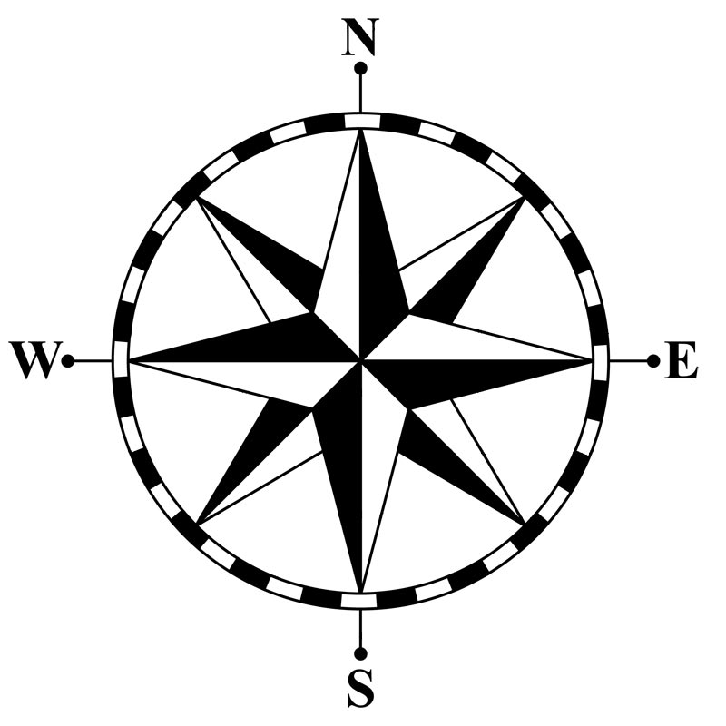
Can we track arm postures with a smartwatch alone?
Y
What is inside a smartwatch?
X
Z
Accelerometer
Gyroscope
Compass
Acceleration along 3 axes
Rotation speed around 3 axes
North vector
projected to 3 axes

Slide 10
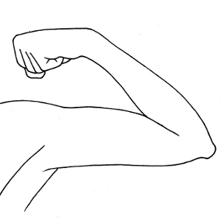
Can we track arm postures with a smartwatch alone?
What do we need to track?
Wrist
Elbow
Shoulder
Posture = < Elbow Location, Wrist Location, Wrist Rotation >

Slide 11
Can we track arm postures with a smartwatch alone?
What do we need to track?
Elbow Location
3D Sphere
(DoF: 2)
Elbow
Shoulder

Slide 12
Can we track arm postures with a smartwatch alone?
What do we need to track?
Elbow Location
Wrist
3D Sphere
(DoF: 2)
Wrist Location
3D Sphere
(DoF: 2)
Shoulder

Slide 13
Can we track arm postures with a smartwatch alone?
What do we need to track?
Elbow Location
Wrist
3D Sphere
(DoF: 2)
Wrist Location
Elbow
3D Sphere
(DoF: 2)
Shoulder
Wrist Rotation
1D Angle
(DoF: 1)

Slide 14

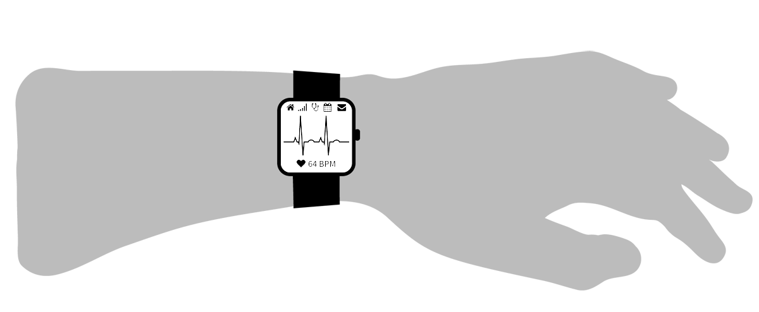

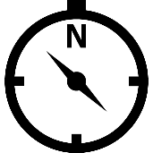
Can we track arm postures with a smartwatch alone?
Smartwatch = < Accelerometer, Gyroscope, Compass>
Accelerometer
Gyroscope
Compass
Wrist
?
Elbow
Shoulder
Posture = < Elbow Location, Wrist Location, Wrist Rotation >

Slide 15
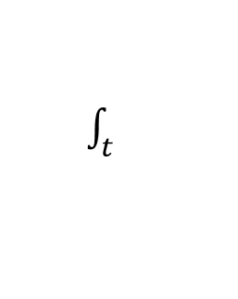
Experiment 1: Double Integration (Dead Reckoning)
Step 1
$\int_{t}^{ }{ }$
Gyroscope
sensor fusion
Wrist Orientation
+
Accelerometer
Compass
Z
Y
Yaw
X
Roll
Pitch

Slide 16
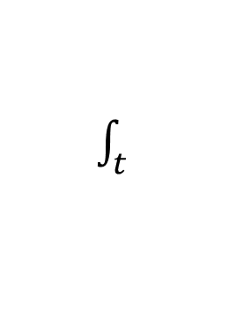
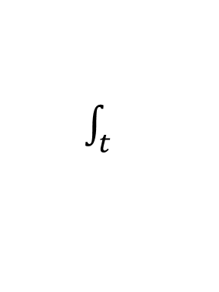
Experiment: Double Integration (Dead Reckoning)
Step 1
$\int_{t}^{ }{ }$
Gyroscope
sensor fusion
Wrist Orientation
+
Accelerometer
Compass
Step 2
$\int_{t}^{ }{ }$
Wrist Location
Velocity
Wrist Orientation
$\int_{t}^{ }{ }$
Gravity Removal
Projection
Global Acceleration
Linear Acceleration
Accelerometer

Slide 17
Experiment: Double Integration (Dead Reckoning)
Wrist Orientation
Wrist Location
Wrist orientation error is okay…
Wrist location error goes unbounded!
Double integration won’t work in unconstrained space

Slide 18


Experiment: State Estimation
Posture space is indeed constrained
Posture = < Elbow Location, Wrist Location, Wrist Rotation >
DoF: 5 = 2 + 2 + 1
Why not estimate 5 unknowns directly?
Posture
Compass
$$\frac{d}{dt} (\text{Posture})$$
Gyroscope
$$\frac{d^{2}}{{dt}^{2}} \left(\text{Posture}\right)$$
Accelerometer
Dimension: 5+5+5=15
The search space is too large for efficient state estimation
Need to find a way to reduce search space!

Slide 19
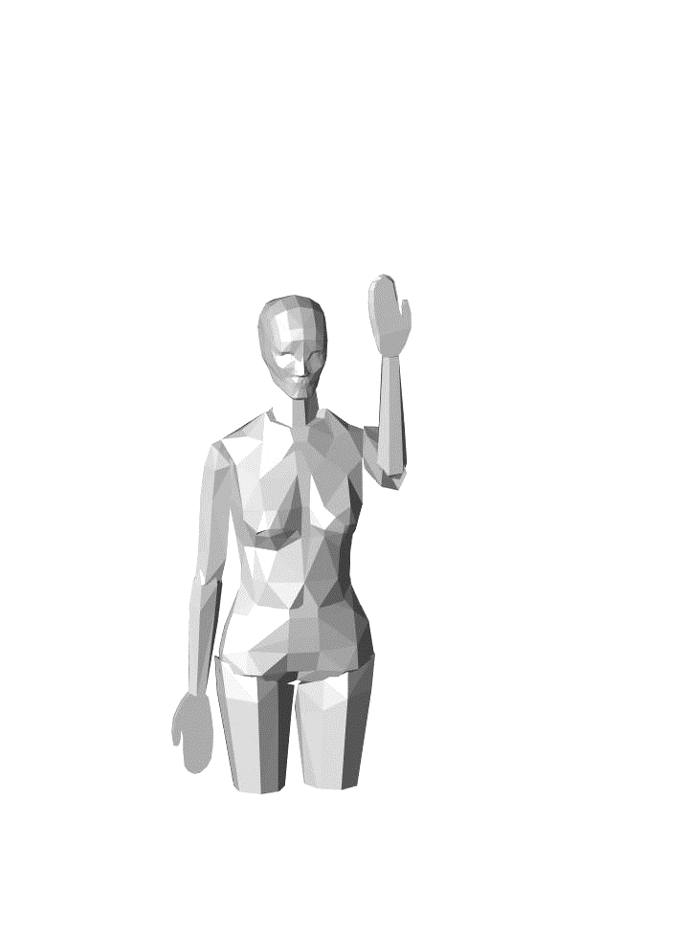
What happens if wrist orientation is fixed…
Forearm pointing upward
Palm facing towards yourself

Slide 20
What happens if wrist orientation is fixed…
Elbow
Forearm pointing upward
Palm facing towards yourself
Elbow Point Cloud:
A subset of elbow sphere

Slide 21
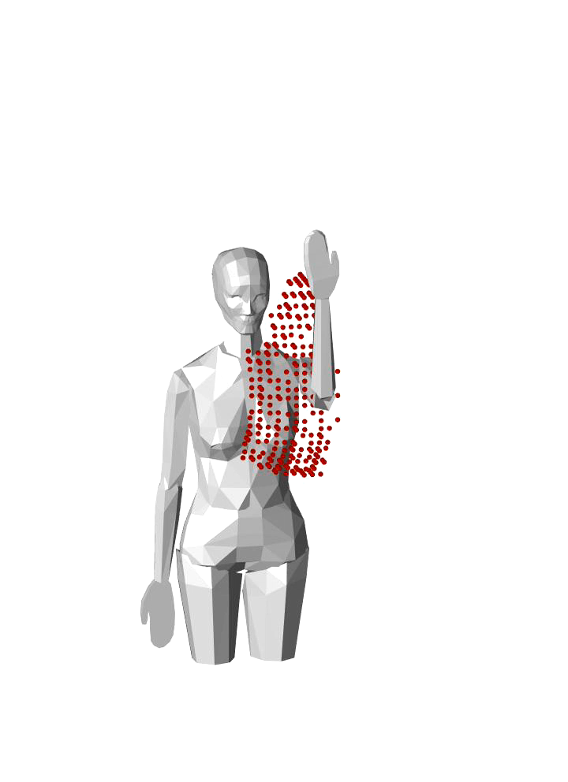
What happens if wrist orientation is fixed…
Elbow
Wrist
Forearm pointing upward
Palm facing towards yourself
Elbow Point Cloud:
A subset of elbow sphere
Wrist Point Cloud:
A shift of elbow point cloud, along forearm direction

Slide 22
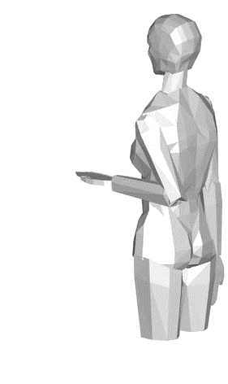
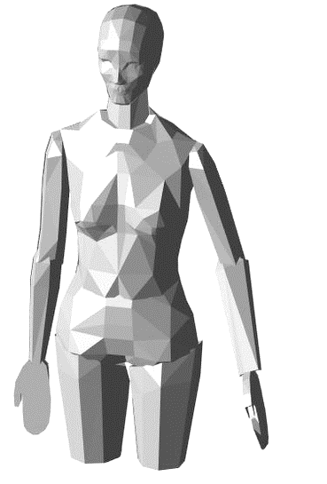
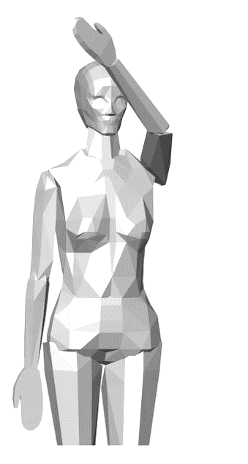
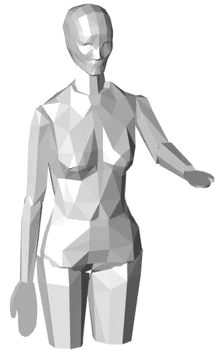
What happens if wrist orientation is fixed…
Elbow
Wrist

Slide 23
What happens if wrist orientation is fixed…
Elbow
Wrist
For a fixed wrist orientation, arm posture space is small!
This is promising, as we already estimate wrist orientation reasonably well…
But how can we derive this point cloud for each wrist orientation?

Slide 24
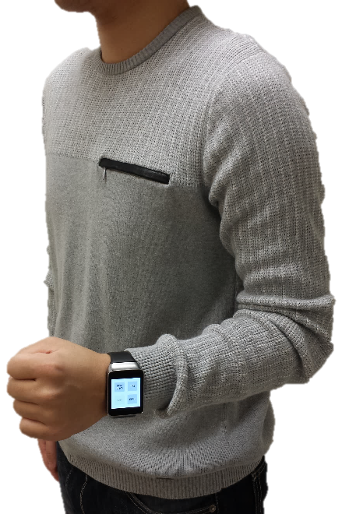




Human Arm Model
Shoulder: $θ_{1},θ_{2},θ_{3}$
$$θ_{3}:\text{[−30° \sim 120°]}$$
$θ_{2}$: [-40° ~ 120°]
$θ_{1}$: [-60° ~ 180°]

Slide 25



Human Arm Model
Shoulder: $θ_{1},θ_{2},θ_{3}$
Elbow: $θ_{4},θ_{5}$
$$θ_{3}:\text{[−30° \sim 120°]}$$
$θ_{2}$: [-40° ~ 120°]
$θ_{1}$: [-60° ~ 180°]
$θ_{5}$: [0° ~ 180°]
$θ_{4}$: [0° ~ 150°]

Slide 26



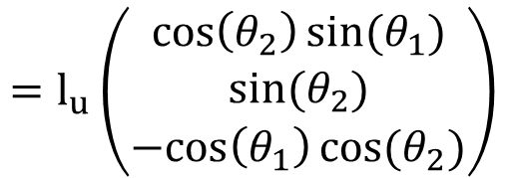





Human Arm Model
Shoulder: $θ_{1},θ_{2},θ_{3}$
Elbow: $θ_{4},θ_{5}$
$$θ_{3}$$
Elbow Location $=f\left(θ_{1},θ_{2}\right)$
$$=l_{u}\left(\begin{matrix}\cos\left(θ_{2}\right)sin(θ_{1}) \\ sin(θ_{2}) \\ −cos\left(θ_{1}\right)cos(θ_{2})\end{matrix}\right)$$
$$θ_{2}$$
$$θ_{1}$$
Wrist Location $=g\left(θ_{1},θ_{2},θ_{3},θ_{4}\right)$
$$θ_{5}$$
$$θ_{4}$$
Wrist Orientation $=h\left(θ_{1},θ_{2},θ_{3},θ_{4},θ_{5}\right)$

Slide 27
Human Arm Model
Shoulder: $θ_{1},θ_{2},θ_{3}$
Elbow: $θ_{4},θ_{5}$
Elbow Location $=f\left(θ_{1},θ_{2}\right)$
$$=l_{u}\left(\begin{matrix}\cos\left(θ_{2}\right)sin(θ_{1}) \\ sin(θ_{2}) \\ −cos\left(θ_{1}\right)cos(θ_{2})\end{matrix}\right)$$
Wrist Location $=g\left(θ_{1},θ_{2},θ_{3},θ_{4}\right)$
Wrist Orientation $=h\left(θ_{1},θ_{2},θ_{3},θ_{4},θ_{5}\right)$
1-N Mapping for each orientation

Slide 28



Orientation – Location Mapping
1-N Mapping for each orientation
Wrist Orientation
Elbow Location
Wrist Location
$$h\left(θ_{1},θ_{2},θ_{3},θ_{4},θ_{5}\right)$$
$$f\left(θ_{1},θ_{2}\right)$$
$$g\left(θ_{1},θ_{2},θ_{3},θ_{4}\right)$$

Slide 29
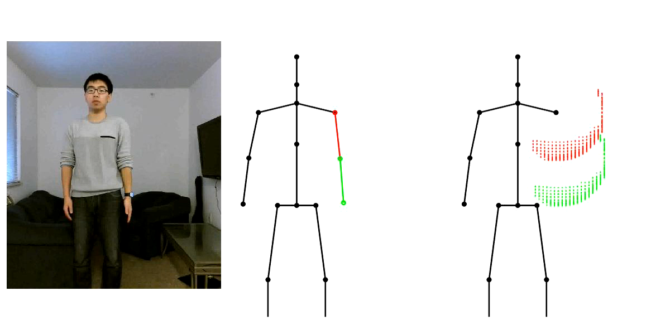
Video: Point Cloud Tracking
RGB Video
Kinect Groundtruth
Elbow/Wrist Point Clouds

Slide 30
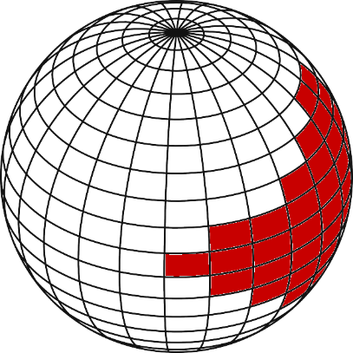
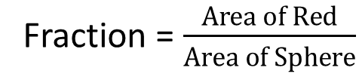
How large are the point clouds?
Fraction = $\frac{Area of Red}{Area of Sphere}$
Median: 8.3%

Slide 31
How large are the point clouds?
Since they are small, what if we simply take an average?
Median Error:
(12.0cm, 13.3cm)

Slide 32

How large are the point clouds?
Since they are small, what if we simply take an average?
What happens if wrist orientation doesn’t change?

Slide 33
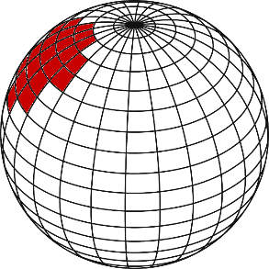
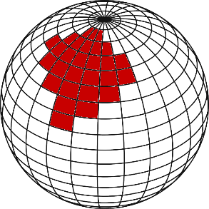
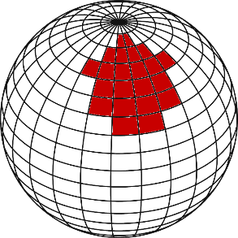
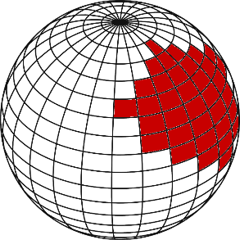

Elbow Location Inferencing
Possible Elbow Locations
t

Slide 34





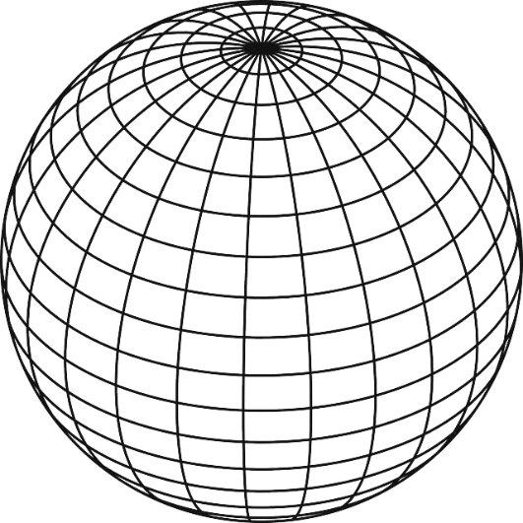
Elbow Location Inferencing
Possible Elbow Locations
t

Slide 35
Elbow Location Inferencing
Possible Elbow Locations
t
Forearm Rotation
Wrist-to-Elbow Acceleration
Elbow Acceleration
Wrist Orientation
Projection
Wrist Acceleration
Gravity Removal
Accelerometer

Slide 36
Elbow Location Inferencing
Possible Elbow Locations
t
Elbow Acceleration
Acceleration
Velocity
Location
State 1

Slide 37
Elbow Location Inferencing
Possible Elbow Locations
t
Elbow Acceleration
Acceleration
Velocity
Location
State 2

Slide 38
Elbow Location Inferencing
Possible Elbow Locations
t
Transition 1→2
Elbow Acceleration
Acceleration
Velocity
Location
HMM & Viterbi gives optimal solution!

Slide 39
Evaluation
Elbow: 12.0cm → 7.9cm
Wrist: 13.3cm → 9.2cm
Median Error:
(7.9cm, 9.2cm)

Slide 40
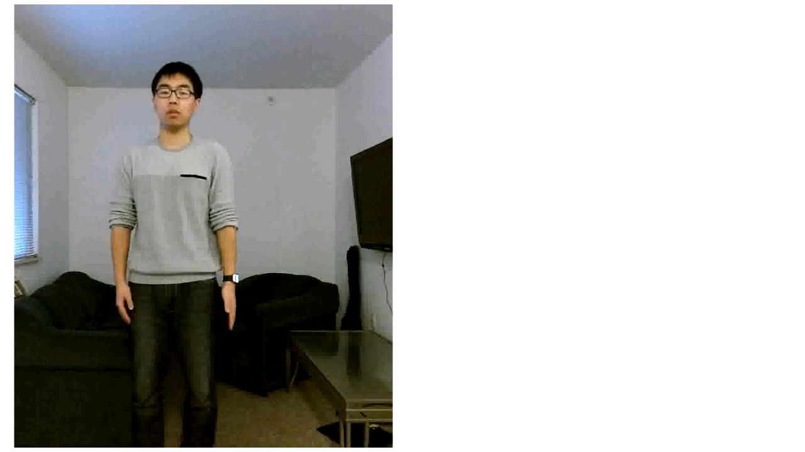
Video: Write in the Air

Slide 41
Limitation
Facing direction
- Need to express arm posture in torso coordinate
system
Tracking on the move
- Body motion will pollute accelerometer signal
Speed
- Need improvement

Slide 42
Conclusion
Tracking arm postures using motion sensors on a smartwatch alone
Fusing observations from human kinematics and IMU sensors into a HMM
<7.9cm, 9.2cm> tracking error for <elbow, wrist>

