Slide 1
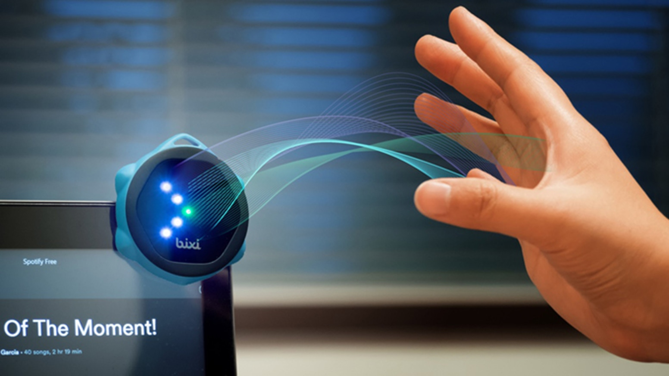
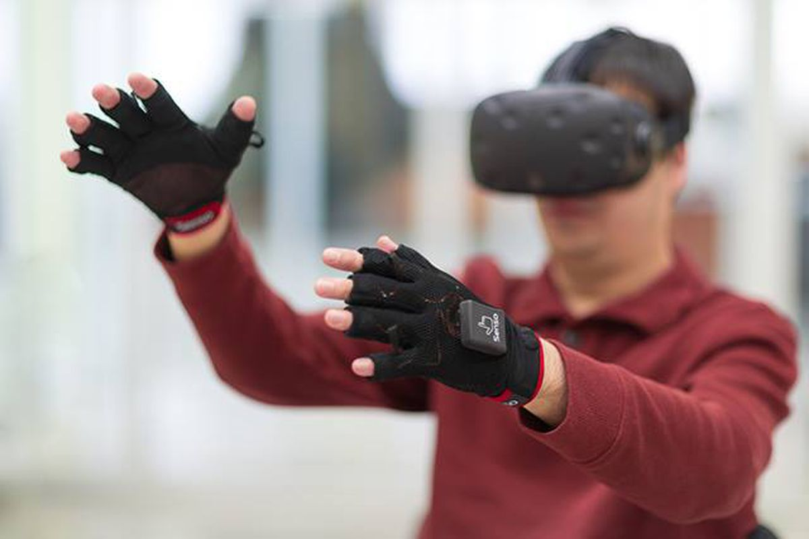
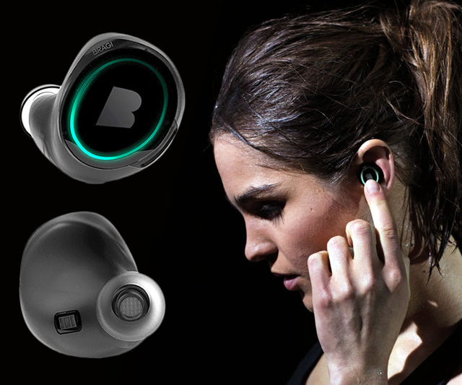
Wireless and Mobile Systems
for the IoT
CMSC 818W : Fall 2020
Lecture 4.1:
Indoor Localization - I
Nirupam Roy
M-W 2:00-3:15pm
Online
This zoom session is being recorded.

Slide 2
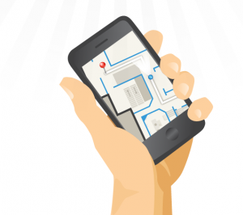
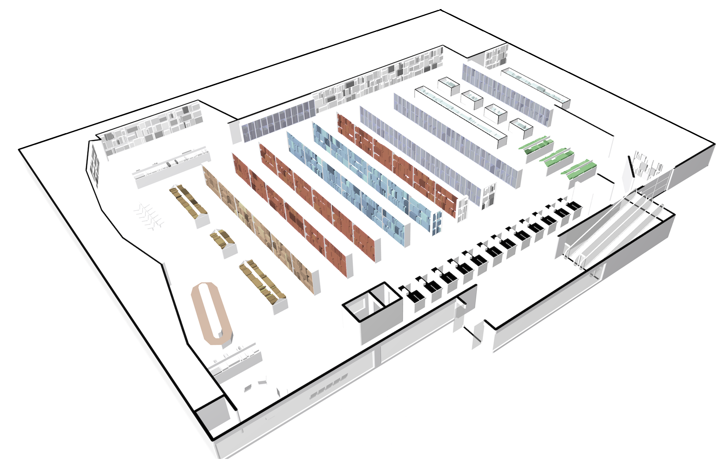
Where am I in a hotel, mall, office, cruise ship?
Notes:
One natural is why not just use outdoor localization technology. GPS is extremely successful for outdoor localization. However, when a user is at lower part of the building, GPS signal is not strong enough to penetrate all the way. Even at some places GPS signal can be sensed, since the signal bounces too much, indoor GPS localization is very difficult.

Slide 3
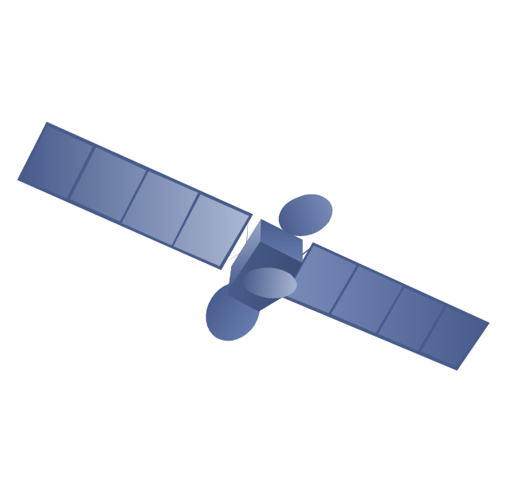
GPS
GPS satellite
Why not outdoor localization technology?
Notes:
One natural is why not just use outdoor localization technology. GPS is extremely successful for outdoor localization.
Signals are not strong enough, even some of them come up, they bounce around a lot. Therefore, it does not indoors.
However, when a user is at lower part of the building, GPS signal is not strong enough to penetrate all the way. Even at some places GPS signal can be sensed, since the signal bounces too much, indoor GPS localization is very difficult.

Slide 4
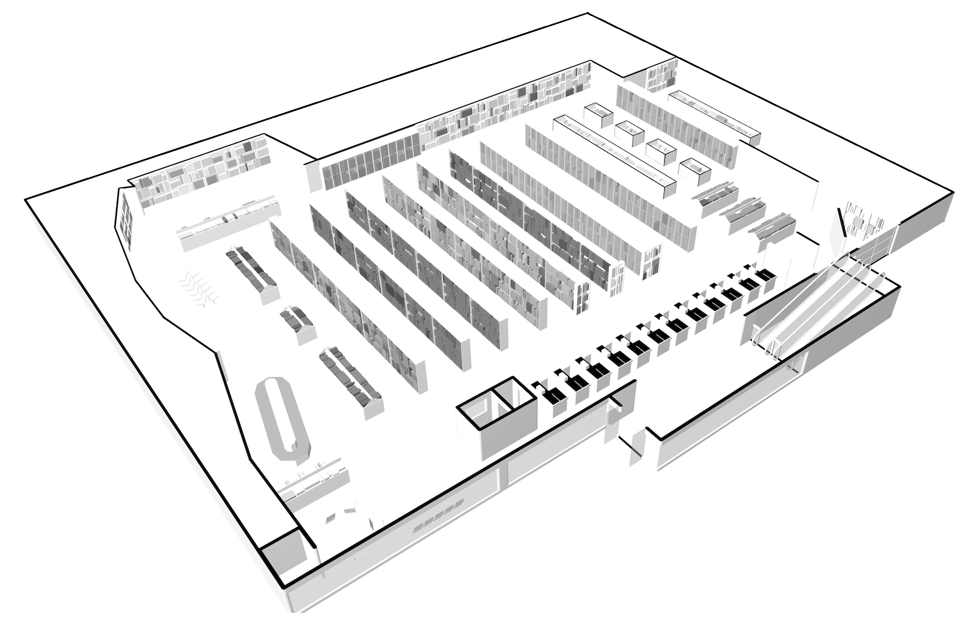
Fingerprint
Notes:
Researchers in our comm have done indoor localization research for years. Using Wi-Fi signal is a popular a approach since Wi-Fi access points are readily available in many indoor environments. The most popular Wi-Fi localization method is to make use of Wi-Fi signal strength empirically. The idea was the following. Let’s assume there are several Aps in the environment. Now, A user’s smartphone can run a WiFi scan and get signal strength of each AP. When the user walks, the received signal strengths by the phone change. Therefore, signal strengths can be used to infer the user’s location. However, to make this happen, someone has to go to every place and record location and signal strengths mapping. That takes a lot of effort. Even worse, the mapping changes overtime and has to be refreshed to ensure good localization performance. periodic calibration.
Wi-Fi is not the only approach that has been considered. People have also looked at [click]

Slide 5
Fingerprint
Unique features of signals
Notes:
Researchers in our comm have done indoor localization research for years. Using Wi-Fi signal is a popular a approach since Wi-Fi access points are readily available in many indoor environments. The most popular Wi-Fi localization method is to make use of Wi-Fi signal strength empirically. The idea was the following. Let’s assume there are several Aps in the environment. Now, A user’s smartphone can run a WiFi scan and get signal strength of each AP. When the user walks, the received signal strengths by the phone change. Therefore, signal strengths can be used to infer the user’s location. However, to make this happen, someone has to go to every place and record location and signal strengths mapping. That takes a lot of effort. Even worse, the mapping changes overtime and has to be refreshed to ensure good localization performance. periodic calibration.
Wi-Fi is not the only approach that has been considered. People have also looked at [click]

Slide 6
Fingerprint
Unique features of signals
Unique fluctuation of the magnetic field
Notes:
Researchers in our comm have done indoor localization research for years. Using Wi-Fi signal is a popular a approach since Wi-Fi access points are readily available in many indoor environments. The most popular Wi-Fi localization method is to make use of Wi-Fi signal strength empirically. The idea was the following. Let’s assume there are several Aps in the environment. Now, A user’s smartphone can run a WiFi scan and get signal strength of each AP. When the user walks, the received signal strengths by the phone change. Therefore, signal strengths can be used to infer the user’s location. However, to make this happen, someone has to go to every place and record location and signal strengths mapping. That takes a lot of effort. Even worse, the mapping changes overtime and has to be refreshed to ensure good localization performance. periodic calibration.
Wi-Fi is not the only approach that has been considered. People have also looked at [click]

Slide 7
(1) Fingerprinting-based Indoor Localization
Notes:
Researchers in our comm have done indoor localization research for years. Using Wi-Fi signal is a popular a approach since Wi-Fi access points are readily available in many indoor environments. The most popular Wi-Fi localization method is to make use of Wi-Fi signal strength empirically. The idea was the following. Let’s assume there are several Aps in the environment. Now, A user’s smartphone can run a WiFi scan and get signal strength of each AP. When the user walks, the received signal strengths by the phone change. Therefore, signal strengths can be used to infer the user’s location. However, to make this happen, someone has to go to every place and record location and signal strengths mapping. That takes a lot of effort. Even worse, the mapping changes overtime and has to be refreshed to ensure good localization performance. periodic calibration.
Wi-Fi is not the only approach that has been considered. People have also looked at [click]

Slide 8
Indoor Location Sensing Using Geo-Magnetism
Jaewoo Chung et al, MIT Media Lab
MobiSys 2011
Notes:
Researchers in our comm have done indoor localization research for years. Using Wi-Fi signal is a popular a approach since Wi-Fi access points are readily available in many indoor environments. The most popular Wi-Fi localization method is to make use of Wi-Fi signal strength empirically. The idea was the following. Let’s assume there are several Aps in the environment. Now, A user’s smartphone can run a WiFi scan and get signal strength of each AP. When the user walks, the received signal strengths by the phone change. Therefore, signal strengths can be used to infer the user’s location. However, to make this happen, someone has to go to every place and record location and signal strengths mapping. That takes a lot of effort. Even worse, the mapping changes overtime and has to be refreshed to ensure good localization performance. periodic calibration.
Wi-Fi is not the only approach that has been considered. People have also looked at [click]

Slide 9
Indoor Location Sensing Using Geo-Magnetism

Slide 10
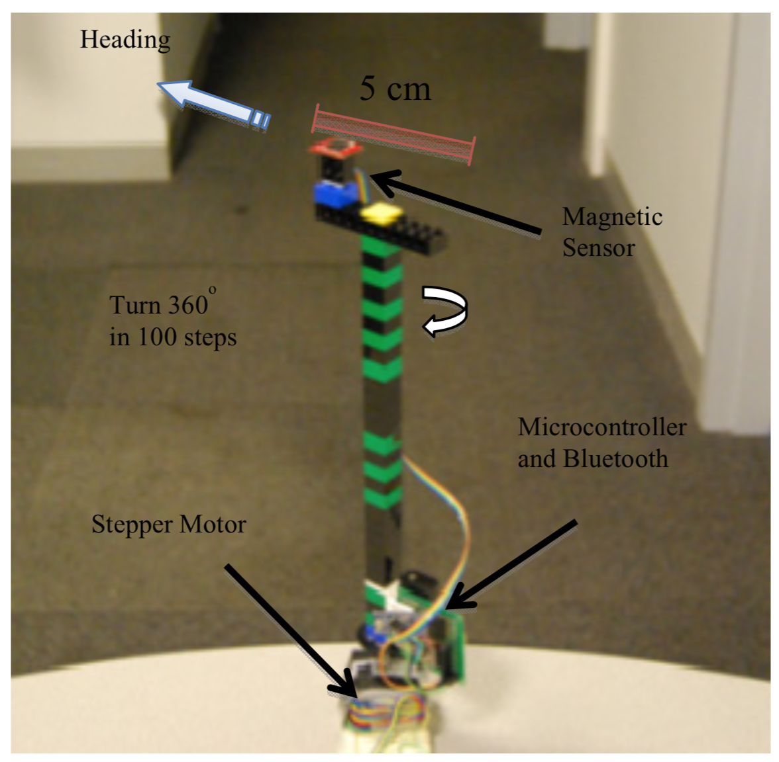
Indoor Location Sensing Using Geo-Magnetism
The client device for detecting magnetic signatures

Slide 11
Indoor Location Sensing Using Geo-Magnetism
Database: <mag_x_i, mag_y_i, mag_z_i, Location_i>
Observation: <mag_x, mag_y, mag_z>
Find the ‘i’ (or a sequence) for which RMS difference between the observation and the stored magnetic value is minimum.

Slide 12
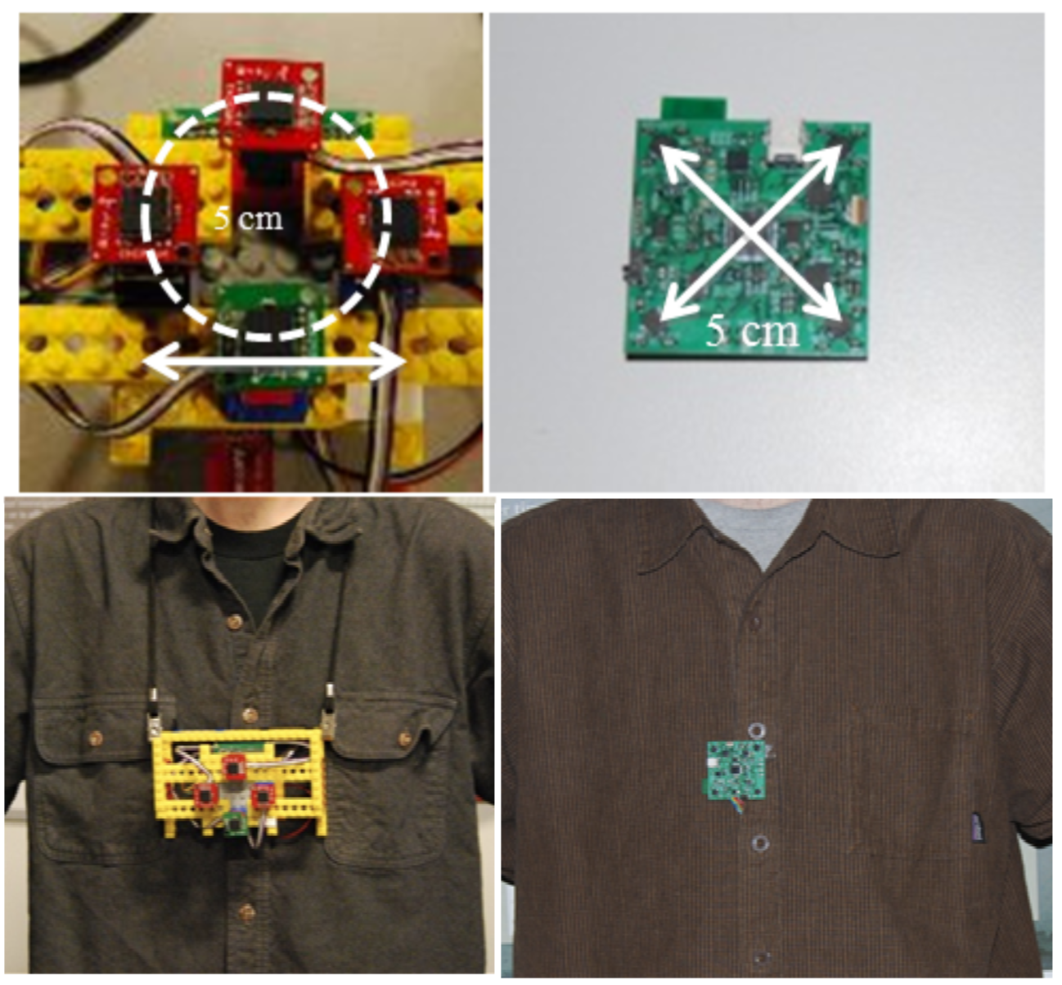
Indoor Location Sensing Using Geo-Magnetism
Wearable device for detecting fingerprints

Slide 13
Fingerprint
Unique features of signals
Notes:
Researchers in our comm have done indoor localization research for years. Using Wi-Fi signal is a popular a approach since Wi-Fi access points are readily available in many indoor environments. The most popular Wi-Fi localization method is to make use of Wi-Fi signal strength empirically. The idea was the following. Let’s assume there are several Aps in the environment. Now, A user’s smartphone can run a WiFi scan and get signal strength of each AP. When the user walks, the received signal strengths by the phone change. Therefore, signal strengths can be used to infer the user’s location. However, to make this happen, someone has to go to every place and record location and signal strengths mapping. That takes a lot of effort. Even worse, the mapping changes overtime and has to be refreshed to ensure good localization performance. periodic calibration.
Wi-Fi is not the only approach that has been considered. People have also looked at [click]

Slide 14
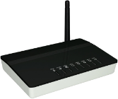
Fingerprint
AP 3
Unique features of signals
AP 2
AP 4
AP 1
Notes:
Researchers in our comm have done indoor localization research for years. Using Wi-Fi signal is a popular a approach since Wi-Fi access points are readily available in many indoor environments. The most popular Wi-Fi localization method is to make use of Wi-Fi signal strength empirically. The idea was the following. Let’s assume there are several Aps in the environment. Now, A user’s smartphone can run a WiFi scan and get signal strength of each AP. When the user walks, the received signal strengths by the phone change. Therefore, signal strengths can be used to infer the user’s location. However, to make this happen, someone has to go to every place and record location and signal strengths mapping. That takes a lot of effort. Even worse, the mapping changes overtime and has to be refreshed to ensure good localization performance. periodic calibration.
Wi-Fi is not the only approach that has been considered. People have also looked at [click]

Slide 15
Wi-Fi
(x1,y1)
(x2,y2)
(x3,y3)
AP 1: -65
AP 2: -50
AP 3: -80
AP 4: -85
AP 1: -60
AP 2: -62
AP 3: -55
AP 4: -50
AP 1: -90
AP 2: -90
AP 3: -53
AP 4: -50
AP 3
AP 1: -90
AP 2: -90
AP 3: -53
AP 4: -50
AP 1: -65
AP 2: -50
AP 3: -80
AP 4: -85
AP 1: -60
AP 2: -62
AP 3: -55
AP 4: -50
AP 2
AP 4
AP 1
Periodic calibration needed
Notes:
Researchers in our comm have done indoor localization research for years. Using Wi-Fi signal is a popular a approach since Wi-Fi access points are readily available in many indoor environments. The most popular Wi-Fi localization method is to make use of Wi-Fi signal strength empirically. The idea was the following. Let’s assume there are several Aps in the environment. Now, A user’s smartphone can run a WiFi scan and get signal strength of each AP. When the user walks, the received signal strengths by the phone change. Therefore, signal strengths can be used to infer the user’s location. However, to make this happen, someone has to go to every place and record location and signal strengths mapping. That takes a lot of effort. Even worse, the mapping changes overtime and has to be refreshed to ensure good localization performance. periodic calibration.
Wi-Fi is not the only approach that has been considered. People have also looked at [click]

Slide 16
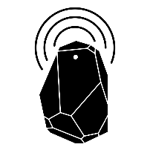
Beacon
sound beacon
Bluetooth beacon
listener
Installation and maintenance costs
Notes:
Other approaches
Another approach is deploying beacons. For example, sound beacons and Bluetooth beacons.
In sound beacons case, the system estimated the distances by looking at the signal propagation time and by getting these estimates from different beacons, people find it is possible to localize where the user is.
In blt beacon cases, when a user pass by the blt beacons, the smartphone can sense the signal and figure out where the user is.
Continuous localization will need large amount of beacon deployment.
Use ble as seed landmark and remove it.
The problem with Bluetooth is that if you want blue only solution, it is good to localize you to very short distance, that is the very reason why you need a lot of them. Anything that you can blank it. It is good because you need only one for the whole building, but you don’t know where you are in the building. Trade-off between granarity in terms of localization and deployment cost.
How to guarantee landmarks? I can create landmarks, If not, add beacons, magnetics or just boxes that people cannot go that way. Locations are automatically learnt.
Later, put an umbrella and say we use wifi, but not war-driving, we use ble if necessary, but a small number.

Slide 17
We do not want to rely on infrastructure
We want a scalable software solution
Notes:
If you want to do this. What is the first thing we need? The first thing we need is to figure out what is a landmark. In some sense, we are going to call a particular unique pattern in sensor data a landmark.
How can we figure the pattern? We don’t want to predefine the patterns.
We want our system to work in a shopping mall in Africa. We don’t know what is in that shopping mall. The shopping mall may not have a water fountain. So we cannot ask the phone to look for a particular signature in the shopping mall, because that signature may not exist. What we really want is as people walk in the shopping mall, they should automatically figure out what are the landmarks in that shopping mall. That is very important.
The first question we ask is “how to automatically detect sensor landmarks”

Slide 18
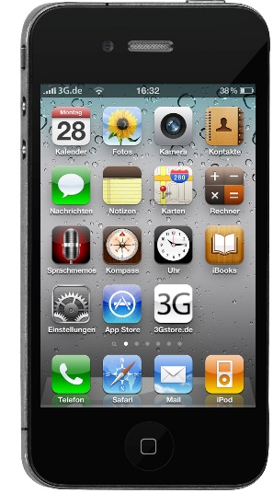
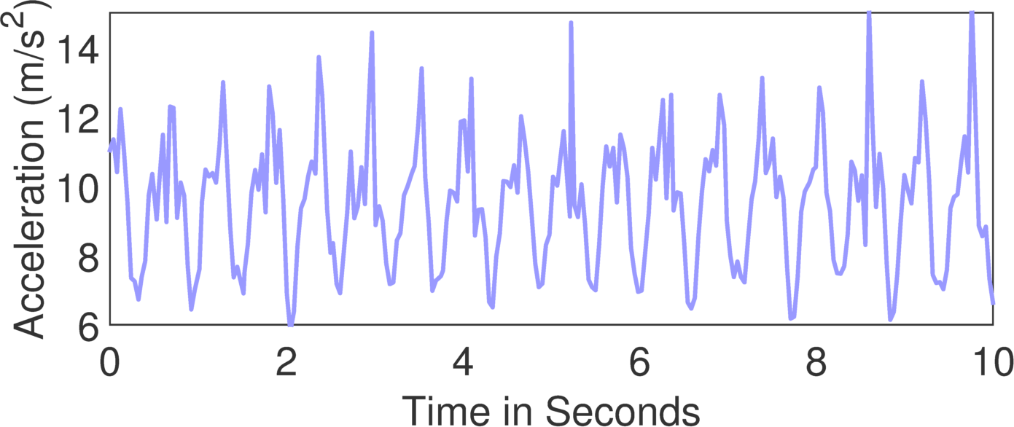
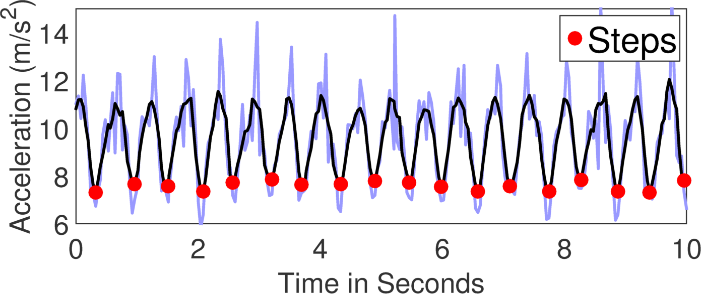
Infrastructure-less Localization
accelerometer
compass
gyroscope
Notes:
We started thinking can we just do localization without relying on any infrasture. That might be possible because around 2007, these phone started coming in. These phones have a rich set of sensors. If you can utility the sensors to understand these mobility patterns of the humans. We don’t need to rely on other infrastures telling us where we are. We are self suffiecent and we can figure it out.
When we started the project, we thought this should be doable. The accelerometer data bounces and gives me the number of steps that the user has walked. Done. If you know the step length, which does not vary too much, we can compute the distance. Done. Given that the compass data tells you where you are walking. I can take and compass and I can out all these together and I should be able to get the user’s actual path. We tried this and this turned out to be the estimated path. And we go back and look into literature, it turns out these algorithms are called dead reckoning and they are very difficult.
---------------------------------------
//In all these existing body of work, people were trying to use signals from external infrastructures.
%At around 2007, accelerometer, compass and gyroscope, these motion sensors, started get integrated into %smartphones. people started thinking can these embedded sensors be used for localization as apposed to relying %these surrounding infrastructures.
Around 2007, acc, compass, gyroscope, these motion sensors started coming onto smartphones, then people start thinking hey, can we use these sensors to actually localize the user as opposed to using all these wireless and acoustic signals from the infrastructures. The idea was to use the phone sensors themselves to figure out where the user is. And the key idea was the following.
So, when a user walks, because the phone actually bounces during walking, the accelerometer data from the phone turns out like this. If you look at this data, you should be able to count the number of steps that the user has walked. Now, let’s say, you know the user’s step length, you could multiply the step length with the number of steps. That should tell you the user’s walking distance. That is not hard to do, if you apply simple filtering techniques. Of course, distance is not enough, you also need to know the direction in which the user is walking, otherwise you won’t be able to track the user. then the compass of the phone gives you a reasonable estimate of direction, so if you now combine distance and direction together, you should be able to track this path in which the user has walked.

Slide 19
(2) Pedestrian Dead Reckoning-based
Indoor Localization
Ref: Improved Pedestrian Dead Reckoning Based on a Robust Adaptive Kalman Filter for Indoor
Inertial Location System. Qigao Fan et.al.
Notes:
Researchers in our comm have done indoor localization research for years. Using Wi-Fi signal is a popular a approach since Wi-Fi access points are readily available in many indoor environments. The most popular Wi-Fi localization method is to make use of Wi-Fi signal strength empirically. The idea was the following. Let’s assume there are several Aps in the environment. Now, A user’s smartphone can run a WiFi scan and get signal strength of each AP. When the user walks, the received signal strengths by the phone change. Therefore, signal strengths can be used to infer the user’s location. However, to make this happen, someone has to go to every place and record location and signal strengths mapping. That takes a lot of effort. Even worse, the mapping changes overtime and has to be refreshed to ensure good localization performance. periodic calibration.
Wi-Fi is not the only approach that has been considered. People have also looked at [click]

Slide 20
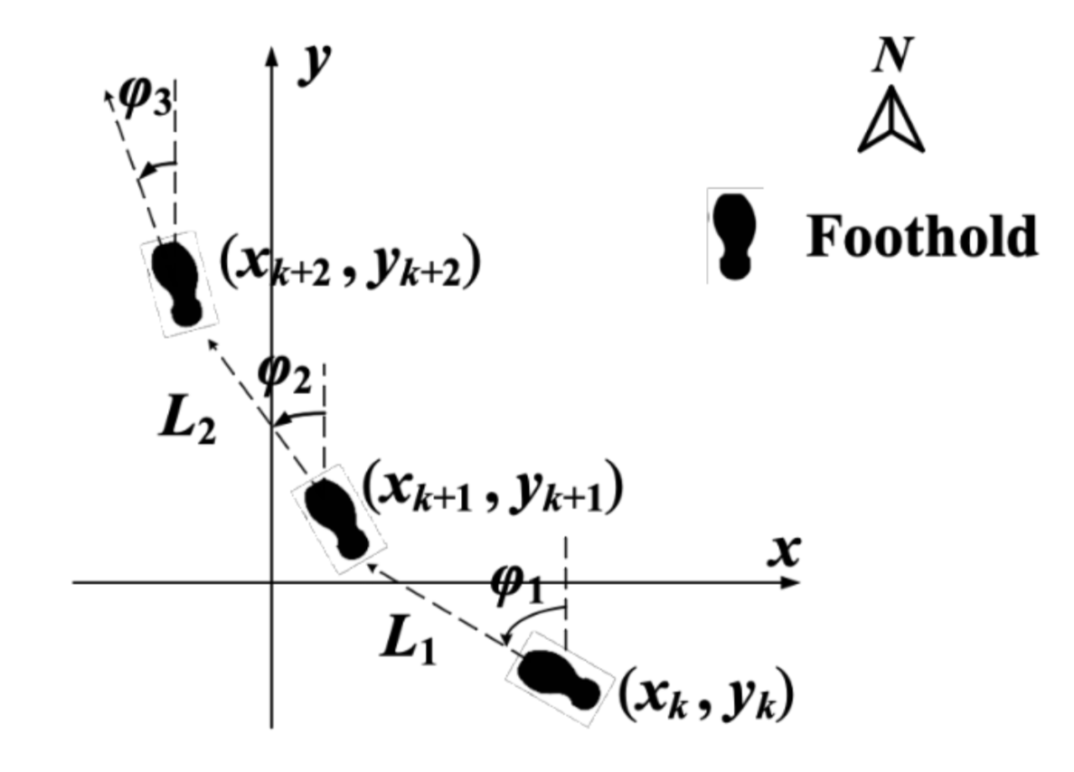

Slide 21
Method overview
(1) Step detection

Slide 22
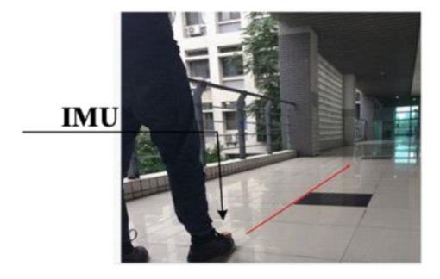
Method overview
(1) Step detection
(2) Heading direction estimation

Slide 23
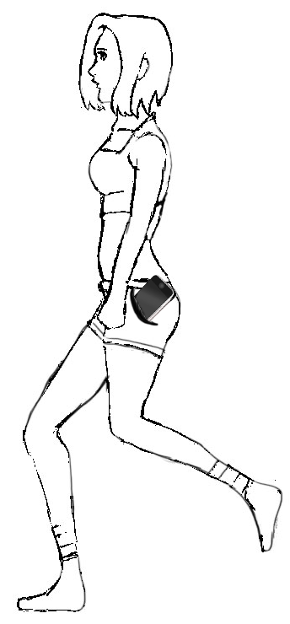
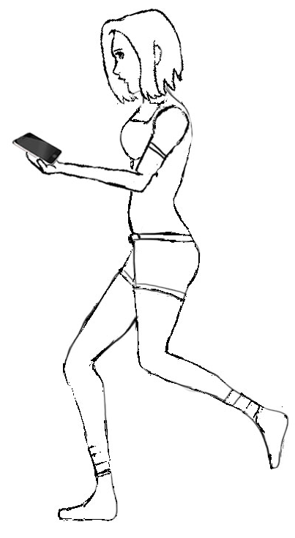
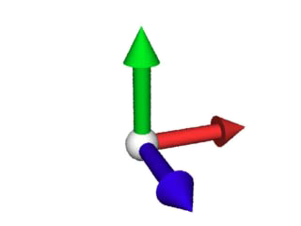
WalkCompass: Heading direction
Compass Direction ≠ Walking Direction
Notes:
But in reality the phone can be at any orientation or location.
The compass can give the walking direction only when it is held correctly in the direction of the walk.
But we don’t want to assume fixed orientation.
Because, there are applications that need to know the walking direction even when the user is not using the phone.
Our goal is to solve this problem in a stand-alone manner, so that it can be useful for a wide range of applications.

Slide 24
Method overview
(1) Step detection
(2) Heading direction estimation
(3) Step length or stride length

Slide 25
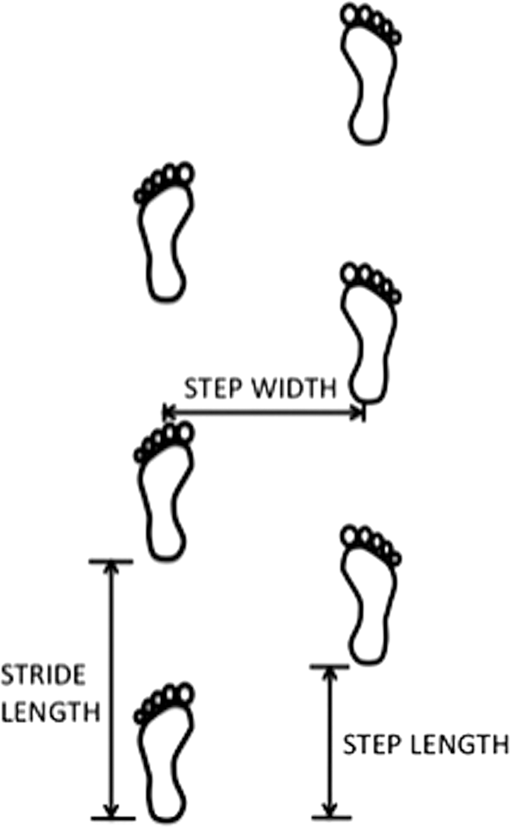
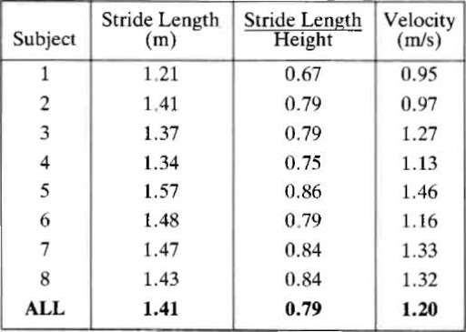

Slide 26
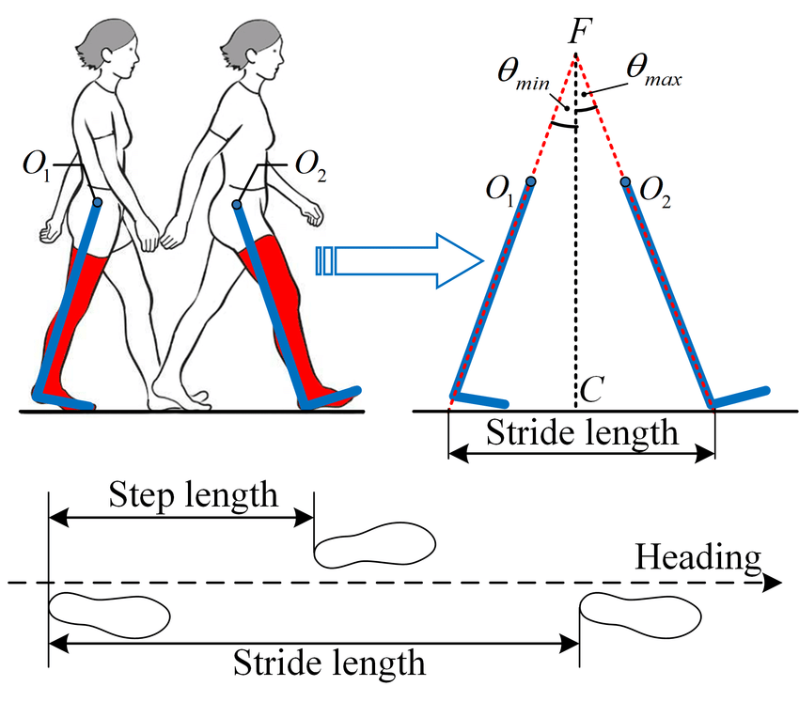
Dynamic stride length measurement techniques

Slide 27
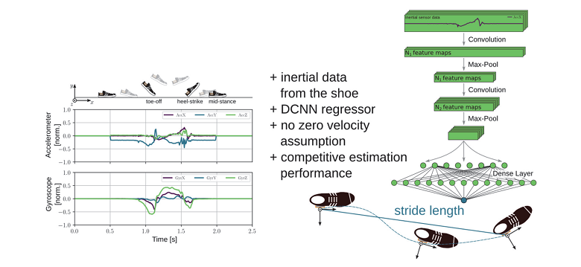
Dynamic stride length measurement techniques

Slide 28
Method overview

Slide 29
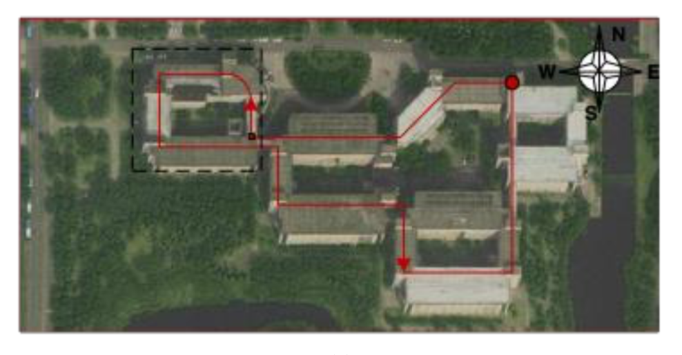
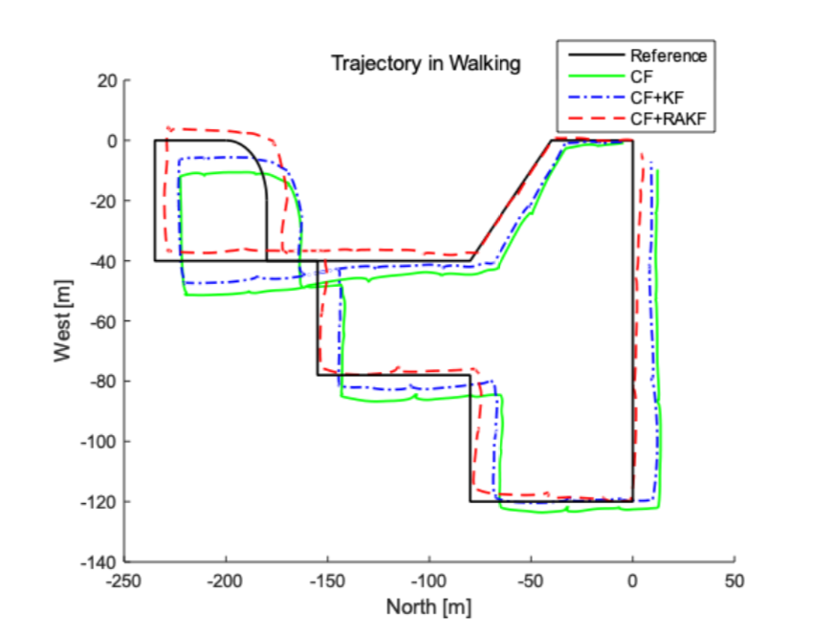
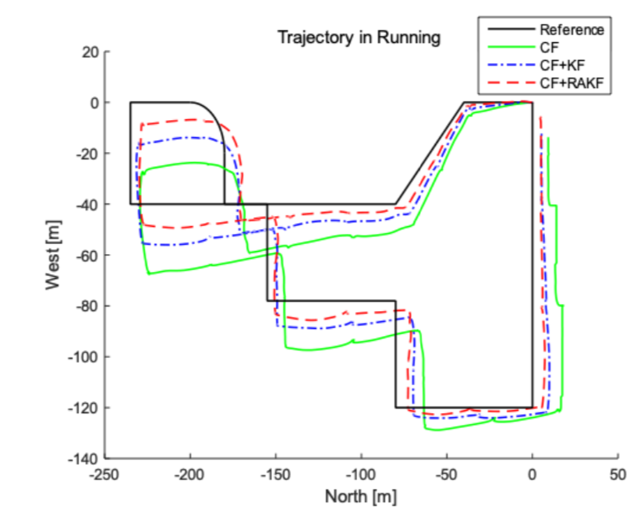
Results

