Slide 1

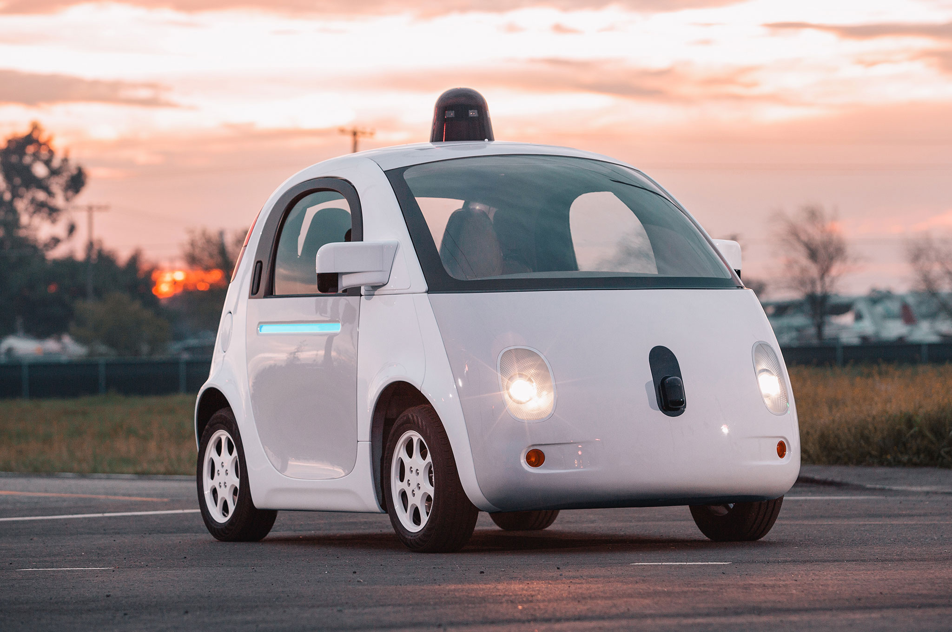



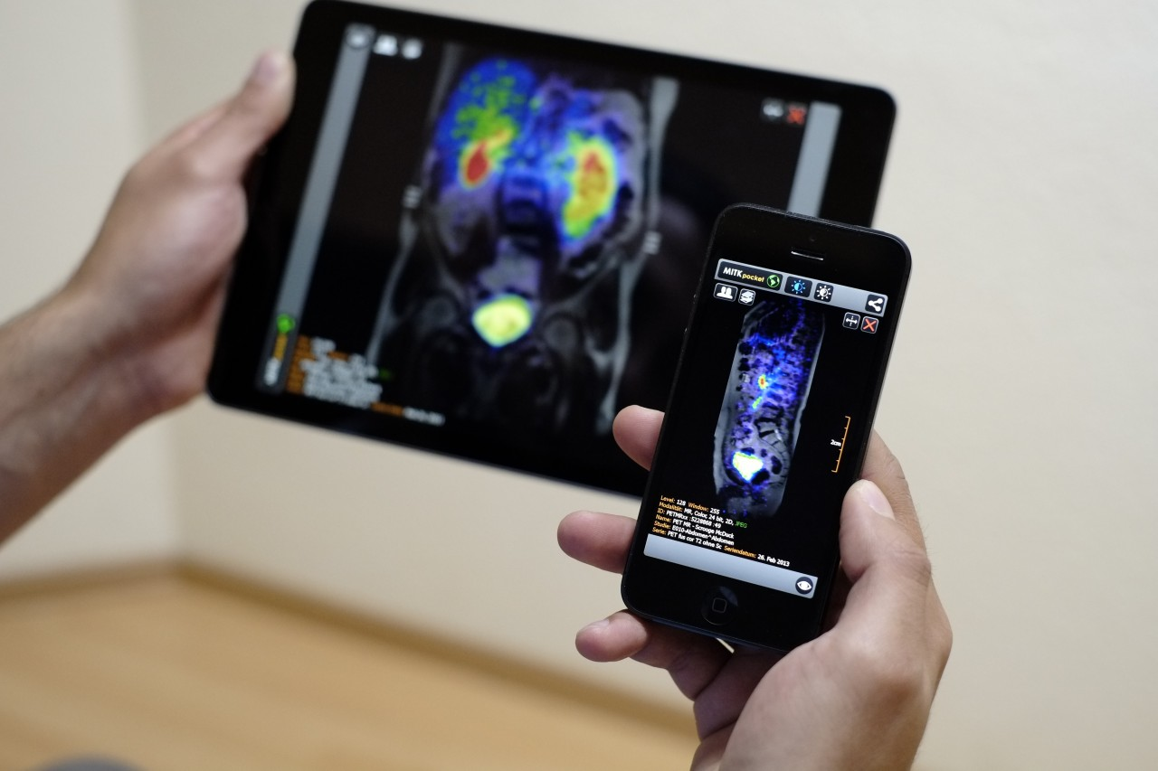
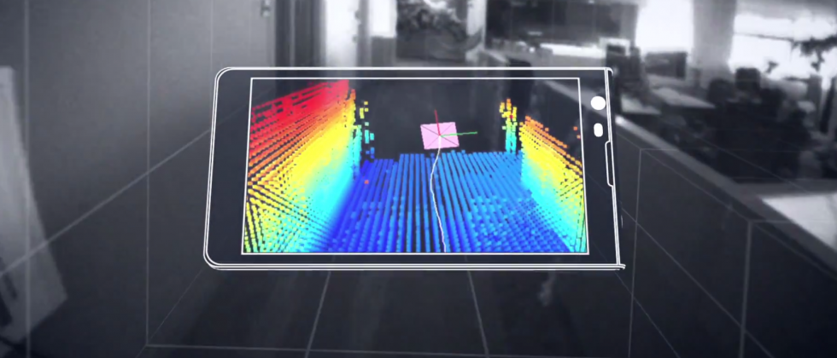

Wireless and Mobile Systems
for the IoT
CMSC 818W : Fall 2020
Lecture 4.4: GPS - II
Nirupam Roy
M-W 2:00-3:15pm
Online
This zoom session is being recorded.

Slide 2
Midterm
Class Projects
The course after the midterm

Slide 3
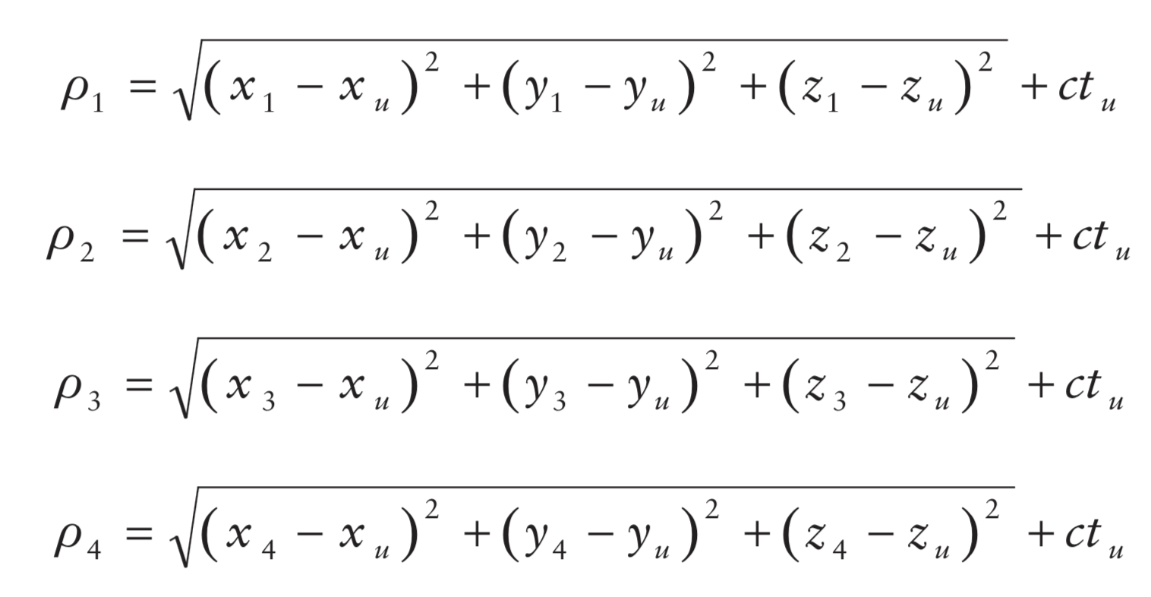
Calculating range
Pseudo-range from i^{th} satellite = 𝝆_{i}
Satellite’s location = (x_{i}, y_{i}, z_{i})
User’s true location = (x_{u}, y_{u}, z_{u})
User’s time offset from satellite = t_{u}

Slide 4
How to find the satellite’s location
Ephemeris and Almanac
Information about the satellite’s precise location and trajectory are embedded in the transmitted data.
Almanac:
Long term orbit course of the satellite.
Used determine which satellites are visible.
Every satellite broadcasts this data for every satellites.
Valid for months.

Slide 5
How to find the satellite’s location
Ephemeris and Almanac
Information about the satellite’s precise location and trajectory are embedded in the transmitted data.
Ephemeris:
Short term location of a satellite at a time of the day.
Used determine the location of a satellite.
Every satellite broadcasts its own data.
Valid for 2-4 hours.

Slide 6
GPS signal modulation

Slide 7
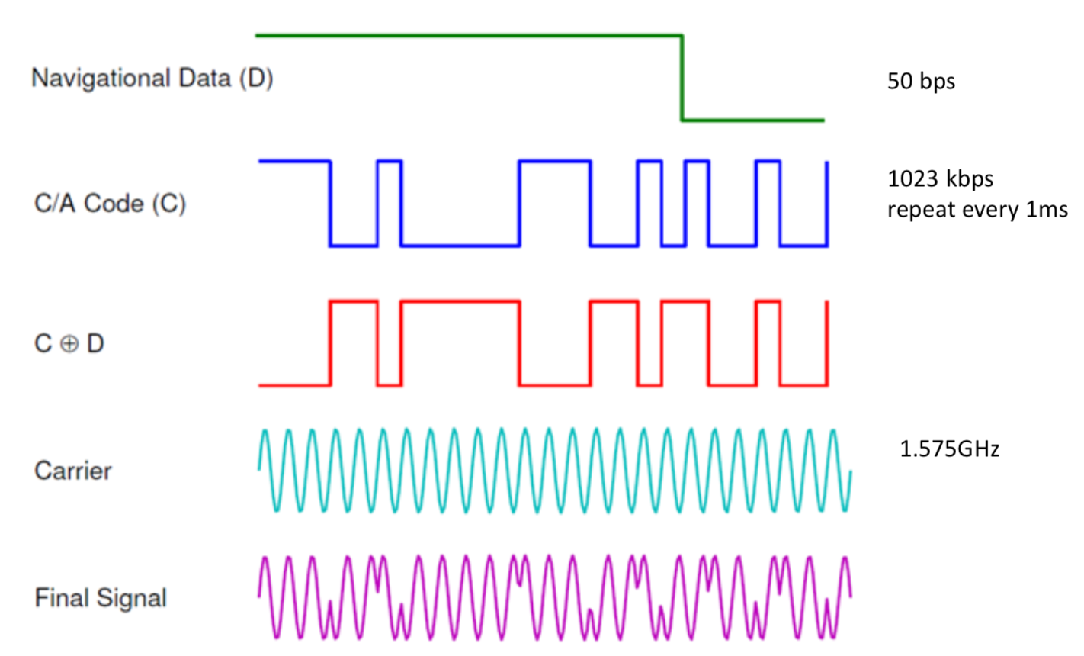
An illustration of GPS signal modulation scheme
Notes:
L1 =1.575 GHz towards the Earth. The bit-rate of data packets is a mere 50 bps, but the bits are modulated with a higher frequency (1MHz) signal for detecting propagation delays.

Slide 8
GPS signal modulation
C/A code:
1023 bits long
Repeats every millisecond
P code:
6.1871 X 10¹² bits long
Repeats every week
Encoded for anti-spoofing

Slide 9
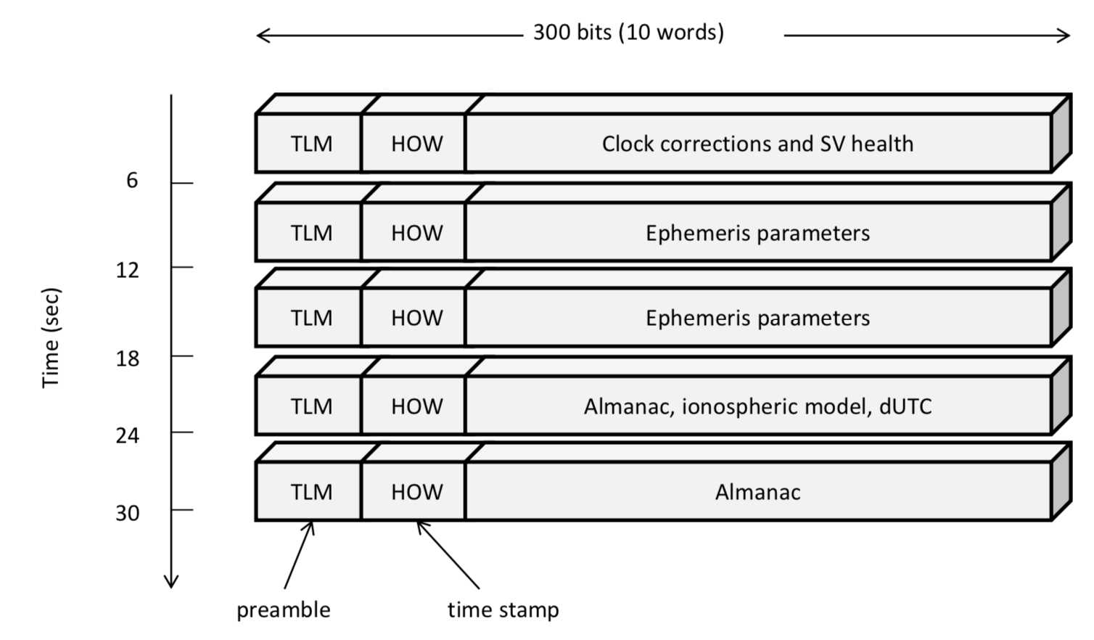
The frame content of a GPS packet of length 1500 bits
Notes:
Thus, the C/A code repeats every millisecond, resulting in 20 repetitions of the C/A code for each data bit sent. The purpose of the C/A code is to allow a receiver to identify the sending satellite and to estimate how long it took the signal to propagate from that satellite to the receiver. Typically, the GPS signals take from 64 to 89 milliseconds to travel from a satellite to the Earth’s surface. Since light travels at 300 km/ms, in order to obtain an accurate distance measurement, the receiver must estimate the signal propaga- tion delay to the microsecond level. The millisecond (NMS) and sub-millisecond (subMS) parts of the propagation time are derived very differently: the NMS is decoded from the packet frames, while the subMS propagation time is detected at the C/A code level using correlations.

Slide 10
Time-to-First-Fix
Time-To- First-Fix (TTFF) is the elapsed time between turning on a receiver and obtaining the first location fix.

Slide 11
Time-to-First-Fix
Time-To- First-Fix (TTFF) is the elapsed time between turning on a receiver and obtaining the first location fix.
1. Satellite Acquisition
Search with all satellites PRN codes (Coarse/Acquisition or C/A code) to find which satellites are visible at that time. Once found need to decode ephemeris and timing information. Need to adjust for unknown Doppler shifts.

Slide 12
Time-to-First-Fix
Time-To- First-Fix (TTFF) is the elapsed time between turning on a receiver and obtaining the first location fix.
1. Satellite Acquisition
Search with all satellites PRN codes (Coarse/Acquisition or C/A code) to find which satellites are visible at that time. Once found need to decode ephemeris and timing information. Need to adjust for unknown Doppler shifts.
2. Location estimation
Finding propagation delay and solve the set of equations for location.

Slide 13
Time-to-First-Fix
Time-To- First-Fix (TTFF) is the elapsed time between turning on a receiver and obtaining the first location fix.
1. Satellite Acquisition
Doppler freq.
Code delay
Satellite Acquisition is a computationally intensive process due to the large code phase and Doppler search space. It may take more than 5 minutes.

Slide 14
Assisted GPS (A-GPS or aGPS)

Slide 15
Notes:
MSC = Mobile Switching Center

Slide 16
Assisted GPS (A-GPS or aGPS)
Mobile Station Based (MSB):
Server at the station provides information (network time, almanac etc.) to the device for faster TTFF.
2) Mobile Station Assisted (MSA):
Server at the station calculates the location for the device.

Slide 17
Differential GPS

Slide 18
GPS ranging error

Slide 19
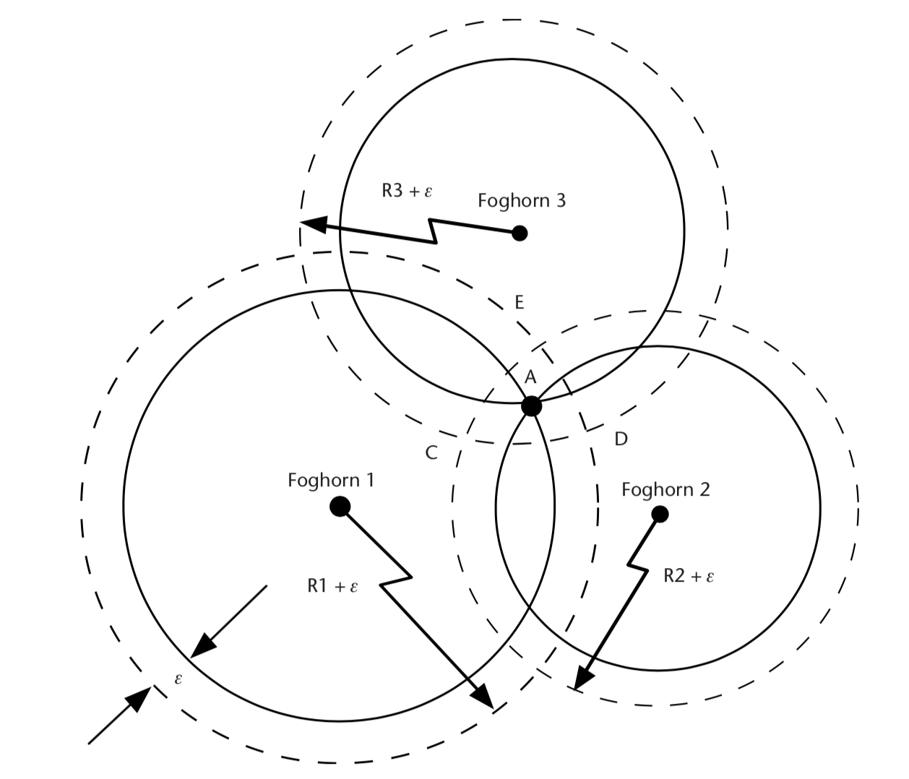
GPS ranging error
Error due to unpredictable signal delay

Slide 20
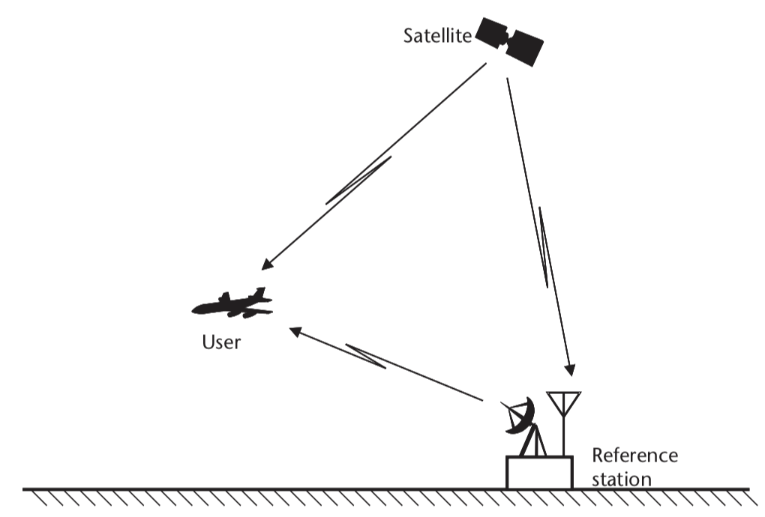
Differential GPS

Slide 21
Differential GPS
(1) Estimate the correct location of the reference
e.g., long term average of GPS location
24 hour estimated location scatter plot

Slide 22
Differential GPS
(1) Estimate the correct location of the reference
e.g., long term average of GPS location

Slide 23
Differential GPS
(2) Estimate the error in received GPS signal using the location of the base station and location of the satellite.
Repeat for all visible satellites
Error

Slide 24
Differential GPS
(3) Apply adjustment to the received GPS signal to reduce error
Send the adjustment info.

Slide 25
Differential GPS
Regular GPS estimate (red)
Differential GPS
with geo-stationary satellite (green)
meter
Differential GPS
with static base station (purple)
meter
24 hour estimated location scatter plot

Slide 26
Inertial Sensor (IMU) Integrated GPS

Slide 27
GPS blockage and multipath in cities

Slide 28
GPS blockage and multipath in cities
Regions of unreliable GPS location

Slide 29
Dead reckoning
Location estimate drifts
-- Use reliable GPS estimates to correct inertial drift
-- Use inertial dead-reckoning in GPS regions
Track movements with inertial sensors

Slide 30
Summary of localization techniques

Slide 31
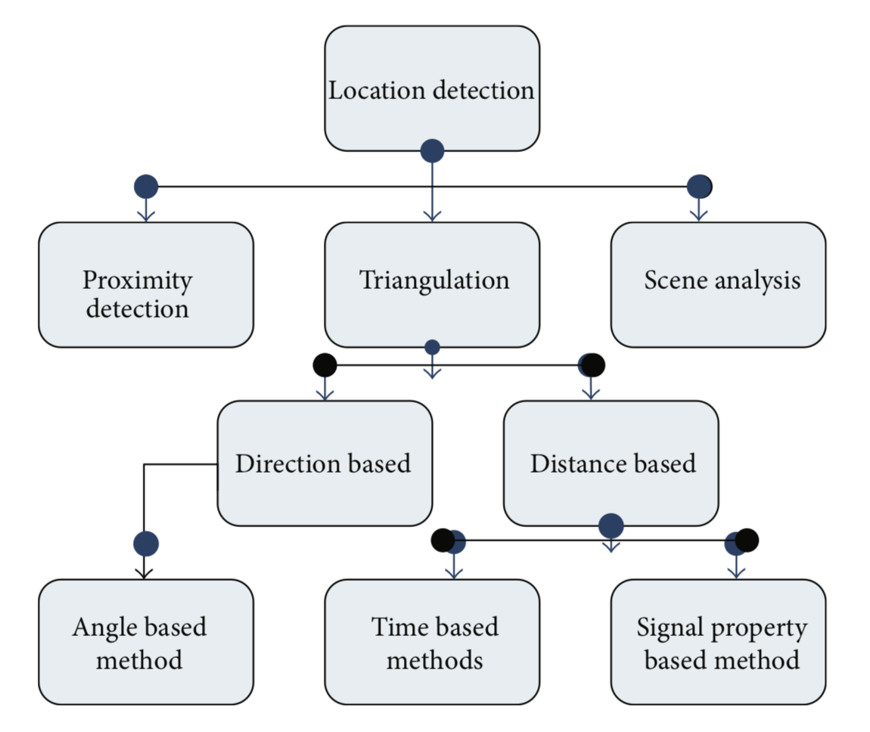
Localization techniques
[Ref] http://downloads.hindawi.com/journals/jcnc/2013/185138.pdf

Slide 32
Localization techniques
Inertial tracking

Slide 33
Localization techniques: Proximity

Slide 34

Localization techniques: Scene analysis

Slide 35
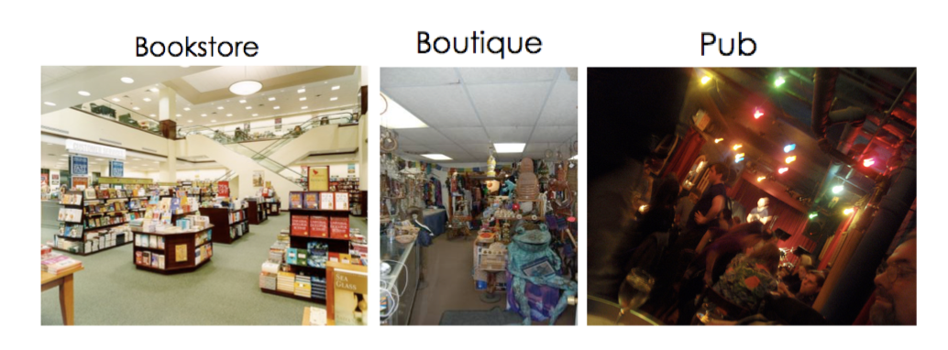
Localization techniques: Scene analysis

Slide 36
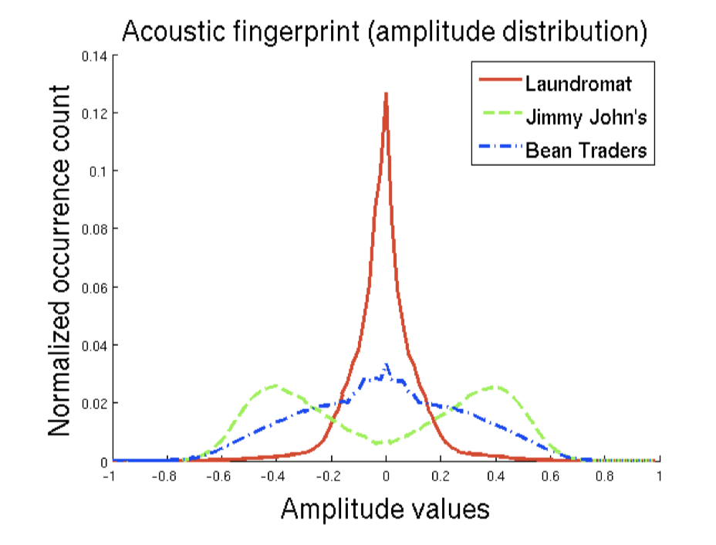
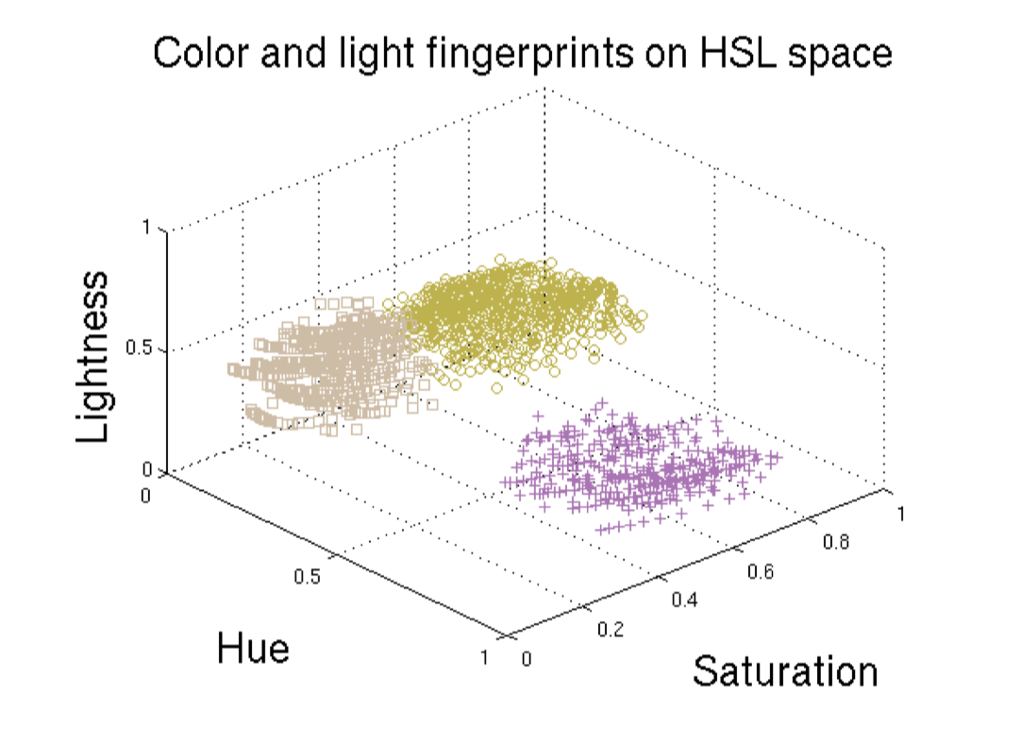
Localization techniques: Scene analysis

Slide 37
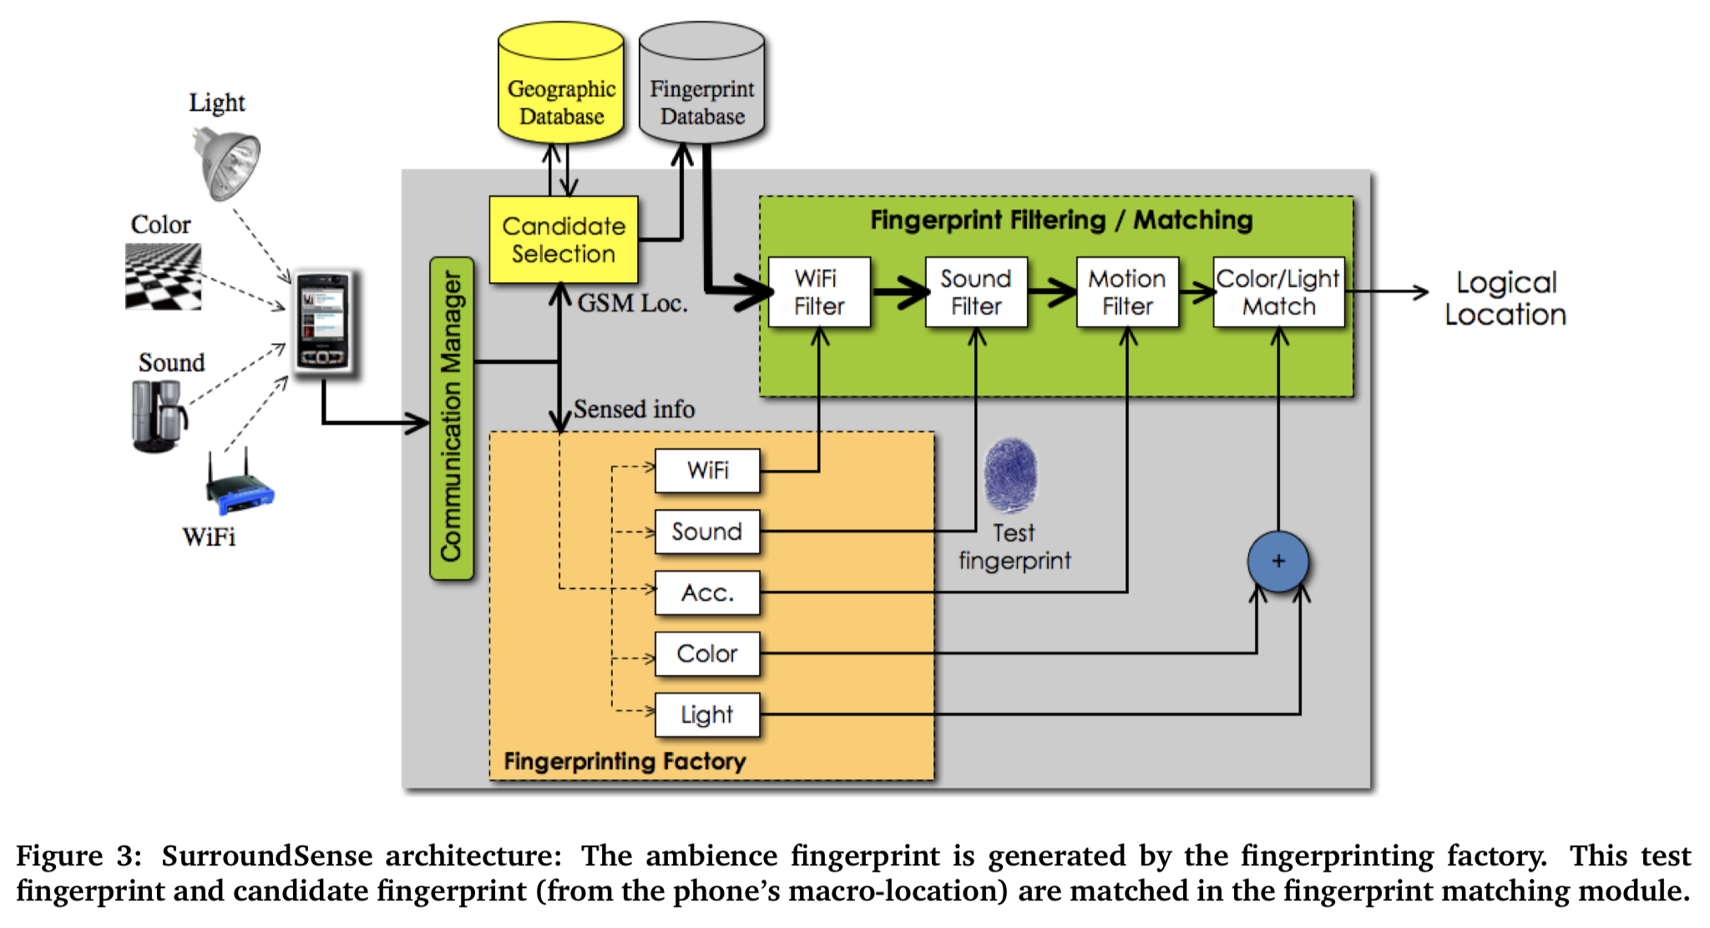
Localization techniques: Scene analysis

Slide 38
Localization techniques
Inertial tracking

Slide 39
COIN-GPS: Indoor Localization from Direct GPS Receiving
Case Study
Shahriar Nirjon
University of Virginia
Jie Liu, Gerald DeJean, Bodhi Priyantha,
Yuzhe Jin, and Ted Hart
Microsoft Research, Redmond

Slide 40
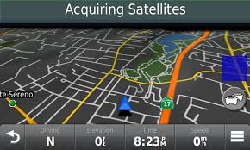
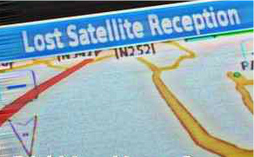
‘GPS does not work indoors’ - Everyone
Why?

Slide 41
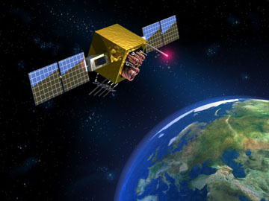
GPS Signal-Strength
500 W
1.4 x 10⁻¹⁶ W

Slide 42
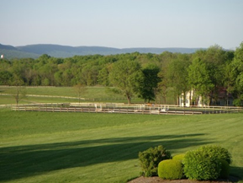
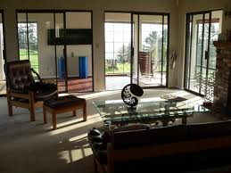
GPS Signal-Strength Indoors
100 attowatts
1 to 10 attowatts
We cannot decode packets (e.g. time stamps, navigational data)
Notes:
Atto = 10^-18

Slide 43

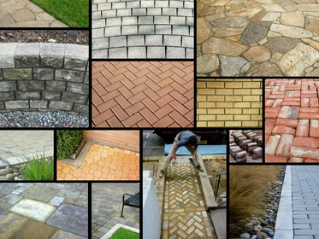
Heterogeneous Building Materials
Concrete
Wood
Glass
Steel
…

Slide 44
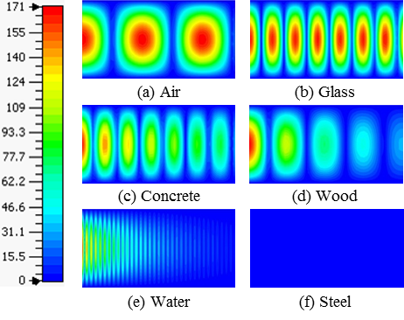
GPS Signals Thorough Building Materials
E⁺
E⁻
Good
Bad
2D electric field plots of a GPS signal propagating
through different materials

Slide 45

Strategy and Leverages
Use no data from the GPS packets.
GPS
Opportunistically sample signals from multiple directions.

Slide 46


Strategy and Leverages
Leverage the slow movement of indoor receivers
Leverage the power of cloud computing

Slide 47
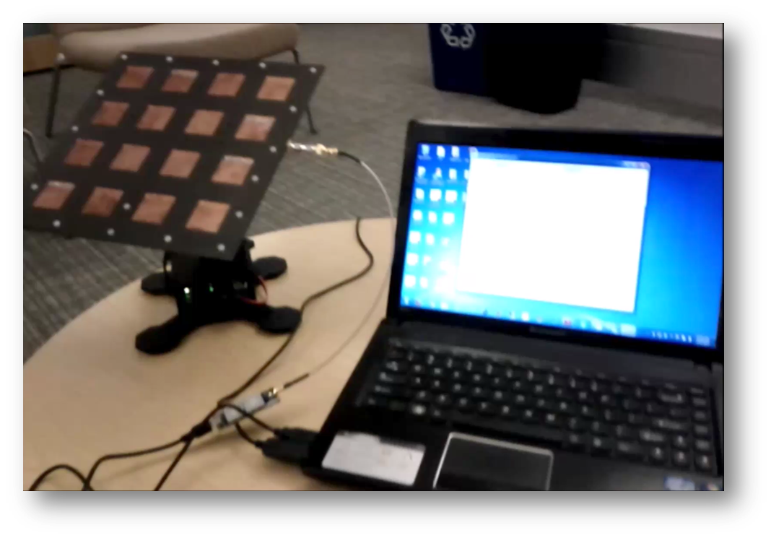
COIN-GPS: Cloud Offloaded Indoor GPS
We mechanically steer the antenna with a PC and collect GPS samples for offline processing

Slide 48
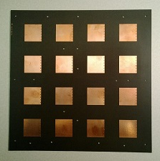
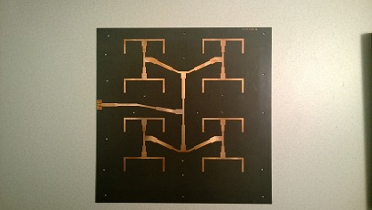
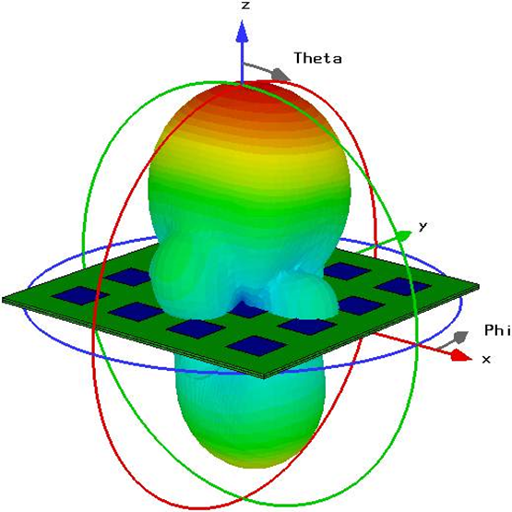
1. The Front End
We use a high-gain, directional antenna to get GPS signals from a certain direction.
Properties:
10 x 10 Sq. Inch
1575.42 MHz
12.3 dBi gain
Half power beam width: 35°

Slide 49
2. The Back-End Processing
Satellite
Acquisition
From
Weak Signals
Location
Estimation
From
Inadequate
Satellites

Slide 50
Detecting Satellites Indoor

Slide 51
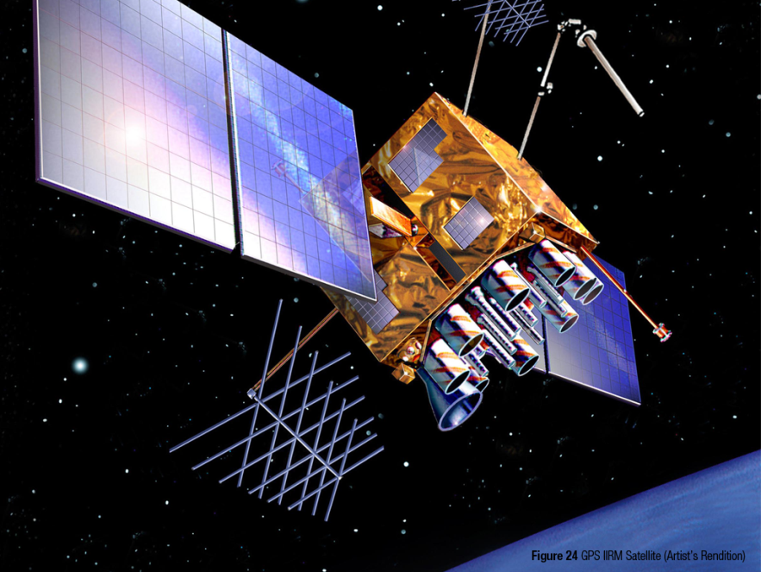
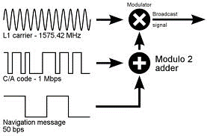
Detecting Satellites
The standard acquisition process:
The Sender

Slide 52
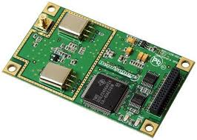
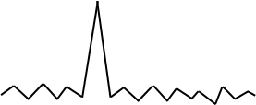


Detecting Satellites (Instant GPS)
The standard acquisition process: (Instant GPS)
The Receiver
1 ms
demodulated GPS signals
Code Phase
Sat 01
*
…
Sat 32
*
Local C/A codes

Slide 53
Satellite Acquisition from Weak Signals
The correlation plot in reality:
K = 1

Slide 54
Satellite Acquisition from Weak Signals
The correlation plot (integrated over multiple ms)
K = 1
K = 2
K = 4
K = 8

Slide 55
2. The Back-End Processing
Satellite
Acquisition
From
Weak Signals
Location
Estimation
From
Inadequate
Satellites

Slide 56
Required Satellites
How many satellites do we need?

Slide 57
Required Satellites (in Various Techniques)
How many satellites do we need?
Type | How Fast? | Unknowns
GPS | 30 sec
COIN-GPS | 1 ms

Slide 58
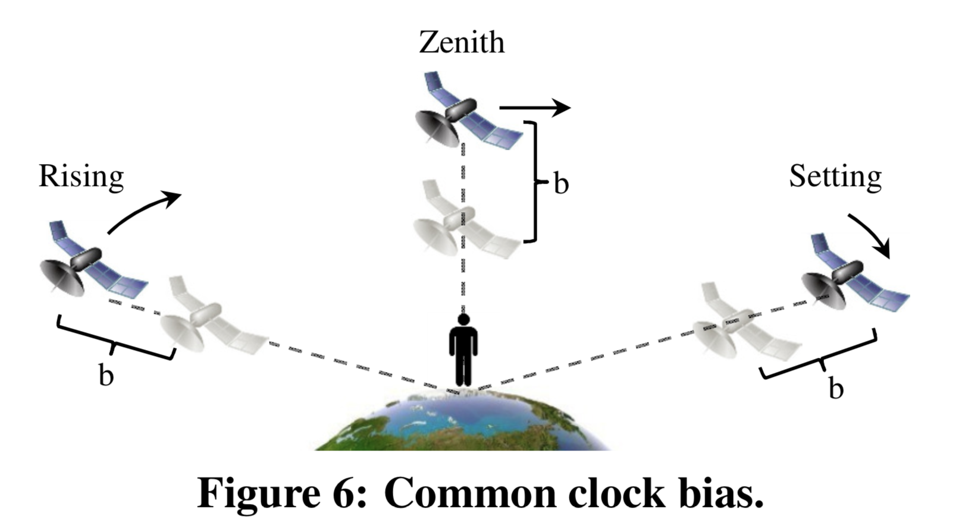
Required Satellites (in Various Techniques)

Slide 59
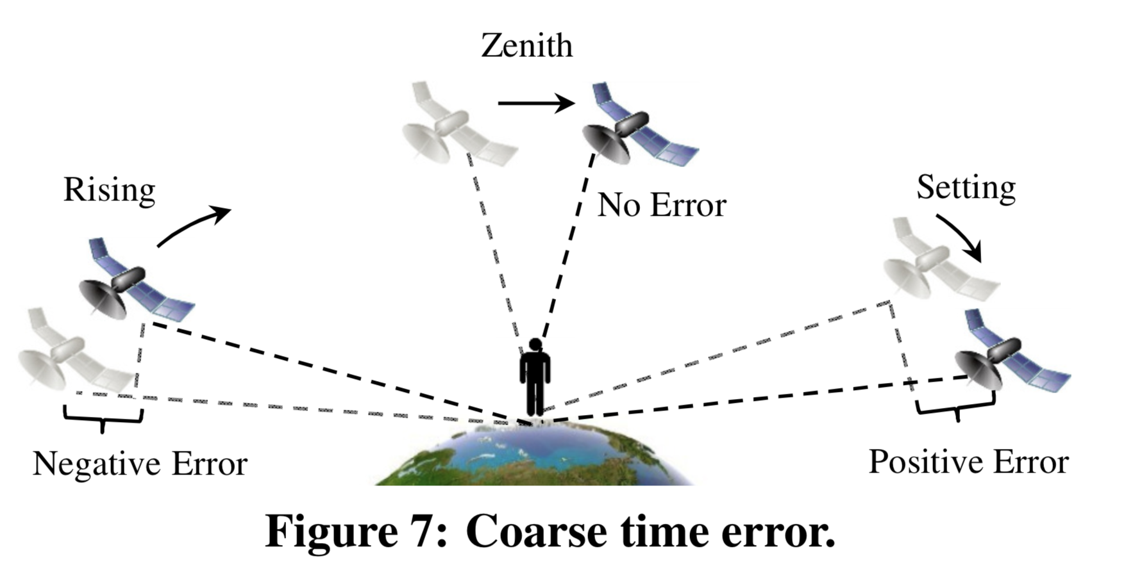
Required Satellites (in Various Techniques)

Slide 60

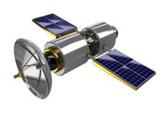


Required Satellites (in Various Techniques)
How many satellites do we need?
Type | How Fast? | Unknowns
GPS | 30 sec | X, Y, Z, B, C
COIN-GPS | 1 ms
Fig. Common bias error

Slide 61



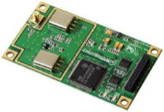
Required Satellites (in Various Techniques)
How many satellites do we need?
Actual
Wrong
Type | How Fast? | Unknowns
GPS | 30 sec | X, Y, Z, B, C
COIN-GPS | 1 ms
800 m/s
C
dt
Fig. Coarse time error

Slide 62
Required Satellites (in Various Techniques)
How many satellites do we need?
Actual
Wrong
Type | How Fast? | Unknowns
GPS | 30 sec | X, Y, Z, B, C
COIN-GPS | 1 ms | X, Y, Z, B, C
800 m/s
C
dt
Fig. Coarse time error

Slide 63
Required Satellites (in Various Techniques)
How many satellites do we need?
Actual
Wrong
Type | How Fast? | Unknowns
GPS | 30 sec | X, Y, Z, B, C
COIN-GPS | 1 ms | X, Y, Z, B, C
800 m/s
C
dt
Fig. Coarse time error
So… for instant GPS, we need 5 visible satellites

Slide 64
Acquired Satellites (Indoors)
How many satellites do we see indoors?

Slide 65
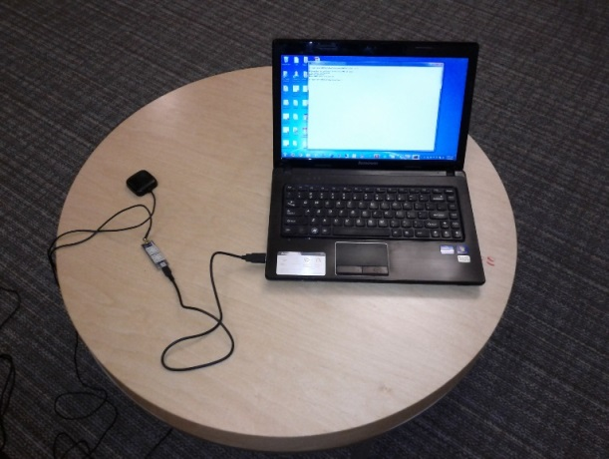
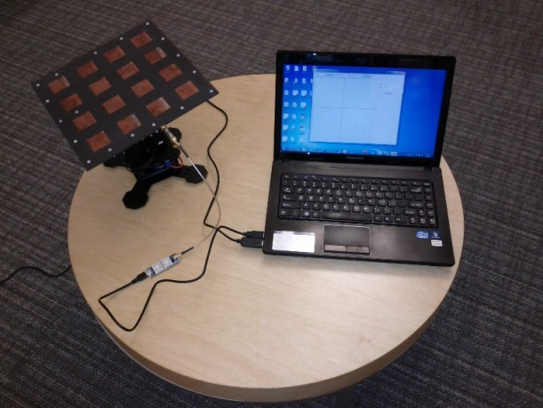
Acquired Satellites (Indoors)
How many satellites do we see indoors?
Garmin Antenna
Our Antenna

Slide 66
Acquired Satellites (Indoors)
How many satellites do we see indoors?
Garmin Antenna
%
N or more visible satellites
Our Antenna
But … 3 < 5

Slide 67
Handling Inadequate Satellites Problem
Our Approach: Receive, Wait and Receive again

Slide 68

Handling Inadequate Satellites Problem
Our Approach: Receive, Wait and Receive again
10:30.000 AM

Slide 69

Handling Inadequate Satellites Problem
Our Approach: Receive, Wait and Receive again
10:30.000 AM

Slide 70

Handling Inadequate Satellites Problem
Our Approach: Receive, Wait and Receive again
10:30.000 AM
10:30.500 AM

Slide 71
Handling Inadequate Satellites Problem
Our Approach: Receive, Wait and Receive again
10:30.000 AM
10:30.500 AM

Slide 72





Handling Inadequate Satellites Problem
Our Approach: Receive, Wait and Receive again
$$\left[\begin{aligned}E_{1} (x, y, z, b1, c1) \\ E_{2} (x, y, z, b1, c1) \\ E_{3} (x, y, z, b1,c1) \\ ? \\ ?\end{aligned}\right]$$
10:30.000 AM
$$\left[\begin{aligned}E_{4} (x, y, z, b2, c2) \\ E_{5} (x, y, z, b2, c2) \\ E_{6} (x, y, z, b2, c2) \\ E_{7} (x, y, z, b2, c2) \\ ?\end{aligned}\right]$$
10:30.500 AM

Slide 73

Handling Inadequate Satellites Problem
Our Approach: Receive, Wait and Receive again
$$\left[\begin{aligned}E_{1} (x, y, z, b1, c1) \\ E_{2} (x, y, z, b1, c1) \\ E_{3} (x, y, z, b1,c1) \\ ? \\ ?\end{aligned}\right]$$
$$\left[\begin{aligned}E_{1} (x, y, z, b1, c1,b2,c2) \\ E_{2} (x, y, z, b1, c1,b2,c2) \\ E_{3} (x, y, z, b1, c1,b2,c2) \\ E_{4} (x, y, z, b1, c1,b2,c2) \\ E_{5} (x, y, z, b1, c1,b2,c2) \\ E_{6} (x, y, z, b1, c1,b2,c2) \\ E_{7} (x, y, z, b1, c1,b2,c2)\end{aligned}\right]$$
10:30.000 AM
$$\left[\begin{aligned}E_{4} (x, y, z, b2, c2) \\ E_{5} (x, y, z, b2, c2) \\ E_{6} (x, y, z, b2, c2) \\ E_{7} (x, y, z, b2, c2) \\ ?\end{aligned}\right]$$
10:30.500 AM

Slide 74
Handling Inadequate Satellites Problem
The COIN-GPS formula:
For a stationary receiver, the required total number of visible GPS satellites for COIN-GPS is 2n + 3, where n is the number of independent readings and the same satellite acquired in different readings is considered different.
n | 2n+3
1 | 5
2 | 7
3 | 9
4 | 11

Slide 75





Experimental Setup
5 places
35 indoor locations
8 – 10 directions

Slide 76
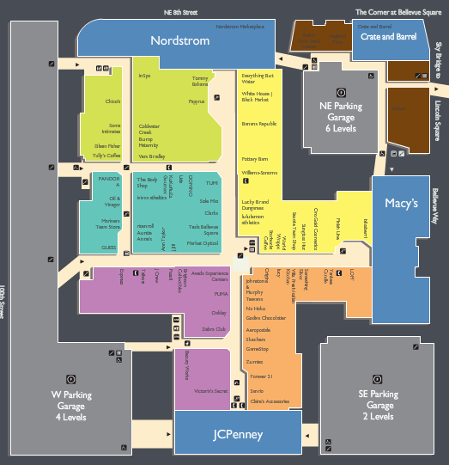
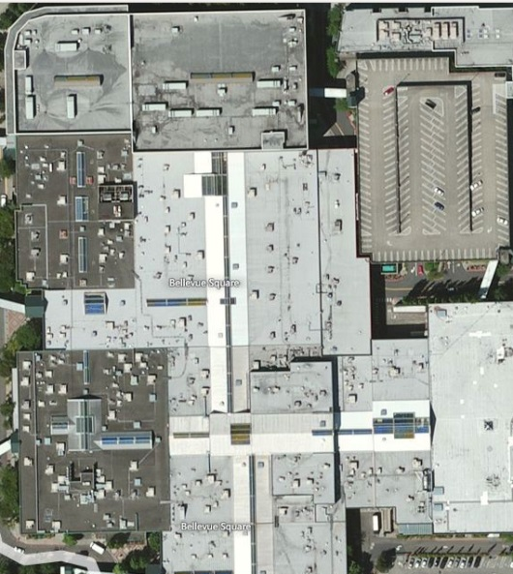
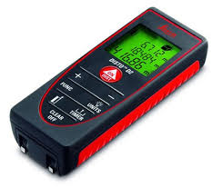
Experimental Setup
5 places
35 indoor locations
8 – 10 directions
Ground truth:
  Floor map
  Bing maps
  Laser pointer

Slide 77
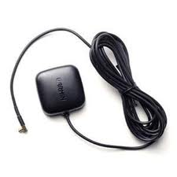
Experimental Setup
5 places
35 indoor locations
8 – 10 directions
Ground truth:
  Floor map
  Bing maps
  Laser pointer
Baseline:
  Garmin antenna with CO-GPS.
Garmin

Slide 78
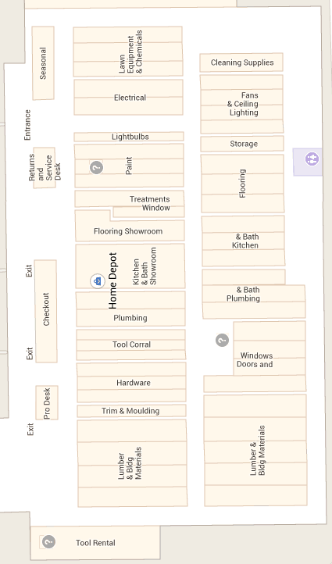
Results: Home Depot
A
System | Total Locations | Got Estimates
Garmin | 4 | None
Proposed | 4 | 4
B
D
C

Slide 79
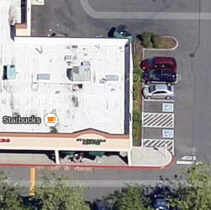
Results: Starbucks
System | Total Locations | Got Estimates
Garmin | 2 | None
Proposed | 2 | 2
A
B

Slide 80
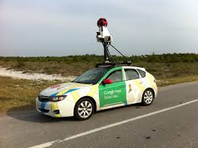
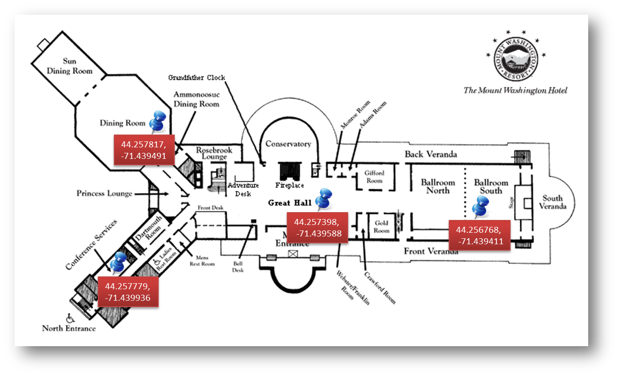
Concluding Remarks
If not for consumers, how about indoor profiling?

Slide 81
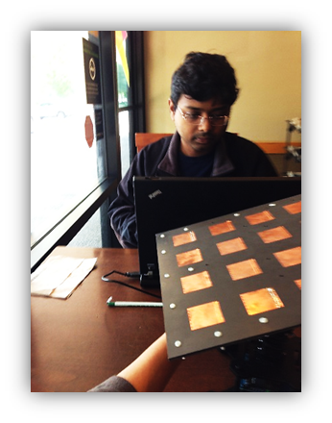

Concluding Remarks
Size does matter, if not phones – how about tabs?
Surface Pro Next ?

Slide 82
Thank You

