Slide 1
Sai Yerramreddy, Anvitha Bhat
Some of the slides are adapted from https://www.usenix.org/conference/usenixsecurity20/presentation/ahmed-muhammad

Slide 2
Overview
Voice Assistants in day to day life
Consumers will interact with voice assistants on 8.4 billion devices by 2024
growth of 113% compared to the 4.2 billion devices expected to be in use by the end of this year
A study by Juniper Research
.

Slide 3
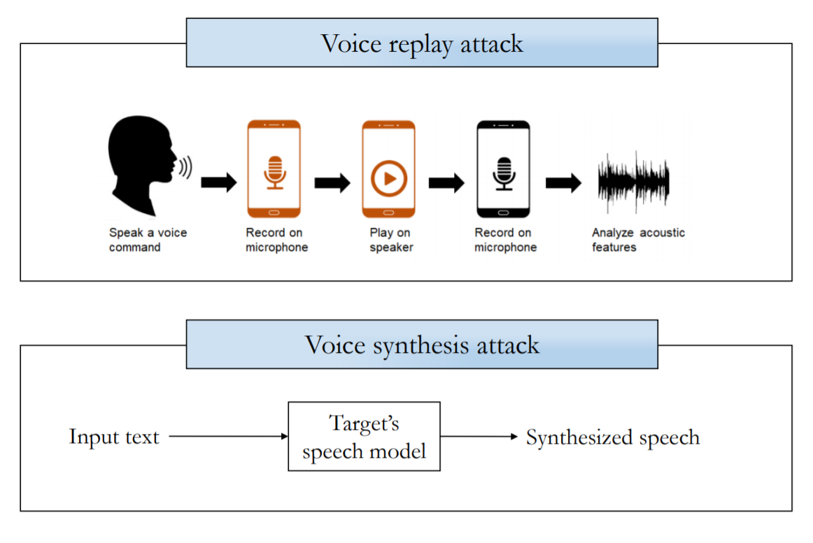
Problem - Voice Presentation Attacks

Slide 4
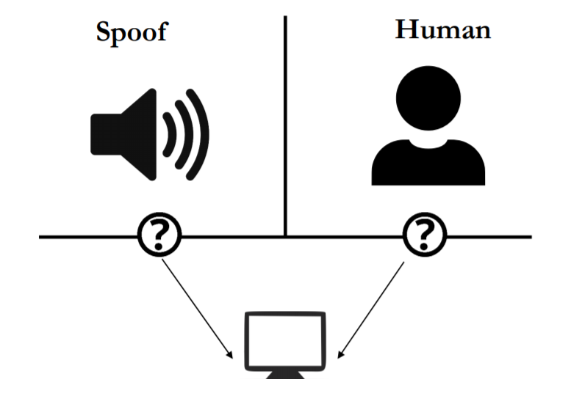
Voice Liveness Detection System

Slide 5
Key Challenges
Latency
Processing delay must be < 100 milliseconds
Model Size
On device implementation without the need to contact remote servers
Detection Accuracy
EER rate around 10% or less to be considered as a usable solution

Slide 6
Key Idea
Most loud speakers inherently add distortions to original sounds while replaying them
With human voices, the sum of power observed across lower frequencies is relatively higher than the sum observed across higher frequencies
Notes:
the overall power distribution over the audible frequency range often show some uniformity and linearity

Slide 7
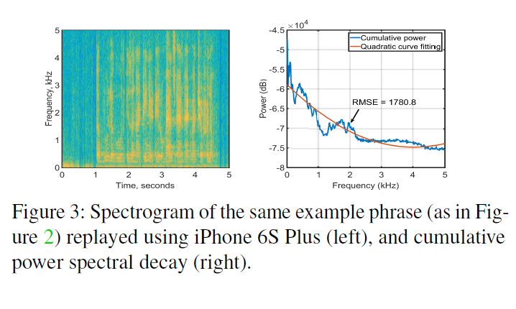
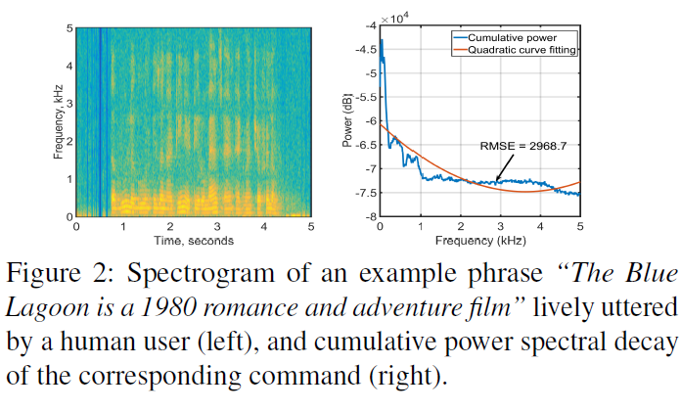
Key classification Features
Decay Patterns in Spectral Power (FV_{LFP} and FV_{LDF})
Notes:
In general, low quality loudspeakers are designed to achieve high sensitivity and volume but at the cost of compromising audio fidelity and adding unwanted distortions

Slide 8
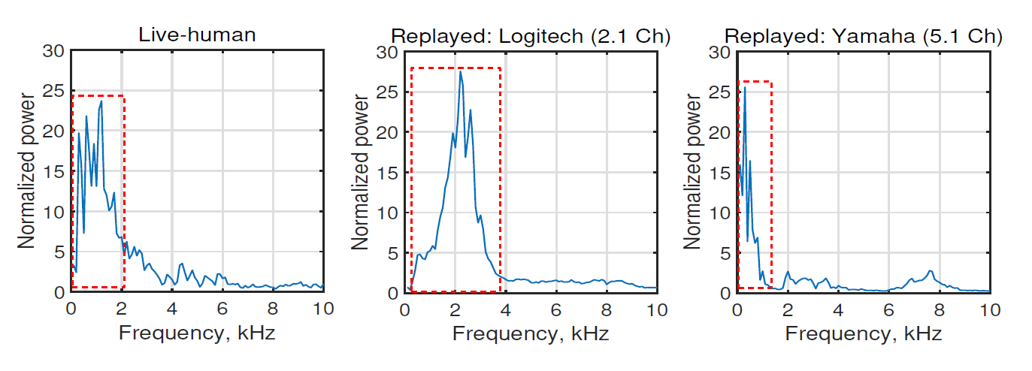
2. Peak Patterns in Spectral Power (FV_{HPF})
Notes:
Because high-quality standalone loudspeakers boost power across a wide range of frequencies to reduce non-linear distortions, the linear decay patterns described above may not be sufficient against such loudspeakers.
Even though they show similar exponential decay patterns overall the power over the same frequency range is more concentrated with less fluctuations in loud speakers

Slide 9
3. Linear Prediction Cepstrum Coefficients (LPCC) (FV_{LPC})
1 and 2 look for specific frequency ranges
General inspection over a wider range of frequencies can be done with LPCC
The key idea behind LPCC is that a speech sample can be approximated as a linear combination of previous samples.
LPCC for a voice sample is computed by minimizing the sum of squared differences between the voice sample and linearly predicted ones

Slide 10
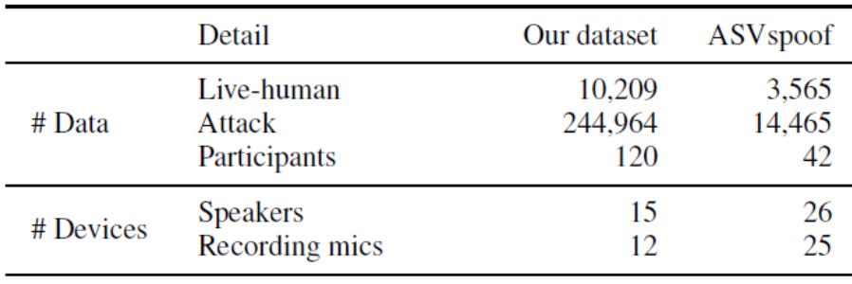
Data Collection
Void Dataset
120 participants recruited for data collection. 53% of the participants were male
50 commands from a prepared list of real-world voice assistant commands
Participants were in the 40-49 (13%), 30-39 (62%), and 20-29 (25%) age groups
ASV spoof 2017 dataset
Dataset contain three sets (training, development, and evaluation)
Voice sample were collected from numerous environments such as balcony, bedroom, canteen, home, office, and lab space

Slide 11
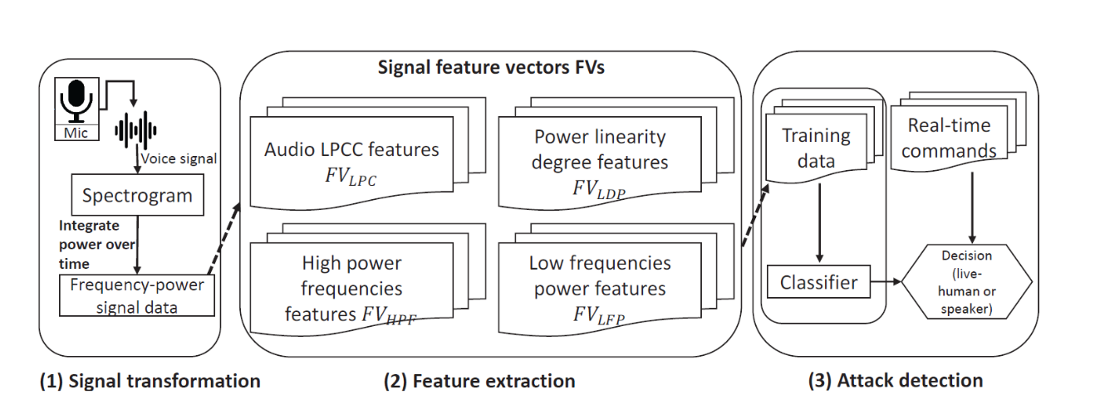
High level overview of Void

Slide 12
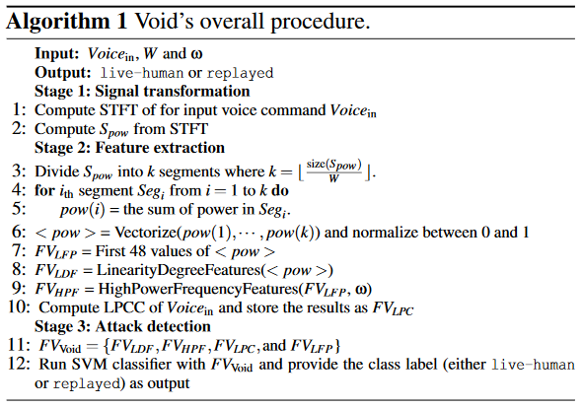
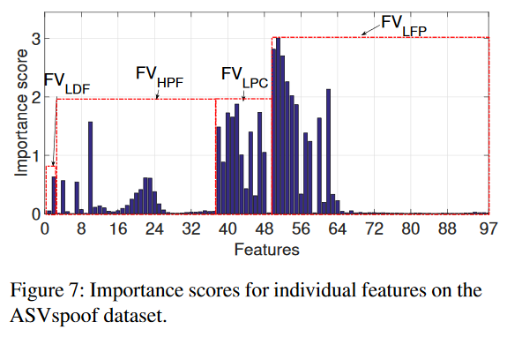
Void Algorithm
Feature Set
Total number of features is 97
Classification and Regression Trees used to analyze the relative importance of individual classification features

Slide 13
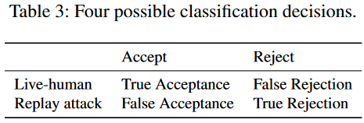
Evaluation - Experimental Setup
Metrics
False acceptance rates (FAR), False rejection rates (FRR), Equal error rates (EERs), Receiver operating characteristic (ROC) curve and Area under the curve (AUC)
Setup
Server with two Intel Xeon E5 (2.10GHz) CPUs, 260 GB RAM and NVIDIA 1080Ti GPU, running 64-bit Ubuntu 16.04 LTS

Slide 14
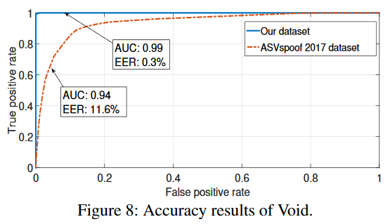
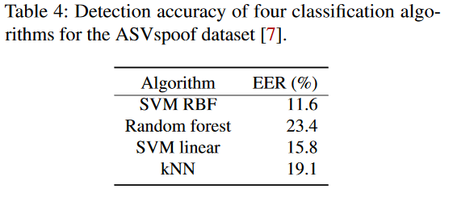
Evaluation - Overall Performance

Slide 15
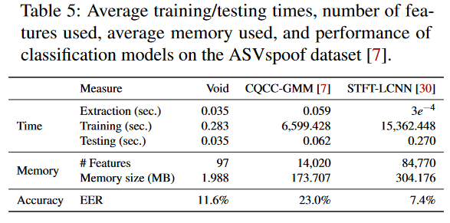
Evaluation - Lightweight nature of Void

Slide 16
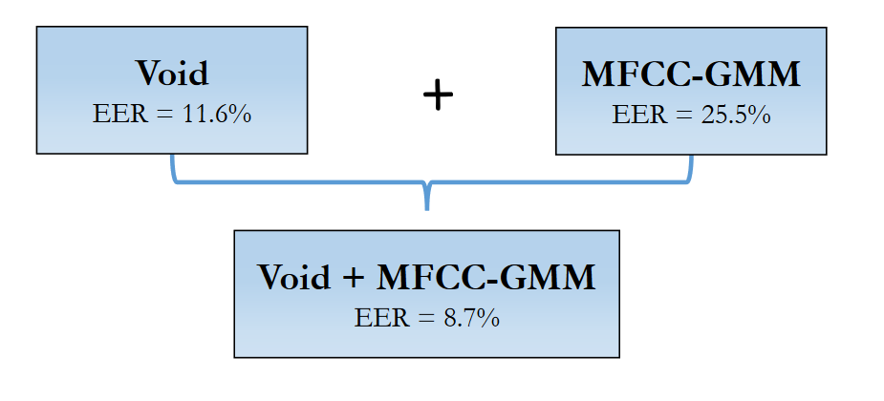
Evaluation - Void as an ensemble solution

Slide 17
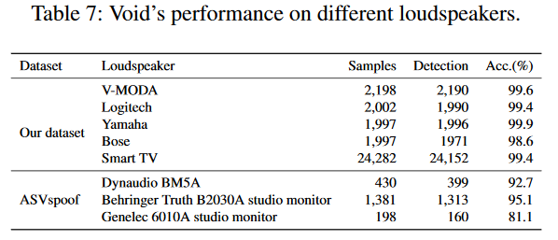
Evaluation - Effects of variances
Attack source distances, Gender and Loudspeaker types
Replay attacks in unseen conditions
Installed the speakers and recording devices in an office building
119,996 replay attack samples recorded with a huge variety of background noises and situations
Void was able to correctly detect 96.2% of the attacks

Slide 18
Robustness against adversarial attacks
Hidden voice command
Hidden voice commands refer to commands that can not be interpreted by human ears but can be interpreted and processed by voice assistant services.
Inaudible voice command (Dolphin attack)
Inaudible voice command attacks involve playing an ultrasound signal with spectrum above 20kHz, which would be inaudible to human ears.
Voice synthesis attack
Open source voice modeling tools called “Tacotron” and “Deepvoice2” to train a user voice model with 13,100 publicly available voice samples.
They then used the trained model to generate 1,300 synthesis voice attack samples by feeding in commands as text inputs.

Slide 19
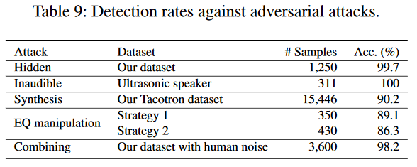
Robustness against adversarial attacks
EQ manipulation attacks
EQ manipulation is a process commonly used for altering the frequency response of an audio system by leveraging linear filters.
By leveraging audio equalization, an attacker could intentionally manipulate the power of certain frequencies to mimic spectrum patterns observed in live-human voices.
Combining replay attacks with live-human voices
To evade detection by Void, attacker can try to simply combine replay attacks with live human voices.

Slide 20
Conclusion
Lightweight
Void runs on single efficient classification model with 97 features and does not require addiction hardware
On average Void took 35 milliseconds to classify a voice sample and just 1.98MB memory
Void is 8 times faster and 153 times lighter than top performing solution of ASVspoof competition
Efficient
Their evaluation on two large datasets, Void achieves 0.3% and 11.6% EER, respectively
Ensemble solution achieves 8.7% EER
Void is also resilient against various adversarial attacks

Slide 21
Discussion
Limitations
Void performance against high-quality speakers may degrade
EQ attack results show that carefully crafted voice samples can bypass Void
Our view
The good:
Impressive results for adversarial attacks mentioned - robust model
Variety of experimentation and different combination of devices used
The bad:
Comparison of models was not convincing enough
Interpretability : Accuracy or EER rate values weren’t explained (why the model works better with their dataset than ASVspoof )

Slide 23
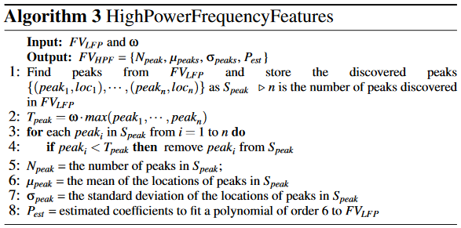
Void Algorithms

Slide 24
Stage 1: Signal Transformation
Signal is divided into short chunks of 1024
STFT computed on each chunk
Hamming window length is 1024 and hop length is 256
NFFT is set to 4096
Spectrogram contains frequencies and power over time
Cumulative spectral power per frequency (S_{pow}) is computed from STFT
S_{pow} contains the total accumulated power for each frequency over the full duration of Voice_{in}
S_{pow} obtained from STFT is a vector of size 1,500

Slide 25
Stage 2: Feature extraction
Low frequencies power features (FV_{LFP})
W set to 10, chosen empirically
If size of S_{pow} cannot be divided by W, omit the last segments
Signal power linearity degree features (FV_{LDF})
Correlation coefficients (ρ)
Quadratic curve fitting coefficients (q)
ρ not sensitive for identifying the distinguishable growth
So we add quadratic curve fitting coefficients as another metric

Slide 26
Stage 2: Feature extraction
High power frequency features (FV_{HPF})
LPCC features (FV_{LPC})
12 LPCC coefficients are stored in the feature vector

