Slide 1
FaceRevelio
A Face Liveness Detection System for Smartphones with a Single Front Camera

Slide 2
Motivation

Slide 3
Problem
Extensive use of smartphones
Needs of user authentication for security
Facial authentication as a alternative to password-based protection
But, limitations

Slide 4
Importance of Facial Authentication
Convenience
Performance
Security

Slide 5
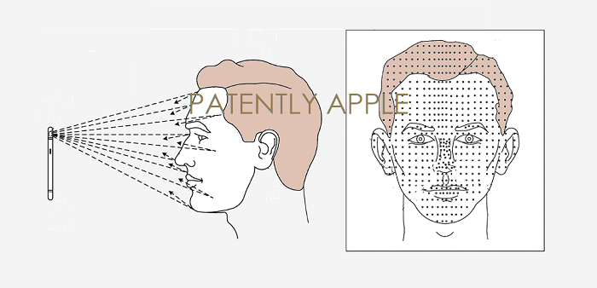
limitations of Existing Solutions
2D face recognition technologies
Vulnerable to various spoofing attacks
Textural features extraction: no ideal lighting
Challenge-response protocols: unreliable
Liveness detection via specialized hardware
Apple’s TrueDepth
Infrared dot projector, dedicated cameras
Conflict between extra spaces required and the desire to maximize screen space
Samsung S10
Higher screen-to-body ratio, No specialized hardware
Vulnerable to attacks

Slide 6
Problem Formulation

Slide 7
Central Question
“How can we enable liveness detection on smartphones only relying on a single front camera?”

Slide 8
Core Intuition & Outline
Illumination via smartphone screen
Facial images captures
Recovery of the face surface structure via photometric stereo
Integration into 3D shape
Distinguishing via facial depth features
Security against replay attacks via random light passcode

Slide 9
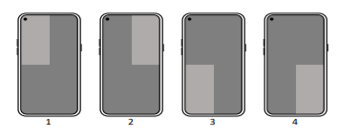
Key Challenges
Simple light patterns vulnerable to replay attacks.
Solution: light passcode
Ambient lighting in environment
Solution:
Carefully designed light passcodes
Separation of passcode from reflection mixture
Unknown lighting direction ⇒ uncertainty in the surface normal maps
Solution: general human surface normals template

Slide 10
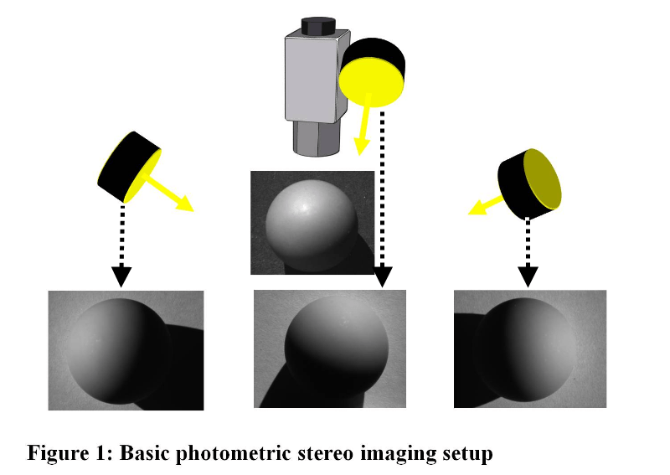
Basic Idea: Photometric stereo
A technique for recovering 3D surface
Uses Multiple images
Fixed object position
Varying lighting conditions
Intuition:
light reflection amount depends on
the orientation of the surface with
respect to the light source and the
camera.
https://multipix.com/supportblog/imaging-software-technique-photometric-stereo-explained/

Slide 11
Basic Idea: Photometric stereo
Computation of surface normal vectors S
Known Lighting Conditions
I^{T} = L^{T}S
Illumination I = [I₁,I₂,I₃], lighting direction L = [L₁,L₂,L₃]
Unknown Lighting Conditions
M = L^{T}S
m is the number of images and n is the number of pixels in each image
Solving by Singular Value Decomposition (SVD)
M = UΣV^{T}, L^{T} = U √Σ A, S = A⁻¹ √Σ V^{T}
A: 3 × 3 linear ambiguity matrix.
Practical visual examples in next section

Slide 12
System Development

Slide 13
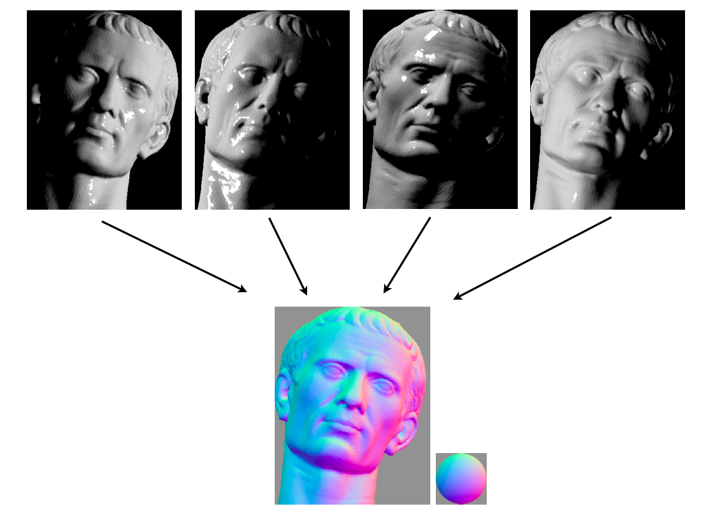
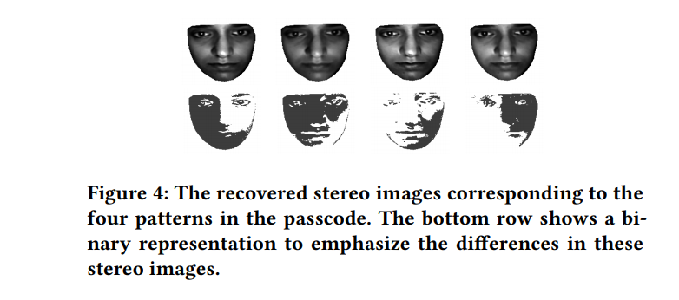
Photometric Stereo
https://upload.wikimedia.org/wikipedia/commons/b/b5/Photometric_stereo.png

Slide 14
light passcode
“Defined as a collection of four random light patterns displayed in the four quarters”

Slide 15
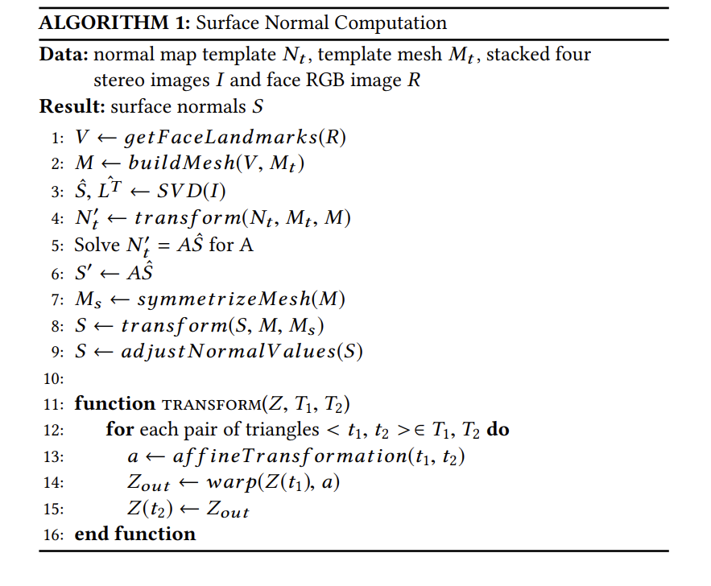
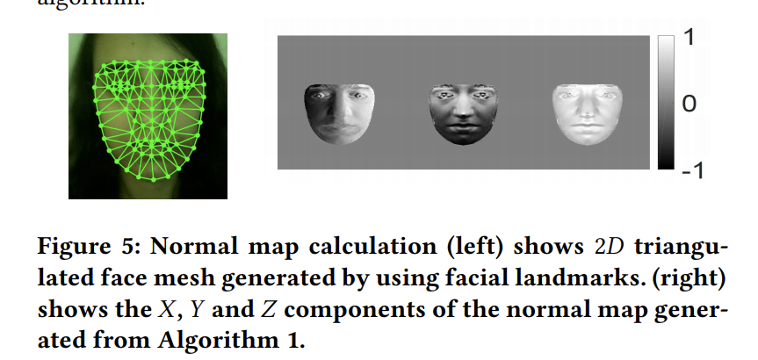
System Overview
Notes:
include linearization of sensor data, white balancing, demosaicing [6] and gamma calibration [7]. Gamma calibration
Apply SVD

Slide 16
Liveness Detection

Slide 17
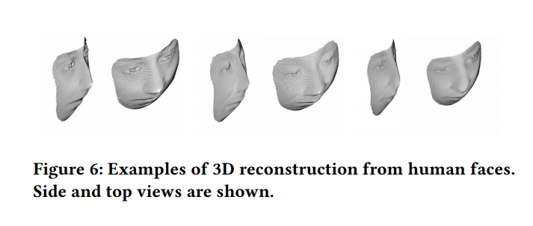
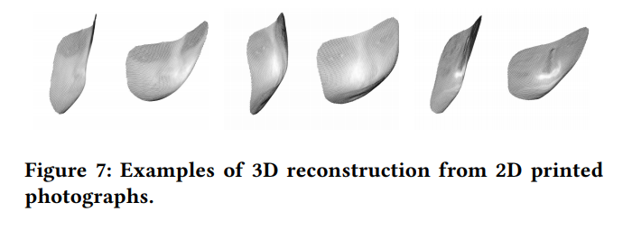
2D Printed Photograph Attack

Slide 18
2D Printed Photograph Attack
Siamese neural network - trained with depth map instead of raw images/videos (to avoid environment conditions) (less data required)

Slide 19
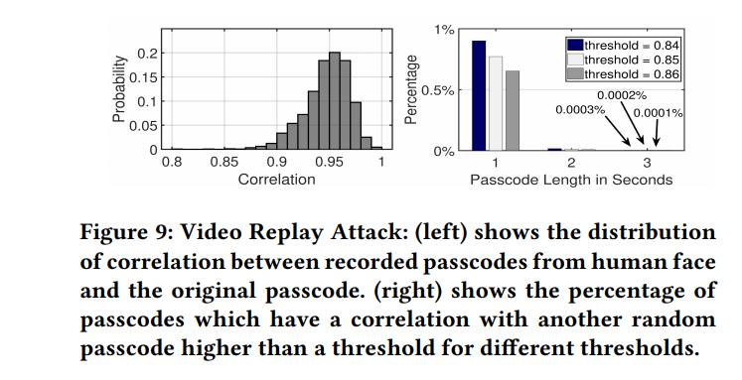
Video Replay Attacks
First Line - Randomness of passcode
Second Line - Same as 2D photo attack

Slide 20
Evaluation

Slide 21
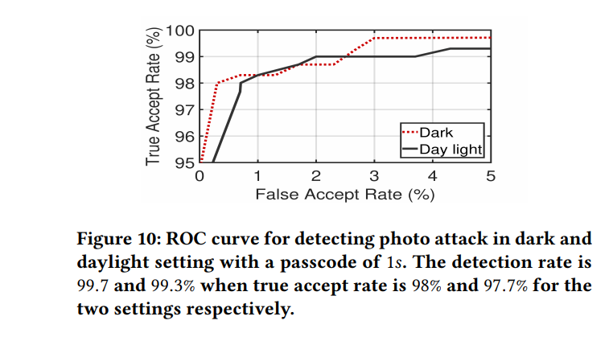
Evaluation - Overall performance
Dark: 98% accept rate, 0.33% false accept rate (2% rejected trails 99.7% photo attack)
Daylight: 97.7% true accept rate (99.3% accuracy on photo attack)
EER 1.4% in both light and dark
The correlation for all the attack videos is less than 0.9. In contrast, 99.8% of the videos from real human users have a correlation higher than 0.9.
Notes:
Samsung S10 which runs Android 9, 1280x960 and 30 fps, 30 volunteers 18-60, 3 weeks, 4900 videos under different lights
EER: False accept rate = false reject rate (equal error rate)

Slide 22
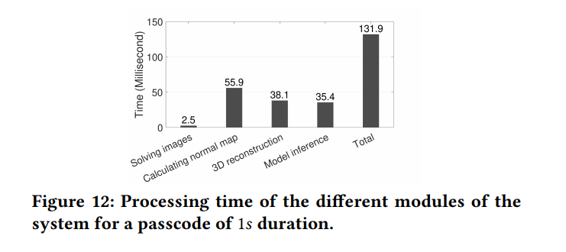
Evaluation - Process time

Slide 23
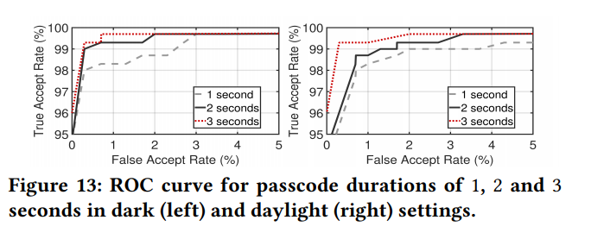
Evaluation - duration of the light passcode
ERR = 1.44% for 1s
ERR = 0.7 for 2s and 3s

Slide 24
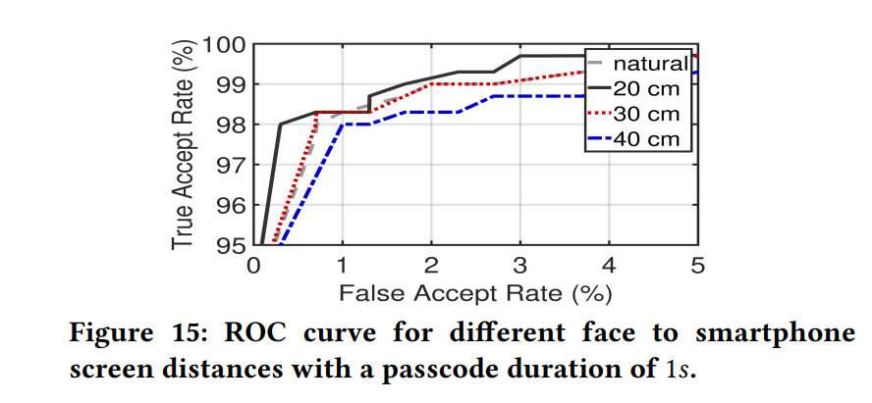
Evaluation - Distance of cell phones
True accept rate drops but accuracy of detecting photo attacks remains 99.3%.

Slide 25
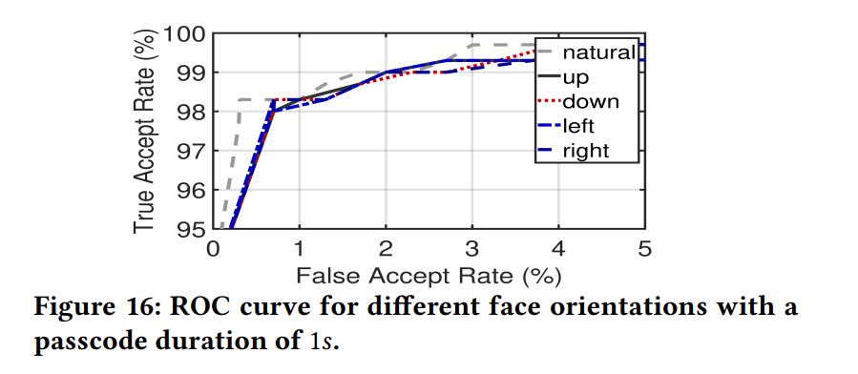
Evaluation - Orientation of cell phones
True accept rate drops (99.3% to ~98%) but accuracy of detecting photo attacks remains 99.3% and EER 1.44%.

Slide 26
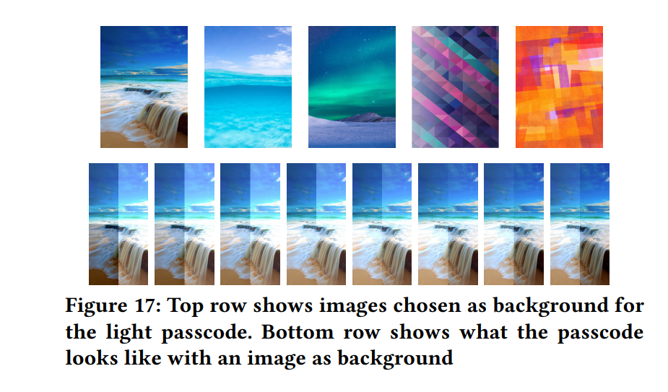
Evaluation - colorful background
EER = 1.15%
Accuracy of 99.4% when accept rate is 97%

Slide 27
Evaluation - power consumption
1.08mAH on average
3.4% with smartphone battery of 3500mAH, assuming unlock phone 100 times

Slide 28
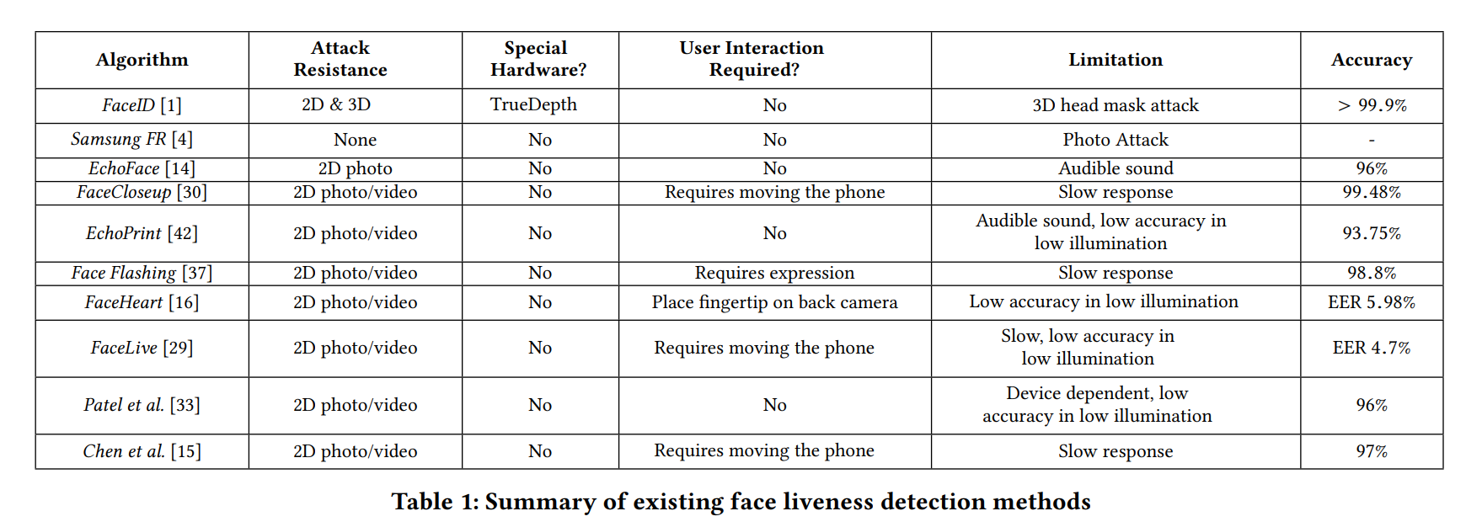
Evaluation - comparison with others

Slide 29
Insights
Using phone at dark environment
More than 4 area of phone display
Suitable solution for smartphones
Great defense against machine-learning-based attacks
Cons: Uniform albedo assumption
Effects of glasses
3D attacks

Slide 30
Some challenges
Phone screen refreshing rate and delay - low pass filter with threshold of 3Hz
Camera:
Using manual camera mode to keep ISO fixed.
Inverse gamma calibration
Delays -

Slide 31
Reference
Habiba Farrukh, Reham Mohamed Aburas, Siyuan Cao, and He Wang. 2020. FaceRevelio: a face liveness detection system for smartphones with a single front camera. In Proceedings of the 26th Annual International Conference on Mobile Computing and Networking (MobiCom '20). Association for Computing Machinery, New York, NY, USA, Article 49, 1–13. DOI:https://doi.org/10.1145/3372224.3419206

