Slide 1
Differentiable Autonomous Driving
Xijun Wang
11/04/2021

Slide 2
Contents
End-to-End Autonomous Driving Background
Interpretable End-to-End Autonomous Driving with Differentiable Semantic Occupancy Representation

Slide 3
Contents
End-to-End Autonomous Driving Background
Interpretable End-to-End Autonomous Driving with Differentiable Semantic Occupancy Representation

Slide 4
Background | Traditional Stack
Maps
Perception
Prediction
Planning
Control
Sensors
Det
Track
Long Term Predictions
Motion Trajectory
Steering/Acceleration
[1] CVPR 2021 Tutorial: All About Self-Driving

Slide 5
Background | End-to-end Stack
Trainable, End to End
Maps
Plan Trajectory Control variables
Sensors
Advantages: single system, low reaction time, trained end-to-end;
Disadvantages: lack of interpretability, difficult to incorporate prior knowledge (e.g., Rules of traffic);
[1] CVPR 2021 Tutorial: All About Self-Driving

Slide 6
Background | End-to-end Stack | Input
Image
RGB Image
Semantic Image
Strengths:
Cheap sensor
Suitable for 2D CNN
Weaknesses
Affected by light conditions
Lacking accurate 3D measurements
Lidar
HD Map
Intention
…
[1] CVPR 2021 Tutorial: All About Self-Driving

Slide 7
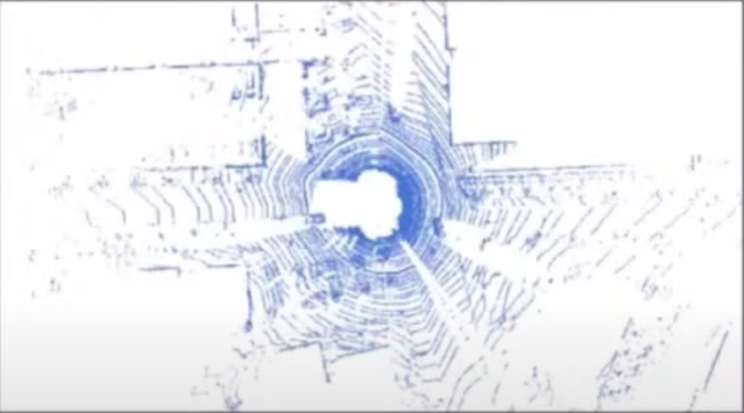
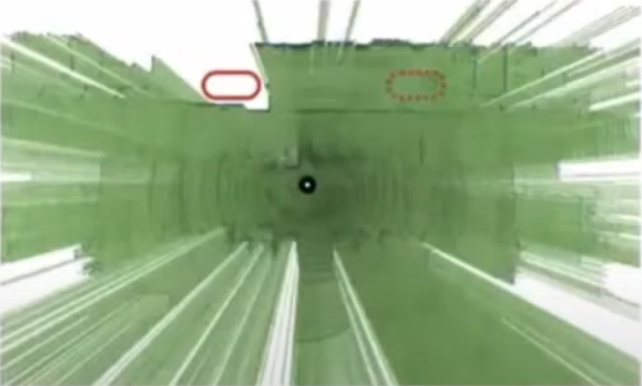
Background | End-to-end Stack | Input
Image
LiDAR Birds-Eye-View
LiDAR Visibility
Strengths:
Robust measurements
Accurate 3D information
Weaknesses
Lack some semantic information
More Expensive
LiDAR
HD Map
Intention
…
[1] CVPR 2021 Tutorial: All About Self-Driving

Slide 8
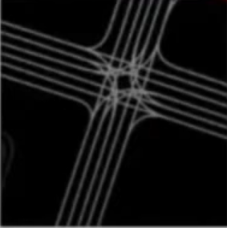
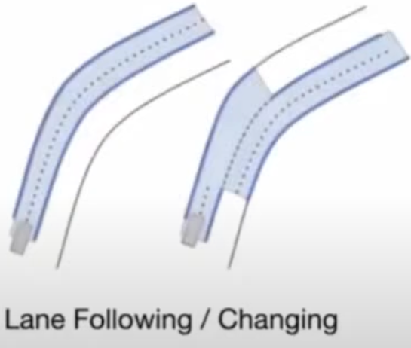
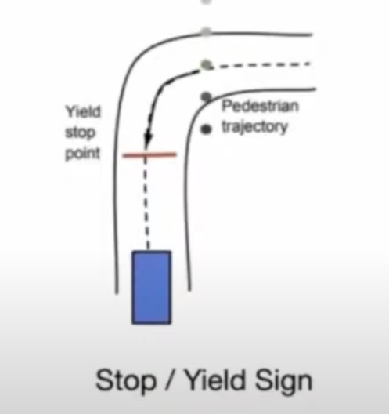
Background | End-to-end Stack | Input
Image
Rasterization
Strengths:
Suit for 2D CNN
Simple Pipeline
Weaknesses
Hard to encode prior knowledge
Affordance
Strengths:
Encode prior knowledge
Weaknesses
Hand-craft features
LiDAR
Road mask
Speed limit
HD Map
Intention
…
[1] CVPR 2021 Tutorial: All About Self-Driving
Notes:
Road Mask Speed limit

Slide 9
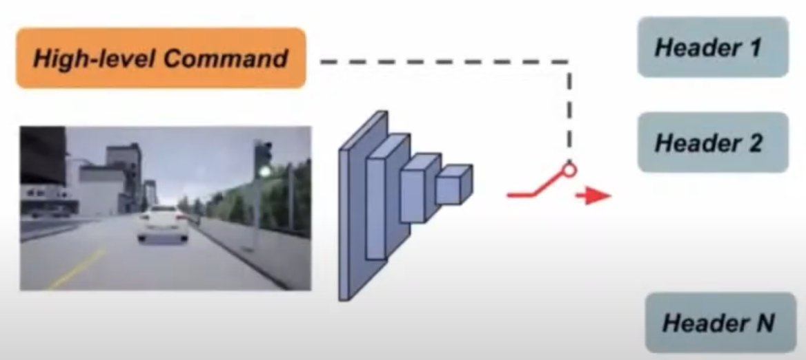
Background | End-to-end Stack | Input
Image
High-Level Command
LiDAR
HD Map
Intention
…
[1] CVPR 2021 Tutorial: All About Self-Driving

Slide 10
Background | End-to-end Stack | Model
CNN
Convolutional Neural Network
Strengths:
Effective and Efficient
Well studied and have a lots of options
Weaknesses
Unfriendly for temporal information
RNN
MLP
Transformer
…
[1] CVPR 2021 Tutorial: All About Self-Driving

Slide 11
Background | End-to-end Stack | Model
CNN
Recurrent Neural Network
Strengths:
Friendly for temporal information
Weaknesses
Unfriendly for efficient parallel computing；
RNN
MLP
Transformer
…
[1] CVPR 2021 Tutorial: All About Self-Driving

Slide 12
Background | End-to-end Stack | Model
CNN
Multilayer Perceptron
Strengths:
High capacity
Global reception
Weaknesses
Large mount of Params and Flops
Over fitting
RNN
MLP
Transformer
…
[1] CVPR 2021 Tutorial: All About Self-Driving

Slide 13
Background | End-to-end Stack | Model
CNN
Transformer
Strengths:
High capacity
Global reception
Suitable for large model
Friendly for multi data modality
Weaknesses
Hard to optimize
Need big data to train
RNN
MLP
Transformer
…
[1] CVPR 2021 Tutorial: All About Self-Driving

Slide 14
Background | End-to-end Stack | Output
Actuation
Control Command
Waypoints
Strengths:
Simple
Well studied in imitation literature
Weaknesses
Hard to encode prior knowledge
Lack interpretability
Cost
Affordance
Auxiliary
…
[1] CVPR 2021 Tutorial: All About Self-Driving

Slide 15
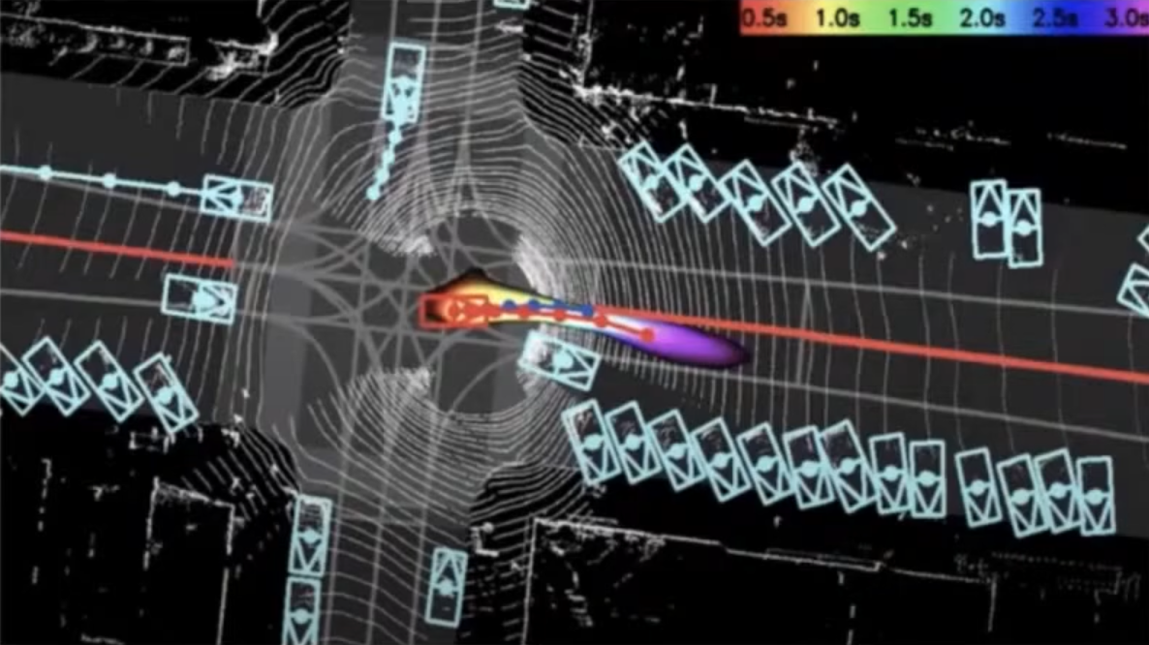
Background | End-to-end Stack | Output
Actuation
Cost / Cost Map
Strengths:
Easy to encoder prior knowledge
Well aligned with traditional methods
Weaknesses
No direct supervision, hard to train.
Cost
Affordance
Auxiliary
…
[1] CVPR 2021 Tutorial: All About Self-Driving

Slide 16
Background | End-to-end Stack | Output
Actuation
Predefined continuous / discrete values
Cost
Affordance
Auxiliary
…
[1] CVPR 2021 Tutorial: All About Self-Driving

Slide 17
Background | End-to-end Stack | Output
Actuation
Auxiliary Outputs:
Object Detection;
Segmentation;
Depth Completion;
Optical Flow;
Cost
Affordance
Auxiliary
…
[1] CVPR 2021 Tutorial: All About Self-Driving

Slide 18
Contents
End-to-End Autonomous Driving Background
Interpretable End-to-End Autonomous Driving with Differentiable Semantic Occupancy Representation

Slide 19
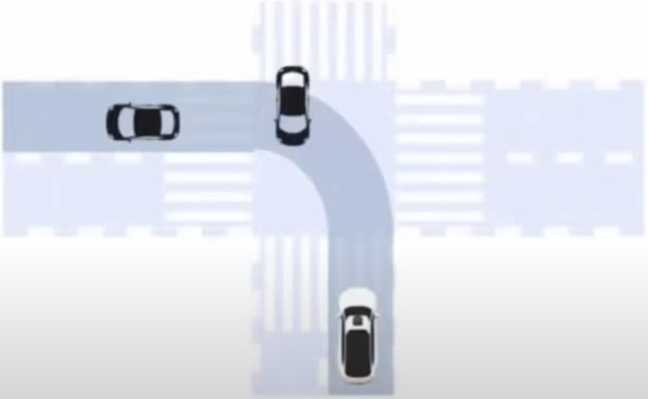
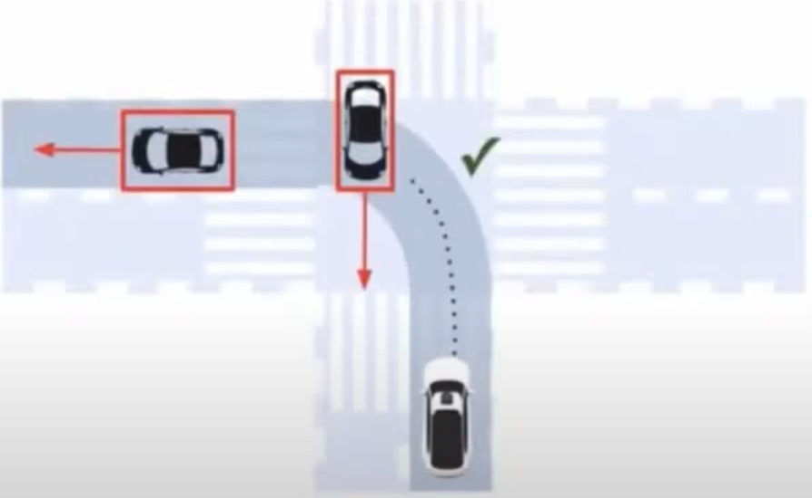
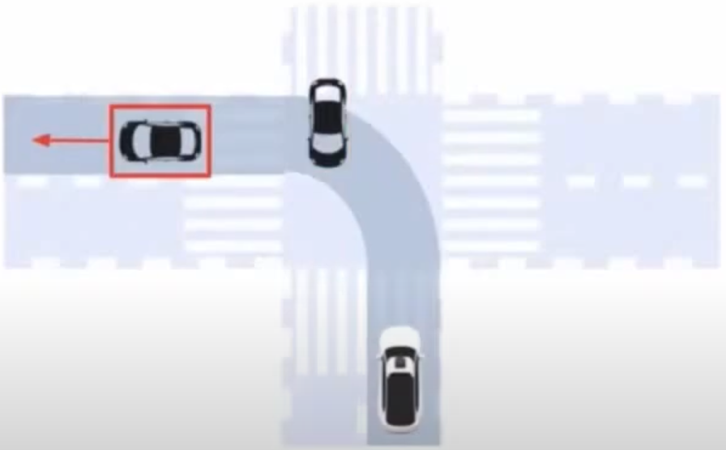
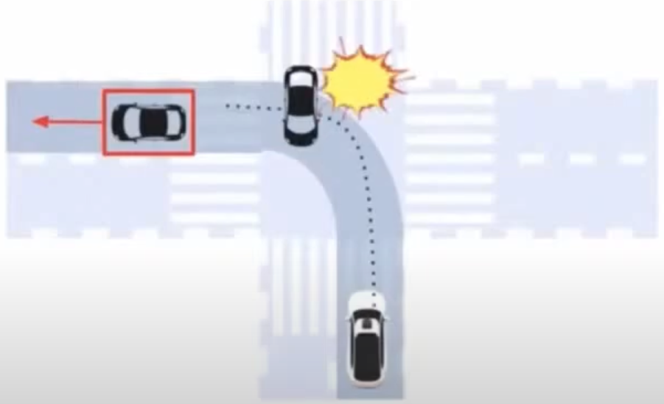
Differentiable Semantic Occupancy Representation
[1] Sadat, A., Casas, S., Ren, M., Wu, X., Dhawan, P., Urtasun, R.: Perceive, predict, and plan: Safe motion planning through interpretable semantic representations. ECCV (2020)

Slide 20
Differentiable Semantic Occupancy Representation
Generates scene-level occupancy representations
Uses structured cost functions
Non-parametric sematic occupancy maps
Interpretable subcosts encoding prior
[1] Sadat, A., Casas, S., Ren, M., Wu, X., Dhawan, P., Urtasun, R.: Perceive, predict, and plan: Safe motion planning through interpretable semantic representations. ECCV (2020)

Slide 21
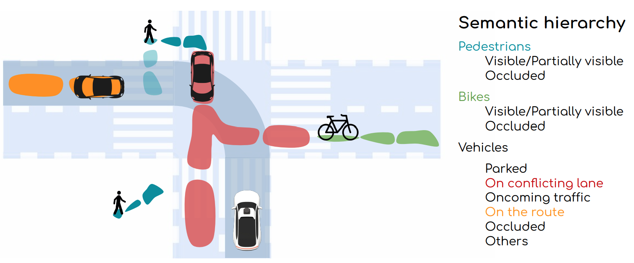
Differentiable Semantic Occupancy Representation
What is Semantic Occupancy?
Predicting the future motion area (free space) of traffic participants;
capturing locations of objects of different classes (i.e., vehicles, bicyclists, and pedestrians) as well as potentially occluded ones.
[1] Sadat, A., Casas, S., Ren, M., Wu, X., Dhawan, P., Urtasun, R.: Perceive, predict, and plan: Safe motion planning through interpretable semantic representations. ECCV (2020)

Slide 22
Differentiable Semantic Occupancy Representation
How to get the Semantic Occupancies?
Traditional methods:
Detection and tracking
Gaussian, mixture of Gaussians;
This incorporates strong assumptions, lacks expressivity, not stable;
The proposed Differentiable programming method:
Remove detection and tracking → efficient and effective;
End-to-end learnable, easy to optimize and more stable;
[1] Sadat, A., Casas, S., Ren, M., Wu, X., Dhawan, P., Urtasun, R.: Perceive, predict, and plan: Safe motion planning through interpretable semantic representations. ECCV (2020)

Slide 23
Differentiable Semantic Occupancy Representation
Semantic Occupancy Design
Subclasses: mutually-exclusive
[1] Sadat, A., Casas, S., Ren, M., Wu, X., Dhawan, P., Urtasun, R.: Perceive, predict, and plan: Safe motion planning through interpretable semantic representations. ECCV (2020)
Notes:
mutually-exclusive

Slide 24
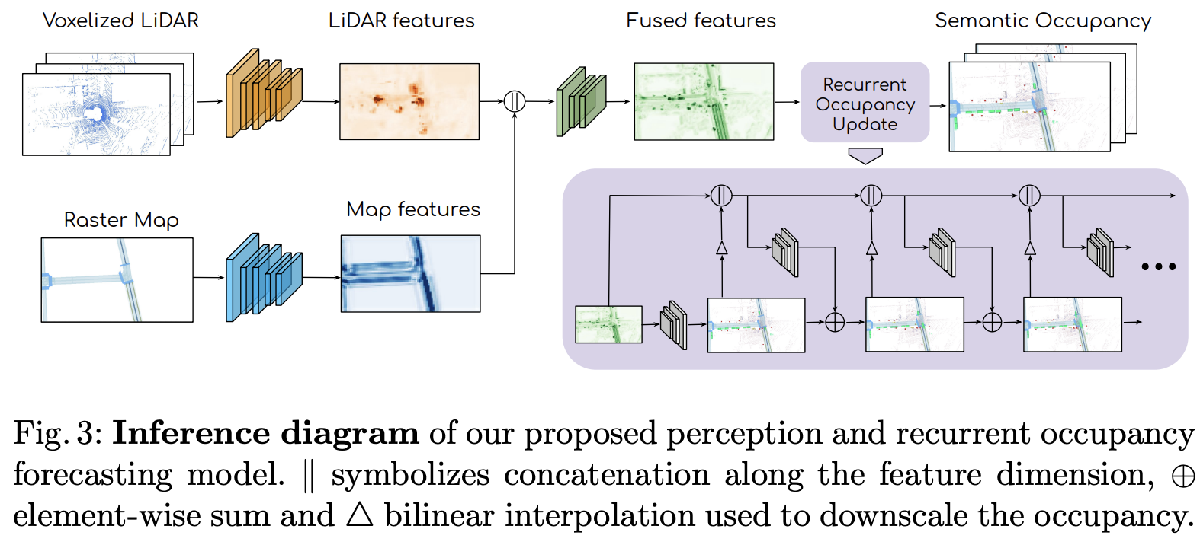
Differentiable Semantic Occupancy Representation
Detail: l: the predicted logits, t: time, c: class, $μ_{θ}^{t}$: neural network, $F_{occ}$: concatenated feature, ||: feature-wise concatenation, $I$: 2x bilinear interpolation.
$o_{i,j}^{t,c}$represent the occupancy of each class, $o_{i,j}^{t,c}=softmax(l^{t,c})$
[1] Sadat, A., Casas, S., Ren, M., Wu, X., Dhawan, P., Urtasun, R.: Perceive, predict, and plan: Safe motion planning through interpretable semantic representations. ECCV (2020)

Slide 25
Differentiable Semantic Occupancy Representation
Cost function
Loss function
$𝒯$: trajectories, f: objective function, X: input, O: occupancy, w: parameter, t: time, c: class, v: velocity;
$f_{o}$: make sure the trajectory is safe with regards to the semantic occupancy forecasts;
$f_{r}$: related to comfort, traffic rules and progress in the route;
[1] Sadat, A., Casas, S., Ren, M., Wu, X., Dhawan, P., Urtasun, R.: Perceive, predict, and plan: Safe motion planning through interpretable semantic representations. ECCV (2020)

Slide 26
Differentiable Semantic Occupancy Representation
Loss function
$ℒ$: loss function, $ℒ_{S}$: Semantic Occupancy Loss (cross entropy), $ℒ_{M}$: Planning Loss (max-margin),
$𝒯$: trajectories, f: objective function, X: input, O: occupancy, w: parameter, t: time, c: class, S: spatial;
$f_{o}$: make sure the trajectory is safe with regards to the semantic occupancy forecasts;
$f_{r}$: related to comfort, traffic rules and progress in the route;
$l_{im}$: imitation task-loss of trajectory, $l_{o}^{t}$: collisions and their severity at each trajectory step
[1] Sadat, A., Casas, S., Ren, M., Wu, X., Dhawan, P., Urtasun, R.: Perceive, predict, and plan: Safe motion planning through interpretable semantic representations. ECCV (2020)
Notes:
H: human

Slide 27
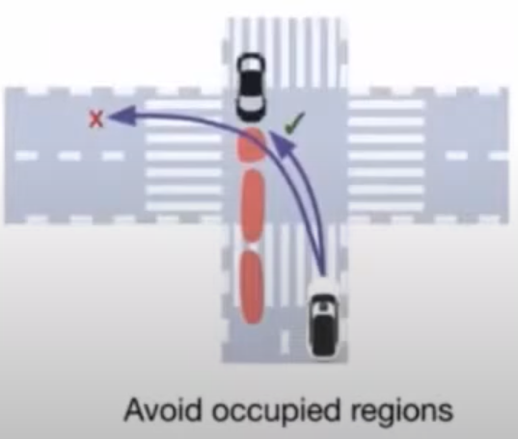
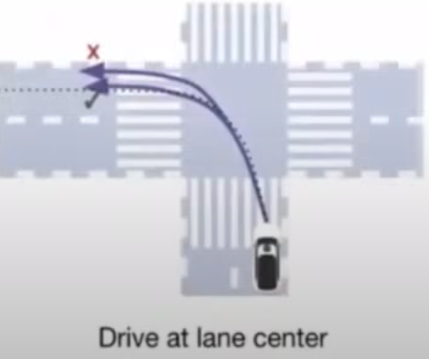
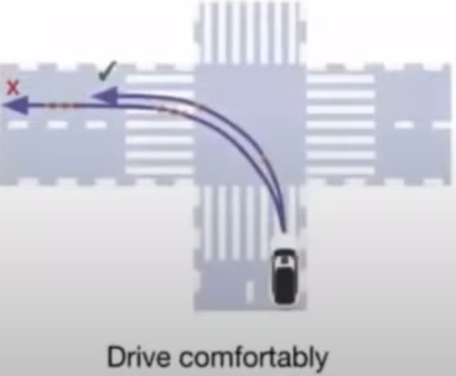
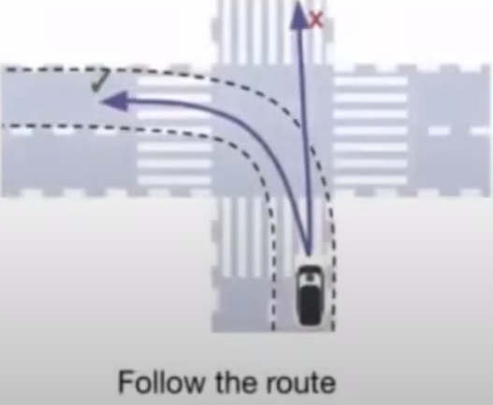
Differentiable Semantic Occupancy Representation
Pick the minimum-cost trajectory
Cost functions
Safety (occupancy predictions)
Comfort and traffic-rules
Route following
[1] Sadat, A., Casas, S., Ren, M., Wu, X., Dhawan, P., Urtasun, R.: Perceive, predict, and plan: Safe motion planning through interpretable semantic representations. ECCV (2020)

Slide 28
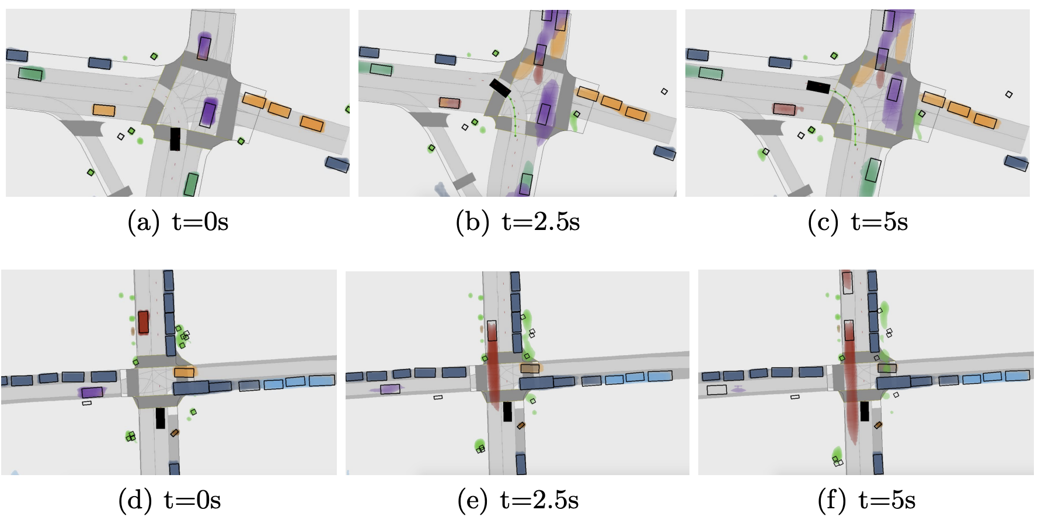
Differentiable Semantic Occupancy Representation
Qualitative results, ego vehicle (solid black rectangle)
[1] Sadat, A., Casas, S., Ren, M., Wu, X., Dhawan, P., Urtasun, R.: Perceive, predict, and plan: Safe motion planning through interpretable semantic representations. ECCV (2020)

Slide 29
Q&A
THANK YOU

