Slide 1
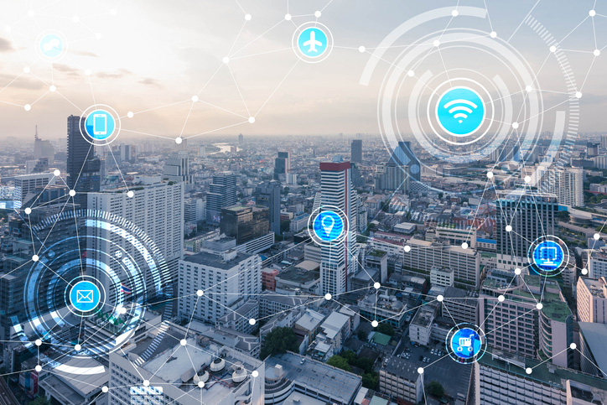
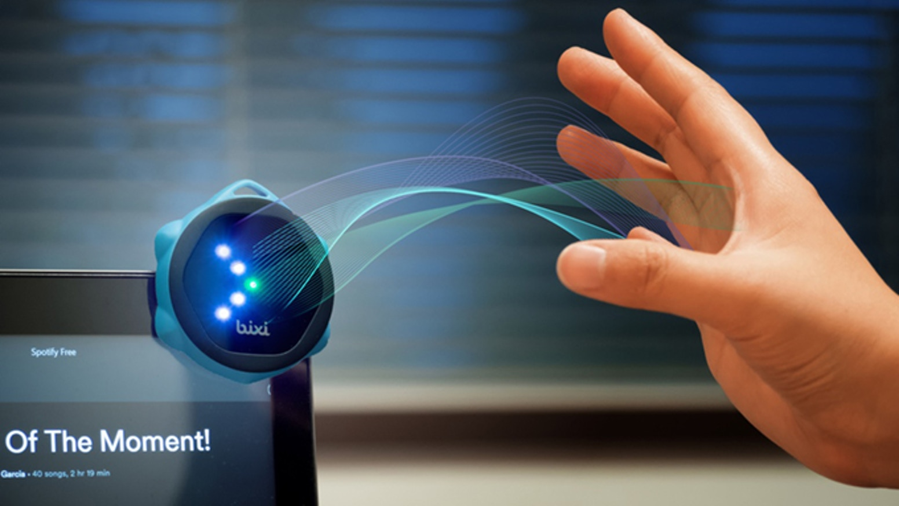
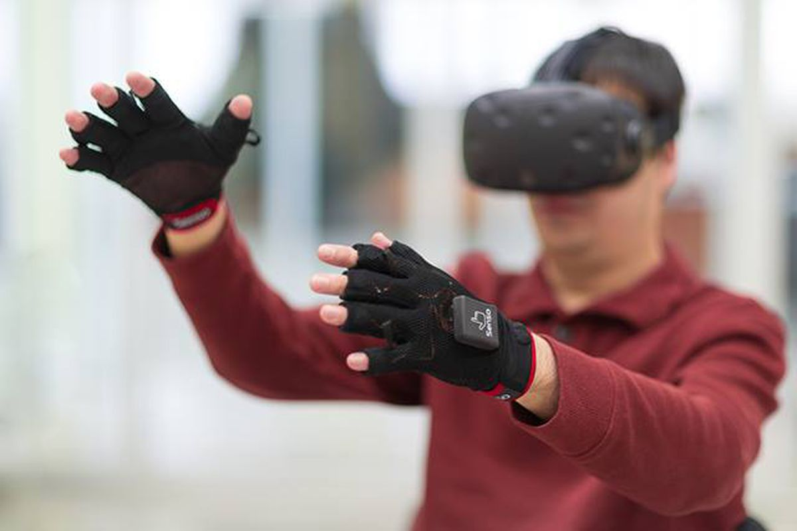
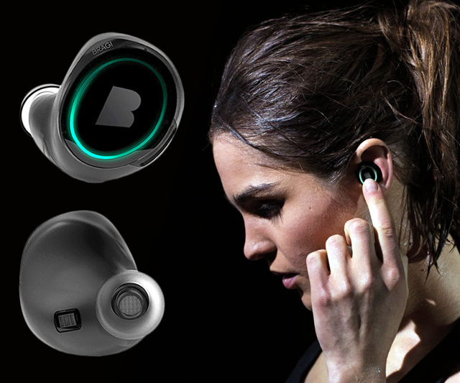
Wireless and Mobile Systems
for the IoT
CMSC 715: Fall 2023
Lecture 1.1: Sensors and DSP Basics
Nirupam Roy
Tu-Th 12:30-1:45pm
CSI 2107

Slide 2
Abstraction
Computing: Models and Algorithms

Slide 3
Abstraction
Computing: Models and Algorithms
Data

Slide 4
Abstraction
Computing: Models and Algorithms
Data
Sensing techniques

Slide 5
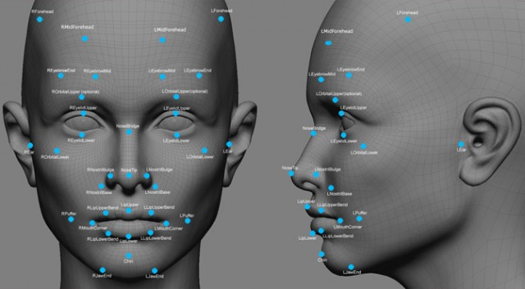
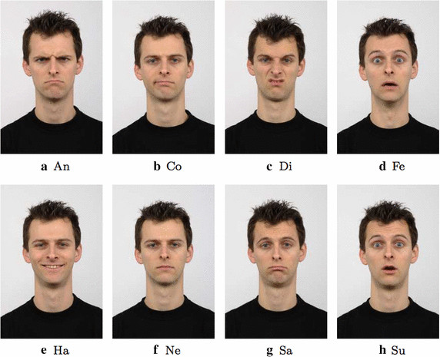
Abstraction
Computing: Models and Algorithms
Data
Sensing techniques

Slide 6
Abstraction: Traditional view
Computing: Models and Algorithms
Data
Data
Sensing techniques

Slide 7
Abstraction: Traditional view
Natural language
processing
Computer
vision
Networking
Data packets
Voice recording
Image/video

Slide 8
Abstraction: Traditional view
Natural language
processing
Computer
vision
Networking
Data packets
Voice recording
Image/video
WiFi signal
Acoustic signal
Light

Slide 9
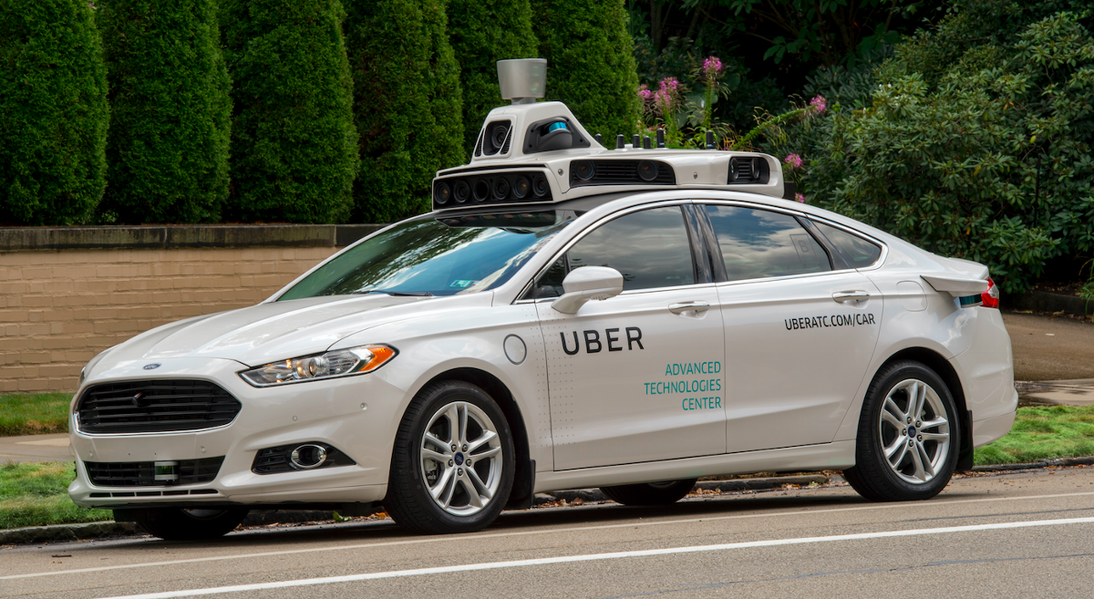
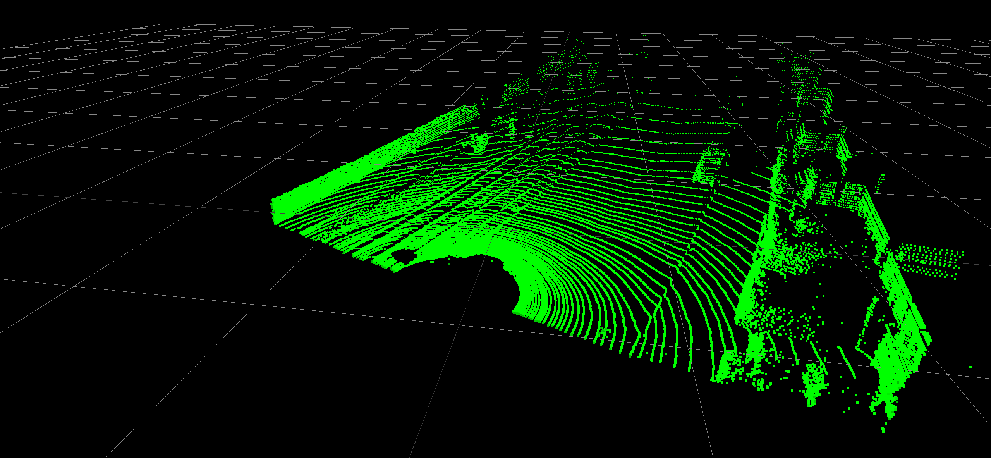
Integration of sensing and computing
Notes:
Image source: https://www.geospatialworld.net/blogs/5-ways-lidar-is-transforming-the-world-before-our-eyes/
Image source: https://github.com/alvinwan/pc2vid

Slide 10
Integration of sensing and computing
Notes:
Image source: https://searchcustomerexperience.techtarget.com/definition/voice-recognition-speaker-recognition

Slide 11
Abstraction
Computing: Models and Algorithms
Data
Sensing techniques

Slide 12
Concept of Sensing

Slide 13
Gesture/Motion/
Orientation
Vital signs detection
Autonomous vehicle control
Physical environment
(light, sound, speed, geomagnetism, radio waves, …)

Slide 14
Gesture/Motion/
Orientation
Vital signs detection
Autonomous vehicle control
Physical environment
(light, sound, speed, geomagnetism, radio waves, …)

Slide 15
Gesture/Motion/
Orientation
Vital signs detection
Autonomous vehicle control
Signal
Physical environment
(light, sound, speed, geomagnetism, radio waves, …)

Slide 16
Sensors
- Definitions
- Generic working principle
2. Signals
- Digital abstraction
- Mathematical model

Slide 17
What is a sensor?

Slide 18
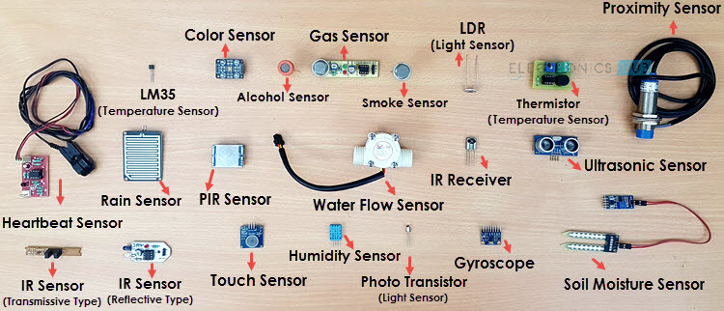
What is a sensor?
Is there a common principle?
Notes:
Image source: https://www.electronicshub.org/different-types-sensors/

Slide 19
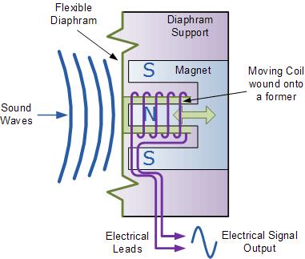
How does a sound sensor (microphone) work?

Slide 20
How does a sound sensor (microphone) work?

Slide 21
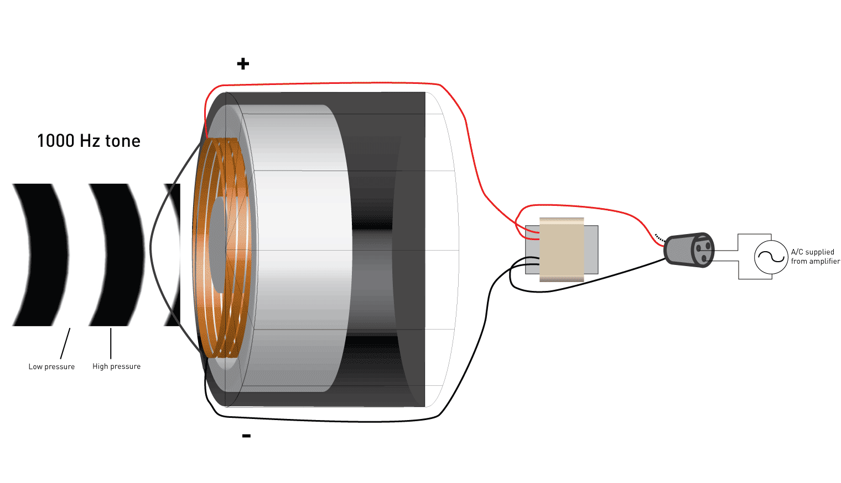
How does a sound sensor (microphone) work?

Slide 22
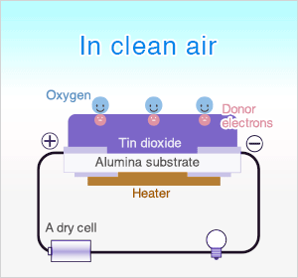
2. How does a gas sensor work?

Slide 23
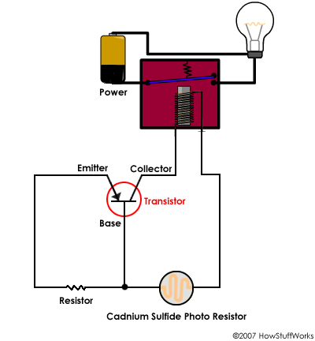
3. How does a light sensor work?

Slide 24
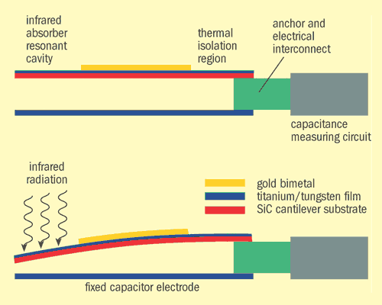
How does a temperature sensor work?
Circuit sensitive to capacitance change
Voltage signal

Slide 25
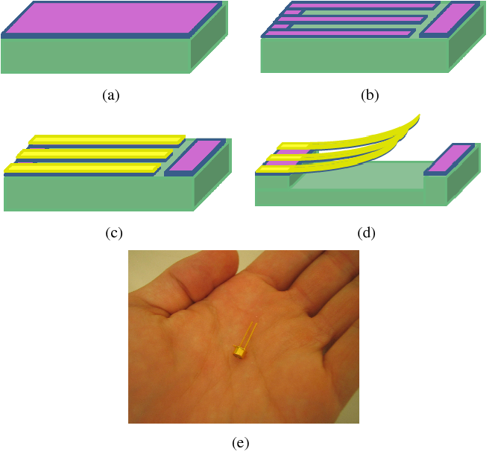
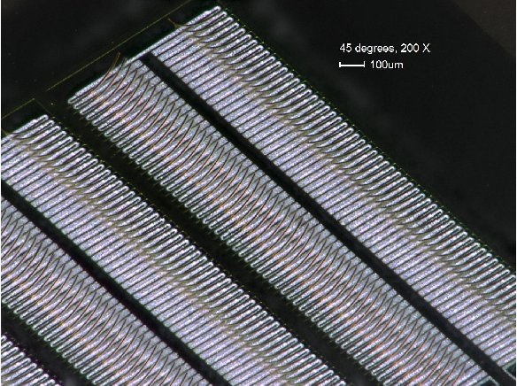
How does a temperature sensor work?
MEMS (Micro-Electro Mechanical Systems)

Slide 26
Fundamental principle of sensors
Electrical fluctuations
proportional to the
speed/volume of air-flow
Air flow
Mapping
10 Miles per hour
Mapping

Slide 27
SENSOR
A structure or material
that reacts to the physical phenomenon
A circuit that converts the reaction to measurable electrical signal (e.g. voltage)
A physical phenomenon
We want to measure
Interpretation of the signal, storing the data

Slide 28
Fundamental principle of sensors
Temperature
Voltage
Thermo-couple
Time
At time t
Mapping
Temp.
40° F
(a scalar value)
Time

Slide 29
Scalar vs. Vector Output

Slide 30
Scalar and vector output
Y
X
Global coordinate system

Slide 31
Coordinate system
Y
X

Slide 32
Coordinate system
Local coordinate system
Y
X

Slide 33
Coordinate system
Local coordinate system
Y
V_{y}
V_{X}
X

Slide 34
Coordinate system
Local coordinate system
Y
V_{y}
V_{X}
X
Output = <V_{x}, V_{y}>

Slide 35
Coordinate system
Local coordinate system
Y
V_{y}
V_{x}
X
Output at time t
<V_{x} (t), V_{y}(t)>
for a 2-axis sensor

Slide 36
Coordinate system
Local coordinate system
Y
V_{y}
V_{x}
X
Z
Output at time t
<V_{x} (t), V_{y}(t), V_{z}(t)>
for a 3-axis sensor

Slide 37
Coordinate system

Slide 38
Coordinate system
North
Y
Local coordinate system
X
Z
Global coordinate system
East

Slide 39
Sensor data
Sensor data
Sensor
Scalar
Time
Vector
Sensor data
Time
Mapping

Slide 40
Sensor data
Sensor data
Sensor
Scalar
Time
Vector
Sensor data
Output at time t
<V_{x} (t), V_{y}(t), V_{z}(t)>
Time
Mapping

Slide 41
Properties of a signal
Frequency, Amplitude, and Phase

Slide 42
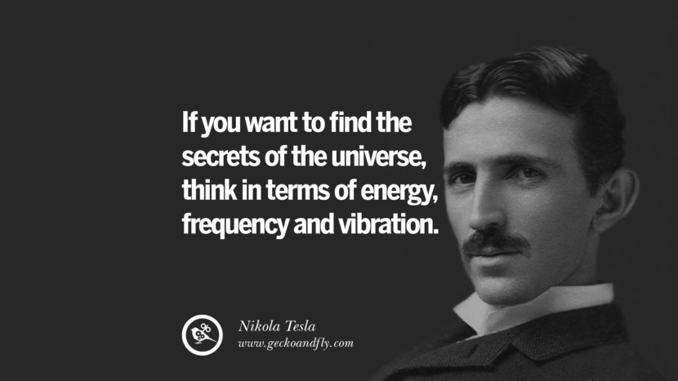
What is frequency?

Slide 43
Definition of Frequency
Frequency is the number of occurrences of a repeating event per unit of time.

Slide 44
Frequency, Amplitude, and Phase

Slide 45
Frequency, Amplitude, and Phase
Time

Slide 46
Frequency, Amplitude, and Phase
$$f cycles per second$$
$$2π angles per cycle$$
Time

Slide 47
Frequency, Amplitude, and Phase
One cycle
+A
A
0
Amplitude
-A
Time

Slide 48
Frequency, Amplitude, and Phase
$$2π angles per cycle$$
$$f cycles per second$$
A
𝚹
time = t second
$$=$$
$$A . sin⁡(θ)$$
$$=$$
$$A . sin⁡(2πft)$$

Slide 49
Frequency, Amplitude, and Phase
$$2π angles per cycle$$
$$f cycles per second$$
A
𝚹
Phase
time = t second
$$=$$
$$A . sin⁡(θ)$$
$$=$$
$$A . sin⁡(2πft)$$

Slide 50
Frequency, Amplitude, and Phase
$$2π angles per cycle$$
$$f cycles per second$$
A
𝚹
Phase
time = t second
$$=$$
$$A . sin⁡(θ)$$
$$=$$
$$A . sin⁡(2πft)$$
$$A . sin⁡(2πft+φ)$$
-- with initial/additional phase ϕ

Slide 51
Frequency, Amplitude, and Phase

Slide 52
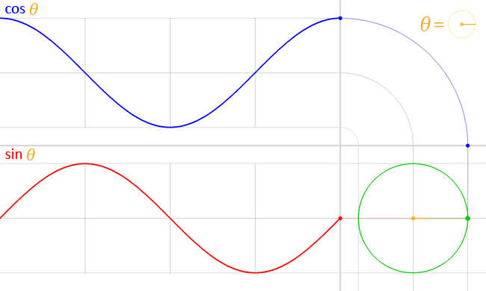
Frequency, Amplitude, and Phase
$$A . sin⁡(θ)$$
$$A . cos⁡(θ)$$

Slide 53
Frequency, Amplitude, and Phase
$$2π angles per cycle$$
$$f cycles per second$$
A
𝚹
time = t second
$$=$$
$$A . cos⁡(θ)$$
$$=$$
$$A . cos⁡(2πft)$$
$$=$$
$$A . sin⁡(2πft+(π/2))$$

Slide 54
Frequency, Amplitude, and Phase
Frequency: 2Hz
Amplitude
Time (sec)
0.00
0.25
0.50
0.75
1.00
1.25
Notes:
1) Two common terms related to signals are amplitude and frequency. Frequency is the number of repetition of the signal per second.

Slide 55
Frequency, Amplitude, and Phase
Frequency: 2Hz
Amplitude
Time (sec)
0.00
0.25
0.50
0.75
1.00
1.25
Frequency: 4Hz
Amplitude
Time (sec)
0.00
0.25
0.50
0.75
1.00
1.25

Slide 56
Frequencies of an arbitrary signal
Frequency: 2Hz
Amplitude
Time (sec)
0.00
0.25
0.50
0.75
1.00
1.25
Amplitude
Time (sec)
0.00
0.25
0.50
0.75
1.00
1.25

Slide 57
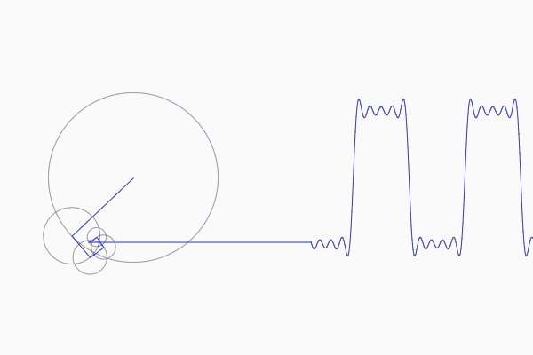
Frequencies of an arbitrary signal

Slide 58
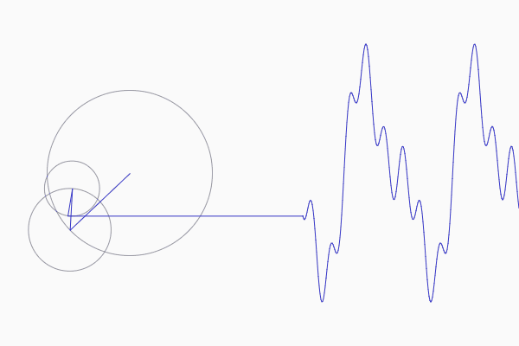
Frequencies of an arbitrary signal

Slide 59
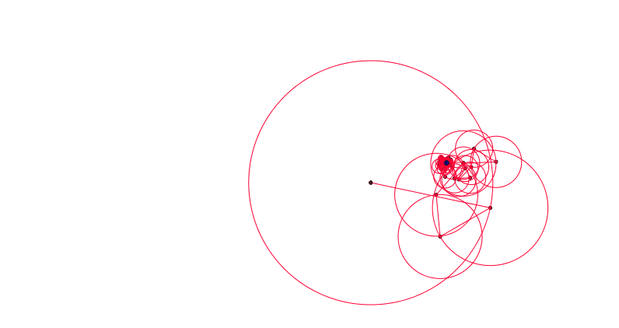
Frequencies of an arbitrary signal

Slide 60
The concept of the Fourier series
Amplitude
Time (sec)
0.00
0.25
0.50
0.75
1.00
1.25
Amplitude
Time (sec)
0.00
0.25
0.50
0.75
1.00
1.25

Slide 61
Time Domain and Frequency Domain
Approx. square wave
$$1 .\sin\left(2πft\right)$$
$$\frac{1}{3} .\sin\left(2π.3ft\right)$$
$$\frac{1}{5} .\sin\left(2π.5ft\right)$$
$$\frac{1}{7} .\sin\left(2π.7ft\right)$$

Slide 62
Time Domain and Frequency Domain
Time domain view
Frequency domain view

Slide 63
Analogy: Food coloring chart
Basis for food colors
Notes:
Emphasize basis and coefficient using Color analogy

Slide 64
Analogy: Food coloring chart
Basis for food colors
Notes:
Emphasize basis and coefficient using Color analogy

Slide 65
Analogy: Food coloring chart
Basis for food colors
Notes:
Emphasize basis and coefficient using Color analogy

Slide 66
Analogy: Food coloring chart
Basis for food colors
Notes:
Emphasize basis and coefficient using Color analogy

Slide 67
Time Domain and Frequency Domain
Amplitude
Time (sec)
0.00
0.25
0.50
0.75
1.00
1.25
$$= A1 .\sin\left(2πf1t\right)+B1 . cos⁡(2πf1t)$$
$$+ A2 .\sin\left(2πf2t\right)+B2 . cos⁡(2πf2t)$$
$$+ A3 .\sin\left(2πf3t\right)+B3 . cos⁡(2πf3t)$$
$$+ …$$

Slide 68
Time Domain and Frequency Domain
Fourier Transform
FFT
Amplitude
Amplitude
IFFT
0.00
0.25
0.50
0
2
4
6
8
Time
Frequency (Hz)
Time domain
Frequency domain
FFT = Fast Fourier Transform
IFFT = Inverse Fast Fourier Transform

Slide 69
Frequency band
Amplitude
0
2
4
6
8
Frequency (kHz)
A 4 kHz frequency band starting at 2 kHz
What is bandwidth?
What is baseband?

Slide 70
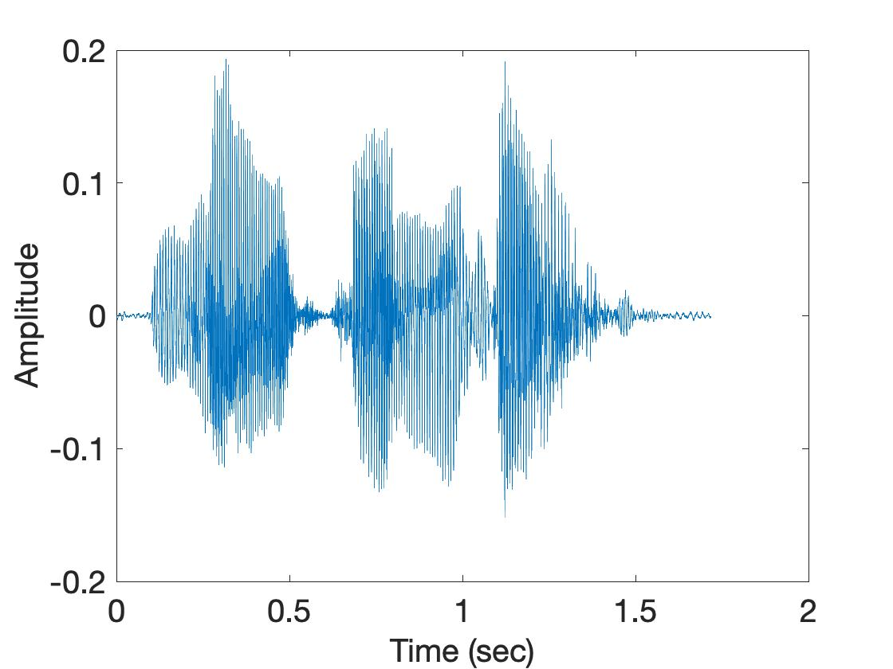
Spectrogram
U
M
D

Slide 71
Spectrogram
U
M
D
[
[
[
FFT of overlapping windows
of samples
(Spectrogram)
[
FFT
FFT
FFT
FFT

Slide 72
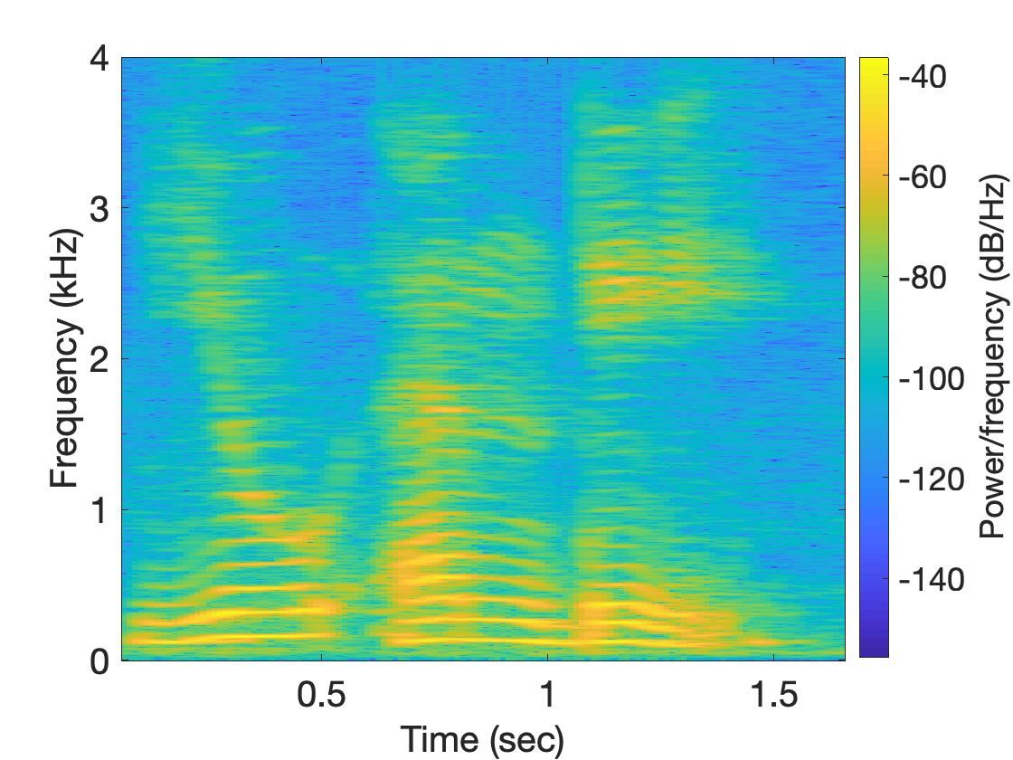
Spectrogram
U
M
D

