Slide 1
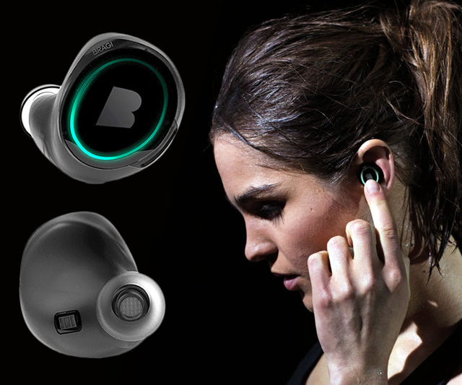
Wireless and Mobile Systems
for the IoT
CMSC 715 : Fall 2023
Lecture 1.4: Properties of the Discrete Fourier Transform
and visualizing DFT coefficients
Nirupam Roy
Tu-Th 12:30-1:45pm
CSI 2107

Slide 2
Discrete Fourier Transform
…
0
1
2
3
4
5
6
N-1
Sample number
…
0
1
2
3
4
5
6
N-1
Sample number
…
0
1
2
3
4
5
6
N-1
Sample number

Slide 3
Discrete Fourier Transform
‘m’ complete cycles in N given samples.
$$e^{j0.\frac{m.2π}{N}}$$
$$e^{j1.\frac{m.2π}{N}}$$
…
$$e^{j2.\frac{m.2π}{N}}$$
0
1
2
3
4
5
6
N-1
Sample number
…
$$e^{j(N−1).\frac{m.2π}{N}}$$

Slide 4
Discrete Fourier Transform
Freq f₀
n=0
$$e^{j0}$$
n=1
$$e^{j0}$$
n=2
$$e^{j0}$$
…
…
n=N-1
$$e^{j0}$$

Slide 5
Discrete Fourier Transform
Number of cycles
…
…
Freq f₀
Freq f₁
Freq f_{m}
Freq f_{N-1}
n=0
$$e^{j0}$$
n=1
$$e^{j0}$$
Sample number
n=2
$$e^{j0}$$
…
…
n=N-1
$$e^{j0}$$

Slide 6
Discrete Fourier Transform
Number of cycles
…
…
Freq f₀
Freq f₁
Freq f_{m}
Freq f_{N-1}
n=0
$$e^{j0}$$
$$e^{j0.\frac{2π}{N}}$$
$$e^{j0.\frac{m.2π}{N}}$$
$$e^{j0.\frac{(N−1).2π}{N}}$$
n=1
$$e^{j0}$$
$$e^{j1.\frac{2π}{N}}$$
$$e^{j1.\frac{m.2π}{N}}$$
$$e^{j1.\frac{(N−1).2π}{N}}$$
Sample number
…
…
$$e^{j2.\frac{(N−1).2π}{N}}$$
$$e^{j2.\frac{2π}{N}}$$
$$e^{j2.\frac{m.2π}{N}}$$
n=2
$$e^{j0}$$
…
…
…
…
…
$$e^{j(N−1).\frac{2π}{N}}$$
$$e^{j(N−1).\frac{m.2π}{N}}$$
$$e^{j(N−1).\frac{(N−1).2π}{N}}$$
n=N-1
$$e^{j0}$$

Slide 7
Discrete Fourier Transform
$$e^{j0}$$
$$e^{j0.\frac{2π}{N}}$$
$$e^{j0.\frac{m.2π}{N}}$$
$$e^{j0.\frac{(N−1).2π}{N}}$$
$$e^{j0}$$
$$e^{j1.\frac{2π}{N}}$$
$$e^{j1.\frac{m.2π}{N}}$$
$$e^{j1.\frac{(N−1).2π}{N}}$$
+
$$e^{j2.\frac{2π}{N}}$$
+
$$e^{j2.\frac{m.2π}{N}}$$
+
$$e^{j2.\frac{(N−1).2π}{N}}$$
Z₀
$$e^{j0}$$
Z₁
…
Z_{m}
…
Z_{N-1}
…
…
…
…
$$e^{j(N−1).\frac{2π}{N}}$$
$$e^{j(N−1).\frac{m.2π}{N}}$$
$$e^{j(N−1).\frac{(N−1).2π}{N}}$$
$$e^{j0}$$

Slide 8
Discrete Fourier Transform
$$e^{j0}$$
$$e^{j0.\frac{2π}{N}}$$
$$e^{j0.\frac{m.2π}{N}}$$
$$e^{j0.\frac{(N−1).2π}{N}}$$
$$e^{j0}$$
$$e^{j1.\frac{2π}{N}}$$
$$e^{j1.\frac{m.2π}{N}}$$
$$e^{j1.\frac{(N−1).2π}{N}}$$
+
$$e^{j2.\frac{2π}{N}}$$
+
$$e^{j2.\frac{m.2π}{N}}$$
+
$$e^{j2.\frac{(N−1).2π}{N}}$$
Z₀
$$e^{j0}$$
Z₁
…
Z_{m}
…
Z_{N-1}
…
…
…
…
$$e^{j(N−1).\frac{2π}{N}}$$
$$e^{j(N−1).\frac{m.2π}{N}}$$
$$e^{j(N−1).\frac{(N−1).2π}{N}}$$
$$e^{j0}$$

Slide 9
Discrete Fourier Transform
$$e^{j0}$$
$$e^{j0.\frac{2π}{N}}$$
$$e^{j0.\frac{m.2π}{N}}$$
$$e^{j0.\frac{(N−1).2π}{N}}$$
$$e^{j0}$$
$$e^{j1.\frac{2π}{N}}$$
$$e^{j1.\frac{m.2π}{N}}$$
$$e^{j1.\frac{(N−1).2π}{N}}$$
+
$$e^{j2.\frac{2π}{N}}$$
+
$$e^{j2.\frac{m.2π}{N}}$$
+
$$e^{j2.\frac{(N−1).2π}{N}}$$
Z₀
$$e^{j0}$$
Z₁
…
Z_{m}
…
Z_{N-1}
…
…
…
…
$$e^{j(N−1).\frac{2π}{N}}$$
$$e^{j(N−1).\frac{m.2π}{N}}$$
$$e^{j(N−1).\frac{(N−1).2π}{N}}$$
$$e^{j0}$$
=
…
0
1
2
3
4
5
6
N-1
Sample number

Slide 10
Discrete Fourier Transform
Frequency domain coefficients
$$e^{j0}$$
$$e^{j0.\frac{2π}{N}}$$
$$e^{j0.\frac{m.2π}{N}}$$
$$e^{j0.\frac{(N−1).2π}{N}}$$
$$e^{j0}$$
$$e^{j1.\frac{2π}{N}}$$
$$e^{j1.\frac{m.2π}{N}}$$
$$e^{j1.\frac{(N−1).2π}{N}}$$
+
$$e^{j2.\frac{2π}{N}}$$
+
$$e^{j2.\frac{m.2π}{N}}$$
+
$$e^{j2.\frac{(N−1).2π}{N}}$$
Z₀
$$e^{j0}$$
Z₁
…
Z_{m}
…
Z_{N-1}
…
…
…
…
$$e^{j(N−1).\frac{2π}{N}}$$
$$e^{j(N−1).\frac{m.2π}{N}}$$
$$e^{j(N−1).\frac{(N−1).2π}{N}}$$
$$e^{j0}$$
x[0]
x[1]
=
X =
x[2]
Time domain samples
…
x[N-1]

Slide 11
Discrete Fourier Transform
_{F}
…
DFT matrix,
=
f₀
f₁
…
f_{m}
f_{N-1}

Slide 12
Discrete Fourier Transform
_{F}
…
DFT matrix,
=
f₀
f₁
…
f_{m}
f_{N-1}
_{Z}
Z₀
Fourier coefficients,
=
Z₁
…
Z_{m}
…
Z_{N-1}

Slide 13
Discrete Fourier Transform
_{F}
…
DFT matrix,
=
f₀
f₁
…
f_{m}
f_{N-1}
_{Z}
Z₀
x[0]
X =
Fourier coefficients,
=
Z₁
Time series,
…
x[1]
Z_{m}
x[2]
…
…
Z_{N-1}
x[N-1]

Slide 14
Discrete Fourier Transform
_{X}
_{F}
_{Z}
=
_{X}
_{Z}
_{F}⁻¹
=
_{H}
_{X}
_{Z}
_{F}
=

Slide 15
Discrete Fourier Transform
_{X}
_{F}
_{Z}
=
_{X}
_{Z}
_{F}⁻¹
=
_{H}
_{X}
_{Z}
_{F}
=
*
f₀
*
f₁
…
*
f_{m}
…
*
f_{N-1}

Slide 16
Discrete Fourier Transform
_{X}
_{F}
_{Z}
=
IDFT
_{X}
_{Z}
_{F}⁻¹
=
DFT
_{H}
_{X}
_{Z}
_{F}
=
*
f₀
x[0]
Z₀
*
Z₁
f₁
x[1]
…
=
…
*
x[2]
Z_{m}
f_{m}
…
…
…
Z_{N-1}
*
x[N-1]
f_{N-1}

Slide 17
Discrete Fourier Transform
$$\sum_{n=0}^{N−1}{x(n)e^{−j\frac{2π}{N}.m.n}}$$
DFT:
z(m) =
$$\sum_{m=0}^{N−1}{z(m)e^{j\frac{2π}{N}.m.n}}$$
IDFT:
x(n) =

Slide 18
Preserving energy in time and frequency domain

Slide 19
Preserving energy in time and frequency domain
Is IDFT( DFT(x) ) = x ?

Slide 20
Preserving energy in time and frequency domain
Is IDFT( DFT(x) ) = x ?
*
_{X ?}
_{X}
_{F F}
=
*
_{N.X}
_{X}
_{F F}
=
_{F}
$$\frac{1}{\sqrt{N}}$$
…
DFT matrix,
=
f₀
f₁
…
f_{m}
f_{N-1}

Slide 21
Discrete Fourier Transform
$$\sum_{n=0}^{N−1}{x(n)e^{−j\frac{2π}{N}.m.n}}$$
z(m) =
$$\frac{1}{\sqrt{N}}$$
DFT:
$$\sum_{m=0}^{N−1}{z(m)e^{j\frac{2π}{N}.m.n}}$$
x(n) =
$$\frac{1}{\sqrt{N}}$$
IDFT:

Slide 22
Plotting
DFT spectrum

Slide 23
Plotting the DFT spectrum
Magnitude
|z_{m}|
m = 0
1
2
3
4
…
Frequency
N-2
N-1

Slide 24
Plotting the DFT spectrum
Magnitude
|z_{m}|
m = 0
1
2
3
4
…
Frequency
N-2
N-1
Phase
⦨ z_{m}
m = 0
1
2
3
4
…
Frequency
N-2
N-1

Slide 25
The Curious Case of “Negative frequency”
$$\frac{(N−1)2π}{N}=2π−\frac{2π}{N}$$
$$\frac{2π}{N}$$
$$\frac{2π}{N}$$
$$\frac{(N−1)2π}{N}=2π−\frac{2π}{N}$$
Positive rotation with $\frac{2π}{N}$ radian angle per step
Negative rotation with $\frac{2π}{N}$ radian angle per step

Slide 26
The Curious Case of “Negative frequency”
m = 0
1
2
3
4
…
Frequency
N-2
N-1
+
+
+
-
-
-

Slide 27
The Curious Case of “Negative frequency”
-4
-3
-2
-1
m = 0
1
2
3
4
Frequency

Slide 28
The Curious Case of “Negative frequency”
Magnitude
|z_{m}|
-4
-3
-2
-1
m = 0
1
2
3
4
Frequency
Real signal’s magnitude spectrum is symmetric.
Why?

Slide 29
The Curious Case of “Negative frequency”
Magnitude
|z_{m}|
-4
-3
-2
-1
m = 0
1
2
3
4
Frequency
Complex signal’s magnitude spectrum may or may not be symmetric.
Why?

Slide 30
Estimating the real-world frequencies
Sampling frequency = f_{s} (i.e., f_{s} samples per second)
Slowest frequency ($\frac{2π}{N}$ radians per step) = N samples per rotation
= (N/ f_{s}) seconds per rotation
Therefore, the slowest frequency = (f_{s} /N) Hz
Higher frequencies are integer multiple of (f_{s} /N) Hz
0, $\frac{\text{f}\text{s}}{N}\text{, }\frac{\text{2}\text{f}\text{s}}{N}$ , $\frac{\text{3}\text{f}\text{s}}{N}$ , $\frac{\text{4}\text{f}\text{s}}{N}$, … , , $\frac{\text{(}\text{N}\text{−1)}\text{f}\text{s}}{N}$

Slide 31
The resolution and the highest frequency
Magnitude/Phase of z_{m}
-4
-3
-2
-1
m = 0
1
2
3
4
Frequency
Resolution
= minimum observable frequency difference =
$\frac{\text{f}\text{s}}{N}$
What if the actual frequency falls in between two frequency bins?

Slide 32
Estimating the real-world frequencies
Sampling frequency = f_{s} (i.e., f_{s} samples per second)
Slowest frequency ($\frac{2π}{N}$ radians per step) = N samples per rotation
= (N/ f_{s}) seconds per rotation
Therefore, the slowest frequency = (f_{s} /N) Hz
Higher frequencies are integer multiple of (f_{s} /N) Hz
0, $\frac{\text{f}\text{s}}{N}\text{, }\frac{\text{2}\text{f}\text{s}}{N}$ , $\frac{\text{3}\text{f}\text{s}}{N}$ , $\frac{\text{4}\text{f}\text{s}}{N}$, … , , $\frac{\text{(}\text{N}\text{/2)}\text{f}\text{s}}{N}$
$$\frac{\text{f}\text{s}}{2}$$
- $\frac{\text{f}\text{s}}{N}\text{, }\text{−}\frac{\text{2}\text{f}\text{s}}{N}$ , - $\frac{\text{3}\text{f}\text{s}}{N}$ , - $\frac{\text{4}\text{f}\text{s}}{N}$, … , , - $\frac{\text{(}\text{N}\text{/2)}\text{f}\text{s}}{N}$

Slide 33
The resolution and the highest frequency
Magnitude/Phase of z_{m}
-4
-3
-2
-1
m = 0
1
2
3
4
Frequency
Resolution
= minimum observable frequency difference =
$\frac{\text{f}\text{s}}{N}$
What if the actual frequency falls in between two frequency bins?

Slide 34
The resolution and the highest frequency
Magnitude/Phase of z_{m}
-4
-3
-2
-1
m = 0
1
2
3
4
Frequency
$−\frac{\text{f}\text{s}}{2}$
$\frac{\text{f}\text{s}}{2}$
Highest frequency =

Slide 35
The resolution and the highest frequency
How can we increase the resolution?
$$\frac{\text{f}\text{s}}{N}$$
= $\frac{\text{sample} \text{rate}}{\# of FFT points}$
How can we increase the range of the spectrum?
$[−\frac{\text{f}\text{s}}{2}$
, $\frac{\text{f}\text{s}}{2} ]$

Slide 36
Time resolution v/s Frequency resolution

Slide 37
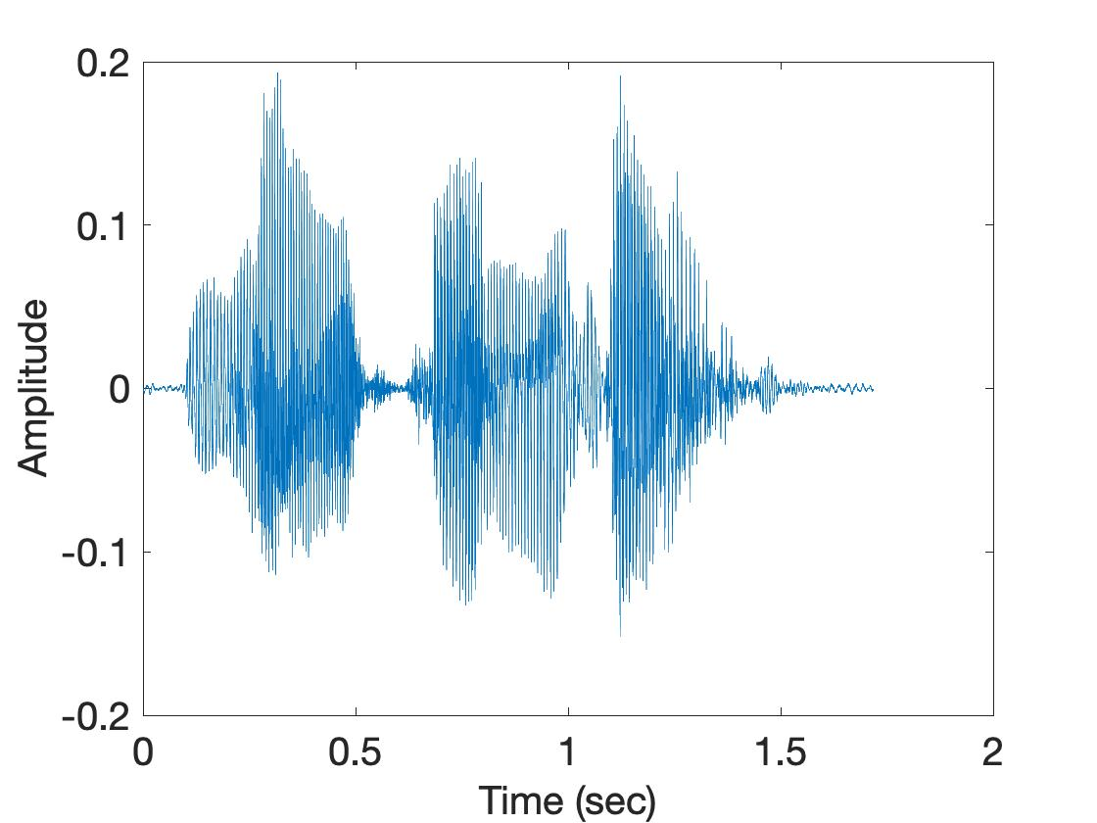
Time resolution v/s Frequency resolution
U
M
D
[
[
DFT
DFT
$$\frac{\text{f}\text{s}}{N}$$
= $\frac{\text{sample} \text{rate}}{\# of FFT points}$
How can we increase the frequency resolution?
How can we increase the time resolution?

Slide 38
Aliasing

Slide 39
Sampling theorem
Amplitude
Time (sec)
0.00
0.25
0.50
0.75
1.00
1.25
Amplitude
Time (sec)
0.00
0.25
0.50
0.75
1.00
1.25
Aliasing: Two signals become indistinguishable after sampling

Slide 40
Time domain samples
Amplitude
Time (sec)
0.00
0.25
0.50
0.75
1.00
1.25
FFT
Amplitude
-6
-4
-2
0
2
4
6
8
Frequency (Hz)
Frequency domain

Slide 41
Aliasing: Different frequencies, same name!!
Magnitude/Phase of z_{m}
-4
-3
-2
-1
m = 0
1
2
3
4
Frequency
Assume, Sample rate $\text{f}\text{s}$ = 8 Hz
For a COMPLEX signal, what value will we see if the actual frequency is:
a) 3 Hz
b) -2 Hz
c) 6 Hz
d) -5 Hz
e) 4 Hz and -4Hz

Slide 42
Magnitude/Phase of z_{m}
-4
-3
-2
-1
m = 0
1
2
3
4
Frequency
5
6
7
8

Slide 43
Magnitude/Phase of z_{m}
-4
-3
-2
-1
m = 0
1
2
3
4
Frequency
5
6
7
8

Slide 44
Magnitude/Phase of z_{m}
-4
-3
-2
-1
m = 0
1
2
3
4
Frequency
0
- F_{s}/4
F_{s}/4
F_{s}/2

Slide 45
Magnitude/Phase of z_{m}
-4
-3
-2
-1
m = 0
1
2
3
4
Frequency
0
-1
1
- 2
2
-3
3
4
-4

Slide 46
Aliasing: Different frequencies, same name!!
Magnitude/Phase of z_{m}
-4
-3
-2
-1
m = 0
1
2
3
4
Frequency
Assume, Sample rate $\text{f}\text{s}$ = 8 Hz
For a COMPLEX signal, what value will we see if the actual frequency is:
a) 3 Hz
b) -2 Hz
c) 6 Hz
d) -5 Hz
e) 4 Hz and -4Hz

Slide 47
Aliasing: Different frequencies, same name!!
Magnitude/Phase of z_{m}
-4
-3
-2
-1
m = 0
1
2
3
4
Frequency
Assume, Sample rate $\text{f}\text{s}$ = 8 Hz
For a REAL signal, what value will we see if the actual frequency is:
a) 3 Hz
b) -2 Hz
c) 6 Hz
d) -5 Hz
e) 4 Hz and -4Hz

Slide 48
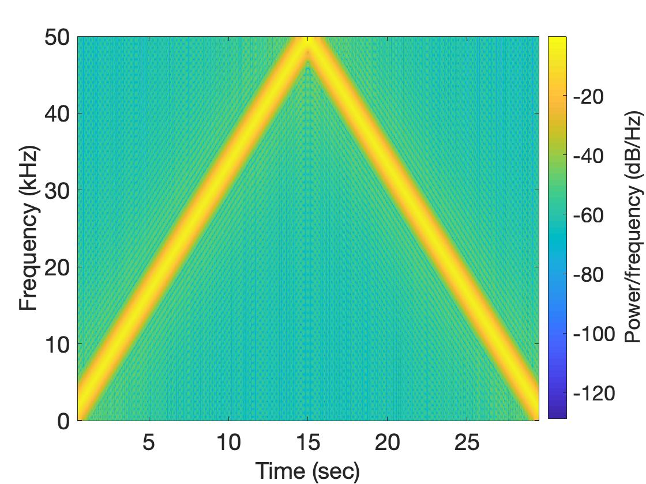
Aliasing: Spectrogram of increasing frequency

Slide 49
Calculating the aliased frequency value for real signals
Sampling frequency = 10Hz
Nyquist frequency = 5Hz
Amplitude
0
2
4
6
8
Frequency (Hz)

Slide 50
Calculating the aliased frequency value for real signals
Sampling frequency = 10Hz
Nyquist frequency = 5Hz
Amplitude
Received
signal
Amplitude
0
2
4
6
8
0
2
4
6
8
Frequency (Hz)
Frequency (Hz)

Slide 51
Calculating the aliased frequency value for real signals
Sampling frequency = 10Hz
Nyquist frequency = 5Hz
Amplitude
Received
signal
Amplitude
0
2
4
6
8
0
2
4
6
8
Frequency (Hz)
Frequency (Hz)
f_{s} = Sampling frequency
f = Target frequency
f_{a} = Aliased(perceived) frequency
K = Non-negative integer
f_{a} = min(abs(K*f_{s} - f))

Slide 52
Aliasing: A real life scenario
Nyquist frequency
Amplitude
10k
20k
30k
40k
50k
60k
70k
80k
90k
100k
Frequency spectrum
Notes:
to amplify the signal power …
Now, this signal typically contains many more frequencies than the sampling system can handle …

Slide 53
Aliasing: A real life scenario
Nyquist frequency
Amplitude
10k
20k
30k
40k
50k
60k
70k
80k
90k
100k
Frequency spectrum
Notes:
to amplify the signal power …
Now, this signal typically contains many more frequencies than the sampling system can handle …

Slide 54
Aliasing: A real life scenario
Nyquist frequency
Amplitude
10k
20k
30k
40k
50k
60k
70k
80k
90k
100k
Frequency spectrum
We need a “Low-pass filter”
to remove unwanted high frequency signals
Notes:
to amplify the signal power …
Now, this signal typically contains many more frequencies than the sampling system can handle …

Slide 55
Anti-aliasing filter
Nyquist frequency
Amplitude
10k
20k
30k
40k
50k
60k
70k
80k
90k
100k
Frequency spectrum
Sensor
ADC
Anti-aliasing
Filter
Notes:
to amplify the signal power …
Now, this signal typically contains many more frequencies than the sampling system can handle …

Slide 56
Anti-aliasing filter
Nyquist frequency
Amplitude
10k
20k
30k
40k
50k
60k
70k
80k
90k
100k
Frequency spectrum
Sensor
ADC
Anti-aliasing
Filter
Notes:
Hence, a low pass filter…

Slide 57
Anti-aliasing filter
Anti-aliasing
filter
Amplitude
10k
20k
30k
40k
50k
60k
70k
80k
90k
100k
Frequency spectrum
Sensor
ADC
Anti-aliasing
Filter
Notes:
removes the unwanted frequencies above 24 kHz …
And ultimately, this filtered signal is sampled by an ADC to generate digital sound samples

Slide 58
Anti-aliasing filter

Slide 59
Aliasing in real life
https://www.youtube.com/watch?v=B8EMI3_0TO0

Slide 60
Aliasing in real life
https://www.youtube.com/watch?v=QOwzkND_ooU

Slide 61
A few more ideas…
1) Filtering frequencies
1) Filtering frequencies
2) Multiplying frequency with frequency
3) Sampling a band of frequencies

Slide 62
Matlab demo code

Slide 63
A few more ideas…
1) Filtering frequencies
2) Multiplying frequency with frequency
3) Sampling a band of frequencies

Slide 64
Multiplying two frequencies
Magnitude/Phase of z_{m}
-4
-3
-2
-1
m = 0
1
2
3
4
Frequency
Two signals with frequencies f1 and f2 are multiplied:
$$ej 2π f1 t$$
$$ej 2π f2 t$$
$$ej 2πf1 t$$
$$+$$
$$e_j 2πf1t$$
$$ej 2πf2 t$$
$$+$$
$$e_j 2πf2t$$
2
2

Slide 65
Matlab demo code

Slide 66
A few more ideas…
1) Filtering frequencies
2) Multiplying frequency with frequency
3) Sampling a band of frequencies

Slide 67
Sample Rate for a Frequency band
$$e^{j2πf1t}$$
$$e^{j2πf2t}$$
Amplitude
$${× e}^{−j2πf1t}$$
0
2
4
6
0
8
Frequency (kHz)
What should be the sample rate?

Slide 68
Sample Rate for a Frequency band
$${× e}^{−j2πf1t}$$
Amplitude
Frequency
down-conversion
Amplitude
0
2
4
6
8
0
2
4
6
8
Frequency (kHz)
Frequency (kHz)
What should be the sample rate?
Generally, bandwidth of the signal determines the sample rate.

Slide 69
Programming Assignment #1

Slide 70
Short-time Fourier Transform (STFT)
U
M
D
[
[
[
DFT of overlapping windows
of samples
(Spectrogram/STFT)
[
DFT
DFT
DFT
DFT

Slide 71
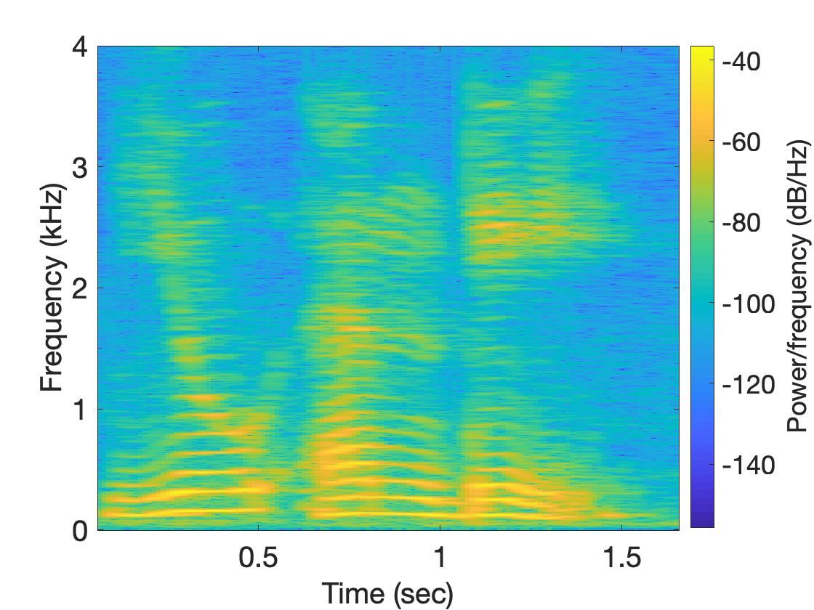
Short-time Fourier Transform (STFT)
U
M
D

Slide 72
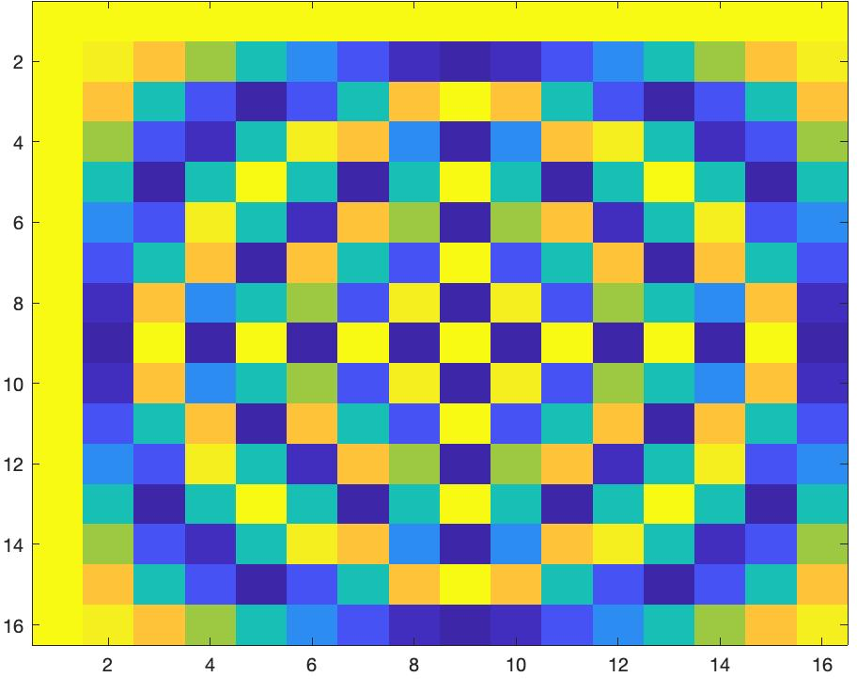
Short-time Fourier Transform (STFT)
*
_{X}
_{Z}
_{F}
=
_{F}
=
_{Matlab function: dftm(N)}
_{X}
=

Slide 73
Short-time Fourier Transform (STFT)
*
_{X}
_{Z}
_{F}
=
_{F}
_{N}
=
_{Matlab function: dftm(N)}
_{N}
_{abs(Z)}
_{X}
_{8N}
=

Slide 74
Short-time Fourier Transform (STFT)
?
_{x}
₌

Slide 75
Extra Slides

Slide 76
Time Domain and Frequency Domain
Fourier Transform
$$ej 2π4t$$
FFT
Amplitude
0
2
4
6
8
Frequency (Hz)
Time domain
Frequency domain
FFT = Fast Fourier Transform
IFFT = Inverse Fast Fourier Transform

Slide 77
Time Domain and Frequency Domain
Fourier Transform
FFT
$$\cos\left(2π4t\right)$$
Amplitude
$$ej 2πft$$
$$+$$
$$e_j 2πft$$
$$=$$
2
-6
-4
-2
0
2
4
6
8
Frequency (Hz)
Time domain
Frequency domain
FFT = Fast Fourier Transform
IFFT = Inverse Fast Fourier Transform

Slide 78
Matlab demo
function fft_test()
freq = 200;
sampleRate = 1000;
time_ticks = 0:1/sampleRate:1;
realSignal = sin(2*pi*freq*time_ticks);
plot_fft(realSignal, sampleRate);
complexSignal = exp(j*2*pi*freq*time_ticks);
plot_fft(complexSignal, sampleRate);
end

Slide 79
A few more ideas…
1) Filtering frequencies
1) Filtering frequencies
2) Multiplying frequency with frequency
3) Sampling a band of frequencies

Slide 80
Matlab demo code

Slide 81
A few more ideas…
1) Filtering frequencies
2) Multiplying frequency with frequency
3) Sampling a band of frequencies

Slide 82
Multiplying two frequencies
Magnitude/Phase of z_{m}
-4
-3
-2
-1
m = 0
1
2
3
4
Frequency
Two signals with frequencies f1 and f2 are multiplied:
$$ej 2π f1 t$$
$$ej 2π f2 t$$
$$ej 2πf1 t$$
$$+$$
$$e_j 2πf1t$$
$$ej 2πf2 t$$
$$+$$
$$e_j 2πf2t$$
2
2

Slide 83
Matlab demo code

Slide 84
A few more ideas…
1) Filtering frequencies
2) Multiplying frequency with frequency
3) Sampling a band of frequencies

Slide 85
Sample Rate for a Frequency band
$$e^{j2πf1t}$$
$$e^{j2πf2t}$$
Amplitude
$${× e}^{−j2πf1t}$$
0
2
4
6
0
8
Frequency (kHz)
What should be the sample rate?

Slide 86
Sample Rate for a Frequency band
$${× e}^{−j2πf1t}$$
Amplitude
Frequency
down-conversion
Amplitude
0
2
4
6
8
0
2
4
6
8
Frequency (kHz)
Frequency (kHz)
What should be the sample rate?
Generally, bandwidth of the signal determines the sample rate.

Slide 87
Programming Assignment #1

Slide 88
Short-time Fourier Transform (STFT)
U
M
D
[
[
[
DFT of overlapping windows
of samples
(Spectrogram/STFT)
[
DFT
DFT
DFT
DFT

Slide 89
Short-time Fourier Transform (STFT)
U
M
D

Slide 90
Short-time Fourier Transform (STFT)
*
_{X}
_{Z}
_{F}
=
_{F}
=
_{Matlab function: dftm(N)}
_{X}
=

Slide 91
Short-time Fourier Transform (STFT)
*
_{X}
_{Z}
_{F}
=
_{F}
_{N}
=
_{Matlab function: dftm(N)}
_{N}
_{abs(Z)}
_{X}
_{8N}
=

Slide 92
Short-time Fourier Transform (STFT)
?
_{x}
₌

