Slide 1
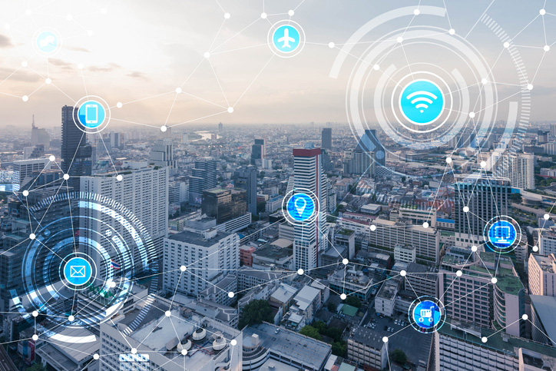
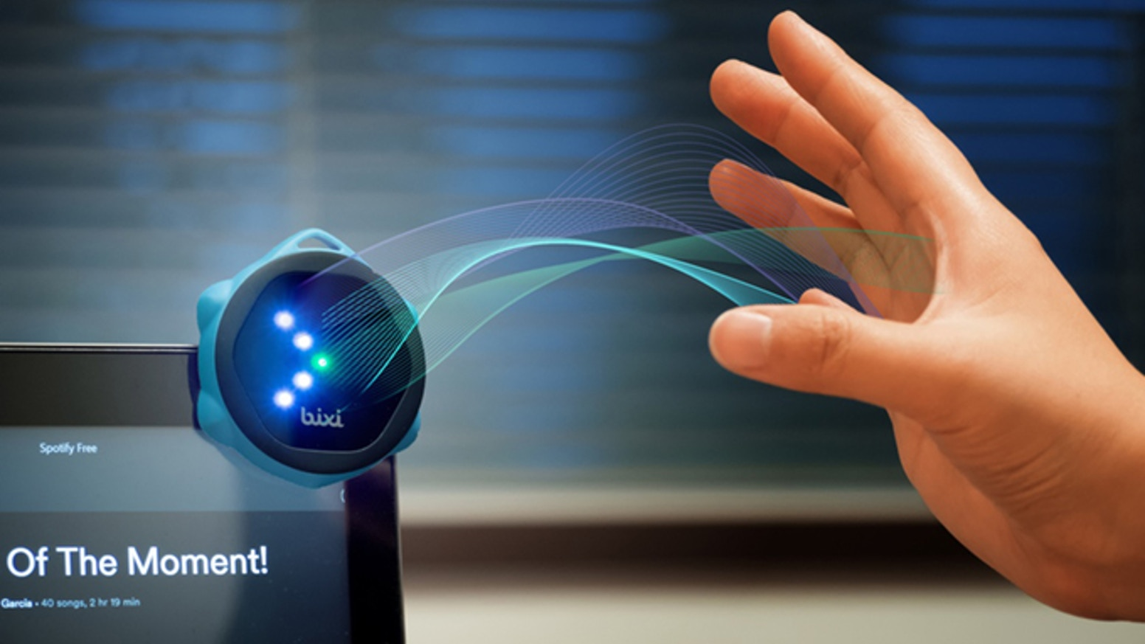
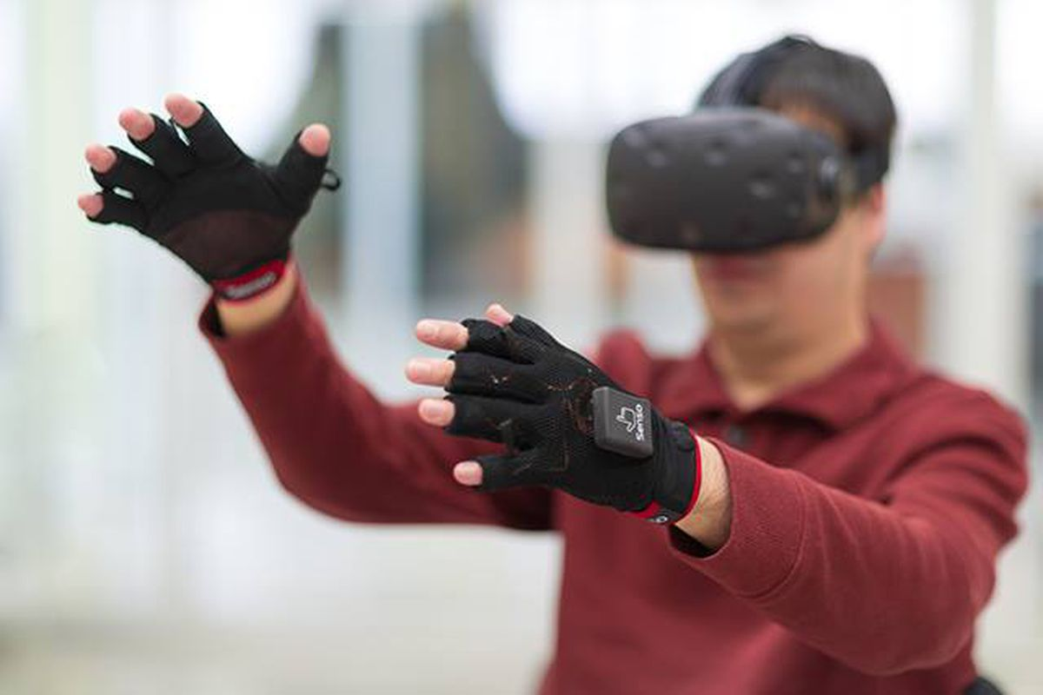
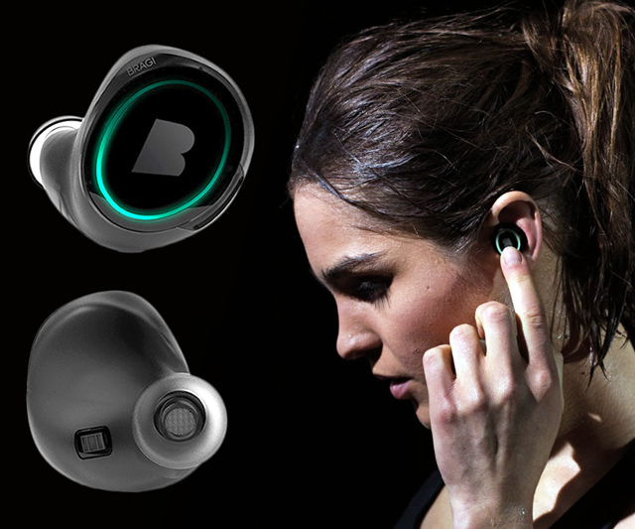
Wireless and Mobile Systems
for the IoT
CMSC 715 : Fall 2023
Lecture 2.2: Sensing in Time and Space
Nirupam Roy
Tu-Th 12:30-1:45pm
IRB 2107

Slide 2
Estimating distance using waves
Application: Contact tracing

Slide 4
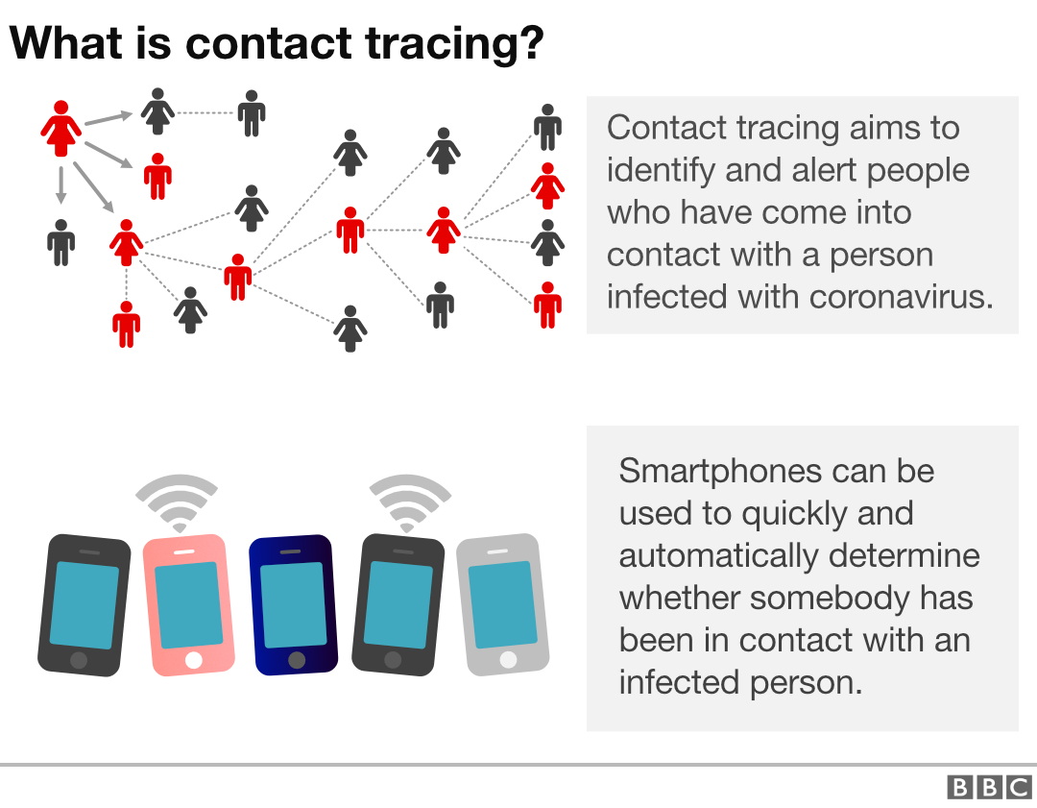
How to find the proximity between two smartphones?

Slide 5
A simple acoustic ranging technique
BeepBeep – SenSys 2007

Slide 6
Distance = d
Device A
Device B

Slide 7
Time = t1
Distance = d
Device A
Device B

Slide 8
Time = t1
Time = t2
Distance = d
Device A
Device B

Slide 9
Bluetooth/WiFi
Time = t1
Time = t1
Time = t2
Distance = d
Device A
Device B

Slide 10
Bluetooth/WiFi
Time = t1
Time = t1
Time = t2
Distance = d
Device A
Device B
d = C . (t2-t1)
C = speed of the wave
= ~340m/s for sound

Slide 11
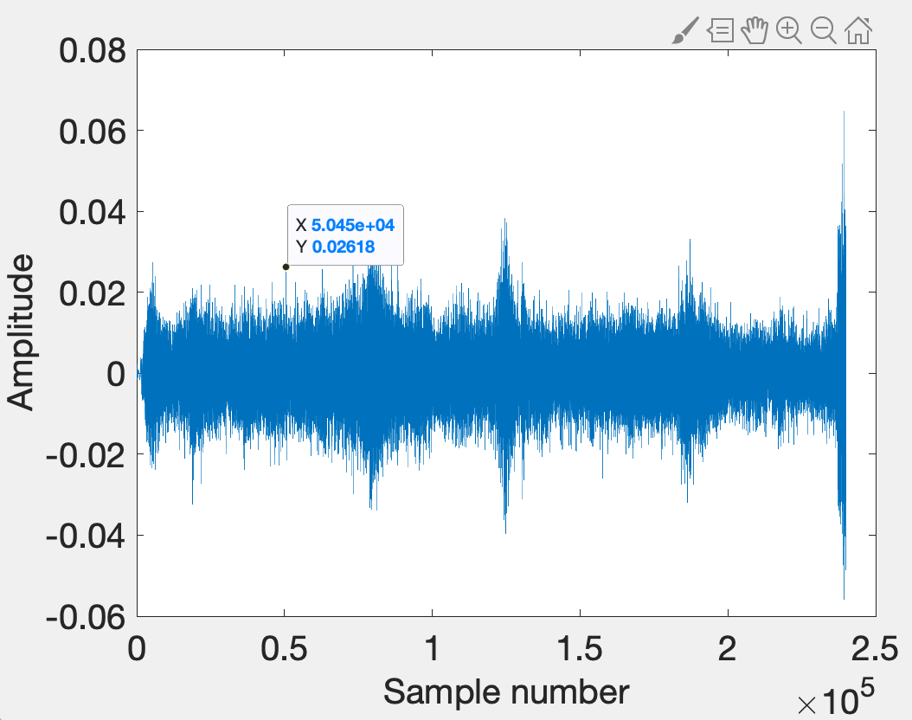
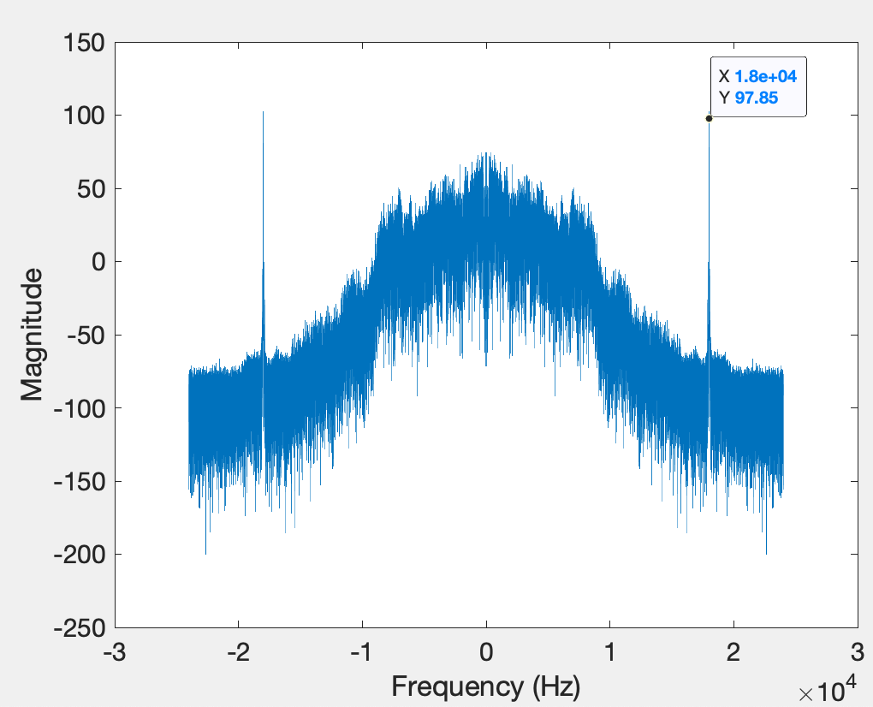
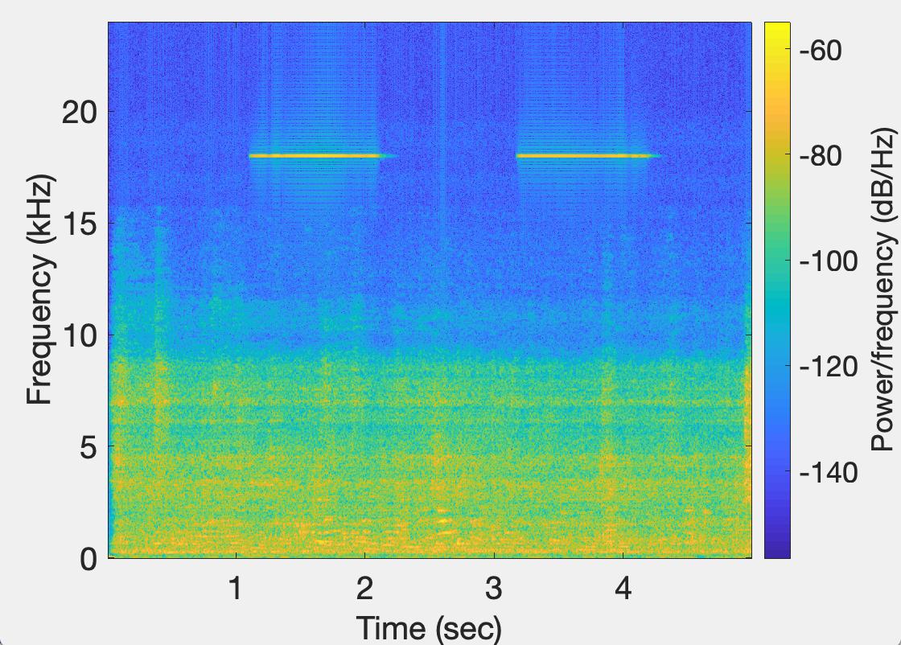
Time domain
signal
FFT Plot
Device A
STFT Plot

Slide 12
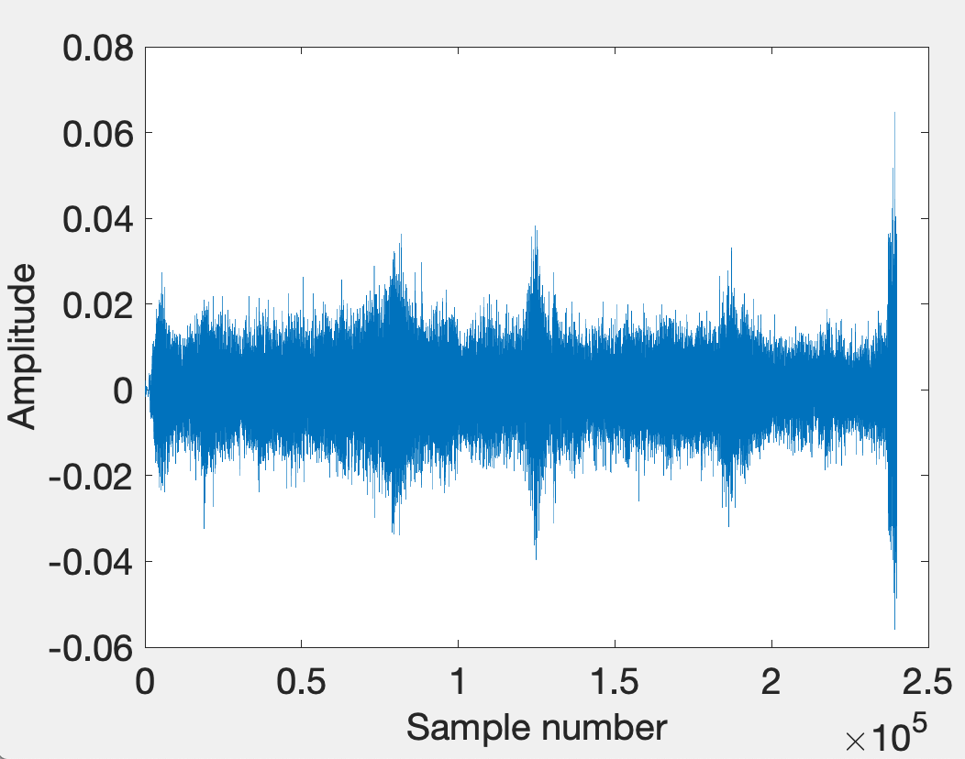
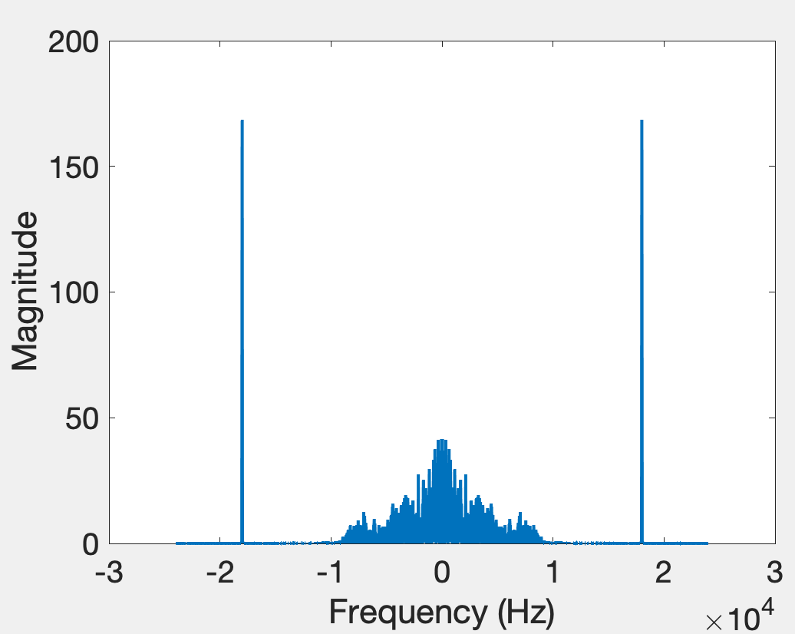
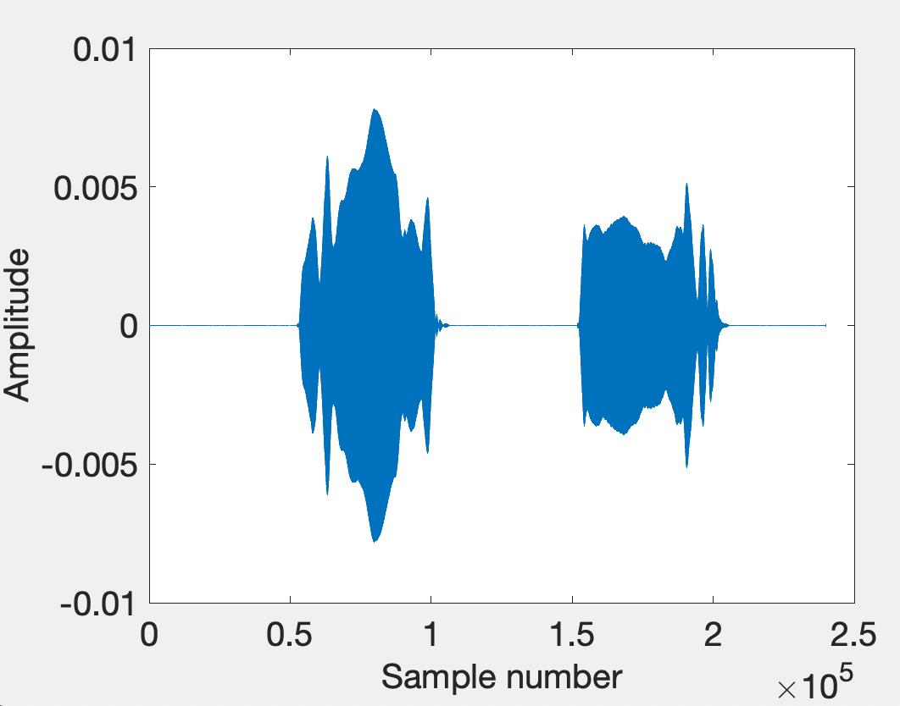
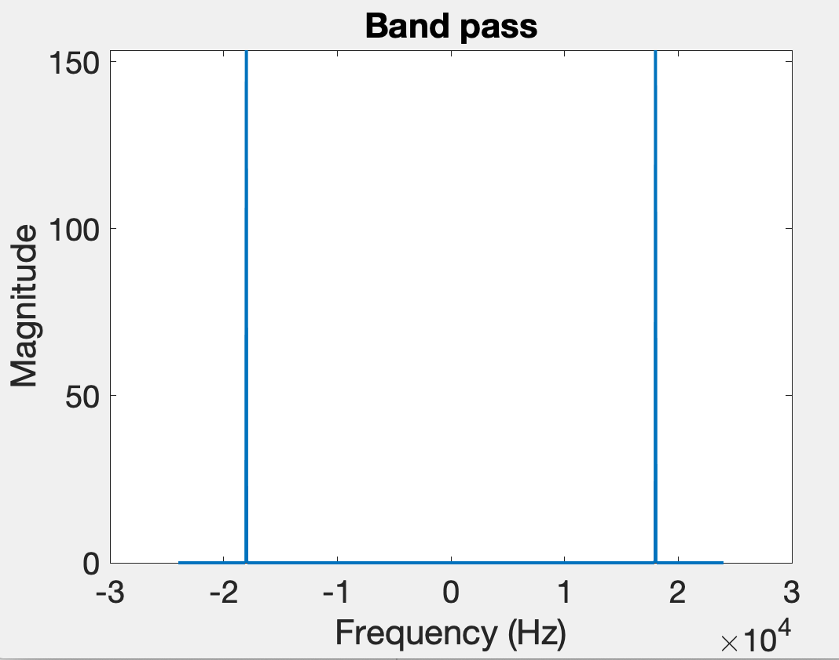
Time domain
Freq. domain
After bandpass filter

Slide 13
Bluetooth/WiFi
Time = t1
Time = t1
Time = t2
Distance = d
Problem: Synchronization
Device A
Device B
d = C . (t2-t1)

Slide 14
The root cause of inaccuracy – three uncertainties
Clock synchronization uncertainty
time

Slide 15
The root cause of inaccuracy – three uncertainties
Clock synchronization uncertainty
Sending uncertainty
time

Slide 16
The root cause of inaccuracy – three uncertainties
Clock synchronization uncertainty
Sending uncertainty
Receiving uncertainty
time

Slide 17
Sound production and recording

Slide 18
Sound recording with microphone
Sound

Slide 19
Sound recording with microphone
Analog signal (voltage)
Sound
ADC
ADC = Analog-to-Digital Converter

Slide 20
Sound recording with microphone
Analog signal (voltage)
Sound
ADC
S6 S5 S4 S3 S2 S1 S0
Audio Sample Buffer
ADC = Analog-to-Digital Converter

Slide 21
Sound production with speaker
S6 S5 S4 S3 S2 S1 S0
Audio Sample Buffer

Slide 22
Sound production with speaker
S6 S5 S4 S3 S2 S1 S0
Analog signal (voltage)
Audio Sample Buffer
DAC
DAC = Digital-to-Analog Converter

Slide 23
Sound production with speaker
S6 S5 S4 S3 S2 S1 S0
Analog signal (voltage)
Audio Sample Buffer
DAC
Sound
DAC = Digital-to-Analog Converter

Slide 24
The root cause of inaccuracy – three uncertainties
Clock synchronization uncertainty
Sending uncertainty
software issuing command
...
t0 = wall_clock();
write(sound_dev, signal);
...
time

Slide 25
The root cause of inaccuracy – three uncertainties
Clock synchronization uncertainty
Sending uncertainty
software issuing command
...
t0 = wall_clock();
write(sound_dev, signal);
...
unknown delays (software, system, driver, hardware, …) ?
sound leaves
speaker
time

Slide 26
The root cause of inaccuracy – three uncertainties
Clock synchronization uncertainty
Sending uncertainty
Receiving uncertainty
software issuing command
...
t0 = wall_clock();
write(sound_dev, signal);
...
unknown delays (software, system, driver, hardware, …) ?
sound leaves
speaker
time

Slide 27
The root cause of inaccuracy – three uncertainties
Clock synchronization uncertainty
Sending uncertainty
Receiving uncertainty
software issuing command
...
t0 = wall_clock();
write(sound_dev, signal);
...
unknown delays (software, system, driver, hardware, …) ?
sound leaves
speaker
sound
reaches mic
time

Slide 28
The root cause of inaccuracy – three uncertainties
Clock synchronization uncertainty
Sending uncertainty
Receiving uncertainty
software issuing command
...
t0 = wall_clock();
write(sound_dev, signal);
...
unknown delays (software, system, driver, hardware, …) ?
sound leaves
speaker
sound
reaches mic
unknown delays (hardware, interrupt, driver, scheduling, …) ?
time

Slide 29
The root cause of inaccuracy – three uncertainties
Clock synchronization uncertainty
Sending uncertainty
Receiving uncertainty
software issuing command
software aware of arrival
...
t0 = wall_clock();
write(sound_dev, signal);
...
...
read(sound_dev, signal);
t1 = wall_clock();
...
unknown delays (software, system, driver, hardware, …) ?
sound leaves
speaker
sound
reaches mic
unknown delays (hardware, interrupt, driver, scheduling, …) ?
time

Slide 30
Beepbeep’s basic procedure
Device A emits a beep while both recording
Device B emits another beep while both continue recording
Both devices detect TOA of the two beeps and obtain respective ETOAs
Exchange ETOAs and calculate the distance
Device A
Device B
A’s recording
B’s recording
ETOA_{A}
ETOA_{B}
D_{AB}=|ETOA_{A}-ETOA_{B}|/2

Slide 31
Timeline
Device A
Device B

Slide 32
Timeline
Device A
Device B
1st Beep
t_{A0}

Slide 33
Timeline
Device A
Device B
1st Beep
t_{A0}
t_{A1}
t_{B1}

Slide 34
Timeline
Device A
Device B
1st Beep
t_{A0}
t_{A1}
t_{B1}
2nd Beep
t_{B2}

Slide 35
Timeline
Device A
Device B
1st Beep
t_{A0}
t_{A1}
t_{B1}
2nd Beep
t_{B2}
t_{B3}
t_{A3}

Slide 36
Timeline
Device A
Device B
1st Beep
t_{A0}
t_{A1}
t_{B1}
ETOA_{A}
2nd Beep
t_{B2}
t_{B3}
t_{A3}

Slide 37
Timeline
Device A
Device B
1st Beep
t_{A0}
t_{A1}
t_{B1}
ETOA_{B}
ETOA_{A}
2nd Beep
t_{B2}
t_{B3}
t_{A3}

Slide 38
Timeline
Device A
Device B
1st Beep
t_{A0}
t_{A1}
P
t_{B1}
ETOA_{B}
ETOA_{A}
2nd Beep
t_{B2}
t_{B3}
t_{A3}

Slide 39
Timeline
Device A
Device B
1st Beep
t_{A0}
t_{A1}
P
t_{B1}
ETOA_{B}
ETOA_{A}
2nd Beep
t_{B2}
t_{B3}
P
t_{A3}

Slide 40
Timeline
Device A
Device B
1st Beep
t_{A0}
t_{A1}
P
t_{B1}
ETOA_{B}
Q
ETOA_{A}
2nd Beep
t_{B2}
t_{B3}
P
t_{A3}

Slide 41
Timeline
Device A
Device B
1st Beep
t_{A0}
t_{A1}
P
t_{B1}
ETOA_{B}
Q
|ETOA_{A}-ETOA_{B}|
ETOA_{A}
2nd Beep
t_{B2}
= (P+Q+P) – (Q)
t_{B3}
P
t_{A3}

Slide 42
Timeline
Device A
Device B
1st Beep
t_{A0}
t_{A1}
P
Did you notice a small scope for error?
t_{B1}
ETOA_{B}
Q
|ETOA_{A}-ETOA_{B}|
ETOA_{A}
2nd Beep
t_{B2}
= (P+Q+P) – (Q)
t_{B3}
= 2P
P
t_{A3}
= 2 (time of flight)

Slide 43
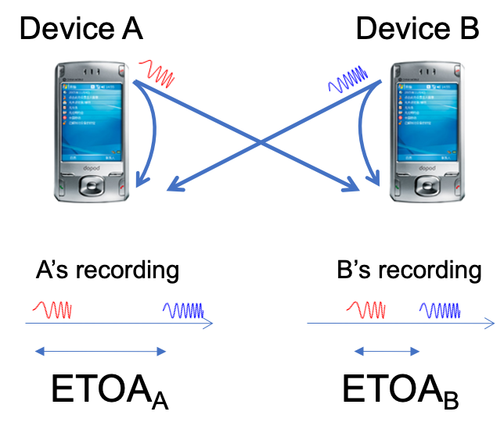
Timeline
Device A
Device B
1st Beep
t_{A0}
t_{A1}
P
t_{B1}
ETOA_{B}
Q
|ETOA_{A}-ETOA_{B}|
ETOA_{A}
2nd Beep
t_{B2}
= (P+Q+P) – (Q)
t_{B3}
= 2P
P
t_{A3}
= 2 (time of flight)

Slide 44
Fine-grained distance measurement
Equation of waves in time and space

Slide 45
Sensing signal in Space

Slide 46
Equation of waves in time and space

Slide 47
Equation of waves in time and space

Slide 48
Equation of waves in time and space

Slide 49
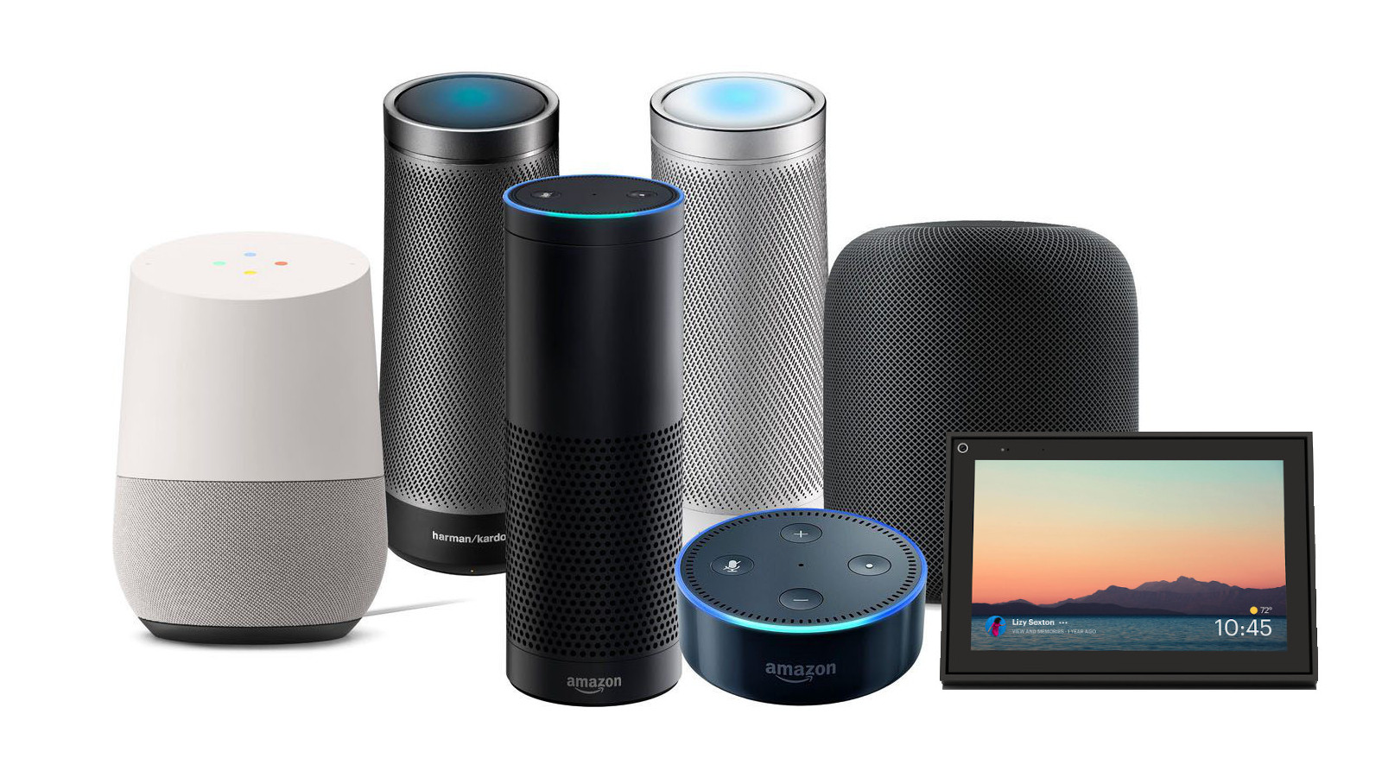

Slide 50
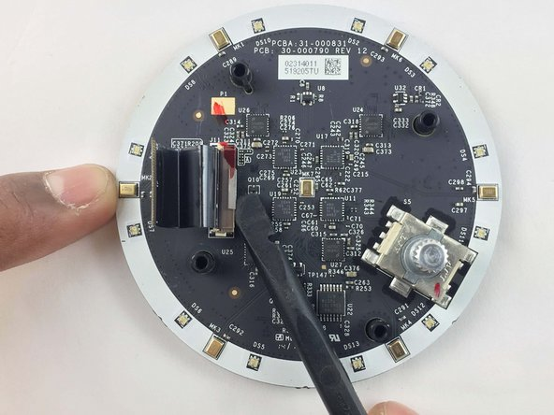
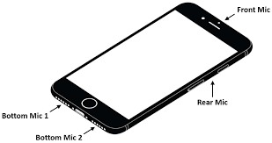
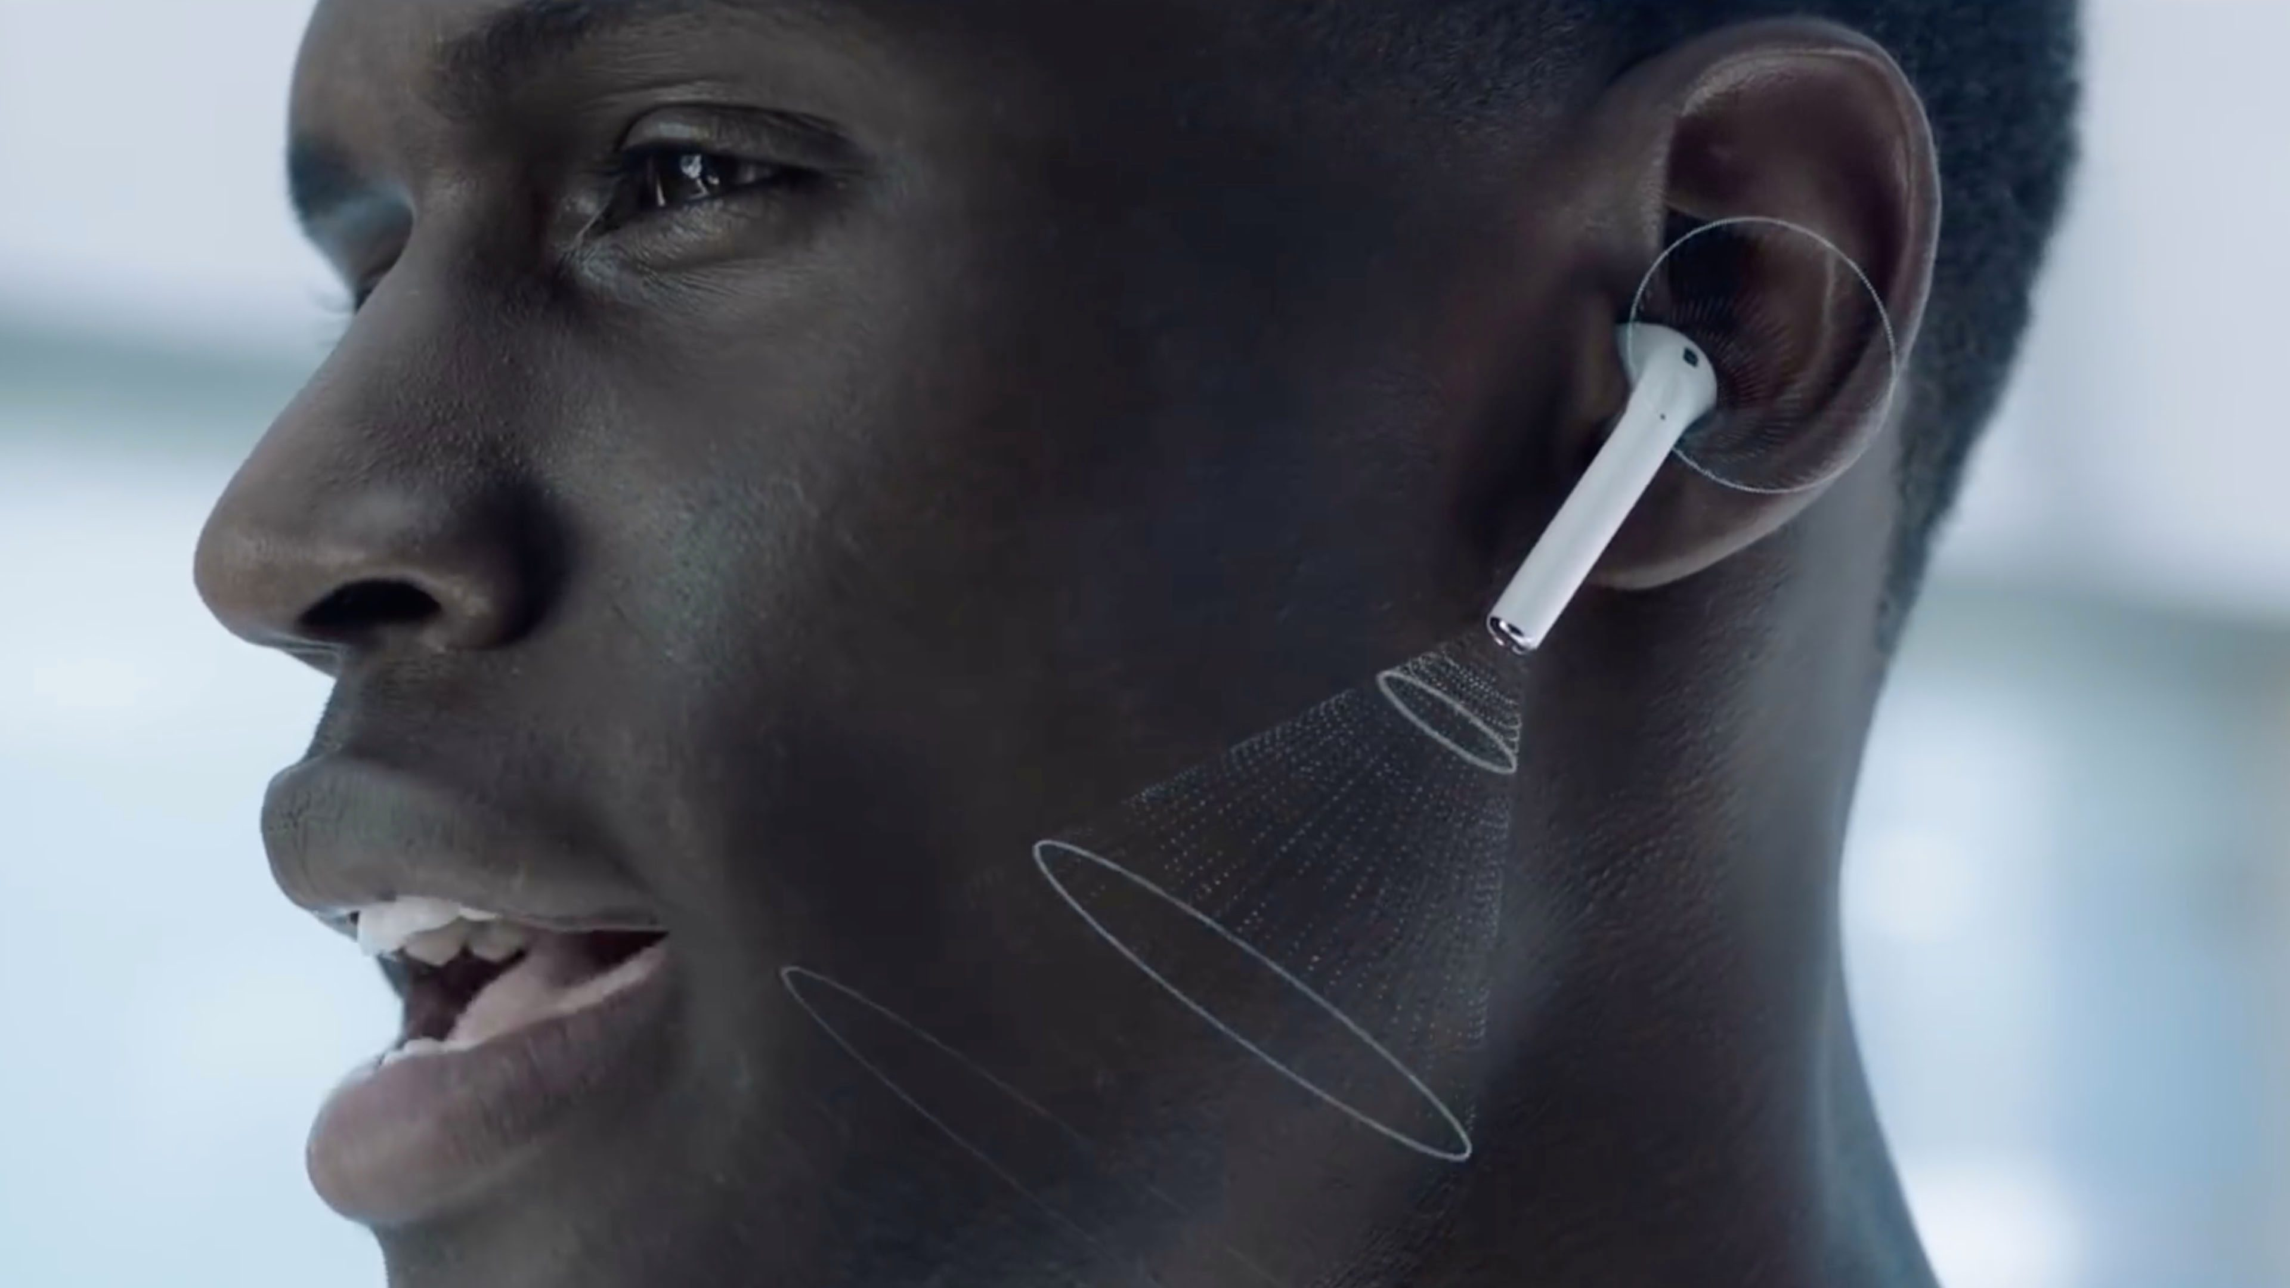

Slide 51
Alexa!

Slide 52
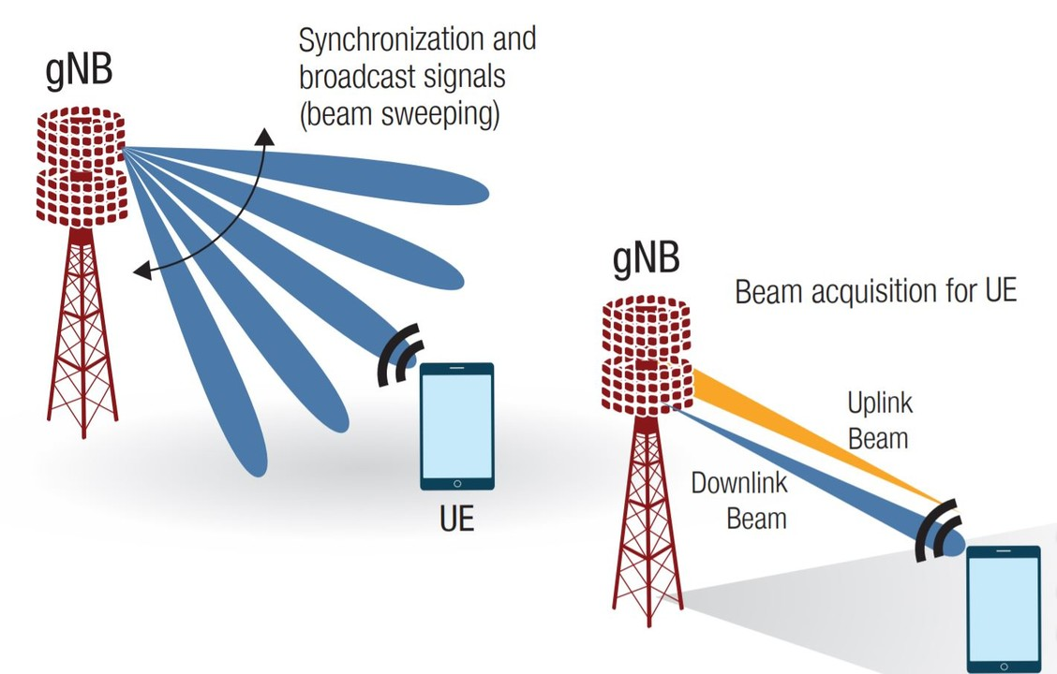
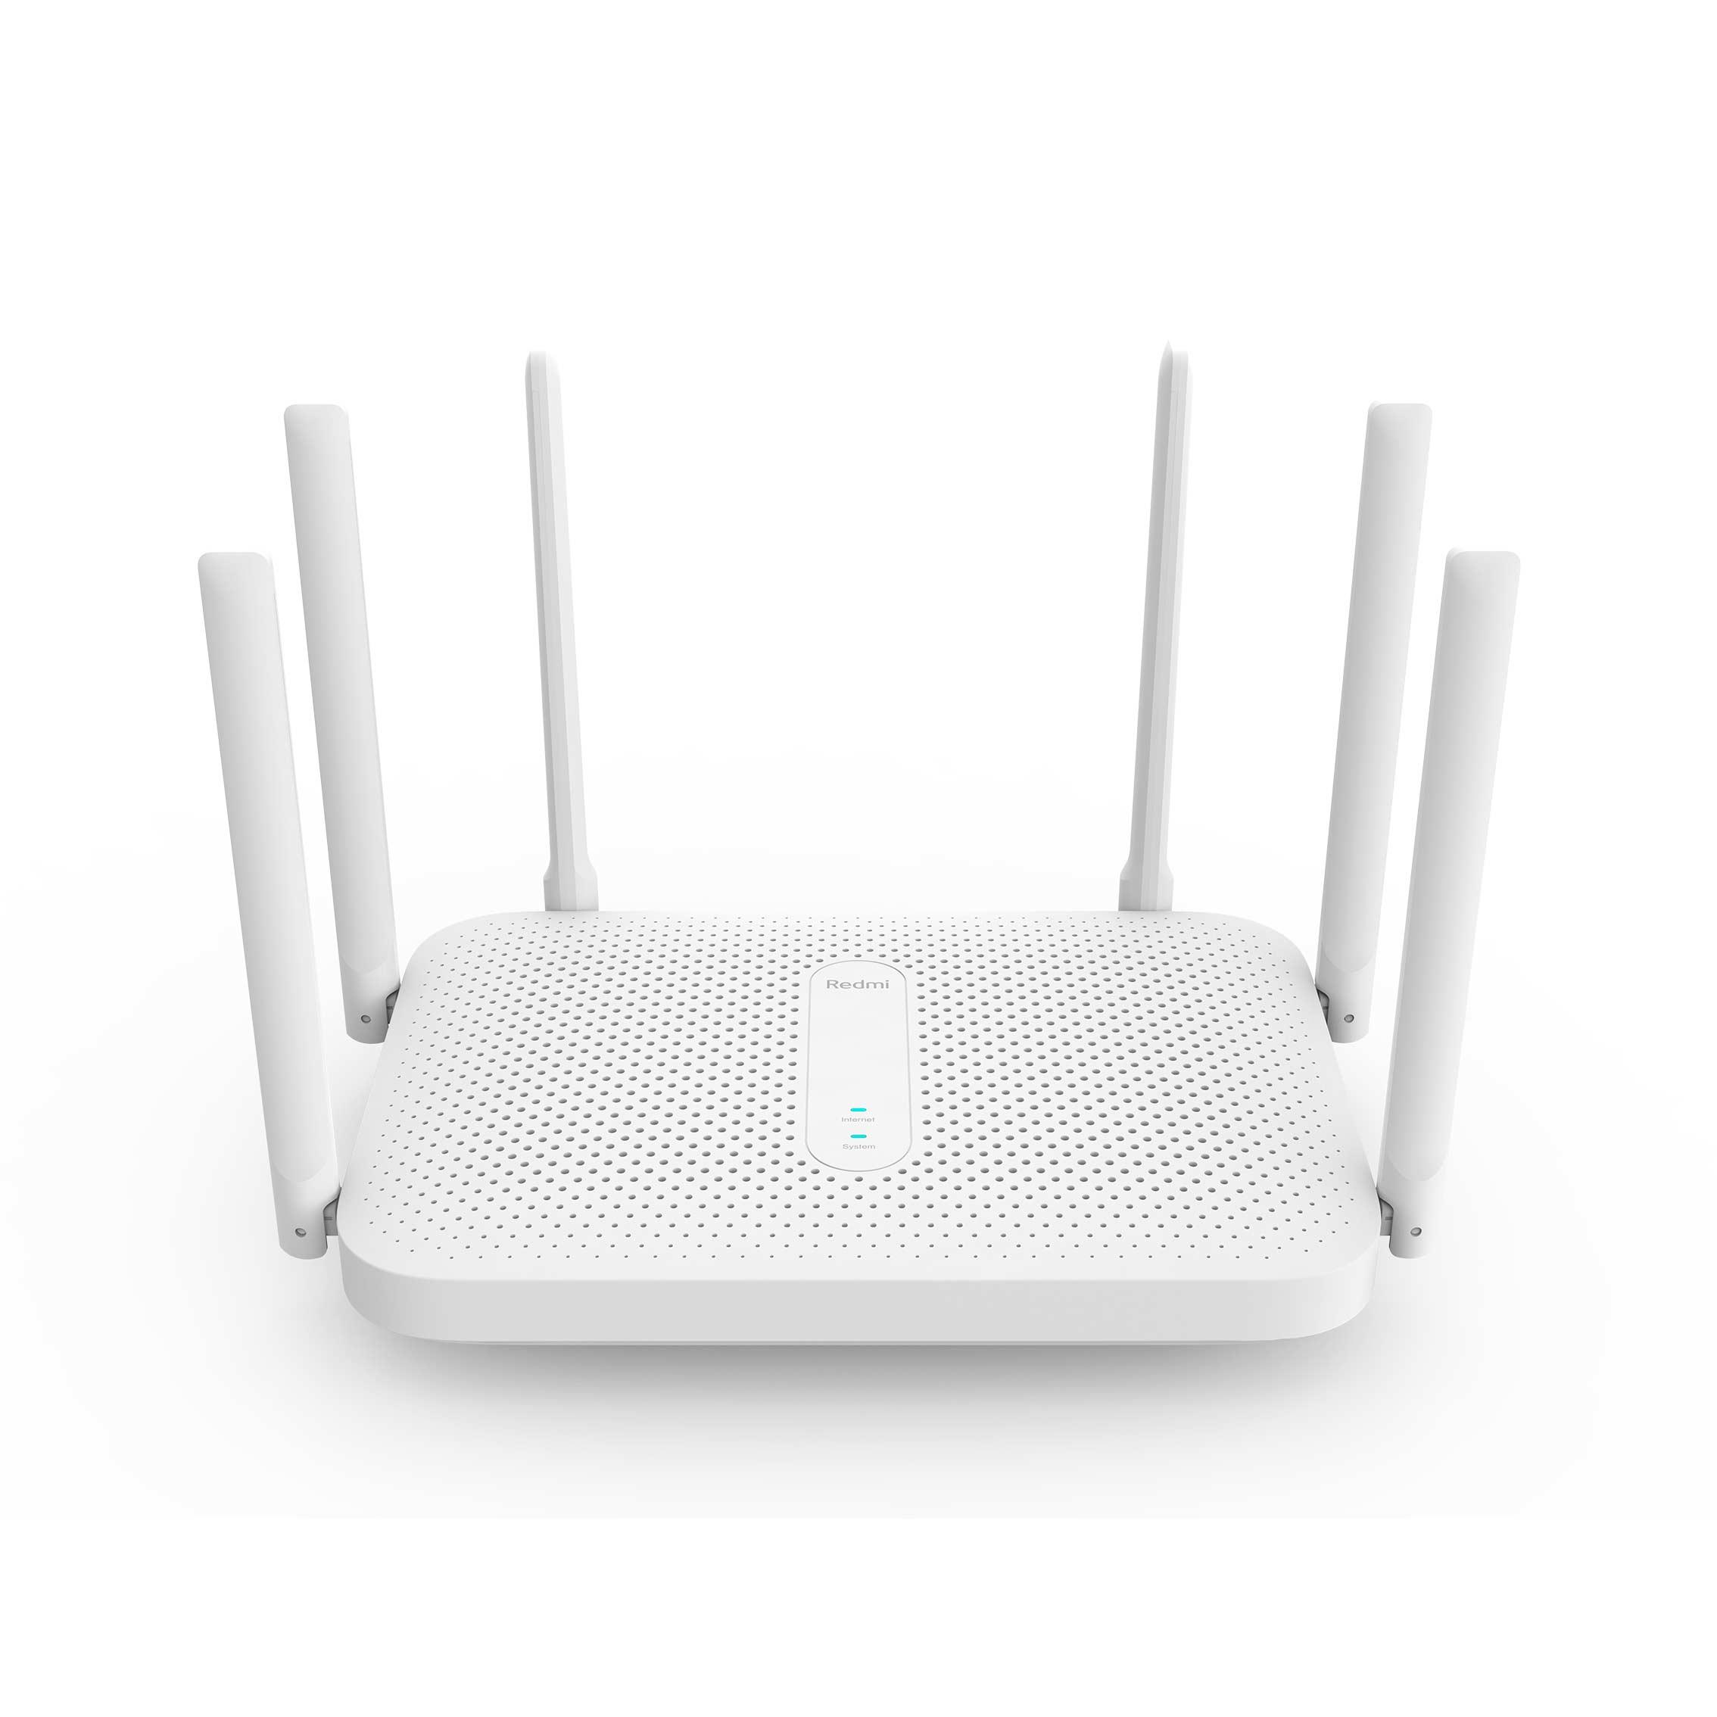

Slide 53
Equation of waves in time and space

Slide 54
Equation of waves in time and space
$$distance from the source (x)$$
$$space$$

Slide 55
Equation of waves in time and space
Amplitude here
$$distance from the source (x)$$
$$space$$
is a delayed version of
the amplitude here.

Slide 56
Equation of waves in time and space
Amplitude here
$$distance from the source (x)$$
$$space$$
is a delayed version of
the amplitude here.

Slide 57
Equation of waves in time and space
Amplitude here
The delay depends
on the distance.
$$distance from the source (x)$$
$$space$$
is a delayed version of
the amplitude here.

Slide 58
Equation of waves in time and space
Amplitude here
The delay depends
on the distance.
$$distance from the source (x)$$
$$space$$
is a delayed version of
the amplitude here.
$$A . sin⁡(\frac{2π}{T}t)$$
$Ψ$(t)
$$=$$
$$A . sin⁡(2πft)$$
$$=$$

Slide 59
Equation of waves in time and space
Amplitude here
The delay depends
on the distance.
$$distance from the source (x)$$
$$space$$
is a delayed version of
the amplitude here.
$Ψ$(t, x)
$$=$$
$$A . sin⁡(2πft−θ(x))$$
Why is this negative?

Slide 60
Equation of waves in time and space
$wavelength$ = λ
$$distance from the source (x)$$
$$space$$
$Ψ$(t, x)
$$=$$
$$A . sin⁡(2πft−θ(x))$$

Slide 61
Equation of waves in time and space
$wavelength$ = λ
$$f number of cycles per second$$
$$C meters of distance per second$$
$$(speed of the wave)$$
$distance per cycle=\text{λ}$ = $C$/ $f$

Slide 62
Equation of waves in time and space
$wavelength$ = λ
$$distance from the source (x)$$
$$space$$
$Ψ$(t, x)
$$=$$
$$A . sin⁡(2πft−θ(x))$$

Slide 63
Equation of waves in time and space
$wavelength$ = λ
$$f number of cycles per second$$
$$C meters of distance per second$$
$$(speed of the wave)$$
$distance per cycle=\text{λ}$ = $C$/ $f$

Slide 64
Equation of waves in time and space
$wavelength$ = λ
$$f number of cycles per second$$
$$C meters of distance per second$$
$$(speed of the wave)$$
$distance per cycle=\text{λ}$ = $C$/ $f$
$$2π radians of angle is covered per cycle$$

Slide 65
$wavelength$ = λ
Equation of waves in time and space
$$f number of cycles per second$$
$$C meters of distance per second$$
$$(speed of the wave)$$
$distance per cycle=\text{λ}$ = $C$/ $f$
$$2π radians of angle is covered per cycle$$
$$\frac{2π}{\text{λ}}radians of angle is covered per unit distance$$

Slide 66
Equation of waves in time and space
$wavelength$ = λ
$$distance from the source (x)$$
$$space$$
$Ψ$(t, x)
$$=$$
$$A . sin⁡(2πft−θ(x))$$

Slide 67
Equation of waves in time and space
$wavelength$ = λ
$$distance from the source (x)$$
$$space$$
$Ψ$(t, x)
$$=$$
$$A . sin⁡(2πft−θ(x))$$
$$A . sin⁡(2πft−\frac{2π}{\text{λ}}x)$$
$$=$$

Slide 68
Equation of waves in time and space
$wavelength$ = λ
$$distance from the source (x)$$
$$space$$
$Ψ$(t, x)
$$=$$
$$A . sin⁡(2πft−θ(x))$$
$$A . sin⁡(2πft−\frac{2π}{\text{λ}}x)$$
$$=$$
$$⁡j(2πft−\frac{2π}{\text{λ}}x)$$
$$A . e$$
$$=$$

Slide 69
Time and space
Cycles per sec = frequency = f Hz
Distance per cycle = wavelength = λ meters
Distance per second = speed = C meters/sec
C = f . λ
Speed of sound in air: 343 m/s
Speed of sound in water: 1493 m/s
Speed of sound in iron: 5130 m/s
Speed of electromagnetic waves: 3*10⁸ m/s
(~ a million times faster than sound)

Slide 70
Time and space
$$A . sin⁡(2πft)$$

Slide 71
Time and space
$$⁡j(2πft)$$
$$A . e$$

Slide 72
Time and space
Distance = d meter
$$⁡j(2πft)$$
$$A . e$$

Slide 73
Time and space
$$⁡j(2πft−\frac{2π}{\text{λ}}d)$$
$$A . e$$
Distance = d meter
$$⁡j(2πft)$$
$$A . e$$

Slide 74
Time and space
$$⁡j(2πft−\frac{2π}{\text{λ}}d)$$
$$A . e$$
d meter
$$⁡j(2πft−\frac{2π}{\text{λ}}d)$$
$$A . e$$
Distance = d meter
$$⁡j(2πft)$$
$$A . e$$

Slide 75
Time and space
$$⁡j(2πft−\frac{2π}{\text{λ}}d)$$
$$A . e$$
d meter
$$⁡j(2πft−\frac{2π}{\text{λ}}d)$$
$$A . e$$
Distance = d meter
$$⁡j(2πft)$$
$$A . e$$

Slide 76
Time and space
$$⁡j(2πft)$$
$$A . e$$

Slide 77
Time and space
X meters
$$⁡j(2πft)$$
$$A . e$$

Slide 78
Time and space
X meters
$$⁡j(2πft)$$
$$Θ$$
$$A . e$$

Slide 79
Time and space
X.sin($Θ$)
X meters
$$⁡j(2πft)$$
$$Θ$$
$$A . e$$

Slide 80
Time and space
d = X.sin($Θ$)
X meters
$$⁡j(2πft)$$
$$Θ$$
$$A . e$$

Slide 81
Time and space
d = X.sin($Θ$)
X meters
$$⁡j(2πft)$$
$$Θ$$
$$A . e$$
Did you notice a small error?

Slide 82
Time and space
d = X.sin($Θ$)
X
X meters
$$⁡j(2πft)$$
$$Θ$$
$$A . e$$

Slide 83
Time and space
d = X.sin($Θ$)
X meters
$$⁡j(2πft)$$
$$Θ$$
$$A . e$$
Far-field approximation, Planar wave

Slide 84
Extra slides

Slide 85
Fine-grained distance measurement
Equation of waves in time and space

Slide 86
Equation of waves in time and space

Slide 87
Equation of waves in time and space
Temporal variation of the wave’s amplitude

Slide 88
Equation of waves in time and space

Slide 89
Frequency, Amplitude, and Phase

Slide 90
Frequency, Amplitude, and Phase
Time
$$f cycles per second$$
$$2π angles per cycle$$

Slide 91
Frequency, Amplitude, and Phase
$$2π angles per cycle$$
$$f cycles per second$$
$$One full cycle in T seconds$$
i.e., $f$ = $\frac{1}{T}$
A
𝚹
Phase
time = t second
$Ψ$(t)
$$=$$
$$A . sin⁡(θ(t))$$
$$A . sin⁡(\frac{2π}{T}t)$$
$$=$$
$$A . sin⁡(2πft)$$
$$=$$

Slide 92
Equation of waves in time and space

Slide 93
Equation of waves in time and space

Slide 94
Equation of waves in time and space

Slide 95
Equation of waves in time and space
$$distance from the source (x)$$
$$space$$

Slide 96
Equation of waves in time and space
Amplitude here
$$distance from the source (x)$$
$$space$$
is a delayed version of
the amplitude here.

Slide 97
Equation of waves in time and space
Amplitude here
$$distance from the source (x)$$
$$space$$
is a delayed version of
the amplitude here.

Slide 98
Equation of waves in time and space
Amplitude here
The delay depends
on the distance.
$$distance from the source (x)$$
$$space$$
is a delayed version of
the amplitude here.

Slide 99
Equation of waves in time and space
Amplitude here
The delay depends
on the distance.
$$distance from the source (x)$$
$$space$$
is a delayed version of
the amplitude here.
$$A . sin⁡(\frac{2π}{T}t)$$
$Ψ$(t)
$$=$$
$$A . sin⁡(2πft)$$
$$=$$

Slide 100
Equation of waves in time and space
Amplitude here
The delay depends
on the distance.
$$distance from the source (x)$$
$$space$$
is a delayed version of
the amplitude here.
$Ψ$(t, x)
$$=$$
$$A . sin⁡(2πft−θ(x))$$
Why is this negative?

Slide 101
Equation of waves in time and space
$wavelength$ = λ
$$distance from the source (x)$$
$$space$$
$Ψ$(t, x)
$$=$$
$$A . sin⁡(2πft−θ(x))$$

Slide 102
Equation of waves in time and space
$wavelength$ = λ
$$f number of cycles per second$$
$$C meters of distance per second$$
$$(speed of the wave)$$
$distance per cycle=\text{λ}$ = $C$/ $f$

