Slide 1

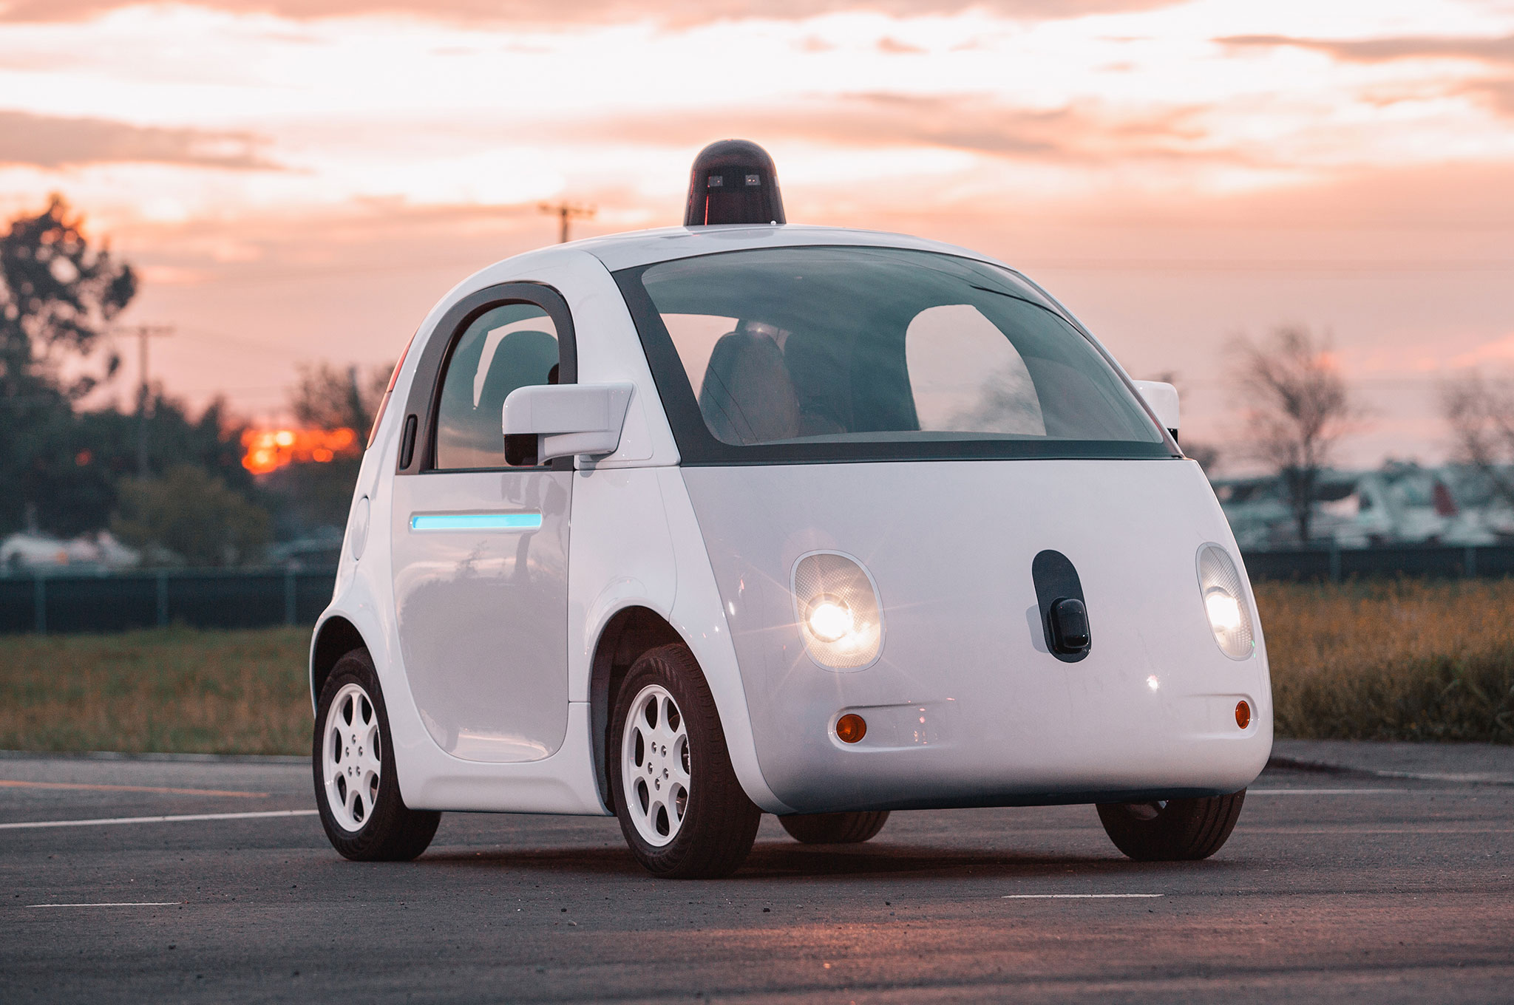
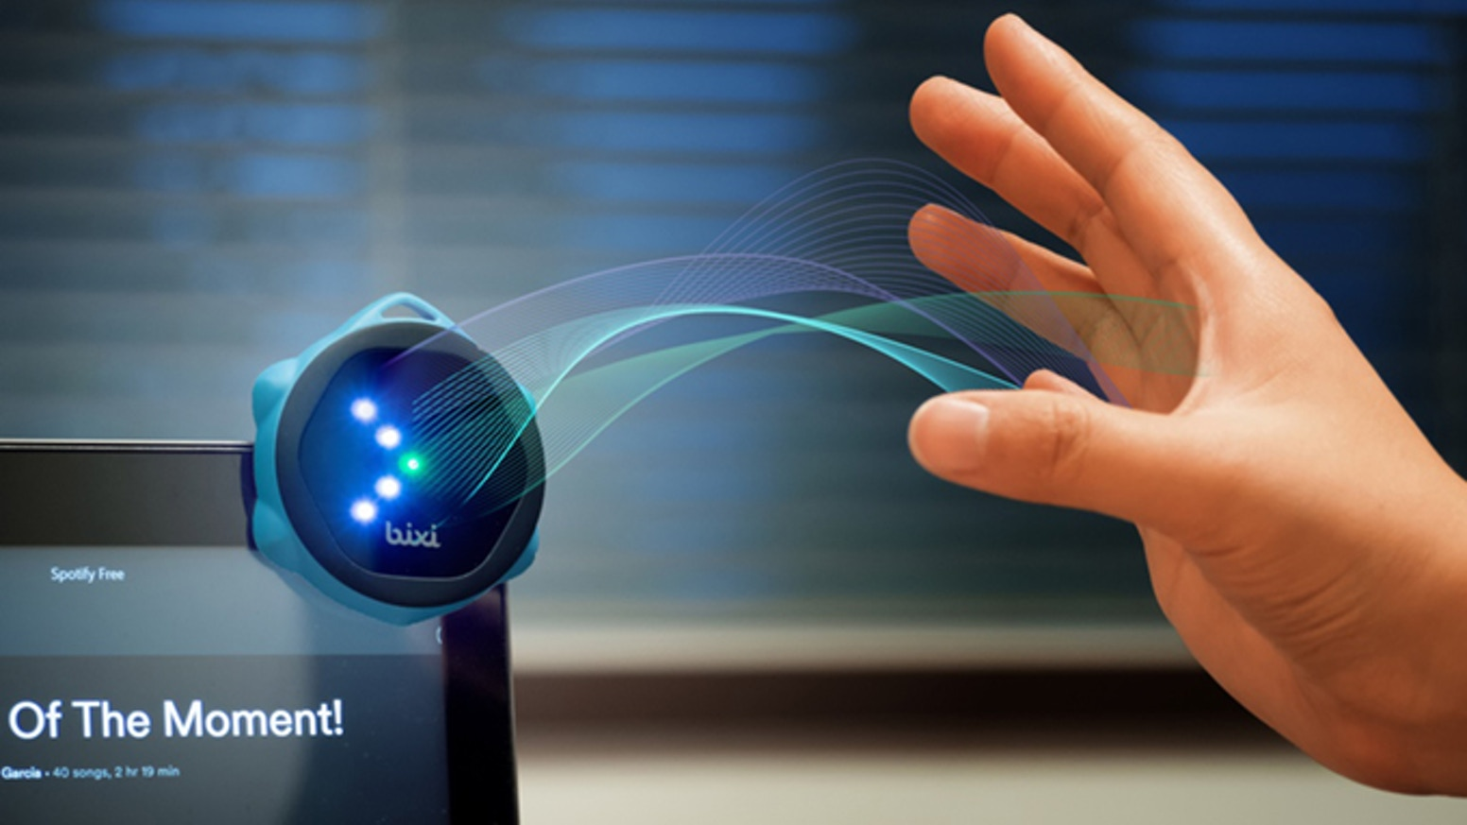
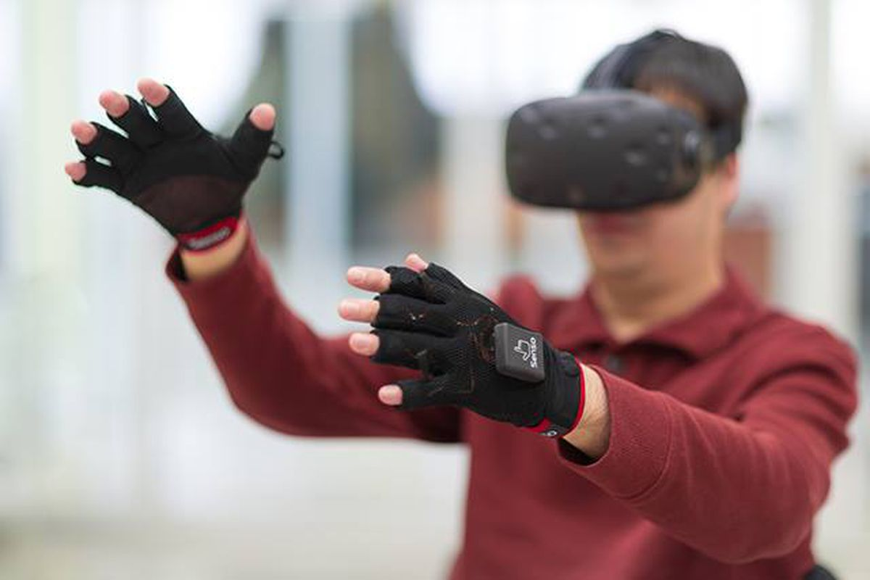

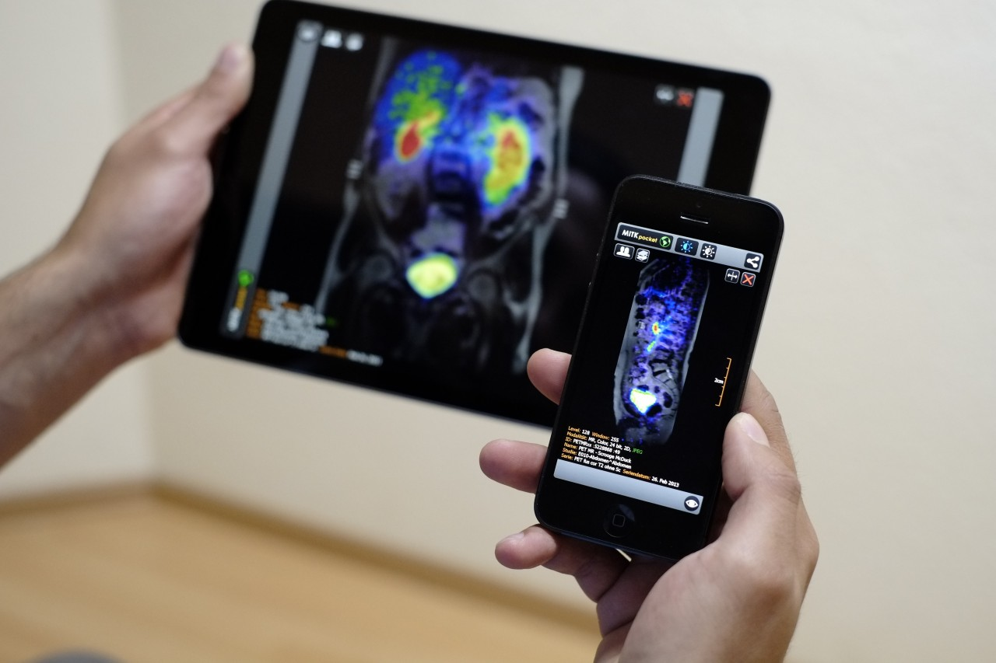
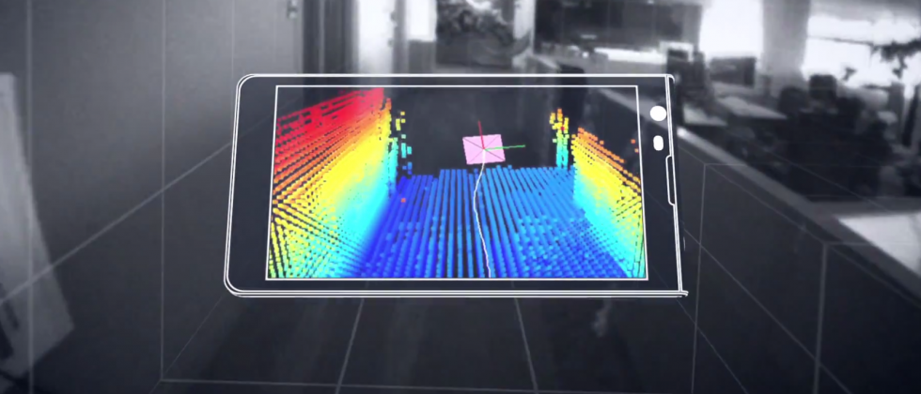
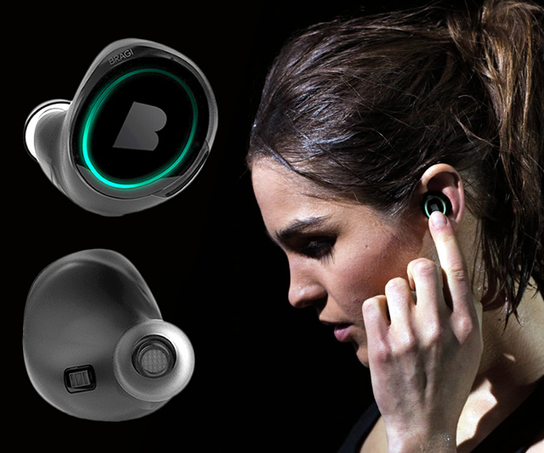
Wireless and Mobile Systems
for the IoT
CMSC 715 : Fall 2023
Lecture 2.4: Spatial Sensing and Ranging
Nirupam Roy
Tu-Th 12:30-1:45pm
IRB 2107

Slide 2
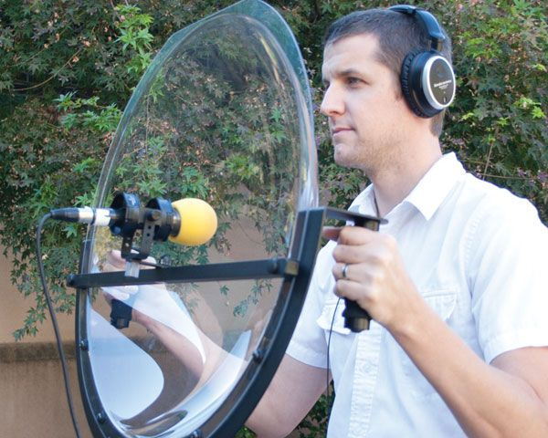
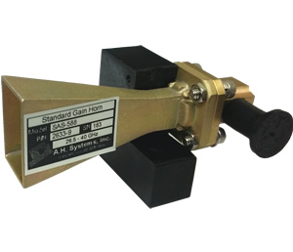
Directionality of signals: Physical guiding

Slide 3
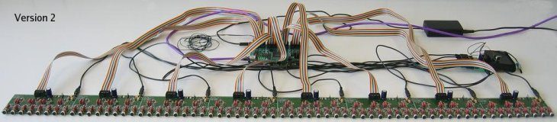
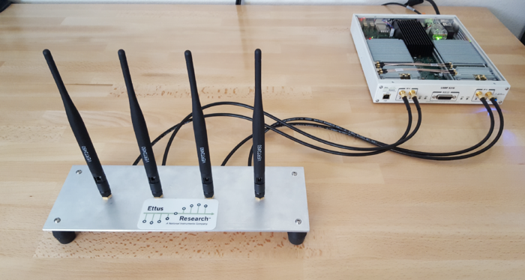
Directionality of signals: Array of sensors

Slide 4
Uniform Linear Array (ULA)

Slide 5
Beamforming in 2D space
$d sin$($φ$)
$$E1$$
$$E2$$
$$E3$$
$$E4$$
…
N elements
$$d$$
$$d$$
$$d$$
Interelement distance = d

Slide 6
Beamforming in 2D space
$3d sin$($φ$)
$2d sin$($φ$)
$d sin$($φ$)
$$E1$$
$$E2$$
$$E3$$
$$E4$$
…
N elements
$$d$$
$$d$$
$$d$$
Interelement distance = d

Slide 7
Beamforming in 2D space
$3d sin$($φ$)
$2d sin$($φ$)
$d sin$($φ$)
$$E1$$
$$E2$$
$$E3$$
$$E4$$
…
N elements
$$d$$
$$d$$
$$d$$
Path difference with n^{th} element:
$\left(n−1\right)d sin$($φ$)
Phase difference with n^{th} element:
$\left(n−1\right)d sin$($φ$) 2Π/λ

Slide 8
Beamforming in 2D space
$3d sin$($φ$)
$2d sin$($φ$)
$d sin$($φ$)
$$E1$$
$$E2$$
$$E3$$
$$E4$$
…
N elements
$$d$$
$$d$$
$$d$$
Interelement distance = d
Path difference with n^{th} element:
$\left(n−1\right)d sin$($φ$)
Phase difference with n^{th} element:
$\left(n−1\right)d sin$($φ$) 2Π/λ

Slide 9
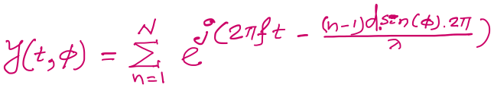

$3d cos$($φ$)
$2d sin$($φ$)
Beamforming in 2D space
$d sin$($φ$)
$$E1$$
$$E2$$
$$E3$$
$$E4$$
…
N elements
$$d$$
$$d$$
$$d$$
Path difference with n^{th} element:
$\left(n−1\right)d sin$($φ$)
Phase difference with n^{th} element:
$\left(n−1\right)d sin$($φ$) 2Π/λ
Signal at 1st sensor:
$e^{j\left(2πft\right)}{ }$
Combined signal:

Slide 10
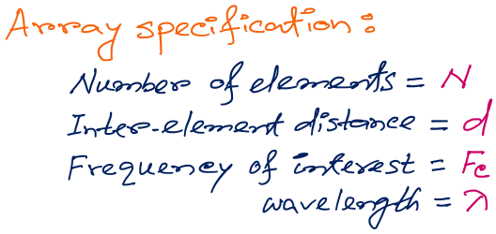
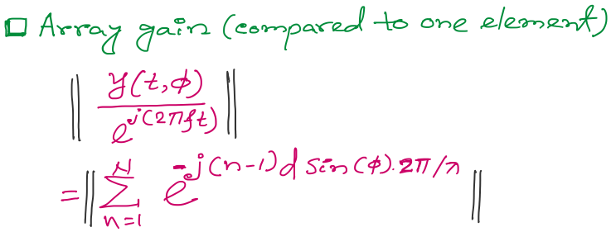
Beamforming in 2D space
f
Notes:
http://www.waves.utoronto.ca/prof/svhum/ece422/notes/15-arrays2.pdf

Slide 11
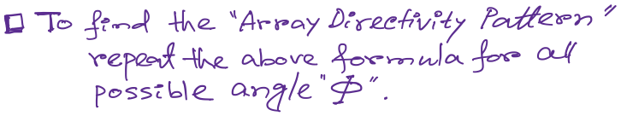
Beamforming in 2D space
Notes:
http://www.waves.utoronto.ca/prof/svhum/ece422/notes/15-arrays2.pdf

Slide 12
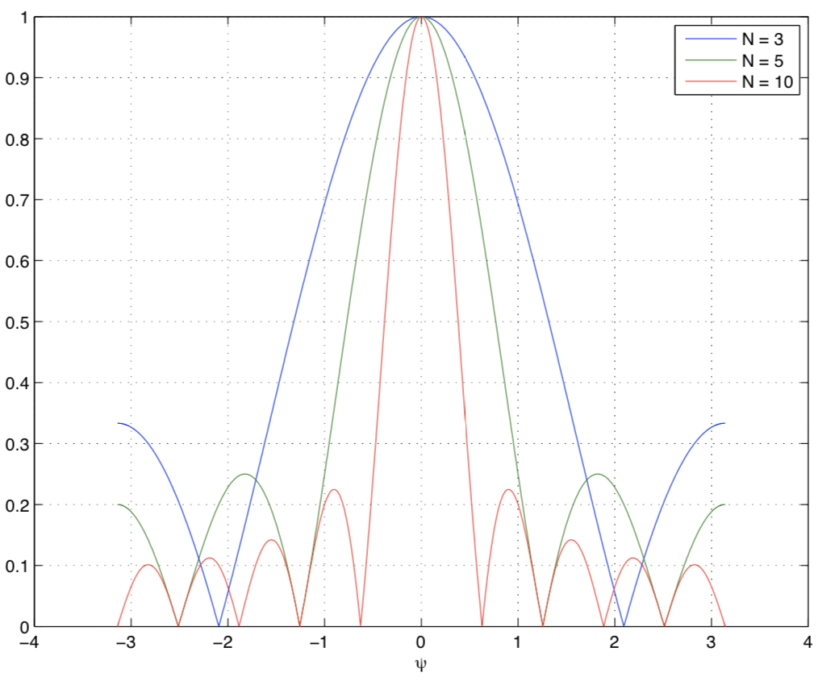
Beamforming in 2D space
Gain
-90 -60 -30 0 30 60 90
Angle
Notes:
http://www.waves.utoronto.ca/prof/svhum/ece422/notes/15-arrays2.pdf

Slide 13
Beamforming in 2D space
Notes:
http://www.waves.utoronto.ca/prof/svhum/ece422/notes/15-arrays2.pdf

Slide 14
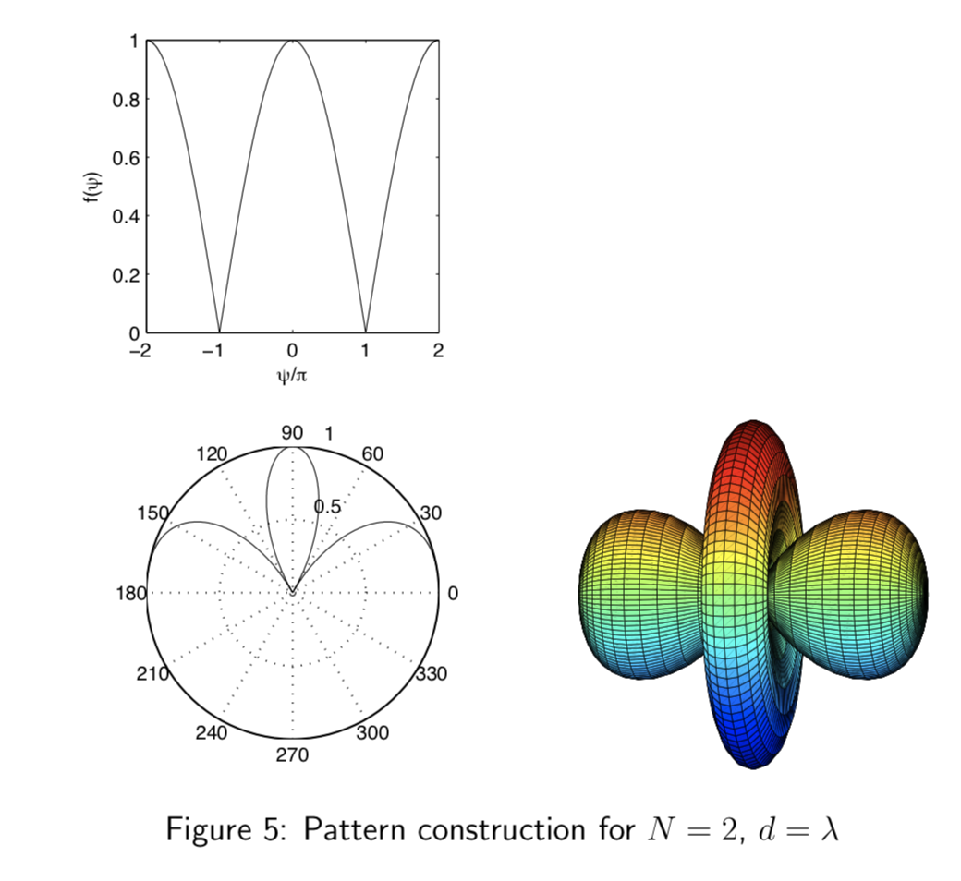
Beamforming in 2D space
Notes:
http://www.waves.utoronto.ca/prof/svhum/ece422/notes/15-arrays2.pdf

Slide 15
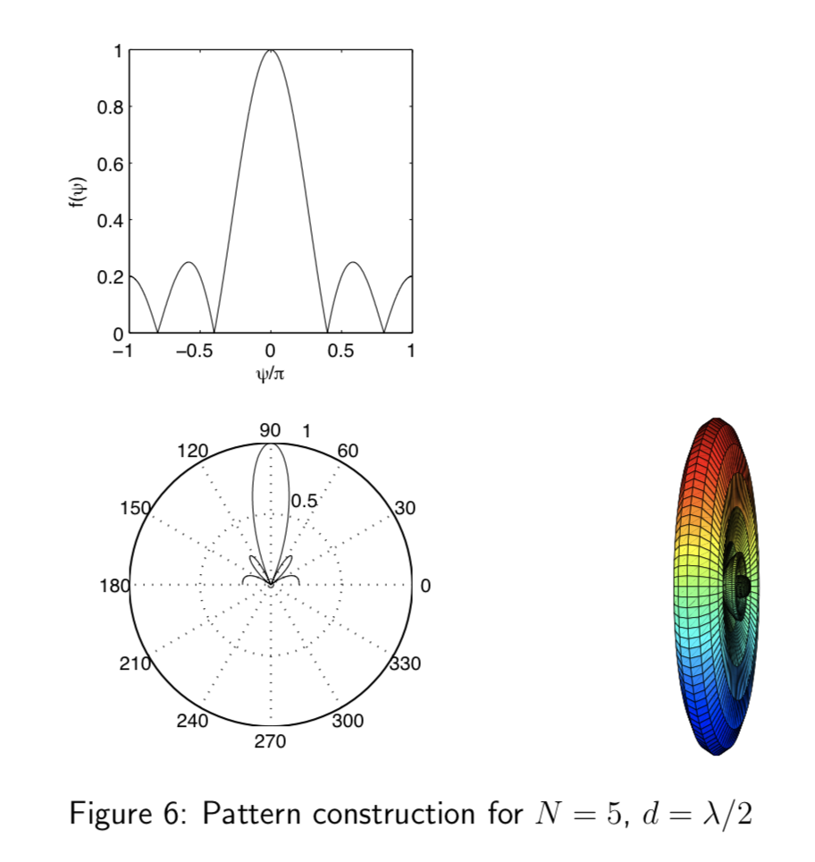
Beamforming in 2D space
Notes:
http://www.waves.utoronto.ca/prof/svhum/ece422/notes/15-arrays2.pdf

Slide 16
Beamforming in 2D space

Slide 17
Sensing with an Array
$$φ$$
$$d$$
Extra phase-1
Extra phase-2
+
Combined signal

Slide 18
Sensing with an Array
$$φ$$
$$d$$
Extra phase-1
Extra phase-2
= $e^{jΘ2}{ }$
= $e^{jΘ1}{ }$
+
= $e^{j\left(2πft\right)}{ }+e^{j\left(2πft + \frac{2π d sin(φ)}{λ}\right)}{ }$

Slide 19
Sensing with an Array
$$φ$$
$$d$$
Extra phase-1
Extra phase-2
= $e^{jΘ2}{ }$
= $e^{jΘ1}{ }$
+
= $e^{j\left(2πft+Θ1\right)}{ }+e^{j\left(2πft + \frac{2π d sin(φ)}{λ}+Θ2\right)}{ }$

Slide 20
Beam-steering
Delay-sum beamformer or Phased array
Notes:
http://www.waves.utoronto.ca/prof/svhum/ece422/notes/15-arrays2.pdf

Slide 21
Beam-steering
Phased array
Add additional phase:
$−\left(n−1\right)d sin$(𝚹_{s}) 2Π/λ
Notes:
http://www.waves.utoronto.ca/prof/svhum/ece422/notes/15-arrays2.pdf

Slide 22
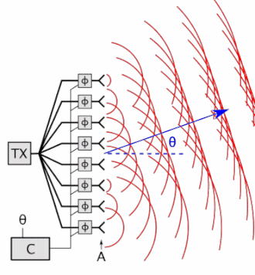
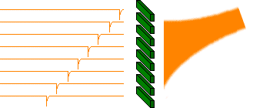
Beam-steering
Delay-sum beamformer or Phased array
Notes:
http://www.waves.utoronto.ca/prof/svhum/ece422/notes/15-arrays2.pdf

Slide 23
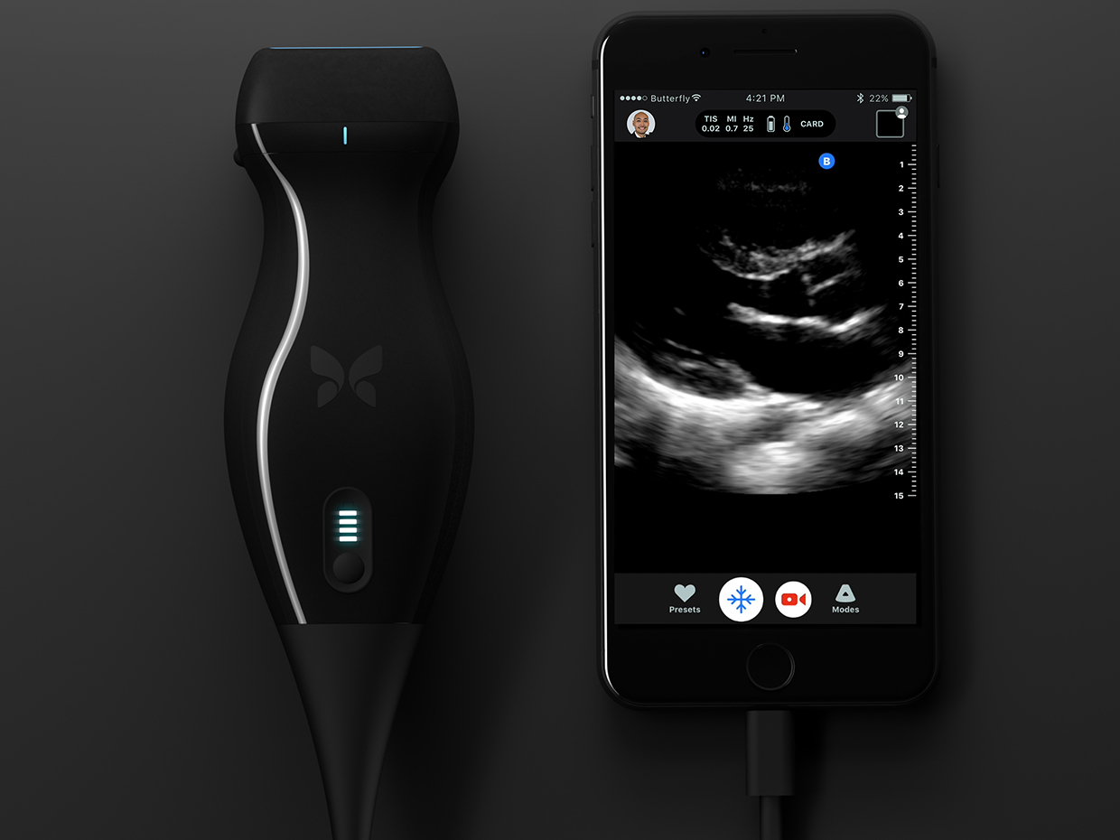
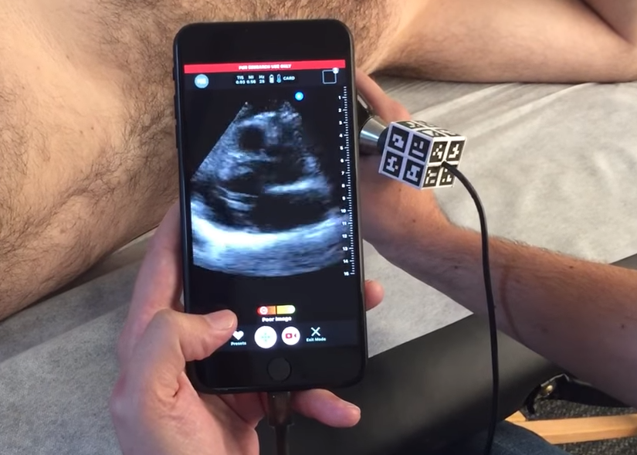

Slide 24
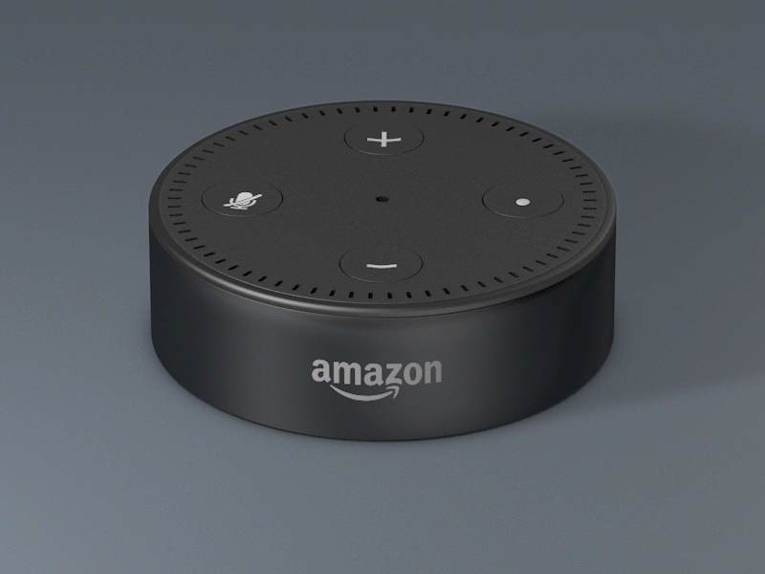

Slide 25
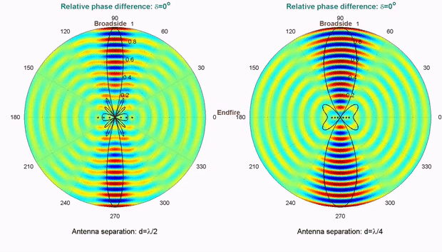
Computationally controlling beam direction

Slide 26
Angle-of-Arrival (AoA)
or
Direction-of-Arrival (DoA)

Slide 27
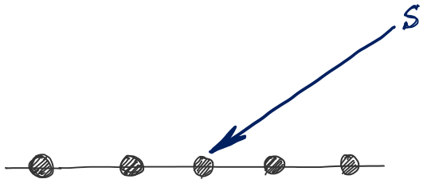
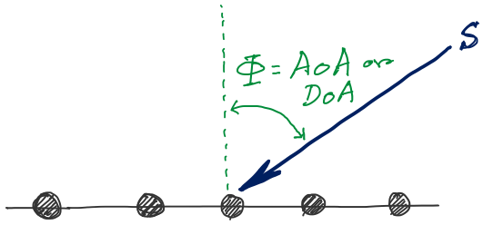
d
d
d
d
Notes:
http://www.waves.utoronto.ca/prof/svhum/ece422/notes/15-arrays2.pdf

Slide 28

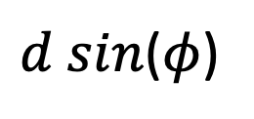




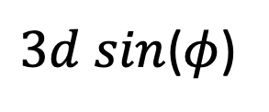


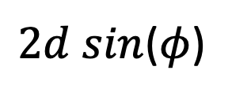
DoA Estimation
$3d sin$($φ$)
$2d sin$($φ$)
$d sin$($φ$)
$$E1$$
$$E2$$
$$E3$$
$$E4$$
…
N elements
$$d$$
$$d$$
$$d$$
Interelement distance = d

Slide 29
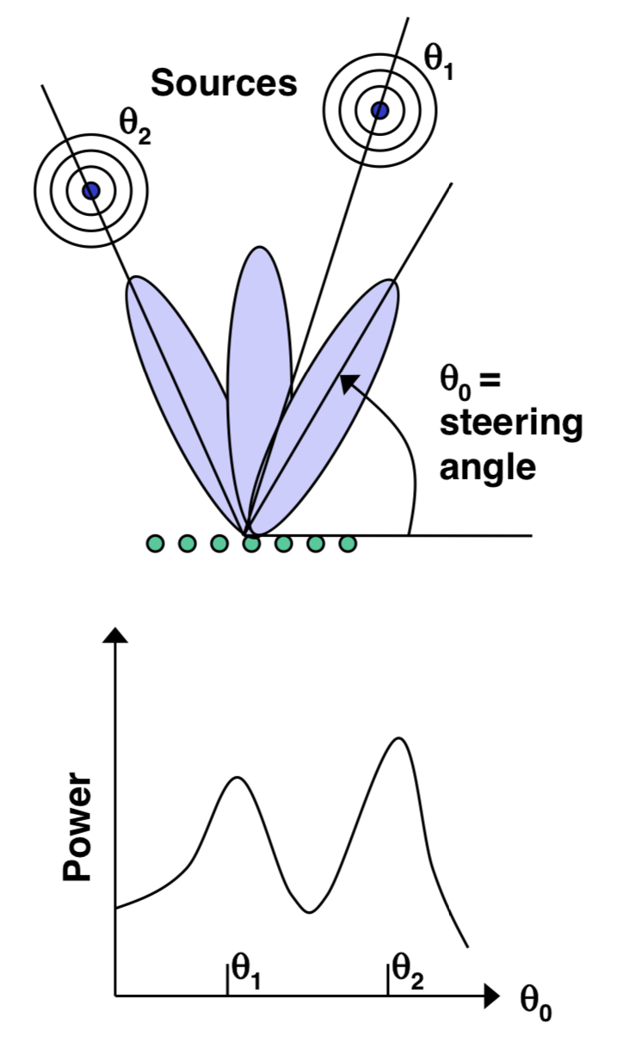
DoA Estimation: Beam-scanning

Slide 30
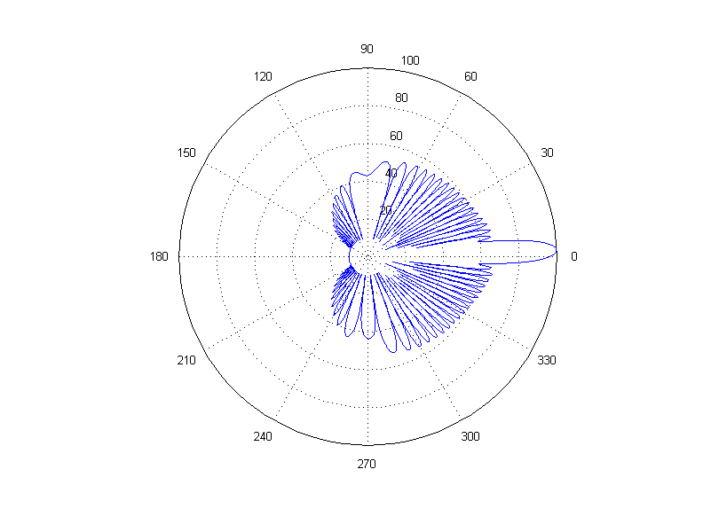
DoA Estimation: Beam-scanning
Number of elements = 30, wave length = 10cm, distance between elements = 6.5 cm
Notes:
http://www.waves.utoronto.ca/prof/svhum/ece422/notes/15-arrays2.pdf

Slide 31
Delay-sum DoA estimation

Slide 32
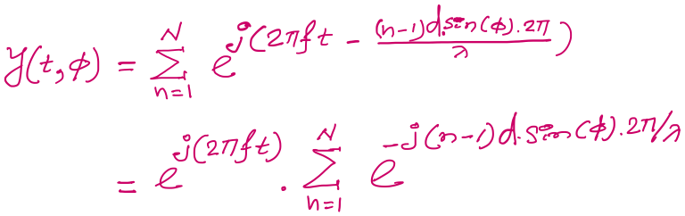
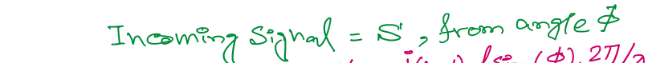
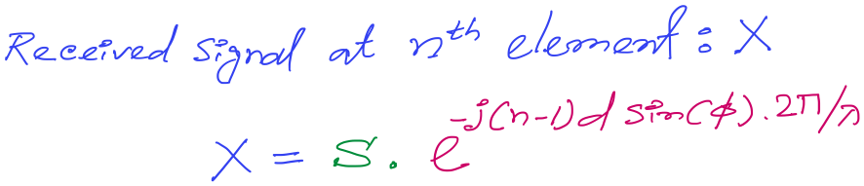
DoA Estimation: Delay-sum
Notes:
http://www.waves.utoronto.ca/prof/svhum/ece422/notes/15-arrays2.pdf

Slide 33
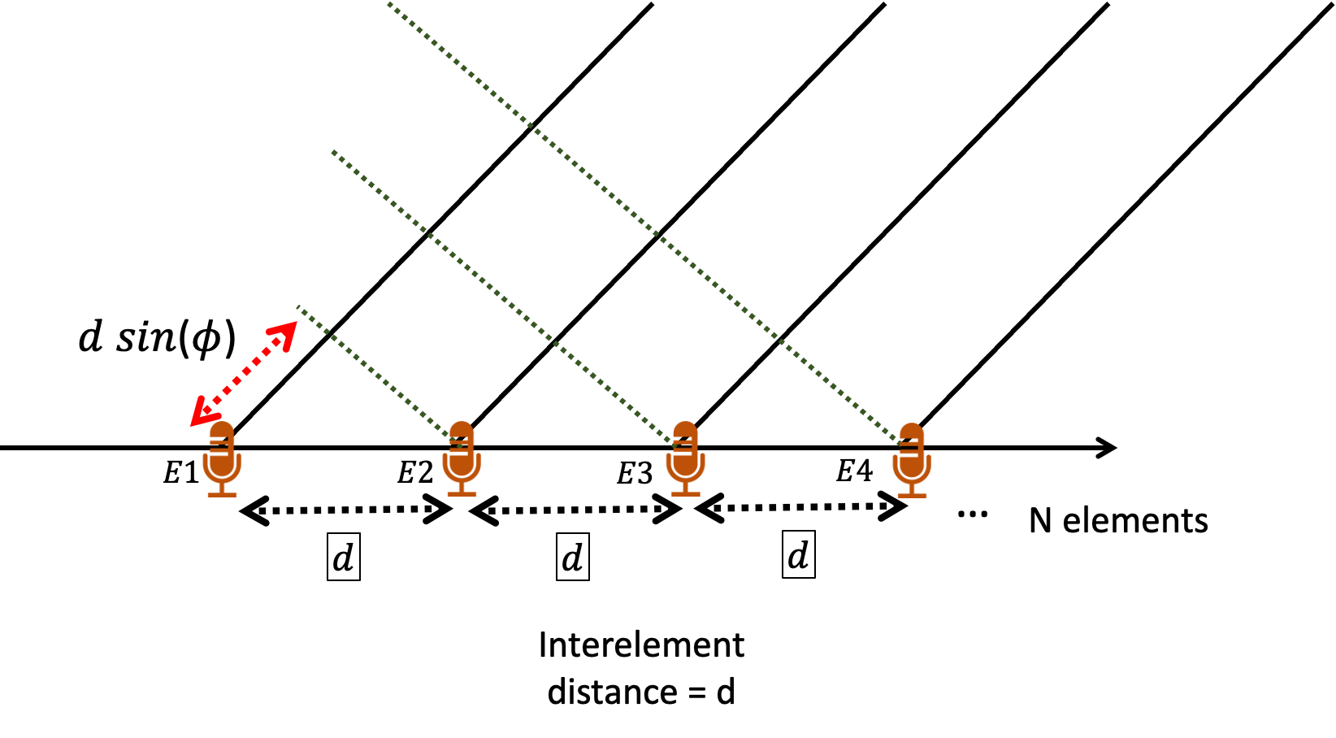
DoA Estimation: Delay-sum
For 3rd mic, n == 3
Notes:
http://www.waves.utoronto.ca/prof/svhum/ece422/notes/15-arrays2.pdf

Slide 34
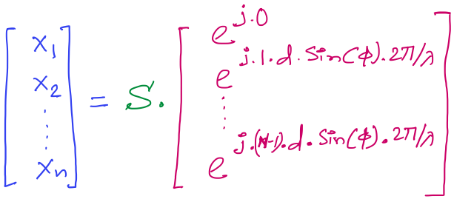

DoA Estimation: Delay-sum
Received signals in all elements:
…
Note: Here the samples from individual sensors are collected separately and simultaneously, not added together.
Steering vector
Notes:
http://www.waves.utoronto.ca/prof/svhum/ece422/notes/15-arrays2.pdf

Slide 35
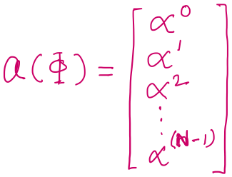

DoA Estimation: Delay-sum
Received signals in all elements:
Notes:
http://www.waves.utoronto.ca/prof/svhum/ece422/notes/15-arrays2.pdf

Slide 36
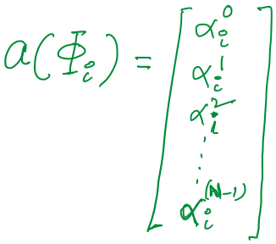

DoA Estimation: Delay-sum

Slide 37
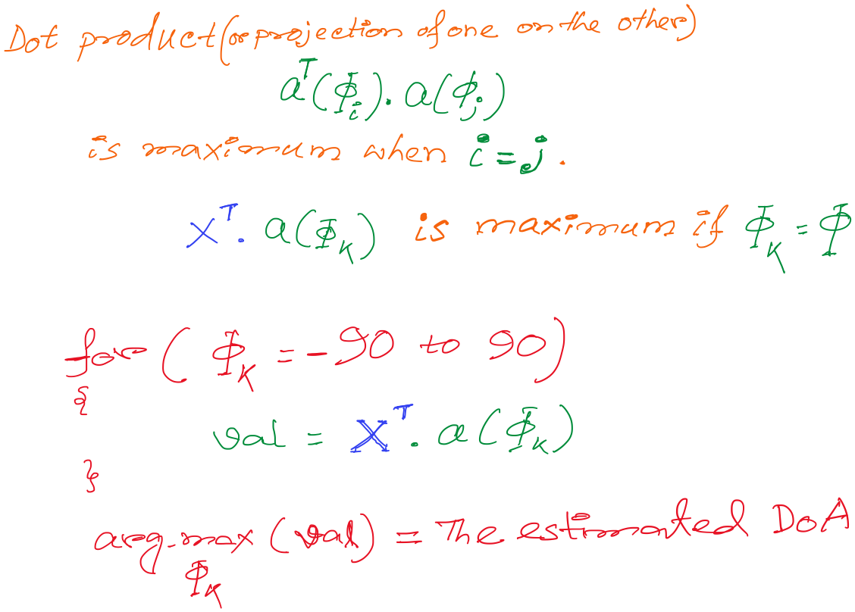
DoA Estimation: Delay-sum

Slide 38
DoA Estimation: Delay-sum

Slide 39
DoA Estimation: Delay-sum
How is this a “delay -sum” ?

Slide 40
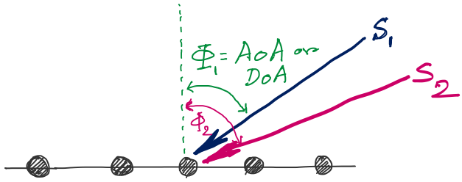
DoA Estimation
d
d
d
d
Notes:
http://www.waves.utoronto.ca/prof/svhum/ece422/notes/15-arrays2.pdf

Slide 41
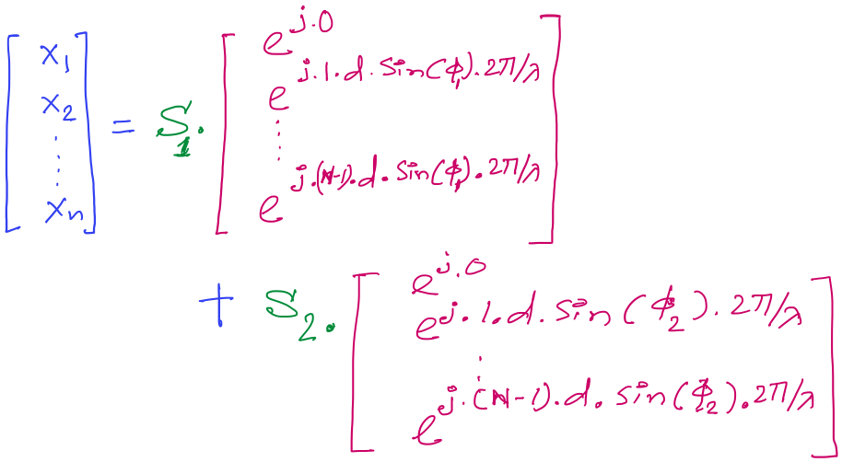
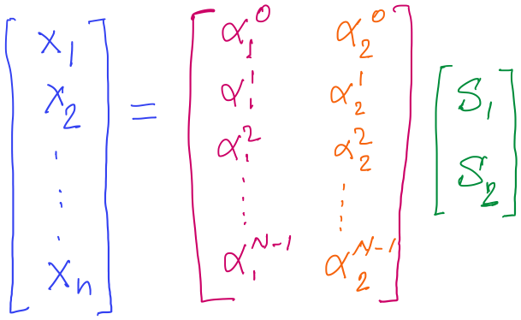
DoA Estimation

Slide 42
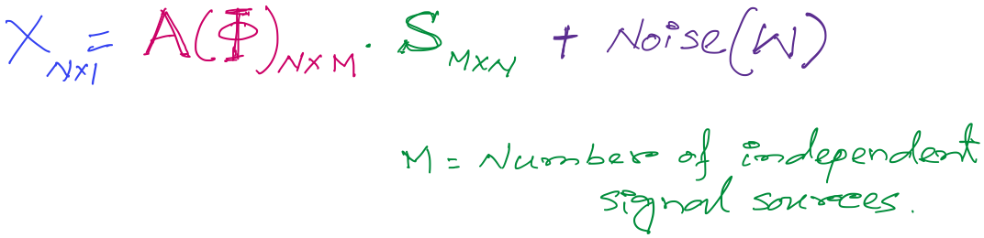
DoA Estimation
Mx1
Steering matrix

Slide 43
A different approach to DoA estimation

Slide 44
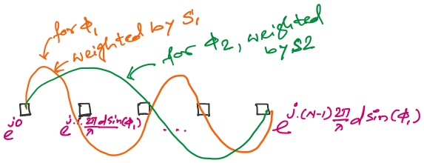
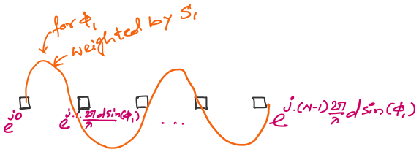
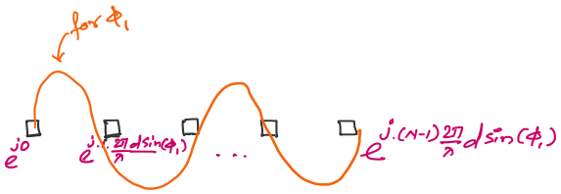

An observation on the spatial samples

Slide 45
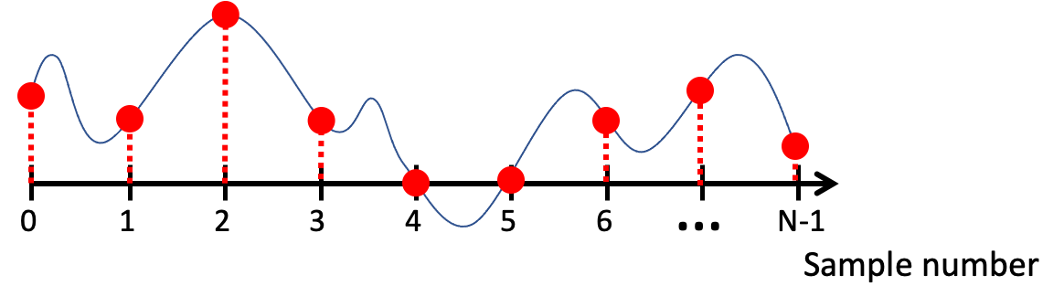
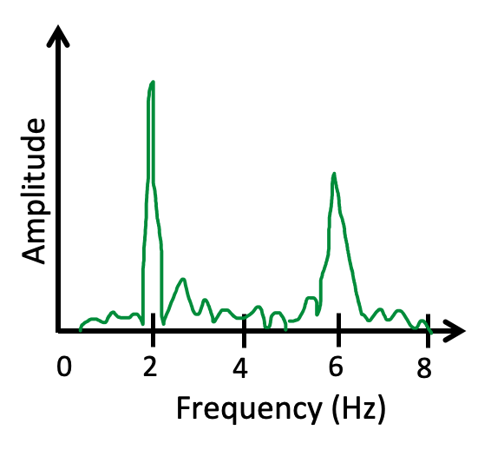
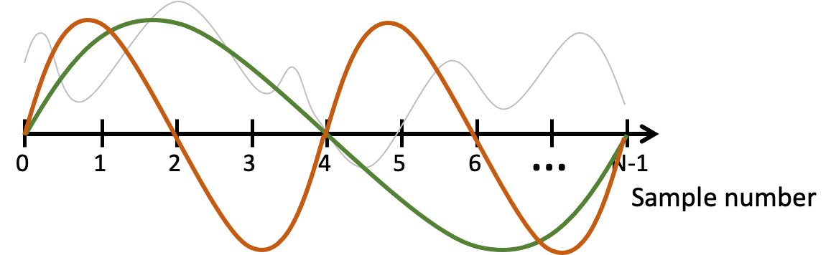
FFT
Arbitrary signals can be represented as a combination of sinusoids

Slide 46
FFT
Arbitrary signals can be represented as a combination of sinusoids
Agnostic of the type of signal or sampling details

Slide 47
FFT
Arbitrary signals can be represented as a combination of sinusoids

Slide 48
FFT
Arbitrary signals can be represented as a combination of sinusoids

Slide 49
DoA Estimation : Classical FFT approach

Slide 50
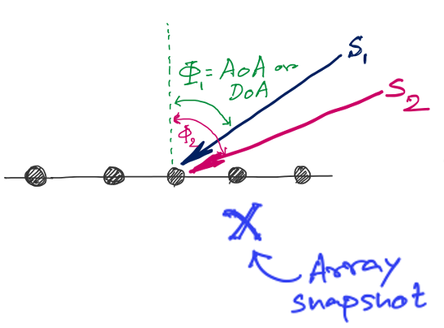
DoA Estimation : Classical FFT approach
FFT
Amplitude
0
4
8
12
16
Frequency (Hz) ??

Slide 51
Discrete Fourier Transform
…
0
1
2
3
4
5
6
N-1
Sample number
X = [ ]
x[0], x[1], x[2], x[3], x[4], … x[N-1]

Slide 52
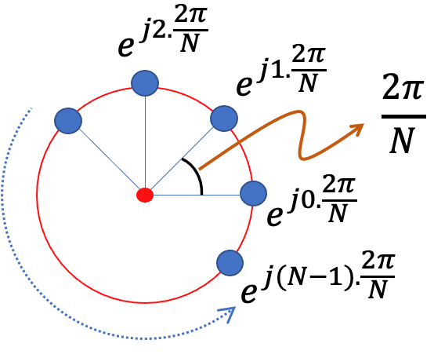
Discrete Fourier Transform
…
0
1
2
3
4
5
6
N-1
Sample number
Slowest frequency goes $\frac{2π}{N}$ radians per step.

Slide 53

Estimating the real-world frequencies
Sampling frequency = f_{s} (i.e., f_{s} samples per second)
Slowest frequency ($\frac{2π}{N}$ radians per step) = N samples per rotation
= (N/ f_{s}) seconds per rotation
Therefore, the slowest frequency = (f_{s} /N) Hz
Higher frequencies are integer multiple of (f_{s} /N) Hz
0, $\frac{\text{f}\text{s}}{N}\text{, }\frac{\text{2}\text{f}\text{s}}{N}$ , $\frac{\text{3}\text{f}\text{s}}{N}$ , $\frac{\text{4}\text{f}\text{s}}{N}$, … , , $\frac{\text{(}\text{N}\text{−1)}\text{f}\text{s}}{N}$

Slide 54
Discrete Fourier Transform
…
0
1
2
3
4
5
6
N-1
Sample number
Slowest frequency goes $\frac{2π}{N}$ radians per step.

Slide 55



Discrete Fourier Transform
…
0
1
2
3
4
5
6
N-1
Sample number
$$\frac{2π}{N}$$
$$\frac{2πdsin\left(ϕ\right)}{λ}$$
$$=$$

Slide 56



Discrete Fourier Transform
…
0
1
2
3
4
5
6
N-1
Sample number
$$\frac{k.2π}{N}$$
$$\frac{2πdsin\left(ϕk\right)}{λ}$$
$$=$$

Slide 57


Discrete Fourier Transform
…
0
1
2
3
4
5
6
N-1
Sample number
$$\frac{kλ}{Nd}$$
$$ϕk$$
$$=$$
asin( )

Slide 58
DoA Estimation : Classical FFT approach
What is the minimum and maximum value of the inter-element distance (d)?
d
d
d
d

Slide 59

DoA Estimation : Classical FFT approach

Slide 60





Slide 61


Slide 62
Extra Slide for reference
(not taught in class)

Slide 63
Finding distance using waves

Slide 64



Slide 65
Finding distance using waves
(Ranging)

Slide 66
…
SONAR
(detection)
Depth/Image
Gesture

Slide 67
…
SONAR
(detection)
Depth/Image
Gesture
Finding distance using waves
(Ranging)

Slide 68
…
SONAR
(detection)
Depth/Image
Gesture
Finding distance using waves
(Ranging)
Speed
Amplitude
Frequency
Phase

Slide 69
1. Distance from the speed information
a. Techniques
b. Signal detection
2. Distance from the amplitude information
a. Absorption
b. Propagation loss
3. Distance from the frequency information
a. Doppler effect
b. A case study (Doppler + Triangulation)
4. Distance from the phase information
a. Overview
b. Impulse function, Impulse response, Convolution
c. A case study

Slide 70
1. Distance from the speed information
a. Techniques
b. Signal detection
2. Distance from the amplitude information
a. Absorption
b. Propagation loss
3. Distance from the frequency information
a. Doppler effect
b. A case study (Doppler + Triangulation)
4. Distance from the phase information
a. Overview
b. Impulse function, Impulse response, Convolution
c. A case study

Slide 71
Distance from the speed information
Dist. = (speed) X (time of travel)
Time of Arrival (ToA)
Signal source
observer

Slide 72
Distance from the speed information
Dist. = (speed) X (time of travel)
Time of Arrival (ToA)
Signal source
observer
Signal source
Time Difference of Arrival (TDoA)
observer 1
observer2

Slide 73

TDoA
a
b
Find the location of the wave source when (a-b) is known.

Slide 74

TDoA

Slide 75
Distance from the speed information
Dist. = (speed) X (time of travel)
Time of Arrival (ToA)
Signal source
observer
Signal source
Time Difference of Arrival (TDoA)
observer 1
observer2
Round-trip Time of Flight (RToF)
Signal source
+ observer
Reflector

Slide 76
Distance from the speed information
Dist. = (speed) X (time of travel)
Time of Arrival (ToA)
Signal source
observer
How to detect the signal at the receiver/observer?
Signal source
Time Difference of Arrival (TDoA)
observer 1
observer2
Round-trip Time of Flight (RToF)
Signal source
+ observer
Reflector

Slide 77
Signal detection
Amplitude
Time/Sample
Transmitter signal

Slide 78
Signal detection
Amplitude
Amplitude
Time/Sample
Time/Sample
Transmitter signal
Receiver signal

Slide 79

Signal detection
Amplitude
Amplitude
Time/Sample
Time/Sample
Transmitter signal
Receiver signal
Energy based signal detector
Energy of a discrete signal x(n),

Slide 80
Signal detection
Amplitude
Amplitude
Time/Sample
Time/Sample
Transmitter signal
Receiver signal

Slide 81


Signal detection
Received signal
Signal matching
Transmit signal template

Slide 82
Signal detection
Received signal
Signal matching
Transmit signal template
Correlation

Slide 83

Signal detection
Correlation

Slide 84
Distance from the speed information
Dist. = (speed) X (time of travel)
Time of Arrival (ToA)
Signal source
observer
Time Difference of Arrival (TDoA)
Signal source
observer 1
observer2
Round-trip Time of Flight (RToF)
Signal source
+ observer
Reflector
Notes:
Slide 23: 20 minutes

Slide 85
1. Distance from the speed information
a. Techniques
b. Signal detection
2. Distance from the amplitude information
a. Absorption
b. Propagation loss
3. Distance from the frequency information
a. Doppler effect
b. A case study (Doppler + Triangulation)
4. Distance from the phase information
a. Overview
b. Impulse function, Impulse response, Convolution
c. A case study

Slide 86

Distance from the amplitude information
Amplitude
Time (sec)
$$AS . sin⁡(2πft)$$

Slide 87

Distance from the amplitude information
Dist. = d
Amplitude
Time (sec)
Amplitude
Time (sec)
$$AS . sin⁡(2πft)$$
$$AO . sin⁡(2πft)$$

Slide 88

Distance from the amplitude information
Dist. = d
Amplitude
Time (sec)
Amplitude
Time (sec)
$$AS . sin⁡(2πft)$$
$$AO . sin⁡(2πft)$$
Attenuation due to atmospheric absorption and diffraction

Slide 89

Distance from the amplitude information
Dist. = d
Amplitude
Time (sec)
Amplitude
Time (sec)
$$AS . sin⁡(2πft)$$
$$AO . sin⁡(2πft)$$
$$AO =AS e^{−αd}$$
α = attenuation coefficient
Depends on frequency and
environment ( temperature, humidity etc.)

Slide 90

Distance from the amplitude information
Propagation loss

Slide 91
Distance from the amplitude information
Propagation loss
Notes:
Slide 30: 25 minutes

Slide 92
1. Distance from the speed information
a. Techniques
b. Signal detection
2. Distance from the amplitude information
a. Absorption
b. Propagation loss
3. Distance from the frequency information
a. Doppler effect
b. A case study (Doppler + Triangulation)
4. Distance from the phase information
a. Overview
b. Impulse function, Impulse response, Convolution
c. A case study

Slide 93
Distance from the frequency information
Motion of the sound source and/or the observer changes the frequency of the observed signal.
The change depends on the velocity of the source/observer.
This phenomena is known as Doppler effect or Doppler shift.

Slide 94

Doppler effect

Slide 95

Doppler effect

Slide 96
Doppler effect

Slide 97
Doppler effect
Simple wave model: Stationary source

Slide 98
Doppler effect
Simple wave model: Stationary source
Time = t1

Slide 99
Doppler effect
Simple wave model: Stationary source
Time = t2

Slide 100
Doppler effect
Simple wave model: Stationary source
Time = t2

Slide 101
Doppler effect
Simple wave model: Stationary source
Time = t3

Slide 102
Doppler effect
Simple wave model: Stationary source
Time = t3

Slide 103
Doppler effect
Simple wave model: Stationary source
Wavelength = λ meters
Time = t3

Slide 104

Doppler effect

Slide 105
Doppler effect
Simple wave model: Moving source

Slide 106
Doppler effect
Simple wave model: Moving source
Time = t1

Slide 107
Doppler effect
Simple wave model: Moving source
Time = t2

Slide 108
Doppler effect
Simple wave model: Moving source
Time = t2

Slide 109
Doppler effect
Simple wave model: Moving source
Time = t2

Slide 110
Doppler effect
Simple wave model: Moving source
Time = t3

Slide 111
Doppler effect
Simple wave model: Moving source
Time = t3

Slide 112
Doppler effect
Simple wave model: Moving source
Time = t3

Slide 113
Doppler effect
Simple wave model: Moving source
Actual wavelength = λ meters
Wavelength = λ₂ meters
Wavelength = λ₁ meters
Time = t3
Notes:
Slide 19: 2 minutes 30 seconds

Slide 114
Doppler effect
Simple wave model: Moving source
Actual wavelength = λ meters
Observer
Wavelength = λ₂ meters
Wavelength = λ₁ meters
Time = t3
Notes:
Slide 19: 2 minutes 30 seconds

Slide 115

Doppler effect

Slide 116

Doppler effect
Simple wave model: Moving source
Source moving towards the observer
v = Velocity of the signal (sound, light etc.)
v_{O} , T_{O} , f_{O} = Velocity of the observer and observed period and frequency
v_{S} , T_{S} , f_{S} = Velocity of the source and original period and frequency
Notes:
Slide 19: 2 minutes 30 seconds

Slide 117
Doppler effect
Simple wave model: Moving observer
Observer

Slide 118
Doppler effect
Simple wave model: Moving observer
t
t
Observer

Slide 119
Doppler effect
Simple wave model: Moving observer
t’ <t
t’ <t

Slide 120

Doppler effect
Simple wave model: Moving observer
Observer moving towards the stationary source
+
+
+
+
v_{O} , T_{O} , f_{O} = Velocity of the observer and observed period and frequency
v_{S} , T_{S} , f_{S} = Velocity of the source and original period and frequency

Slide 121
Doppler effect
Simple wave model: Moving observer
Observer moving towards the stationary source
+
Doppler shift, Δf = f_{O}-f_{S} = f_{S} (v_{O}/v)
+
+
How will it change with signal’s velocity and frequency?
+
v_{O} , T_{O} , f_{O} = Velocity of the observer and observed period and frequency
v_{S} , T_{S} , f_{S} = Velocity of the source and original period and frequency

Slide 122

Doppler effect
Simple wave model: Moving observer
Both the source and the observer are moving
v_{O} , T_{O} , f_{O} = Velocity of the observer and observed period and frequency
v_{S} , T_{S} , f_{S} = Velocity of the source and original period and frequency
Notes:
Slide 58: 30 minutes

Slide 123


Doppler effect

Slide 124
Doppler effect

