Slide 1
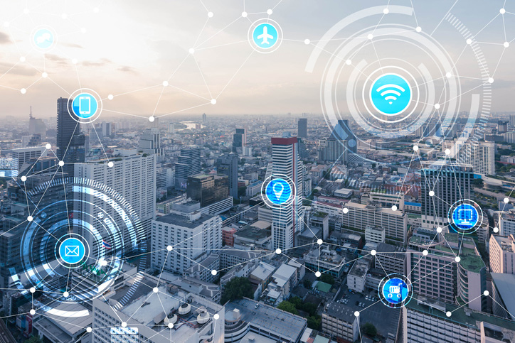
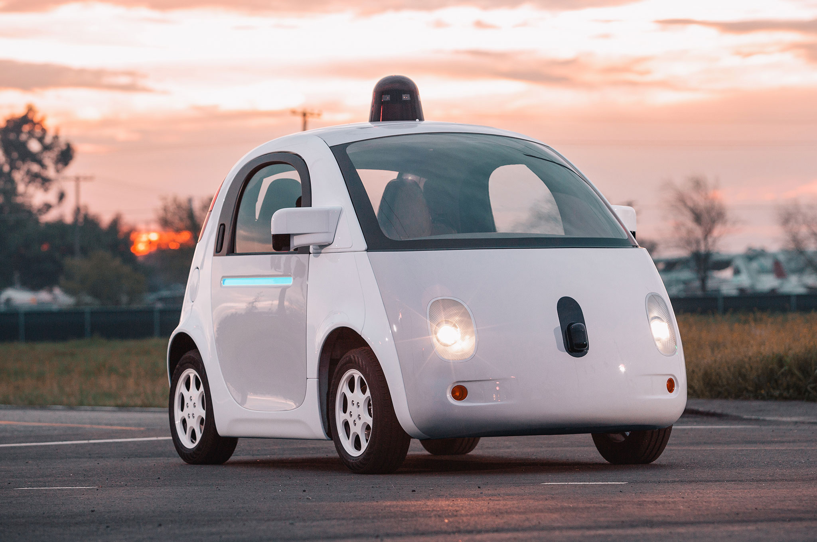
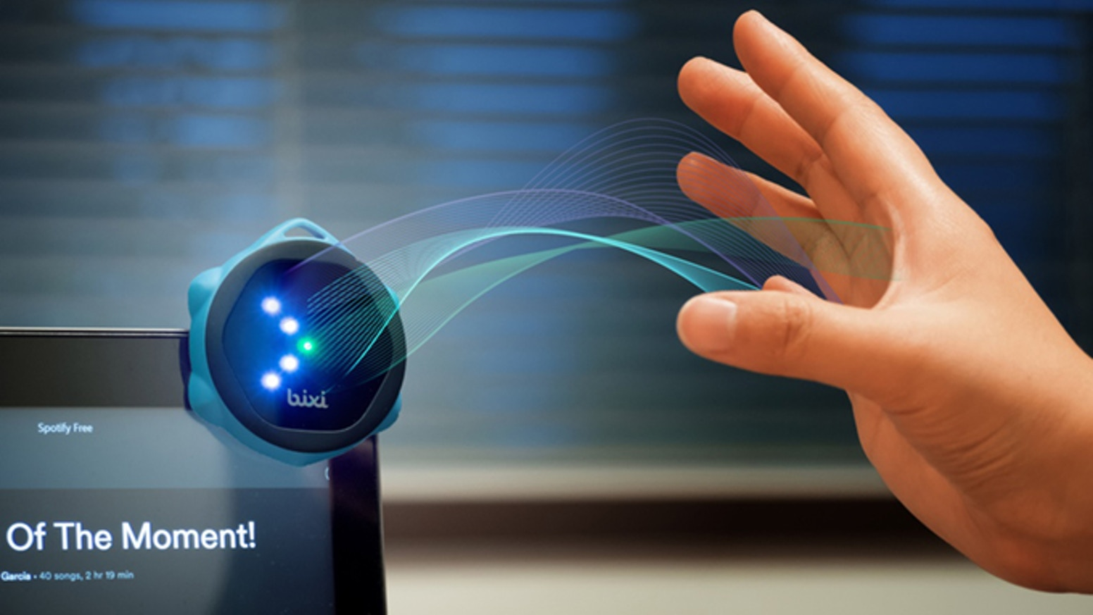
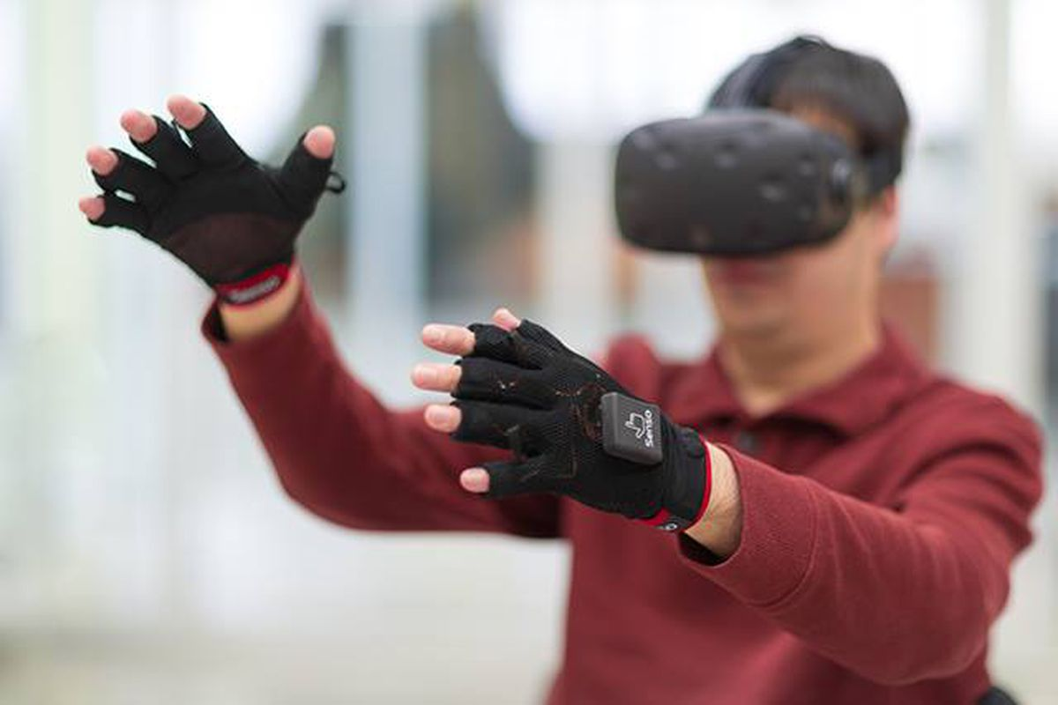

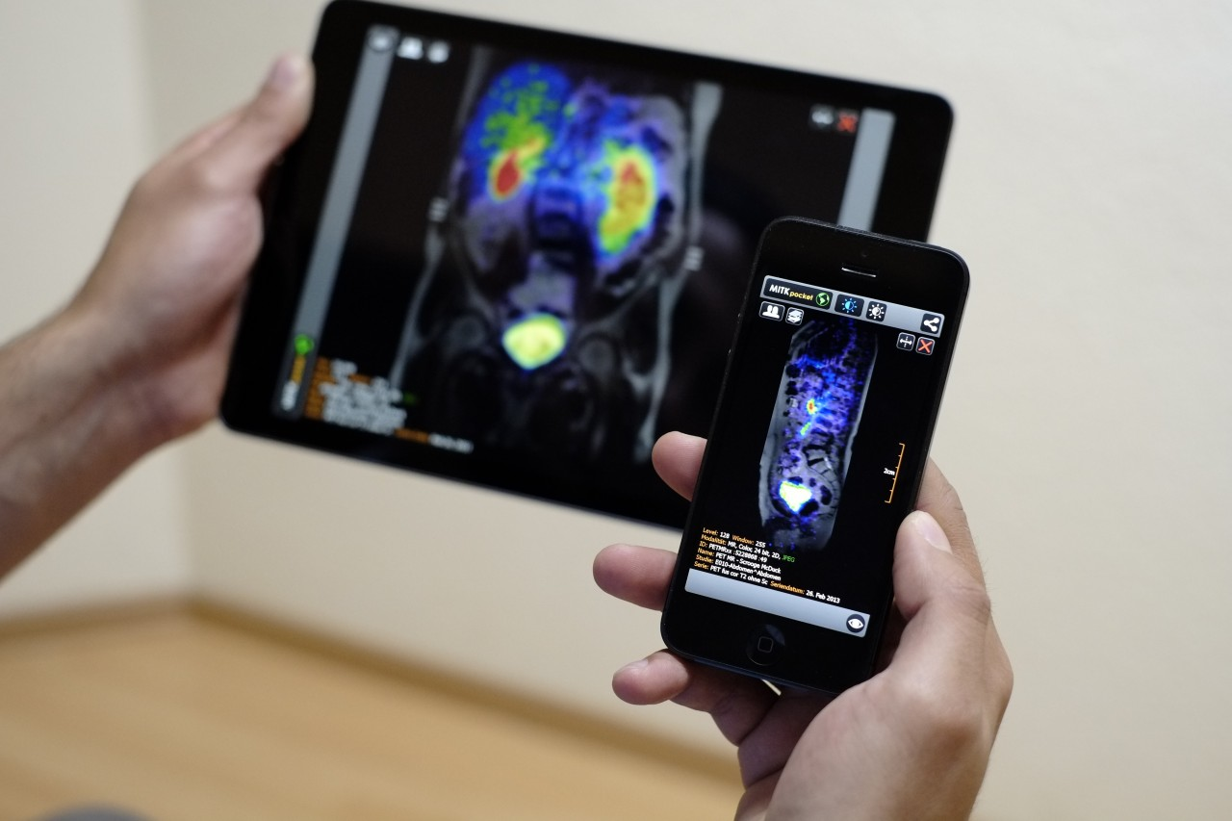
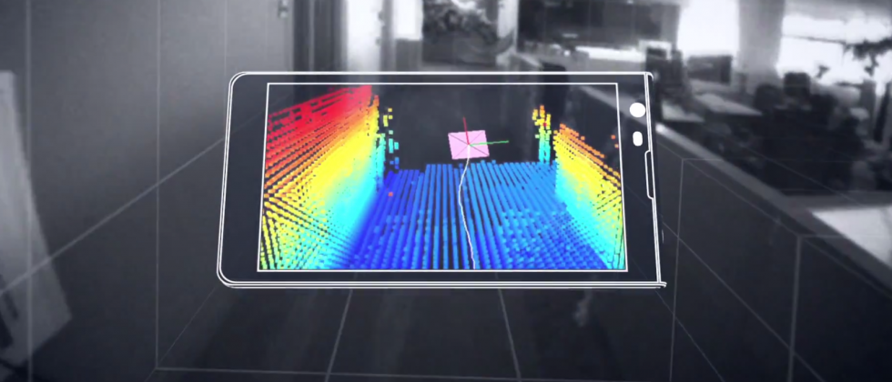
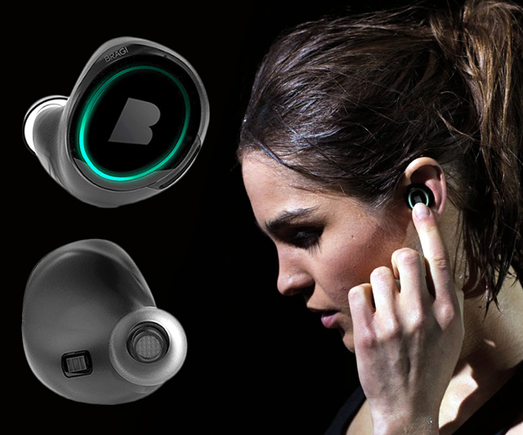
Wireless and Mobile Systems
for the IoT
CMSC 715 : Fall 2023
Lecture 3.3: Machine Learning for IoT
Nirupam Roy
Tu-Th 12:30-1:45pm
IRB 2107

Slide 2
Problems solved by HMM
1) Likelihood:
  Determine the likelihood of an observation sequence.
2) Decoding:
  Given an observation sequence, determine the best sequence of hidden states.
[Viterbi algorithm]
[Forward-backward algorithm]
[Baum-Welch algorithm]
3) Learning:
  Given an observation sequence and a sequence of states, learn the HMM parameters:
  i) Transition probabilities
  ii) Emission probabilities

Slide 3
Problems solved by HMM
1) Likelihood:
  Determine the likelihood of an observation sequence.
2) Decoding:
  Given an observation sequence, determine the best sequence of hidden states.
[Viterbi algorithm]
[Forward-backward algorithm]
[Baum-Welch algorithm]
3) Learning:
  Given an observation sequence and a sequence of states, learn the HMM parameters:
  i) Transition probabilities
  ii) Emission probabilities

Slide 4
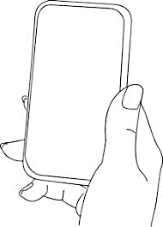
A simple gesture recognition example
States:
Observations:
No
Call
Call
Near
Far
Notes:
http://www.davidsbatista.net/assets/documents/posts/2017-11-11-hmm_viterbi_mini_example.pdf

Slide 5
A simple gesture recognition example
Start
End
St
No
Call
Call
Near
Far
Near
Far

Slide 6
A simple gesture recognition example
 | Call | NoCall | End
Start | 0.7 | 0.3 | 0
Call | 0.2 | 0.7 | 0.1
NoCall | 0.7 | 0.2 | 0.1
 | St | Near | Far
Start | 1 | 0 | 0
Call | 0 | 0.7 | 0.3
NoCall | 0 | 0.4 | 0.6
State transition
probabilities
Emission
probabilities

Slide 7
A simple gesture recognition example
Emission states are: Near, Far, Far
What is the hidden state sequence?

Slide 8
A simple gesture recognition example
i = 1 2 3
Call
Call
Call
Start
End
No
Call
No
Call
No
Call
St
Near
Far
Far

Slide 9
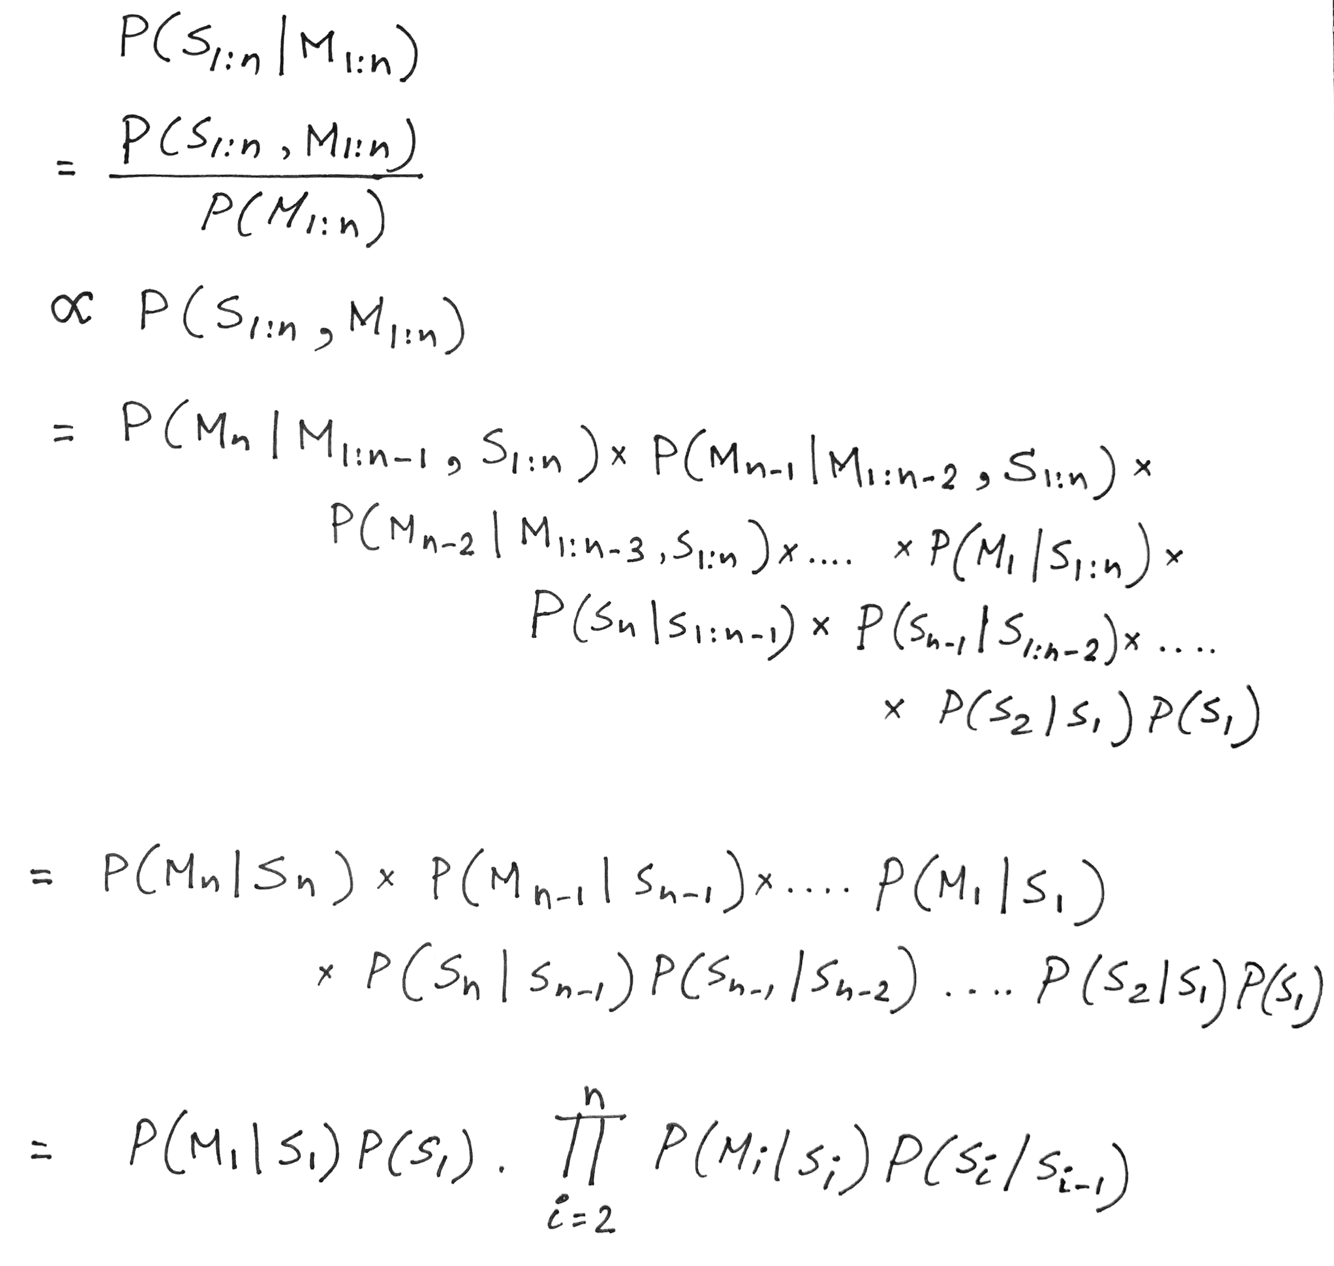
Hidden Markov Model: Definition

Slide 10
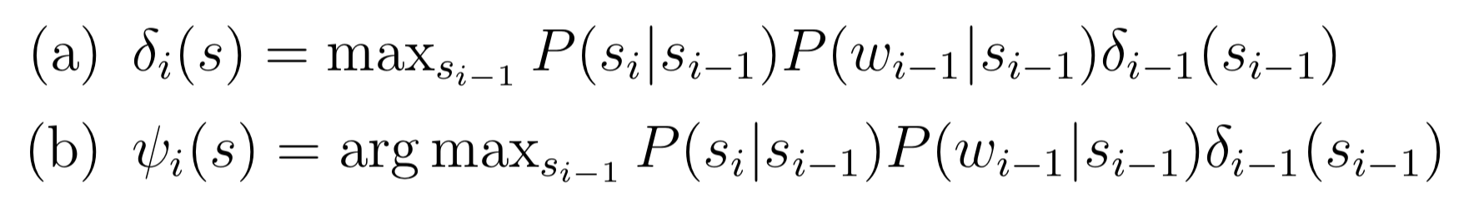

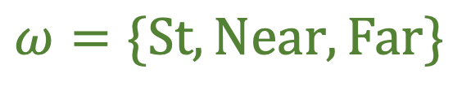

A simple gesture recognition example
Save two parameters per iteration, per state:
Recursion
$$Initialize, δ0\left(Start\right)=1$$
$$S=\{Start, Call, NoCall, End\}$$
$$ω=\{St, Near, Far\}$$
[Ref] http://www.davidsbatista.net/assets/documents/posts/2017-11-11-hmm_viterbi_mini_example.pdf

Slide 11


A simple gesture recognition example
i = 1 2
Call
Call
No
Call
Near
Far

Slide 12
A simple gesture recognition example
i = 1 2 3
Call
Call
Call
Start
End
No
Call
No
Call
No
Call
St
Near
Far
Far

Slide 13




A simple gesture recognition example
i = 1
 | Call | NoCall | End
Start | 0.7 | 0.3 | 0
Call | 0.2 | 0.7 | 0.1
NoCall | 0.7 | 0.2 | 0.1
Call
State transition probabilities
Start
$$δ0\left(Start\right)=1$$
 | St | Near | Far
Start | 1 | 0 | 0
Call | 0 | 0.7 | 0.3
NoCall | 0 | 0.4 | 0.6
No
Call
St
Near
Emission probabilities

Slide 14


A simple gesture recognition example
i = 1 2
Call
Call
Start
No
Call
No
Call
Near
Far

Slide 15





A simple gesture recognition example
i = 1 2 3
0.14406
Call
Call
Call
0.0043
Start
0.343
0.04116
End
No
Call
No
Call
No
Call
Near
Far
Far

Slide 16
A simple gesture recognition example
i = 1 2 3
Call
Call
Call
The values of delta and psi are not correct on this slide. Please refer to the calculation shown at the following link.
http://www.cs.umd.edu/class/fall2020/cmsc818w/course_materials/slides/Viterbi_solution.pdf
Start
End
No
Call
No
Call
No
Call
Near
Far
Far

Slide 17
A simple gesture recognition example
i = 1 2 3
0.14406
Call
Call
Call
0.0043
Start
0.343
0.04116
End
No
Call
No
Call
No
Call
Near
Far
Far

Slide 18
A simple gesture recognition example
i = 1 2 3
0.14406
Call
Call
Call
0.0043
Start
0.343
0.04116
End
No
Call
No
Call
No
Call
Near
Far
Far

Slide 19
A simple gesture recognition example
i = 1 2 3
0.14406
Call
Call
Call
For complete step by step solution of this example visit:
http://www.cs.umd.edu/class/fall2022/cmsc715/course_materials/slides/Viterbi_solution.pdf
0.0043
Start
0.343
0.04116
End
No
Call
No
Call
No
Call
Viterbi sequence: < Call, NoCall, Call >
P( <Call, NoCall, Call > | <Near, Far, Far>) = 0.0043
Near
Far
Far

Slide 20
Applications of statistical inference in IoT

Slide 21
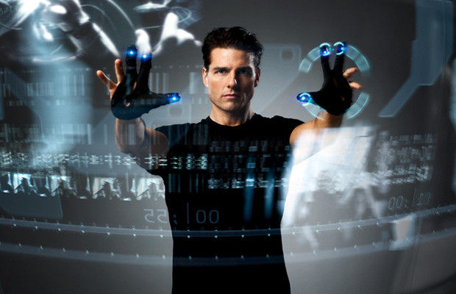

I am a Smartwatch and I can
Track my User’s Arm
Sheng Shen, He Wang, Romit Roy Choudhury

Slide 22
Understanding human arm motion
How is the arm moving?
What is the meaning of this motion?

Slide 23
Gesture Recognition
What is the meaning of this motion?

Slide 24
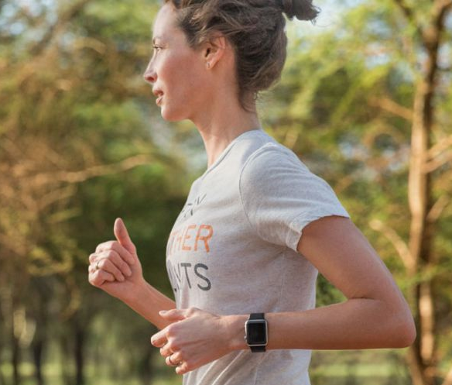


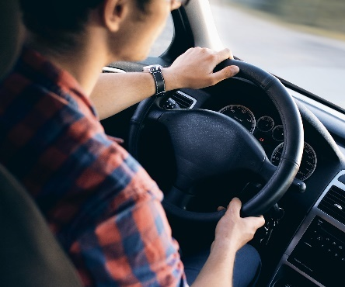
Gesture Recognition
Running
Smoking
Drinking
Driving

Slide 25
Gesture Recognition
Running
[Rithmio]
Smoking
[MobiSys’14]
Drinking
[WaterMinder]
Driving
[WearSys’15]

Slide 26
Posture Tracking
Gesture Recognition
How is the arm moving?
What is the meaning of this motion?

Slide 27
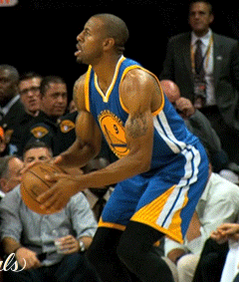
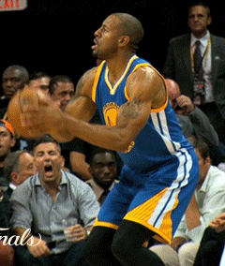
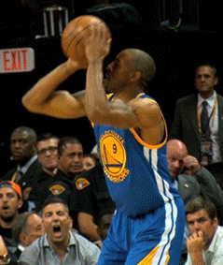
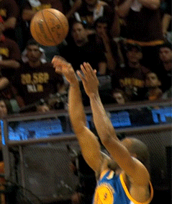
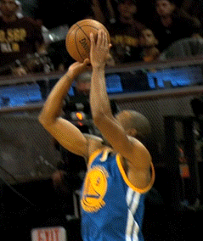
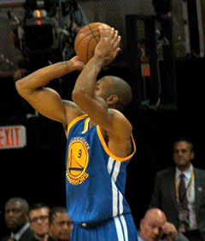

Slide 28
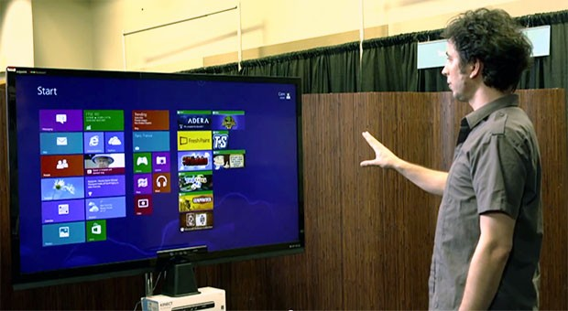
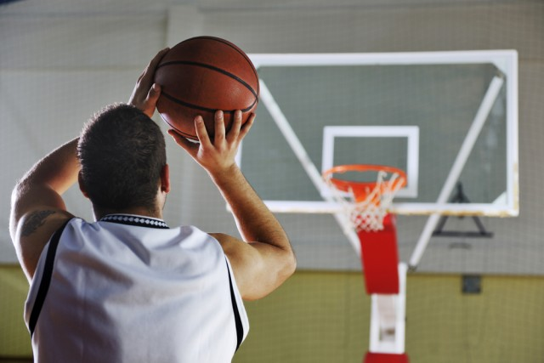
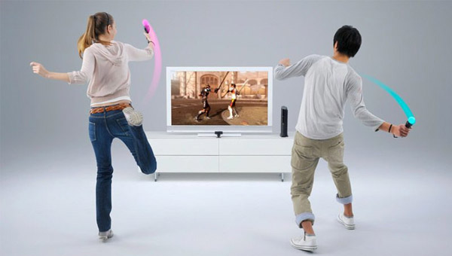
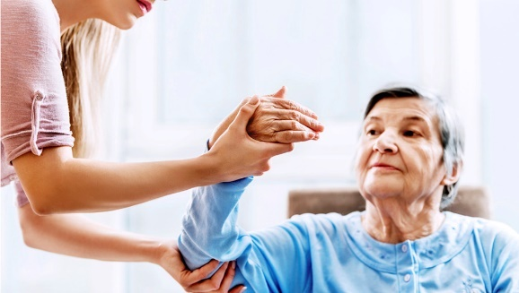
Arm Posture Tracking - Applications
Natural User Interface
Sports Analytics
Can we track arm postures with a smartwatch alone?
Motion Gaming
Healthcare

Slide 29
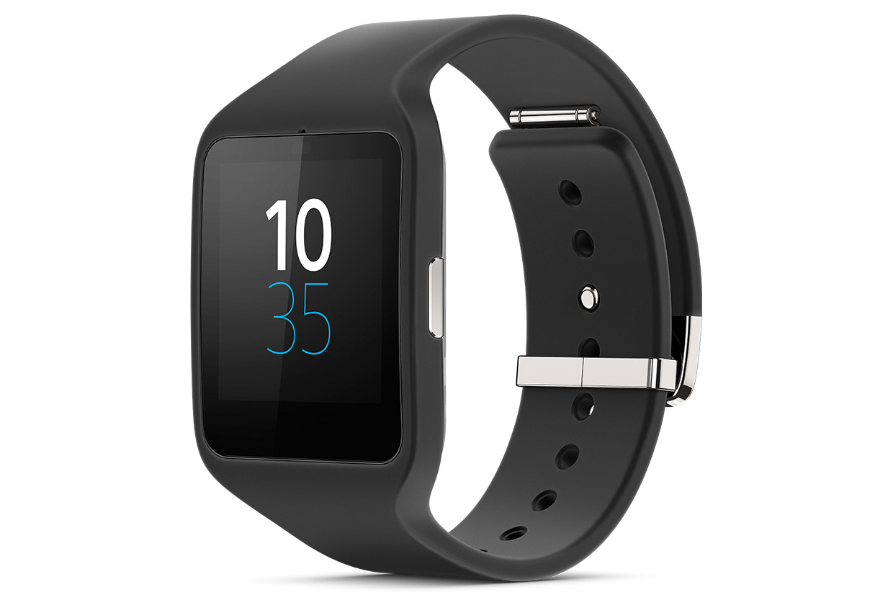
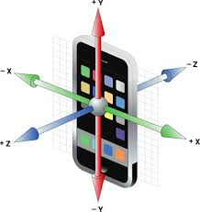
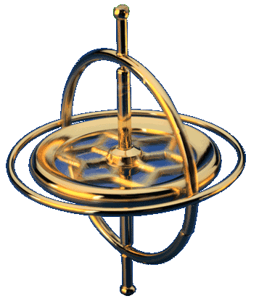
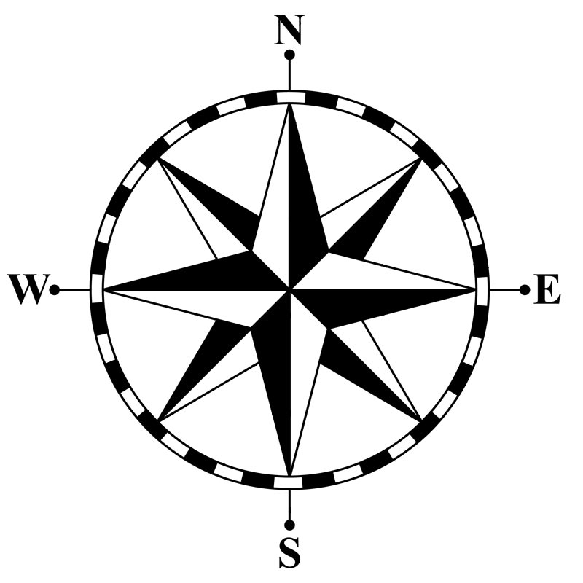
Can we track arm postures with a smartwatch alone?
Y
What is inside a smartwatch?
X
Z
Accelerometer
Gyroscope
Compass
Acceleration along 3 axes
Rotation speed around 3 axes
North vector
projected to 3 axes

Slide 30
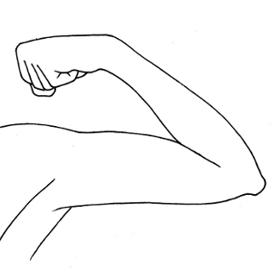
Can we track arm postures with a smartwatch alone?
What do we need to track?
Wrist
Elbow
Shoulder
Posture = < Elbow Location, Wrist Location, Wrist Rotation >

Slide 31
Can we track arm postures with a smartwatch alone?
What do we need to track?
Elbow Location
3D Sphere
(DoF: 2)
Elbow
Shoulder

Slide 32
Can we track arm postures with a smartwatch alone?
What do we need to track?
Elbow Location
Wrist
3D Sphere
(DoF: 2)
Wrist Location
3D Sphere
(DoF: 2)
Shoulder

Slide 33
Can we track arm postures with a smartwatch alone?
What do we need to track?
Elbow Location
Wrist
3D Sphere
(DoF: 2)
Wrist Location
Elbow
3D Sphere
(DoF: 2)
Shoulder
Wrist Rotation
1D Angle
(DoF: 1)

Slide 34

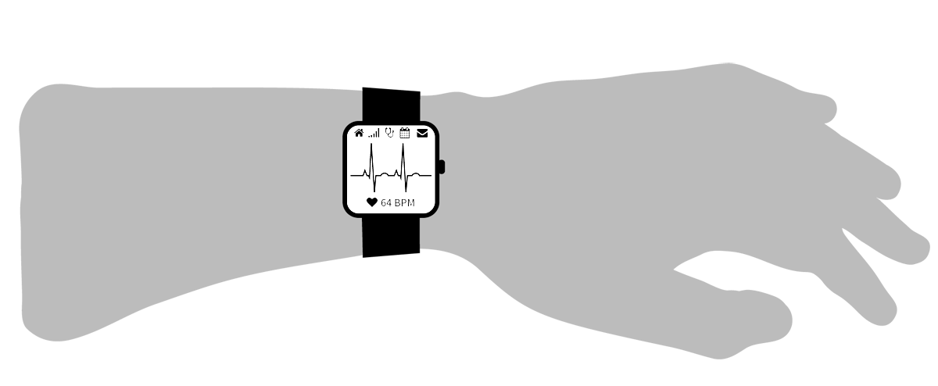

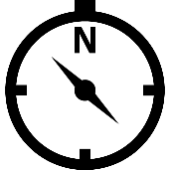
Can we track arm postures with a smartwatch alone?
Smartwatch = < Accelerometer, Gyroscope, Compass>
Accelerometer
Gyroscope
Compass
Wrist
?
Elbow
Shoulder
Posture = < Elbow Location, Wrist Location, Wrist Rotation >

Slide 35
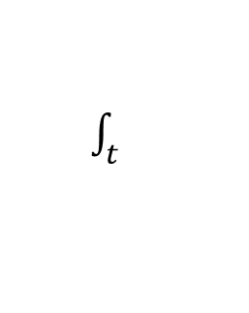
Experiment 1: Double Integration (Dead Reckoning)
Step 1
$\int_{t}^{ }{ }$
Gyroscope
sensor fusion
Wrist Orientation
+
Accelerometer
Compass
Z
Y
Yaw
X
Roll
Pitch

Slide 36
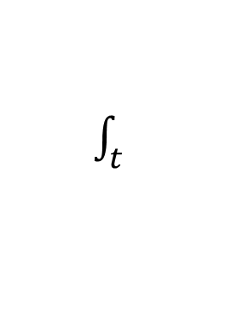
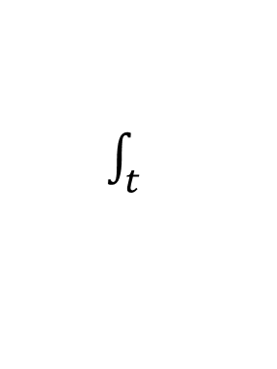
Experiment 1: Double Integration (Dead Reckoning)
Step 1
$\int_{t}^{ }{ }$
Gyroscope
sensor fusion
Wrist Orientation
+
Accelerometer
Compass
Step 2
$\int_{t}^{ }{ }$
Wrist Location
Velocity
Wrist Orientation
$\int_{t}^{ }{ }$
Gravity Removal
Projection
Global Acceleration
Linear Acceleration
Accelerometer

Slide 37
Experiment 1: Double Integration (Dead Reckoning)
Wrist Orientation
Wrist Location
Wrist orientation error is okay…
Wrist location error goes unbounded!
Double integration won’t work in unconstrained space

Slide 38


Experiment 2: State Estimation
Posture space is indeed constrained
Posture = < Elbow Location, Wrist Location, Wrist Rotation >
DoF: 5 = 2 + 2 + 1
Why not estimate 5 unknowns directly?
Posture
Compass
$$\frac{d}{dt} (\text{Posture})$$
Gyroscope
$$\frac{d^{2}}{{dt}^{2}} \left(\text{Posture}\right)$$
Accelerometer
Dimension: 5+5+5=15
The search space is too large for efficient state estimation
Need to find a way to reduce search space!

Slide 39
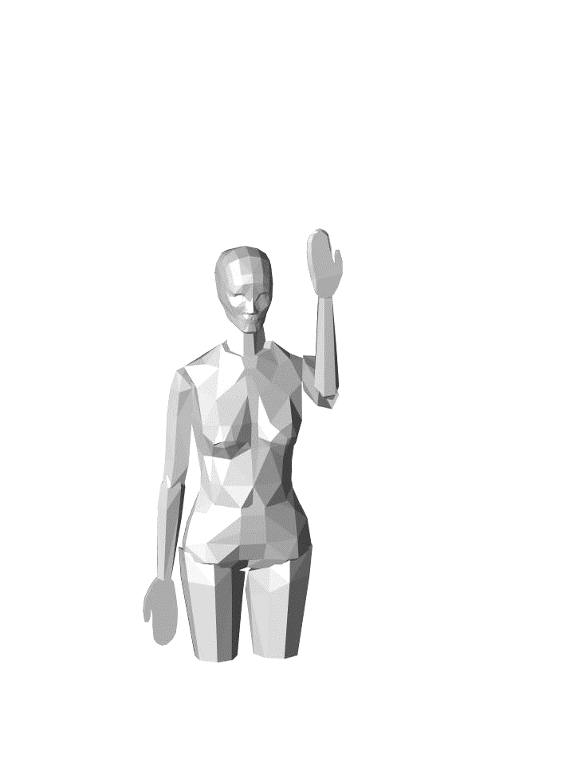
What happens if wrist orientation is fixed…
Forearm pointing upward
Palm facing towards yourself

Slide 40
What happens if wrist orientation is fixed…
Elbow
Forearm pointing upward
Palm facing towards yourself
Elbow Point Cloud:
A subset of elbow sphere

Slide 41
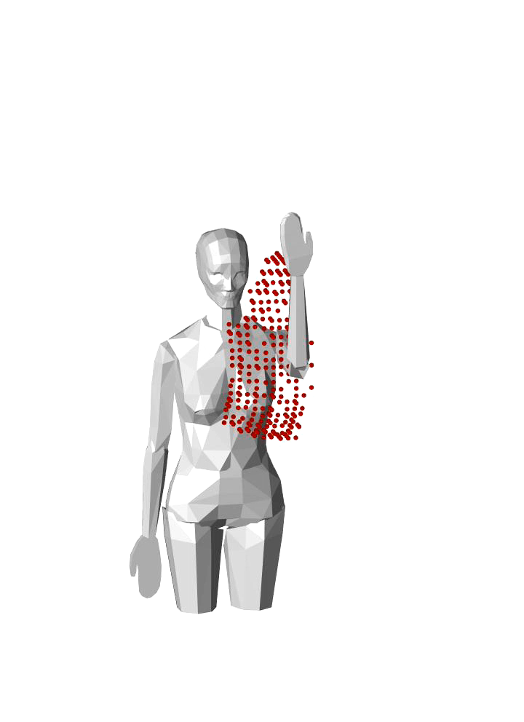
What happens if wrist orientation is fixed…
Elbow
Wrist
Forearm pointing upward
Palm facing towards yourself
Elbow Point Cloud:
A subset of elbow sphere
Wrist Point Cloud:
A shift of elbow point cloud, along forearm direction

Slide 42
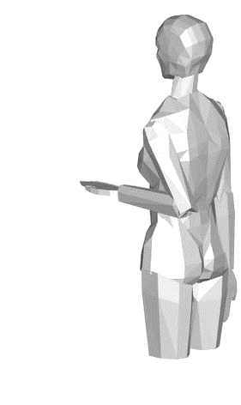
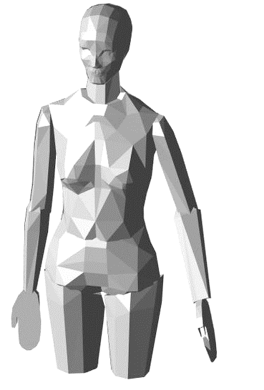
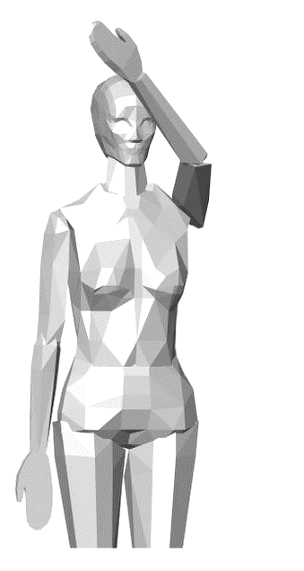
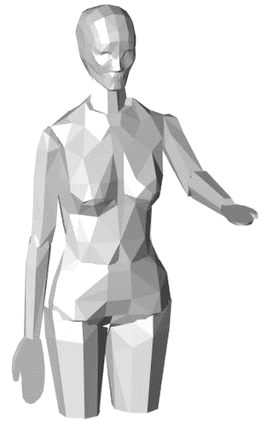
What happens if wrist orientation is fixed…
Elbow
Wrist

Slide 43
What happens if wrist orientation is fixed…
Elbow
Wrist
For a fixed wrist orientation, arm posture space is small!
This is promising, as we already estimate wrist orientation reasonably well…
But how can we derive this point cloud for each wrist orientation?

Slide 44
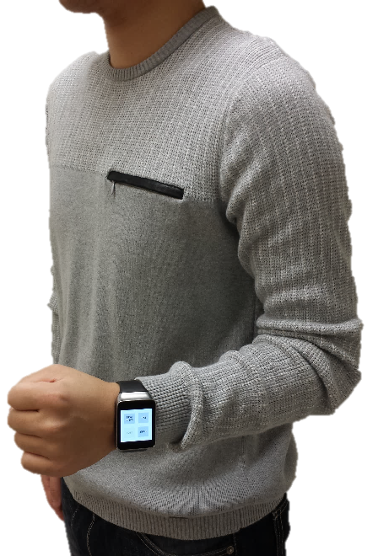




Human Arm Model
Shoulder: $θ_{1},θ_{2},θ_{3}$
$$θ_{3}:\text{[−30° \sim 120°]}$$
$θ_{2}$: [-40° ~ 120°]
$θ_{1}$: [-60° ~ 180°]

Slide 45



Human Arm Model
Shoulder: $θ_{1},θ_{2},θ_{3}$
Elbow: $θ_{4},θ_{5}$
$$θ_{3}:\text{[−30° \sim 120°]}$$
$θ_{2}$: [-40° ~ 120°]
$θ_{1}$: [-60° ~ 180°]
$θ_{5}$: [0° ~ 180°]
$θ_{4}$: [0° ~ 150°]

Slide 46



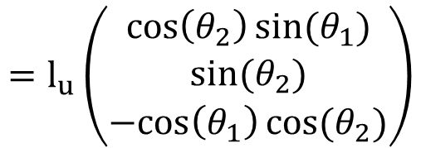





Human Arm Model
(Denavit–Hartenberg transformation)
Shoulder: $θ_{1},θ_{2},θ_{3}$
Elbow: $θ_{4},θ_{5}$
$$θ_{3}$$
Elbow Location $=f\left(θ_{1},θ_{2}\right)$
$$=l_{u}\left(\begin{matrix}\cos\left(θ_{2}\right)sin(θ_{1}) \\ sin(θ_{2}) \\ −cos\left(θ_{1}\right)cos(θ_{2})\end{matrix}\right)$$
$$θ_{2}$$
$$θ_{1}$$
Wrist Location $=g\left(θ_{1},θ_{2},θ_{3},θ_{4}\right)$
$$θ_{5}$$
$$θ_{4}$$
Wrist Orientation $=h\left(θ_{1},θ_{2},θ_{3},θ_{4},θ_{5}\right)$

Slide 47
Human Arm Model
Shoulder: $θ_{1},θ_{2},θ_{3}$
Elbow: $θ_{4},θ_{5}$
Elbow Location $=f\left(θ_{1},θ_{2}\right)$
$$=l_{u}\left(\begin{matrix}\cos\left(θ_{2}\right)sin(θ_{1}) \\ sin(θ_{2}) \\ −cos\left(θ_{1}\right)cos(θ_{2})\end{matrix}\right)$$
M-N Mapping
Wrist Location $=g\left(θ_{1},θ_{2},θ_{3},θ_{4}\right)$
Wrist Orientation $=h\left(θ_{1},θ_{2},θ_{3},θ_{4},θ_{5}\right)$
1-N Mapping for each orientation

Slide 48



Orientation – Location Mapping
1-N Mapping for each orientation
Wrist Orientation
Elbow Location
Wrist Location
$$h\left(θ_{1},θ_{2},θ_{3},θ_{4},θ_{5}\right)$$
$$f\left(θ_{1},θ_{2}\right)$$
$$g\left(θ_{1},θ_{2},θ_{3},θ_{4}\right)$$

Slide 49
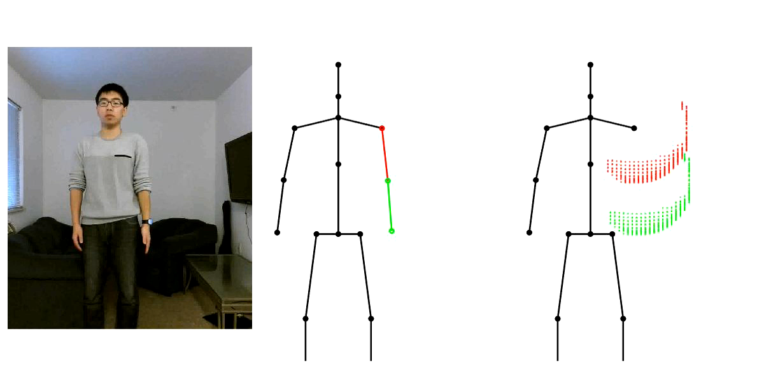
Video: Point Cloud Tracking
RGB Video
Kinect Groundtruth
Elbow/Wrist Point Clouds

Slide 50
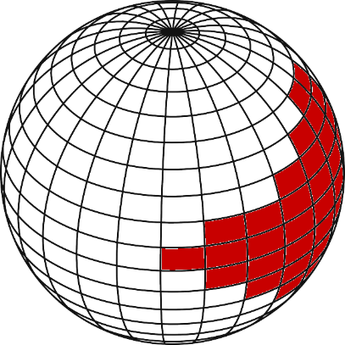
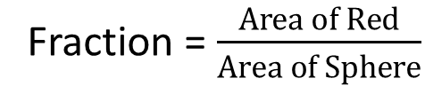
How large are the point clouds?
Fraction = $\frac{Area of Red}{Area of Sphere}$
Median: 8.3%

Slide 51
How large are the point clouds?
Since they are small, what if we simply take an average?
Median Error:
(12.0cm, 13.3cm)

Slide 52

How large are the point clouds?
Since they are small, what if we simply take an average?
What happens if wrist orientation doesn’t change?

Slide 53
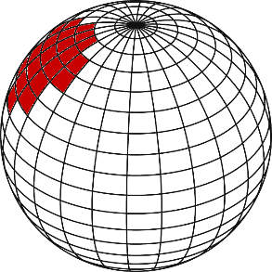
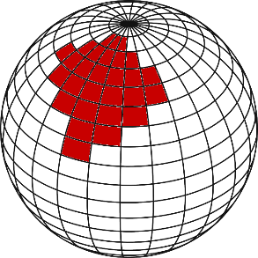
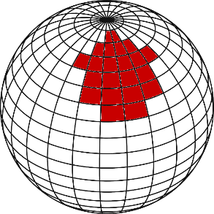


Elbow Location Inferencing
Possible Elbow Locations
t

Slide 54






Elbow Location Inferencing
Possible Elbow Locations
t

Slide 55
Elbow Location Inferencing
Possible Elbow Locations
t
Forearm Rotation
Wrist-to-Elbow Acceleration
Elbow Acceleration
Wrist Orientation
Projection
Wrist Acceleration
Gravity Removal
Accelerometer

Slide 56
Elbow Location Inferencing
Possible Elbow Locations
t
Elbow Acceleration
Acceleration
Velocity
Location
State 1

Slide 57
Elbow Location Inferencing
Possible Elbow Locations
t
Elbow Acceleration
Acceleration
Velocity
Location
State 2

Slide 58
Elbow Location Inferencing
Possible Elbow Locations
t
Transition 1→2
Elbow Acceleration
Acceleration
Velocity
Location
HMM & Viterbi gives optimal solution!

Slide 59

Viterbi Decoding
N Possible Elbow Locations
T Time Steps
State (2 Locations)
Velocity
Acceleration (Transition)
Acceleration (Observation)
Transition Prob.

Slide 60
Evaluation
Elbow: 12.0cm → 7.9cm
Wrist: 13.3cm → 9.2cm
Median Error:
(7.9cm, 9.2cm)

Slide 61

Video: Write in the Air

Slide 62
Limitation
Facing direction
- Need to express arm posture in torso coordinate
system
Tracking on the move
- Body motion will pollute accelerometer signal
Speed
- Need improvement

Slide 63
Conclusion
Tracking arm postures using motion sensors on a smartwatch alone
Fusing observations from human kinematics and IMU sensors into a HMM
<7.9cm, 9.2cm> tracking error for <elbow, wrist>

