Slide 1

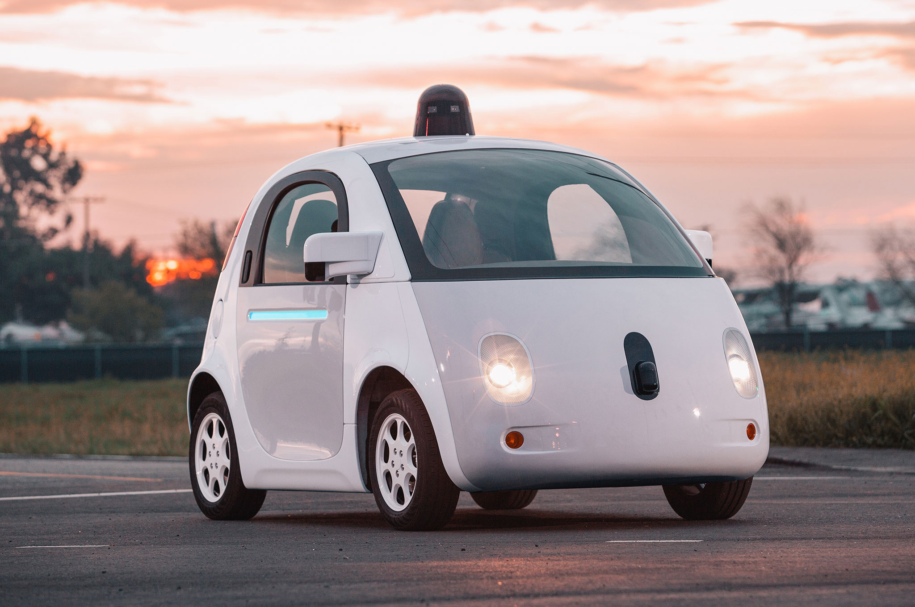

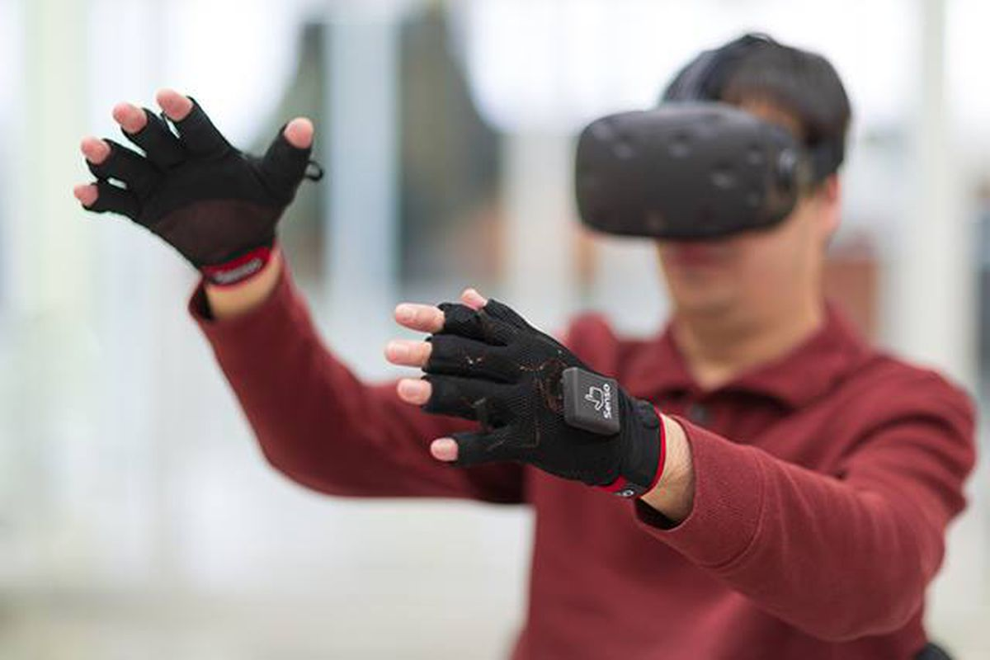

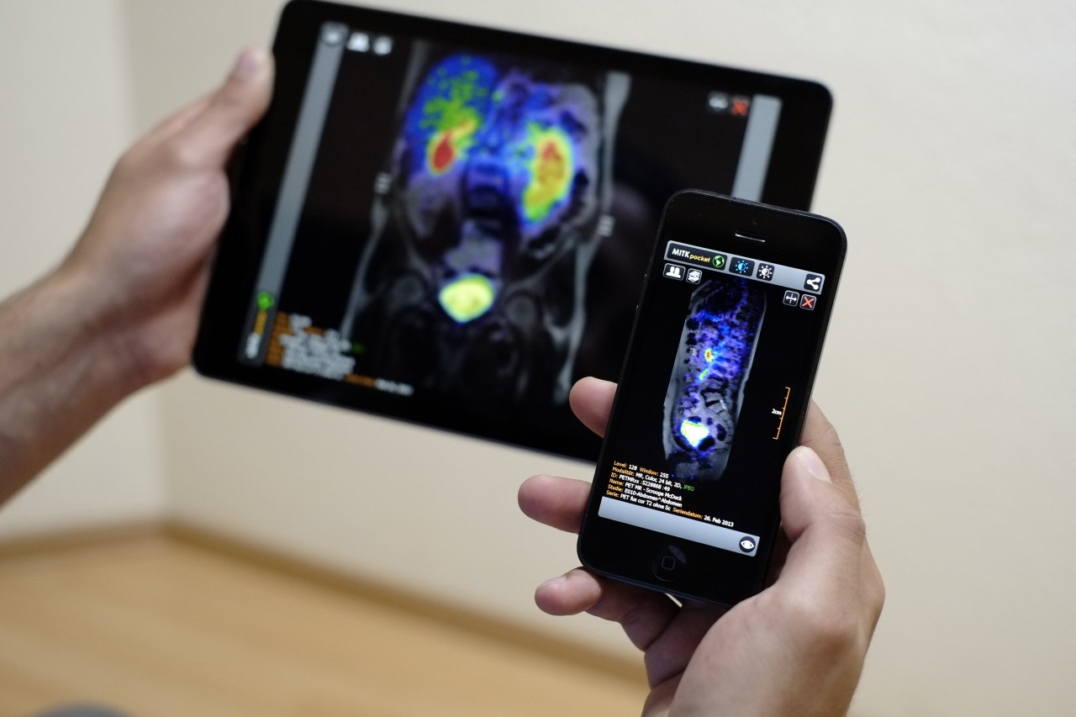
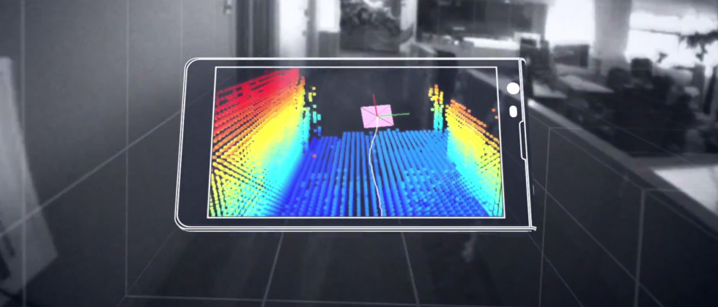

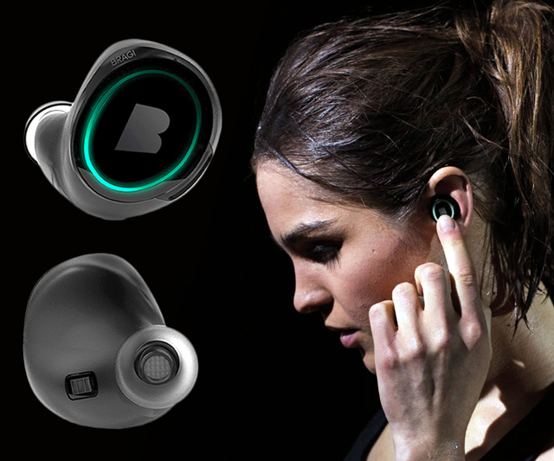
Machine Learning for Physical Sensing & Perception
CMSC 818V : Fall 2026
Lecture 3: Inverse Problems
-- From measurements to Physical States
Nirupam Roy
Tu-Th 12:30 – 1:45pm
IRB 2107

Slide 2
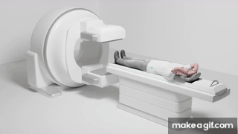
Computed Tomography

Slide 3
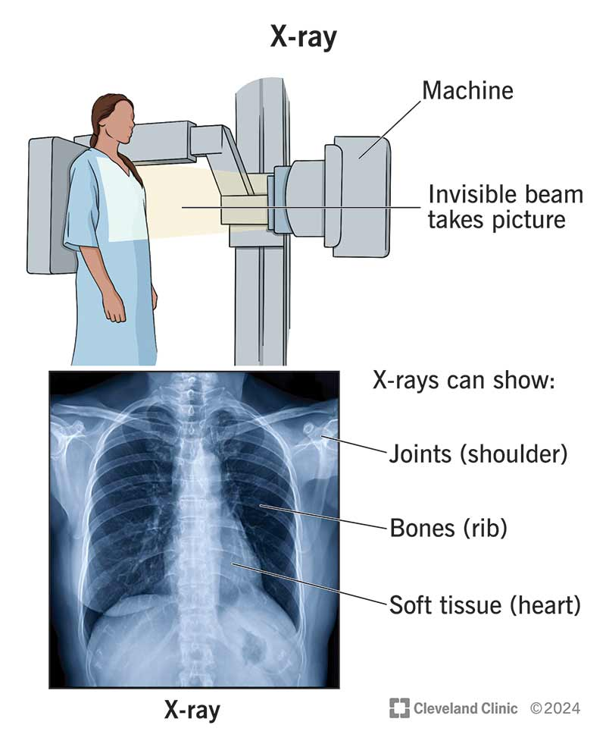
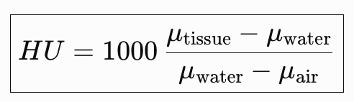
Computed Tomography: From 2D projection to 3D cross-sections
The Hounsfield scale is the standardized numerical scale used in CT images to represent the X-ray attenuation of different materials/tissues relative to water.
Hounsfield Unit (HU)

Slide 4
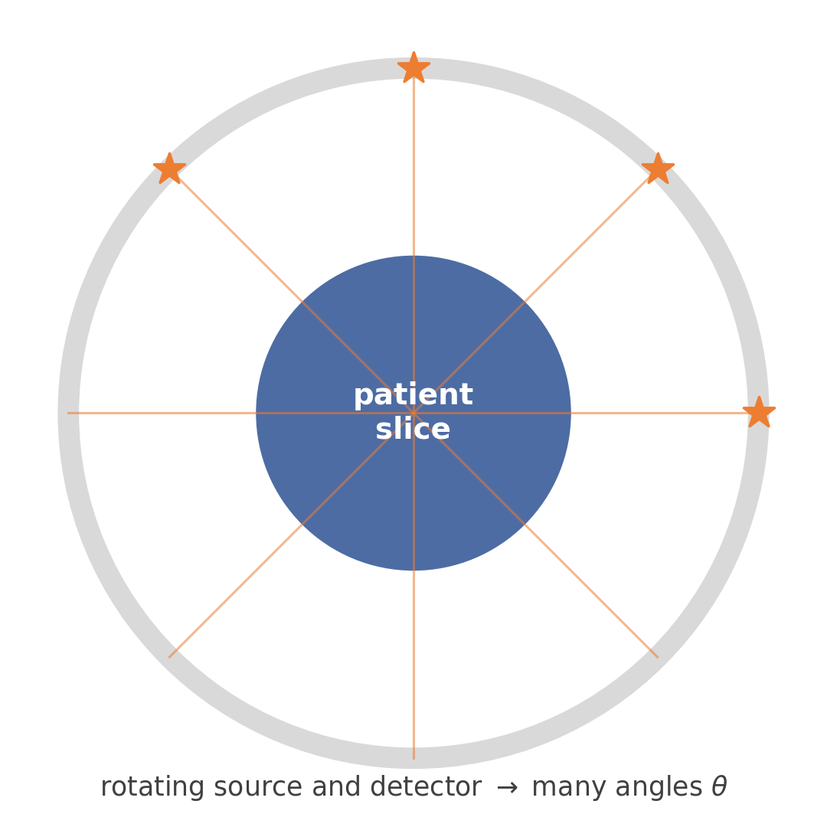
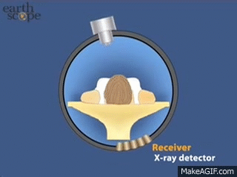
The central question
A CT detector never measures this image directly.
So how can measurements taken outside the body tell us what is inside it?
Today we build a CT scanner from scratch — and mathematical ideas in this lecture solves a problem that scanner runs into.
1

Slide 5
How the lecture builds, one problem at a time
X-ray physics
what does a detector measure?
Forward model y = Ax
discretize the body into voxels
Identifiability
can the scanner even see the object?
Noise y = Ax + n
measurements are never exact
ML → least squares
which image best explains the data?
Conditioning → SVD
which patterns are seen strongly, weakly, not at all?
Prior → MAP → regularization
what to do when data alone isn't enough
Learned reconstruction
→ bridge to the rest of the course
Every concept below is introduced because the CT scanner we are building needs it.
2

Slide 6
1. What does an X-ray detector (the sensor) measure?
The simplest possible patient: one uniform slab
3

Slide 7
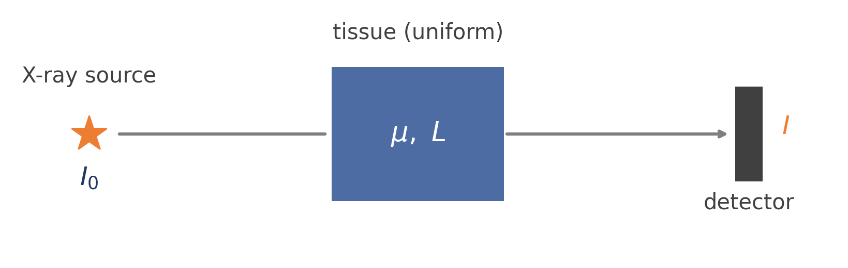
A single beam through a uniform slab
I = I₀ e^{−μL}
μ = X-ray attenuation coefficient of the tissue
L = distance traveled through the material
Rearranging and defining y = −ln(I / I₀) gives the clean linear relation y = μL.
4

Slide 8

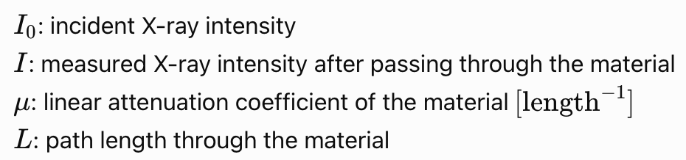
Forward model: Beer-Lambert Law
The Beer–Lambert law states that the intensity of radiation passing through an absorbing material decreases exponentially with the material’s attenuation coefficient and the distance traveled through the material.
The physical interpretation of the exponential: every additional unit of distance removes approximately the same fraction of the photons that remain, rather than subtracting the same absolute amount.
4

Slide 9
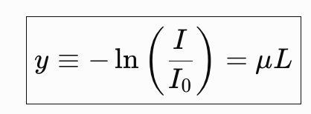
Forward model: Beer-Lambert Law
The Beer–Lambert law states that the intensity of radiation passing through an absorbing material decreases exponentially with the material’s attenuation coefficient and the distance traveled through the material.
Log transformed measurements:
4

Slide 10
Forward vs. Inverse
Forward problem
Inverse problem
μ → y
y → μ
“If I knew the material, what would the detector read?”
“I measured the attenuation. What material caused it?”
latent physical state
physics
sensor measurement
This chain — physical state → physics → measurement — is the pattern every sensing problem in this course follows.
5

Slide 11
2. The body is spatially varying
One ray through several tissues
6

Slide 12
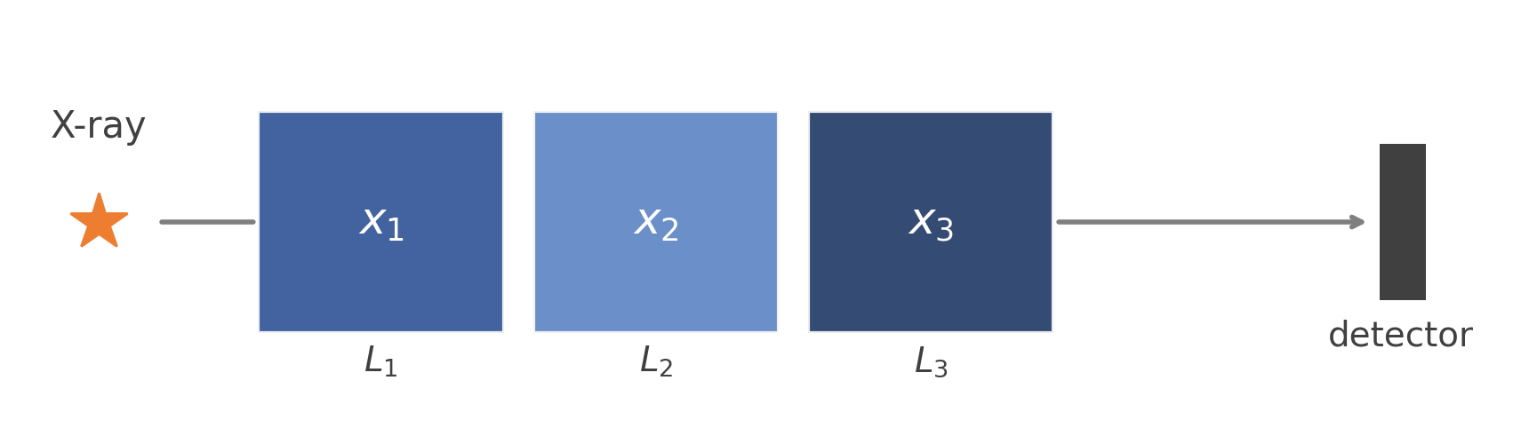
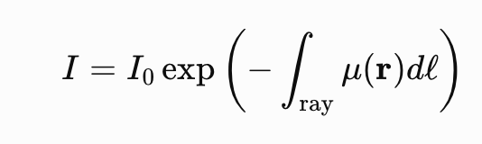
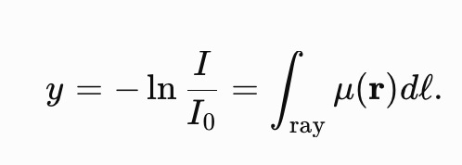
Several tissues along one ray
I = I₀ e^{−(L1} ^{x1 + L2 x2 + L3 x3)}
Taking logs of both sides collapses the physics into one linear equation:
y = L₁x₁ + L₂x₂ + L₃x₃ = a^{T}x
One X-ray = one linear equation. To reconstruct an image, we will need many such equations.
7

Slide 13

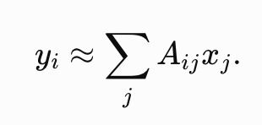
Discretization: from a continuous field to a vector x
A continuous attenuation field μ(x, y) is approximated by a grid of voxels:
x = [x₁, x₂, …, x_{N}]^{T}
For one X-ray i, the measurement sums attenuation along its path:
Aᵢⱼ has a physical meaning: the length ray i travels through voxel j.
Every entry of A is geometry — nothing about A is arbitrary or abstract.
8

Slide 14
3. One ray is obviously not enough
The first appearance of non-uniqueness
9

Slide 15
Same measurement, many possible objects
y = x₁ + x₂ + x₃ = 6
Was the object [1, 2, 3]? Or [2, 2, 2]? Or [0, 1, 5]?
Candidate object | Predicted y
[1, 2, 3] | 6
[2, 2, 2] | 6
[0, 1, 5] | 6
One measurement is not enough — but the fix is not simply “more numbers.”
More measurements only help if they reveal new information about the object. That is exactly what CT rotation is for.
10

Slide 16
4. Build a toy CT scanner
11

Slide 17
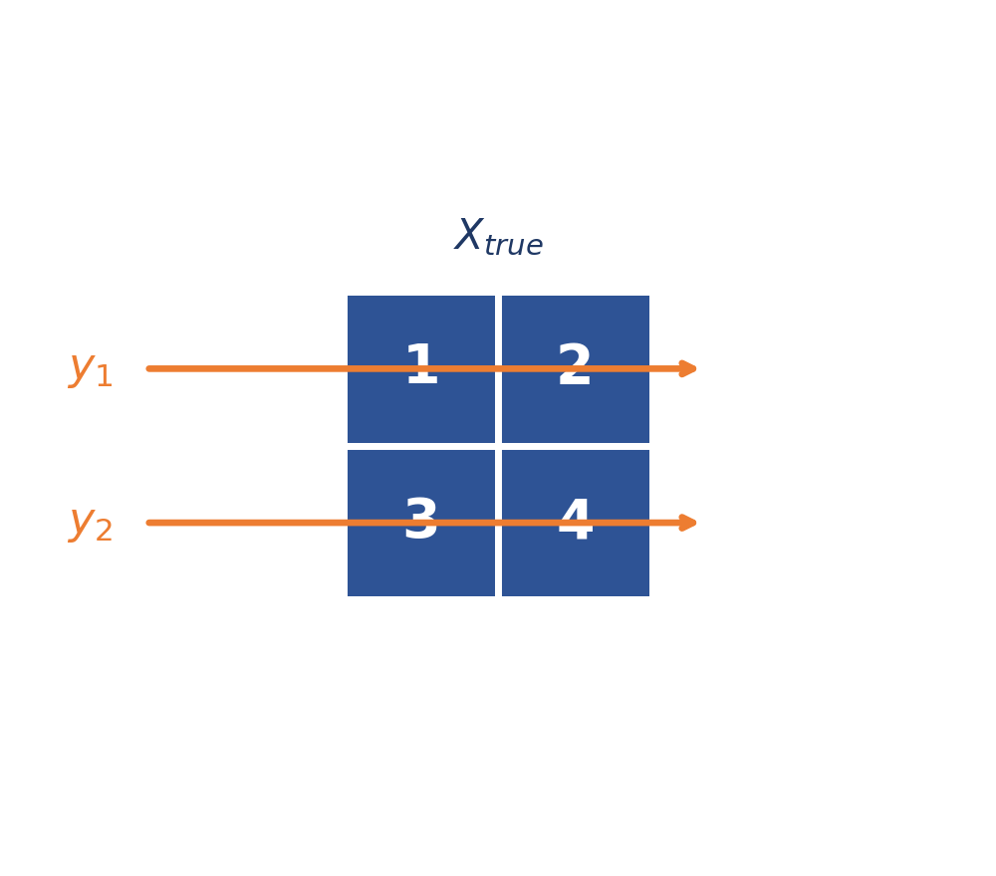
Two horizontal projections through a 2×2 object
y₁ = x₁+x₂ = 3, y₂ = x₃+x₄ = 7
Two equations cannot determine four unknowns. So we rotate the scanner and add another angle.
12

Slide 18
5. Add another projection angle
Vertical measurements — now 4 equations, 4 unknowns
13

Slide 19
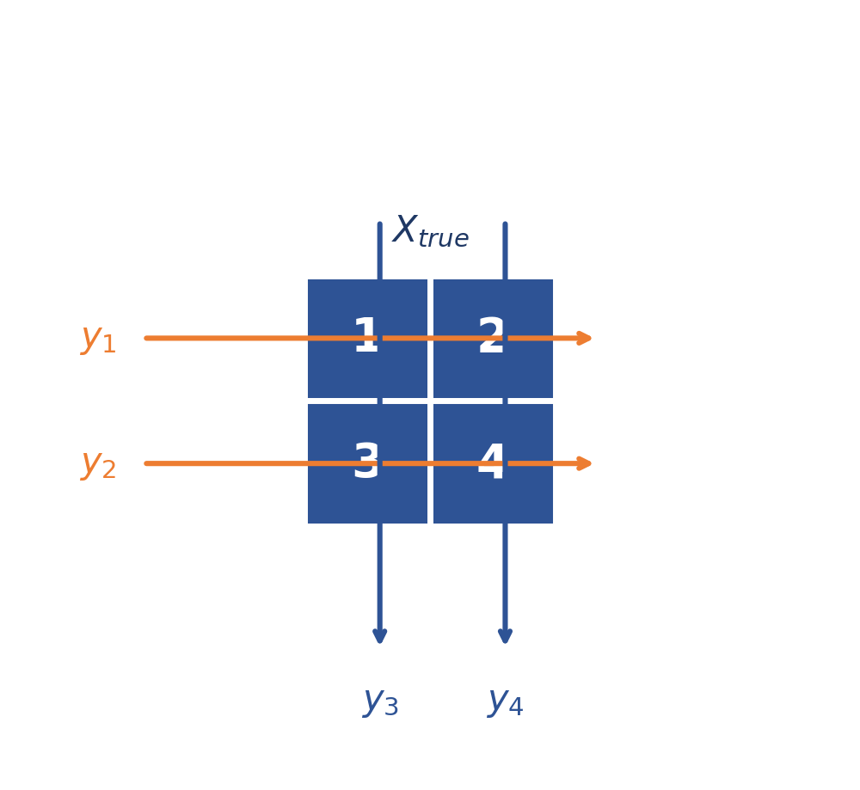
Four measurements, four unknowns — solved?
y₁ = x₁+x₂ = 3, y₂ = x₃+x₄ = 7
y₃ = x₁+x₃ = 4, y₄ = x₂+x₄ = 6
Can we reconstruct the image now?
14

Slide 20
6. Four numbers ≠ four pieces of information
A hidden redundancy in the measurements
15

Slide 21
Four measurements, four unknowns — solved?
y₁ = x₁+x₂ = 3, y₂ = x₃+x₄ = 7
y₃ = x₁+x₃ = 4, y₄ = x₂+x₄ = 6
y₁+y₂ = 3+7 = 10 y₃+y₄ = 4+6 = 10
14
Notes:
column 1 = column 2 + (Column 3 – column 4)

Slide 22
Four measurements, four unknowns — solved?
y₁ = x₁+x₂ = 3, y₂ = x₃+x₄ = 7
y₃ = x₁+x₃ = 4, y₄ = x₂+x₄ = 6
y₁+y₂ = 3+7 = 10 y₃+y₄ = 4+6 = 10
Whose fault is this?
14
Notes:
column 1 = column 2 + (Column 3 – column 4)

Slide 23

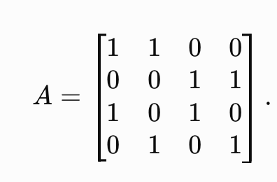
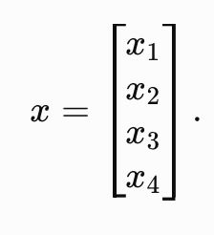
Four measurements, four unknowns — solved?
Physical sensing geometry
Mathematical sensing model
y₁ = x₁+x₂ = 3, y₂ = x₃+x₄ = 7
y₃ = x₁+x₃ = 4, y₄ = x₂+x₄ = 6
14
Notes:
column 1 = column 2 + (Column 3 – column 4)

Slide 24
The redundancy is sitting in plain sight
y₁+y₂ = 3+7 = 10 y₃+y₄ = 4+6 = 10
Both sums equal the same thing — the total attenuation of all four pixels:
x₁+x₂+x₃+x₄
So one equation carries no new information — it is redundant with the other three.
rank(A) = 3
det(A) = 0
even though A ∈ ℝ⁴ˣ⁴
so A⁻¹ does not exist
What does a “singular CT scanner” actually mean for the image?
16

Slide 25
7. What does “singular” mean, physically?
Two different patients, identical scan
17

Slide 26
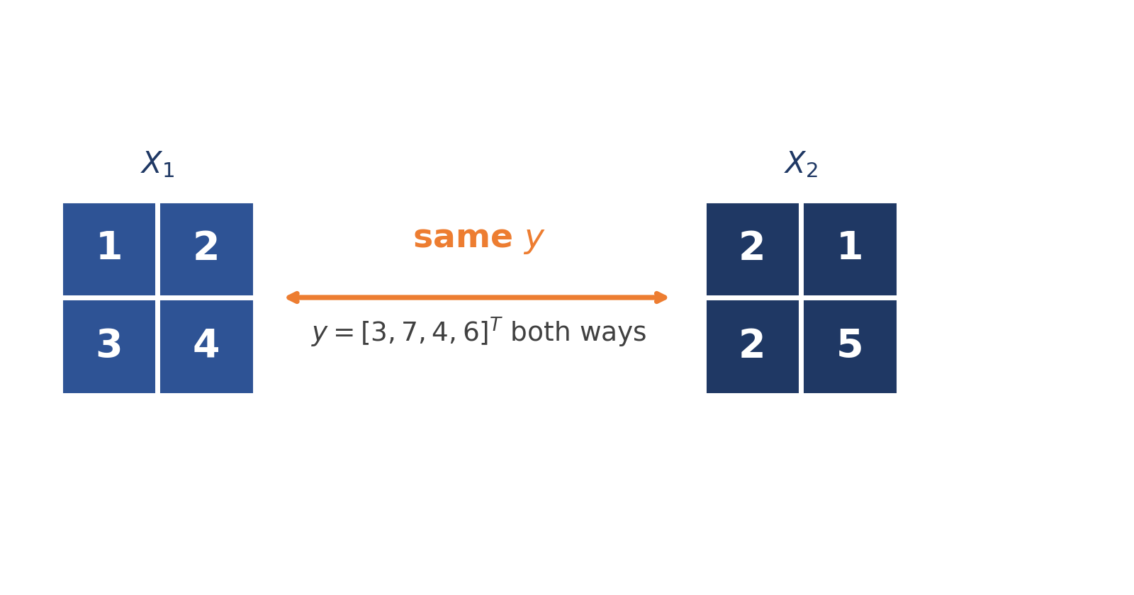
The scanner cannot tell these two patients apart
Check X₂'s projections: horizontal 2+1=3, 2+5=7. Vertical: 2+2=4, 1+5=6 — exactly the same as X₁.
This is what singularity means physically: the acquisition geometry has failed to encode some spatial pattern of the object.
18

Slide 27
8. Find exactly what the scanner cannot see
The central explanation of singularity
19

Slide 28
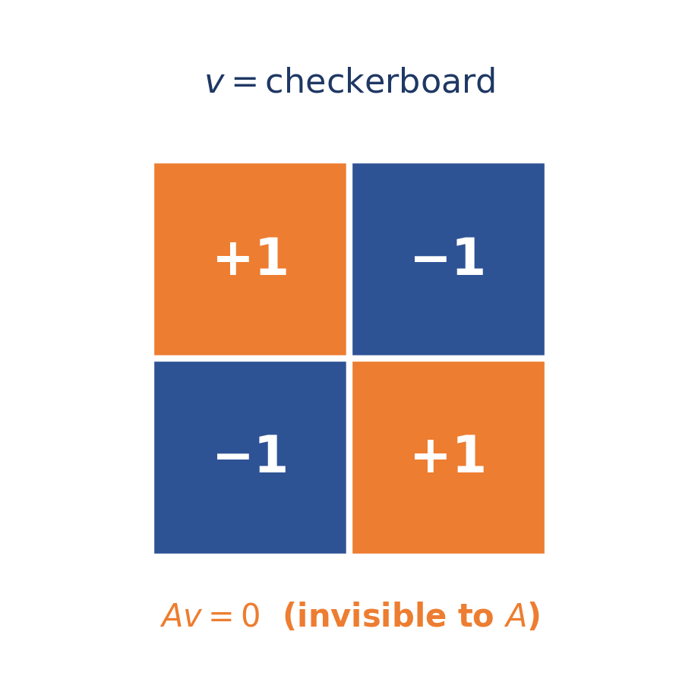
Subtract the two objects — a checkerboard appears
X₂ − X₁ → v = [1, −1, −1, 1]^{T}
Av = 0
Ax = A (x+ αv)
20

Slide 29
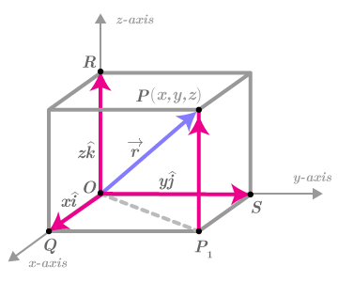
Image is a point/vector, measurement matrix “A” transforms it

Slide 30
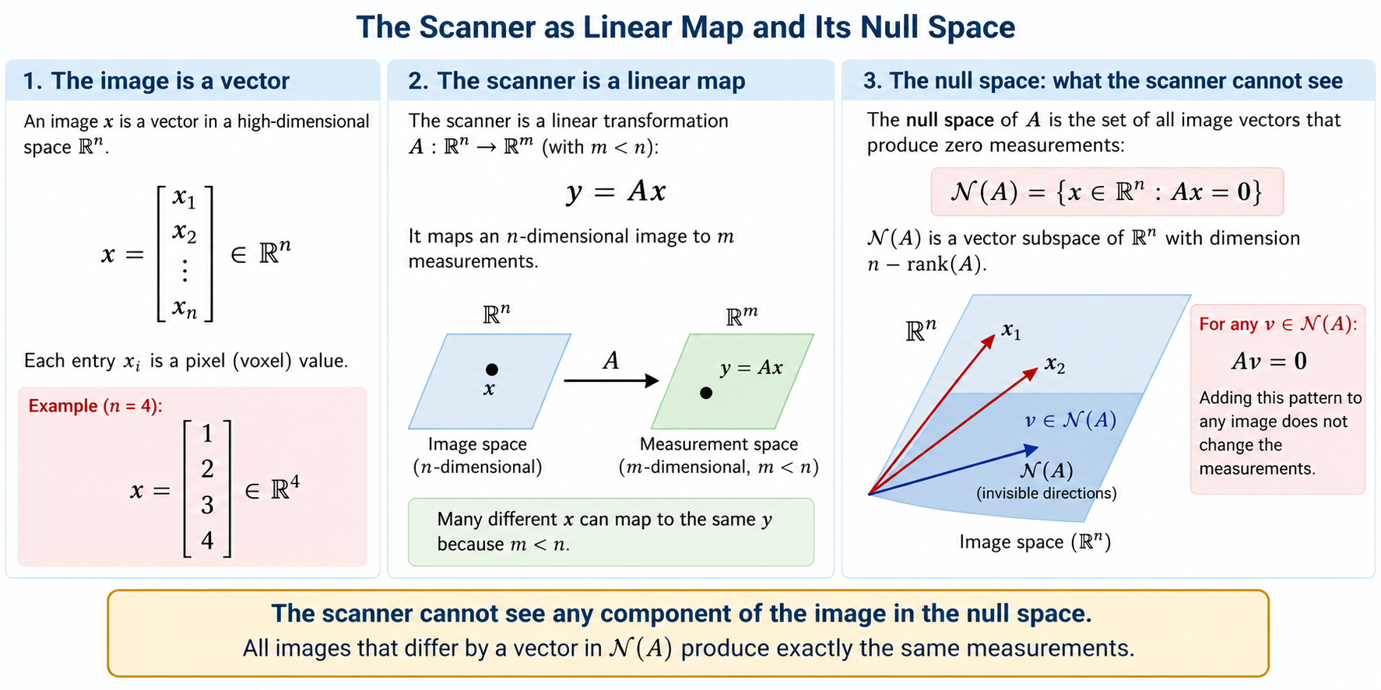

Slide 31
Any amount of this pattern is invisible to A
x′ = x + αv Ax′ = Ax + αAv = Ax
The null space contains anatomical patterns that this acquisition geometry cannot see — no matter how large α is.
“Invertible” and “identifiable” are properties of A and the acquisition geometry, not of the patient.
A null-space vector v is a direction you can add to the true image with zero effect on any measurement.
This is the single picture to keep in mind for the rest of the lecture: singularity, rank deficiency, and (soon) small singular values are all the same idea, just in degree.
Null space: The set of input directions that a linear forward model maps to zero; in sensing, these represent changes in the physical state that are invisible to the measurements.
21

Slide 32
9. How should the scanner fix this?
A measurement sensitive to the missing checkerboard mode
22

Slide 33
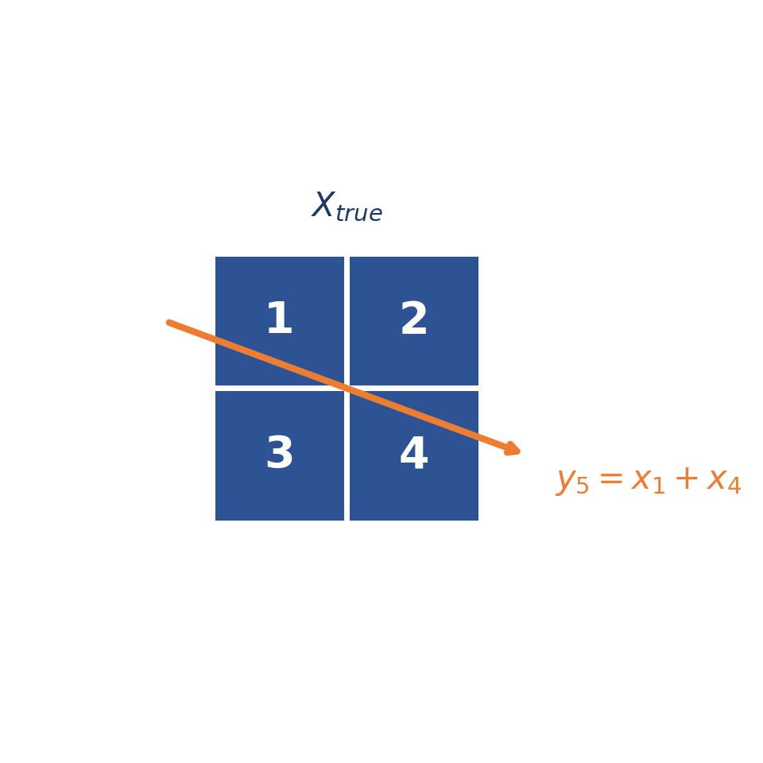
Change measurement geometry to “sees” the checkerboard
y₅ = x₁+x₄ → true: 1+4=5, alt: 2+5=7
Now A_new v = [0,0,0,0,2]ᵀ ≠ 0 — the previously invisible mode is observable. CT rotation isn't just “more images”; different angles expose different spatial modes.
23

Slide 34
10. From toy CT to actual tomography
The Radon transform and the sinogram
24

Slide 35
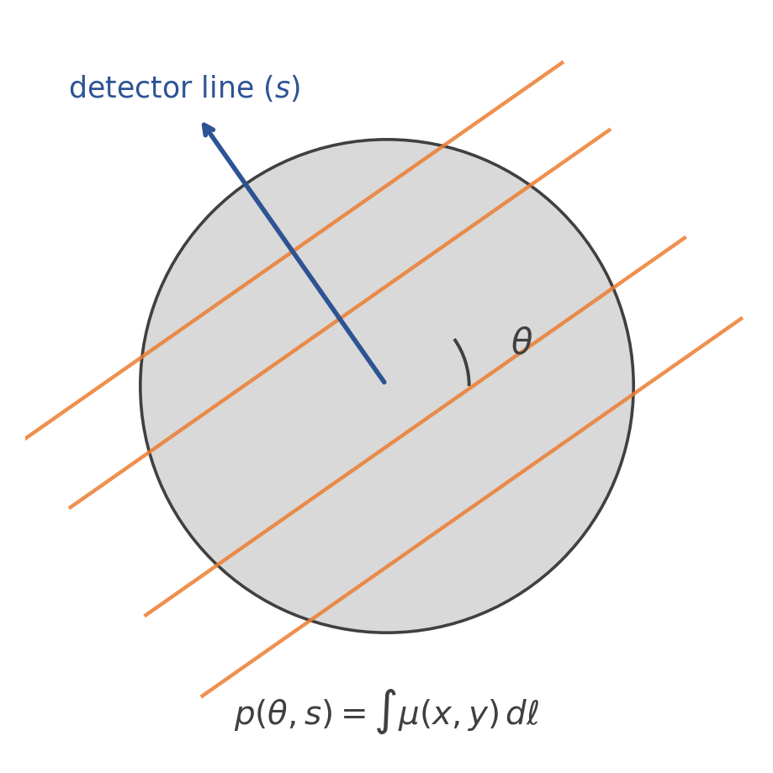
Line integrals at every angle and offset
p(θ, s) = ∑_{ray(θ,s)} μ(x, y) dℓ
One angle θ, all detector offsets s → one projection
All angles together → a sinogram
After discretizing: y = Ax — the same equation as our 2×2 toy scanner, just enormous
25

Slide 36
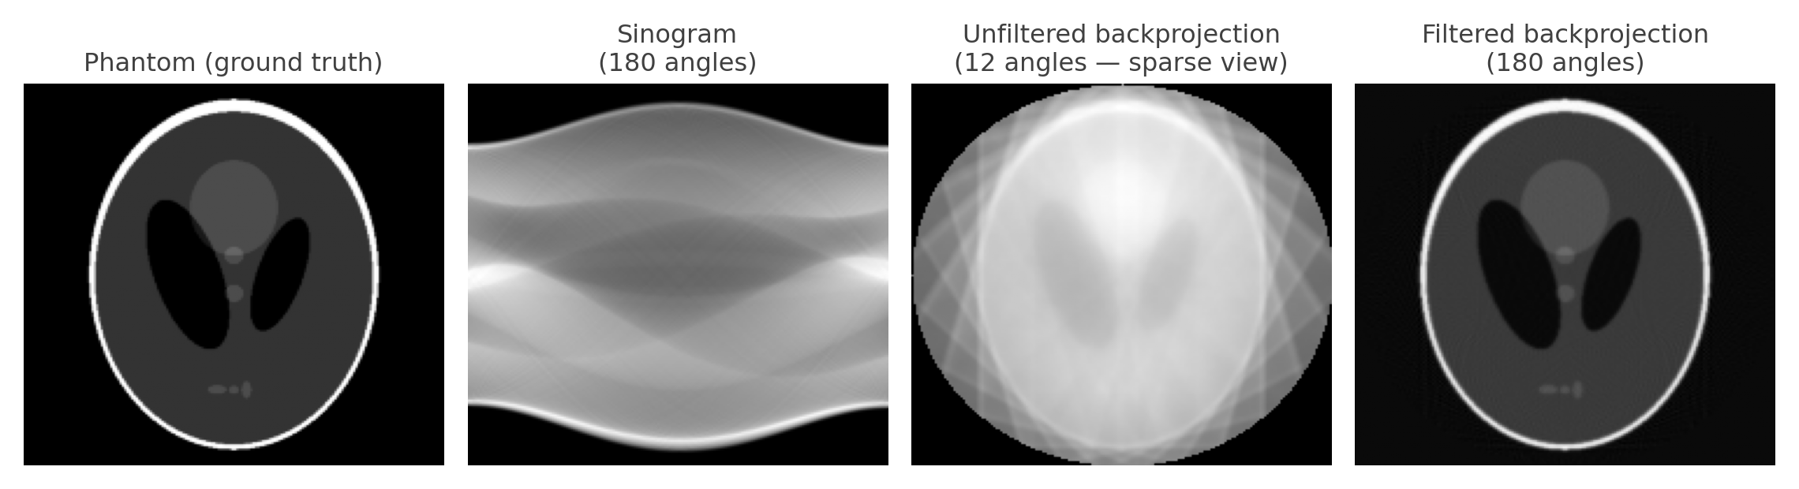
A genuine reconstruction: what angle count buys you
Too few projection angles (sparse view) leaves the image under-determined, exactly like our 2-equation toy scanner — filtered backprojection with enough angles recovers it cleanly.
The giant matrix A represents the discretized geometry of every ray in the scan.
26

Slide 37
11. Real measurements are not exact
From y = Ax to y = Ax + n
27

Slide 38
The residual: what a candidate image gets wrong
y = Ax + n
For a candidate reconstruction x̂, it predicts ŷ = Ax̂. Define the residual:
r = y − Ax̂
r is the disagreement between what the real scanner measured and what it would measure if x̂ were the true anatomy
if x̂ = x_true, then r = n — pure noise
A correct reconstruction leaves discrepancies consistent with the noise model — not necessarily zero.
28

Slide 39
12. Maximum likelihood
Which CT image best explains the measurements?
29

Slide 40
Choosing among competing reconstructions
Candidates x_A, x_B, x_C each predict different projections: Ax_A, Ax_B, Ax_C. Which one should we choose?
x̂_{ML} = arg max_{x} p(y | x)
Among all possible internal attenuation maps, find the one for which the actual detector readings would be most probable.
This is where statistics enters — because the CT problem itself demands it, not because it's the next topic on a syllabus.
30

Slide 41
13. Gaussian noise → least squares
The sequence becomes logically clean
31

Slide 42
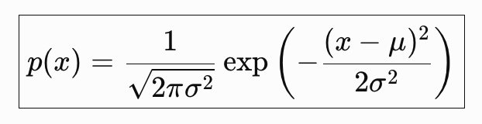
From a noise model to a concrete objective
∝
n ~ N(0, σ²I) ; p(y|x) exp(−||y−Ax||² / 2σ²)
x̂_{ML} = arg min_{x} ||y − Ax||²
CT physics
y = Ax+n
noise stats
p(y|x)
ML
least squares
Least squares in CT means: find the attenuation map whose simulated X-ray projections are closest, in squared error, to what was measured.
32

Slide 43
14. Solving least squares
What Aᵀ actually does: backprojection
33

Slide 44
Setting the gradient to zero
J(x) = ||y−Ax||² ∇_{x} J = −2A^{T}(y−Ax)
A^{T}Ax = A^{T}y
x̂ = (A^{T}A)⁻¹A^{T}y
But the formula is not the point — the physical meaning of the two operators is:
34
Notes:
Why $A^{T}$ alone isn't enough
Suppose
$$y=Ax.$$
Backprojecting gives
$$A^{T}y=A^{T}Ax.$$
You want $x$, but you have $A^{T}Ax$.
Therefore, assuming appropriate rank conditions,
$$x={\left(A^{T}A\right)}^{−1}A^{T}y.$$
This is exactly why the normal equations in your Slide 35 contain both $A^{T}$ and ${\left(A^{T}A\right)}^{−1}$.

Slide 45
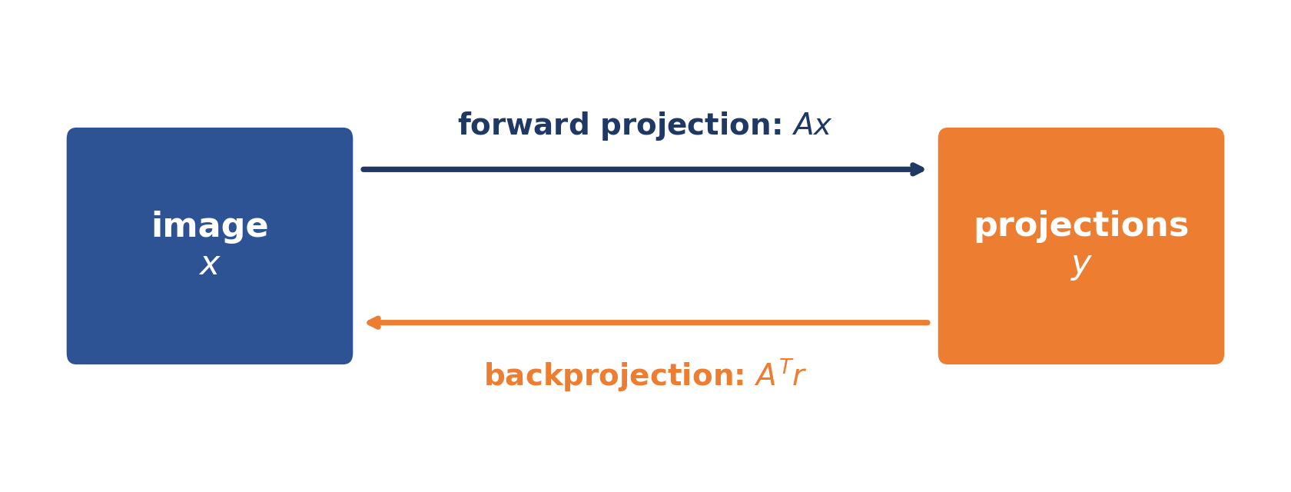
A projects forward; Aᵀ backprojects
A (forward projection): take a proposed image and predict the X-ray projections it would produce
Aᵀ (backprojection): take projection-domain discrepancies and smear them back across the pixels the rays traversed
Aᵀ(y − Ax) means: backproject the projection errors to determine how the image should change.
35

Slide 46
15. Turning least squares into an algorithm
36

Slide 47
Simulate — compare — backproject — update
image xₖ
forward project
compare to y
backproject
update image
x^{k+1} = x^{k} + η A^{T}(y − Ax^{k})
1. Simulate the scanner: ŷₖ = Axₖ
2. Compare with measurements: rₖ = y − ŷₖ
3. Backproject the discrepancy: gₖ = Aᵀrₖ
4. Update the image: xₖ₊₁ = xₖ + ηgₖ
This connects optimization directly to iterative reconstruction — no longer an abstract “Gradient-Descent” formula.
37

Slide 48
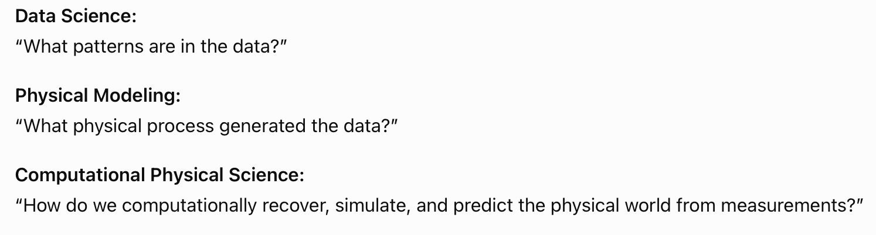
Lecture 3: Day 2
Revisiting Least Square and more
Data Science → Physical Science → Computational Physical Science

Slide 49
A question we quietly skipped
Every time we solved an inverse problem, we minimized squared error:
x̂ = arg min_{x} ||y − Ax||²
Why square the error? Why not absolute error, fourth power, or the single worst error?
1
Notes:
Today we answer that question properly — and along the way see exactly what changes when the measurement noise isn't Gaussian.

Slide 50
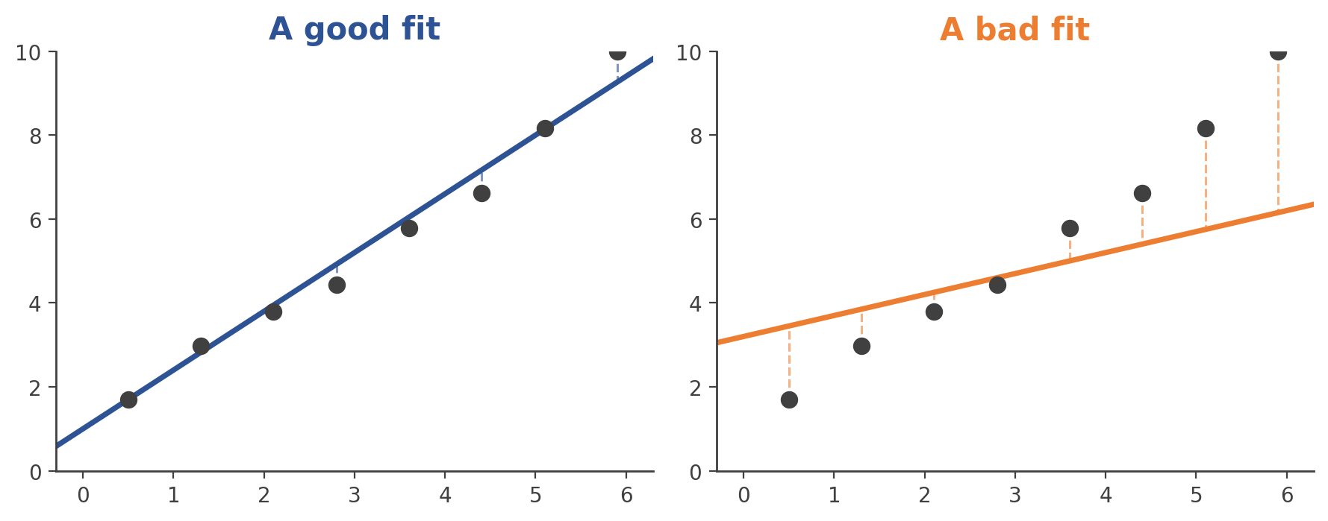
What does it mean for one line to fit better?
(t_{i}, y_{i}), i = 1, …, N y_{i} = x₁ t_{i} + x₂ + ϵ_{i}
Students will say: the line should be “close” to the points. But close, measured how?
4

Slide 51
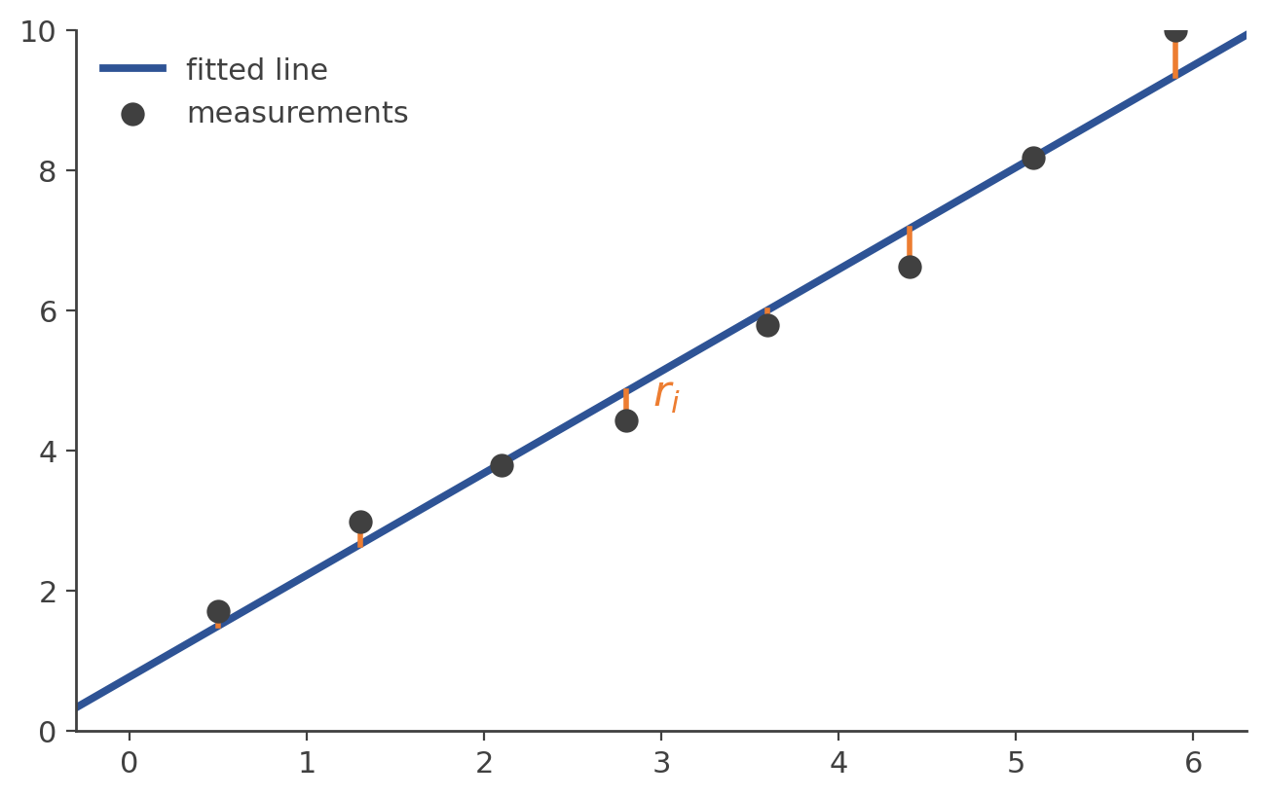
Define the residual — then ask how to combine them
r_{i} = y_{i} − (x₁ t_{i} + x₂)
There is nothing mathematically inevitable about squaring.
Combine residuals as… | Named
Σᵢ rᵢ | signed sum — cancels out, useless
Σᵢ |rᵢ| | sum of absolute errors
Σᵢ rᵢ² | sum of squared errors — least squares
maxᵢ |rᵢ| | worst-case error
5

Slide 52
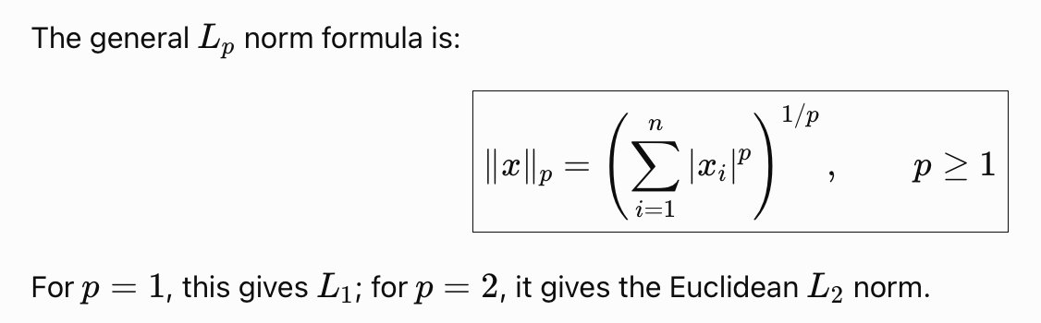
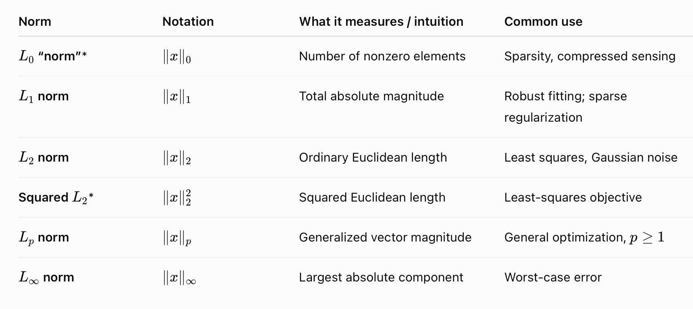

Slide 53
Line-fitting is y = Ax + n in disguise
Lecture 3, general form
Today, line fitting
y = Ax + n
y_{i} = x₁ t_{i} + x₂ + n_{i}
The unknown parameters are θ = [t; 1], and the forward model predicts:
ŷ_{i}(θ) = x₁ t_{i} + x₂ r_{i}(θ) = y_{i} − ŷ_{i}(θ)
forward model
prediction
measurement
residual
inference
Least squares isn't just a geometric rule for a good-looking line — it can be derived from a probabilistic model of how the measurements were generated.
7

Slide 54
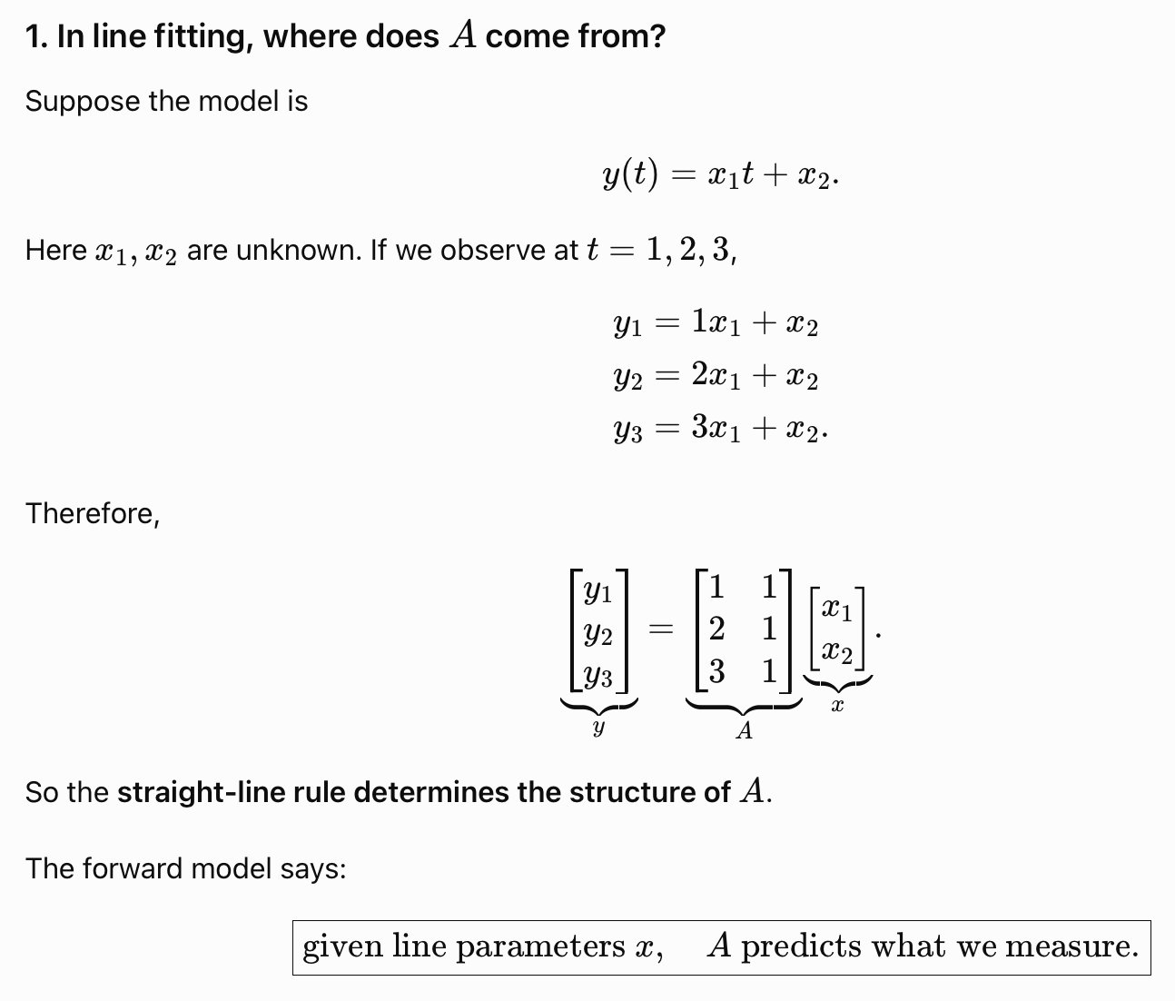
“A” tells us how the unknown parameters $x$ generate measurements $y$.

Slide 55
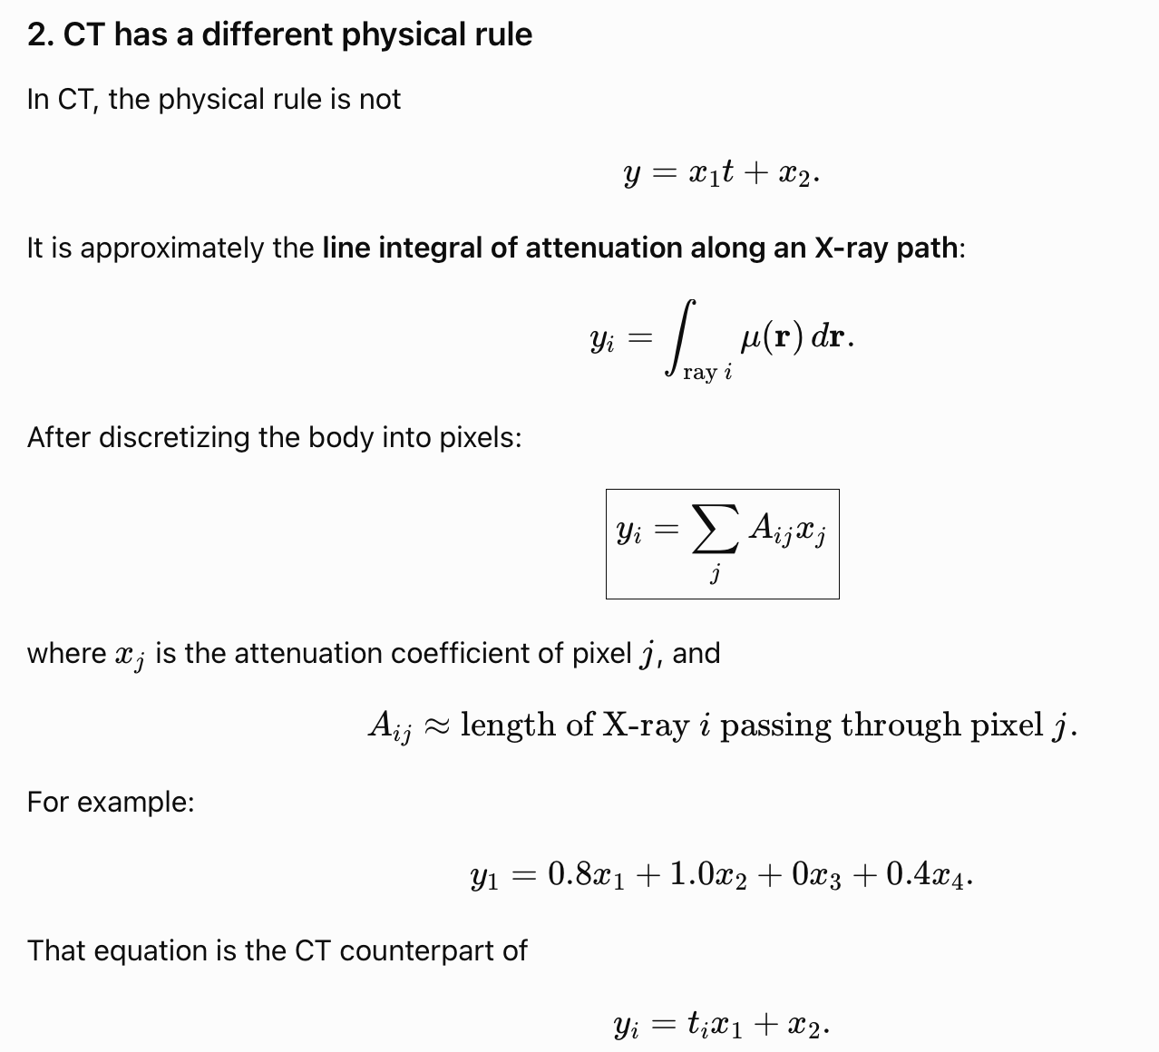

Slide 56
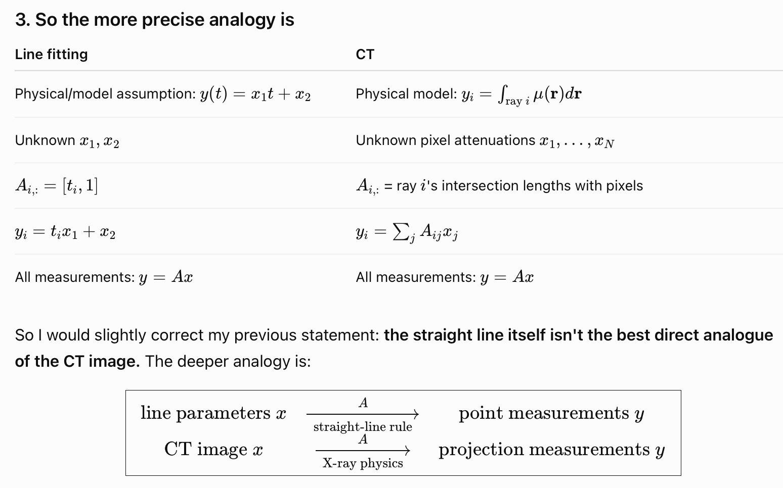

Slide 57
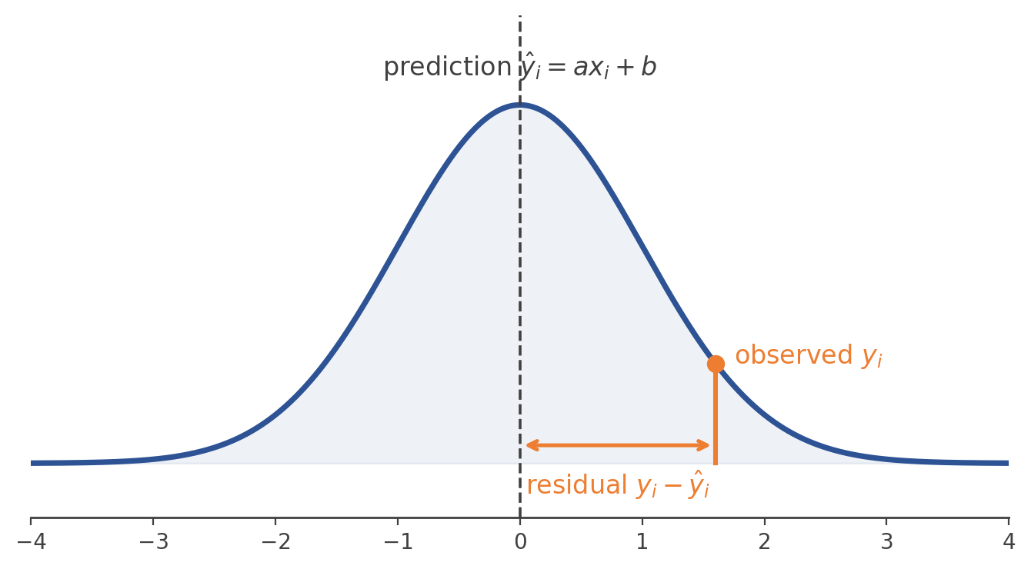
The probability model tells us how to penalize errors
y_{i} = x₁ t_{i} + x₂ + n_{i} n_{i} ~ N(0, σ²)
p(y_{i} | x₁, x₂) = 1/√(2πσ²) exp−(y_{i}−(x₁ t_{i}+ x₂))²/2σ²
The term inside the exponent is precisely the squared residual: a line producing a large residual makes the observed measurement exponentially less probable.
9

Slide 58
Independent noise ⇒ multiply the probabilities
p(y | x₁, x₂) = ∏_{Ni=1} p(y_{i} | x₁, x₂)
L(x₁, x₂) = ∏_{i} 1/√(2πσ²) exp−(y_{i}− x₁ t_{i}− x₂)²/2σ²
What are we trying to find? Not the most probable y — we already measured y.
We want the parameters that make the measurements we actually observed most plausible.
^
^
(x1, x2)_{ML} = arg max_{x1, x2} p(y | x₁, x₂)
11

Slide 59
The key payoff
log L(x₁, x₂) = −N/2 log(2πσ²) − 1/2σ² Σᵢ (y_{i} − x₁ t_{i} − x₂)²
The first term doesn't depend on x1, x2 — it drops out of the arg max
The multiplier 1/2σ² is positive and constant — it doesn't change where the max is
arg max_{x1, x2} log L(x₁, x₂) = arg min_{x1,x2} Σᵢ (y_{i}− x₁ t_{i}− x₂)²
Gaussian noise + Maximum Likelihood ⇒ Least Squares
So: why did we square the residual? Because under Gaussian measurement noise, the negative log-probability of a residual is proportional to its square — a much deeper reason than “squares stop positive and negative errors from canceling.”
13

Slide 60
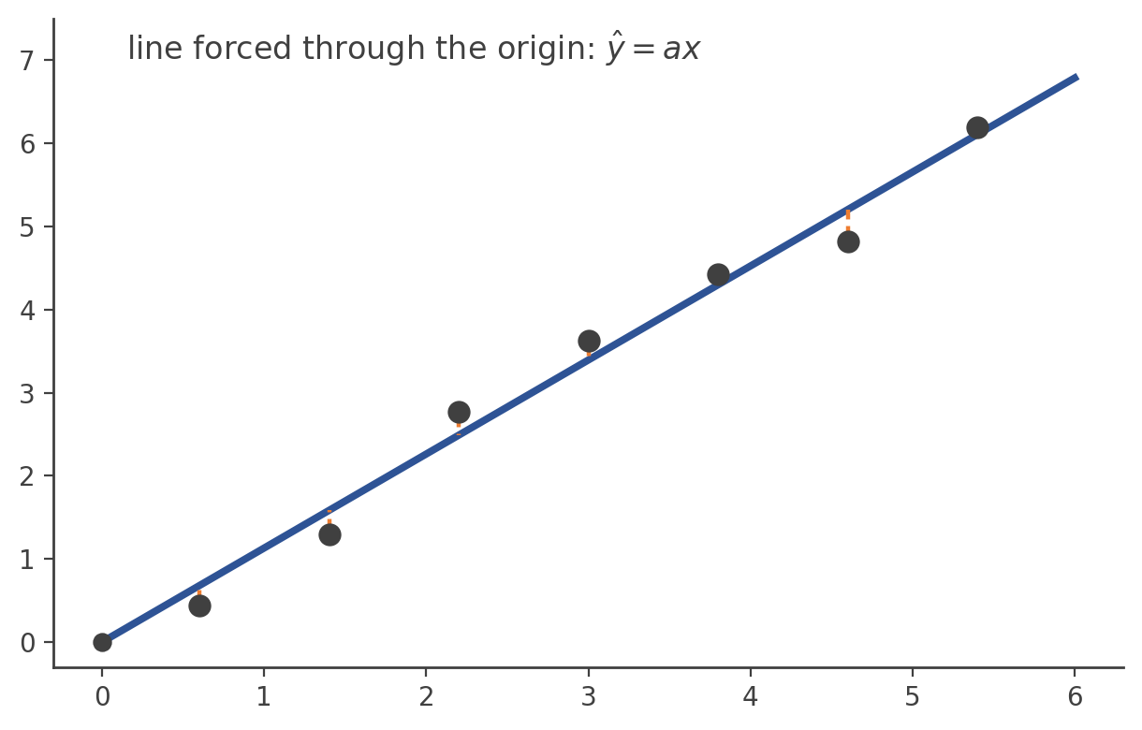
One unknown parameter: y = a x + n
J(a) = Σᵢ (y_{i} − a t_{i})² dJ/da = −2Σᵢ t_{i}y_{i} + 2xΣᵢ t_{i}²
â = Σᵢ x_{i}y_{i} / Σᵢ x_{i}²
The complete chain: noise assumption → likelihood → loss function → derivative → parameter estimate.
15

Slide 61
Exactly the same derivation, in vector form
y = Ax + n, n ~ N(0, σ²I) x̂ = arg min_{x} ||y−Ax||²
J(x) = (y−Ax)^{T}(y−Ax) ∇_{x}J = −2A^{T}(y−Ax)
A^{T}(y−Ax̂) = 0 A^{T}Ax̂ = A^{T}y
x̂ = (A^{T}A)⁻¹A^{T}y
This connects directly back to CT:
y_{measured projections} = A_{CT forward operator} x_{unknown image} + n_{measurement noise}
Least squares no longer looks like an arbitrary optimization objective — it's what Gaussian noise plus maximum likelihood forces on us.
17

Slide 62
One general principle governs every case
noise distribution
likelihood
−log likelihood
loss function
Change the noise assumption, and the “right” loss function changes with it — least squares was never the only option, just the Gaussian one.
Let's derive a few concrete cases.
19

Slide 63
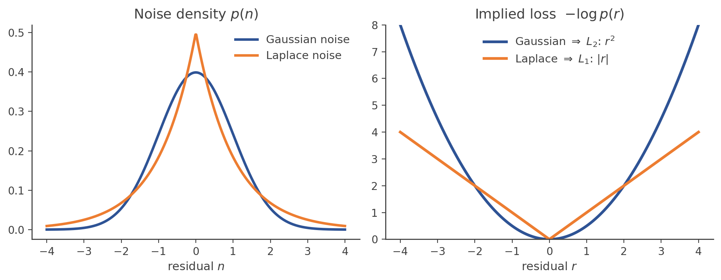
Laplace noise → L1 loss — robust to outliers
∝
p(r) exp(−|r|/b) −log p(r) = |r|/b + const.
x̂ = arg min_{x} Σᵢ |y_{i} − [Ax]_{i}|
Laplace noise → absolute-error loss (L1). L1 grows only linearly with a large residual, so a single bad outlier can't dominate the fit the way it does under L2.
20
Notes:
Laplace noise is a noise model similar to Gaussian noise, but with a distribution that is more sharply concentrated near zero and has heavier tails. Physically, it represents situations where errors are usually small, but occasional large deviations occur more frequently than a Gaussian model would predict.
Laplace noise is a noise model similar to Gaussian noise, but with a distribution that is more sharply concentrated near zero and has heavier tails. Physically, it represents situations where errors are usually small, but occasional large deviations occur more frequently than a Gaussian model would predict.

Slide 64
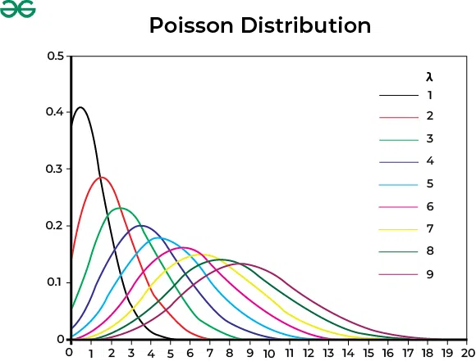
Poisson measurements → the CT callback
Particularly relevant for CT: X-ray detectors fundamentally count photons.
y_{i} ~ Poisson(λ_{i}(x)) p(y_{i}|λ_{i}) = λ_{i}y_{i}e^{−λ}_{i} / y_{i} !
min_{x} Σᵢ [λ_{i}(x) − y_{i} log λ_{i}(x)]
Notes:
Poisson randomness is the randomness associated with counting discrete events that occur independently at some average rate.
Here, $λ$ is the expected (average) number of events you expect to count during the measurement interval.

Slide 65
Poisson measurements → the CT callback
Particularly relevant for CT: X-ray detectors fundamentally count photons.
y_{i} ~ Poisson(λ_{i}(x)) p(y_{i}|λ_{i}) = λ_{i}y_{i}e^{−λ}_{i} / y_{i} !
min_{x} Σᵢ [λ_{i}(x) − y_{i} log λ_{i}(x)]
If CT measurements fundamentally involve photon counting, should ordinary least squares always be the statistically correct objective? Not necessarily — the physics of sensing shapes the statistics, and the statistics shape the loss function.
Noise model | Implied loss
Gaussian, equal variance | L2 — squared error (“least squares”)
Laplace | L1 — absolute error
Poisson (photon counts) | λ(x) − y logλ(x)
21
Notes:
Poisson randomness is the randomness associated with counting discrete events that occur independently at some average rate.
Here, $λ$ is the expected (average) number of events you expect to count during the measurement interval.

Slide 66
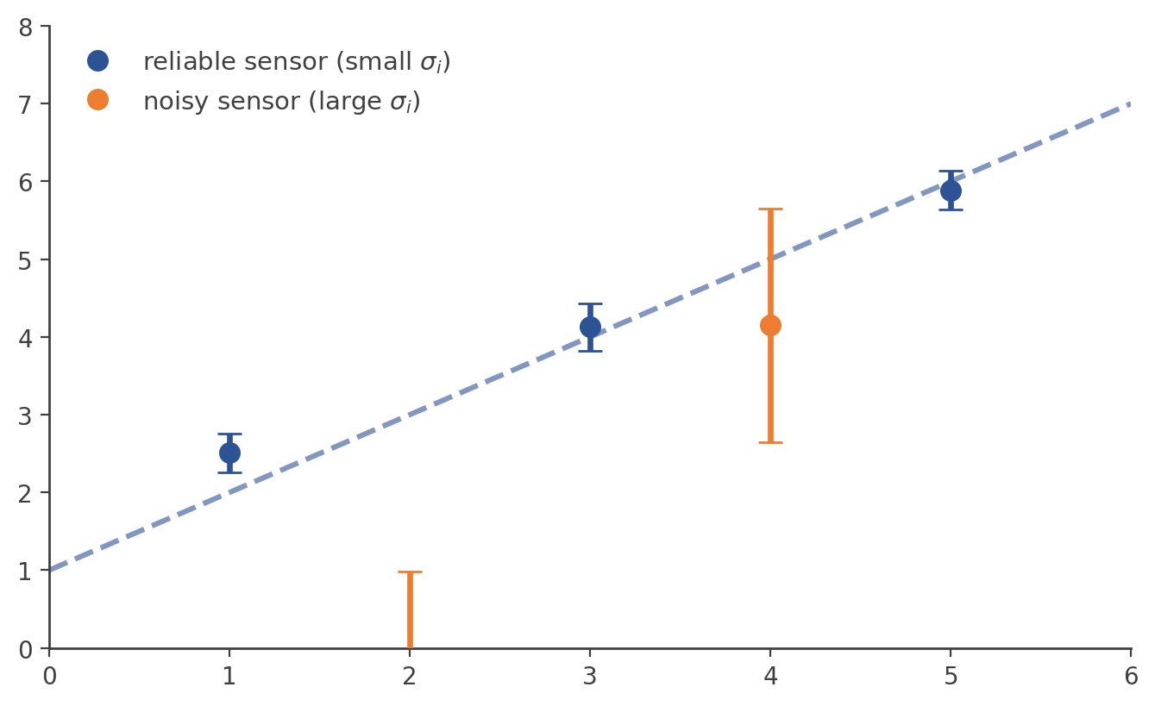
Not every sensor is equally trustworthy
n_{i} ~ N(0, σ_{i}²) — each measurement has its own noise level
min_{x} Σᵢ r_{i}² / σ_{i}²
Weighted least squares: a reliable sensor (small σᵢ) gets high weight 1/σᵢ² in the objective; a noisy sensor (large σᵢ) gets down-weighted automatically.
23

Slide 67
The general case — and a misconception to retire
n ~ N(0, Σ) x̂ = arg min_{x} (y−Ax)^{T} Σ⁻¹ (y−Ax)
Σ is the full noise covariance — it reduces to σ²I only in the special i.i.d., equal-variance case.
Gaussian noise does not automatically mean ordinary ∥y−Ax∥₂². Plain least squares follows specifically from i.i.d., equal-variance Gaussian noise — the moment sensors disagree in reliability, the correct objective is weighted.
24

Slide 68
We already have the closed-form answer — so why iterate?
J(x) = ||y − Ax||₂² x* = (A^{T}A)⁻¹A^{T}y
“Why would I iterate if I already have the answer?” — an segue into computational inverse problems.
For CT, A can be enormous — one row per detector reading, one column per image pixel
Explicitly forming and inverting AᵀA may be computationally infeasible, or A may not even be stored explicitly
So instead of solving in one shot, we improve x one step at a time
26

Slide 69
We have a formula for x̂. Why isn't that the end of the story?
x̂ = (A^{T}A)⁻¹A^{T}y = A†y
The pseudoinverse tells us what the least-squares solution is. Iterative methods tell us how to compute it practically — and let us solve far more than plain least squares.
Two separate reasons push us toward iterative inversion:
Computational scale
More realistic problems
The formula exists, but forming and inverting AᵀA may be computationally infeasible at real sensing scale.
Noise amplification, priors, constraints, and nonlinear forward models — none of these have a simple closed-form inverse.
“We have a formula for x. Why don't we just use it?” — that question is today's motivation.
1

Slide 70
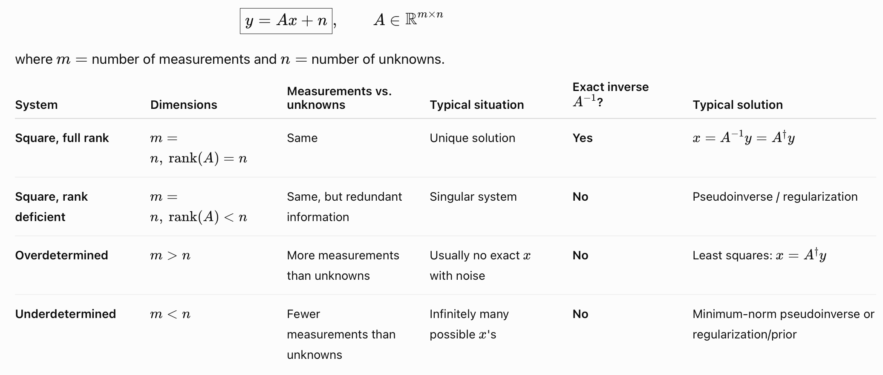

Slide 71
Four reasons the closed form isn't the end of the story
1. A can be enormous
storing / inverting AᵀA is infeasible at scale
2. Pseudoinverse amplifies noise
small singular values → huge errors
3. No room for prior knowledge
smoothness, sparsity, nonnegativity, …
4. The forward model may be nonlinear
y = f(x) + n has no matrix to invert
Each limitation motivates a piece of the same answer: treat reconstruction as a computational procedure, not a formula.
2

Slide 72
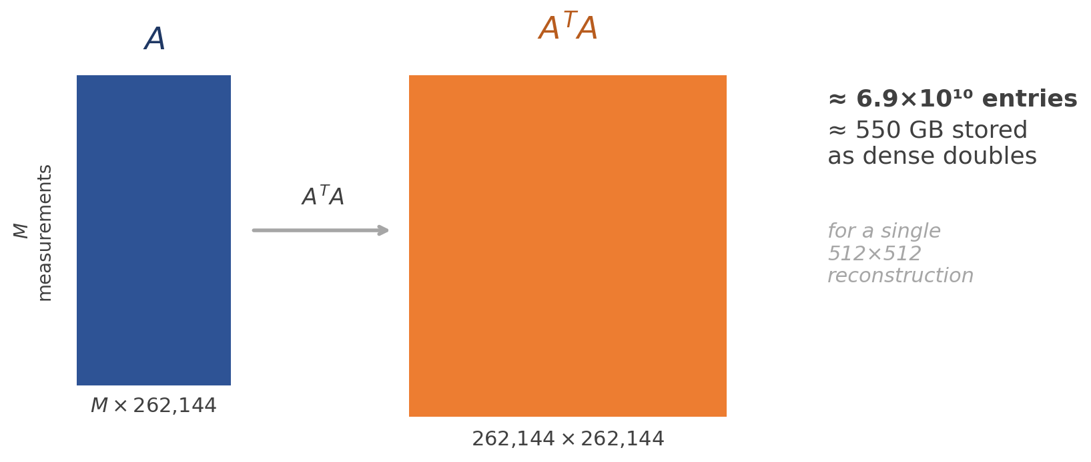
Limitation 1: Measurement matrix is huge
512 × 512 image x ∈ ℝ_{262,144}
With hundreds of thousands to millions of X-ray measurements, A can conceptually have dimensions:
A ∈ ℝ_{M × 262,144}
4

Slide 73
Closed form ≠ practical algorithm
Mathematical closed form ≠ computationally practical algorithm.
Explicitly forming AᵀA already produces a 262,144 × 262,144 matrix — roughly 6.9×10¹⁰ entries
At 8 bytes per double, that's about 550 GB just to store AᵀA densely
And then you'd still have to solve that huge linear system
So in real imaging systems, we often don't even store A explicitly.
implement Ax
implement Aᵀr
never form A or AᵀA
We implement the operations that compute Ax and Aᵀr efficiently — as algorithms, not as stored matrices.
5

Slide 74
Limitation 2: Pseudoinverse Can Amplify Noise
x̂ = (A^{T}A)⁻¹A^{T}y = A†y

Slide 75
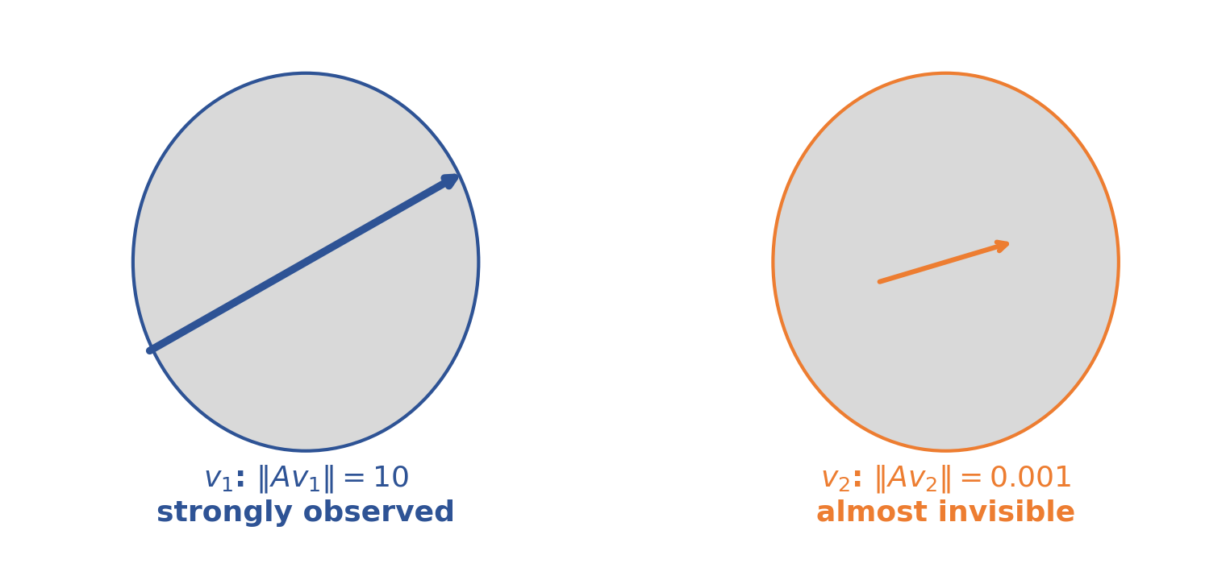
Even with enough measurements, not all directions are equal
v₂ isn't completely invisible — Av₂ ≠ 0 — but it is almost invisible. This is the noisy counterpart of the earlier null-space problem.
Regime | Condition | Meaning
Exact singularity | Av = 0 | scanner cannot see the pattern at all
Near-singularity | Av ≈ 0 | sees it so weakly that noise can overwhelm it
This is precisely why inversion can be unstable even when a unique mathematical solution exists.
39

Slide 76
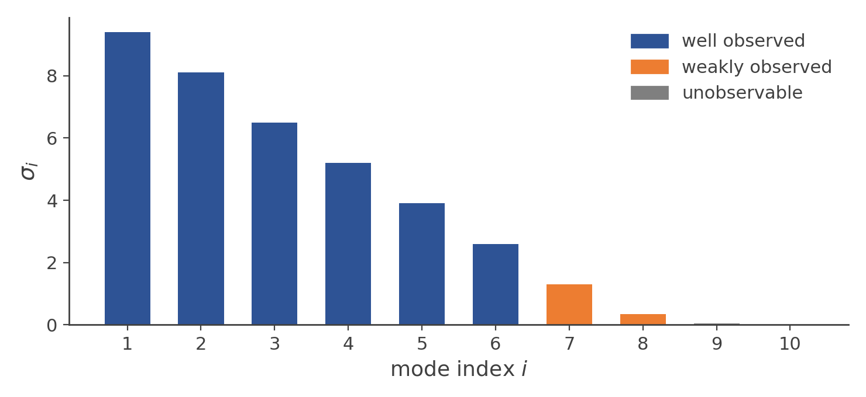
SVD: A = UΣVᵀ: object modes and how strongly they're seen
A = UΣV^{T} Av_{i} = σ_{i}u_{i}
The right singular vectors vᵢ are object/image modes; σᵢ measures how strongly mode i appears in the measurements.
σᵢ | What it means
large | strong detector change — well observed
small | very little detector change — poorly observed
zero | no detector change — invisible (null space)
41

Slide 77
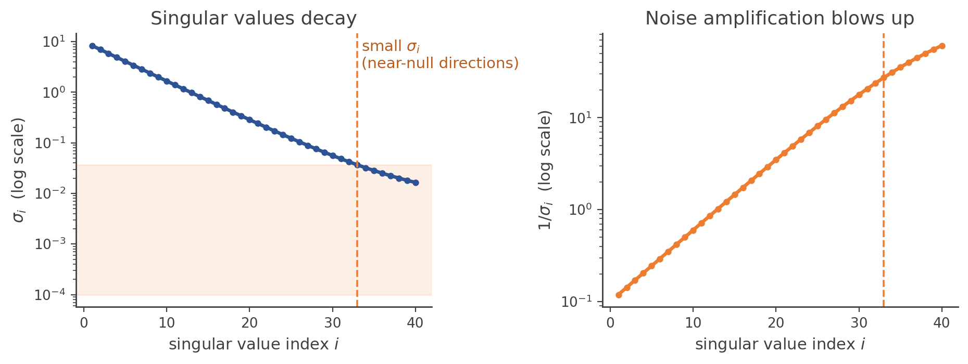
Limitation 2: Pseudoinverse Can Amplify Noise
A = UΣV^{T} A† = VΣ†U^{T}
x̂ = Σᵢ u_{iT}y / σ_{i} v_{i}
If σᵢ ≈ 0, then 1/σᵢ ≫ 1 — even a tiny amount of measurement noise along that direction becomes a huge error in x̂.
7

Slide 78
Well-defined mathematically, unstable in practice
small σᵢ → noise amplification
An ill-conditioned sensing system has some directions that are only weakly observed
The pseudoinverse is mathematically well-defined in many such cases
But the resulting reconstruction can still be practically unstable
This is an inverse-problem limitation, not purely a computational one — no amount of extra compute fixes a direction the sensor barely measures.
This is exactly the near-singularity / conditioning story from Lecture 3 — reappearing here as a property of the pseudoinverse itself.
8

Slide 79
Limitation 3: No room for “prior knowledge”
min_{x} ||y − Ax||₂²
But you may already know things about x — say, a CT image should be spatially smooth, nonnegative, piecewise smooth, or sparse in some transform domain.
min_{x} ‖y − Ax‖₂² + λR(x)
measurement consistency
prior / regularization
You might additionally require xᵢ ≥ 0 — a hard constraint plain least squares has no way to express.
Once R(x) or a constraint enters the picture, there's usually no simple pseudoinverse formula — iterative optimization becomes the natural approach.
10

Slide 80
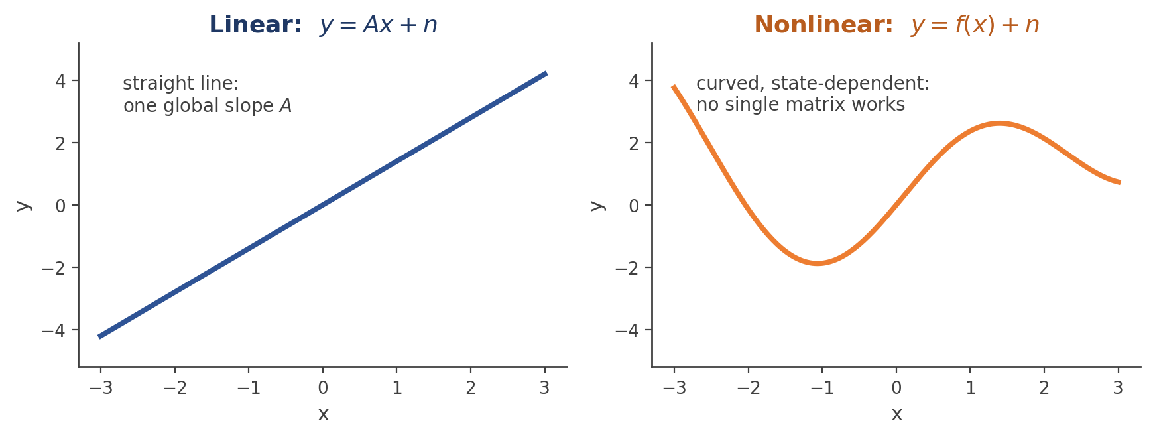
Limitation 4: Forward model may not be linear
x̂ = arg min_{x} ||y − f(x)||²
There is no matrix A† to calculate. You generally need an iterative nonlinear optimization procedure.
A connection to ML: a neural network or a differentiable physical simulator can become part of f(x) — the same optimization principles still apply.
12

Slide 81
What Does Iterative Inversion Actually Do?
13

Slide 82
Four steps, repeated: J(x) = ∥y − Ax∥²₂, start from x⁽⁰⁾
1
Forward projection
ŷ⁽ᵏ⁾ = Ax⁽ᵏ⁾
If this were the true image, what would the scanner have measured?
2
Compare with reality
r⁽ᵏ⁾ = y − Ax⁽ᵏ⁾
How inconsistent is the current image with the actual measurements?
3
Map error back to image space
∇ J(x⁽ᵏ⁾) = −2Aᵀ(y−Ax⁽ᵏ⁾)
Aᵀ maps information from measurement space back into image space.
4
Correct the estimate
x⁽ᵏ⁺¹⁾ = x⁽ᵏ⁾ + 2η Aᵀ(y−Ax⁽ᵏ⁾)
Update, then repeat from Step 1.
14

Slide 83
The intuitive physical loop, not just the formula
1
2
3
4
5
guess physical state
simulate measurement
compare to real data
backproject error
correct, repeat
This is the reading I'd emphasize more than the gradient-descent equation itself: guess → simulate → compare → backproject → correct — the same loop underlies every iterative inverse method.
15

Slide 84
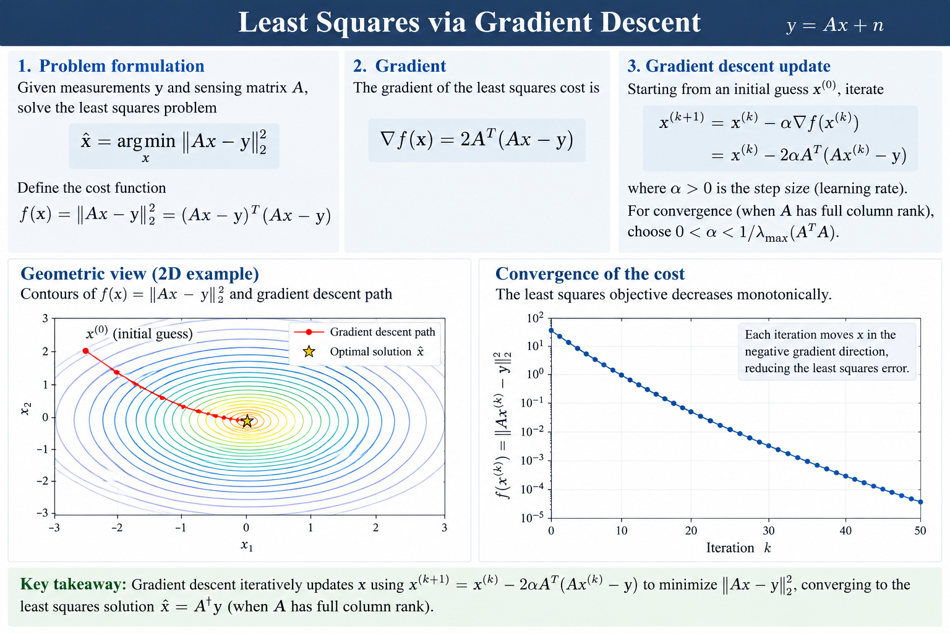

Slide 85
What Exactly Is “Computational Inverse”?
16

Slide 86
Broader than “iterative” — a shift in what we're solving
Analytical / direct inversion
Computational inverse problem
x = A†y
x̂ = arg min_{x} [data mismatch + prior]
obtain x through a formula or direct factorization
treat reconstruction as a computational procedure, solved numerically
Iterative optimization is one major way to solve a computational inverse problem — but “pseudoinverse vs. computational inverse” are not two competing definitions of inverse.
I would not teach these as a binary choice. Instead:
Inverse Problem
Direct / closed-form
Iterative numerical
Regularized computational
Learned / data-driven
x = A†y via factorization or SVD
gradient descent, conjugate gradient, …
min mismatch + λR(x), constraints
learned priors, end-to-end reconstruction
17

Slide 87
Gradient descent on the same objective
ŷ^{(k)} = Ax^{(k)} r^{(k)} = y − Ax^{(k)}
∇J(x^{(k)}) = −2A^{T} r^{(k)}
x^{(k+1)} = x^{(k)} + 2η A^{T} (y − Ax^{(k)})
start with x⁽⁰⁾
predict Ax⁽ᵏ⁾
compare to y
backproject error
update x
This deserves a physical reading, not just a gradient-descent formula: Aᵀ(y−Ax⁽ᵏ⁾) takes a discrepancy measured in sensor space and backprojects it into the space of the unknown physical state.
27

Slide 88
For CT, this loop is the reconstruction algorithm itself
1
2
3
4
5
current image
simulate projections
compare to measured
backproject discrepancy
update image, repeat
That is an excellent endpoint for the lecture: iterative least squares is not a separate algorithm bolted onto CT — it's what solving y = Ax + n by gradient descent looks like, one backprojection at a time.
28

Slide 90
16. Near-singularity
A unique solution can still be almost invisible
38

Slide 91
Even with enough angles, not all patterns are equal
v₂ isn't completely invisible — Av₂ ≠ 0 — but it is almost invisible. This is the noisy counterpart of the earlier null-space problem.
Regime | Condition | Meaning
Exact singularity | Av = 0 | scanner cannot see the pattern at all
Near-singularity | Av ≈ 0 | sees it so weakly that noise can overwhelm it
This is precisely why inversion can be unstable even when a unique mathematical solution exists.
39

Slide 92
17. SVD answers a concrete question
Which patterns does this scanner see strongly, weakly, or not at all?
40

Slide 93
SVD: A = UΣVᵀ: object modes and how strongly they're seen
A = UΣV^{T} Av_{i} = σ_{i}u_{i}
The right singular vectors vᵢ are object/image modes; σᵢ measures how strongly mode i appears in the measurements.
σᵢ | What it means
large | strong detector change — well observed
small | very little detector change — poorly observed
zero | no detector change — invisible (null space)
41

Slide 94
18. Why inversion amplifies noise
Dividing by a small singular value
42

Slide 95

Small σᵢ turns tiny detector noise into large image artifacts
A† = VΣ†U^{T} reconstruction contains terms ~ ϵ_{i} / σ_{i}
σᵢ = 1 → no severe amplification. σᵢ = 0.001 → gain = 1000×. Tiny detector noise can become a large image artifact.
An ill-conditioned inverse problem: the measurements carry only a faint signature of some object modes, so recovering those modes amplifies both signal and noise together.
43

Slide 96
Why not just collect data from every angle/all possible combinations of the target variables?
Real acquisition has constraints
44

Slide 97
An excellent question — and why the answer is no
“Then why not just collect more projections from every possible angle?”
Radiation dose to the patient
Acquisition time
Patient motion during the scan
Scanner geometry and detector limitations
Deliberately reducing projections for dose gives sparse-view CT: some spatial modes become weakly constrained or unconstrained — the inverse problem is unstable again.
Now — and only now — prior information becomes necessary.
45

Slide 98
Least squares uses one source of information. What about the other?
Continuing directly from the CT example: the likelihood p(y|x) tells us how well an image explains the measurements. But before we ever measured anything, were all images equally plausible?
No. We already know things about what a CT image should look like — and Bayes' rule is how we combine that knowledge with the measurements.
p(x|y) p(y|x) · p(x)
measurement evidence × prior knowledge
Least squares / maximum likelihood used only p(y|x) — the measurement term
Today we bring in p(x) — the prior — and see exactly where regularization comes from
1

Slide 99
Five steps from Bayes' rule to a regularized inverse problem
1. Bayes' rule
two sources of information about x
2. What do we already know?
physical knowledge about CT images
3. Encode belief as a probability
piecewise smooth ⇒ p(x)
4. MAP estimation
balance measurement fit and prior
5. MAP becomes regularization
‖y−Ax‖² + λR(x)
By the end: regularization stops looking like an arbitrary extra term and becomes an explicit statement of prior knowledge about x.
2

Slide 100
Part 1 — Bayes: Two Sources of Information
3

Slide 101


We measured y. What should we believe about x?
For estimating x, p(y) is just a constant:
p(y | x)
p(x)
What does the sensor tell us?
What do we already know about plausible CT images?
If this were the true attenuation image, how likely are the measured X-ray projections?
Before looking at these measurements, how plausible is this image as a CT image?
Posterior knowledge = measurement evidence × prior knowledge
Least squares / maximum likelihood used only the left box. Today we bring in the right one.
4

Slide 102
Part 2 — What Do We Already Know About a CT Image?
5

Slide 103

Before measuring anything, are all x's equally plausible?
No. Some images are physically plausible, some are noisy, and some are outright impossible (negative attenuation) — before we've measured a single X-ray.
6

Slide 104
Concrete prior knowledge we could write down
Physical knowledge | Mathematical statement
Attenuation cannot be negative | xᵢ ≥ 0
Neighboring pixels within one tissue are similar | xᵢ ≈ xⱼ
Sharp changes mainly occur at tissue boundaries | ∇x is sparse
CT images are approximately piecewise smooth | TV(x) tends to be small
Outside the body is approximately air | known / estimated support
Bayesian inference requires us to translate physical knowledge like this into p(x).
We can build p(x) around these: E.g., CT images are approximately piecewise smooth.
7

Slide 105
3. Part 3 — Turning “Piecewise Smooth” Into a Probability
8

Slide 106

A 1-D cross-section: air | soft tissue | bone | soft tissue
within a tissue: x_{i+1} − x_{i} ≈ 0 only near boundaries are differences large
So ∇x should contain relatively few large values — measure this with R(x) = ‖∇x‖₁.
9

Slide 107


Turn the statement into a probability distribution
Small ‖∇x‖₁ → high p(x). Large ‖∇x‖₁ → low p(x). Important: Bayes did not discover that CT images are piecewise smooth — we encoded that knowledge in p(x).
10

Slide 108
4. Part 4 — MAP: Balance Measurement Fit and Prior
11

Slide 109




Combine the CT forward model with our piecewise-smooth prior
y = Ax + n, n ~ N(0, σ²I)
Bayes combines them:
Find an image that both explains the X-ray measurements AND looks physically plausible.
12

Slide 110
5. Part 5 — Bayesian MAP Becomes Regularization
13

Slide 111

Take the negative logarithm
x̂_{MAP} = arg min_{x} −log p(x|y)
Substitute the previous expressions:
x̂_{MAP} = arg min_{x} [ 1/2σ² ‖y−Ax‖₂² + λ‖∇x‖₁ ]
‖y−Ax‖₂² + λ'‖∇x‖₁
DATA FIDELITY
REGULARIZATION
Prior probability, passed through −log, becomes a regularization penalty.
14

Slide 112
The three-stage progression, now complete
Least Squares / ML
MAP
Regularized Inverse Problem
‖y−Ax‖²
p(y|x) p(x)
‖y−Ax‖² + λR(x)
Regularization is not an arbitrary extra term bolted onto least squares — it is the explicit mathematical representation of prior knowledge about the physical state x.
This is exactly the gap left open in the computational-inverse deck's “no room for prior knowledge” limitation — now we know precisely where λR(x) comes from.
This sets up iterative CT reconstruction, and eventually deep / unrolled tomography.
15

Slide 113
20. Prior knowledge gets a clear job
Trust the data where it's strong; trust the prior where it's weak
And vice versa.
46

Slide 114
When σ₄ ≈ 0, the data alone can't tell us
σ₁,σ₂,σ₃ >> 0 but σ₄ ≈ 0
What kinds of attenuation maps are physically or anatomically plausible? We encode that as p(x).
p(x|y) $∝$ p(y|x) p(x) x̂_{MAP} = arg max_{x} p(y|x) p(x)
Where measurements are informative
Where measurements are weak or ambiguous
trust the data
the prior constrains the solution
This fixes the earlier conceptual jump: priors aren't introduced out of nowhere — they answer a need the scanner itself created.
47

Slide 115
21. Regularization: the optimization version
Two terms, two concrete CT jobs
48

Slide 116
Data fidelity + prior, in one objective
x̂ = arg min_{x} ||y−Ax||² + λ R(x)
Data term ∥y−Ax∥²
Regularizer R(x)
“Would this reconstruction produce the X-ray measurements the scanner actually observed?”
“Is this a plausible, stable reconstruction according to our prior assumptions?”
λ controls the tradeoff between trusting the measurements and trusting the prior.
49

Slide 117


Slide 118
22. Regularization meets the singular values
50

Slide 119
Regularization tells inversion not to over-trust weak modes
Without regularization, inversion still tries to recover components with σᵢ ≈ 0 by dividing by tiny σᵢ — amplifying noise enormously.
Limited CT geometry
Small singular values
Noise amplification
Unstable reconstruction
Regularization / prior
Don't trust the measurement enough to make enormous corrections in directions the scanner barely observes. This chain is the centerpiece of the lecture's second half.
51

Slide 120
23. Refining the noise model: counting photons
Gaussian noise was a convenient approximation
52

Slide 121
CT noise is fundamentally photon statistics
k_{i} ~ Poisson(λ_{i}(x)) λ_{i}(x) = I_{0,i} e^{−(Ax)}_{i}
x
Ax
Beer–Lambert
I₀e⁻ᴬˣ
photon stats
k
y = Ax + n is not “the physics of CT.” It is a useful, transformed approximation of a Poisson process.
x̂_{ML} = arg max_{x} p(k | x)
The corresponding negative log-likelihood is not simply ordinary L₂. The lesson: measurement physics + noise statistics together determine the appropriate loss.
53

Slide 122
24. Modern learned reconstruction
54

Slide 123
The classical objective, one more time
x̂ = arg min_{x} D(y, F(x)) + λ R(x)
Term | Meaning
F | CT physics (the forward model)
D | consistency with measured data and its noise statistics
R | prior knowledge
Classical
Modern / learned
design R mathematically
learn R, or the reconstruction procedure, from data (unrolled networks, learned reconstruction)
Learning does not make the forward physics disappear — that is the message this whole course is built on.
55

Slide 124
The entire lecture as one causal chain (1 of 2)
We want internal anatomy x
Physically: Av = 0 → invisible anatomical patterns
X-rays interact with matter → CT physics
Add angles → invisible modes become observable
Discretize anatomy → forward model A
Real measurements fluctuate: y = Ax + n → noise
Collect projections: y = Ax
Candidate: r = y − Ax̂ → residual
Too few directions: Ax₁ = Ax₂ → non-identifiability
Best explains data? arg max p(y|x) → ML
Why? A(x₁−x₂) = 0 → null space
Gaussian noise → arg min ∥y−Ax∥² → least squares
det(A) = 0, rank(A) < N → singularity
∇J = −2Aᵀ(y−Ax) → forward / backprojection
56

Slide 125
The entire lecture as one causal chain (2 of 2)
Some modes only weakly observed: Av ≈ 0 → near-singularity
Use knowledge beyond the data: p(x) → prior
Characterize all modes: A = UΣVᵀ → SVD
Combine: p(x|y) ∝ p(y|x)p(x) → MAP
Small σᵢ amplifies noise → conditioning and instability
Optimization form: min D(y,F(x)) + λR(x) → regularized inverse problems
Can't scan forever: dose, time, motion → practical CT constraints
Learn R, or the reconstruction procedure → modern ML for physical sensing
One thread, start to finish: every idea in this lecture exists because the CT scanner we built needed it.
57

Slide 126
The one picture worth dwelling on
Two different patients — identical measurements — because their difference is a checkerboard pattern invisible to this acquisition geometry.
This single 2×2 example carries: null space, rank deficiency, singularity, missing information, projection-angle diversity — and eventually small singular values and regularization.
When you later write A = UΣVᵀ, students won't see SVD as an unrelated linear-algebra detour — they'll know exactly which question it answers.
58

Slide 127
What I would expect students to learn
Deep core — worth full mastery
Shorter previews — conceptual only
forward vs. inverse problems
discretization: y = Ax, and what A means physically
identifiability: null space, rank, singularity
the 2×2 CT example — Av = 0 in one picture
least squares, forward projection and backprojection
near-singularity, conditioning, SVD
regularization and MAP as the remedy for small σᵢ
the Radon transform and the sinogram
Poisson photon-counting noise vs. the Gaussian approximation
sparse-view CT and acquisition constraints (dose, time, motion)
learned reconstruction and unrolled networks → later lectures
For a 75-minute class: let the 2×2 example carry identifiability → conditioning → regularization as the deep core; treat the rest as shorter conceptual extensions.
59

Slide 128
Questions?
60

