Slide 1

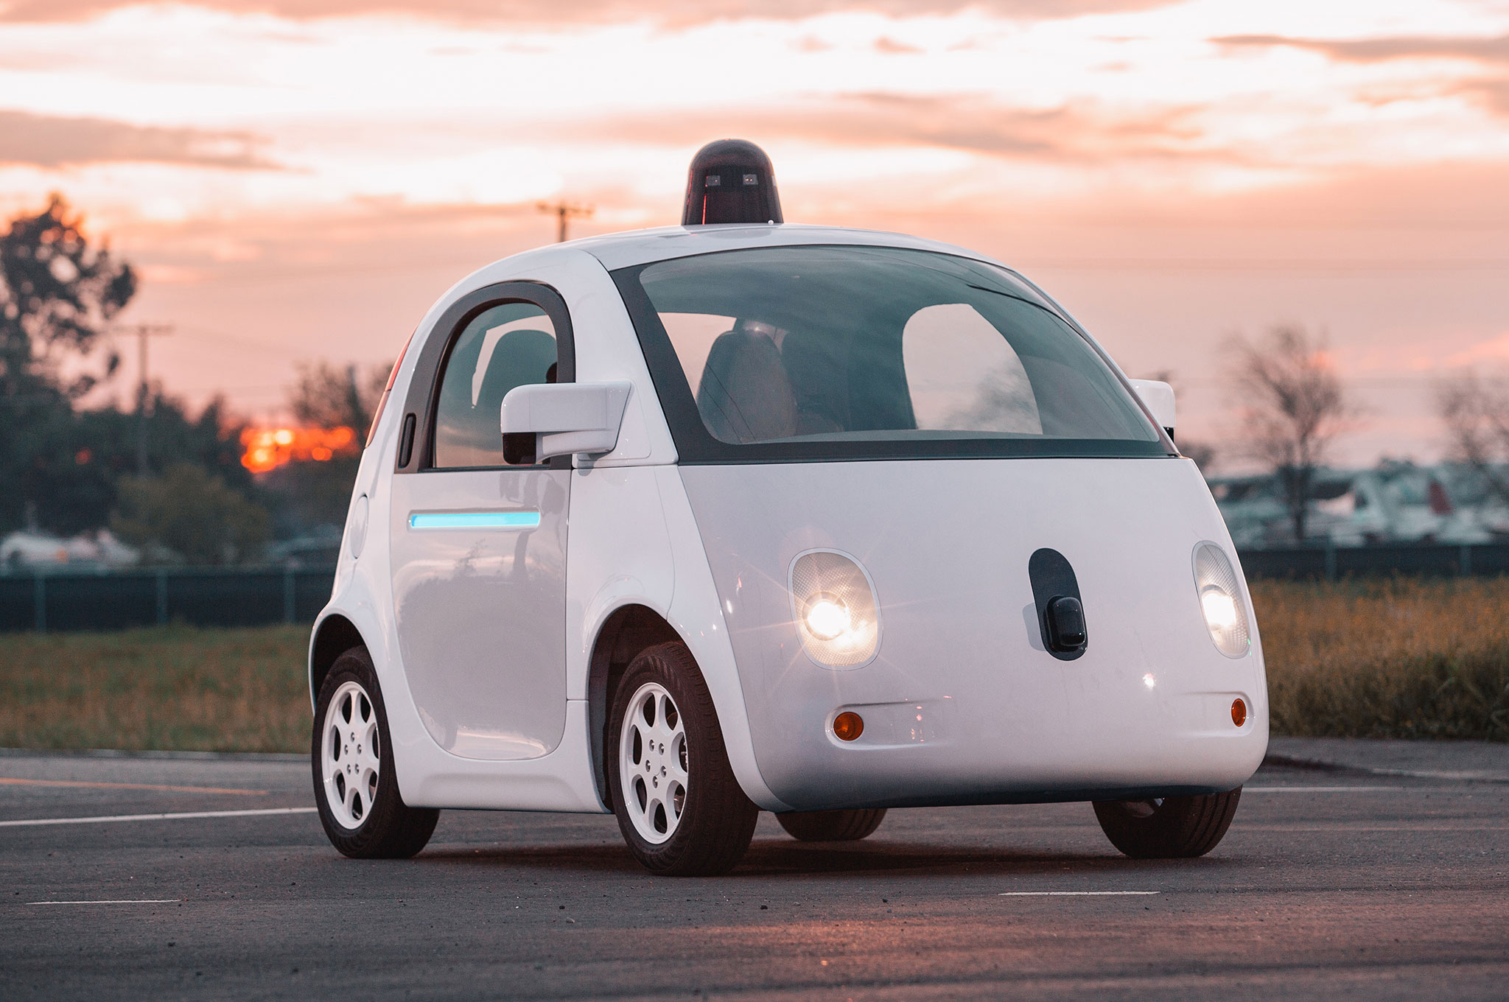



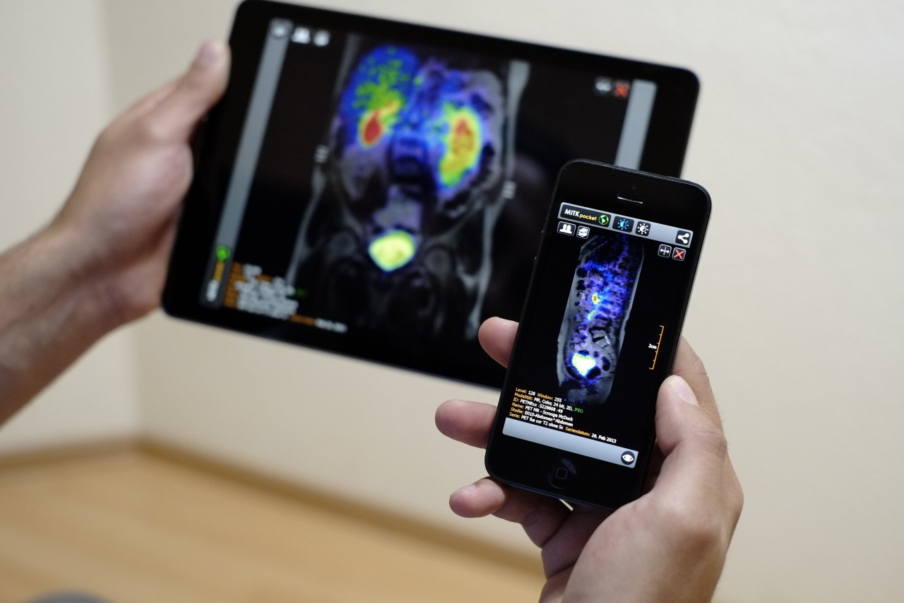
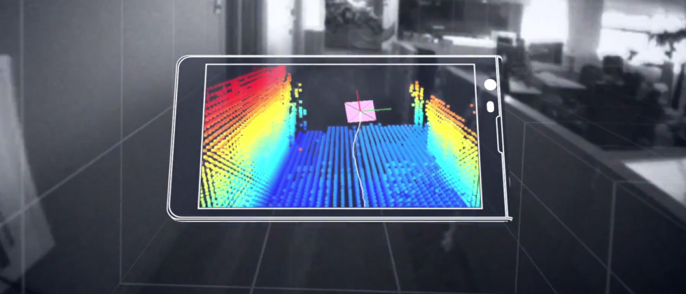

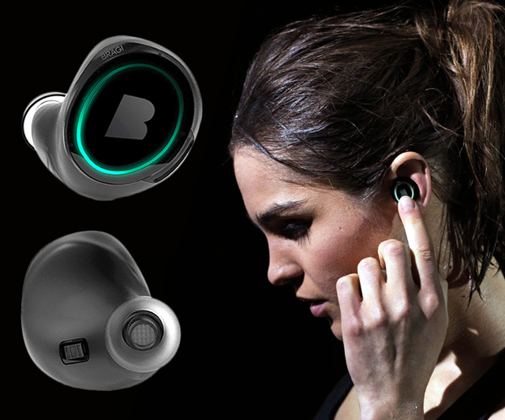
Machine Learning for Physical Sensing & Perception
CMSC 818V : Fall 2026
Lecture 4: From Inverse Problems to Physics-Guided Learning
Nirupam Roy
Tu-Th 12:30 – 1:45pm
IRB 2107

Slide 2
Where Lecture 3 left off
y = f(x, θ) + n
A physical forward model turns a state x into a measurement y.
The classical inverse recovers x by fitting the data and penalizing implausible solutions.
x̂ = arg min_{x} D(y, f(x,θ)) + λR(x)
data term — stay consistent with what the sensor actually measured
regularizer — prefer plausible states among those consistent with the data
Lecture 4 is not a switch from physics to generic deep learning — it is the next question forced by the inverse problem itself.
1

Slide 3
The central lecture question
Which component of the inference chain is still missing?
When the classical inverse is inaccurate, non-unique, computationally expensive, or based on incomplete physics — should learning...
replace the inverse outright,
supply the missing prior,
accelerate / unroll the solver,
repair the forward model,
discover the dynamics, or
only enforce a known physical law?
2

Slide 4
Six answers, one per section of this lecture
1
2
3
Learn the
Inverse
Learn the
Prior
Unroll the
Optimizer
the map itself
is too complex
data alone doesn't
pick one state
the objective is right;
iteration is slow
4
5
6
Learn Missing
Physics
Learn the
Dynamics
Constrain with
Physics
the model is
incomplete, biased
the transition law
itself is unknown
the law is known;
the field is sparse
Same rhythm every time: meet the physical systems, expose the shared failure mode, add exactly the learning that failure demands.
3

Slide 5
Every section follows the same rhythm
Two or three very different sensing systems will turn out to share exactly one mathematical failure — that repetition, not the sensor hardware, is the actual lesson.
meet the
physical systems
write the forward
model x, y, f, θ, n
expose the shared
mathematical failure
add the precise
learning remedy
Notation stays fixed throughout: physical state x, forward physics f(x,θ), measurement y, noise n, learned component φ. New vocabulary is the sensor's — not the mathematics'.
Watch for the moment each section closes: what the new method still cannot guarantee becomes the transition question into the next one.
4

Slide 6
1 Learn the Inverse Directly
When a useful inverse mapping exists statistically, even though an analytic inverse is unavailable
5

Slide 7
A formal definition: the direct learned inverse
Use this to establish the simplest possible relationship between Machine Learning and inverse problems: the network is an approximator of the map from sensor measurements to a desired latent physical state.
y = f(x, θ) + n → x̂ = g_{φ}(y)
Given paired data {(yᵢ, xᵢ)}, gφ is fit directly by empirical risk minimization — no explicit optimization runs at test time.
This can be useful even when the analytic inverse is hard to write down or too slow to invert online.
6

Slide 8
Supervised training and a physical consistency check
φ̂ = arg min_{φ} (1/N) Σᵢ L(g_{φ}(yᵢ), xᵢ)
For squared error, the predictor is driven toward the conditional mean E[x | y]. This can be useful even when the analytic inverse is hard — but it does not ensure that the predicted state actually reproduces the observed measurement.
physical consistency check: f(x̂, θ) ?≈ y
A direct learned inverse can be accurate statistically without being an explicit model of the sensing physics. It may exploit reproducible correlations that are useful in-distribution but brittle when the sensing environment changes.
7
Notes:
L() = per example Loss function.

Slide 9
Example A — sparse-view CT: what a detector measures
X-ray source
(rotating)
tissue
(attenuation)
detector value =
ray integral
An X-ray source and detector rotate around the body; each detector value is produced after X-rays pass through tissue.
With only a small number of projection angles, the scanner records incomplete angular information.
y ≈ Ax + n (after Beer–Lambert log transform; A encodes ray–pixel intersection lengths)
8

Slide 10
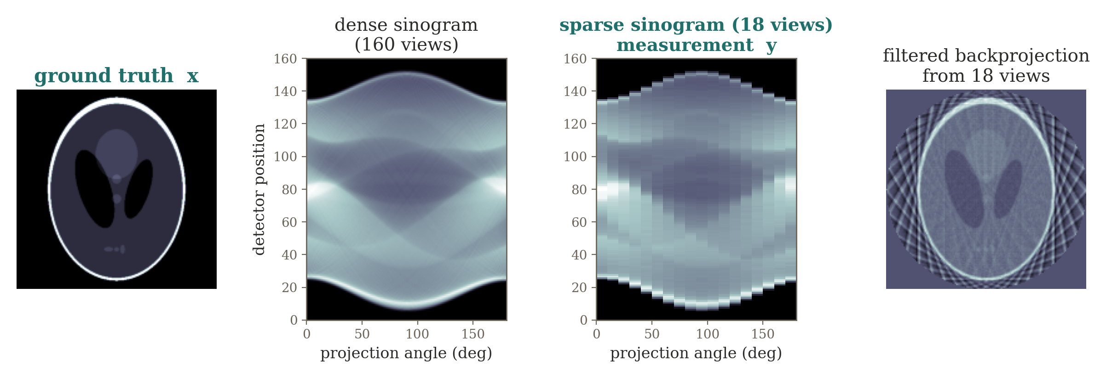
CT measurement formation: dense to sparse
Filtered backprojection assumes sufficiently dense angular sampling. With few views, the reconstruction shows streaks and large null / near-null directions — several images become almost equally consistent with the data.
9

Slide 11
Learned direct reconstruction
sparse
sinogram y
learned
inverse gφ
reconstructed
image x̂
A network gφ can be trained to map sparse projection data directly to the image, or to map an initial artifact-laden reconstruction to a corrected image.
What the network has learned that is not in the sparse sinogram?
[Ref] Zhu et al., AUTOMAP, Nature 2018 — a canonical learned-reconstruction example.
10
Notes:
Answer: “anatomy” as the answer for the next section.
Learned inverse is fast and flexible, but can sacrifice physical consistency and robustness.​
This is exactly why methods like LISTA, unrolled networks, MoDL, and physics-guided reconstruction are attractive: they try to retain the known forward model while learning only the difficult parts.

Slide 12
Example B — RF fingerprint localization: the physical environment
A device receives Wi-Fi / UWB / cellular signals from several fixed transmitters (access points).
Walls, furniture, and people create site-specific reflection, diffraction, and shadowing.
Two locations with similar geometric ranges can therefore have very different channel signatures.
y = f_{site}(x) + n f_{site} unknown / too costly to model
A complete electromagnetic / multipath forward model exists in principle but is too costly and too environment-specific for routine inversion. Classical triangulation's simplified distance-to-signal model is what multipath violates.
11

Slide 13
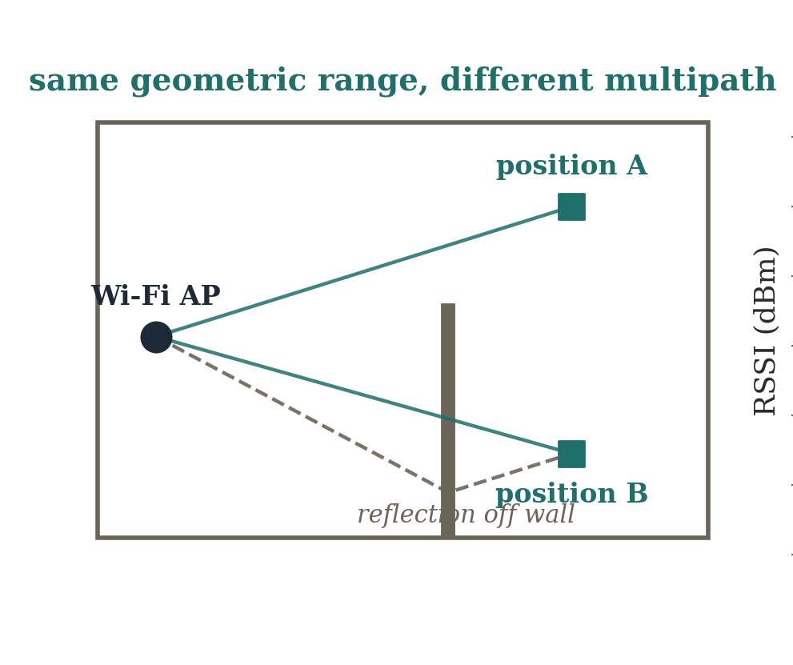
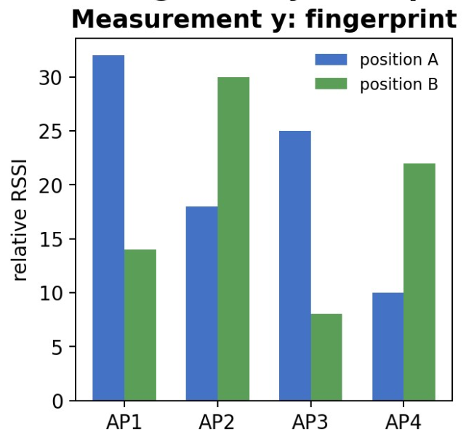
From fingerprint to position: a site-specific inverse
gφ learns the empirical inverse from fingerprint vector to position. Contrast “geometry-based localization” with “fingerprint-based inverse inference” — what happens when furniture or AP placement changes?
[Ref] Wang et al., DeepFi, MobiCom 2015.
12

Slide 14
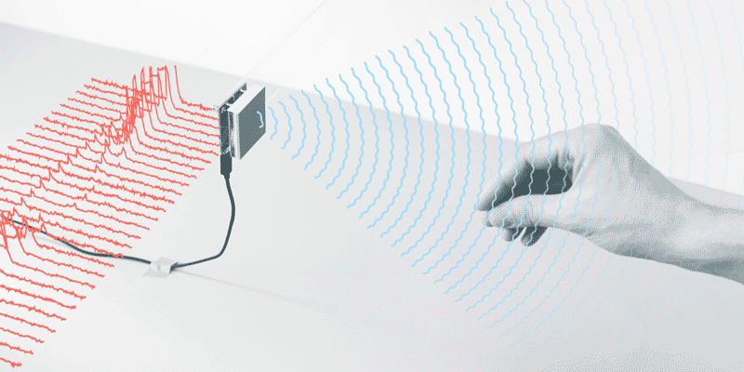
Example C — radar gesture sensing: the physical measurement
FMCW radar
(chirps)
moving scatterers
(hand / body)
range / Doppler /
angle features
Different body parts create time-varying reflections with different range and radial velocity.
Raw beat signals are transformed by known radar signal processing into range / Doppler / angle features — exact inversion from distributed scattering to semantics is not analytically defined.
Broadens “inverse problem”: the target x can be a low-dimensional state or label, not only a pixelwise image.
13

Slide 15
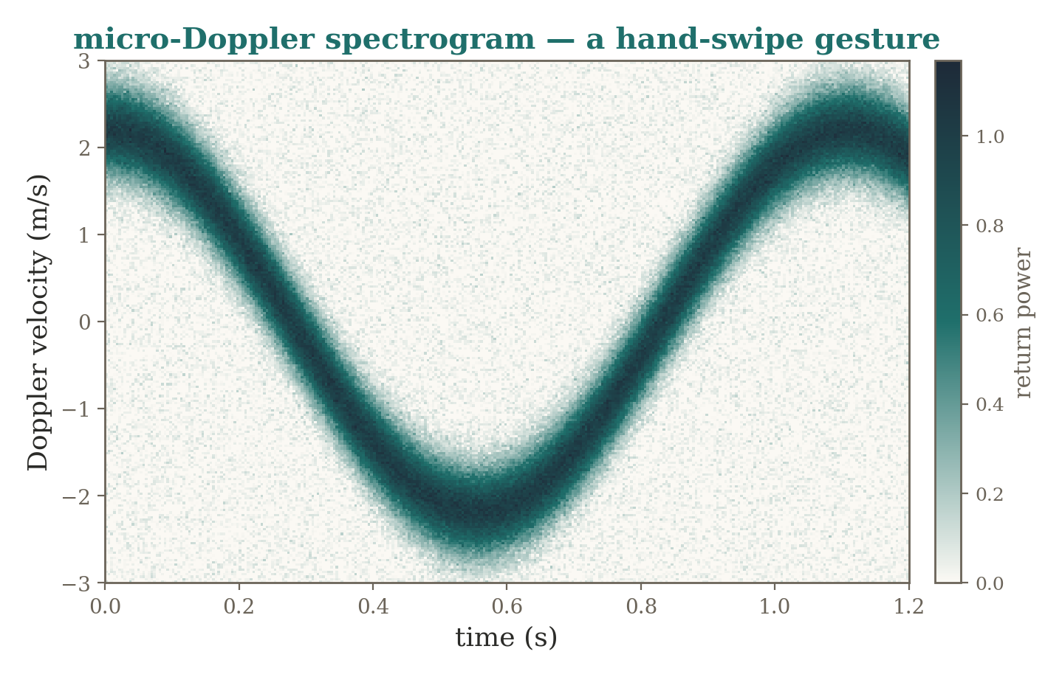
Radar gesture sensing: inverse inference need not mean image reconstruction
The full physical reflectivity field is more detailed than the task requires — gφ maps the structured radar measurement directly to a semantic, task-relevant state, not a full reflectivity image.
14

Slide 16
Three systems, one learned-inverse abstraction
System | measurement y | target x | why direct learning helps | what it may ignore
CT | sparse projections | attenuation image | learn difficult inverse | known projector A / consistency
RF localization | RSSI / CSI | position | site-specific inverse | causal propagation / domain shift
Radar gesture | radar tensor | activity / gesture | task-level inverse | full scene physics
15

Slide 17
Why direct learning is not enough
A direct inverse is trained on a particular distribution of states and environments — performance can degrade sharply out of distribution.
Nothing in the training objective enforces that f(x̂,θ) actually reproduces the observed measurement y.
Measurement consistency and generalization are both left entirely to the data.
If the forward operator A is already known and the real difficulty is that the measurements are insufficient, why learn the entire inverse? Can we keep measurement physics exact and learn only what makes a state plausible?
16

Slide 18
2 Learn the Prior, Not the Entire Inverse
When many physical states explain the same measurements equally well
17

Slide 19
Two sources of information in reconstruction
x̂ = arg min_{x} D(y, Ax) + λ R(x)
sensor physics A
D(y, Ax): does x explain what the sensor measured?
prior knowledge R(x)
is x plausible, independent of this measurement?
reconstruction x̂
The measurement term knows the experiment; the prior knows the world.
4
Notes:
Reconnect to Lecture 3 (MAP estimation, least squares). Two questions judge every candidate x: does it explain the data (D), and is it plausible regardless of this particular measurement (R)?

Slide 20
Ambiguity lives in the null space
y = Ax + n
With limited or weak measurements, A can be rank-deficient or ill-conditioned. If z lies in the null space, then:
Az = 0 ⟹ A(x + z) = Ax
Even when the null space is only approximate, small singular values create directions that are weakly observed and therefore unstable under noise.
The likelihood / data term can tell us whether a candidate explains y — never whether it is a plausible physical state.
18

Slide 21
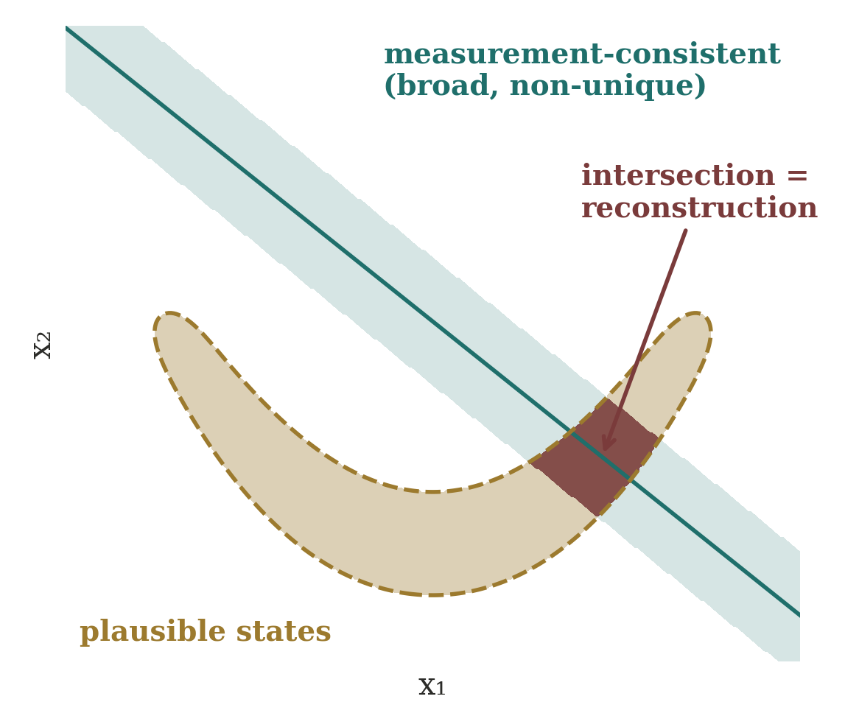
Why is a prior needed at all?
Undersampling, null spaces, ill-conditioning, noise, missing frequencies, limited views, occlusion…
…all let many states x explain the same y.
Data consistency narrows the set; it may not select one stable answer.
Reconstruction seeks the intersection with the plausible set.
Without a prior, “the” solution of an inverse problem is often not even defined.
5

Slide 22
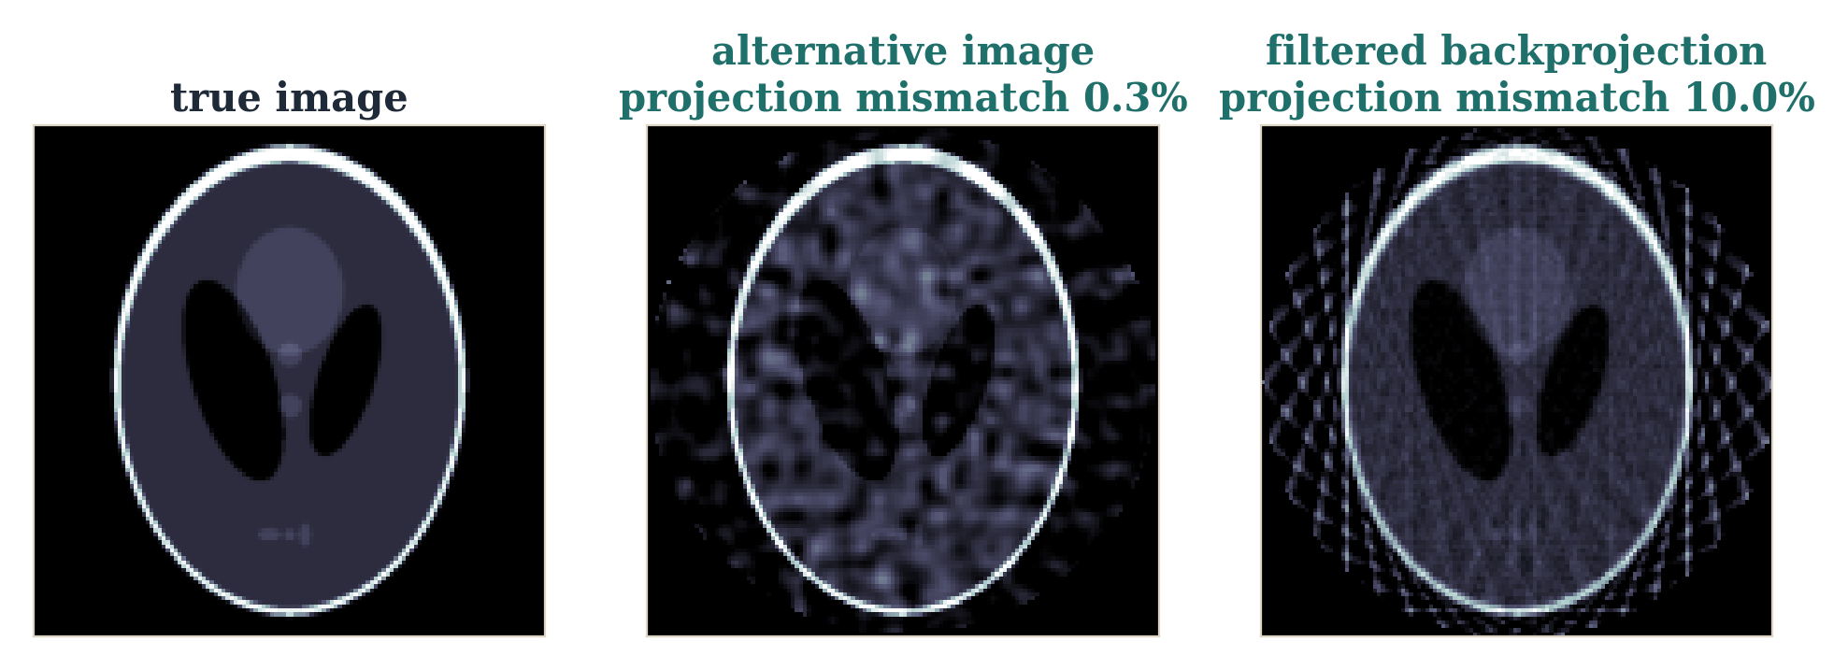
Sparse-view CT: fitting data is not enough
18 projection angles. The middle image was built by adding a (near) null-space pattern of A to the truth: its projections differ by only 0.3%, yet the anatomy is visibly different. FBP matches the data worse (10%) and shows streaks.
The sensor cannot tell these images apart — something else must.
6
Notes:
Computed with skimage radon: z was obtained by gradient descent on ||Az||^2 from a smooth random image, so Az is nearly zero. x + z is therefore almost perfectly measurement-consistent. This is the concrete version of the 2D picture on the previous slide.

Slide 23
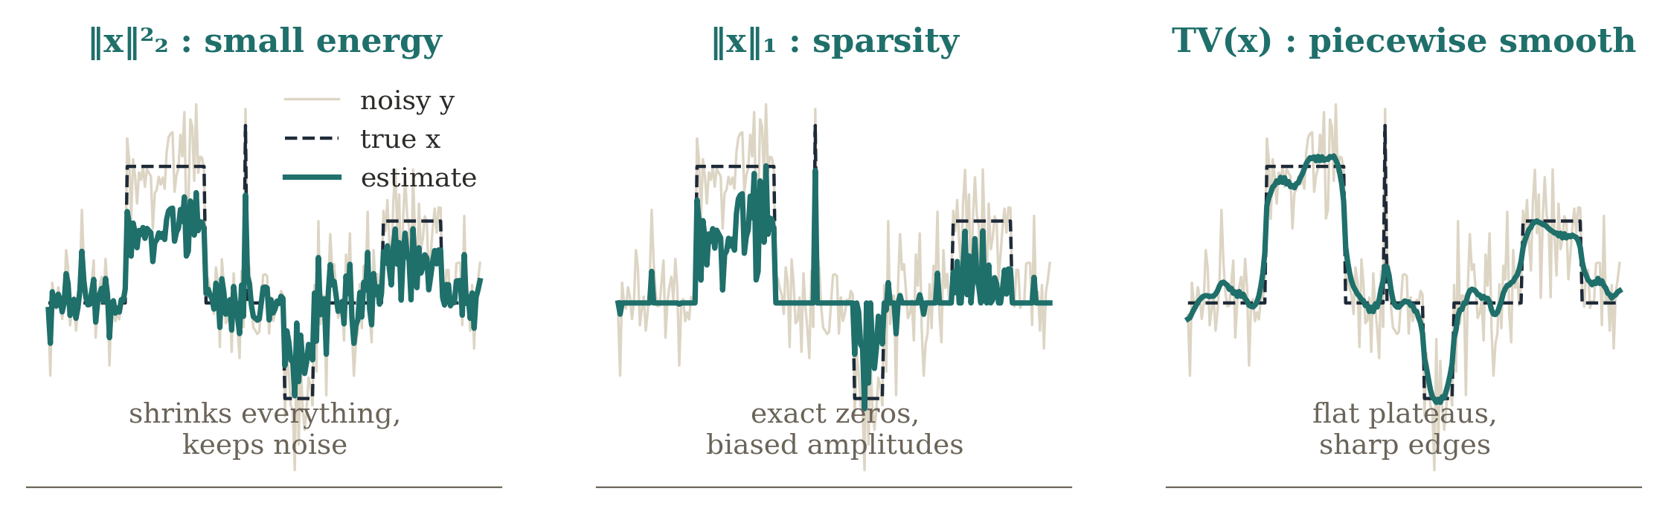
Classical priors are assumptions
R(x) = ‖x‖₂² R(x) = ‖x‖₁ R(x) = TV(x)
Hand-designed: small energy (Tikhonov), sparsity, piecewise smoothness.
Powerful because they encode structure — intentionally simple.
Who decided “sparse”, “smooth”, or “piecewise smooth”? We did.
Real anatomy, RF occupancy patterns and room impulse responses carry richer structure than these can express.
7
Notes:
Same noisy signal, three hand-designed priors. L2 shrinks everything uniformly and keeps the noise; L1 produces exact zeros but biases amplitudes; TV gives flat plateaus with sharp edges. Each prior is a statement about the world. Learned priors continue this idea rather than replacing inverse-problem thinking.

Slide 24
Learn the prior, not the whole inverse
direct inverse: x̂ = g_{φ}(y)
learned prior: x̂ = arg min_{x} D(y, Ax) + λ R_{φ}(x)
labels teach the entire y → x map
y
large network gφ
x̂
physics stays explicit; data only teach what x looks like
y
known A +
data consistency
learned
prior
x̂
Smaller sample burden: the network need not rediscover A.
More interpretable, and measurement consistency stays explicit.
8

Slide 25
Three technical forms of learned prior
1 Explicit regularizer
2 Learned proximal
3 Generative / score
Rφ(x)
Dφ(x)
Gφ(z), sφ(x, t)
outputs a scalar
outputs a corrected x
outputs x, or a direction
how implausible is x?
how should x be improved?
where do plausible x live?
All three keep A. They differ in what the network outputs, and so in how the prior enters the solver.
9

Slide 26
MAP estimation: the Bayesian connection
x̂_{MAP} = arg min_{x} ∥Ax−y∥₂² + λR(x)
p(x|y) ∝ p(y|x) p(x) R(x) ∝ −log p(x)
R(x) is simply extra information about x that the measurement term cannot supply. A learned prior replaces a hand-designed R with a model learned from plausible states.
The likelihood tells us which x agrees with the data — never which data-consistent x is physically plausible.
19

Slide 27
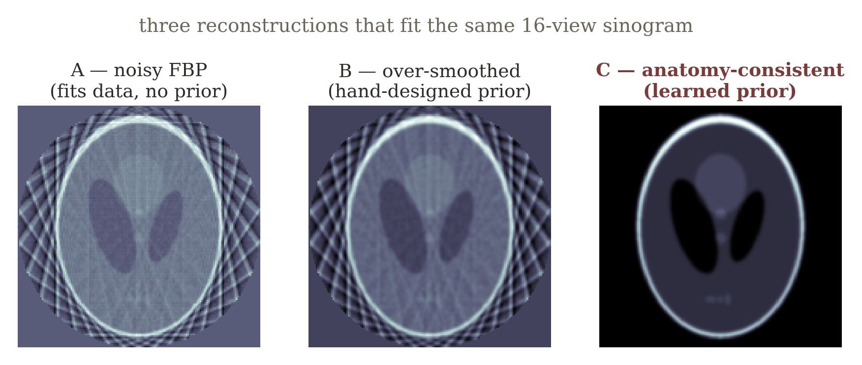
Example A — sparse-view CT, revisited: non-uniqueness
Reuse exactly the same scanner from Section 1, but now focus on what sparse angular sampling fails to observe. “Which term in the objective can distinguish A, B, and C if ‖Ax−y‖ is nearly the same for all three?”
20

Slide 28
What anatomical knowledge contributes
Tikhonov / smoothness — neighboring pixels should not fluctuate arbitrarily.
Total variation — the image may be piecewise-smooth with a small number of important edges.
Sparsity in a transform basis — coefficients in wavelets or learned dictionaries may be mostly small.
Learned prior — a network, denoiser, or generative / score model captures higher-order structure from examples.
Important wording: the learned prior should not be described as “hallucinating missing measurements.” It supplies a statistical preference among states that already compete under the measurement model. The risk of hallucination arises when the prior overwhelms data consistency.
21

Slide 29
Example B — device-free RF tomography: the physical setup
Fixed radios surround a room. A person or object perturbs wireless links whose propagation paths pass through or near the body.
The room is discretized into many candidate cells — the unknown is a 2-D attenuation or occupancy field over hundreds of cells.
y ≈ Ax + n each row of A describes how one radio link weights the cells it crosses
Optional anchor: Wilson & Patwari, “Radio Tomographic Imaging with Wireless Networks,” IEEE TMC 2010.
22

Slide 30
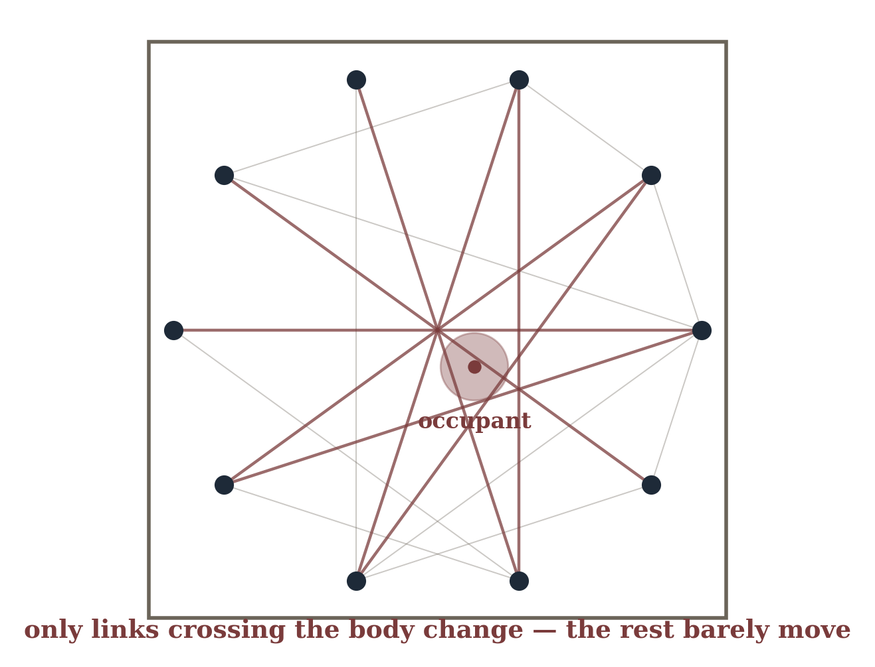
RF tomography made visible: perimeter links, pixel grid
There can be far fewer links than pixels — a dense arbitrary attenuation pattern is impossible to determine uniquely from the measurements alone.
23

Slide 31
Count equations against unknowns
~20–50
≪
~400+
independent link
measurements
unknown grid
cells
24

Slide 32
Occupancy priors: what model learns
Sparsity — an occupied region is a small fraction of the full grid.
Spatial contiguity — a person occupies a connected region, not scattered isolated cells.
Nonnegativity and human-scale shape — physically meaningful occupancy has size and form constraints.
Or a fully learned occupancy distribution fit from many observed room layouts.
Same shared failure mode as CT: measurement consistency alone does not choose a unique plausible state.
25

Slide 33
Example C — motion deblurring: the physical forward model
sharp scene
x
blur kernel H
(motion / exposure)
blurred pixels
y
During finite exposure, camera or object motion spreads light from a sharp scene across neighboring pixels; H approximates the integration process.
y = Hx + n or in frequency: Y(f) = H(f)X(f) + N(f)
26

Slide 34
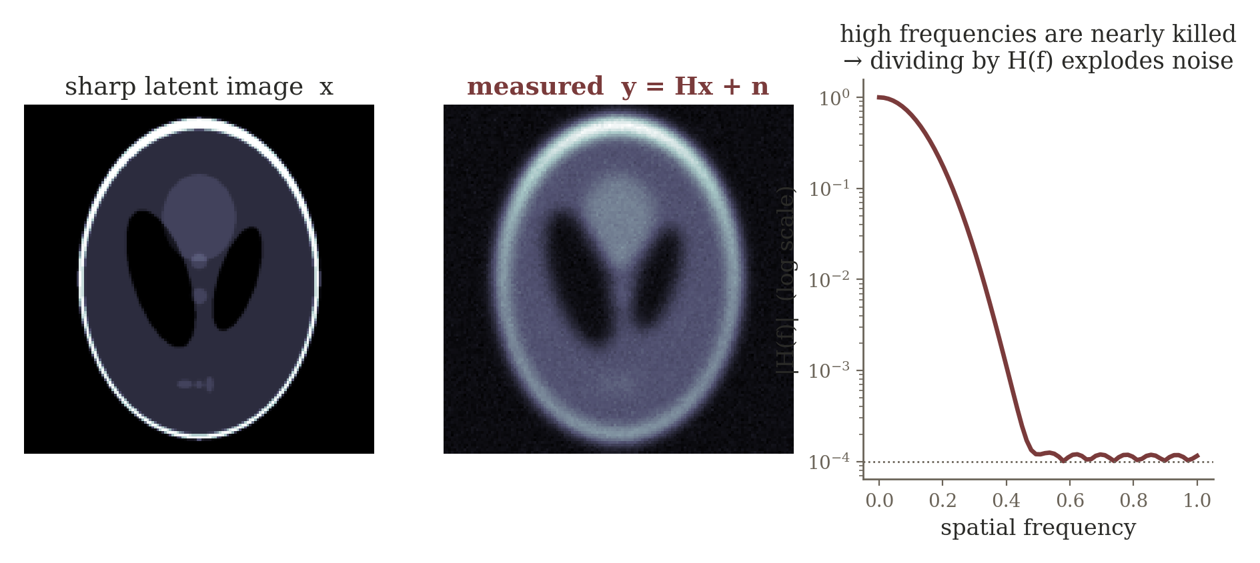
Frequency-domain instability: small H(f), small singular value
If H(f) is close to zero at some frequencies, naive inversion x̂ = y/H amplifies noise severely — explicitly the same singular-value story from Lecture 3, now expressed in the Fourier basis.
27

Slide 35
Natural-image priors recover what the sensor lost
Natural-image knowledge: edges persist, textures have structure, local statistics are non-arbitrary.
A learned image prior can restore stable high-frequency structure while the data-fidelity term preserves what was actually observed.
Many different sharp images can be almost equally data-consistent with a blurry observation — the prior is what selects the one that also looks like a photograph.
28

Slide 36
Three technical forms of a learned prior
Explicit learned regularizer — learn a scalar plausibility penalty and retain explicit optimization
min_{x} D(y,Ax) + λR_{φ}(x)
Learned proximal / denoising operator — replace the hand-designed proximal step with a trainable denoiser
x_{k+1} = D_{φ}( x_{k} + ηA^{T}(y−Ax_{k}) )
Generative / score prior — restrict or bias x toward a learned distribution of plausible states
x ~ p_{φ}(x), or use ∇_{x} log p_{φ}(x)
CT anatomy, human occupancy, and natural-image structure are physically different priors, but mathematically they answer the same question: among the states that agree with the sensor, which should we consider plausible?
29

Slide 37
Shared failure mode across three systems
Sparse-view CT
RF tomography
Motion deblurring
same projections;
many images can
approximately fit
limited measurements
few links cannot
uniquely identify a
dense attenuation
field
many sharp images
can produce nearly
the same blur
prior: anatomy is structured
prior: occupancy is sparse + contiguous
prior: natural images have
structured edges / textures
Shared failure mode: measurement consistency alone does not choose a unique plausible state.
Transition question: the objective and prior are now good, but solving the optimization requires tens or hundreds of expensive iterations. Can the algorithm itself become the architecture?
30

Slide 38
Form 1: Explicit Learned Regularizer
Learn a scalar plausibility penalty; keep the optimizer explicit
10

Slide 39
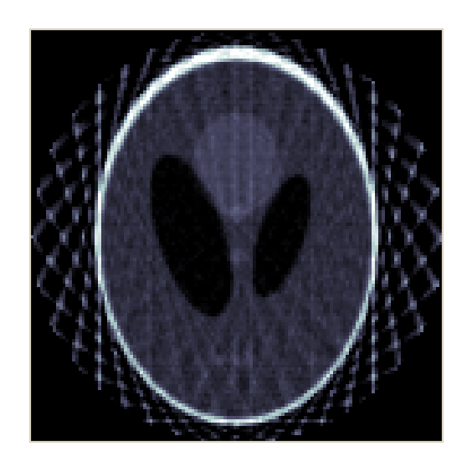
Form 1: an explicit learned regularizer
x̂ = arg min_{x} D(y, Ax) + λ Rφ(x)
R_{φ} : R^{n} → R
network Rφ
one scalar “energy”
candidate x
Input: a candidate state or image x. Output: one number.
Low Rφ(x): plausible. High Rφ(x): implausible.
The optimizer stays explicit; only the prior term is learned.
11

Slide 40
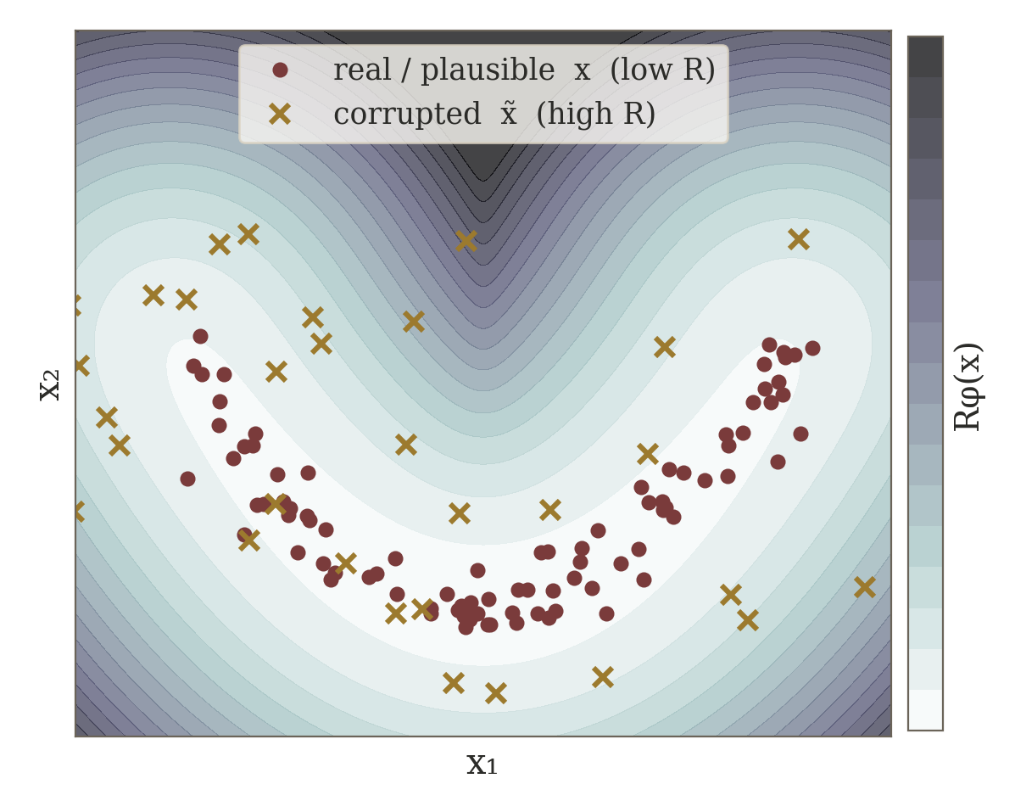
How can the explicit regularizer be trained?
R_{φ}(x_{real}) < R_{φ}(x̃_{bad})
view: R_{φ}(x) ≈ −log p_{φ}(x)
Separate: train Rφ on real vs. corrupted / unrealistic states (ranking or energy loss), freeze, plug in.
End-to-end: unroll the reconstruction and train Rφ for final reconstruction quality.
Once Rφ is frozen, the inverse solver only needs its gradient with respect to x.
12
Notes:
Toy picture: the energy shown is -log of a density fitted to plausible samples (a Gaussian mixture standing in for a trained network). Real samples sit in the low-energy valley; corrupted versions land on the high-energy slopes. A ranking loss enforces exactly this ordering.

Slide 41
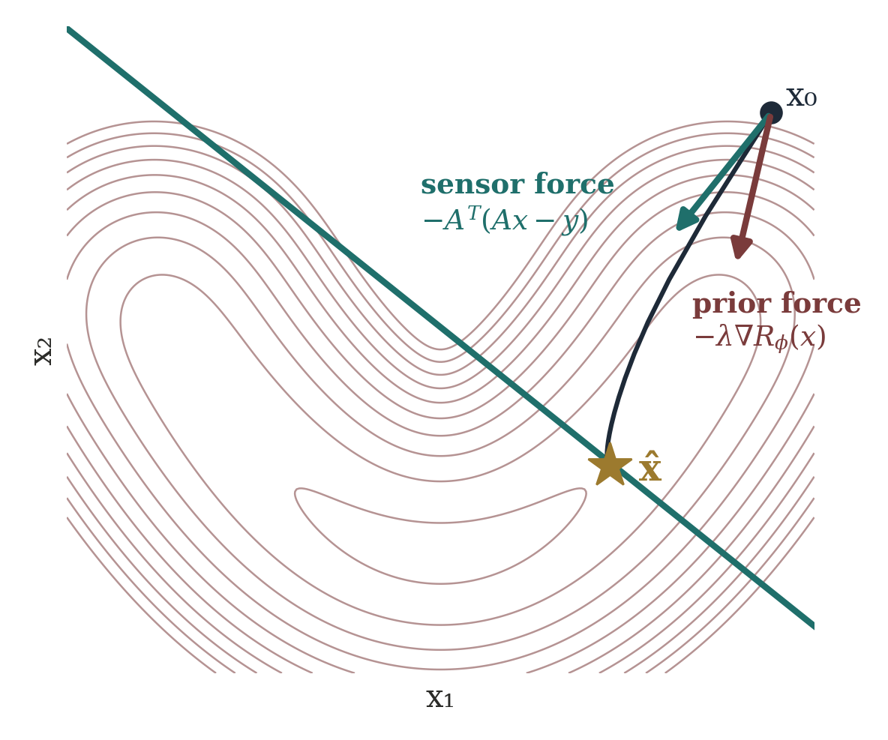
What does the optimizer do with a scalar?
x_{k+1} = x_{k} − η [ A^{T}(Ax_{k} − y) + λ∇_{x}R_{φ}(x_{k}) ]
Sensor force: pull toward the measured data.
Prior force: the direction that reduces learned implausibility.
The network never outputs the reconstruction — it shapes the landscape.
Sparse-view CT: one force pushes toward the projections, the other toward plausible anatomy.
13
Notes:
The 2D figure is a real gradient-descent run on D + lambda R with R = -log p from the toy density. At x0 the two unit arrows show the sensor and prior forces; the iterate converges to the point on the measurement line that is also plausible. Note the landscape has another intersection on the left arm — initialization and lambda matter.

Slide 42
Form 2: Learned Proximal / Denoiser
Learn the correction step instead of writing R(x)
14

Slide 43
Form 2: Learn the Proximal/Denoiser
(proximal is a mechanism, not “sparsity”)
z_{k} = x_{k} + η A^{T}(y − Ax_{k}), x_{k+1} = prox_{ηλR}(z_{k})
data-consistency
gradient step
prior / proximal
step
repeat
Prior R(x) | Its proximal step
‖x‖₁ (sparsity) | soft-thresholding (ISTA)
TV(x) | a TV-denoising problem
other priors | a different correction operator
“Proximal” names how a prior is enforced — broader than sparsity or any activation function.
15

Slide 44
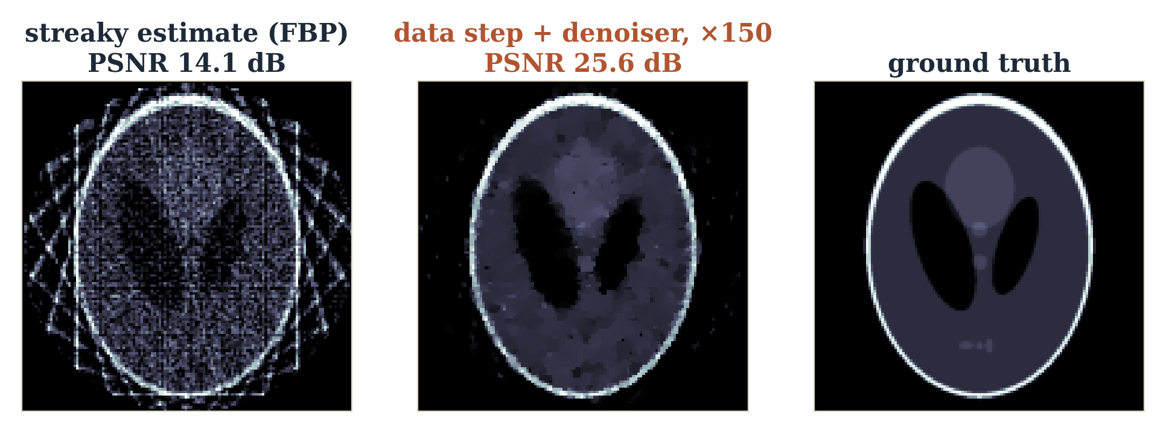
Learn the proximal action instead of R(x)
x_{k+1} = D_{φ}( x_{k} + η A^{T}(y − Ax_{k}) )
Input: a measurement-corrected but imperfect zₖ. Output: a corrected state of the same size.
Dφ may be a CNN, U-Net, ResNet or transformer.
“Denoising” includes noise, aliasing, streaks, ringing — any artifact.
16
Notes:
Real run: 12-view sparse CT with 2% noise, plug-and-play FISTA for 150 iterations. The denoiser here is TV (Chambolle) standing in for a learned D_phi — the slot a CNN or U-Net would occupy. PSNR goes from 14.1 dB (FBP) to 25.6 dB.

Slide 45
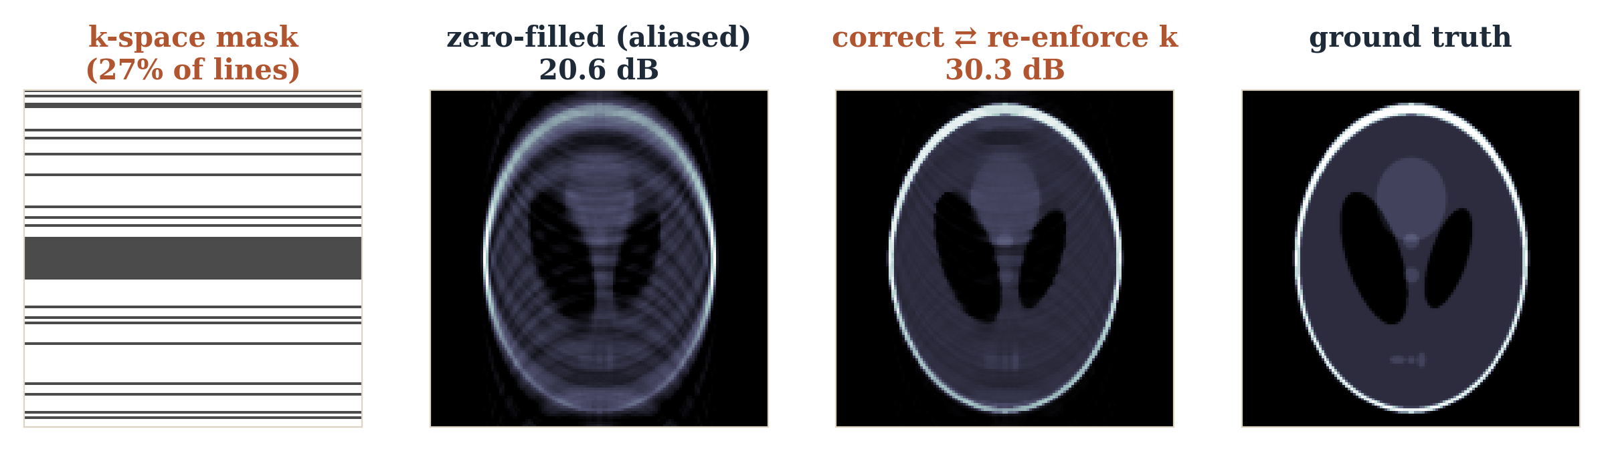
How is a learned denoiser trained?
separate: min_{φ} ‖D_{φ}(x̃) − x*‖²
end-to-end: min_{φ} ‖x_{K}(y; φ) − x*‖²
Separate: make corrupted / clean pairs, train Dφ, freeze it, insert it in the loop.
End-to-end: unroll K steps and train Dφ for this inverse task — task-specific correction, not generic denoising.
MRI loop: undersampled k-space → data consistency → learned correction → repeat.
17
Notes:
Real simulation: Cartesian undersampling keeps 27% of phase-encode lines (16 central + random). Zero-filled inverse FFT is aliased (20.6 dB). Alternating a correction step (TV, standing in for D_phi) with re-inserting the measured k-space lines reaches 30.3 dB after 80 iterations.

Slide 46
Explicit regularizer vs. learned proximal
Rφ(x)
Dφ(x)
“How bad is this x?”
“How should I improve this x?”
outputs a scalar
outputs a corrected signal / image
enters through ∇Rφ in the objective
replaces the proximal step directly
Both are learned priors. The denoiser route is often easier to deploy: it learns the correction action directly.
18

Slide 47
Form 3: Generative and Score Priors
Model the whole plausible set — or the direction toward it
19

Slide 48
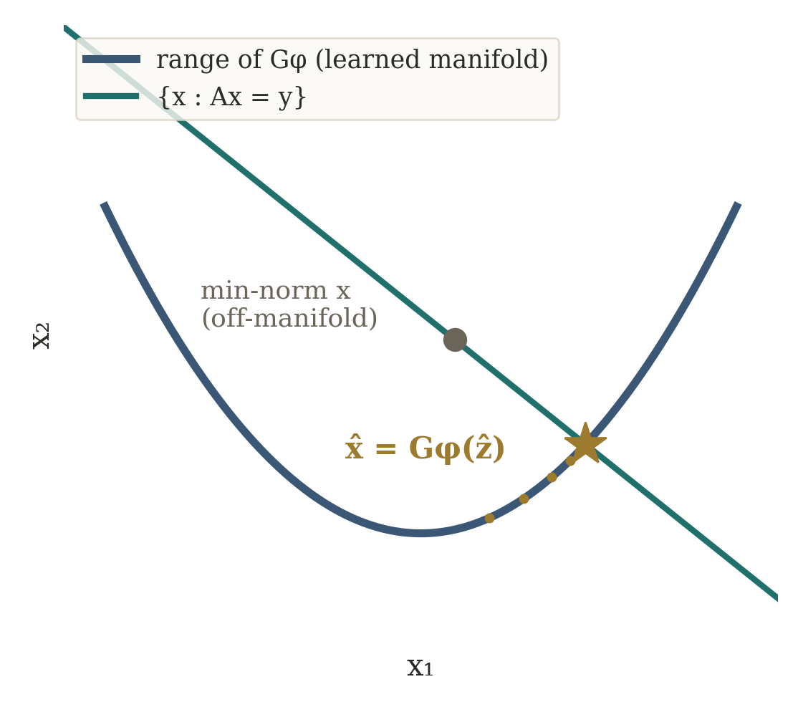
Form 3: a generative prior
z ~ p(z), x = G_{φ}(z)
ẑ = arg min_{z} D(y, AG_{φ}(z))
x̂ = G_{φ}(ẑ)
G is trained on examples of plausible states.
Reconstruction is restricted to what G can produce.
Far stronger than “smooth” or “sparse”.
CT: search only among anatomically plausible images, then pick the one that best explains the projections.
20

Slide 49
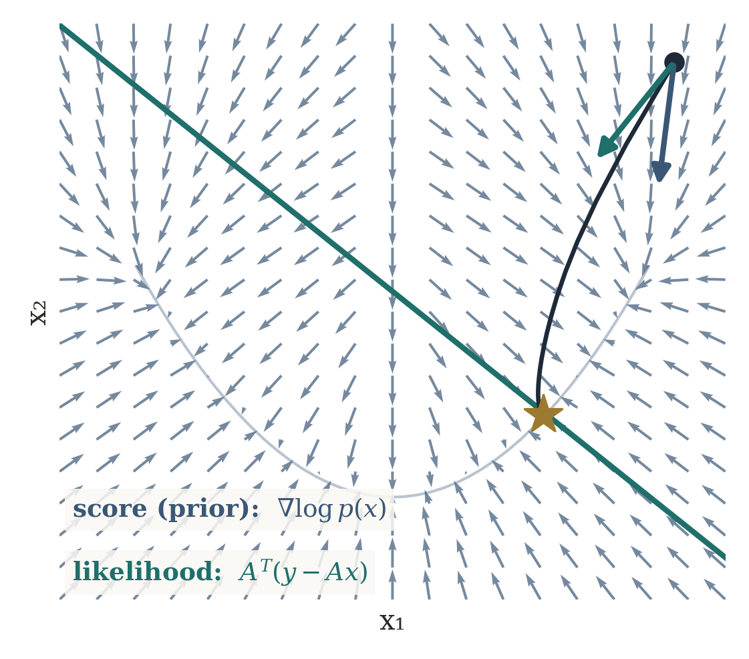
Score prior: a direction toward probability
s_{φ}(x, t) ≈ ∇_{x} log p_{t}(x)
∇log p(x|y) = ∇log p(y|x) + ∇log p(x)
Input: noisy state xₜ and noise level t.
Output: a vector the size of x, pointing to more probable states.
Gaussian noise: likelihood direction ∝ Aᵀ(y − Ax).
Posterior direction = measurement consistency + learned plausibility — the same two forces, now as vectors.
21
Notes:
Keep diffusion mechanics light. The quiver field is the exact score of the toy density; the dark path is gradient ascent on log p(x|y) = score + likelihood, ending on the measurement line inside the plausible set.

Slide 50
Training input / output summary
Model | Input | Output | Training signal
Explicit Rφ | state x | scalar Rφ(x) | plausible < implausible
Learned proximal Dφ | imperfect x̃ | corrected x | corrupted→clean, or end-to-end
Generator Gφ | latent z | plausible x | distribution of real x
Score sφ | noisy xₜ, t | direction | clean x + controlled noise
In every row the forward model A is not learned — it stays in the solver.
23

Slide 51
How each form enters the inverse
Form | How it is used | Intuition
Explicit regularizer | add to objective, differentiate | score plausibility
Learned proximal | replace the proximal step | correct toward plausible
Generative prior | search the generator's range | stay on learned manifold
Score prior | add to likelihood direction | climb toward high probability
Spend most class time on the first two rows — they build directly on MAP, regularization, ISTA and LISTA.
24

Slide 52
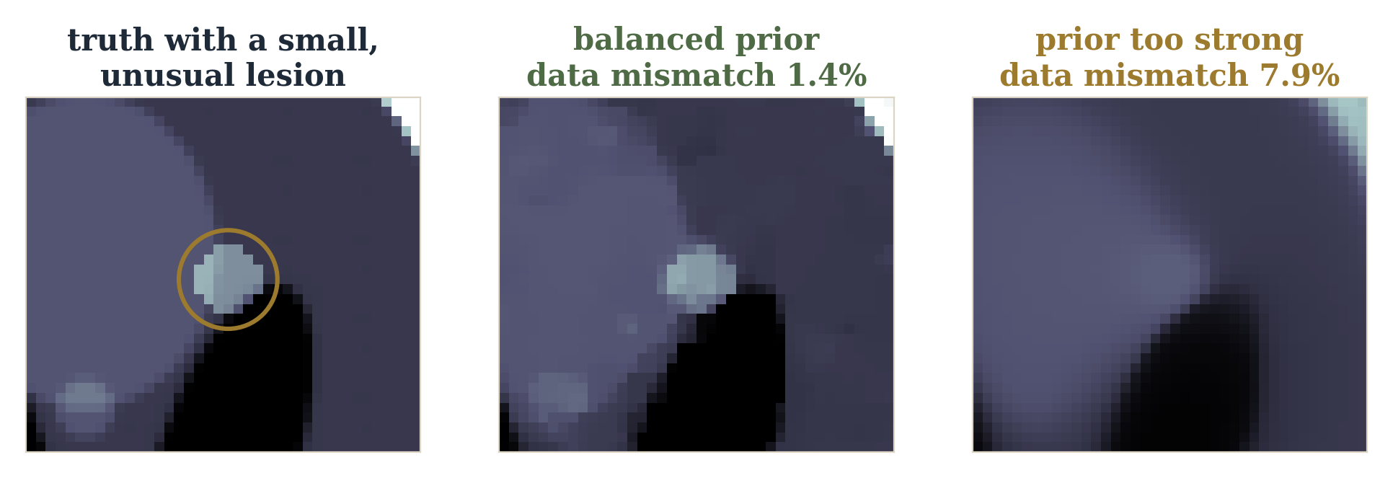
Plausibility must not overpower evidence
Too large a λ or too strong a prior hides unusual but real structure (here a small lesion).
A strong prior can give a plausible-looking answer that no longer matches the measurements (1.4% → 7.9% mismatch).
Keep measurement consistency explicit whenever the forward model is trustworthy.
Known physics → what can explain y. Learned prior → which explanations are plausible.
26
Notes:
Real 24-view CT run with a 3.5-pixel lesion added to the phantom. Same plug-and-play solver; only the prior strength changes (TV weight 3e-4 vs 1e-2). The strong prior removes the lesion and the data residual rises from 1.4% to 7.9% — the reconstruction is 'cleaner' but no longer explains the measurements. Next: learned iterative reconstruction, where the prior block and parts of the optimizer are trained together while the sensing physics remains explicit.

Slide 53
Summary: three ways to learn the prior
known A + learned prior
scalar energy
Rφ(x)
correction
Dφ(x)
distribution / score
pφ(x), ∇log pφ(x)
Next: learned iterative reconstruction — train the prior block and parts of the optimizer together, while the sensing physics stays explicit.
27

Slide 54
3 Learn / Unroll the Optimizer
When the objective is principled but repeated numerical optimization is too slow
31

Slide 55
Keep the objective. Learn the solver.
The purpose of this section: show that a neural-network architecture can be derived from a known numerical algorithm — the most concrete bridge from optimization to deep learning in this course.
principled objective,
slow generic solver
unroll K iterations
into K trainable stages
The architecture inherits the inverse algorithm rather than being chosen arbitrarily.
32

Slide 56
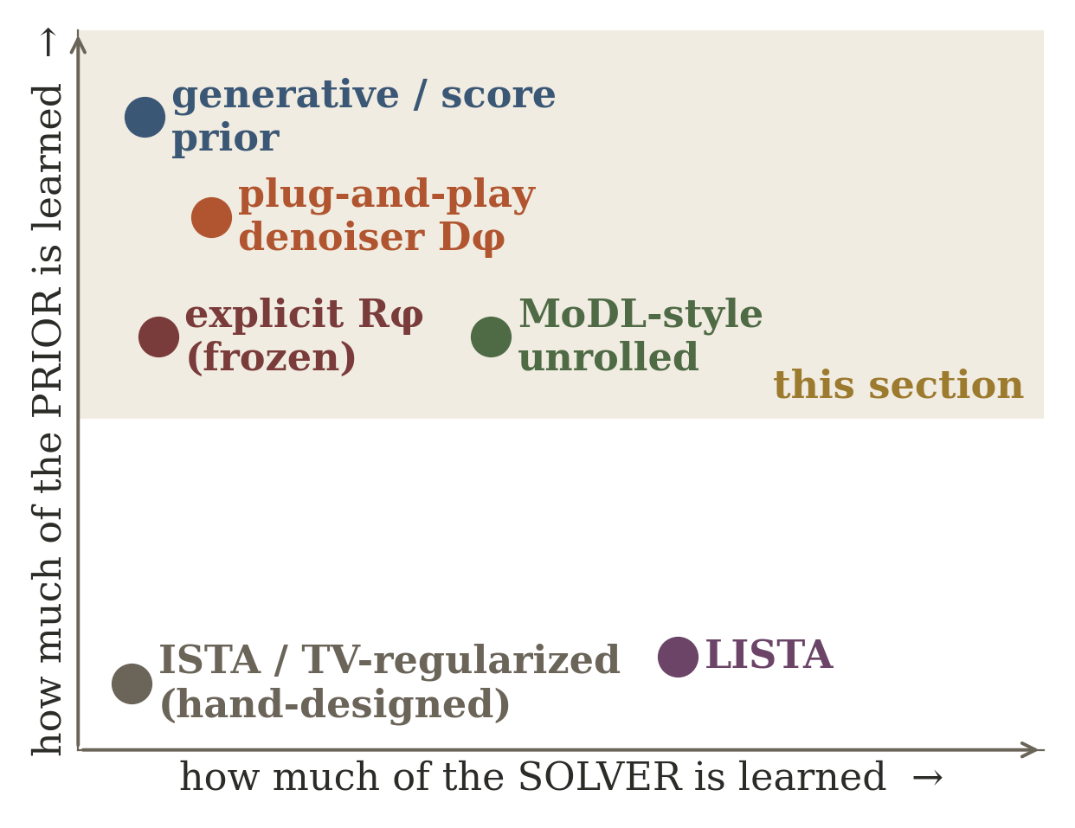
Where does this sit relative to LISTA?
LISTA: learn the solver
learned prior: learn x
LISTA learns how to optimize a sparse problem faster.
Learned priors learn what plausible x looks like.
Unrolled methods (MoDL) do both: A fixed, prior block learned, steps optionally learned.
Two independent axes: “what is learned?” — the solver, the prior, or both.
25

Slide 57
By the end, students should be able to…
1
2
3
derive GD
trace backprop
explain unrolling
and the role of curvature in a stable step
state vs. trainable parameters
finite graph; tied vs. untied
4
5
6
derive ISTA
derive LISTA
map to sensing
proximal gradient for least squares + ℓ1
from the ISTA update; say what is learned
ISTA/LISTA for radar DOA
3

Slide 58
3 Learn / Unroll the Optimizer
a
Gradient descent: local slope gives the direction
b
Curvature: L sets the step scale; least squares L = ‖A‖₂²
c
Backprop: differentiates a composed graph w.r.t. parameters
d
Unrolling: K iterations → K-stage graph; tying is separate
e
ISTA: gradient on the data term, prox on the sparse prior
f
LISTA: the ISTA layer as a trainable finite-depth solver
g
Radar DOA: A = array physics, Aᴴ(Ax − y) = backprojected error
44

Slide 59
3.a) Gradient Descent and Backpropagation
Start with geometry, not the update equation
4

Slide 60
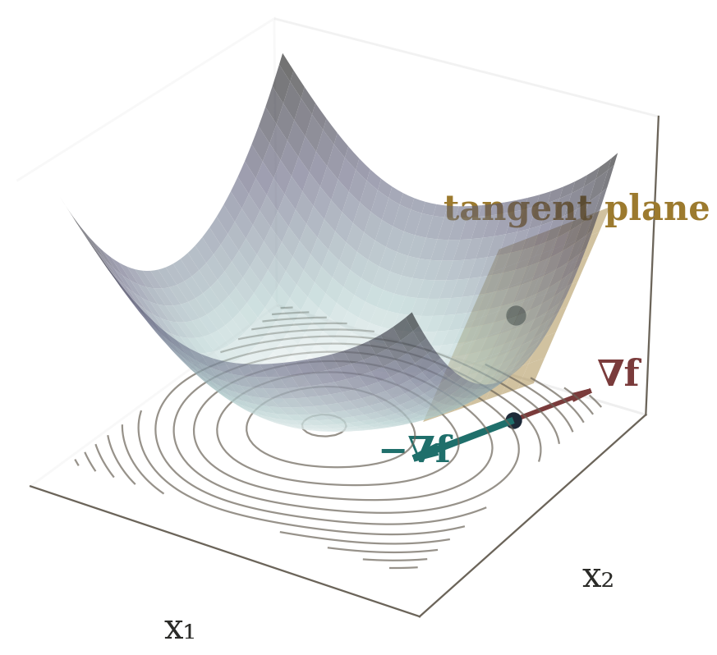
Gradients
f(x + Δx) ≈ f(x) + ∇f(x)^{T}Δx
Δx = −α∇f(x)
f(x + Δx) ≈ f(x) − α‖∇f‖₂²
x_{k+1} = x_{k} − α∇f(x_{k})
The tangent plane is a local linear model; −∇f is its steepest descent.
“The first-order picture gives the direction — not how far the tangent model stays trustworthy.”
5
Notes:
Do not yet call alpha a hyperparameter to tune. Say: the first-order picture tells us the direction, but it does not tell us how far the tangent model remains trustworthy. That is a curvature question, and we answer it next.

Slide 61
3.b) Step Size from Curvature
The learning rate is not born empirically
9

Slide 62
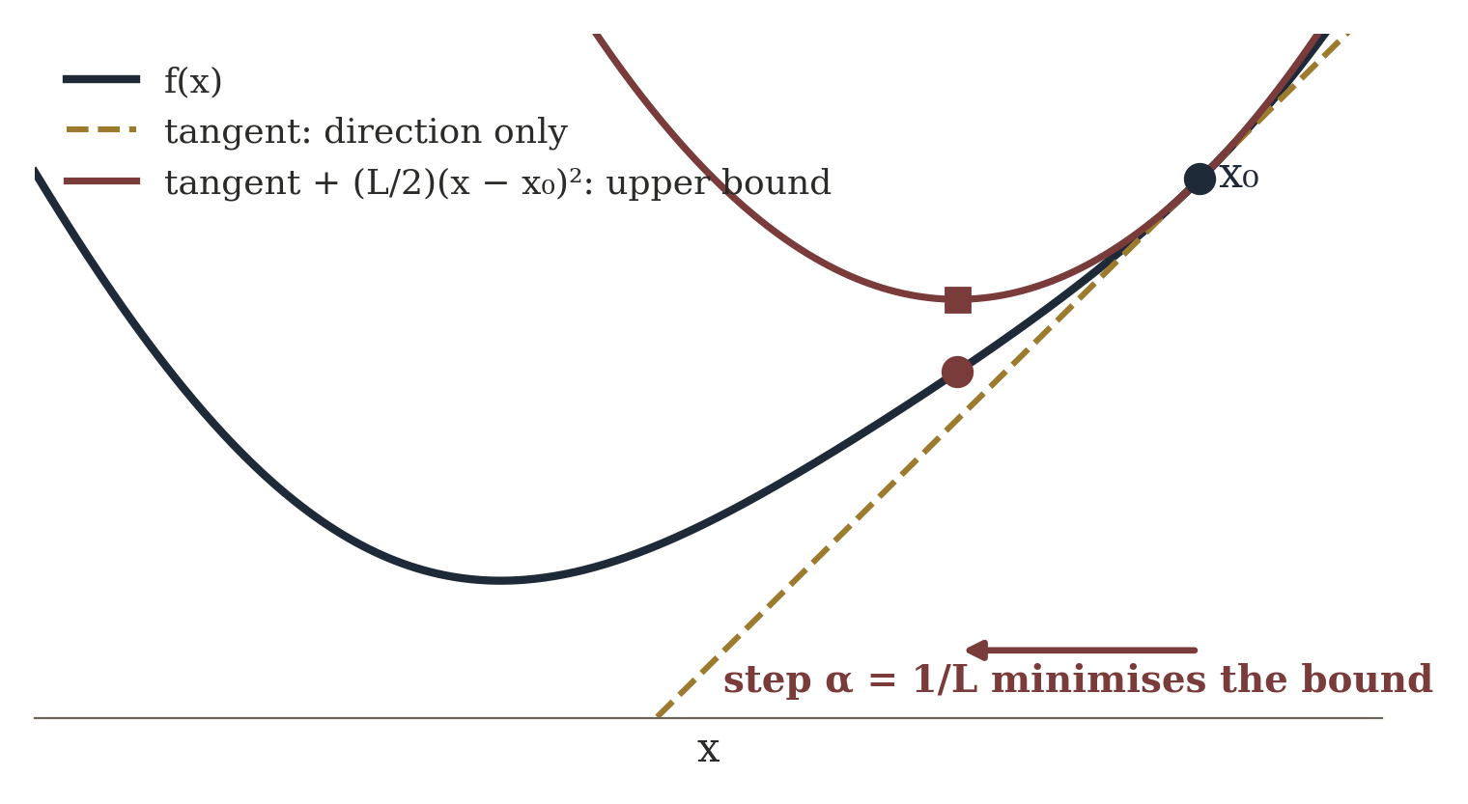
Tangent -> direction. Curvature -> distance.
f(x − αg) − f(x) ≈ −α‖g‖² + (α²/2) g^{T}Hg, H = ∇²f
Large curvature makes the quadratic term grow fast: a step can overshoot even when it points the right way.
10

Slide 63
Lipschitz gradient: a global curvature bound
‖∇f(x) − ∇f(z)‖ ≤ L‖x − z‖
f(x + Δ) ≤ f(x) + ∇f(x)^{T}Δ + (L/2)‖Δ‖² (descent lemma)
f(x_{k+1}) ≤ f(x_{k}) − α(1 − αL/2)‖∇f(x_{k})‖²
Step size | What the bound gives
0 < α < 2/L | guaranteed decrease (smooth GD)
α ≤ 1/L | standard conservative choice
0 < α ≤ 1/L | canonical safe step for ISTA
When L is unknown: backtracking line search.
11

Slide 64
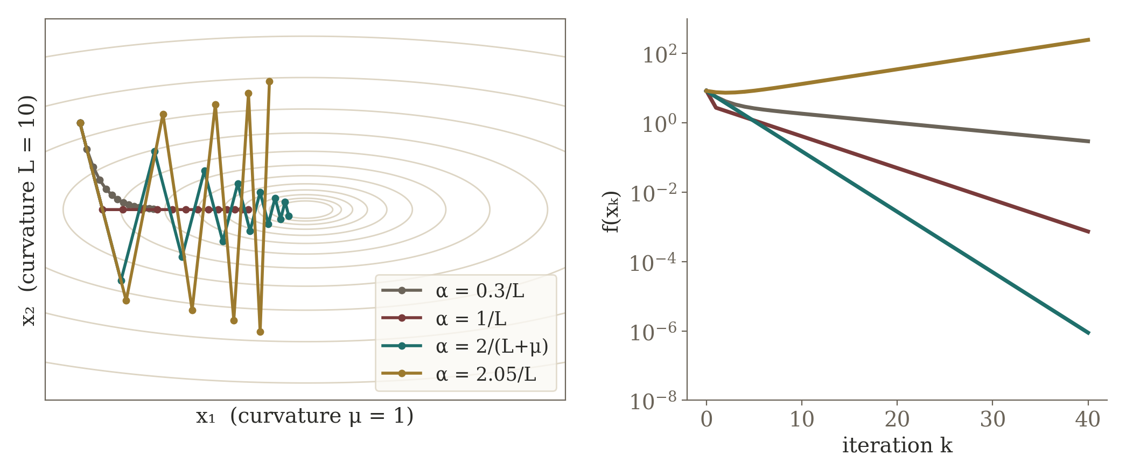
Least squares: the bound becomes concrete
f(x) = ½‖Ax − y‖², ∇f = A^{T}(Ax − y), H = A^{T}A
L = λ_{max}(A^{T}A) = ‖A‖₂² ⇒ α ≤ 1/‖A‖₂²
Same quadratic (μ = 1, L = 10, κ = 10); only α changes. The largest-curvature direction sets the stability limit; 2/(L+μ) is the best fixed step.
12

Slide 65
A common misconception about 1/L
misconception
correction
“α = 1/L is always the fastest possible step.”
1/L is a standard safe choice. With known μ and L, 2/(L+μ) is the optimal fixed step (worst case). Momentum, preconditioning, line search — or learned layer-wise steps — can do better.
“The learning rate can still be tuned empirically, but it is not born empirically. Analysis gives the scale; tuning chooses within it.”
κ = L/μ decides how badly an elongated valley slows first-order descent.
13

Slide 66
Two gradients, two jobs
inside an inverse solver
while training a network
∇ₓf(x) tells the algorithm how to update the current estimate xₖ.
The state x changes every iteration, for every new measurement y.
∇θL tells backprop how to update trainable parameters θ.
θ changes during training, then is frozen for inference.
min_{θ} L(θ) = (1/N) Σ_{i} ℓ(f_{θ}(x_{i}), y_{i}), θ_{t+1} = θ_{t} − η∇_{θ}L
LISTA contains both: at inference only the state update remains; training shaped its parameters.
6

Slide 67
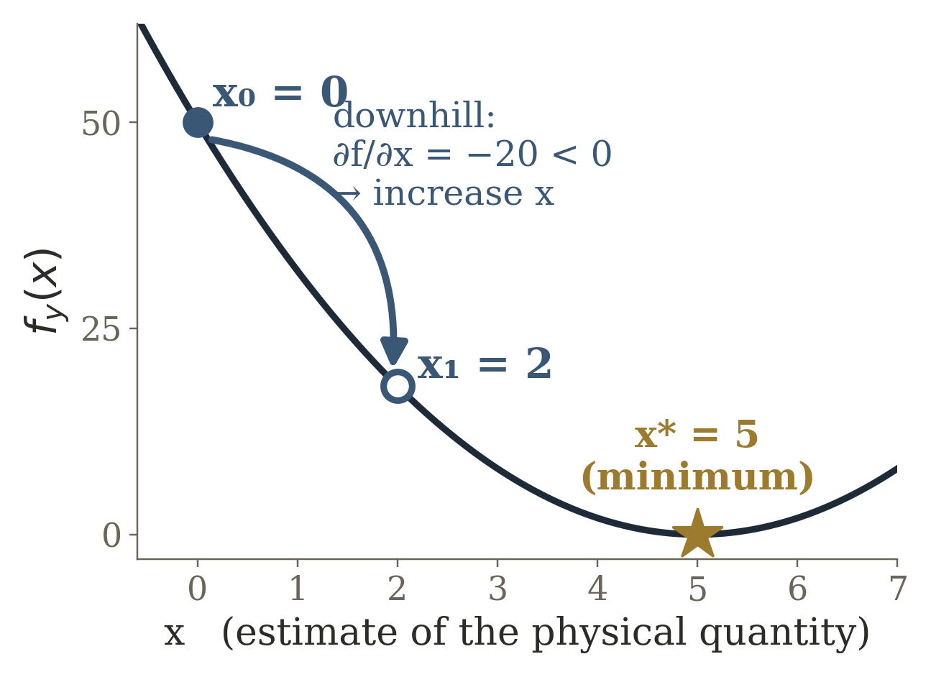
What is x? What is θ?
x unknown quantity
sensor: y = 2x
measured y = 10
f_{y}(x) = ½ (2x − y)²
how badly does x explain y?
x_{k+1} = x_{k} − α ∂f/∂x
∂f/∂x = 2(2x − y) = 4x − 2y
x₀ = 0, y = 10, α = 0.1
∂f/∂x at x₀ = 0: 2(0 − 10) = −20
x₁ = 0 − 0.1(−20) = 2
x : 0 → 2
x is the answer we are trying to compute for THIS measurement.
α = 0.1: a setting we chose by hand. Nothing learned yet.
∇_{x}f changes the CURRENT SOLUTION.
Notes:
BUILD ORDER (click): 1 sensor row; 2 objective + parabola; 3 gradient-descent update; 4 numbers and x: 0 → 2; 5 banner.
A sensor doubles the physical quantity: y = 2x. We measure y = 10, so the true value is x* = 5. The reconstruction objective f_y(x) = ½(2x − y)² scores how badly a candidate x explains this measurement. Starting from x0 = 0 the slope is −20, so gradient descent moves right: x1 = 0 − 0.1(−20) = 2. Stress: x is the answer for THIS measurement — a new y gives a new x. α = 0.1 is a setting we picked; nothing is learned yet.

Slide 68
Now make the solver itself trainable
x₁ = x₀ −
α
∂f/∂x(x₀)
Why must I choose α by hand?
α → θ trainable
x₁(θ) = x₀ − θ ∂f/∂x(x₀) = 20θ
with θ = 0.1: x₁ = 2
forward: θ decides x₁ decides L
TRAINING: we know the answer x* = 5
θ
x₁
L
L(θ) = ½ [ x₁(θ) − x* ]²
backward: L → x₁ → θ
= ½ (20θ − 5)²
θ : 0.10 → 0.16
∂L/∂θ = (20θ − 5)·20 = −60 at θ = 0.1
θ_{new} = θ − β ∂L/∂θ (β = 0.001)
now x₁ = 3.2, closer to x* = 5
= 0.1 − 0.001(−60) = 0.16
x changed because we were solving a sensing problem.
θ changed because we were learning how the solver should behave.
∇_{x}f improves the ANSWER
∇_{θ}L improves the SOLVER
Notes:
BUILD ORDER (click): 1 the familiar update; 2 circle α; 3 ask “Why must I choose this by hand?”; 4 replace α by a trainable θ; 5 x1(θ) = 20θ; 6 reveal x* = 5 and the training loss L; 7 forward dependency θ → x1 → L; 8 backward arrows L → x1 → θ; 9 ∂L/∂θ = −60 and the update θ: 0.10 → 0.16; 10 left/right contrast and the two-part banner.
Same measurement (y = 10, x0 = 0, ∂f/∂x = −20), so one step gives x1(θ) = 20θ. With θ = 0.1 we land at 2, but the right answer is 5, so the training loss is L(θ) = ½(20θ − 5)². Its derivative at θ = 0.1 is −60: increasing θ lowers the error. A small training step (β = 0.001) moves θ to 0.16, and the same one-step solver now outputs 3.2. (The best one-step θ for this problem is 0.25.) Close with: we have learned a parameter of the algorithm — not the answer itself.

Slide 69
Two gradients, two jobs
STATE UPDATE — solving one problem
y = 10
measured
objective
f_{y}(x)
∇_{x}f
x: 0 → 2 → …
estimated
quantity x
For a particular measurement, move x toward the solution.
PARAMETER UPDATE — learning the solver
(y, x*)
training pair
solver
θ
x₁(θ)
loss L =
½‖x₁−x*‖²
∇_{θ}L
θ →
better θ
Across many training examples, change the algorithm that produces x.
x | θ
current solution | solver parameter
depends on y | shared by all problems
changes at inference | frozen at inference
updated by ∇ₓf | updated by ∇θL
θ → x₁(θ) → L
∂L/∂θ = ∂L/∂x₁ · ∂x₁/∂θ
= (2 − 5) · 20 = −60
Backprop: how does the error change if θ changes?
x is the answer. θ describes how the algorithm produces the answer.
∇ₓf : solve the problem · ∇θL : learn the solver
Notes:
BUILD ORDER (click): 1 state-update pipeline; 2 parameter-update pipeline; 3 comparison table; 4 chain rule; 5 banner.
Chain rule with the numbers from the previous slide: ∂L/∂x1 = x1 − x* = 2 − 5 = −3 and ∂x1/∂θ = −∂f/∂x(x0) = 20, so ∂L/∂θ = −60. Backprop is exactly this bookkeeping: it traces how a change in the solver parameter propagates through the solver's output into the loss.
TRANSITION to the next slide: “But real optimization uses many iterations. How do we train θ based on the result after K steps?” — this is the question that motivates algorithm unrolling.

Slide 70
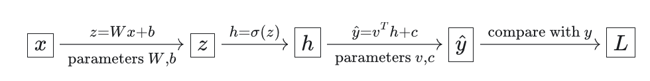
Backpropagation on a tiny network
z = Wx + b, h = σ(z), ŷ = v^{T}h + c, L = ½(ŷ − y)²
forward: store values →
x
z
h
ŷ
L
← backward: multiply local derivatives
δŷ = ŷ − y ∂L/∂v = δŷ h, ∂L/∂c = δŷ
δh = δŷ v
δz = δh ⊙ σ′(z)
∂L/∂W = δz x^{T}, ∂L/∂b = δz
Board: write δŷ, then δh, then δz — ask which local derivative each arrow multiplies. Only then write ∂L/∂W.
7

Slide 71
Nondifferentiable is not the end
Backprop needs local derivatives along the graph. ReLU (kink at 0) and soft-thresholding (kinks at ±τ) are differentiable almost everywhere; autodiff uses a valid subgradient at isolated kinks.
backprop through a kink
optimising a nonsmooth objective
fine: piecewise-differentiable operators train normally (ReLU networks, unrolled ISTA).
different issue: ‖x‖₁ has no ordinary gradient at 0 — proximal methods solve that term exactly.
Ask: if ReLU is nondifferentiable at zero, why can we train ReLU nets? Then: should we just take a gradient of ‖x‖₁ at zero? (No.)
8

Slide 72
3.c) Unrolling
Turn an iterative algorithm into a finite computation graph
14

Slide 73
Unrolling
x_{k+1} = F(x_{k}, y; θ), GD: F(x_{k}, y; α) = x_{k} − α∇_{x}f(x_{k}; y)
x_{K} = F( F( ⋯ F(x₀, y; θ) ⋯ , y; θ), y; θ)
x₀
F
F
F
F
x_{K}
The nested expression is already a depth-K computation graph; y enters every stage.
Unrolling is a representation before it is a learning method. Learning enters only when we expose parameters and fit them to data.
15

Slide 74
Tied vs. untied unrolling
tied: θ₁ = θ₂ = ⋯ = θK (one recurrent cell, applied K times)
x₀
Fθ
Fθ
Fθ
Fθ
untied: each stage has its own θₖ
x₀
Fθ₁
Fθ₂
Fθ₃
Fθ₄
Two independent choices | Consequence
unroll or not? | explicit K-stage graph, end-to-end gradients
untie? | more expressive, more parameters
tie? | closer to the algorithm; extrapolates to more K
Repeated application of one layer = a tied unrolled graph.
16

Slide 75
What need leads to unrolling?
Not “solve to arbitrary precision”, but:
Given this distribution of sensing problems, produce a sufficiently accurate answer in exactly K stages, with predictable latency and memory.
what data can tune inside the fixed skeleton
step sizes
precon-
ditioners
thresholds
transforms
Learning decides how to spend a fixed computational budget.
The algorithmic skeleton keeps its model-based structure (forward/adjoint of A).
17

Slide 76
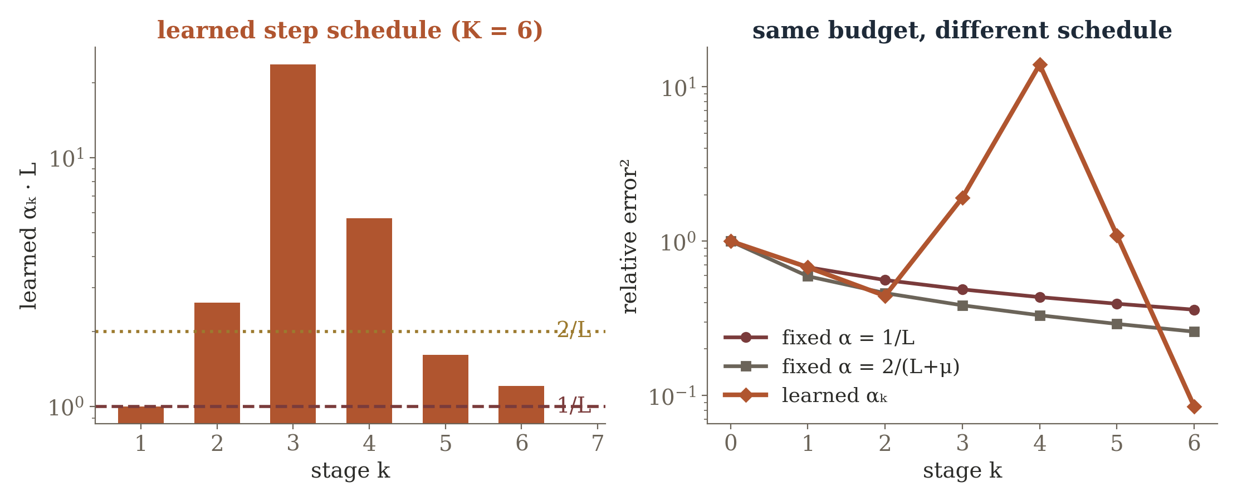
Warm-up: learned gradient descent
x_{k+1} = x_{k} − α_{k}A^{T}(Ax_{k} − y) x_{k+1} = x_{k} − P_{k}A^{T}(Ax_{k} − y)
learn how far · learn scale + rotation
Real run: least squares with κ(AᵀA) = 100, K = 6 learned αₖ. Error after 6 stages: 0.36 (α = 1/L), 0.26 (2/(L+μ)), 0.085 (learned). Some learned steps exceed 2/L — unstable alone, but the 6-step product is not.
18
Notes:
The learned schedule (alpha_k * L = 1.0, 2.6, 23.6, 5.7, 1.6, 1.2) rediscovers the Chebyshev idea: large steps kill low-curvature error components, small steps clean up the ones they amplified. This is why backprop was reviewed first: the K stages are just a deeper computation graph, and the loss at x_K sends gradients back through all of them. Learned P_k (preconditioners) are more aggressive and weaken guarantees.

Slide 77
3.d) ISTA
Gradient descent plus an exact step for sparsity
19

Slide 78
The problem plain GD does not handle cleanly
min_{x} ½‖Ax − y‖₂² + λ‖x‖₁
f(x): smooth data fidelity
g(x) = λ‖x‖₁: nonsmooth
take an ordinary gradient step
|xᵢ| has a kink at 0 — solve its step exactly
Smoothing |x| changes the problem and weakens exact sparsity.
ISTA’s contribution is not “add thresholding”: it is the proximal-gradient split — gradient on f, exact proximal step on g.
20

Slide 79
Derivation of the proximal-gradient step
quadratic upper model (α = 1/L)
f(x) ≤ f(x_{k}) + ∇f(x_{k})^{T}(x − x_{k}) + (L/2)‖x − x_{k}‖²
add g, complete the square
x_{k+1} = arg min_{x} (1/2α)‖x − (x_{k} − α∇f(x_{k}))‖² + λ‖x‖₁
which is a proximal operator
= prox_{αλ‖·‖₁}( x_{k} − α∇f(x_{k}) )
for f = ½‖Ax − y‖²:
z_{k} = x_{k} − αA^{T}(Ax_{k} − y), x_{k+1} = S_{αλ}(z_{k})
21

Slide 80
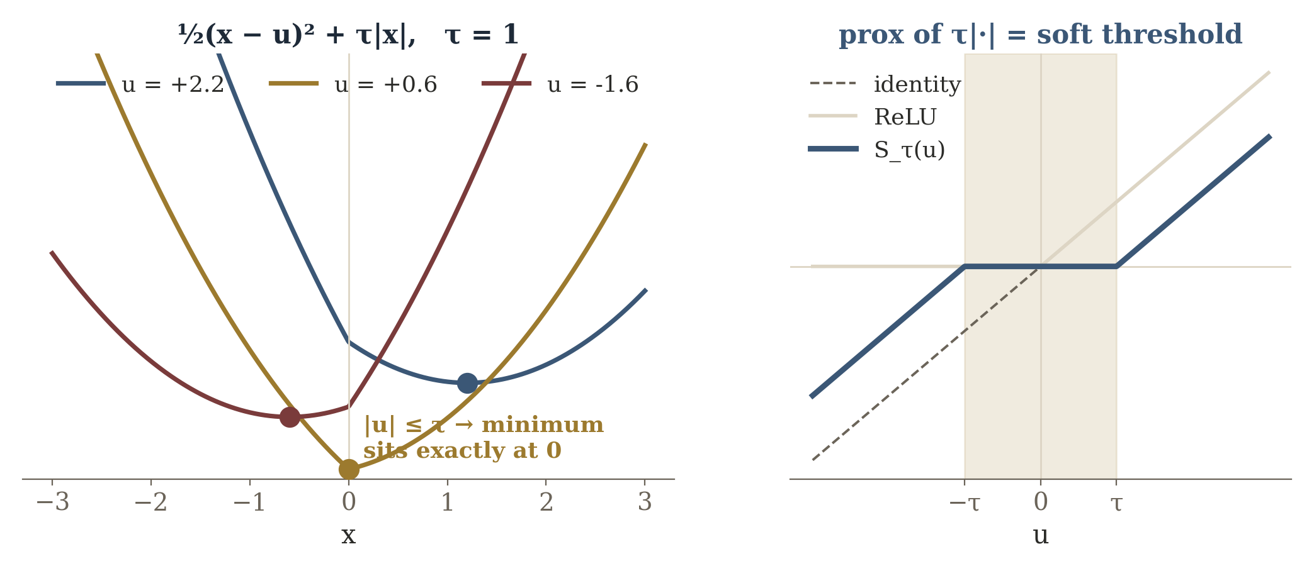
Why the prox becomes soft-thresholding
prox_{τ|·|}(u) = arg min_{x} ½(x − u)² + τ|x| = sign(u) max(|u| − τ, 0)
Separable across coordinates. By cases: x > 0 ⇒ x = u − τ; x < 0 ⇒ x = u + τ; if |u| ≤ τ neither is consistent, so the optimum sits exactly at 0.
The “dead zone” is derived, not chosen as an activation function.
22

Slide 81
ISTA, line by line, in sensing language
Step | Math | Sensing meaning
1 residual | rₖ = Axₖ − y | predicted vs. measured data
2 adjoint | gₖ = Aᵀrₖ = ∇f(xₖ) | backproject the mismatch
3 smooth step | zₖ = xₖ − αgₖ | data-consistency correction
4 prox step | xₖ₊₁ = Sαλ(zₖ) | apply the sparse prior
Input: A, y, λ, step 0 < α ≤ 1/‖A‖₂². Initialise x₀ = 0. Repeat K times.
A is the forward physics; Aᵀ maps measurement error back into the scene; shrinkage applies the prior.
23

Slide 82
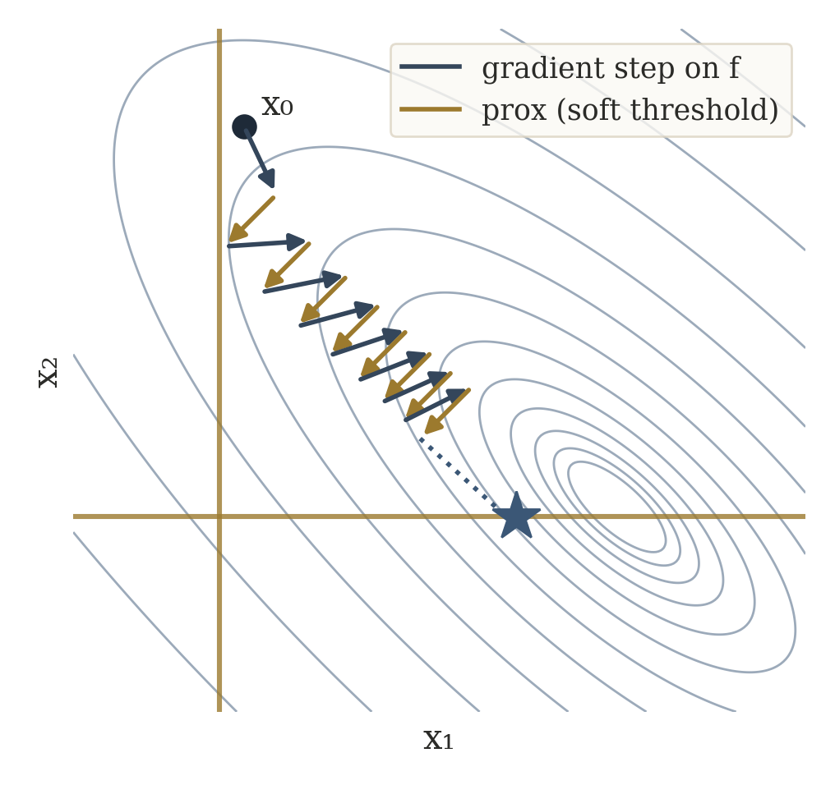
What ISTA contributes — and what it does not
Combines a smooth forward-model loss with a nonsmooth convex prior.
Convergence guarantees under standard assumptions.
But it can need many iterations.
If A and the problem distribution recur, can data learn a better finite-depth solver?
That question is exactly the opening for LISTA.
24

Slide 83
3.e) LISTA
Learn a finite-depth version of ISTA
25

Slide 84
Rewrite ISTA as a neural-network layer
x_{k+1} = S_{αλ}( (I − αA^{T}A) x_{k} + αA^{T}y )
x_{k+1} = S_{θ}( W_{e}y + W_{s}x_{k} ), W_{e} = αA^{T}, W_{s} = I − αA^{T}A, θ = αλ
y
W_{e}
+
S_{θ}(·)
x_{k+1}
W_{s}
xₖ (from the previous stage)
Linear maps + an elementwise nonlinearity: a single ISTA iteration already is a neural-network layer.
26

Slide 85
The LISTA move (Gregor & LeCun, 2010)
x_{k+1} = S_{θk}( W_{e}^{(k)}y + W_{s}^{(k)}x_{k} ), k = 0, …, K − 1
Train a fixed-depth feed-forward predictor that approximates sparse codes much faster than running the optimizer to convergence.
ISTA supplies a physically meaningful initialisation:
W_{e}^{(k)} ← αA^{T}, W_{s}^{(k)} ← I − αA^{T}A, θ_{k} ← αλ
Training then adapts the finite sequence of updates to the distribution of problems seen in data.
27

Slide 86
What is actually learned?
Variant | Learned | Interpretation
Step-LISTA | αₖ (and θₖ) | how far to move per stage
Threshold-LISTA | θₖ | sparsity schedule
Structured LISTA | constrained Wₑ, Wₛ | keep the link to A
Full LISTA | Wₑ⁽ᵏ⁾, Wₛ⁽ᵏ⁾, θₖ | most expressive
Tied LISTA | one Wₑ, Wₛ, θ | recurrent, fewer params
Untied LISTA | per-layer params | stage specialisation
Misconception: “LISTA learns A⁻¹.” It learns the parameters of an iterative sparse-inference architecture — still alternating a measurement-driven linear correction with a sparsity nonlinearity.
28

Slide 87
Training LISTA by backpropagation
Pairs (yᵢ, xᵢ*): ground-truth sparse scenes, or high-accuracy offline solutions. Run the K layers forward, then:
L(Θ) = (1/N) Σ_{i} ‖x_{K}(y_{i}; Θ) − x_{i}*‖², Θ = {W_{e}^{(k)}, W_{s}^{(k)}, θ_{k}}
optional deep supervision:
L(Θ) = Σ_{k} ω_{k} ‖x_{k} − x*‖²
forward:
K layers
loss at
last layer
backward:
∇Θ L
update Θ
Soft-thresholding is differentiable almost everywhere — backprop runs straight through the unrolled stages.
29

Slide 88
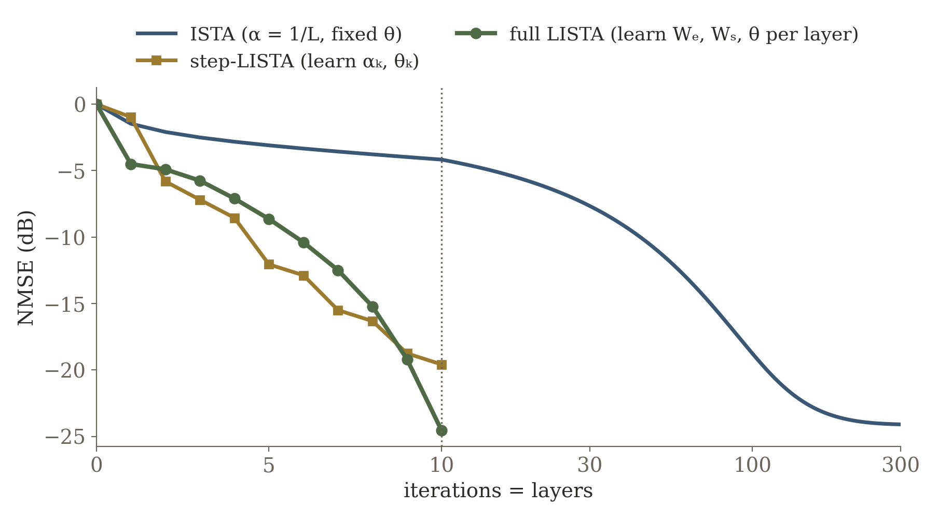
Why can LISTA be faster at a fixed depth?
Real run: A is 32 × 64 Gaussian, 4-sparse x, σ = 0.01, 10 layers, numpy-trained. At 10 stages — ISTA −4.2 dB, step-LISTA −19.6 dB, full LISTA −24.5 dB; ISTA needs ~300 iterations to reach −24 dB.
Ask: “If ISTA gets 10,000 iterations, must LISTA win?” No — LISTA’s edge is under a fixed inference budget.
30
Notes:
ISTA is designed to converge for a broad class of inputs; LISTA specializes to a data distribution. Learned matrices partly precondition dictionary correlations, thresholds change over stages, and untied layers act as specialized moves. Even step-LISTA, which learns only 2 numbers per layer, gets most of the gain here; its learned alpha_k*L alternates between ~1-3 and ~10 — the same large/small pattern as the learned-GD warm-up. Theory: Chen et al. (NeurIPS 2018) give structured parameterizations with linear convergence.

Slide 89
What is preserved, and what is sacrificed?
preserved / encouraged
at risk as learning grows
• known forward-model structure
• meaningful intermediate states
• fixed compute and latency
• less data than a generic network
• interpretable steps and thresholds
• exact optimization interpretation
• global convergence guarantees
• robustness outside training data
• easy transfer when A / hardware changes
The more of the layer we learn, the more speed we buy — and the more physics-derived guarantees we spend.
31

Slide 90
Sparse DOA Estimation in Radar
Every ISTA/LISTA symbol becomes a piece of hardware or physics
32

Slide 91
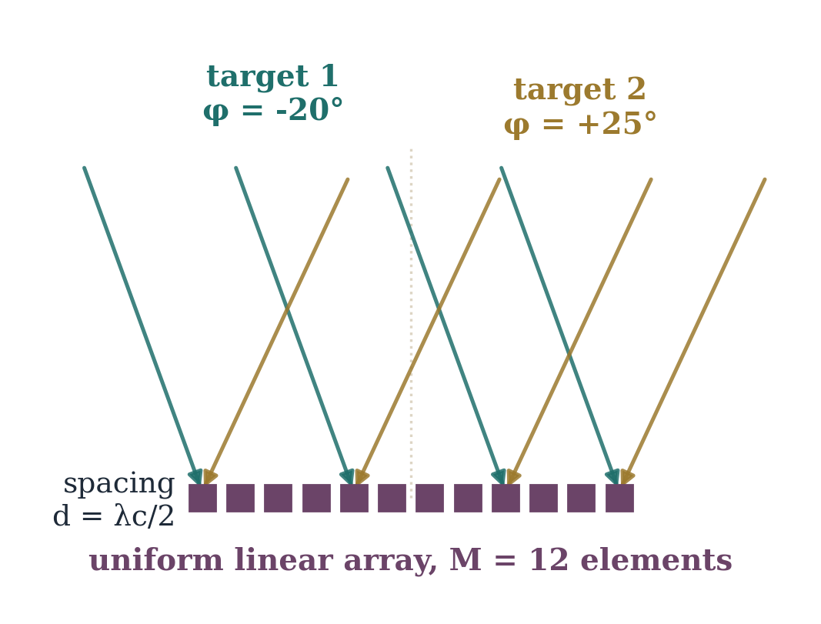
DOA example
After range-Doppler processing, one cell gives an array snapshot.
A few far-field targets superpose at the array.
Discretise G candidate angles → a steering dictionary.
a(φ) = (1/√M) [1, e^{j2π(d/λc) sin φ}, …, e^{j2π(M−1)(d/λc) sin φ}]^{T}
few targets ⇒ sparse x
33

Slide 92
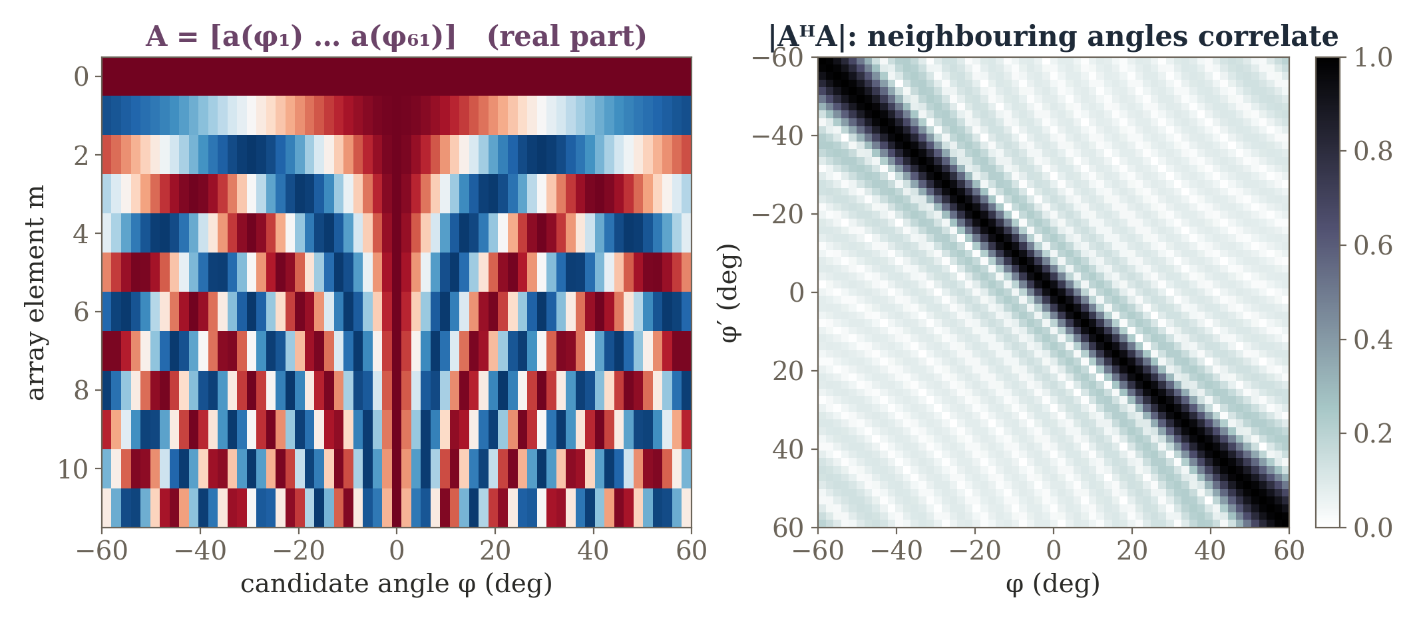
The physics fixes the dictionary
y = Ax + n, A = [a(φ₁), …, a(φ_{G})] ∈ C^{M×G}, x ∈ C^{G} sparse
12 elements, 61 bins from −60° to +60°. Neighbouring steering vectors are strongly correlated — the reason a generic ISTA step is slow here.
34

Slide 93
ISTA as array-processing operations
ISTA line | Radar meaning
rₖ = Axₖ − y | predicted-array mismatch
gₖ = Aᴴrₖ | matched filter / adjoint backprojection
zₖ = xₖ − αgₖ | data-consistency correction
xₖ₊₁ = Sαλ(zₖ) | suppress weak angular bins
Complex data: use Aᴴ (or stack real and imaginary parts); the complex soft threshold shrinks the magnitude and keeps the phase.
The update is not abstract: every term is a familiar array-processing operation.
35

Slide 94
Now map LISTA to the same hardware
x_{k+1} = S_{θk}(W_{e}^{(k)}y + W_{s}^{(k)}x_{k}), W_{e} ≈ αA^{H}, W_{s} ≈ I − αA^{H}A
training can adapt the operators to:
finite depth
typical target separations
noise level
array correlations
calibration mismatch
the chosen angle grid
Multiple snapshots / channels sharing support: group sparsity (MMV / group LASSO) — the scalar soft threshold becomes a group shrinkage, as in step-learned ISTA for FMCW MIMO radar.
36

Slide 95
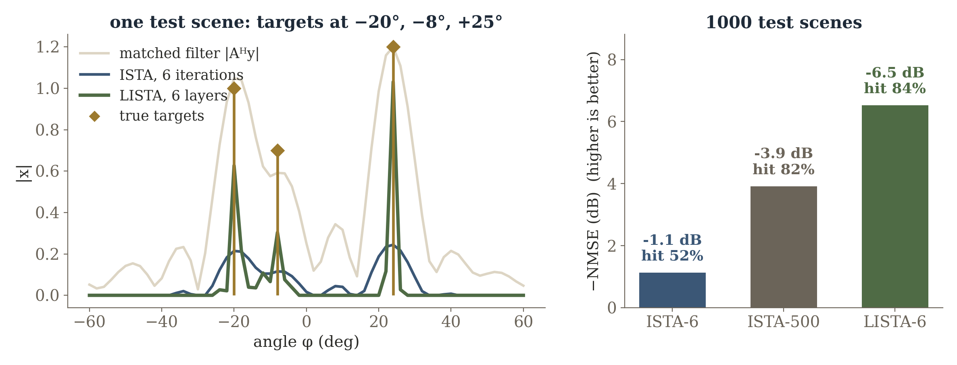
A synthetic demonstration: six stages
Generated for this lecture: 12-element ULA, 61 bins, 1–3 targets, σ = 0.05, λ = 0.08. Six untied LISTA layers initialised from ISTA and trained on synthetic scenes. “hit” = true bins among the top-k peaks.
Six learned stages recover the support as well as 500 ISTA iterations (84% vs. 82%); six ISTA steps reach 52%.
37
Notes:
Before revealing the LISTA curve, hide it and ask students to predict what a learned six-stage solver might change: larger/smaller early steps, non-uniform shrinkage, decorrelation / preconditioning of nearby steering vectors, stage-dependent behavior. These numbers come from this lecture's own simulation (make_plots_gl.py) — present them as illustrative, not as a literature benchmark. Complex values are handled by stacking real and imaginary parts and using a group (magnitude) soft threshold.

Slide 96
Connecting the example to the literature
Work | Idea
Youn et al., EuRAD 2022 | circular-convolutional LISTA for automotive DOA
Guo et al., Signal Proc. 2022 | complex Toeplitz LISTA, unknown mutual coupling
Hong et al., IET RSN 2023 | step-learned group ISTA, FMCW MIMO radar
Yeganegi et al., SAM 2024 | LISTA for one-bit DOA
Niu et al., Remote Sens. 2025 | deep-unfolded LISTA, non-uniform metasurface
Zhang & Ghanem, CVPR 2018 | ISTA-Net: learned transforms for imaging
Full references at the end of the deck.
38

Slide 97
Wrap-up
Board plan, checks, extensions, and the exit question
39

Slide 98
A compact board plan
Board | Write
1 GD geometry | f(x+Δ) ≈ f + ∇fᵀΔ; Δ = −α∇f
2 curvature | + ½ΔᵀHΔ; 0 < α < 2/L; L = ‖A‖₂²
3 backprop | δŷ → δh → δz → ∂W
4 unrolling | four boxes Fθₖ; tied vs. untied
5 ISTA | surrogate → complete square → prox → Sτ
6 LISTA | Sθ(Wₑy + Wₛxₖ); circle what is learnable
7 radar | array + two targets; y = Ax + n
40

Slide 99
Instructor prompts (1/2)
Prompt | What you want to hear
Why does −∇f give a direction but not a safe distance? | first-order model; distance depends on curvature (Hessian / L)
Why is the step scale 1/‖A‖₂² for least squares? | Hessian AᵀA; its largest eigenvalue is ‖A‖₂²
What exactly is “unrolled”? | K updates as an explicit graph; learning and untying are optional
Is repeating one layer different from unrolling? | it is a tied unrolled graph
41

Slide 100
Instructor prompts (2/2)
Prompt | What you want to hear
Why not ordinary GD on the ℓ1 objective? | nonsmooth at 0; prox keeps the sparse objective
What does soft-thresholding do beyond ReLU? | symmetric, exact dead zone, prox of ℓ1
What does LISTA learn? | steps, thresholds and/or the linear maps
Why can LISTA beat a few ISTA iterations? | trained for finite depth on a distribution
What risk comes with fully learned matrices? | weaker link to physics; weaker OOD guarantees
42

Slide 101
Optional extensions (+15–20 min)
FISTA
Structured LISTA
Learn the prox
Analytic momentum: O(1/k) → O(1/k²).
When should acceleration be derived, and when learned?
Weight structures and thresholds with linear convergence (Chen et al., 2018).
Learned vs. theoretically structured is a false dichotomy.
xₖ₊₁ = Dθₖ(xₖ − αₖAᵀ(Axₖ − y)).
Keep the physics; learn the prior. D may no longer be the prox of any regularizer.
All three keep the forward model explicit and change only how the iterations are spent.
43

Slide 102
Exit question
The radar hardware changes, so the steering matrix becomes Ã. Which transfers automatically — and why?
ISTA
step-only unrolling
full LISTA
uses Ã directly — physics lives in the operator
keeps Ã in every layer; learned steps may need re-tuning
physics absorbed into learned W — must be retrained
What exactly did learning replace, and what did it preserve?
45
Notes:
Reveal the three cards only after students answer. The point: ask where the physics lives in each architecture.

Slide 103
References (1/2)
[1] I. Daubechies, M. Defrise, C. De Mol, “An iterative thresholding algorithm for linear inverse problems with a sparsity constraint,” Comm. Pure Appl. Math., 57(11), 2004.
[2] A. Beck, M. Teboulle, “A fast iterative shrinkage-thresholding algorithm for linear inverse problems,” SIAM J. Imaging Sci., 2(1), 2009.
[3] K. Gregor, Y. LeCun, “Learning fast approximations of sparse coding,” ICML, 2010.
[4] J. R. Hershey, J. Le Roux, F. Weninger, “Deep unfolding: model-based inspiration of novel deep architectures,” arXiv:1409.2574, 2014.
[5] X. Chen, J. Liu, Z. Wang, W. Yin, “Theoretical linear convergence of unfolded ISTA and its practical weights and thresholds,” NeurIPS, 2018.
[6] J. Zhang, B. Ghanem, “ISTA-Net: interpretable optimization-inspired deep network for image compressive sensing,” CVPR, 2018.
46

Slide 104
References (2/2)
[7] V. Monga, Y. Li, Y. C. Eldar, “Algorithm unrolling: interpretable, efficient deep learning for signal and image processing,” IEEE Signal Process. Mag., 38(2), 2021.
[8] Y. Guo et al., “Position-enabled complex Toeplitz LISTA for DOA estimation with unknown mutual coupling,” Signal Processing, 194, 2022.
[9] J. Youn et al., “Circular convolutional learned ISTA for automotive radar DOA estimation,” EuRAD, 2022.
[10] S. Hong, S.-C. Kim, S. Lee, “Advanced DOA estimation using step-learnt iterative soft-thresholding for FMCW MIMO radar,” IET Radar Sonar Navig., 17(1), 2023.
[11] F. Yeganegi et al., “Deep learning-enabled one-bit DoA estimation,” IEEE SAM, 2024.
[12] X. Niu et al., “DOA estimation using a deep unfolded LISTA network in a non-uniform metasurface,” Remote Sensing, 17(7), 2025.
47

Slide 105
Keep the objective. Learn the solver.
The purpose of this section: show that a neural-network architecture can be derived from a known numerical algorithm — the most concrete bridge from optimization to deep learning in this course.
principled objective,
slow generic solver
unroll K iterations
into K trainable stages
The architecture inherits the inverse algorithm rather than being chosen arbitrarily.
32

Slide 106
Sparse inverse objective
min_{x} ½∥Ax−y∥₂² + λ∥x∥₁
This is a LASSO-form objective: a quadratic data-fit term plus an ℓ₁ penalty that prefers sparse x.
ISTA performs a gradient step on the measurement term followed by the proximal operator of the ℓ₁ prior — soft-thresholding.
33

Slide 107
One ISTA update
x_{k+1} = S_{λη} [ x_{k} + ηAᵀ(y − Ax_{k}) ]
Write four ISTA iterations vertically. This single update, repeated, is the entire classical algorithm.
34

Slide 108
Physical meanings of the terms
Axₖ — what the current candidate state predicts the sensor should have measured.
y − Axₖ — the residual in measurement space.
Aᵀ(y − Axₖ) — maps that disagreement back into state / image coordinates.
η — how aggressively to correct the state.
Sλη — imposes that most coefficients / candidate paths should be small or zero.
35

Slide 109
Turn an iterative solver into a trainable architecture
classical iteration
residual
y − Axₖ
backproject
Aᵀ(·)
update
xₖ + η·
prox / shrink
Sλ
unrolled network
Iteration 1
(trainable)
Iteration 2
(trainable)
Iteration 3
(trainable)
Iteration 4
(trainable)
Keep the physics operators A and Aᵀ; learn the thresholds, step sizes, denoisers, or selected transforms.
36

Slide 110
From iterations to layers: what becomes trainable?
Step sizes η, thresholds λ, transforms, denoisers, or preconditioners can each be made learnable.
“Tied” parameters reuse the same values across all stages; “untied” parameters let each stage specialize.
Trainable choices: the architecture is fixed by the algorithm; only how much freedom each stage gets is a design decision.
Erase the repeated algebra and replace each written-out iteration with one reusable block — this is the moment an optimizer visually becomes a network.
37

Slide 111
Example A — accelerated MRI: what the scanner measures
MRI measures spatial-frequency coefficients in k-space rather than image pixels.
Acquisition time is reduced by sampling only a subset of k-space.
y = PFx + n F: Fourier transform; P: selects acquired coefficients
F and P are known almost exactly from the acquisition protocol — there is little reason to ask a network to relearn the Fourier transform.
38

Slide 112
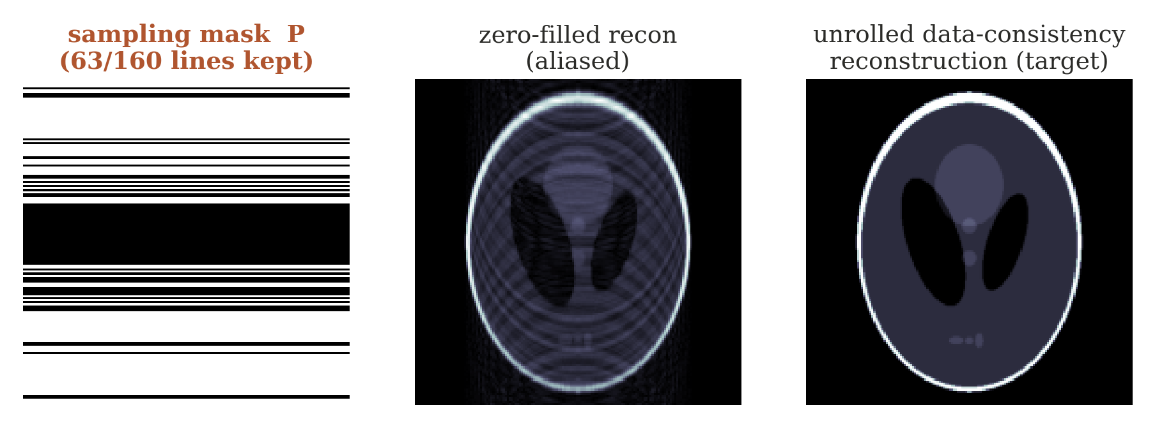
Undersampling mask and the inverse difficulty
Reconstruction from undersampled k-space is ill-posed; compressed-sensing / iterative methods can be computationally expensive.
39

Slide 113
MRI unrolled reconstruction: exact physics, learned correction
data
consistency
learned
prior
data
consistency
learned
prior
Every stage explicitly enforces consistency with measured k-space, alternating with a learned image-domain prior / denoiser.
Teaching move: which block should never be learned? The known sampling / Fourier operation — unless there is a calibration error.
Optional anchor: Aggarwal, Mani & Jacob, MoDL, IEEE TMI 2019.
40

Slide 114
Example B — iterative CT: one physical correction loop
predict projections Axₖ
compare to scanner data y − Axₖ
backproject the residual Aᵀ(·)
denoise / regularize the update
Keep the first CT iteration entirely physical — only after this loop is understood should the unrolled network be drawn.
41

Slide 115
The CT loop becomes unrolled stages
stage 1
(trainable)
stage 2
(trainable)
stage 3
(trainable)
stage 4
(trainable)
Repeated A / Aᵀ operations are computationally costly; hand-tuned regularization may be suboptimal for the true image distribution.
Learn update strength and image prior / correction while retaining A and Aᵀ, exactly, in every stage.
42

Slide 116
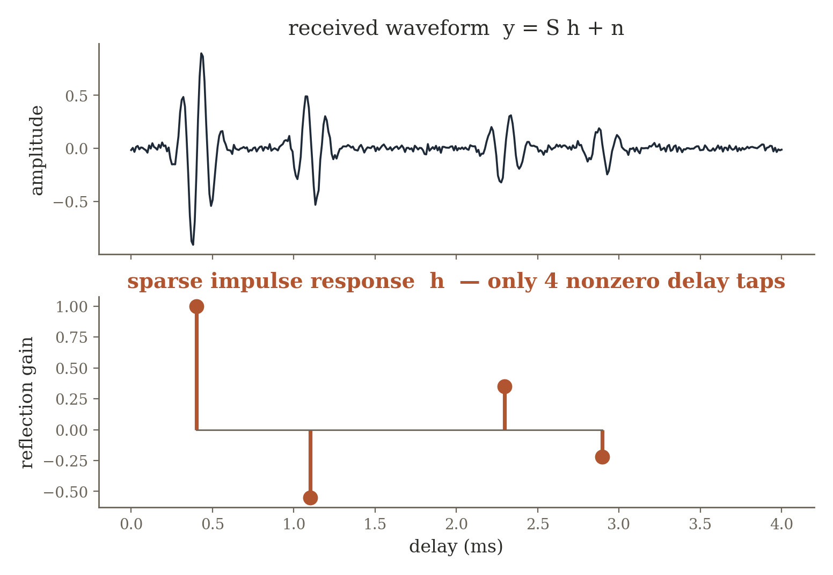
Example C — sparse acoustic channel estimation
y = Sh + n S built from the known transmitted probe / convolution operator
Each nonzero tap is one physical reflection path — soft-thresholding becomes a physical statement: most candidate delays correspond to no path.
LISTA-like stages learn thresholds / transforms that solve the whole family of sparse channel problems rapidly. Optional anchor: Gregor & LeCun, LISTA, ICML 2010.
43

Slide 117
MoDL: learned prior + exact data consistency
x^{k+1} = DataConsistency( D_{φ}(x_{k}), y, A )
The learned block proposes a more plausible state.
The physics block pulls that proposal back toward what the sensor actually measured.
Repeating the pair creates a strong inductive bias and reduces the burden on training data.
Synthesis of Sections 1–3: direct inverse, learned prior, and unrolling are not three unrelated deep-learning tricks. They are three increasingly conservative decisions about how much of a classical inverse pipeline to retain explicitly.
44

Slide 118
4 Learn the Missing Physics
When the analytic model is valuable but does not capture the real environment
45

Slide 119
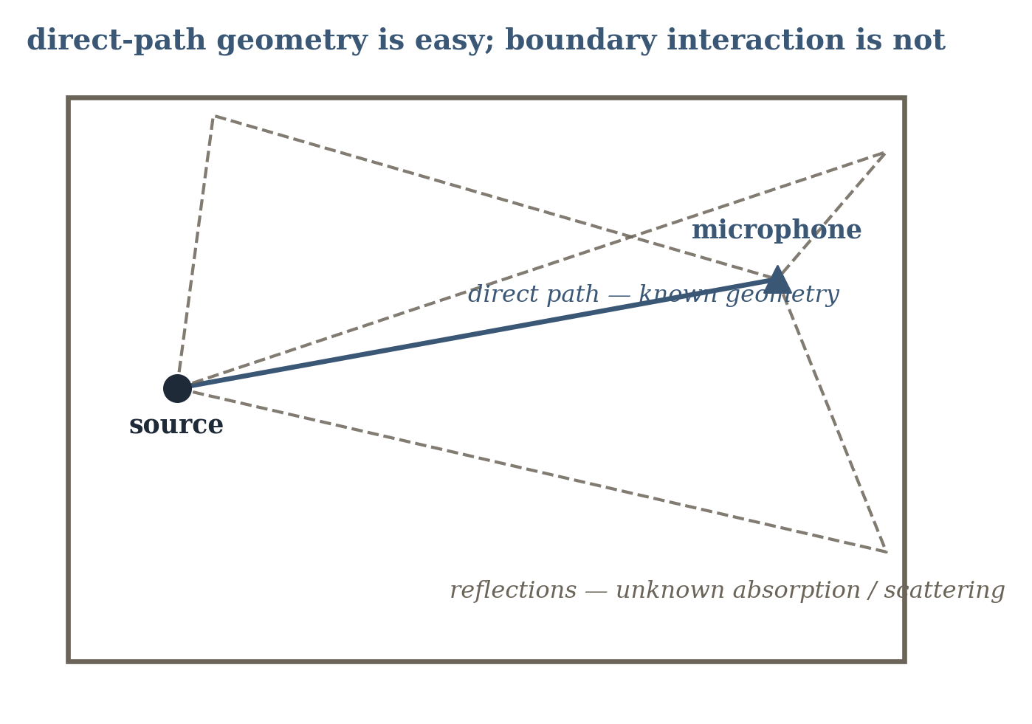
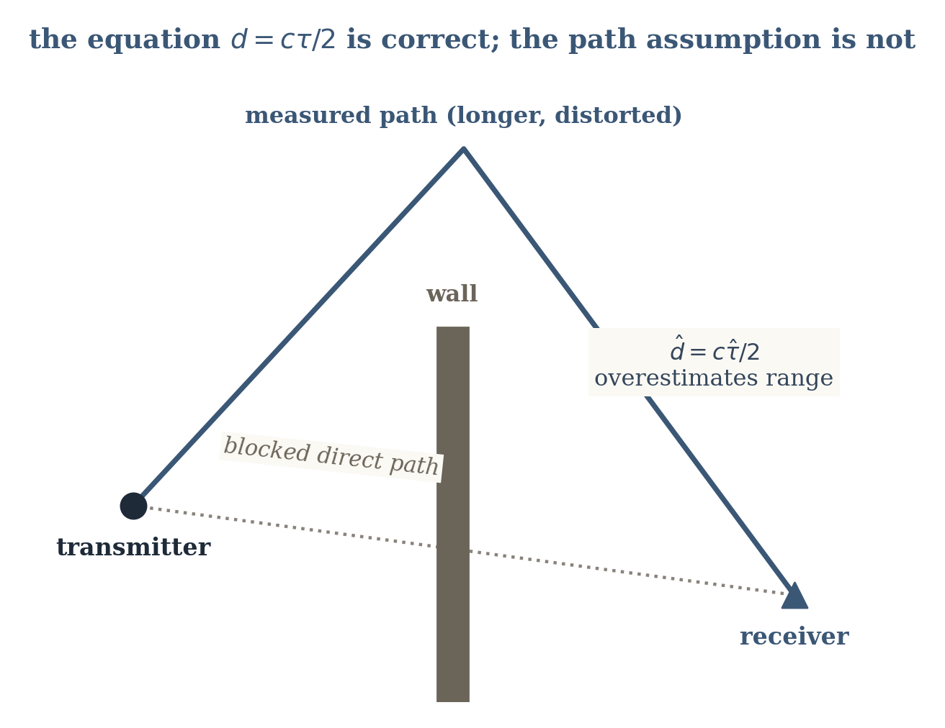
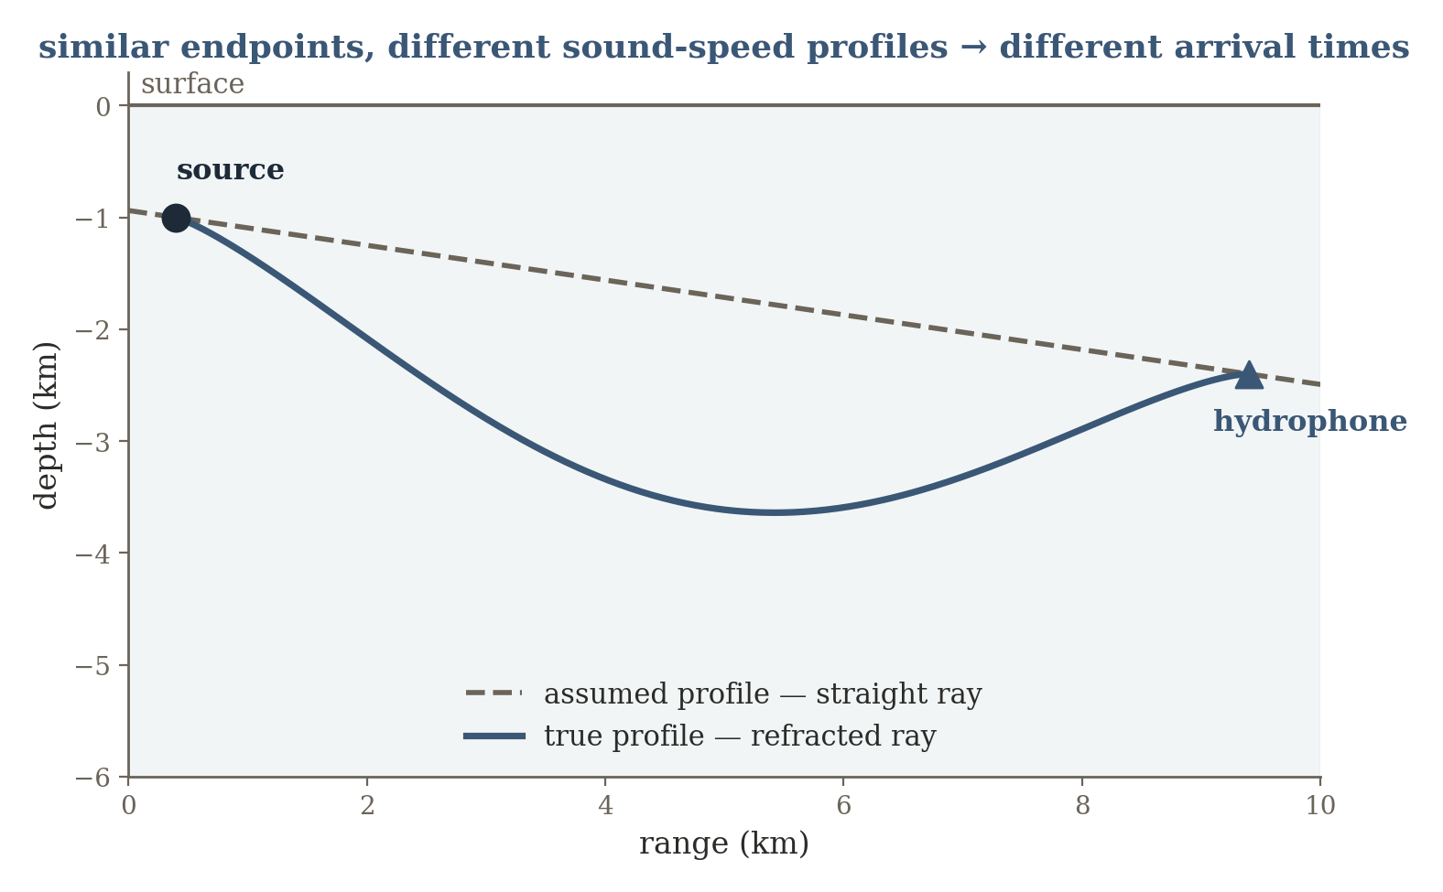
A new failure mode: the forward model itself is imperfect
So far, A or f(x,θ) was assumed correct. Real sensing systems often fail because the analytic model itself is systematically incomplete.
sound-speed profile bends rays;
boundaries vary
known geometry;
uncertain materials / scattering
d = cτ is valid;
measured τ may be a reflected path
Three different environments, one shared design principle: trusted physics remains useful, plus a learned correction for the omitted mechanism.
46

Slide 120
Noise versus model mismatch
y = f_{true}(x,θ) + n = f_{phys}(x,θ) + δ(x,θ,context) + n
Noise n describes stochastic variation around a model.
The mismatch δ is structured: it repeats, because the simplified forward model omits a real mechanism, a latent path, a boundary condition, a calibration error, or an environmental parameter.
This section should sharply distinguish model mismatch from random measurement noise — δ is where the physics is wrong, not where the sensor is noisy.
47

Slide 121
Three hybrid strategies
Parameter learning — keep the functional form f fixed but infer unknown θ.
Residual learning — retain fphys and learn only a residual correction rφ.
Neural component / constitutive relation — replace one difficult submodel inside a larger physical computation.
ŷ = f_{phys}(x,θ) + r_{φ}(x, context)
hybrid model
48

Slide 122
Example A — room acoustics: the physical problem
A source emits sound in a room. The direct path is set mainly by source–microphone geometry and sound speed.
Reflections and reverberation depend on walls, materials, furniture, scattering, directivity, and frequency.
Measurement y: impulse responses or transfer functions between measured source and microphone positions. Target x: the acoustic transfer function at new positions, or latent room parameters.
49

Slide 123
Room acoustics: what is known, what is not
Geometric acoustics or the wave equation provides a meaningful baseline for the direct path and early reflections.
Exact boundary conditions and reflection / scattering coefficients are usually unavailable — a purely geometric model gets delay structure right but misses realistic reverberant energy and frequency dependence.
Teaching move: ask students to classify each quantity as x, θ, a known constant, or a nuisance variable — this reinforces forward-model notation.
50

Slide 124
Learn the acoustic residual or its parameters
Estimate boundary / material parameters, learn a residual acoustic field, or learn one difficult boundary interaction — while keeping propagation geometry explicit.
51

Slide 125
Example B — UWB / radar ranging: line-of-sight vs NLOS
A transmitter and receiver estimate propagation delay. Under line of sight, the earliest path approximates geometric distance.
A wall or corner can block the direct path, so the first detected energy arrives only after reflection or diffraction.
d = cτ (one-way radio ranging; cτ/2 for monostatic radar) — correct for the path whose delay τ is measured
52

Slide 126
Correct law, wrong path assumption
The hidden assumption “measured path = geometric direct path” fails under NLOS, producing a systematic positive bias rather than zero-mean sensor noise.
d_{corrected} = cτ − b_{φ}(features)
53

Slide 127
Example C — underwater acoustics: known wave law, uncertain medium
Sound propagates through water whose sound speed varies with temperature, salinity, and depth. Refraction bends rays; surface and seafloor boundaries create additional paths.
Wave / ray physics is known, but the sound-speed profile c(z,t) and boundary state can be only partially measured and time-varying.
Target x: source range / location, environmental profile, or scene structure. Measurement y: arrival times, phases, amplitudes, or impulse responses at hydrophones.
54

Slide 128
Same endpoints, different ray path: structured mismatch
A nominal straight-line or fixed-profile model produces structured range and phase errors as the medium changes. Should environmental uncertainty be folded into noise? Doing so throws away exploitable structure.
55

Slide 129
Identifiability warning
Technical caution: if both x and an expressive residual rφ are free, the network can explain the measurements in many ways. Hybrid models still need identifiability, calibration data, parameter constraints, or regularization so the learned correction does not absorb the entire physics.
Transition question: what if the unknown physical component is not a static correction, but the rule that carries the state forward through time?
56

Slide 130
5 Learn the Dynamics
When sensing gives trajectories and the unknown is the transition law itself
57

Slide 131
Dynamics: the state-space framing
x_{t+1} = f(x_{t}, u_{t}; θ) + w_{t}
y_{t} = h(x_{t}) + v_{t}
The target isn't a single static inverse — now we want a model for how a physical state evolves under a control input.
A trajectory supplies repeated state-transition examples. Depending on what is known, learning can target only θ, a residual around known dynamics, or the functional form of f itself.
58

Slide 132
Three levels: parameters → residual → equation discovery
classical
parameter ID
residual /
hybrid dynamics
black-box
neural dynamics
sparse equation
discovery
A spectrum, not a binary choice — how much of the transition law do we already trust?
As trust in the known transition law decreases from left to right, the learning target grows from a handful of parameters to an entire governing equation.
59

Slide 133
Example A — mobile robot with wheel slip
Motor commands imply an ideal velocity and turning rate, but actual motion depends on friction, slip, vibration, surface texture, battery voltage, and mechanical asymmetry.
The nominal kinematic model fkin(xt, ut) is known — ideal kinematics systematically miss slip and platform-specific effects.
A fully black-box model would waste the correct geometric part that fkin already gets right.
60

Slide 134
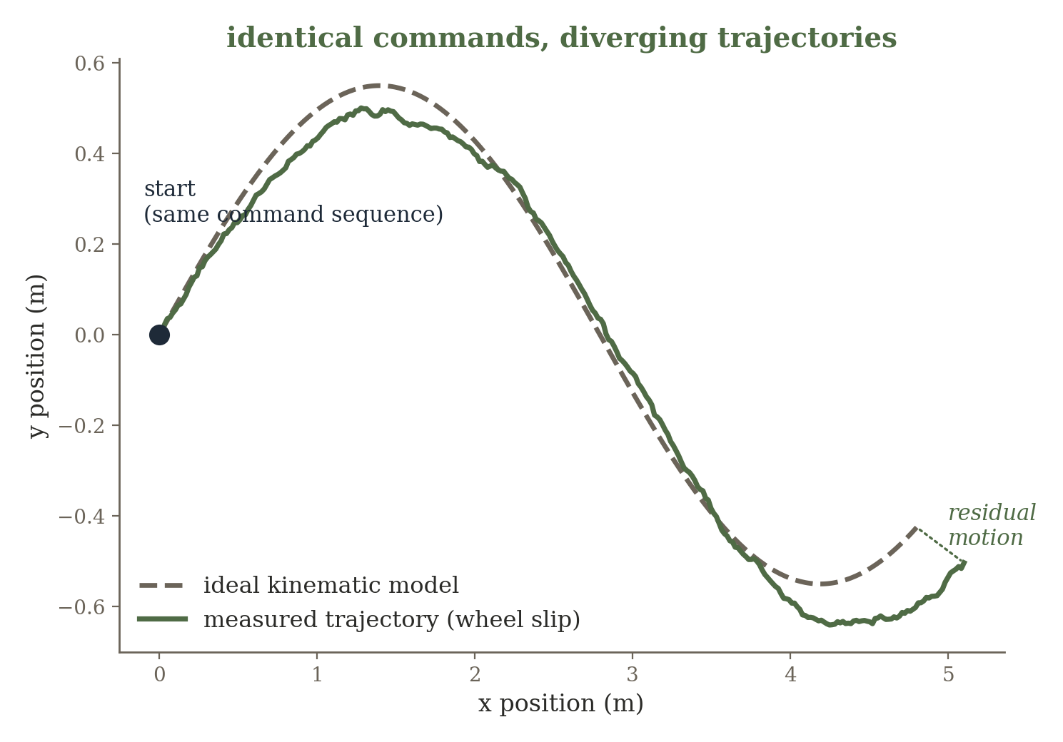
Keep kinematics, learn the residual motion
x_{t+1} = f_{kin}(x_{t},u_{t}) + r_{φ}(x_{t},u_{t},context)
Teaching move: which variables should the residual receive? Surface type, battery voltage, or recent motion history can make the missing physics observable.
61

Slide 135
Example B — HVAC / room thermal dynamics: the physical setup
Room temperature changes because of thermal capacitance, heat transfer through walls, outdoor temperature, HVAC input, solar gain, and occupancy.
Energy-balance / RC-network equations provide the structure.
C (dT/dt) = (T_{out} − T)/R + Q_{HVAC}
Coefficients R and C vary by building and are not known from first principles with enough precision for prediction / control.
62

Slide 136
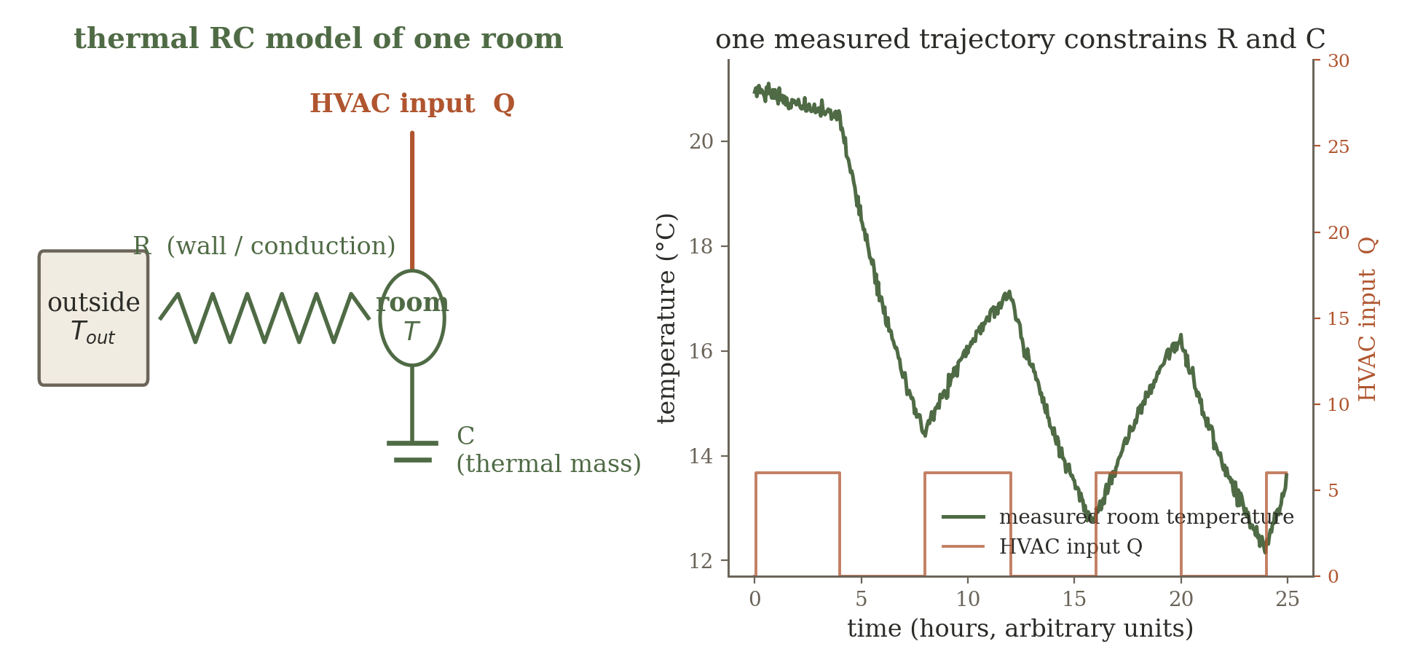
System identification of R and C
Estimate θ = {R, C, …} from measured trajectories rather than replacing the energy-balance model. This distinguishes “learning a physical parameter” from “learning a neural network” — both are system identification.
63

Slide 137
Example C — discover the pendulum's equation
Observe angular position over time, possibly under several initial conditions; construct or estimate velocity and acceleration.
We deliberately pretend the exact equation form is unknown, although the state variables and candidate nonlinearities are available.
A familiar system on purpose — students can check whether the discovered terms make physical sense.
Teaching move: what goes wrong if the derivative estimates are noisy? This exposes a real practical difficulty in equation discovery.
64

Slide 138
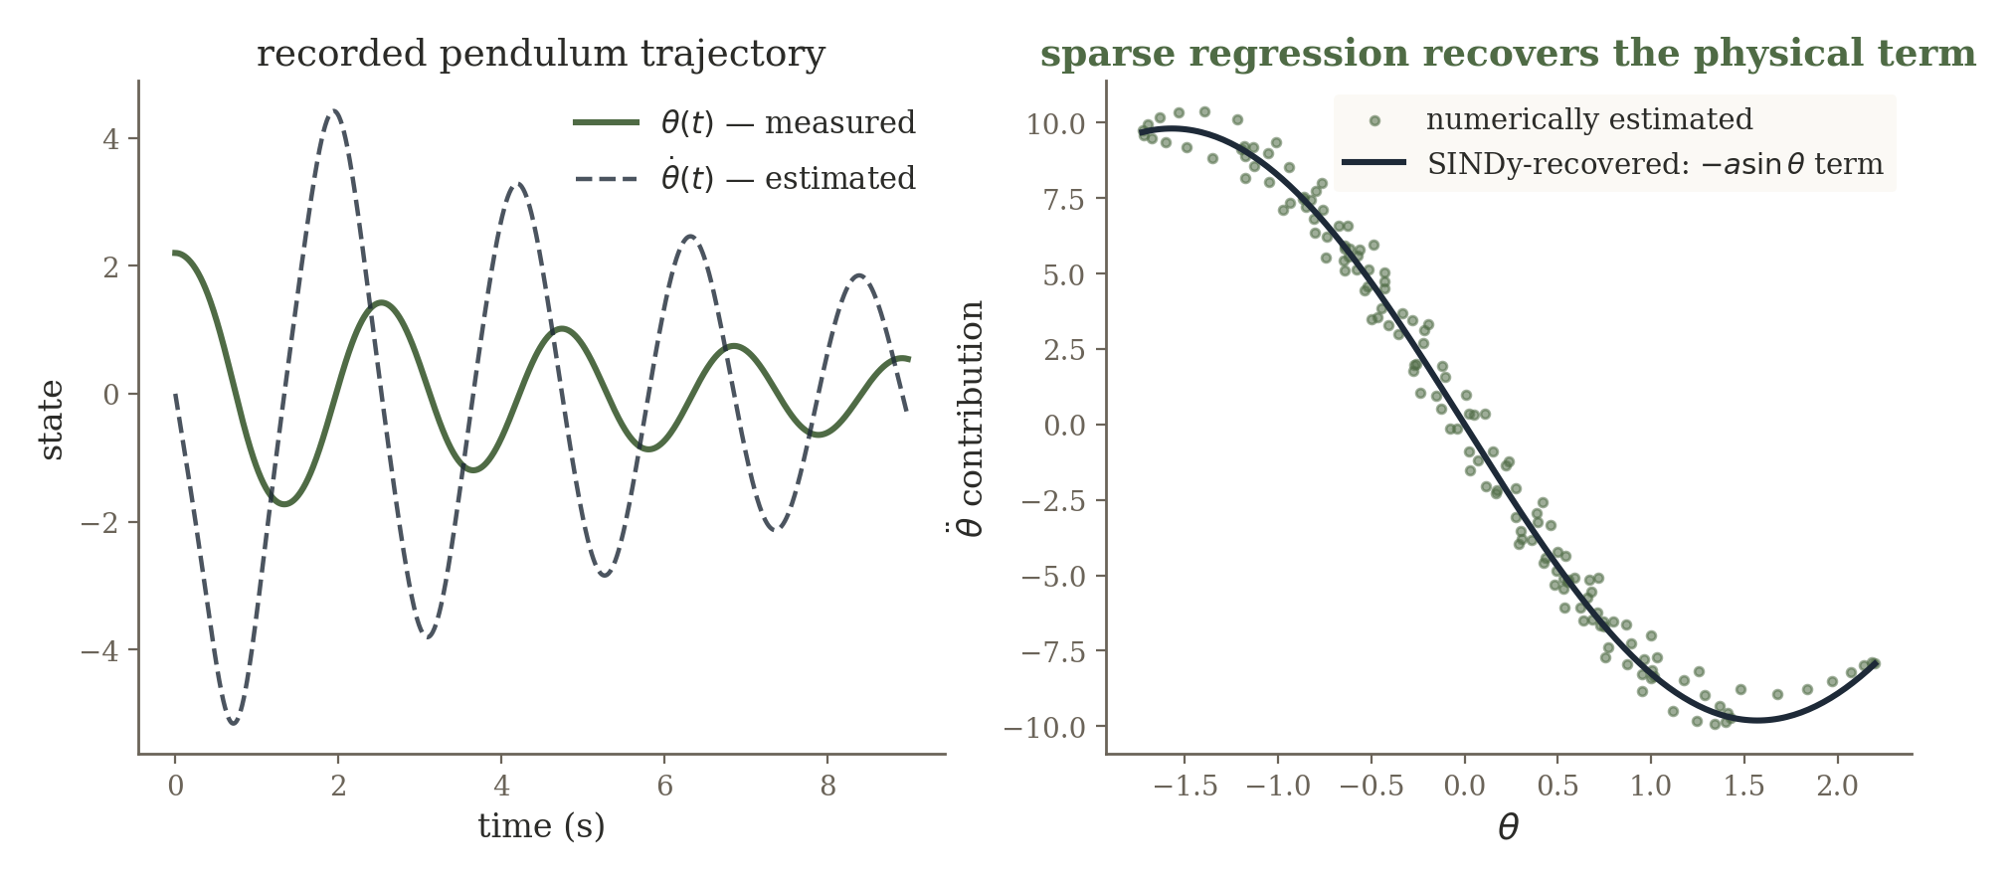
SINDy: sparse identification of nonlinear dynamics
Θ(X) = [ 1, x, x², xv, sin(x), … ]
Ẋ = Θ(X) Ξ
Sparse regression keeps only a few columns — the result is an explicit candidate physical law, not merely a predictor.
Brunton, Proctor & Kutz — SINDy, PNAS 2016
65

Slide 139
Robot vs HVAC vs SINDy: what part of dynamics is trusted?
Compared to... | Trade-off
neural dynamics model | higher expressive power, much lower interpretability
classical parameter ID | SINDy can also search over the equation's form, not just coefficients
Shared question across robot, HVAC, and pendulum: how much of the transition law do we trust? Robot — trust geometry, learn the residual. HVAC — trust the equation form, estimate parameters. Pendulum / SINDy — use data to select the equation terms themselves.
Important caveat: numerical differentiation amplifies noise, and the candidate-library choice strongly affects what gets discovered.
66

Slide 140
6 Constrain Learning with Known Physics
When the law is known but the field is only sparsely observed
67

Slide 141
The reverse problem: law known, state sparsely observed
This section deliberately reverses the previous one. In system identification the trajectory is observed and the law is uncertain. Here the governing law is known, but the spatial / temporal field is only sparsely measured.
System ID (SINDy)
Physics-Constrained Field
state fully observed;
equation unknown
equation known;
state sparsely observed
Same recurring question, mirrored: how much of the physical description can we trust, and where must data fill the gap?
68

Slide 142
A continuous neural field: uφ(r, t)
uφ(r, t): spatial–temporal coordinate → predicted physical field value
Rather than predicting a fixed image, a coordinate network can represent temperature, pressure, displacement, velocity, concentration, or another continuous field.
Automatic differentiation supplies spatial and temporal derivatives of uφ directly — exactly what a PDE residual needs.
69

Slide 143
The physics-constrained objective
L = L_{data} + λ_{PDE}L_{PDE} + λ_{BC}L_{boundary} + λ_{IC}L_{initial}
Ldata — match sensor observations at measured coordinates.
LPDE — penalize residual of the governing equation at collocation points, including places with no sensor.
LBC / LIC — enforce boundary and initial conditions.
The PDE residual is evaluated at collocation points that need no sensor at all — the physical law supervises the network between sensors.
70

Slide 144
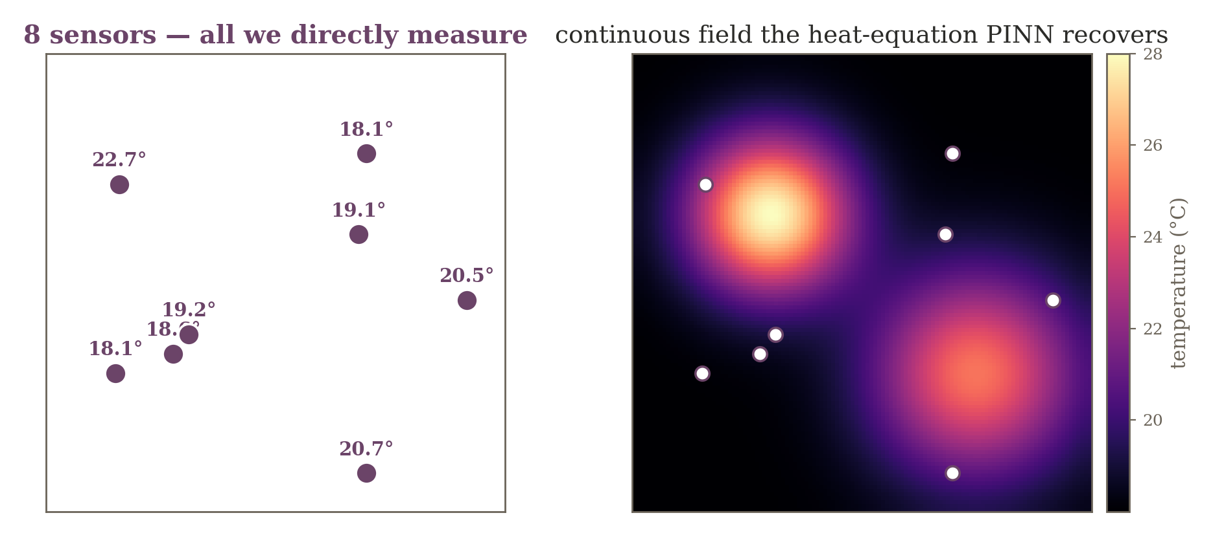
Example A — room temperature field from 8 sensors
∂T/∂t = α∇²T
Pure interpolation admits infinitely many fields through 8 points. The heat equation eliminates every field with impossible spatial curvature or temporal evolution.
71

Slide 145
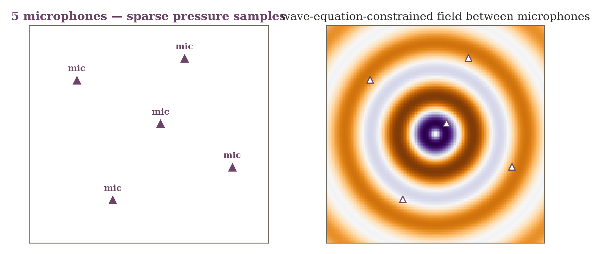
Example B — acoustic pressure field from 5 microphones
Ordinary spatial interpolation ignores phase and wave behavior. A wave / Helmholtz residual enforces physically consistent oscillation between microphones.
72

Slide 146
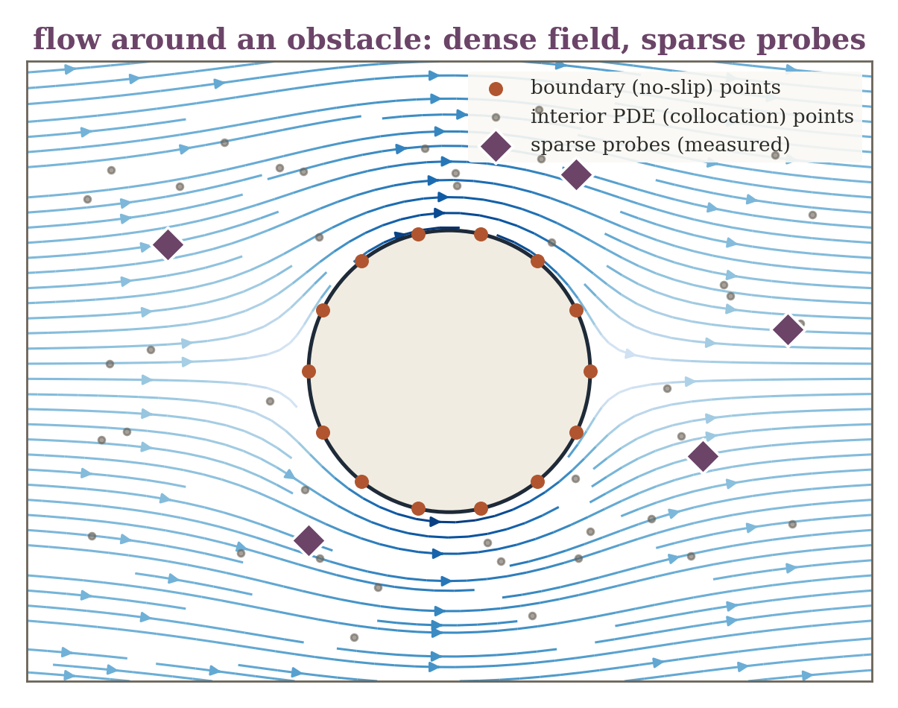
Example C — flow field from sparse probes
Same idea, different PDE family — a conceptual preview, not a full computational-fluid-dynamics treatment.
Pressure / velocity probes sample only a few locations around an obstacle; continuity and momentum equations couple distant points and constrain the boundary separately from the interior.
The idea is not specific to heat or acoustics — any field with a known governing PDE and sparse sensors fits this same recipe.
73

Slide 147
Technical caution: PINNs are not automatically superior
Loss terms can live on very different scales — balancing data, PDE, and boundary losses matters.
High-frequency solutions and stiff PDEs can be difficult to optimize.
If the governing equation or boundary conditions are wrong, physics constraints can force the network toward the wrong solution.
The broader idea matters more than the acronym: use known governing laws as supervision and inductive bias — not as an unquestionable oracle.
74

Slide 148
7 Synthesis: Choose the Learning Target from the Failure Mode
A design procedure, not a catalog of model names
75

Slide 149
The decision ladder, complete
1
2
3
Learn the
Inverse
Learn the
Prior
Unroll the
Optimizer
map too complex
to write down
data alone doesn't
pick one state
objective is right;
iteration is slow
4
5
6
Learn Missing
Physics
Learn the
Dynamics
Constrain with
Physics
model incomplete
or biased
transition law
itself unknown
law known; field
sparsely observed
The architecture follows from what is known, what is measured, and what is missing — not the other way around.
76

Slide 150
Cross-domain synthesis — sensing systems I
System | Known physics | Failure mode | Learning role
Sparse-view CT | ray-integral geometry A | non-uniqueness, slow inverse | learn prior / unroll solver
RF fingerprint localization | partial propagation knowledge | analytic inverse impractical | learn direct inverse
RF tomography (occupancy) | link-sensitivity matrix | underdetermined | learn prior
Accelerated MRI | Fourier transform + sampling mask | iterative reconstruction is slow | unroll / data consistency
Sparse echo / channel est. | convolution with known probe | slow sparse recovery | LISTA-like unrolling
Room acoustics | geometry / wave propagation law | unknown boundaries, materials | learn residual / parameters
77

Slide 151
Cross-domain synthesis — sensing systems II
System | Known physics | Failure mode | Learning role
UWB / radar NLOS ranging | c × delay relation | wrong latent-path assumption | learn bias / mismatch
Underwater acoustics | wave propagation | unknown sound-speed profile | hybrid forward model
Robot / bristle-bot motion | nominal kinematics | wheel slip / friction | system ID / residual dynamics
HVAC thermal dynamics | energy balance (RC model) | unknown coefficients | parameter identification
Pendulum / oscillator | basic state variables | equation form unknown | SINDy — equation discovery
Room temperature field | heat equation | state sparsely observed | PINN / constrained field
Acoustic pressure field | wave / Helmholtz equation | state sparsely observed | PINN / neural field
Fluid flow field | continuity / momentum | state sparsely observed | PINN / neural field
78

Slide 152
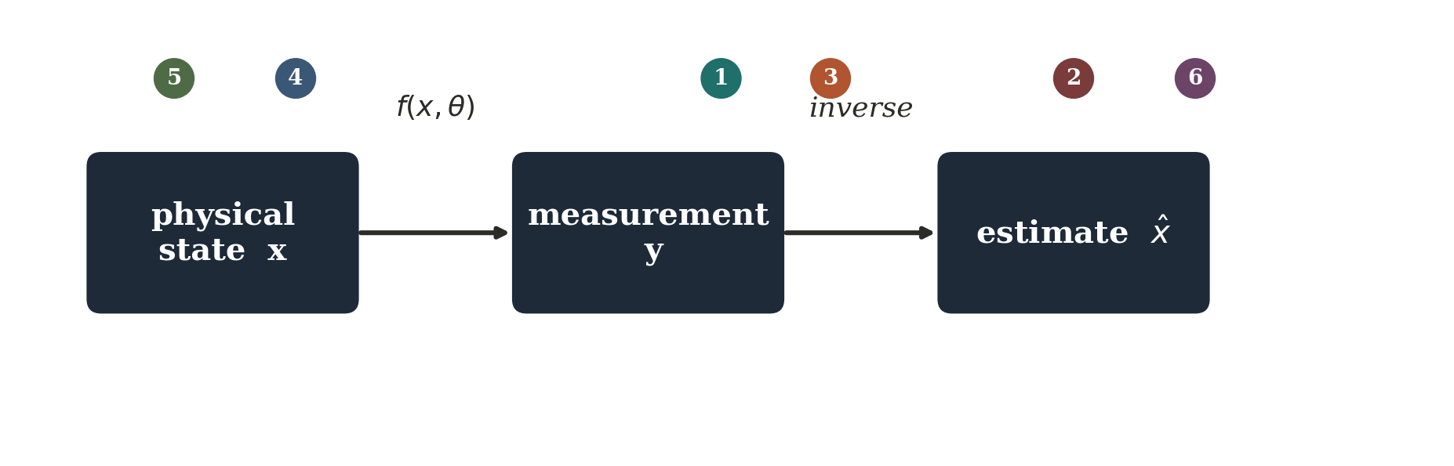
One board diagram to keep visible throughout
circle the inverse g — direct learning circle R(x) — learned priors
circle the iterative arrows — unrolling circle f or θ — model mismatch & system ID
circle the governing PDE — physics-constrained neural fields
Physical sensing ML is the design of inference systems that decide carefully what should come from measurements, what from known physics, and what should be learned from data.
79

Slide 153
Questions worth sitting with
CT: if two images produce nearly identical sparse projections, can any optimizer determine the correct one without additional information?
MRI: why is it wasteful to ask a neural network to re-learn the Fourier transform?
UWB NLOS: is the error best modeled as sensor noise, an unknown latent path, or a systematic bias term?
Temperature PINN: can a field match every sensor perfectly and still violate the heat equation?
80

Slide 154
Selected references
Role | Reference
Direct learned inverse | Zhu et al. — AUTOMAP, Nature 2018
Learned sparse inference / unrolling | Gregor & LeCun — LISTA, ICML 2010
Model-based deep reconstruction | Aggarwal, Mani & Jacob — MoDL, IEEE TMI 2019
Plug-and-play priors | Venkatakrishnan, Bouman & Wohlberg — GlobalSIP 2013
Equation discovery | Brunton, Proctor & Kutz — SINDy, PNAS 2016
Physics-informed neural networks | Raissi, Perdikaris & Karniadakis — J. Comp. Phys. 2019
Kak & Slaney, Principles of Computerized Tomographic Imaging — CT foundations.
81

