Slide 1
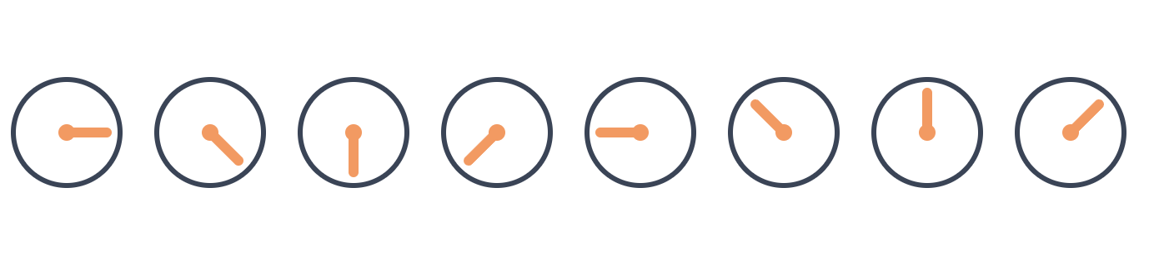
Seeing Though Subspaces
ARRAY PROCESSING · GRADUATE LECTURE
From MUSIC to SubspaceNet
[CMSC-818 V] · [7 October 2026] – Aritrik Ghosh
Notes:
Plan for 90 minutes: hook 6 min, Act 1 10, Act 2 15, Act 3 15, Act 4 8, Act 5 10, Act 6 14, discussion 7, buffer 5. Tell them up front: today is about one idea, subspaces, and we'll earn SubspaceNet at the end.

Slide 2
UFO

Slide 5
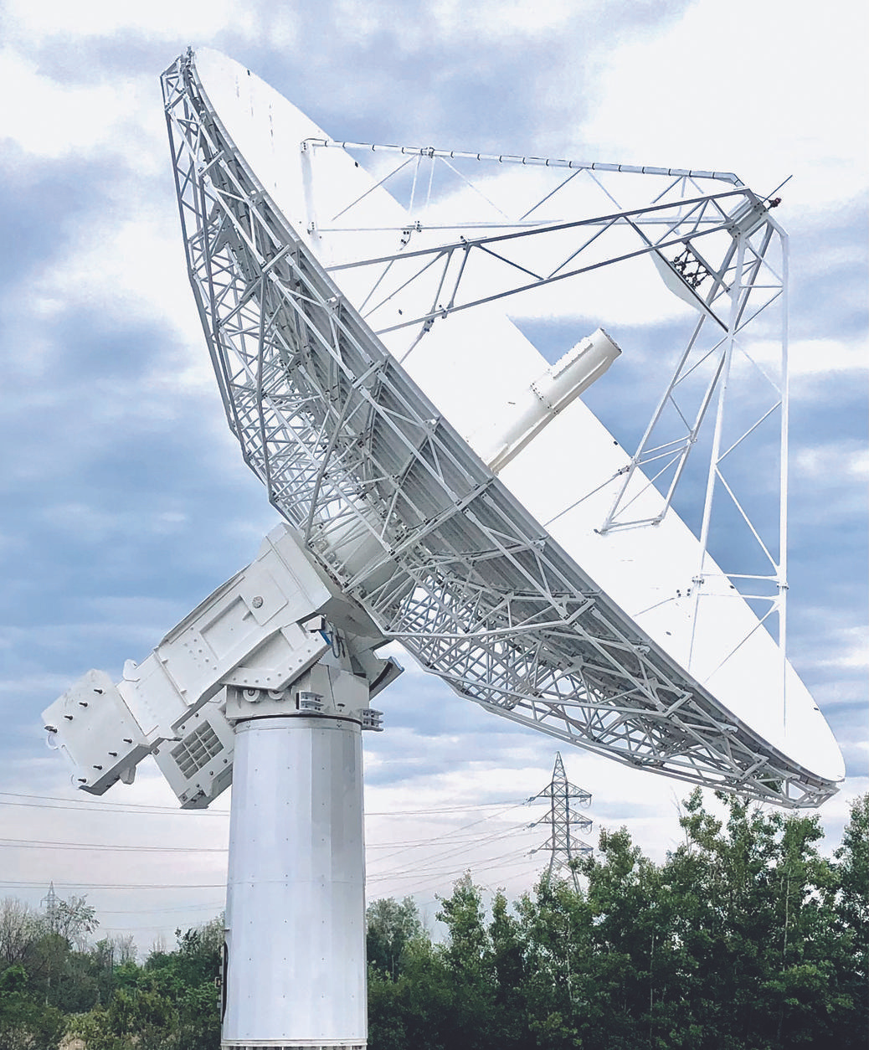
Haha! Found You

Slide 6
Haha! Found You

Slide 7
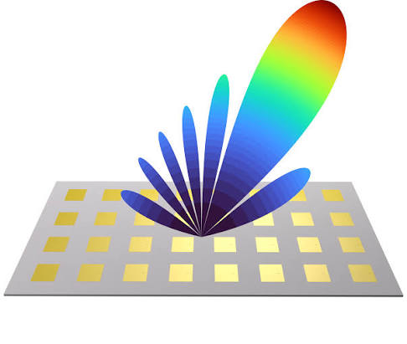
LOL! Found You Again

Slide 8
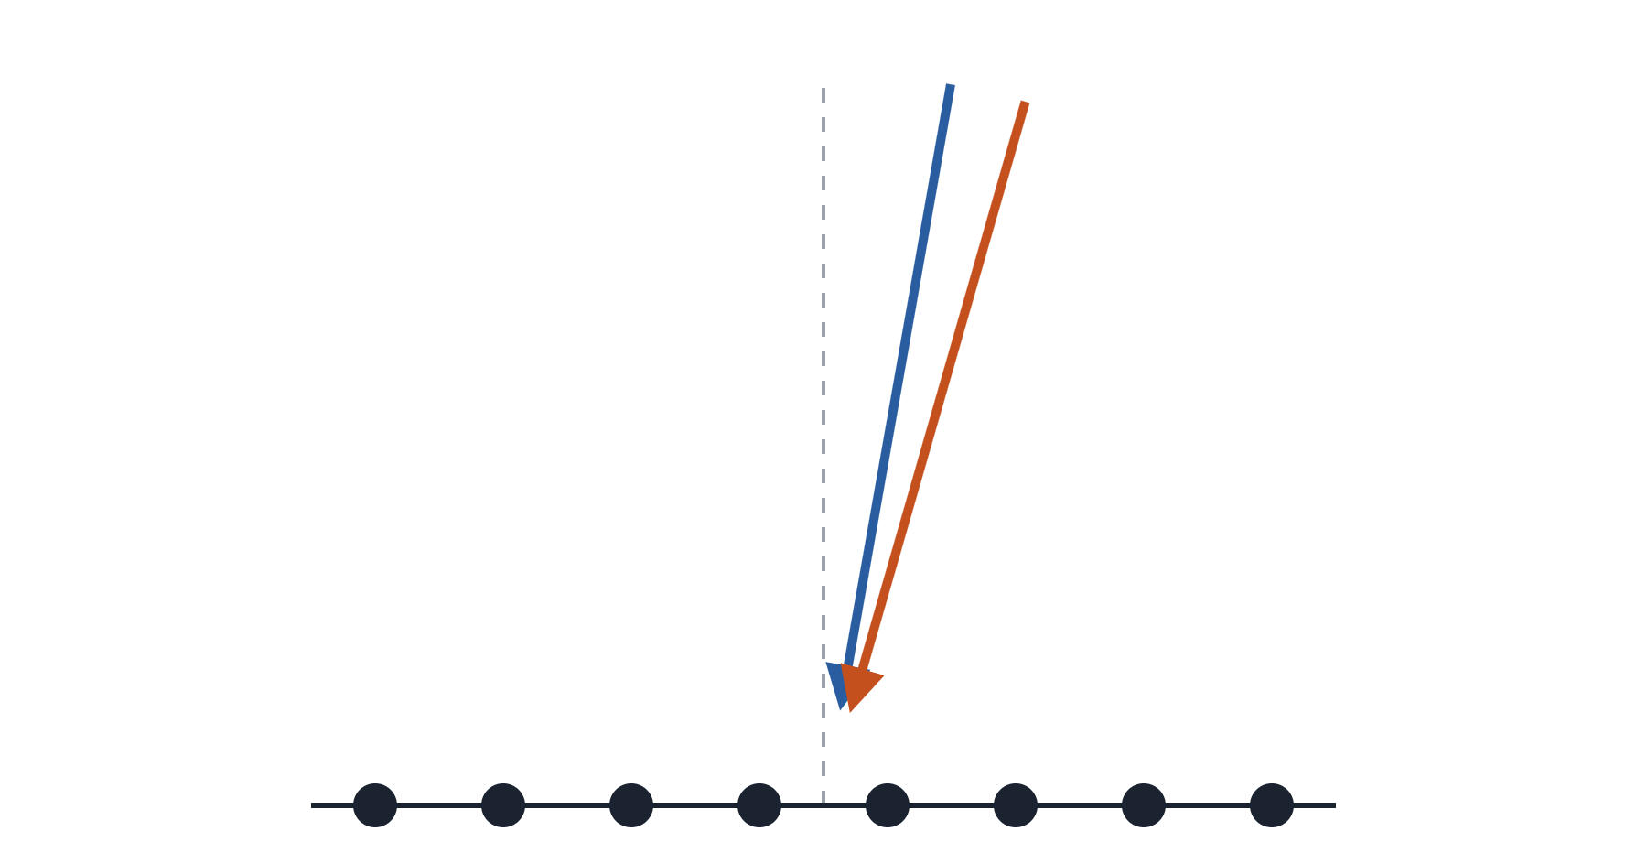
One Scene: Eight Antennas, Two Sources 6° Apart
HOOK
broadside
Array | 8-element ULA, d = λ/2
Sources | K = 2, uncorrelated
Directions | θ₁ = 10°, θ₂ = 16°
SNR | 10 dB per source
Snapshots | N = 200
From the snapshots alone: how many sources, and where?
8 antennas · spacing d = λ/2
━ θ₁ = 10° ━ θ₂ = 16°
Notes:
One scene, and we'll keep coming back to it all lecture. 8-element half-wavelength ULA, two uncorrelated sources at 10° and 16°, 10 dB each, 200 snapshots. All figures in this deck are simulated from exactly this setup. Ask the room: how would you find the two directions? Most will say 'beamform and look for peaks.' Good, let's do that.

Slide 9
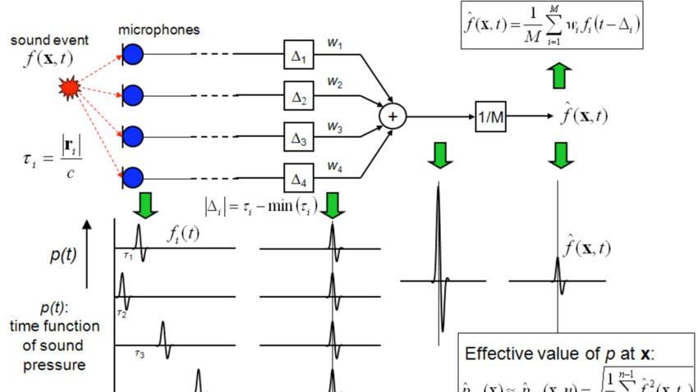

Slide 10
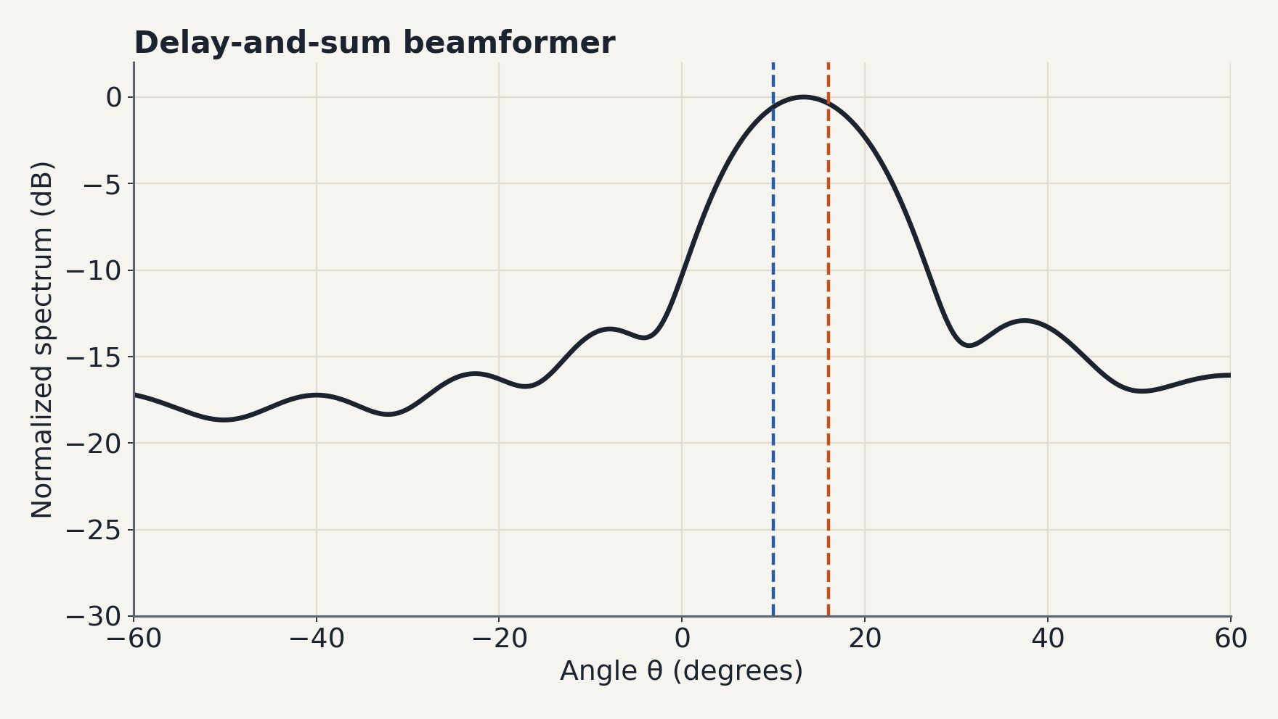
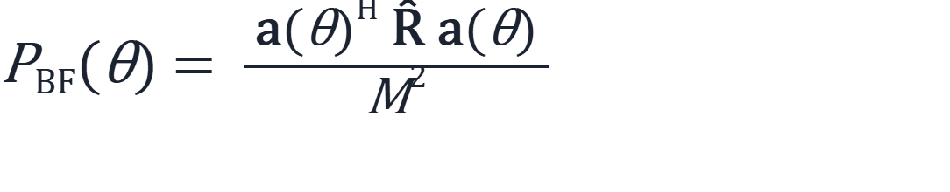
Beamforming Sees One Blob
HOOK
Steer the array to every θ and measure the power that comes through.
Main lobe ≈ 2/M rad ≈ 14°. Two sources 6° apart sit inside one lobe.
One peak, near 13° — between the two.
Notes:
Delay-and-sum: steer to every angle and measure output power. With 8 elements the Rayleigh limit is about 2/M radians, roughly 14 degrees. Our sources are 6 degrees apart, so we get one broad peak around 13°, in between. More antennas would help; that's the classical answer: resolution is bought with aperture.

Slide 11


Slide 12
Multi Signal Classification

Slide 13
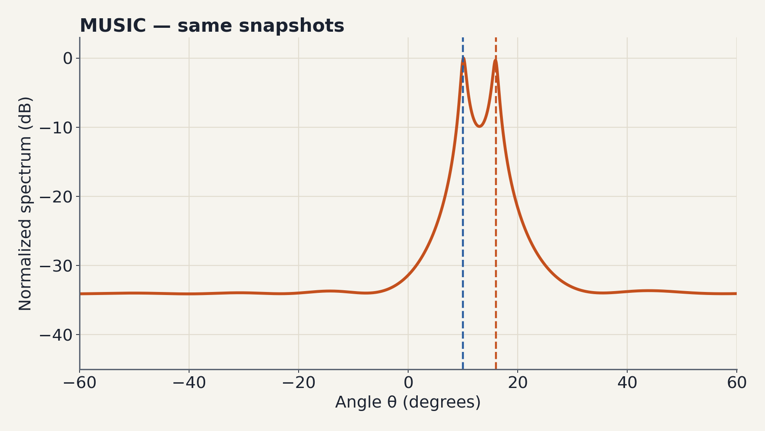
MUSIC Sees Two Needles — Same Data
HOOK
Same 8 antennas. Same 200 snapshots.
Peaks at 10.1° and 15.9° — two sources 6° apart, well inside the 14° beamwidth.
Nothing about the hardware changed. What does MUSIC know that the beamformer doesn't?
Notes:
Same snapshots, run through MUSIC: two needle-sharp peaks at 10.1° and 15.9°. Let that sit. The question for today: what does MUSIC know that the beamformer doesn't? Roadmap: we'll answer it (Acts 1-4), break it (Act 5), and fix the break with a neural network (Act 6).

Slide 14
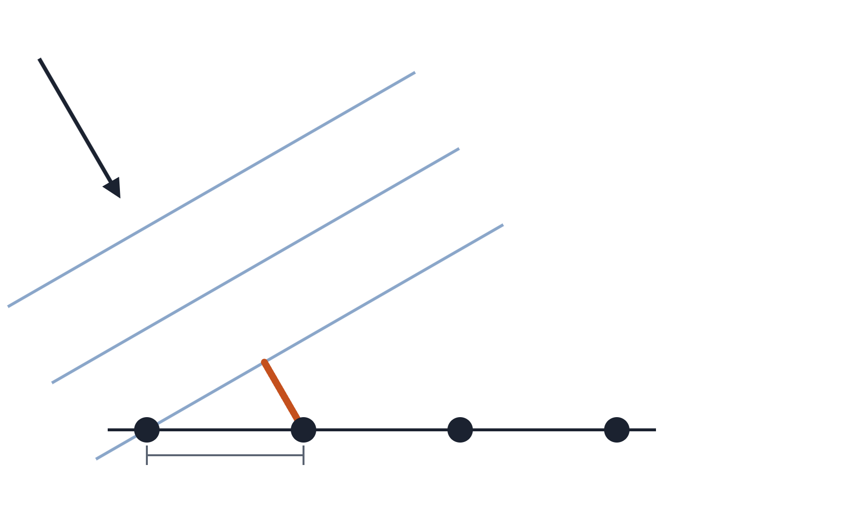
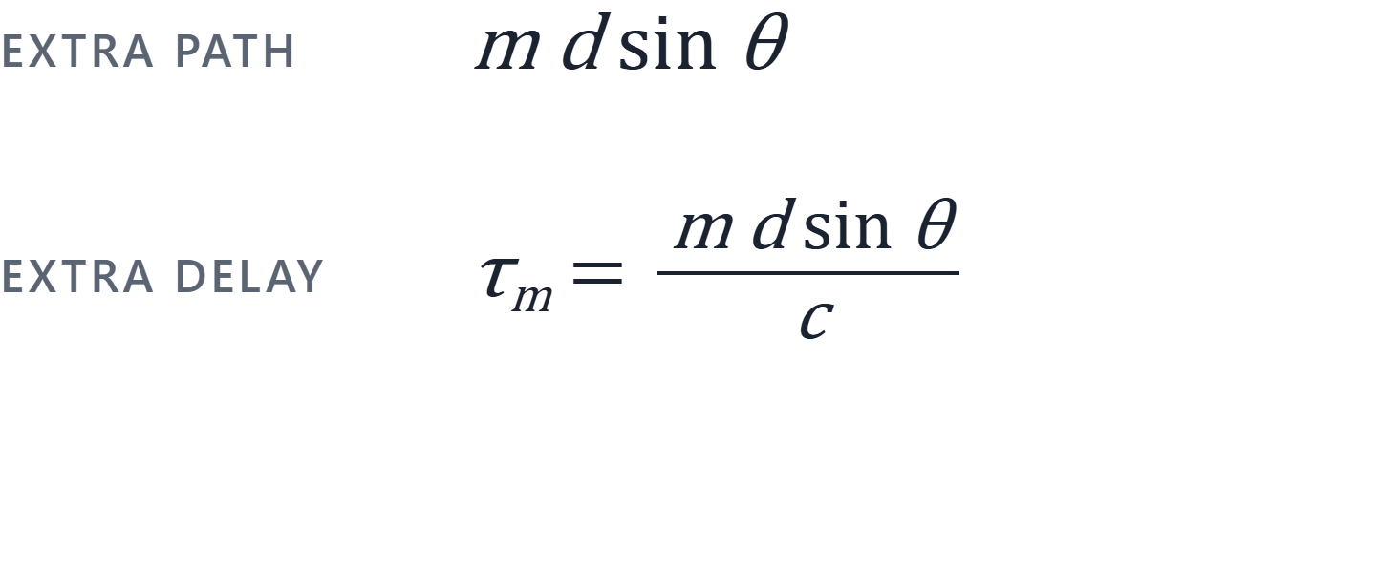
A Plane Wave Reaches Each Antenna a Little Late
ACT 1 · PHASE IS GEOMETRY
plane wave from θ
RUNNING EXAMPLE · 4 ANTENNAS
d sin θ
θ is measured from broadside (straight ahead). ANT1 is the reference, m = 0; ANT4 is m = 3.
d
ANT1
ANT2
ANT3
ANT4
Notes:
The wave arrives tilted by θ from broadside. The wavefront touches ANT1 first; to reach ANT2 it travels an extra d·sinθ (orange). Element m is m·d·sinθ further, so its delay is m·d·sinθ/c. Pure geometry: this is all the array 'knows' about direction.

Slide 15
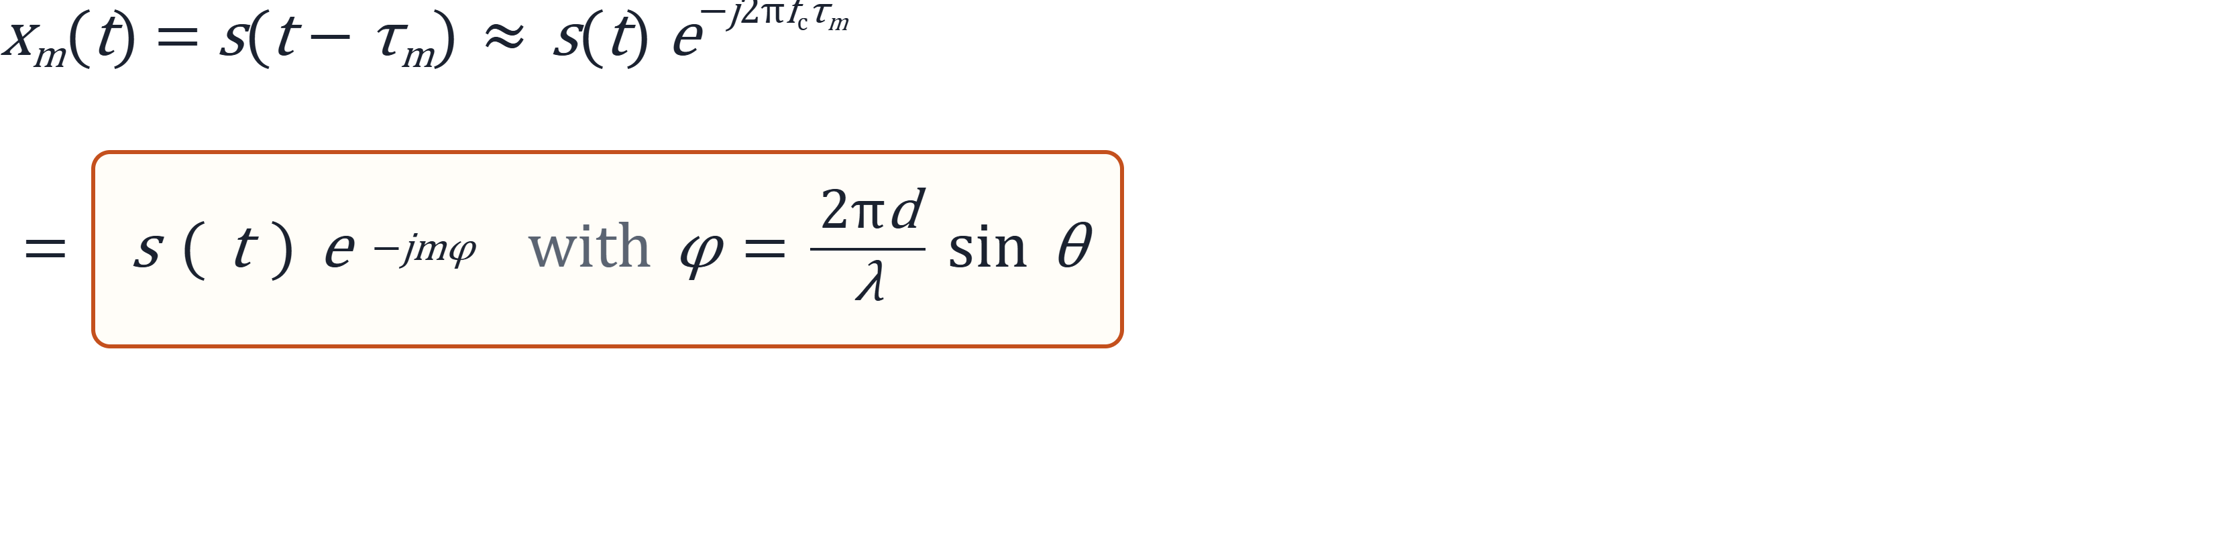
A Delay Is Just a Phase Rotation
ACT 1 · PHASE IS GEOMETRY
Antenna m sees the same signal, rotated by −mφ.
Narrowband assumption: the delay across the whole aperture, (M−1)d/c, is much shorter than 1/B. The envelope s(t) barely changes across the array — only the carrier phase does.
Notes:
Complex baseband, narrowband. The envelope s(t) moves slowly compared with the aperture delay, so s(t − τ_m) ≈ s(t) times a carrier phase factor. Plug τ_m = m d sinθ / c and f_c = c/λ: the phase is −mφ with φ = 2πd sinθ/λ. Delay became rotation. Next: stack these rotations into one vector.

Slide 16
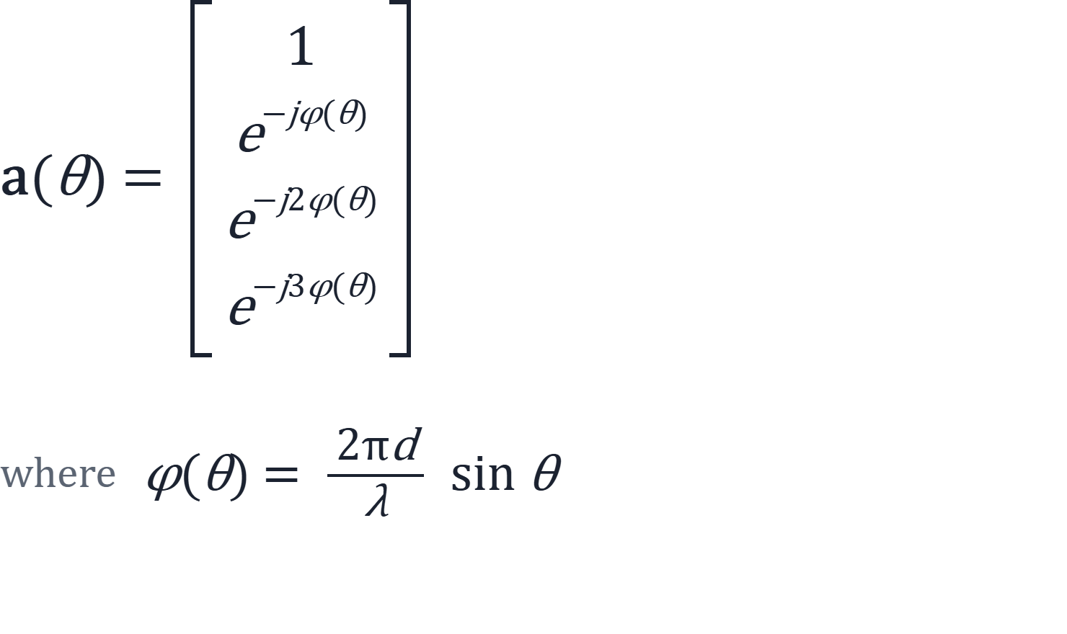
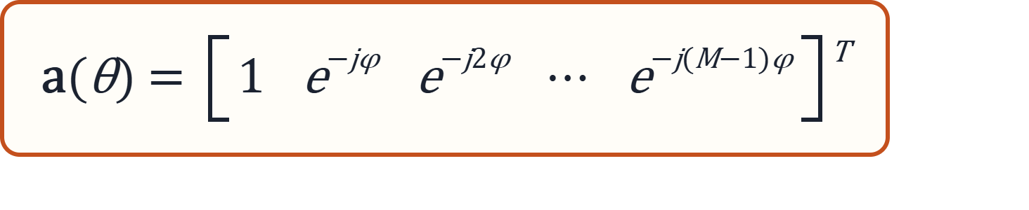

A Direction Has a Spatial Fingerprint
ACT 1 · PHASE IS GEOMETRY
OUR 4-ELEMENT ARRAY · WAVE FROM Θ
STEERING VECTOR
any M
Think of it as the array's spatial fingerprint for direction θ.
Entry m is element m's phase, −mφ, relative to the first element (m = 0, …, M−1). It depends only on geometry and direction — not on the signal.
Notes:
Return to the 4-element array. A plane wave from θ reaches each successive element a little later; at the carrier, that extra delay is just a phase shift of φ(θ) = (2πd/λ) sin θ per element. Stack the phases of all elements relative to the first one and you get the steering vector. Generalize to M elements: entry m is e^(−jmφ). Key point: a(θ) is set entirely by array geometry (d, λ) and direction θ — not by what is being transmitted. Every direction stamps its own pattern of phases across the array. That's why "spatial fingerprint" is the right mental model.

Slide 17
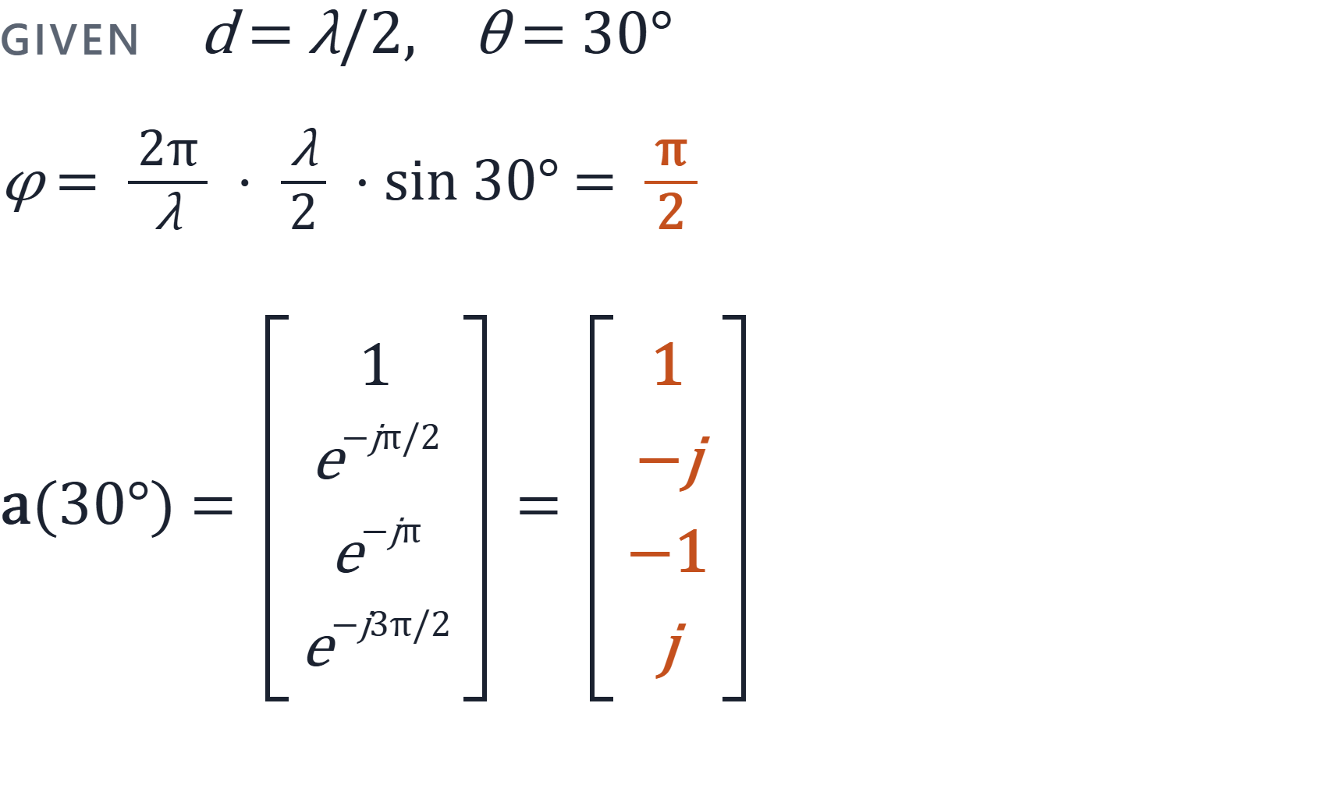
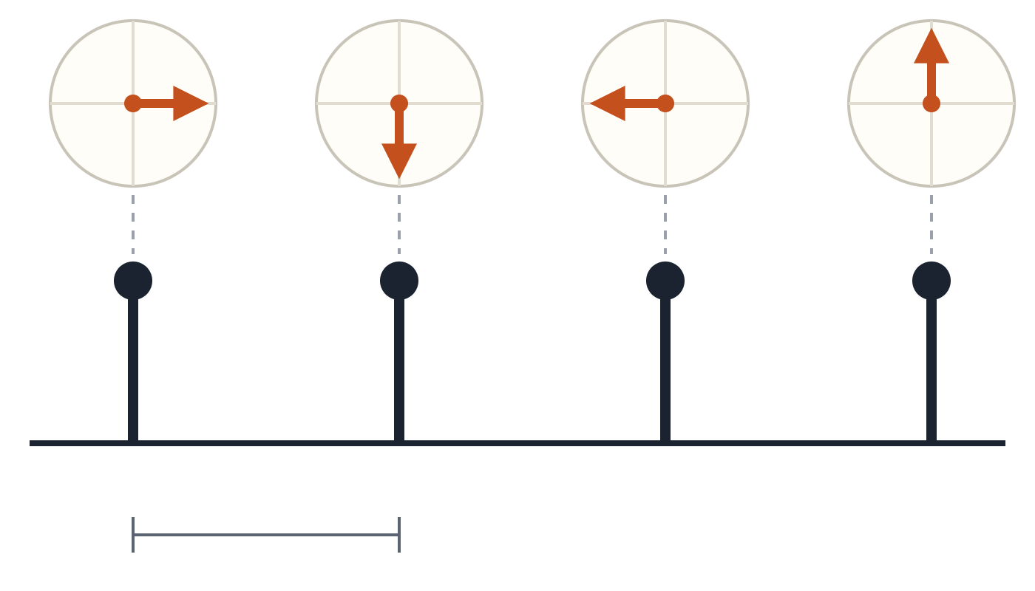
At θ = 30°, Each Element Lags by a Quarter Turn
ACT 1 · PHASE IS GEOMETRY
1
−j
−1
j
−π/2
−π/2
−π/2
ANT1
ANT2
ANT3
ANT4
d = λ/2
If every possible direction has a known fingerprint, can we determine which fingerprints are present in our received data?
NEXT · ACT 2
x(t) = a(θ) s(t) + n(t)
Notes:
Running example: d = λ/2 and θ = 30°. Then φ = (2π/λ)(λ/2) sin 30° = π · 1/2 = π/2. So each element is delayed by a quarter cycle relative to its neighbor, and the steering vector is [1, e^(−jπ/2), e^(−jπ), e^(−j3π/2)] = [1, −j, −1, j]. On the right: the same four numbers as phasors sitting above each antenna — every step rotates the phasor another 90° clockwise. That rotation pattern is the fingerprint of 30°; a different θ gives a different rotation rate per element. Closing question: if every direction has a known fingerprint, can we look at the received data and tell which fingerprints are in it? That sets up the signal model x(t) = a(θ)s(t) + n(t) for one source, and then multiple sources.

Slide 18
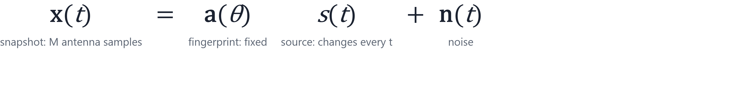
One Source: Every Snapshot Is the Same Fingerprint, Rescaled
ACT 2 · DATA LIVES IN A SUBSPACE
Different scalars, same vector: every snapshot points along a(θ).
Notes:
Here's the payoff of the fingerprint picture. One source: each snapshot is the fingerprint times a complex number that changes over time, plus noise. Drop noise for a moment. Then all snapshots are scalar multiples of one vector. Ask: what shape does that make if we plot snapshots as points?

Slide 19
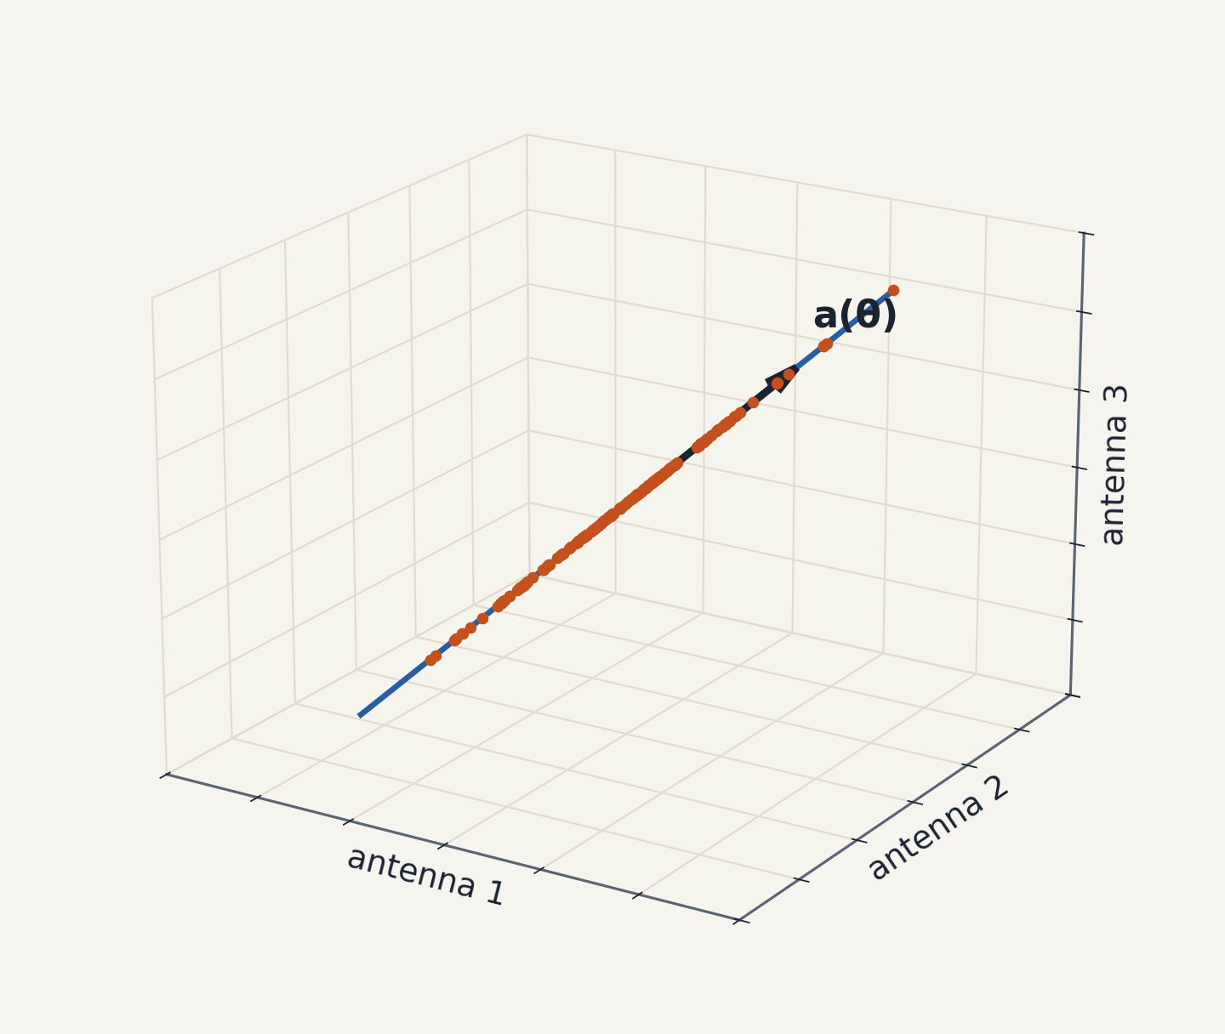

Without Noise, the Data Lives on a Line
ACT 2 · DATA LIVES IN A SUBSPACE
CARTOON · ℝ³ STANDS IN FOR ℂᴹ
Each dot is one snapshot from a 3-antenna array. With one source and no noise, every dot lies on the line through a(θ).
A subspace: closed under scaling and adding. This one has dimension 1.
Finding this line = finding the direction.
Notes:
Real 3D cartoon of a complex M-dimensional space; say this out loud so nobody gets confused later. Each snapshot is a point; with one source they all lie on a line through the origin. That line is the span of a(θ). Define subspace here, informally: a set closed under scaling and adding, so it always passes through the origin. Dimension = number of independent directions = 1.

Slide 20
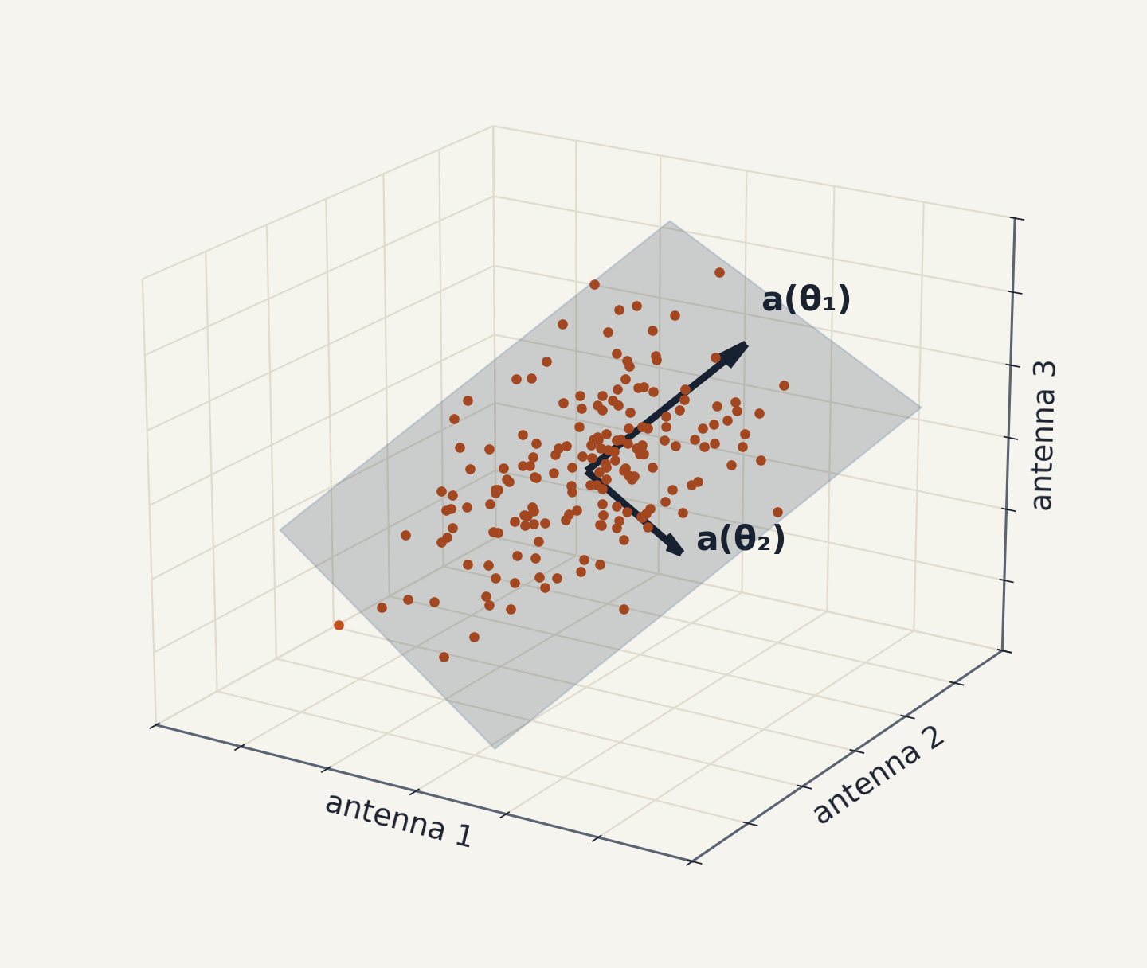
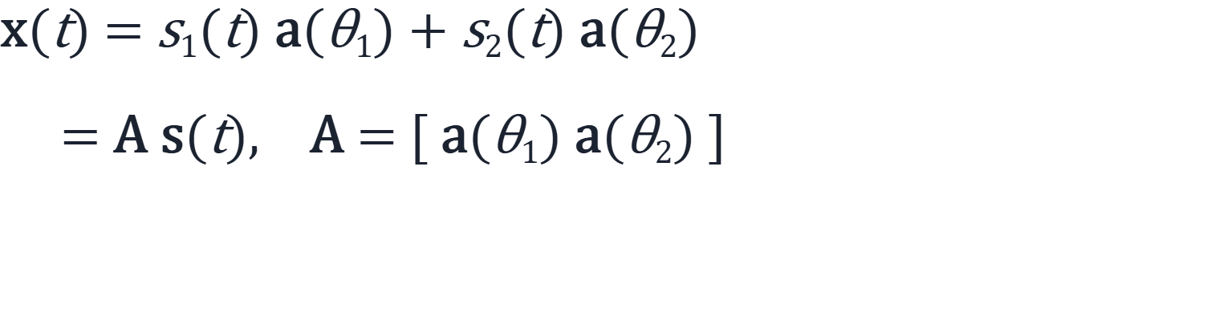
Two Sources: The Data Fills a Plane
ACT 2 · DATA LIVES IN A SUBSPACE
TWO SOURCES
Every snapshot mixes the two fingerprints, so it lies in their span: a plane.
K sources → a K-dimensional signal subspace, as long as the fingerprints are linearly independent (distinct θ).
Notes:
Two sources: each snapshot is a mix of two fingerprints, so the cloud fills the plane they span. Matrix form: x = A s, with A the M×K matrix of steering vectors. K sources, K-dimensional subspace. Point out the condition: distinct angles give linearly independent columns for a ULA (Vandermonde structure).

Slide 21
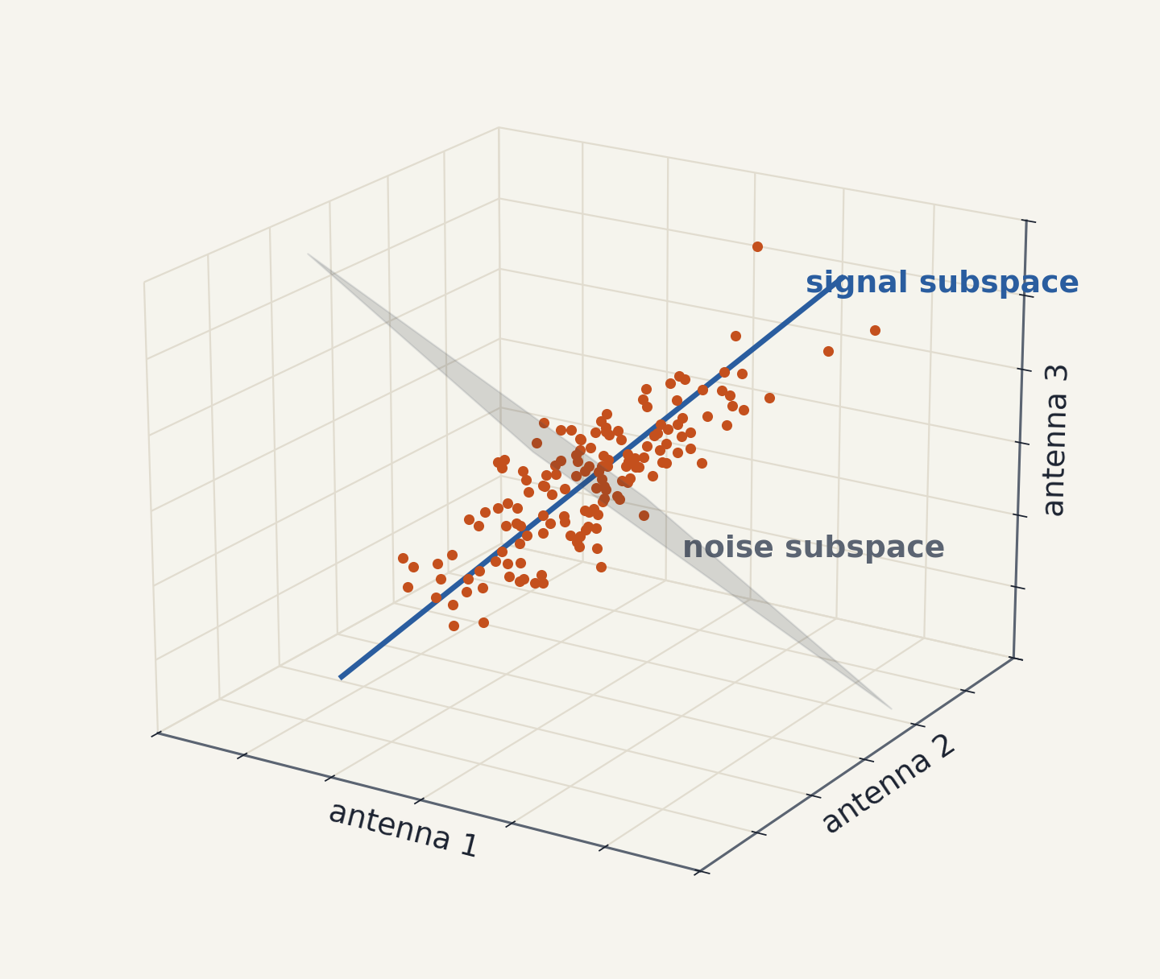
Noise Fuzzes the Cloud — in Every Direction
ACT 2 · DATA LIVES IN A SUBSPACE
ADD NOISE
Signal subspace
span of the fingerprints · dimension K
Noise subspace
everything orthogonal to it · dimension M − K
Noise adds energy equally in all M directions. The signal adds energy only along K of them.
That imbalance is what we will measure.
Notes:
Add noise: the cloud gets fuzzy, but notice the fuzz goes in every direction equally (white noise), while the signal energy is only along the line. Define orthogonal complement: everything perpendicular to the signal subspace, dimension M − K. Call it the noise subspace. The key imbalance: noise is isotropic, signal is not.

Slide 22
The Plan: Two Steps
ACT 2 · DATA LIVES IN A SUBSPACE
1
2
Estimate the signal subspace from the data
Test every candidate fingerprint against it
Find the K directions the snapshot cloud stretches along.
Keep the θ whose a(θ) lies inside that subspace.
Step 1 needs a tool that finds the directions data stretches along → the covariance matrix and its eigenvectors.
Notes:
Pause and state the plan. Step 1: from data, estimate the subspace. Step 2: for each candidate angle, check if its fingerprint lives in that subspace. Step 2 is easy once step 1 is done. Step 1 is the next act.

Slide 23
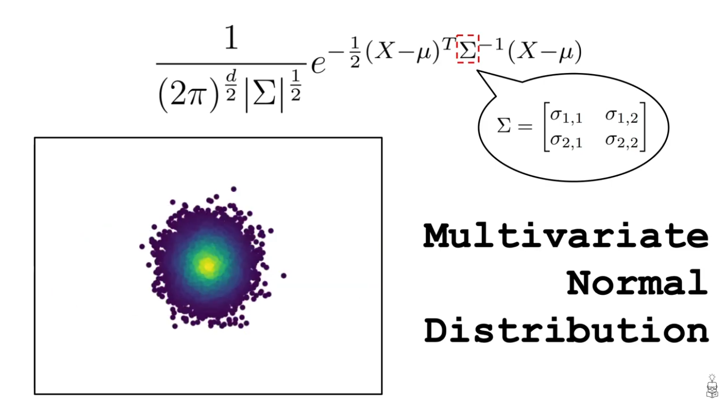
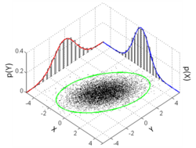

Slide 24
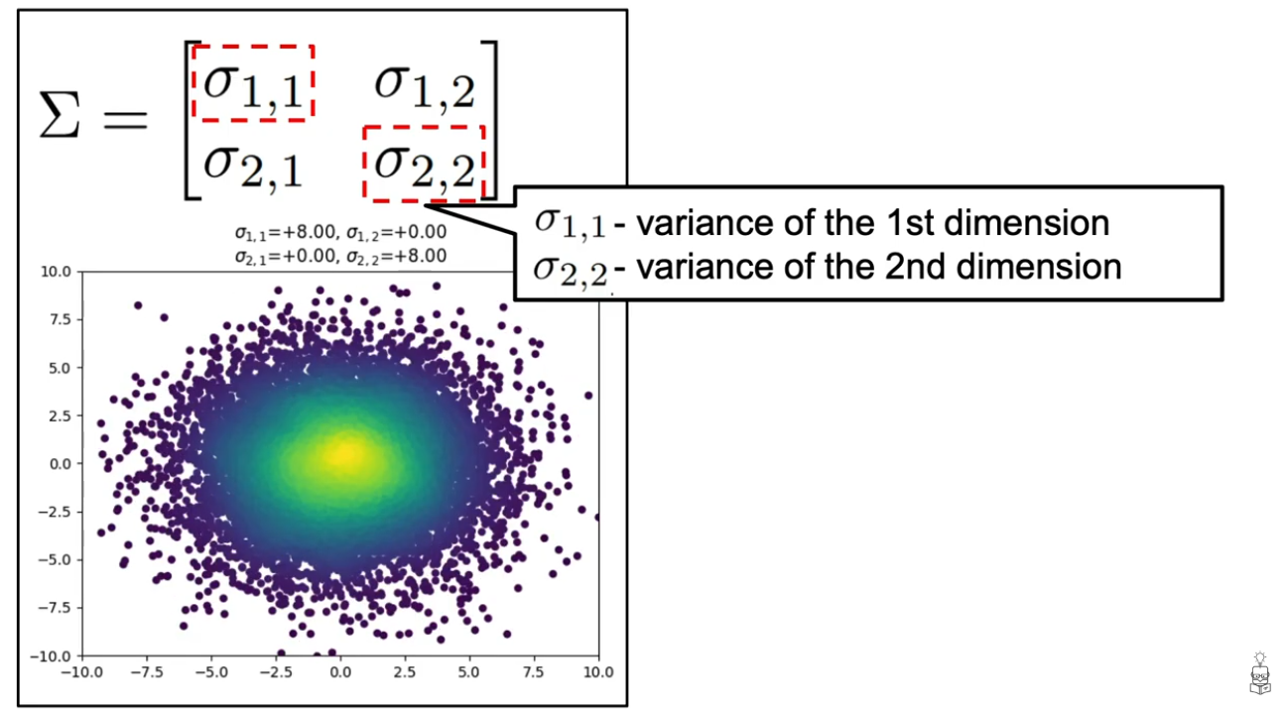

Slide 25
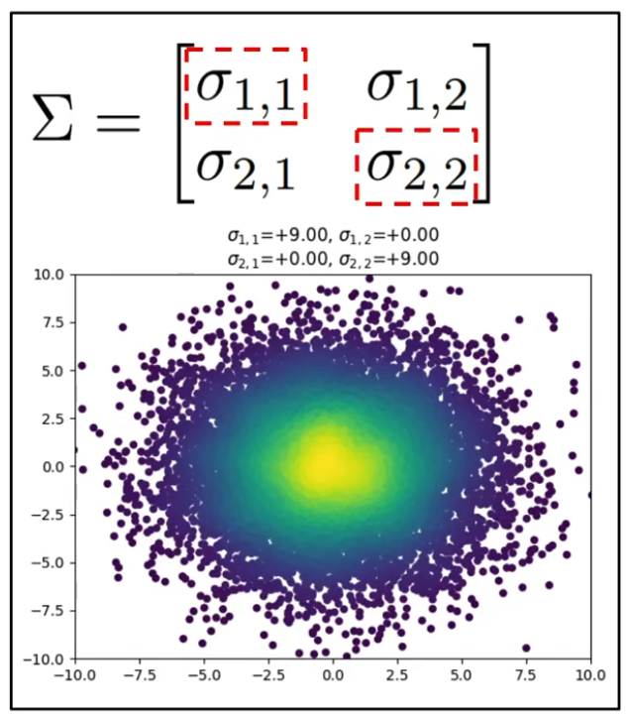
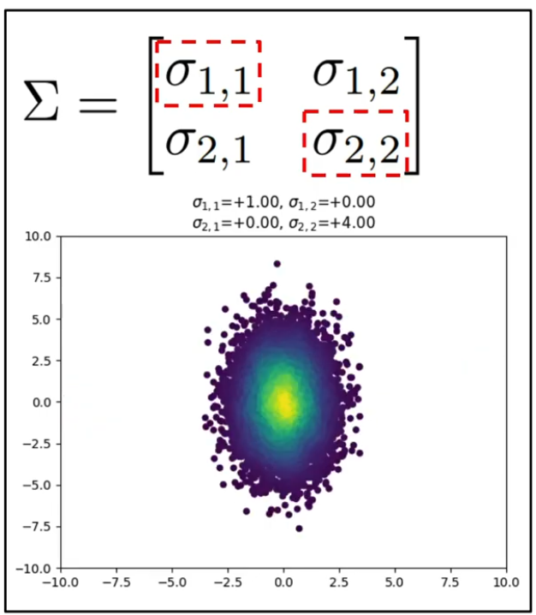

Slide 26
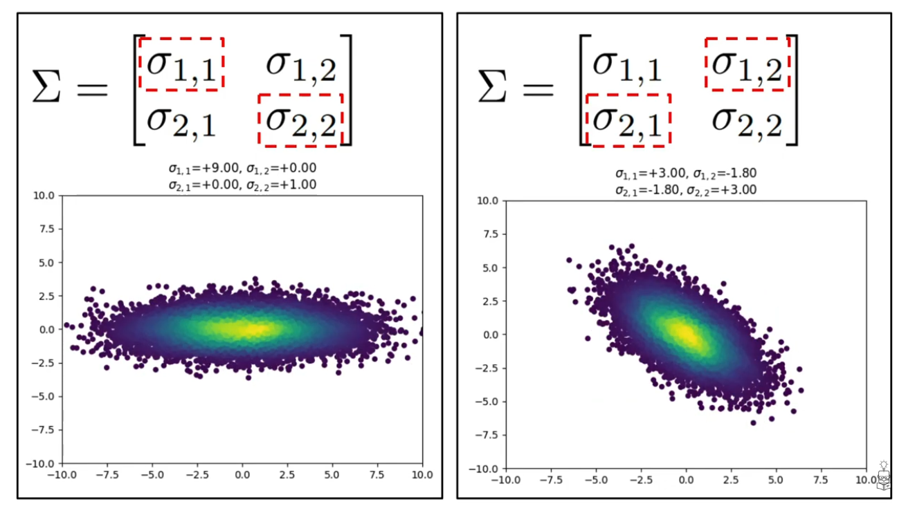

Slide 27
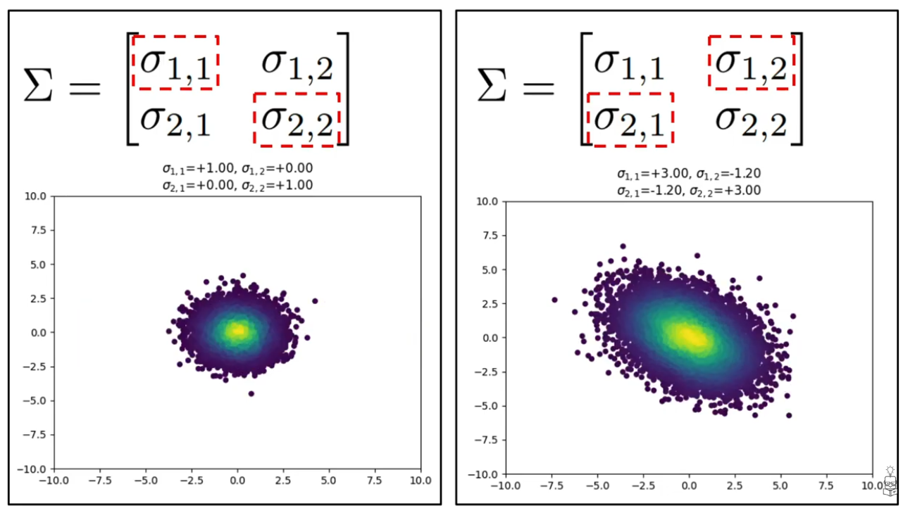

Slide 28
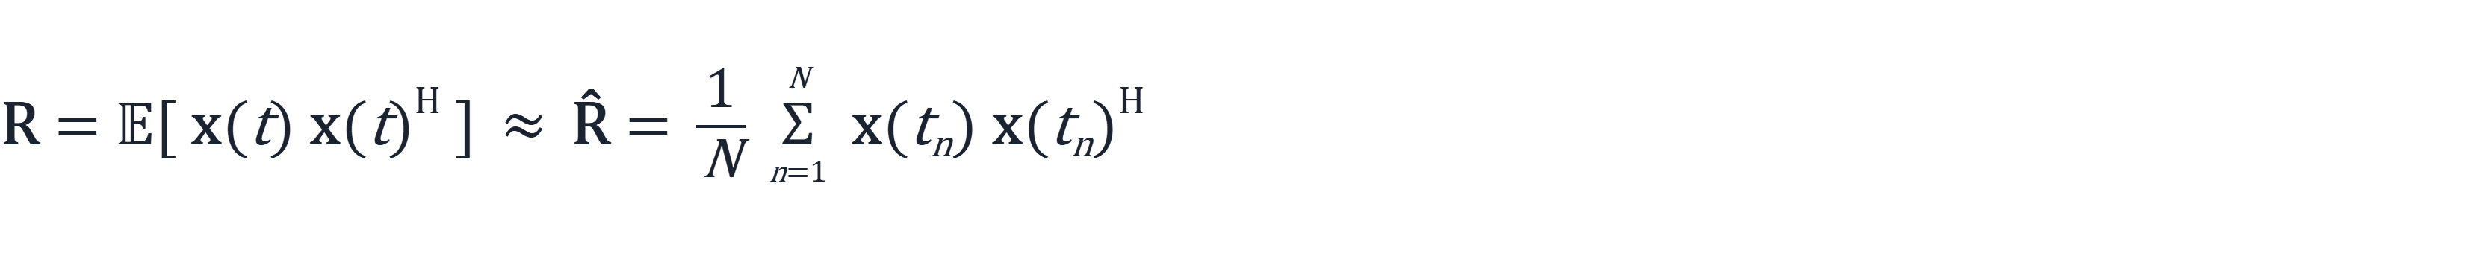
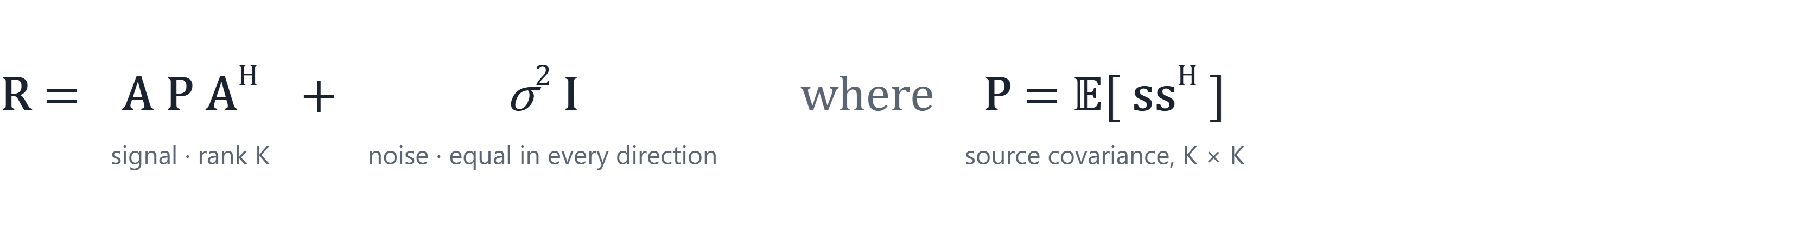

The Covariance Matrix Summarizes the Cloud's Shape
ACT 3 · EIGENVECTORS FIND THE SUBSPACE
R is M × M and Hermitian positive semidefinite. Entry Rij: how antennas i and j vary together.
R encodes the shape of the snapshot cloud.
Notes:
Covariance: the average outer product of snapshots. In practice we only have the sample estimate R-hat. Plug in x = As + n with independent white noise: R = A P A^H + σ² I. Two pieces: a rank-K signal part that lives in the plane, and an identity-shaped noise part that's the same in every direction, exactly the imbalance from the last act.

Slide 29
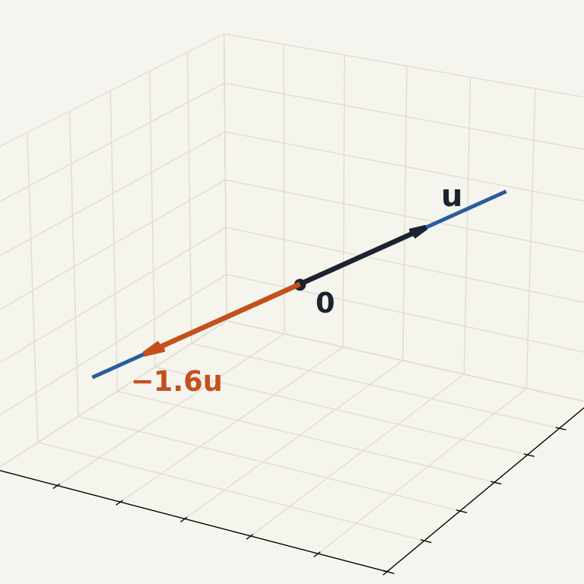
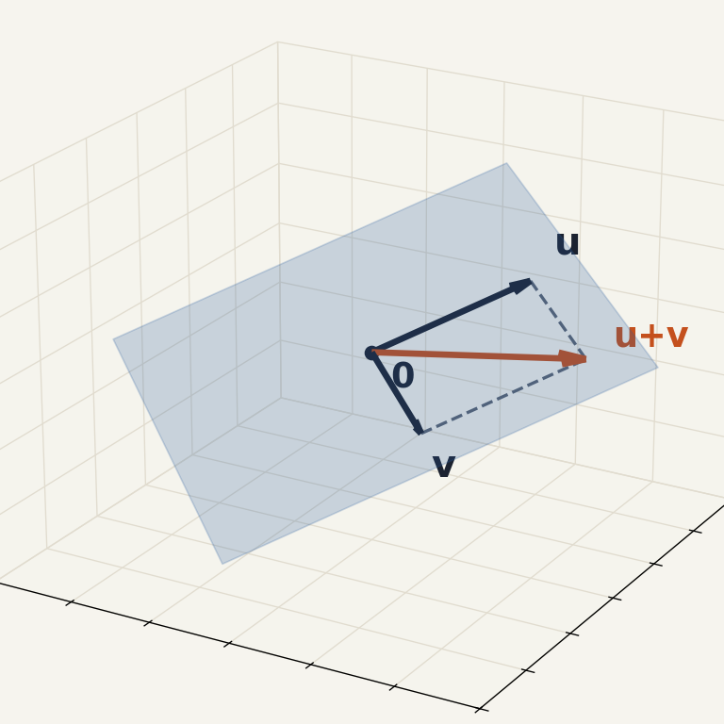
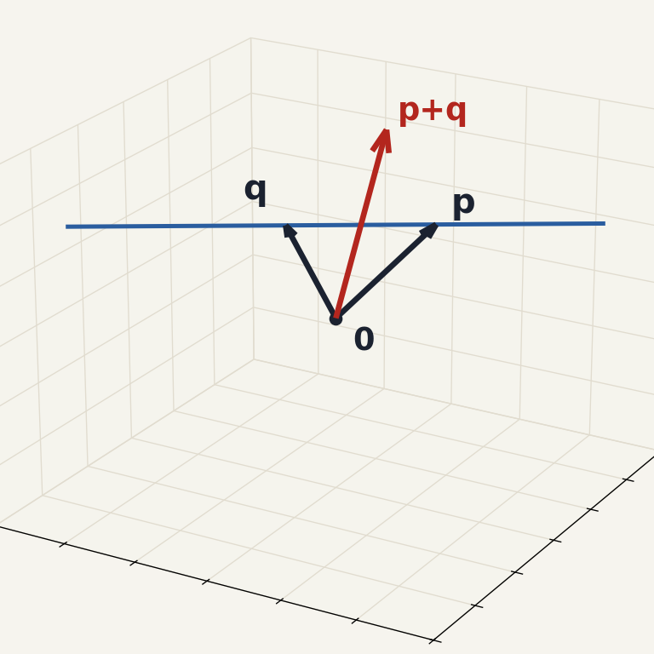
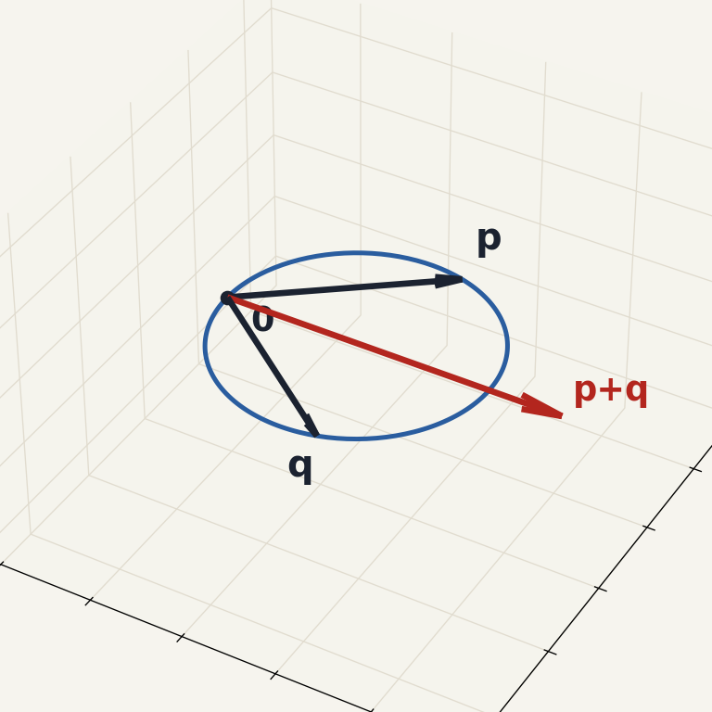
A Subspace Is a Flat Set Through the Origin
PRIMER · VECTOR SUBSPACES
① contains 0
② u + v stays inside
③ c · u stays inside
✓ Line through 0
✓ Plane through 0
✗ Shifted line
✗ Circle through 0
Scaling u slides along the line. Dimension 1.
u + v lands back in the plane. Dimension 2.
Misses 0, and p + q leaves the line.
Contains 0, but p + q leaves the circle.
Subspace = flat, and pinned at the origin.
Notes:
Three rules, then four pictures. Left two pass: a line and a plane through the origin; scaling or adding never takes you off them. Right two fail. The shifted line doesn't contain zero, and adding two of its points leaves it. The circle is the instructive one: it does contain zero, but p + q falls outside, so 'contains 0' alone isn't enough. Takeaway: subspaces are flat and pass through the origin. Ask: is the set of all snapshots from one source a subspace? (Yes, once noise is removed: it's the line through a(θ).)

Slide 30
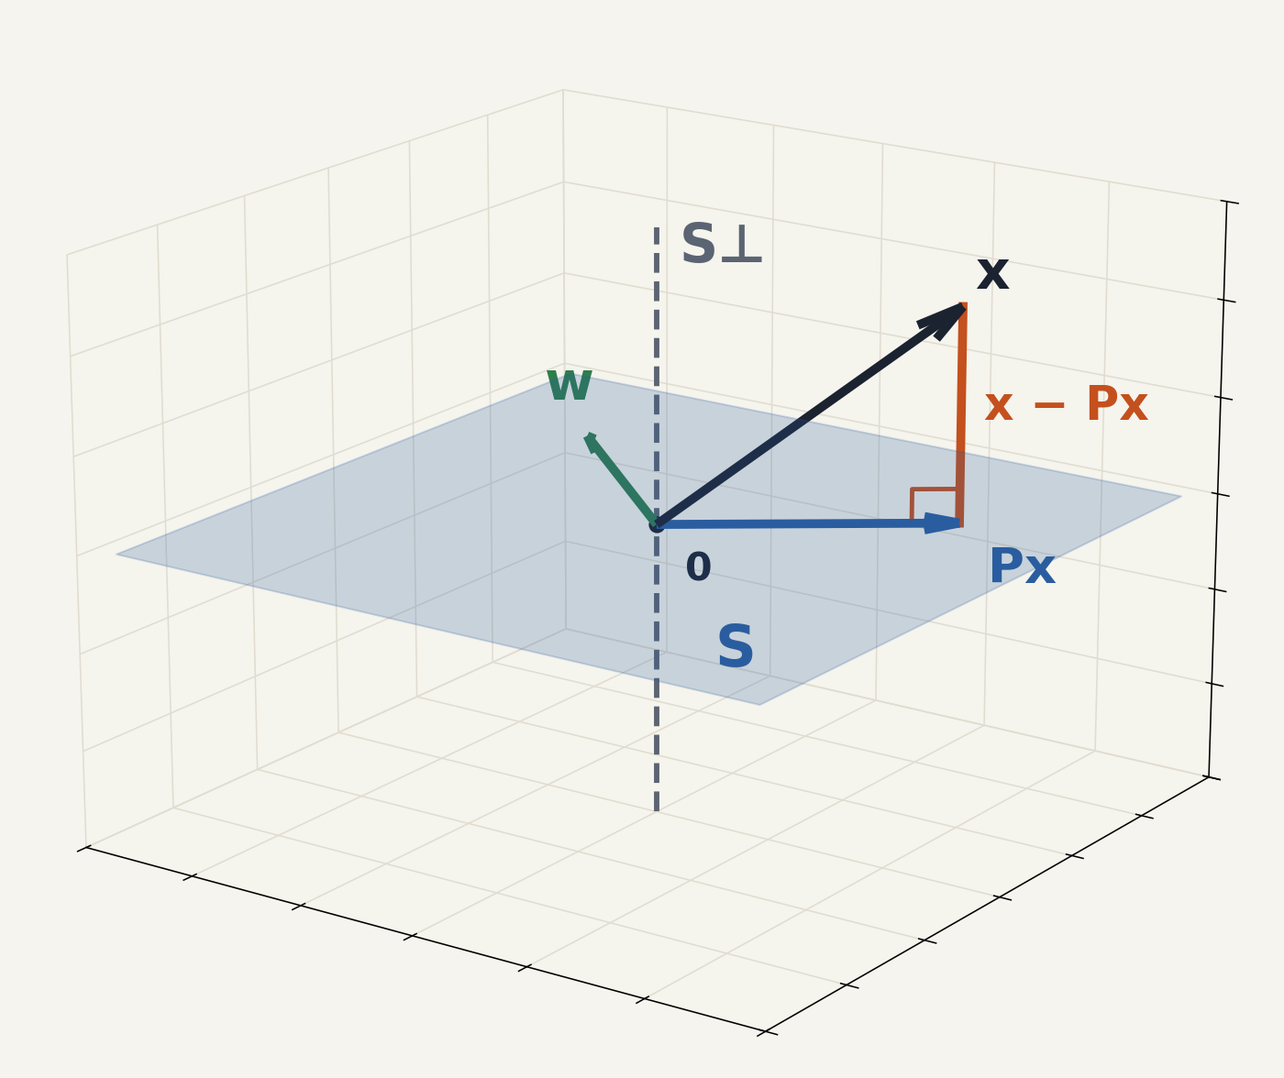
Every Vector Splits Into Two Perpendicular Parts
PRIMER · VECTOR SUBSPACES
Px is the closest point of S to x. The leftover x − Px is perpendicular to all of S.
dim S + dim S⊥ = M (here 2 + 1 = 3).
w lies in S ⇔ its leftover is 0.
Notes:
One picture carries the rest of the lecture. S is a plane, S-perp is the line perpendicular to it. Any vector x splits uniquely into a part in S (its projection Px, the closest point) and a leftover that is perpendicular to S. With an orthonormal basis U for S, the projector is U U^H. Dimensions add up to M. The green vector w already lies in S, so its leftover is zero; that is the membership test. Foreshadow: MUSIC computes exactly this leftover for every candidate fingerprint, with S = signal subspace and S-perp = noise subspace.

Slide 31
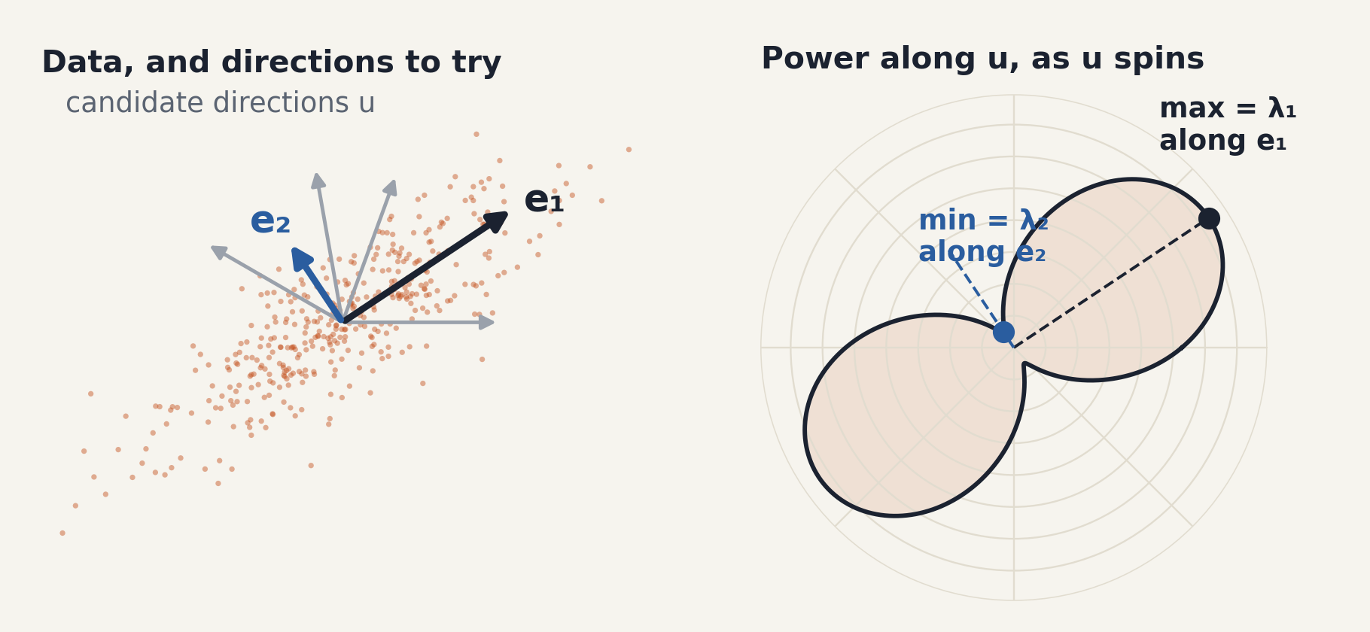
Finding the Subspace = Finding Where the Data Stretches
ACT 3 · EIGENVECTORS FIND THE SUBSPACE
THE PROBLEM
The data lives in a subspace S — but we never see S, only noisy snapshots.
THE IDEA
Spin a unit vector u and measure the data's average power along it.
THE ANSWER
The extreme directions are the eigenvectors. The power there is the eigenvalue.
[Interactive web embed — view it in the original presentation]
Big power → signal subspace. Floor-level power → noise subspace.
Notes:
Transition from 'what is a subspace' to 'how do we find it from data'. We know the snapshots live near a K-dimensional subspace, but nobody hands us a basis for it. Idea: pick a unit direction u and measure how much power the data has along it; that's u^H R-hat u. Spin u around (right panel): the power traces a peanut. The longest direction is e1, the shortest is e2, and the power values there are the eigenvalues. That's all an eigenvector of a covariance is: a direction where this power is stationary (the Rayleigh quotient). Directions with big power span the signal subspace; directions stuck at the noise floor span the noise subspace. Next slide makes R-hat precise.

Slide 32
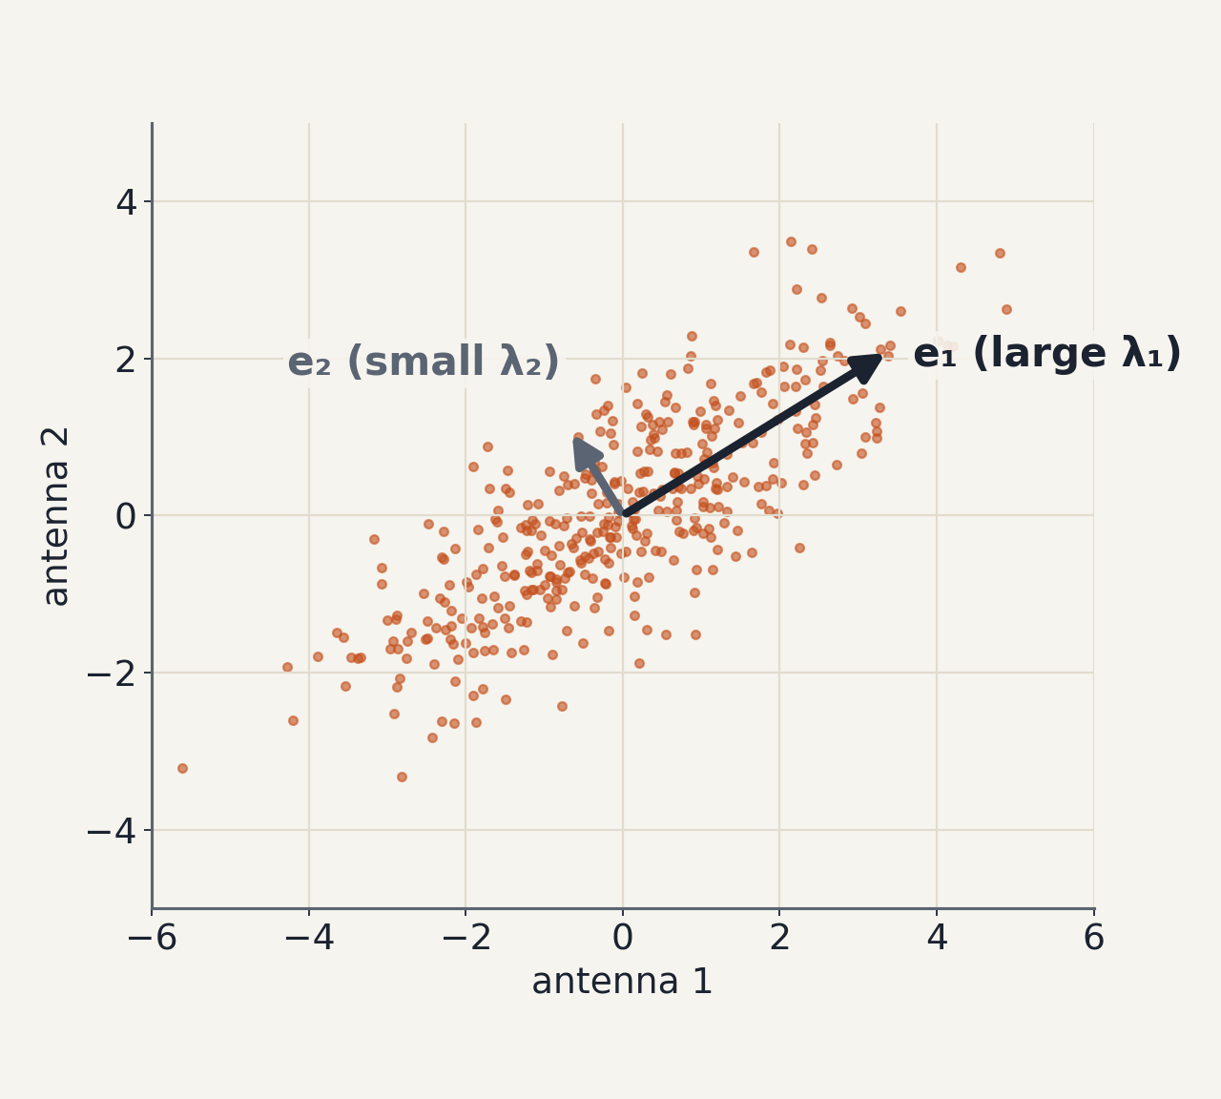

Eigenvectors Are the Directions the Cloud Stretches
ACT 3 · EIGENVECTORS FIND THE SUBSPACE
e: a direction that R only stretches, never turns.
λ = eᴴRe: the data's average power along e.
R Hermitian ⇒ eigenvalues are real and ≥ 0, eigenvectors are orthonormal (spectral theorem).
This is PCA: e₁ points along the cloud.
Notes:
Definition from scratch: an eigenvector is a direction the matrix scales without rotating. For a covariance, the eigenvalue is literally the power of the data along that direction (e^H R e). So eigenvectors of a covariance = the principal axes of the cloud, sorted by how stretched the cloud is. Spectral theorem gives real nonnegative eigenvalues and an orthonormal set.

Slide 33
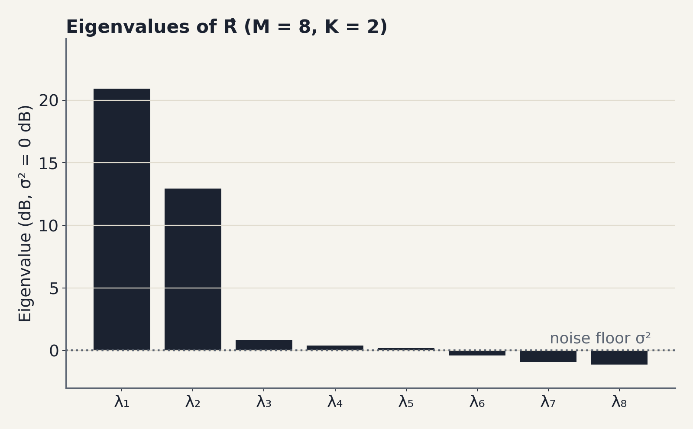
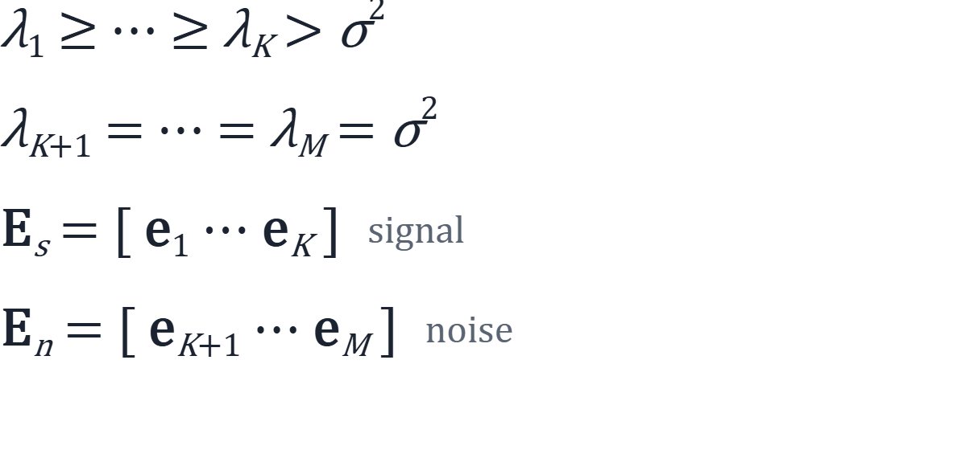
K Large Eigenvalues, M − K at the Noise Floor
ACT 3 · EIGENVECTORS FIND THE SUBSPACE
Our scene: two eigenvalues 13–21 dB up, six within ±1 dB of the floor.
The gap counts the sources.
And span(Eₛ) = span(A): the top eigenvectors recover the plane.
Notes:
Eigen-decompose R = APA^H + σ²I. Any vector orthogonal to the columns of A sees only noise: eigenvalue σ². There are M − K such directions. The K directions inside the signal plane get σ² plus signal power. So the sorted eigenvalues show a cliff. In our scene: 20.9 and 12.9 dB, then six values within about a dB of the floor. Name the two groups E_s and E_n.

Slide 34
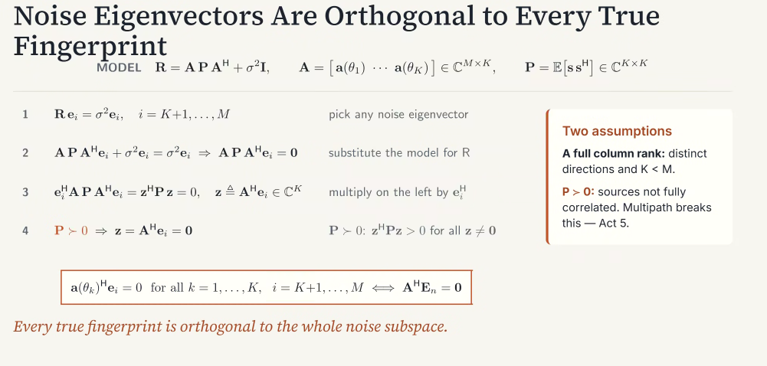
ACT 3 · EIGENVECTORS FIND THE SUBSPACE
Notes:
The one theorem of the lecture; do it on the board too. Take any noise eigenvector. Subtract σ²e from both sides, sandwich with e^H, and you get a quadratic form in A^H e with P in the middle. If P is positive definite, the only way that's zero is A^H e = 0. So every true steering vector is orthogonal to every noise eigenvector. Flag P ≻ 0 now; we'll break it on purpose later.

Slide 35
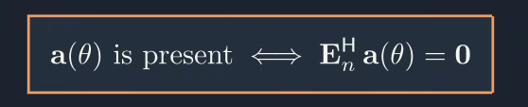

Back to Our Question
ACT 3 · EIGENVECTORS FIND THE SUBSPACE
“If every direction has a known fingerprint, which fingerprints are present in our received data?”
Exactly the directions whose fingerprints leave nothing behind in the noise subspace.
Notes:
Callback to the end of the fingerprint slides. We now have a concrete test: a fingerprint is present if and only if it has zero projection onto the noise subspace (the 'only if' direction for ULAs with M > K, by uniqueness of the Vandermonde structure). That test, run over all angles, is MUSIC.

Slide 36
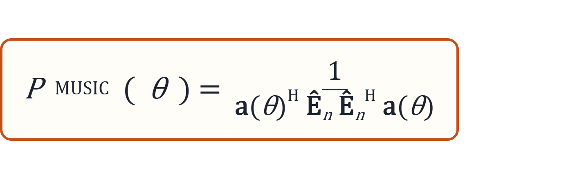
MUSIC Scans Every Fingerprint Against the Noise Subspace
ACT 4 · MUSIC
Estimate R̂ from N snapshots.
Eigendecompose R̂; keep the M − K smallest eigenvectors as Êₙ.
For every θ on a grid, measure the leftover ‖Êₙᴴ a(θ)‖².
Peaks of 1 / leftover are the directions of arrival.
MUltiple SIgnal Classification — R. O. Schmidt, IEEE Trans. Antennas and Propagation, 1986.
A fingerprint scan: score every θ by how little it leaks into noise.
Notes:
Four steps. Emphasize step 3: the denominator is the squared length of the fingerprint's projection onto the estimated noise subspace. Zero means 'fully inside the signal subspace'. Schmidt 1986 is the classic reference.

Slide 37
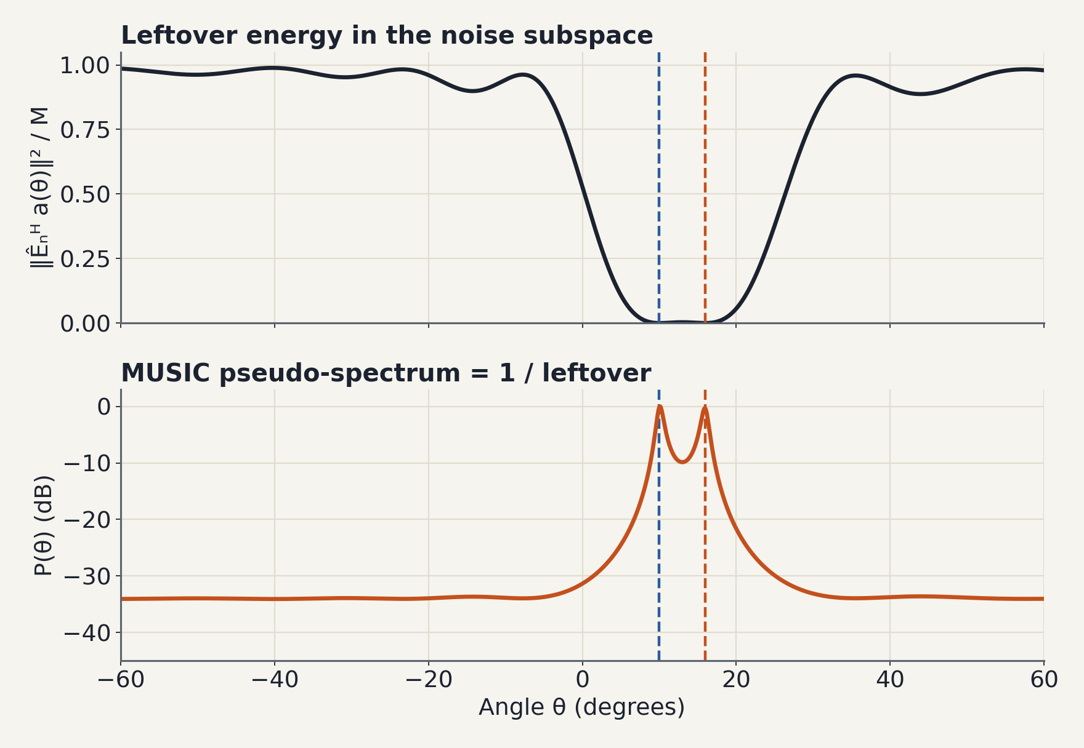
At the True Angles, the Leftover Drops to Zero
ACT 4 · MUSIC
Top: the leftover falls to ≈ 0.0004 of its maximum at 10° and 16°.
Bottom: invert it, and a near-zero becomes a needle.
Sharpness comes from the subspace, not the beamwidth — it is limited by how well R̂ estimates Eₙ.
Recovered: 10.1° and 15.9°.
Notes:
Show both panels for the same scene. Top is the thing MUSIC actually computes; it drops to essentially zero at the true angles. Bottom is the reciprocal; dividing by something near zero is why the peaks look like needles. Back to the hook question: the beamformer measures power; MUSIC measures orthogonality to noise. That's the answer.

Slide 38
Same Subspace, Different Readouts
ACT 4 · MUSIC
Spectral MUSIC
Root-MUSIC
ESPRIT
GRID SEARCH
ULA · NO GRID
SHIFT INVARIANCE
Scan a(θ) over a grid and find the peaks of 1/‖Êₙᴴa(θ)‖². Works for any array geometry; accuracy tied to the grid.
For a ULA the leftover is a polynomial in z = e^(−jφ). Angles come from the roots closest to the unit circle — and the steps are differentiable.
Two overlapping subarrays see the same fingerprints, shifted by one phase step. Solve for that rotation from the signal subspace; no search.
All three need the same input: a good estimate of the subspace.
Notes:
Quick tour, don't derive. Root-MUSIC matters later: SubspaceNet uses it because rooting is differentiable and grid-free. ESPRIT uses the signal subspace instead of the noise subspace. The common dependency: the covariance estimate. Hold that thought.

Slide 39
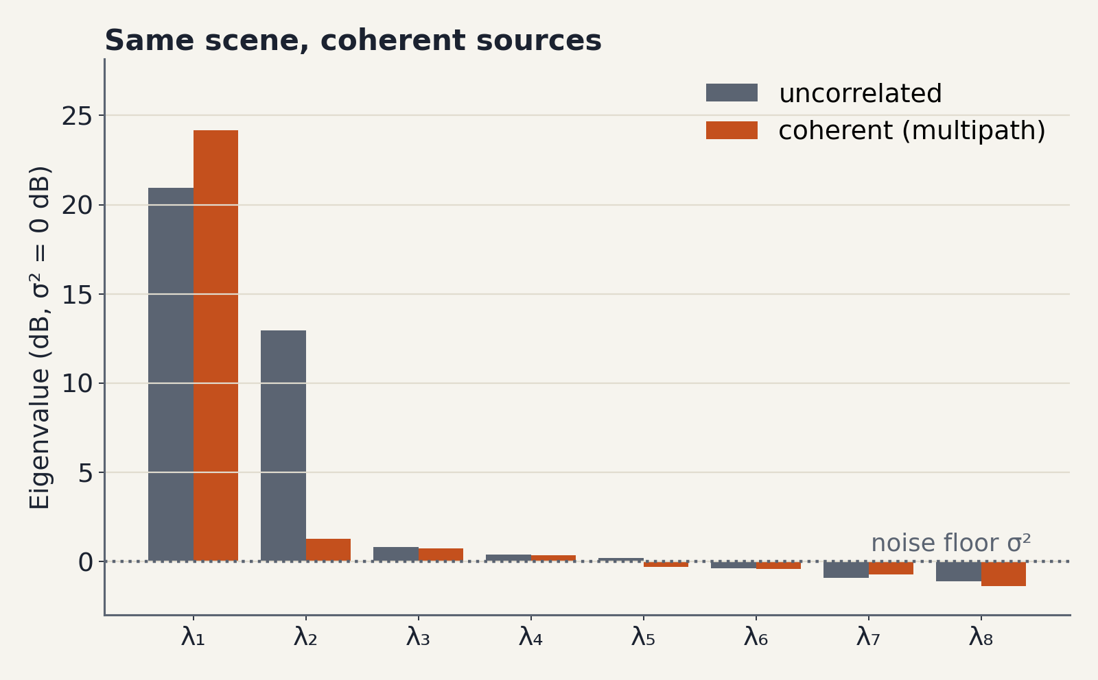
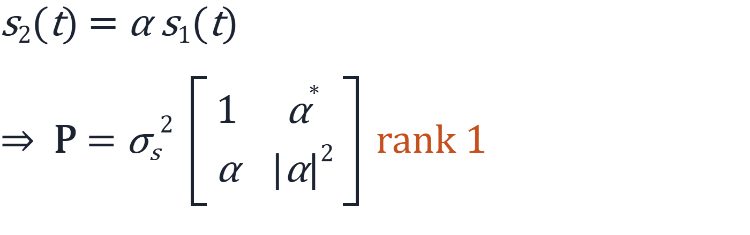
Multipath Makes Sources Coherent — and the Plane Collapses
ACT 5 · WHEN MUSIC BREAKS
FAILURE 1 · COHERENT SOURCES
A wall reflection is a delayed, scaled copy of the direct path.
Both fingerprints now carry one waveform: signal energy spans 1 dimension, not 2.
The gap now says: one source.
Notes:
Multipath: the reflection carries the same waveform as the direct path, just scaled and phase-shifted. Then P is rank one. The signal energy collapses into one direction inside the plane. Figure: same scene, now coherent; λ2 drops from about 13 dB to about 1 dB. Eigenvalue counting would say one source.

Slide 40
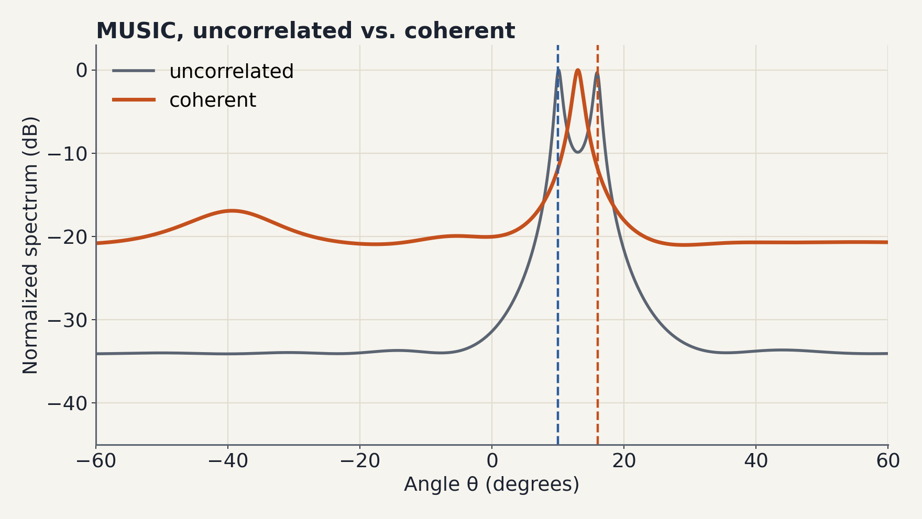
MUSIC Returns One Peak, in the Wrong Place
ACT 5 · WHEN MUSIC BREAKS
The theorem needed P ≻ 0. With P rank 1, the true fingerprints are no longer orthogonal to Êₙ.
Here: a single peak at 13°, between the two true sources.
Classical fix: spatial smoothing — average the covariances of overlapping subarrays to restore rank. Cost: a smaller effective aperture.
Two sources, one answer.
Notes:
This is where the earlier proof bites: step 4 used P ≻ 0. Without it, A^H e need not be zero, so the true fingerprints leak into the noise subspace. Result in our scene: a single peak at 13°. Note it depends on the reflection phase; this run used α = e^{jπ/4}. Spatial smoothing is the textbook fix; mention its aperture cost as motivation for a learned alternative.

Slide 41
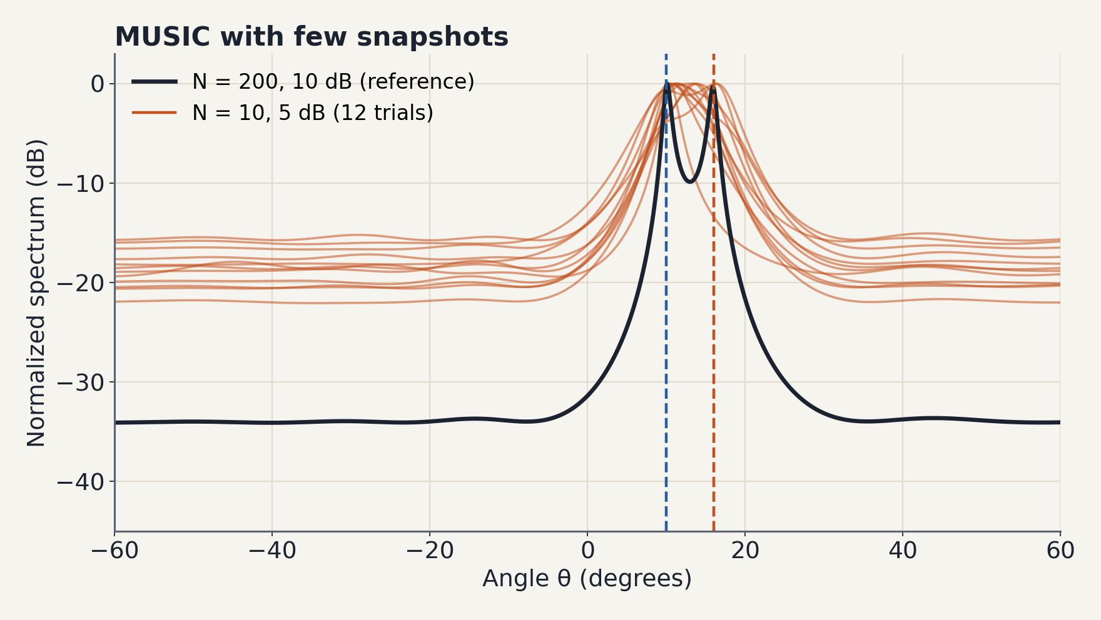
Few Snapshots: The Estimated Subspace Wobbles
ACT 5 · WHEN MUSIC BREAKS
FAILURE 2 · FEW SNAPSHOTS
R̂ is an average over N snapshots. With N = 10 it is a noisy guess of R.
Noise directions leak into Êₛ — a “subspace swap” — and the two peaks merge.
Here (N = 10, 5 dB): both sources resolved within 1.5° in about 9% of 500 trials.
MUSIC is only as good as R̂.
Notes:
Everything so far used the true R. In practice we have R-hat from N snapshots. With 10 snapshots at 5 dB, the estimated noise subspace wobbles from trial to trial; the 12 orange curves are 12 independent trials. Over 500 trials, both sources were resolved within 1.5° only about 9% of the time.

Slide 42
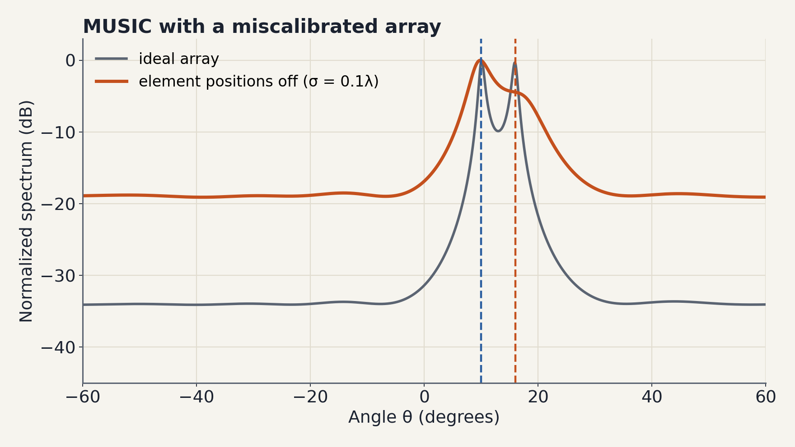
A Wrong Array Model Means Wrong Fingerprints
ACT 5 · WHEN MUSIC BREAKS
FAILURE 3 · ARRAY MISMATCH
MUSIC trusts a(θ) exactly. Real arrays have position, gain and phase errors.
Here: element positions off by σ = 0.1λ. The 16° source collapses into a shoulder; the other peak lands at 9.8°.
Wrong fingerprints, wrong answer.
Notes:
Third failure: model mismatch. The scan uses nominal fingerprints, but the real array's fingerprints are different. Here element positions are randomly perturbed with standard deviation 0.1 wavelength. Takeaway for the next act: in all three failures the MUSIC logic is fine; what's wrong is the covariance we feed it, or its consistency with the model.

Slide 43
SubspaceNet: Keep MUSIC, Learn the Covariance
ACT 6 · SUBSPACENET
Failure | What goes wrong in R̂ | What a learned R̃ can do
Coherent sources | rank collapses below K | restore a K-dimensional signal subspace
Few snapshots | noisy, unstable eigenvectors | denoise toward the true structure
Array mismatch | inconsistent with the nominal a(θ) | absorb the mismatch so a(θ) fits again
Don't replace the algorithm. Repair its input.
Shmuel, Merkofer, Revach, van Sloun & Shlezinger, “SubspaceNet: Deep Learning-Aided Subspace Methods for DoA Estimation.” An instance of model-based deep learning: a network inside a classical pipeline.
Notes:
The pivot. All three failures live in the covariance, not in MUSIC's logic. So instead of training a black box from snapshots to angles, train a network to produce a better covariance, and keep the interpretable, well-understood estimator downstream. This is model-based deep learning.

Slide 44
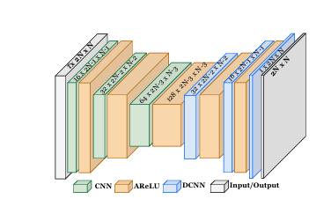




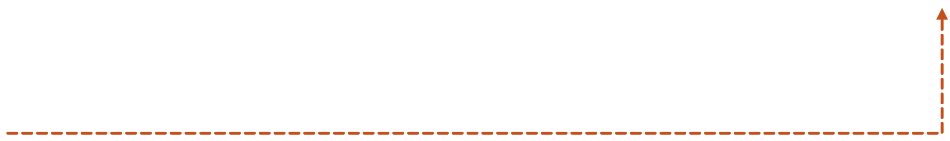
The Pipeline
ACT 6 · SUBSPACENET
■ learned ■ fixed
Snapshots
Lagged autocorrelations
CNN autoencoder
x(t), t = 1…N · M antennas
R̂ₓ(τ), τ = 0 … τₘₐₓ · real and imaginary parts as channels
outputs an M × M matrix K
DOA estimates
Root-MUSIC
Surrogate covariance
θ̂₁, …, θ̂_K
eigendecompose R̃, then root the polynomial
R̃ = K Kᴴ + εI
RMSPE loss vs. true θ
gradients flow back through Root-MUSIC and R̃ into the CNN
Notes:
Walk the snake. Input: snapshots, turned into a stack of empirical autocorrelation matrices at several lags (real and imaginary parts as channels). A convolutional autoencoder outputs a matrix K; the surrogate covariance is K K^H plus a small ε identity. That goes into a standard Root-MUSIC, which outputs angles. The loss is computed on angles, and gradients flow all the way back. Check the paper for the exact number of lags and ε used.

Slide 45
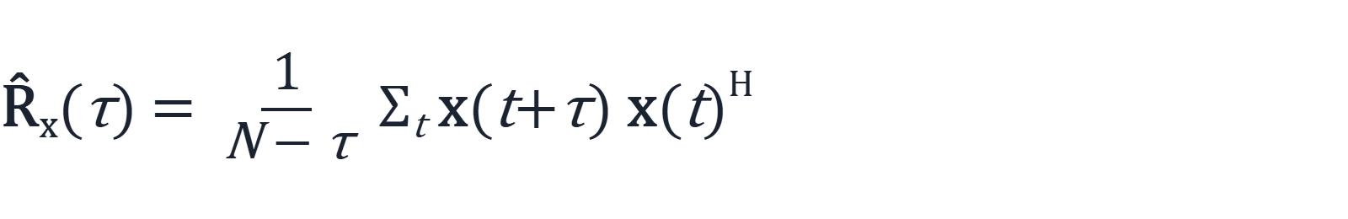

Two Design Choices That Make It Work
ACT 6 · SUBSPACENET
INPUT
OUTPUT
Lagged autocorrelations, not just R̂
A valid covariance by construction
Lag 0 is the usual sample covariance. Lags τ > 0 add how snapshots co-vary over time: extra statistics for the network beyond what R̂ alone shows.
K Kᴴ is always Hermitian and PSD; ε > 0 makes R̃ full rank. Whatever the network outputs, MUSIC's assumptions hold: real eigenvalues, orthonormal eigenvectors.
Notes:
Two small choices with big effect. Input: lag-0 alone is the covariance that broke in Act 5; adding time-lagged autocorrelations gives the network more to work with. Output: by building R-tilde as K K^H plus ε I, the network can never hand MUSIC an invalid covariance. Positive definiteness is guaranteed by architecture, not learned.

Slide 46


Slide 47

What the Network Must Learn: Put the Gap Back
ACT 6 · SUBSPACENET
Orange bars: raw R̂ in the coherent scene, with one eigenvalue above the floor.
The paper reports a clear signal/noise eigenvalue separation in the learned covariance, with lower DoA error in coherent and few-snapshot settings.(Example with 3 coherent sources)
Notes:
Close the loop with the coherent scene. Left: the raw covariance with the collapsed gap. Right: placeholder for your own trained model's R-tilde eigenvalues on the same scene. The message: the network's job is to hand MUSIC a covariance whose subspace structure is clean again.

Slide 48




Slide 49
Discussion
WRAP-UP
01
02
Why learn R̃ instead of predicting θ directly? What do we gain, and what do we give up?
The paper assumes K is known. Would you estimate K from R̃'s eigenvalue gap, or with a learned head?
03
04
The network is trained for one array. What breaks with a new M, spacing or calibration, and how would you fix it?
Where else could “learn the statistic, keep the estimator” work? Frequency estimation, spectrum sensing, localization…
Notes:
Pick two if time is short. Q1 is about interpretability and data efficiency versus flexibility. Q2 connects back to the eigenvalue gap; ask whether a gap test still makes sense on a learned covariance. Q3: generalization across geometries. Q4: invite them to map the idea onto their own research.

Slide 50
Three Ideas to Keep
WRAP-UP
1
Snapshots from K sources live in a K-dimensional subspace.
2
Eigenvectors of R̂ find it, and the noise subspace is orthogonal to every true fingerprint.
3
SubspaceNet repairs the covariance and keeps the classical estimator.
Notes:
If they remember one picture: the cloud on a line or plane, and noise everywhere else. Everything else, MUSIC and SubspaceNet included, follows from that.

