Slide 1
Using Without Royalties:
Is it ethical?
Brandon, Ryan, Tim, and Bryce

Slide 2

Intro
What is a royalty?
When should someone be paid royalties?
How often do they occur?
Thousands of major copyright cases per year
ie: Psystar v. Apple (2008)

Slide 3
Why it's Unethical
The company did none of the work
What if the shoe was on the other foot?
Pat on the back doesn't put food on the table
Hard work demands compensation

Slide 4
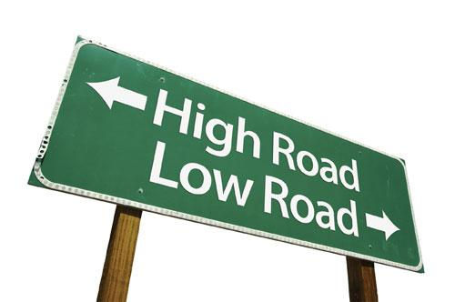
Why it's Unethical
"Everyone else is doing it" is not good enough
Warren Buffet - "How would this look on the front page of the newspaper? How would society perceive your actions?"

Slide 5

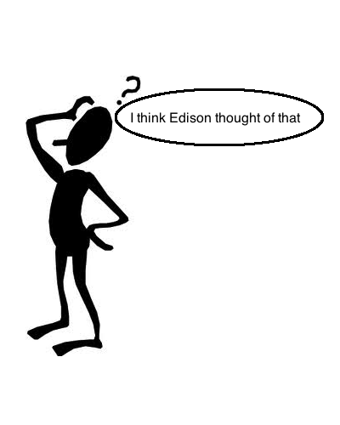
Yes it's ethical
It is difficult to draw a line.
There are no new ideas so let's just jam the old ones together.
How can we patent an idea?

Slide 6
Yes it's ethical
- Does the "work" being used have a market value?
-Company needs to be responsible for what they make available

Slide 7

What To Take From This?
Cover your bases: Communicate with the other party, get everything in writing, read things carefully
It usually depends on the information, and the potential money involved
What you thought was minor, might end up costing you a fortune in court

Slide 8
Questions/Comments?

