Slide 1
Should there be a law that forbids people from sending email to thousands of
people (spam)?
By:
Bennett Moss
Daniel Hoyt
Hizkias Neway
Junyu Wang

Slide 2
Spam
What is spam?
    It is received without consent
    It does not contain information about sender
    It does not have an unsubscribe option
More than 13,000,000,000 spam messages are sent per day
Spam accounts for 75%-90% of all email traffic
In 2004, 1 out of 500,000 persons would respond to spam, and about 400 responses would be received a day

Slide 3
Why Spam is Bad
You receive spam without permission
It can be used to spread viruses and malware
Spam can be used to steal personal information such as financial data
Computers can be turned into zombies computers and can spam personal contacts
ISPs have to spend large quantities of money on spam filtering
It is cheap, and is thus highly sustainable

Slide 4
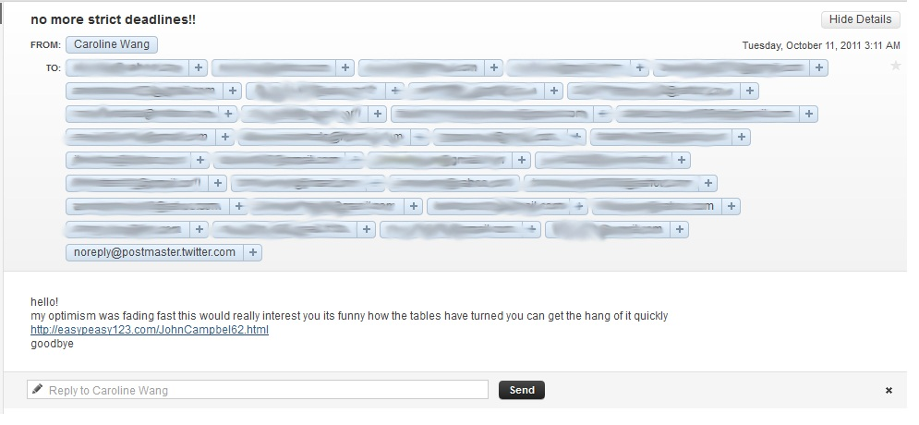
Example of a zombie account

Slide 5
Bacn
Different from spam:
Advertisement emails from companies
Information about sales, items, etc.
You have to sign up for them
There is an unsubscribe option

Slide 6
Current U.S. Law
Can-Spam Act of 2003
  Spam must contain information about the sender (mailing address, phone number, etc.)
  Recipients have the choice to opt-out of emails
  No scamming
  Caveats:
  Hard to enforce. (look in your spam folder)

Slide 7

How to improve on stopping spam
Learn from the Aussies! More enforcement
Anyone who violates these principles:
make sure you have consent to contact the recipient and can prove you have obtained it
include accurate information to identify yourself or your organisation as the authorised sender of the message
make sure your messages have a functional unsubscribe facility, so that recipients can unsubscribe at any time.
will have to pay. ISPs should track down spammers that violate terms and impose legal action.

Slide 8
Don't want spam?
Report it! from www.onlineguard.gov:
Forward messages to spam@uce.gov
Contact your sender's ISP; they want to cut down on spam
Contact your ISP's abuse desk

Slide 9
The Reality
Spam exists because it is the natural course of action.
It provides a means of exploitation on mass levels
It makes the global email population a phish farm
Simplistic scams, phishing websites, and advertisement are what the majority of the world acknowledges spam to be
Despite the automation, complex social engineering exploitation is at play
Complex exploitation software has been written to take advantage of the reality of spam

Slide 10
Get over It
Spam forces users to maintain computers at an elevated security level
Extreme measures to disable spam will make awareness of new software exploits hard to come by
Active measures to disable spam globally will result in a lower level of overall protection from viruses and malware
The reason the global system of critical vulnerabilities works so well in assessing threats is because the world acts as testers(spam is an enabler).
Getting rid of spam will pamper the world's computers into a vulnerable state, ultimately allowing more devastating attacks on the world's IT infrastructure.
Forcing the spam engineers into obscurity will make them evolve past their current state, which is working for them just fine, into a more advanced state that will pose greater risk to email recipients.
Spam, regardless of law, is INEVITABLE, so we should accept what it is currently, get over it, and not force it to evolve into something more unstoppable and unmanageable.

Slide 11
Get over It
Spam is inevitable.
Even with anti-spam laws set in place, spammers are likely to continue their habits.
With an immense amount of spammers out there it will very likely become overly costly to seriously enforce anti-spam laws. Rather, it should be the responsibility of private businesses to protect their customers against spam.
Also, since spam can originate from any part of the world, it will be very difficult if not impossible to successfully implement.
Anti-spam laws might endanger personal freedom in the web. We will need a very narrow definition of what is spam. Look at SOPA and PIPA; anti-spam can be used as an excuse, too.

Slide 12
Sources
Edelstein, Julia. "Unsubscribing From E-Mail Lists." Real Simple 12.7 (2011): 133. MasterFILE Premier. Web. 21 Apr. 2012.
72 U. Chi. L. Rev. 355. (Winter, 2005 ): 12360 words. LexisNexis Academic. Web. Date Accessed: 2012/04/21.
www.acma.gov.au/WEB/STANDARD/pc=PC_310296
www.ic.gc.ca/eic/site/ecic-ceac.nsf/eng/gv00521.html

