Slide 1
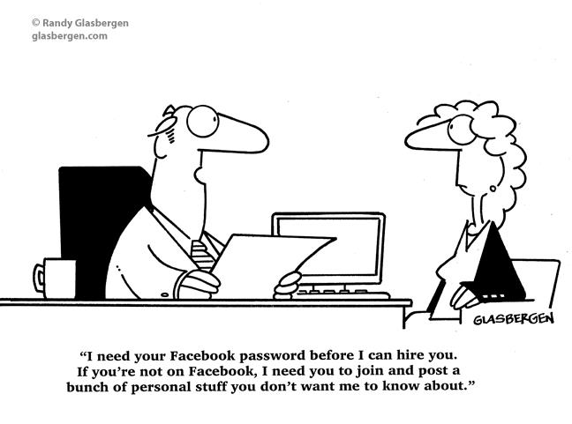
Should employers have access to your social feeds?

Slide 2
Pros
Employers find content favorable for hiring
“You post User Content ... on the Site at your own risk. Although we allow you to set privacy options that limit access to your pages, please be aware that no security measures are perfect or impenetrable. We cannot control the actions of other Users with whom you may choose to share your pages and information.” (Facebook TOS)

Slide 3
Pros
Employers have the reasonable right to your Facebook account because they have the right to ensure the integrity of the workplace.
Negative comments towards previous employers affects companies image

Slide 4
Cons
Inaccuracy of information
Friend’s security/privacy
Violation of Facebook TOS. Section 4, subsection 8.
  You will not share your password, (or in the case of developers, your secret key), let anyone else access your account, or do anything else that might jeopardize the security of your account.
Employers may use Key loggers to capture passwords

Slide 5
Cons
Creates room for legal liability if the candidate is not hired.
“Currently, employers may
search these online profiles without ever disclosing the search, the results of
the search, or the reason for any attendant adverse decision regarding the
candidate or employee.”

Slide 6
Recent Development
Maryland becomes first state to OK Facebook password protection bill
Employers can no longer ask for your Facebook password so that they may view your page

Slide 7
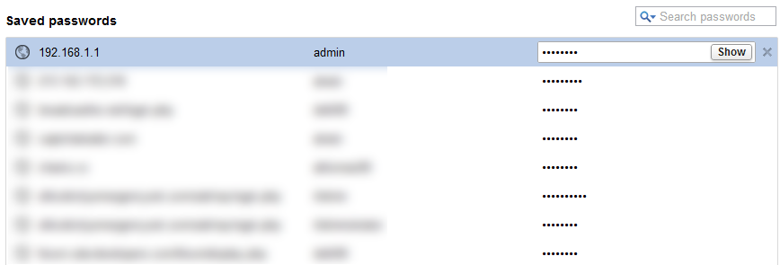
General Password Vulnerability
Both FireFox and Google Chrome store your saved passwords in plain text.

Slide 8
Works Cited
Elzweig, Brian, and Donna K. Peeples. "Using Social Networking Web Sites In Hiring and Retention Decisions." SAM Advanced Management Journal 74.4 (2009).
Davis, Donald. "MYSPACE ISN’T YOUR SPACE: EXPANDING THE FAIR CREDIT REPORTING ACT TO ENSURE ACCOUNTABILITY AND FAIRNESS IN EMPLOYER SEARCHES OF ONLINE SOCIAL NETWORKING SERVICES."KANSAS JOURNAL OF LAW & PUBLIC POLICY 16.2 (2007).

