Slide 1
How Bad Is Selfish Routing?
Dantong Ji
University of Maryland
April 19, 2018

Slide 2
Outline
Worst Case For Linear Latency Functions
Extensions

Slide 3
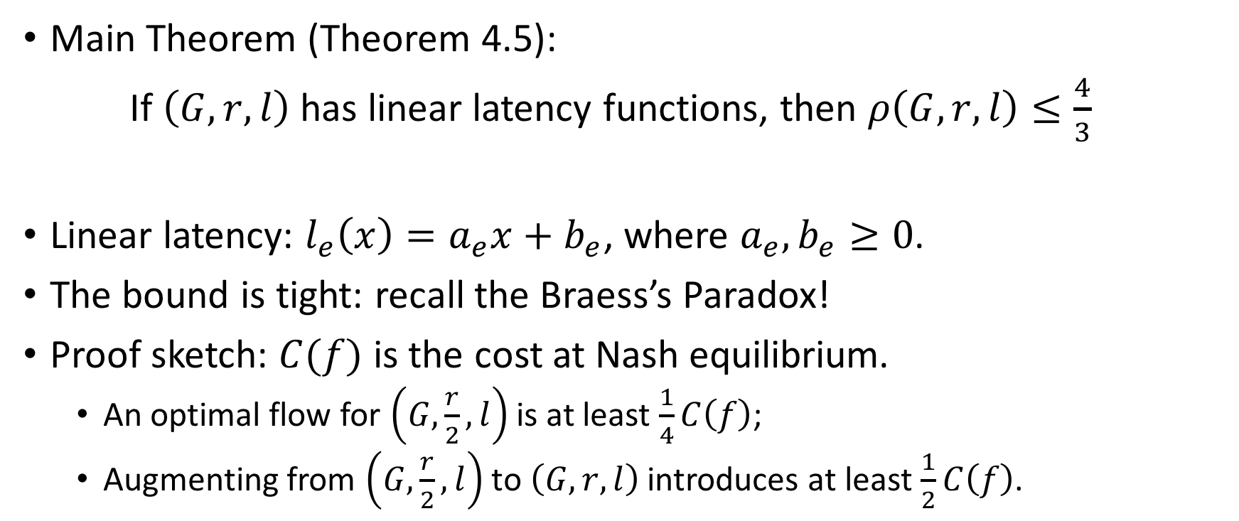
Worst Case For Linear Latency Functions
Main Theorem (Theorem 4.5):
If $\left(G, r, l\right)$ has linear latency functions, then $ρ\left(G, r, l\right)≤\frac{4}{3}$
Linear latency: $l_{e}\left(x\right)=a_{e}x+b_{e}$, where $a_{e}, b_{e}≥0$.
The bound is tight: recall the Braess’s Paradox!
Proof sketch: $C(f)$ is the cost at Nash equilibrium.
  An optimal flow for $\left(G,\frac{r}{2}, l\right)$ is at least $\frac{1}{4}C\left(f\right)$;
  Augmenting from $\left(G,\frac{r}{2}, l\right)$ to $\left(G, r, l\right)$ introduces at least $\frac{1}{2}C\left(f\right)$.

Slide 4

Lemmas
Lemma 2.2: A flow $f$ feasible for instance $(G, r, l)$ is at Nash equilibrium if and only if for every $i∈\left\{1, ⋯, k\right\}$ and $P_{1}, P_{2}∈Ρ_{i}$ with $f_{P_{1}}>0, { l}_{p_{1}}\left(f\right)≤{ l}_{p_{2}}\left(f\right).$

Slide 5
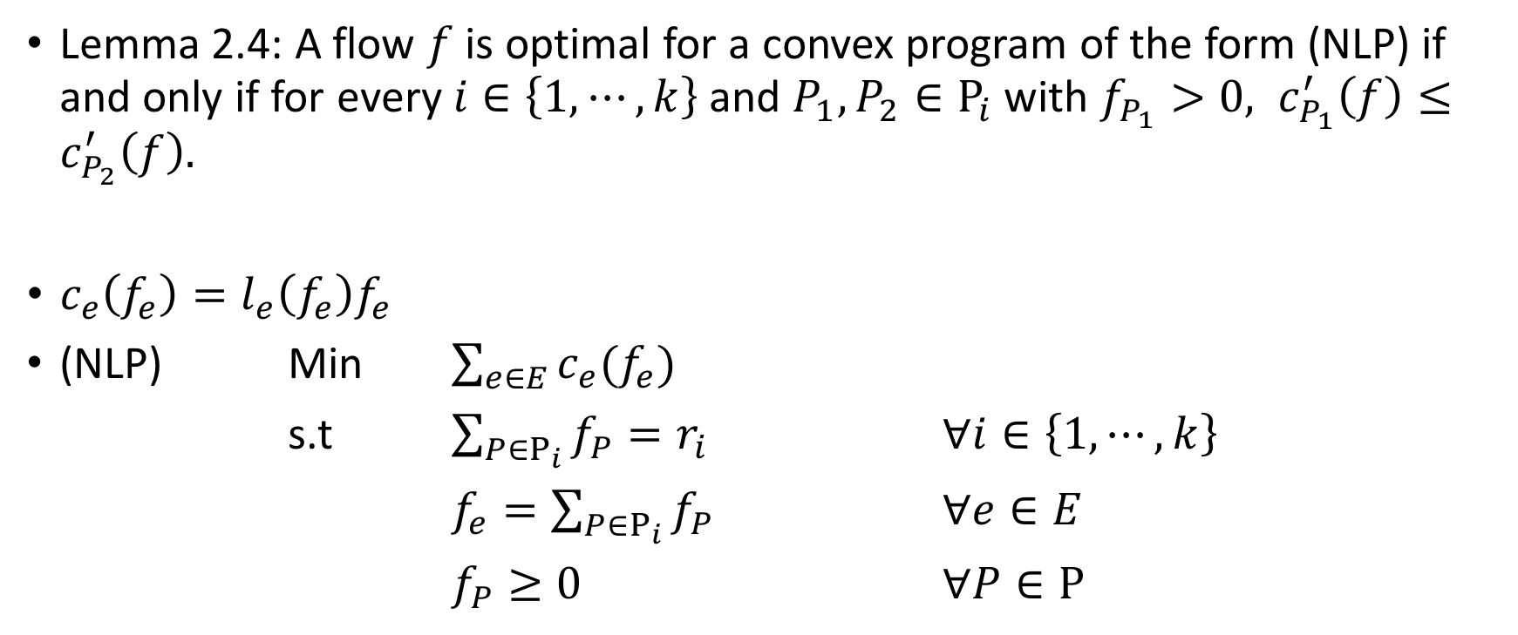
Lemmas
Lemma 2.4: A flow $f$ is optimal for a convex program of the form (NLP) if and only if for every $i∈\left\{1, ⋯, k\right\}$ and $P_{1}, P_{2}∈Ρ_{i}$ with $f_{P_{1}}>0, c_{P_{1}}^{′}\left(f\right)≤c_{P_{2}}^{′}\left(f\right).$
$c_{e}\left(f_{e}\right)=l_{e}\left(f_{e}\right)f_{e}$
(NLP) Min $\sum_{e∈E}{c_{e}(f_{e})}$
s.t $\sum_{P∈Ρ_{i}}{f_{P}}=r_{i}$ $∀i∈\left\{1, ⋯,k\right\}$
$f_{e}=\sum_{P∈Ρ_{i}}{f_{P}}$ $∀e∈E$
$f_{P}≥0$ $∀P∈Ρ$
Notes:
Intuitive: Move any bit of the flow in $Ρ_{i}$ from the current path $P_{1}$to another, will result in an increase in the cost.

Slide 6
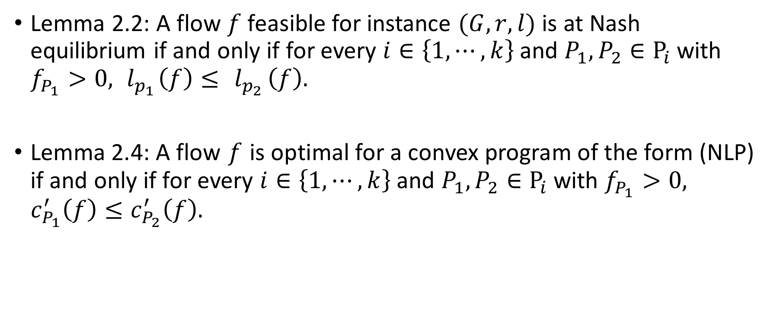
Lemmas
Lemma 2.2: A flow $f$ feasible for instance $(G, r, l)$ is at Nash equilibrium if and only if for every $i∈\left\{1, ⋯, k\right\}$ and $P_{1}, P_{2}∈Ρ_{i}$ with $f_{P_{1}}>0, { l}_{p_{1}}\left(f\right)≤{ l}_{p_{2}}\left(f\right).$
Lemma 2.4: A flow $f$ is optimal for a convex program of the form (NLP) if and only if for every $i∈\left\{1, ⋯, k\right\}$ and $P_{1}, P_{2}∈Ρ_{i}$ with $f_{P_{1}}>0, c_{P_{1}}^{′}\left(f\right)≤c_{P_{2}}^{′}\left(f\right).$

Slide 7
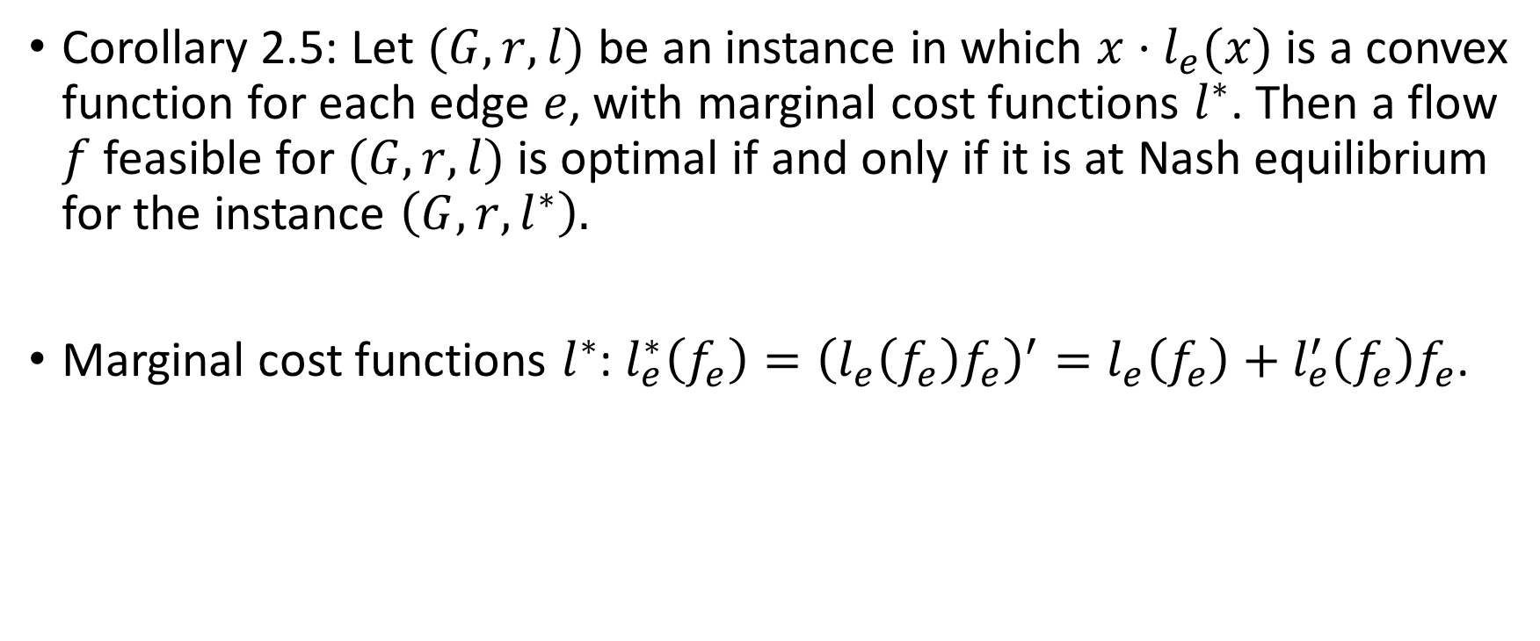
Lemmas
Corollary 2.5: Let $(G, r, l)$ be an instance in which $x⋅l_{e}(x)$ is a convex function for each edge $e$, with marginal cost functions $l^{∗}$. Then a flow $f$ feasible for $(G, r, l)$ is optimal if and only if it is at Nash equilibrium for the instance $\left(G, r, l^{∗}\right).$
Marginal cost functions $l^{∗}$: $l_{e}^{∗}\left(f_{e}\right)={\left(l_{e}\left(f_{e}\right)f_{e}\right)}^{′}=l_{e}\left(f_{e}\right)+l_{e}^{′}\left(f_{e}\right)f_{e}$.

Slide 8
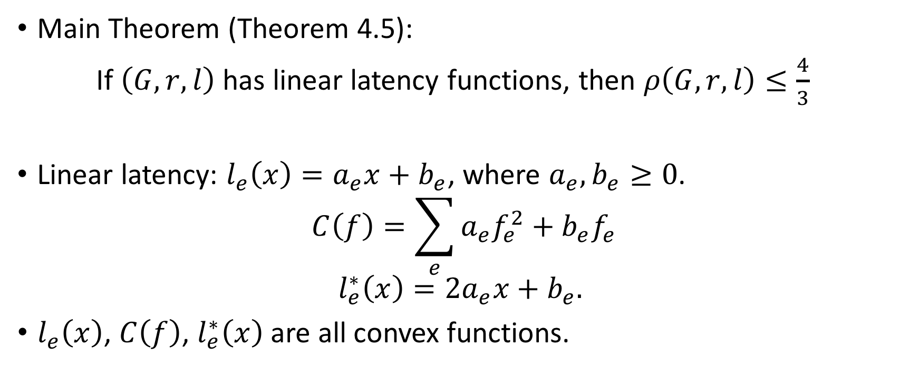
Quick Refresh
Main Theorem (Theorem 4.5):
If $\left(G, r, l\right)$ has linear latency functions, then $ρ\left(G, r, l\right)≤\frac{4}{3}$
Linear latency: $l_{e}\left(x\right)=a_{e}x+b_{e}$, where $a_{e}, b_{e}≥0$.
$$C\left(f\right)=\sum_{e}{a_{e}f_{e}^{2}+b_{e}f_{e}}$$
$$l_{e}^{∗}\left(x\right)=2a_{e}x+b_{e}.$$
$l_{e}\left(x\right)$, $C\left(f\right)$, $l_{e}^{∗}\left(x\right)$ are all convex functions.

Slide 9
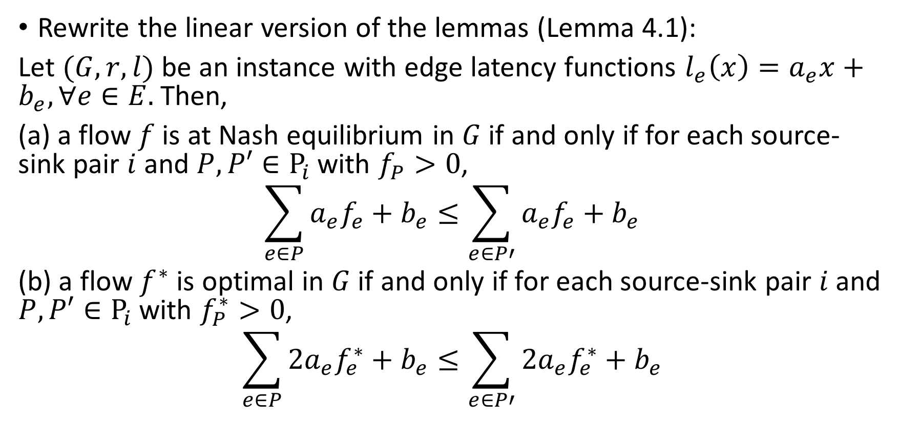
Lemmas
Rewrite the linear version of the lemmas (Lemma 4.1):
Let $(G, r, l)$ be an instance with edge latency functions $l_{e}\left(x\right)=a_{e}x+b_{e}, ∀e∈E.$ Then,
(a) a flow $f$ is at Nash equilibrium in $G$ if and only if for each source-sink pair $i$ and $P, P′∈Ρ_{i}$ with $f_{P}>0$,
$$\sum_{e∈P}{a_{e}f_{e}+b_{e}}≤\sum_{e∈P′}{a_{e}f_{e}+b_{e}}$$
(b) a flow $f^{∗}$ is optimal in $G$ if and only if for each source-sink pair $i$ and $P, P′∈Ρ_{i}$ with $f_{P}^{∗}>0$,
$$\sum_{e∈P}{{2a}_{e}f_{e}^{∗}+b_{e}}≤\sum_{e∈P′}{{2a}_{e}f_{e}^{∗}+b_{e}}$$

Slide 10
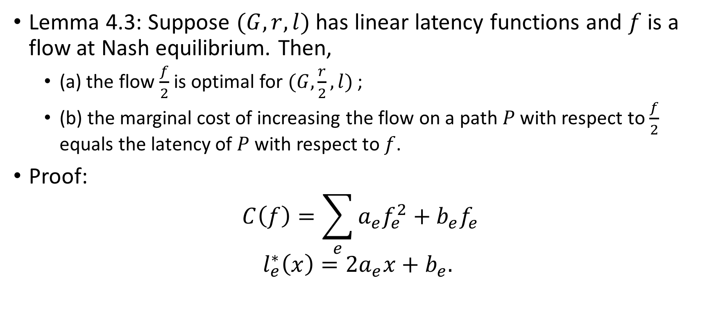
Lemmas
Lemma 4.3: Suppose $(G, r, l)$ has linear latency functions and $f$ is a flow at Nash equilibrium. Then,
  (a) the flow $\frac{f}{2}$ is optimal for $(G,\frac{r}{2}, l)$ ;
  (b) the marginal cost of increasing the flow on a path $P$ with respect to $\frac{f}{2}$ equals the latency of $P$ with respect to $f$.
Proof:
$$C\left(f\right)=\sum_{e}{a_{e}f_{e}^{2}+b_{e}f_{e}}$$
$$l_{e}^{∗}\left(x\right)=2a_{e}x+b_{e}.$$

Slide 11
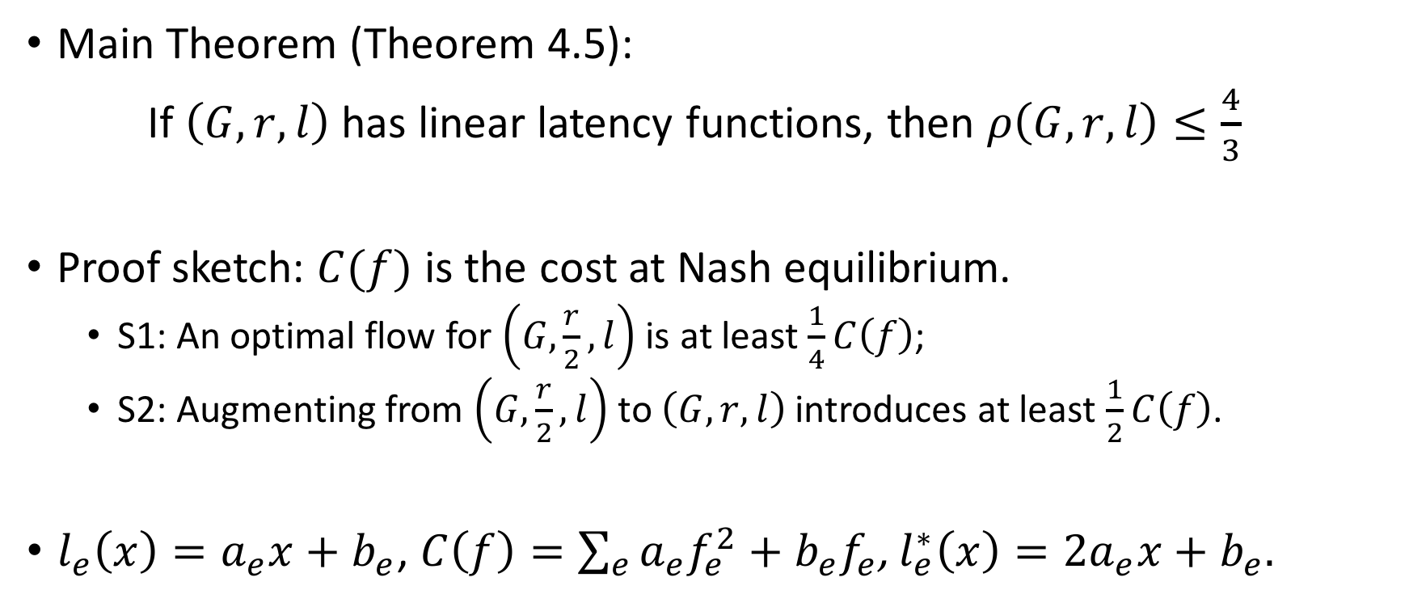
Worst Case For Linear Latency Functions
Main Theorem (Theorem 4.5):
If $\left(G, r, l\right)$ has linear latency functions, then $ρ\left(G, r, l\right)≤\frac{4}{3}$
Proof sketch: $C(f)$ is the cost at Nash equilibrium.
  S1: An optimal flow for $\left(G,\frac{r}{2}, l\right)$ is at least $\frac{1}{4}C\left(f\right)$;
  S2: Augmenting from $\left(G,\frac{r}{2}, l\right)$ to $\left(G, r, l\right)$ introduces at least $\frac{1}{2}C\left(f\right)$.
$l_{e}\left(x\right)=a_{e}x+b_{e}$, $C\left(f\right)=\sum_{e}{a_{e}f_{e}^{2}+b_{e}f_{e}}$, $l_{e}^{∗}\left(x\right)=2a_{e}x+b_{e}.$

Slide 12

Worst Case For Linear Latency Functions-1
  Step 1: An optimal flow for $\left(G,\frac{r}{2}, l\right)$ is at least $\frac{1}{4}C\left(f\right).$
  Proof:
  $$C\left(\frac{f}{2}\right)=\sum_{e}{\frac{1}{4}a_{e}f_{2}^{2}+\frac{1}{2}b_{e}f_{e}}$$
  $$≥\frac{1}{4}\sum_{e}{a_{e}f_{e}^{2}+b_{e}f_{e}}$$
  $$=\frac{1}{4}C\left(f\right)$$

Slide 13
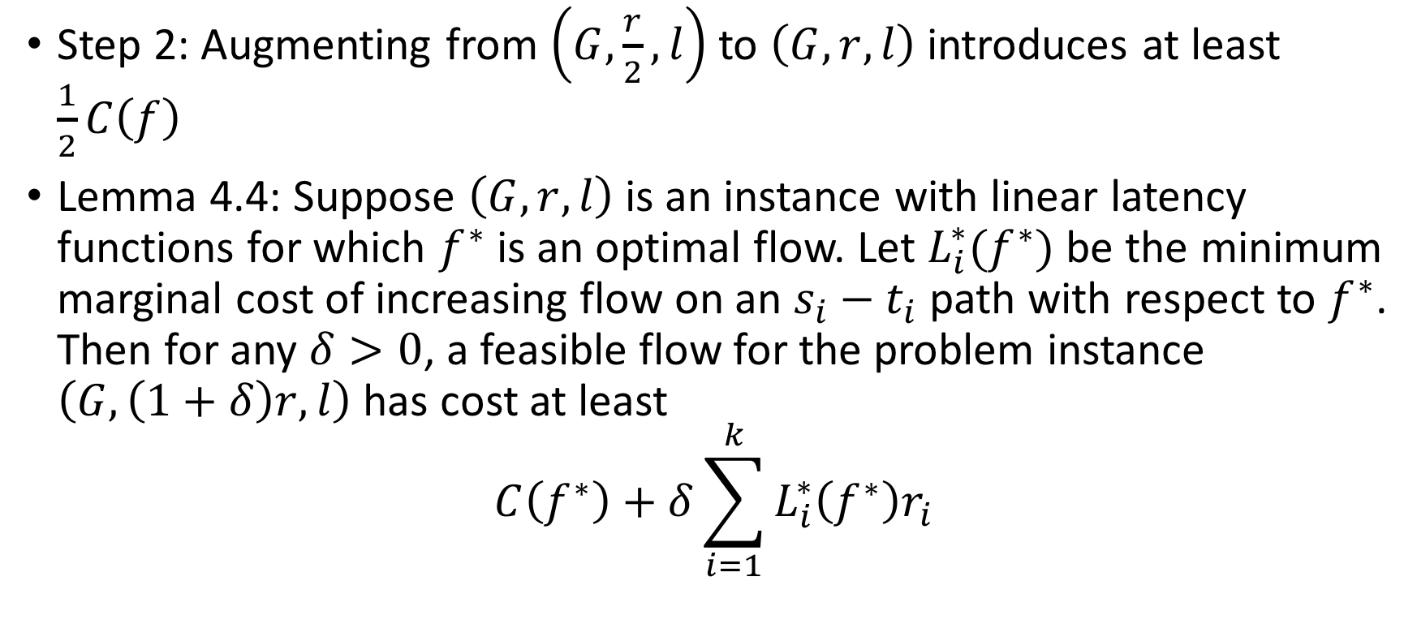
Worst Case For Linear Latency Functions-2
Step 2: Augmenting from $\left(G,\frac{r}{2}, l\right)$ to $\left(G, r, l\right)$ introduces at least $\frac{1}{2}C\left(f\right)$
Lemma 4.4: Suppose $\left(G, r, l\right)$ is an instance with linear latency functions for which $f^{∗}$ is an optimal flow. Let $L_{i}^{∗}(f^{∗})$ be the minimum marginal cost of increasing flow on an $s_{i}−t_{i}$ path with respect to $f^{∗}$. Then for any $δ>0$, a feasible flow for the problem instance $\left(G, \left(1+δ\right)r, l\right)$ has cost at least
$$C\left(f^{∗}\right)+δ\sum_{i=1}^{k}{L_{i}^{∗}\left(f^{∗}\right)r_{i}}$$

Slide 14
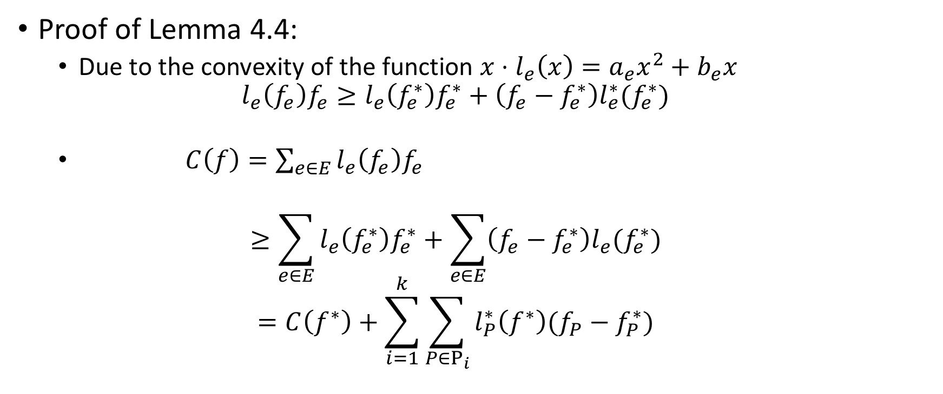
Worst Case For Linear Latency Functions-2
Proof of Lemma 4.4:
  Due to the convexity of the function $x⋅l_{e}\left(x\right)=a_{e}x^{2}+b_{e}x$
  $$l_{e}\left(f_{e}\right)f_{e}≥l_{e}\left(f_{e}^{∗}\right)f_{e}^{∗}+\left(f_{e}−f_{e}^{∗}\right)l_{e}^{∗}(f_{e}^{∗})$$
  $C\left(f\right)=\sum_{e∈E}{l_{e}\left(f_{e}\right)f_{e}}$
  $$≥\sum_{e∈E}{l_{e}\left(f_{e}^{∗}\right)f_{e}^{∗}}+\sum_{e∈E}{\left({f_{e}−f}_{e}^{∗}\right){l_{e}(f}_{e}^{∗})}$$
  $$=C\left(f^{∗}\right)+\sum_{i=1}^{k}{\sum_{P∈Ρ_{i}}{l_{P}^{∗}\left(f^{∗}\right)(f_{P}−f_{P}^{∗})}}$$

Slide 15

Worst Case For Linear Latency Functions-2
$C\left(f\right)≥C\left(f^{∗}\right)+\sum_{i=1}^{k}{\sum_{P∈Ρ_{i}}{l_{P}^{∗}\left(f^{∗}\right)(f_{P}−f_{P}^{∗})}}$
$≥C\left(f^{∗}\right)+\sum_{i=1}^{k}{L_{i}^{∗}(f^{∗})\sum_{P∈Ρ_{i}}{ (f_{P}−f_{P}^{∗})}}$
$=C\left(f^{∗}\right)+δ\sum_{i=1}^{k}{L_{i}^{∗}\left(f^{∗}\right)r_{i} }$
■

Slide 16
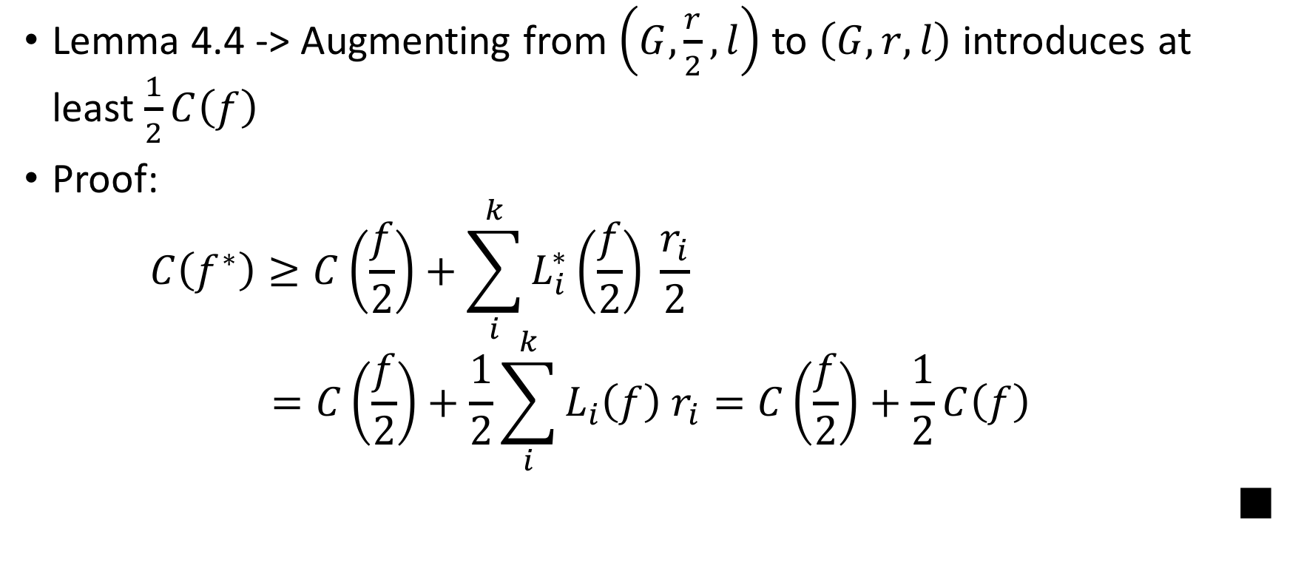
Worst Case For Linear Latency Functions-2
Lemma 4.4 -> Augmenting from $\left(G,\frac{r}{2}, l\right)$ to $\left(G, r, l\right)$ introduces at least $\frac{1}{2}C\left(f\right)$
Proof:
$$C\left(f^{∗}\right)≥C\left(\frac{f}{2}\right)+\sum_{i}^{k}{L_{i}^{∗}\left(\frac{f}{2}\right) \frac{r_{i}}{2}}$$
$$=C\left(\frac{f}{2}\right)+\frac{1}{2}\sum_{i}^{k}{L_{i}\left(f\right) r_{i}}=C\left(\frac{f}{2}\right)+\frac{1}{2}C\left(f\right)$$
■

Slide 17
Extensions
Assumption:
  Agents have full information of the latency of different paths.
  Infinitely many agents, each controlling a negligible fraction of the traffic.
These assumptions do not always hold.
  Approximate Nash Equilibrium
  Finite Splittable Flow
  Finite Unsplittalbe Flow

Slide 18
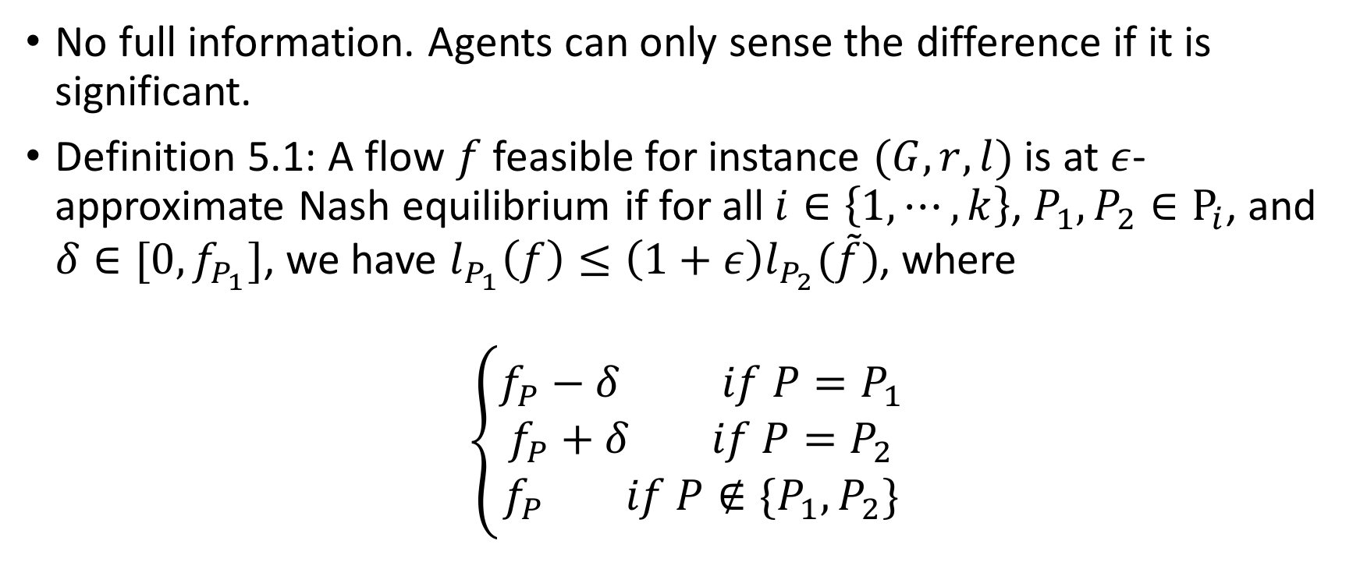
Approximate Nash Equilibrium
No full information. Agents can only sense the difference if it is significant.
Definition 5.1: A flow $f$ feasible for instance $(G, r, l)$ is at $ε$-approximate Nash equilibrium if for all $i∈\left\{1, ⋯, k\right\}$, $P_{1},P_{2}∈Ρ_{i}$, and $δ∈[0, f_{P_{1}}]$, we have $l_{P_{1}}\left(f\right)≤\left(1+ε\right)l_{P_{2}}(\tilde{f})$, where
$$\left\{\begin{aligned}f_{P}−δ if P=P_{1} \\ f_{P}+δ if P=P_{2} \\ f_{P} if P∉\{P_{1},P_{2}\}\end{aligned}\right.$$

Slide 19
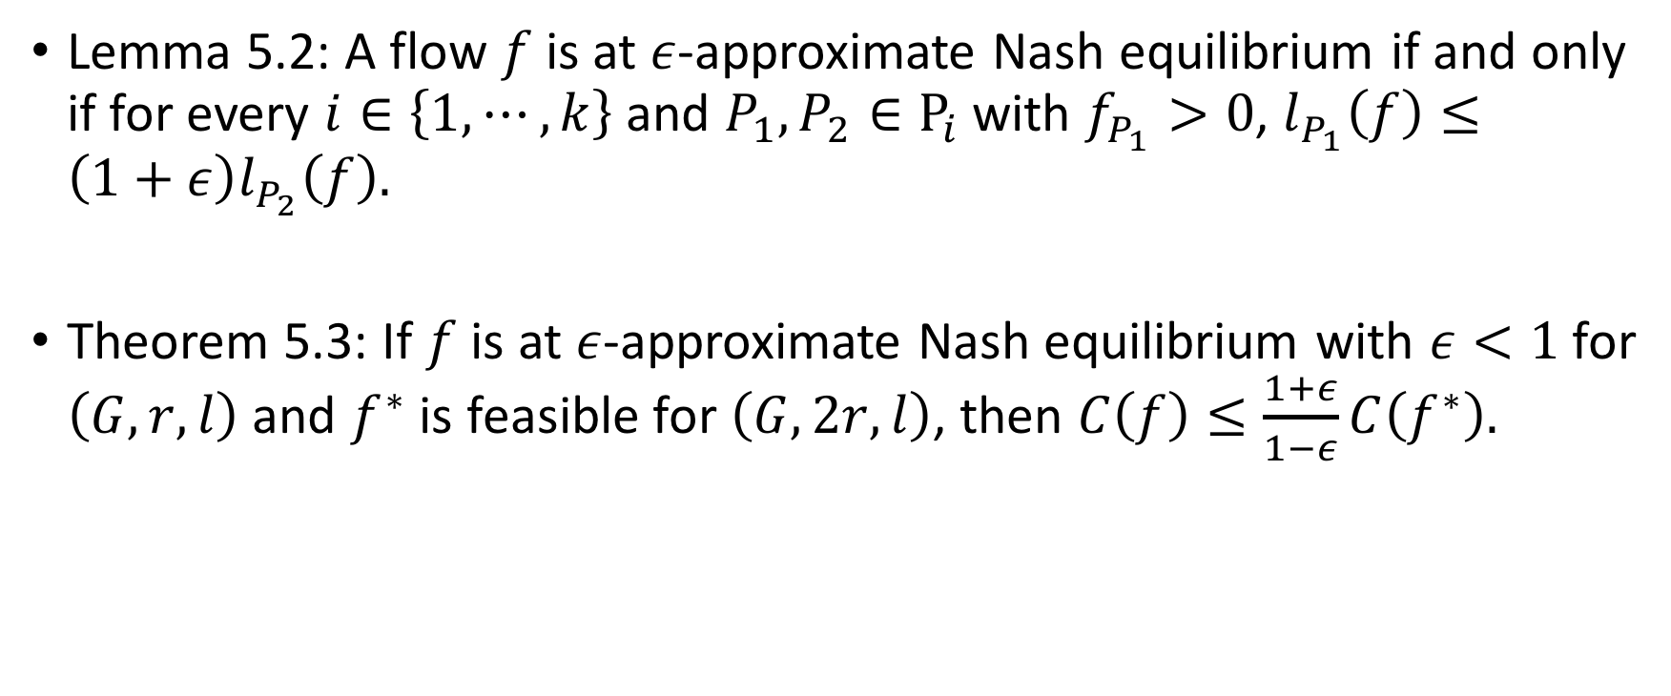
Approximate Nash Equilibrium
Lemma 5.2: A flow $f$ is at $ε$-approximate Nash equilibrium if and only if for every $i∈\left\{1,⋯,k\right\}$ and $P_{1}, P_{2}∈Ρ_{i}$ with $f_{P_{1}}>0$, $l_{P_{1}}\left(f\right)≤\left(1+ε\right)l_{P_{2}}\left(f\right).$
Theorem 5.3: If $f$ is at $ε$-approximate Nash equilibrium with $ε<1$ for $\left(G, r, l\right)$ and $f^{∗}$ is feasible for $\left(G, 2r, l\right)$, then $C\left(f\right)≤\frac{1+ε}{1−ε}C\left(f^{∗}\right).$

Slide 20
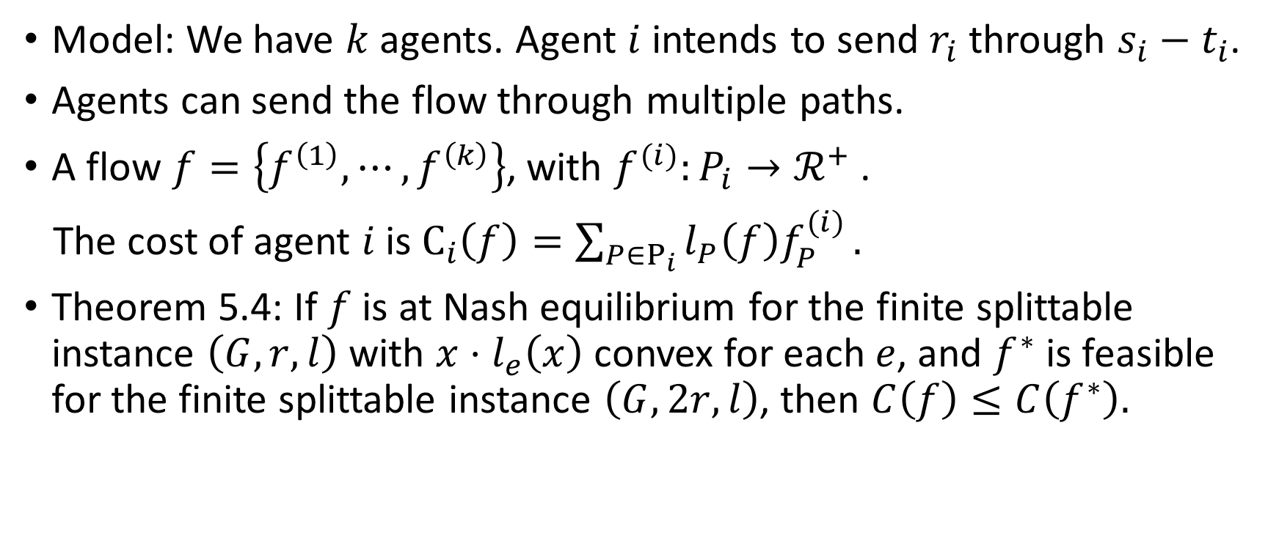
Finite Splittable Flow
Model: We have $k$ agents. Agent $i$ intends to send $r_{i}$ through $s_{i}−t_{i}$.
Agents can send the flow through multiple paths.
A flow $f=\left\{f^{\left(1\right)},⋯,f^{\left(k\right)}\right\}$, with $f^{(i)}:P_{i}→ℛ^{+}$ .
The cost of agent $i$ is $C_{i}\left(f\right)=\sum_{P∈Ρ_{i}}{l_{P}\left(f\right)f_{P}^{(i)}}.$
Theorem 5.4: If $f$ is at Nash equilibrium for the finite splittable instance $\left(G, r, l\right)$ with $x⋅l_{e}\left(x\right)$ convex for each $e$, and $f^{∗}$ is feasible for the finite splittable instance $\left(G, 2r, l\right)$, then $C\left(f\right)≤C\left(f^{∗}\right).$

Slide 21
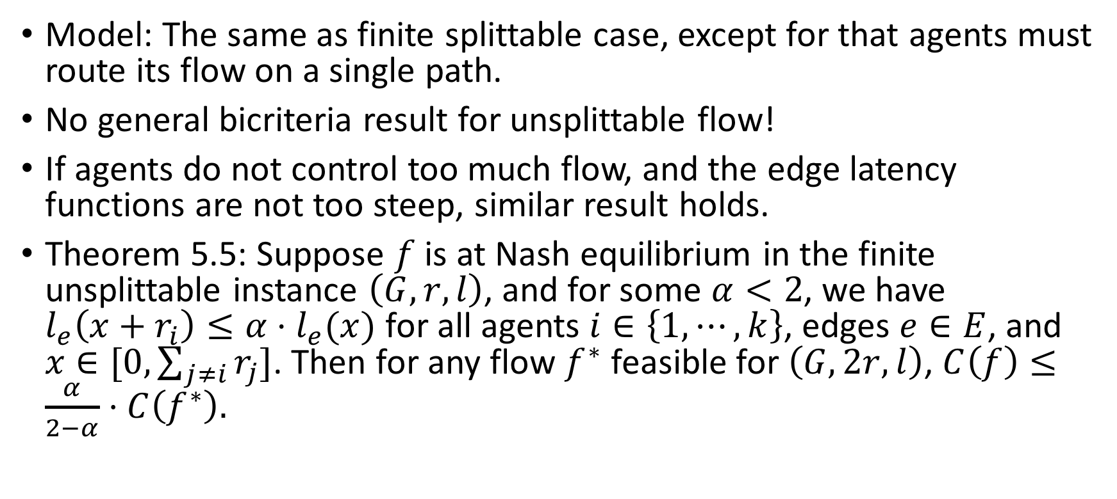
Finite Unsplittable Flow
Model: The same as finite splittable case, except for that agents must route its flow on a single path.
No general bicriteria result for unsplittable flow!
If agents do not control too much flow, and the edge latency functions are not too steep, similar result holds.
Theorem 5.5: Suppose $f$ is at Nash equilibrium in the finite unsplittable instance $\left(G, r, l\right)$, and for some $α<2$, we have $l_{e}\left(x+r_{i}\right)≤α⋅l_{e}(x)$ for all agents $i∈\left\{1,⋯,k\right\}$, edges $e∈E$, and $x∈[0, \sum_{j≠i}{r_{j}}]$. Then for any flow $f^{∗}$ feasible for $\left(G, 2r, l\right)$, $C\left(f\right)≤\frac{α}{2−α}⋅C\left(f^{∗}\right).$

Slide 22
Thanks!

