Slide 1
Deploying PAWS: Field Optimization of the Protection Assistant for Wildlife Security
Fang et al.

Slide 2
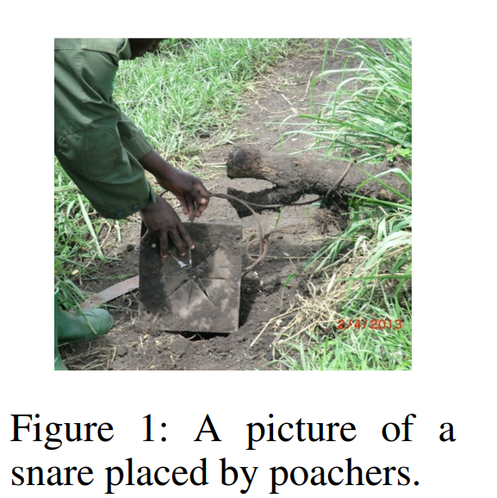
The Problem
Poaching is a big problem!
Tigers, elephants, rhinos, and many more
Patrols can be used to combat poaching
Limited resources
How can we allocate patrols optimally?

Slide 3
PAWS-Initial
First attempt: PAWS-Initial
Game theoretic approach to planning patrol routes
Models poaching as repeated Stackelberg security game
Poachers are attackers and patrollers are defenders
Produces suggested areas to protect
Uses data from previous patrols to optimize

Slide 4
PAWS-Initial: Stackelberg Security Game
Conservation area modeled as a grid
1km x 1km
Each cell is a potential target
Payoff of a cell is determined by animal density
Defender chooses a strategy, can be mixed, of which cells to protect
Attacker observes defender’s strategy, then attacks a target
Attack: snare, poacher, poaching camp, etc
Zero-sum game
Attacker uses bounded rationality for decisions
SUQR model

Slide 5
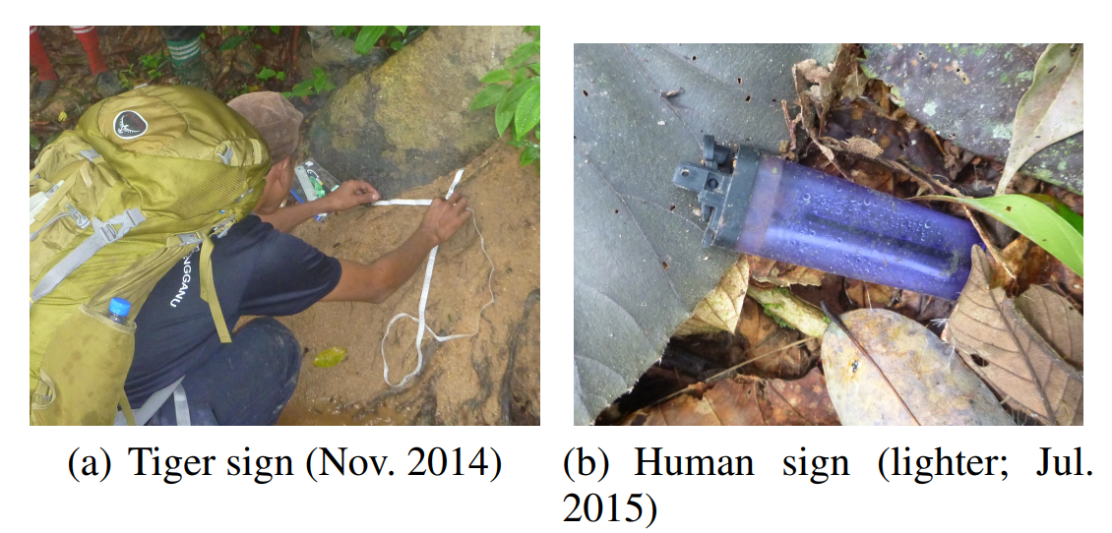
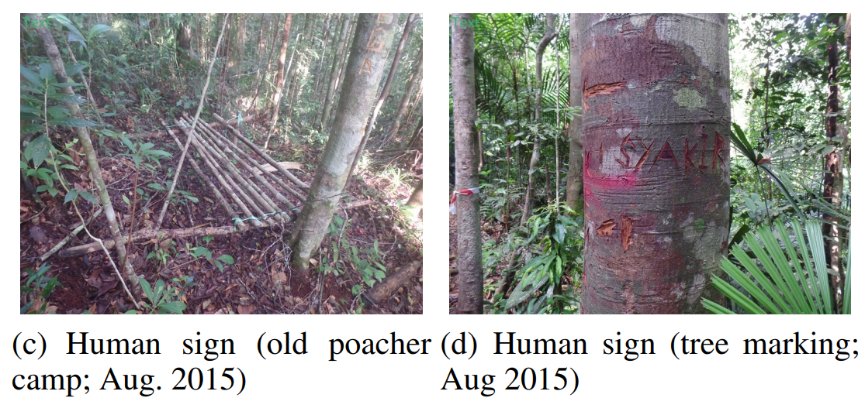
PAWS-Initial: Gathering Data
Patrollers gather data and photos from patrol route
Human signs and animal signs
This data is used to infer human activity and animal density
Patrols improve over time

Slide 6
PAWS-Initial: What it Did Well
Information from previous patrols/rounds used in subsequent rounds
Effectiveness improves over time
Bounded rationality better models real attackers
Attackers are not completely rational

Slide 7
PAWS-Initial: Issues
Didn’t account for topography
“completely unanticipated” - Really?
Patrol routes crossed large bodies of water, extreme slopes, etc
Didn’t account for uncertainty in animal locations
We don’t always know where they are
Not scalable
Too slow for large areas
Chooses targets but not routes
Set of targets not necessarily practical

Slide 8
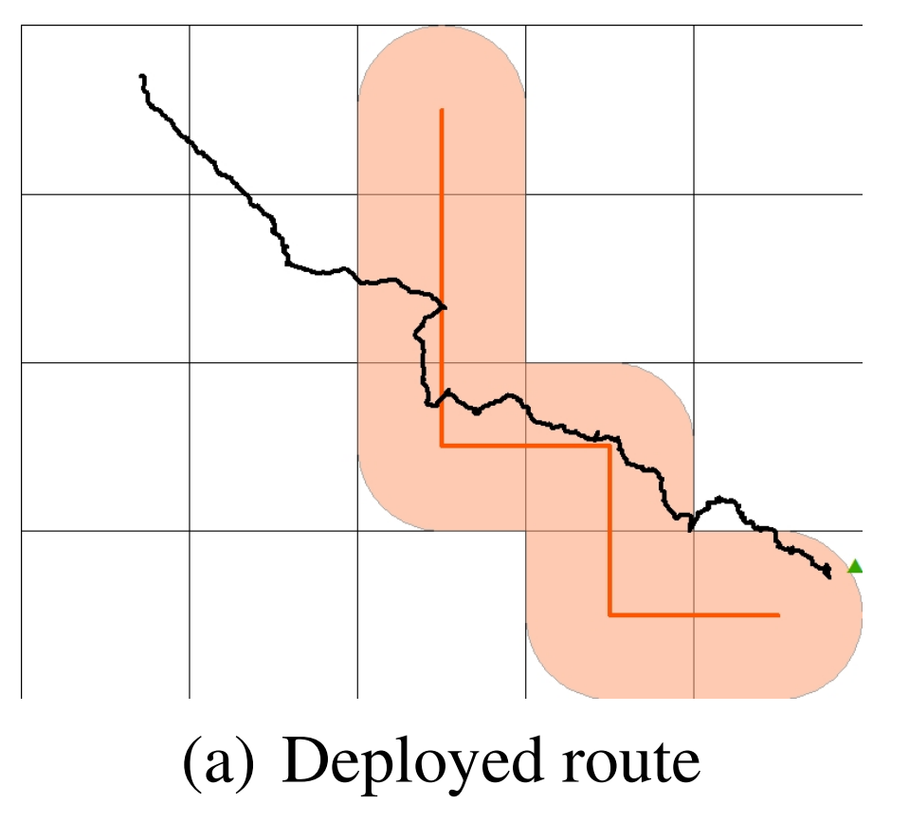

Slide 9
Accounting for Topography
Divide each cell into 50m x 50 m “Raster Pieces”
These record topographic information
Elevation, water, etc
Derived from topographical map input
Account for elevation changes using standard hiking difficulty functions
Account for extra difficulty as added distance, bound total distance
Identify and prioritize “preferred terrain features”
Ridgelines, river banks
Easier to traverse, often followed by animals and poachers
Route distance limits

Slide 10
Improving Scalability
“Street map” approach
Map area as set of nodes and edges
Nodes are small groups of raster pieces with significance
Edges are easiest topographical path between them
Allows scalability while still providing 50m resolution

Slide 11
Accounting for Uncertainty
Interval uncertainty used to model unknown animal locations
Payoffs are known to lie within a certain interval
Cells patrolled more frequently have less uncertainty
More information gathered

Slide 12
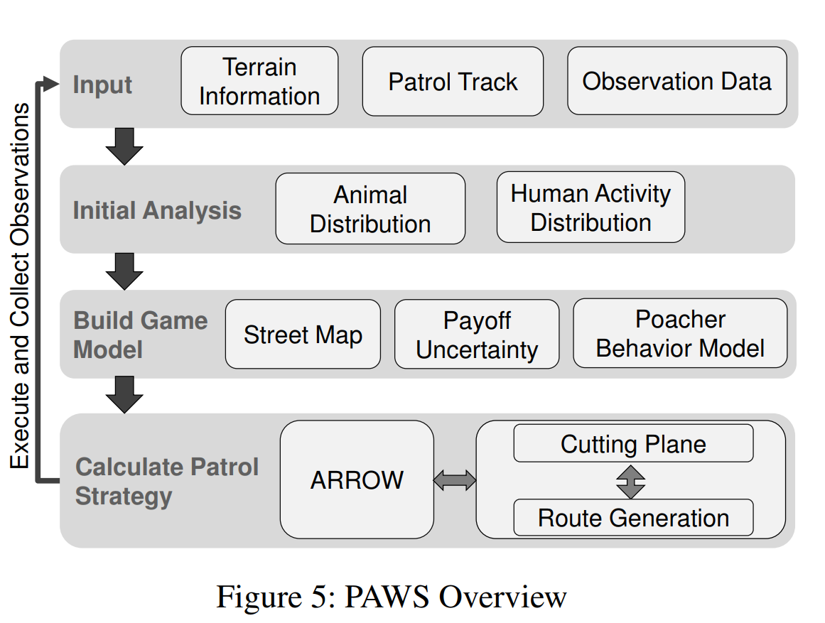

Slide 14
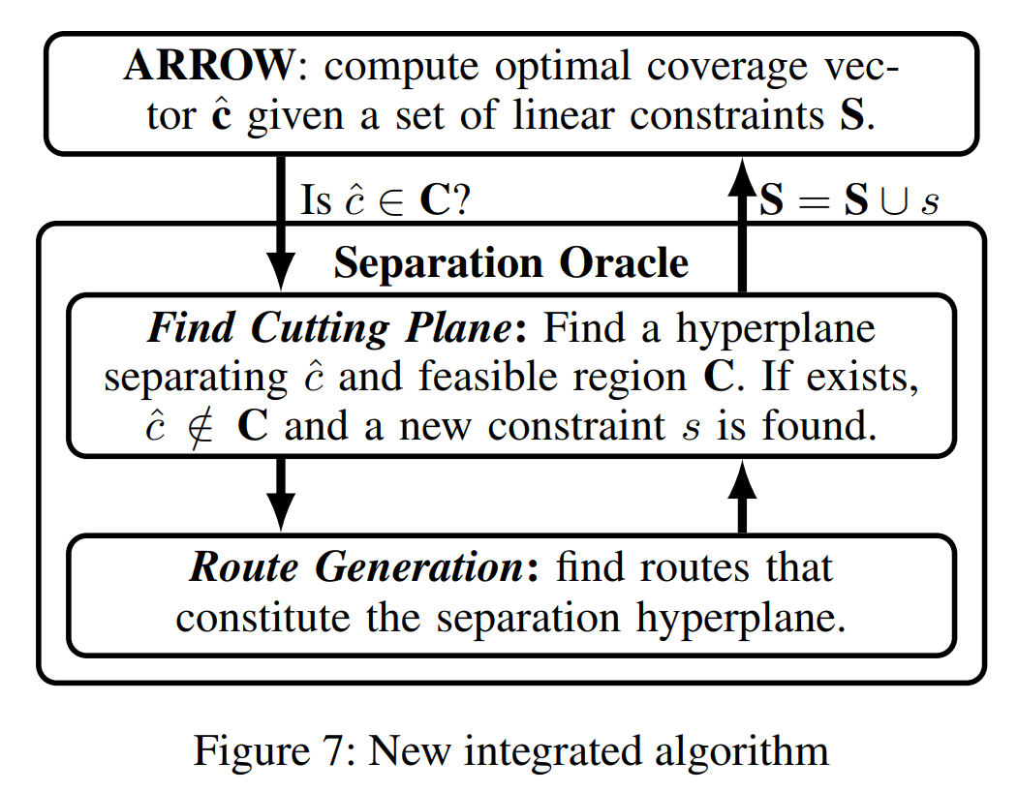

Slide 15
Making it All Work Together: ARROW
ARROW algorithm for payoff uncertainty and bounded rationality
Behavioral minimax regret
Naive Solution: Find route that minimizes maximum regret for defenders
But there are too many routes
Instead, find optimal set of targets to protect WITHOUT considering route
Coverage vector: List of targets and probability of defending them
Then, check if coverage vector is satisfiable.
If so, done!
If not, refine solution.

Slide 16
Making it All Work Together: BLADE
Given coverage vector, check if there is a valid route that satisfies it.
Iteratively generate routes until:
We find a constraint verifying it’s impossible
We have enough valid routes to match the coverage vector probabilities with a mixed strategy
Avoids enumerating all routes
Scalable
If not possible, return a constraint to ARROW
This is a cutting plane through
This allows ARROW to refine its solution
Routes generated using S-algorithm for orienteering
Local search over large number of possible routes
Approximates optimal route

Slide 17
ARROW
BLADE
S-Algorithm

Slide 18
PAWS: Real-World Results
“PAWS patrols are now regularly deployed at a conservation area in Malaysia.”
“The patrollers mostly followed PAWS’s suggested route, indicating that the route generated by PAWS is easy to follow.”
“In addition, patrollers commented that PAWS is able to guide them towards poaching hotspots”

Slide 19
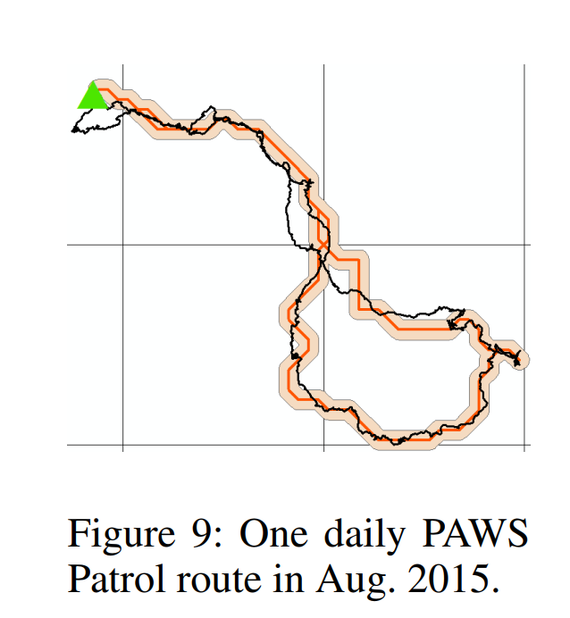
PAWS: Real-World Results
PAWS-Initial
PAWS

Slide 20
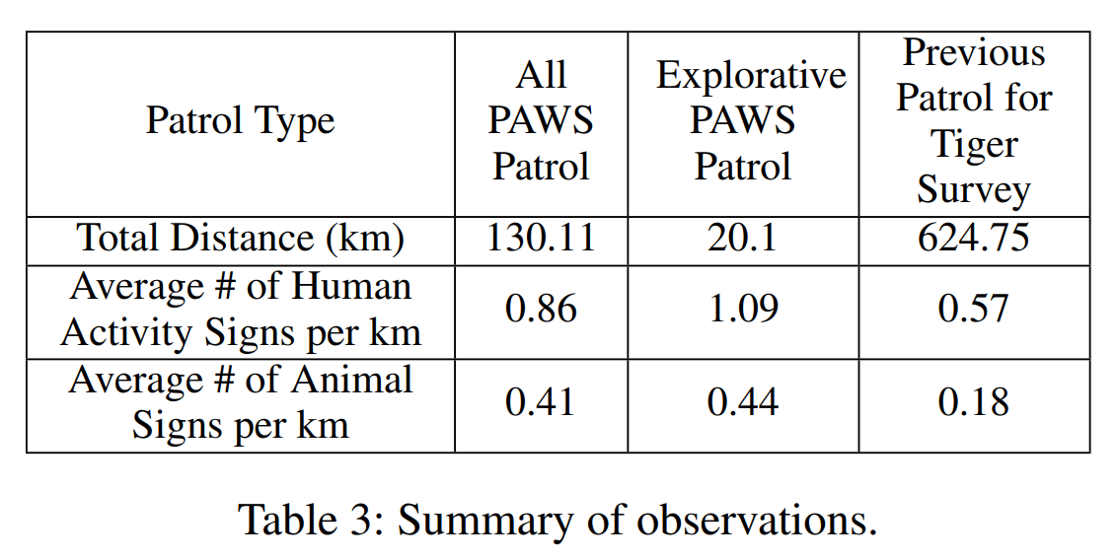
PAWS: Real-World Results

Slide 21
Conclusion
A pure game theoretic approach was a good start.
Real-world problems are often messy.
Field experience was needed to make this tool useful.
Now it is deployed and getting real results!
Management of PAWS was turned over to ARMORWAY according to paper
Not sure if this actually happened

