Slide 1
A Lightweight And Inexpensive In-ear Sensing System For Automatic Whole-night Sleep Stage Monitoring
Anh Nguyen, Raghda Alqurashi, Zohreh Raghebi
Presenters：Justin Shen & Ruomin Ba

Slide 2
CONTENTS
01
Background
02
Challenges
（Section 1, 2）
（Section 1, 2）
03
Hardware
04
Architecture
（Section 3, 7）
（Section 3,4,5,6,7）
05
Evaluation
06
Conclusion
（Section 8）
（Section 10）

Slide 3
01
BACKGROUND

Slide 4
Background
Sleep is important for healthy body function and has impact on
Learning
Psychological health
Hormone regulation
Appetite
And much more
Thus, it is clinically important to reliably monitor a person’s sleep health
Figure: https://www.israel21c.org/sleep-vital-to-repair-dna-damage-israeli-study-finds/

Slide 5
Background
Sleep Monitoring: Polysomnography (PSG)
Typically sleep studies involve Polysomnography (PSG) in a sleep laboratory
Monitors three main signals (among others):
(1) Brain activity (EEG)
(2) Eye movements (EOG)
(3) Muscle activity (EMG)
Figure: http://www.alphasleeplab.com/blog /2017/5/22/sleep-studies-part-1

Slide 6
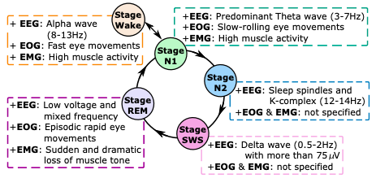
Background
Drawbacks of PSG:
obtrusive attachment of large number of wired sensors
need to travel to sleep laboratory
risk of losing sensor contact whenever patient move
need of well-trained expert to review sleep staging result
Propose the use of Low-cost in-ear biosignal sensing system (LIBS) to monitor sleep without these drawbacks

Slide 7
02
CHALLENGES

Slide 8
Challenges
The desired signal is low amplitude, thus LIBS must be able to measure the signal well without sacrificing comfort
Separation of EEG, EOG, and EMG signals from the single channel in-ear mixture
Separation algorithm must be robust to account for difference of physiological condition and other variation among individuals

Slide 9
03
HARDWARE

Slide 10
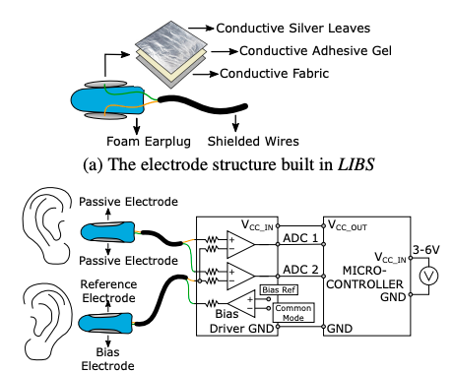
Hardware
Signal Acquisition: Hardware Design (1/3)
Sensor compose of a earplug base with electrode
Block foam earplug as base
Allows the sensor to follow the shape of the ear canal
Provides comfort while avoiding high cost associated with personalization
Also reduces the motion noise caused by jaw motion

Slide 11
Hardware
Signal Acquisition: Hardware Design (2/3)
Sensor compose of a earplug base with electrode
Coat surface with layers of thin silver leaves
Conductive silver cloth acts as electrode
Works with base for a low and consistent surface resistance -> reliable signals

Slide 12
Hardware
Signal Acquisition: Hardware Design (3/3)
Oval shaped electrode based on anatomy of ear canal
Experimented with different materials (silver leaves, fabric, copper)
Increase of the distance between the main electrodes -> signal fidelity
Signals amplified and passed to microcontroller

Slide 13
04
ARCHITECTURE

Slide 14
Architecture
Three separate modules

Slide 15
Architecture
Data Acquisition and Preprocessing
LIBS uses a brain-computer interface (BCI) board named OpenBCI to sample and digitize the in-ear signal
6V battery source for power and safety
Sampling rate of 2kHz and a gain of 24dB
Captured signals are preprocessed to eliminate possible signal interference (from body movement, electrical noise, etc.)
Signals are stored in an SD card and then processed offline
Signal separation
Signal classification

Slide 16
Architecture
Signal Separation
The biosignal sensed by LIBS is a single channel mixture of four components: EEG, EOG, EMG and noise.
Why separate EEG, EOG, EMG and noise is difficult?
Overlapping characteristics of three signals in both time and frequency domains.
Random activation of the sources generating them.
Signal variation from person to person and in different recordings.

Slide 17
Architecture
Signal Separation
What tools we could use to solve the problem?
A. Principle Component Analysis (PCA)
B. Independent Component Analysis (ICA)
C. Empirical Mode Decomposition (EMD)
D. Non-negative Matrix Factorization (NMF)
Why authors choose NMF?
The number of collected channels is equal to or larger than the number of source signals (except NMF)
The factorized components describing the source signal are selected manually.
The channel number that LIBS has (1 channel) is lower than the number of signals of interest (3 signals).

Slide 18
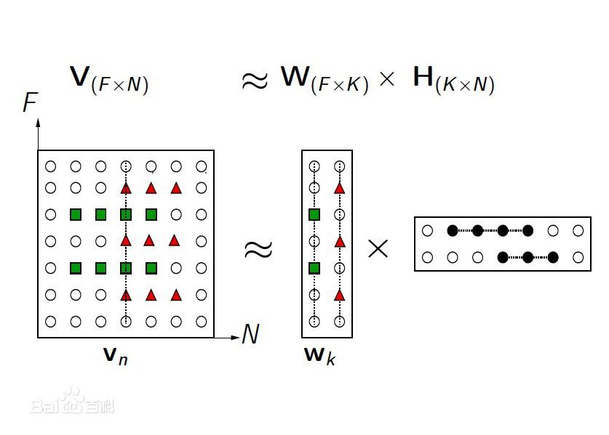
Architecture
Signal Separation
What is Non-negative Matrix Factorization (NMF)?
NMF is one kind of non-linear dimension reduction algorithm
Optimization Target:
The non-negativity makes the resulting matrices easier to inspect

Slide 19
Architecture
Signal Separation
What are the problems with applying NMF into LIBS?
The non-convex solution space of NMF causes the non-unique estimation of the original source signals.
The variance of the biosignals on different sleeps.
How to solve these two problems?
Combine NMF with Spectral Template Learning Algorithm
Use Itakura Saito (IS) divergence as the cost function. Since it holds a scale-invarianct property that could help minimize the variance on different sleeps.

Slide 20
Architecture
Signal Separation
W is the spectral template matrix representing basis patterns (components).
H is the activation matrix expressing time points (positions) when the signal patterns in W is activatied.

Slide 21
Architecture
Sleep Stage Classification
Feature Extraction
Classification
Find the pattern between sleep stage and EEG, EOG & EMG
Decision Tree and Random Forest
Feature Selection
Among All features, find what features are important

Slide 22
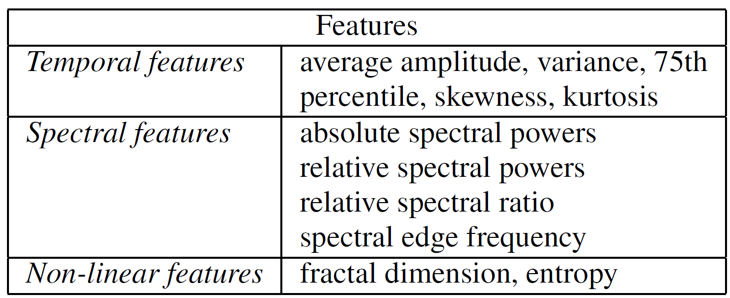
Architecture
Sleep Stage Classification

Slide 23
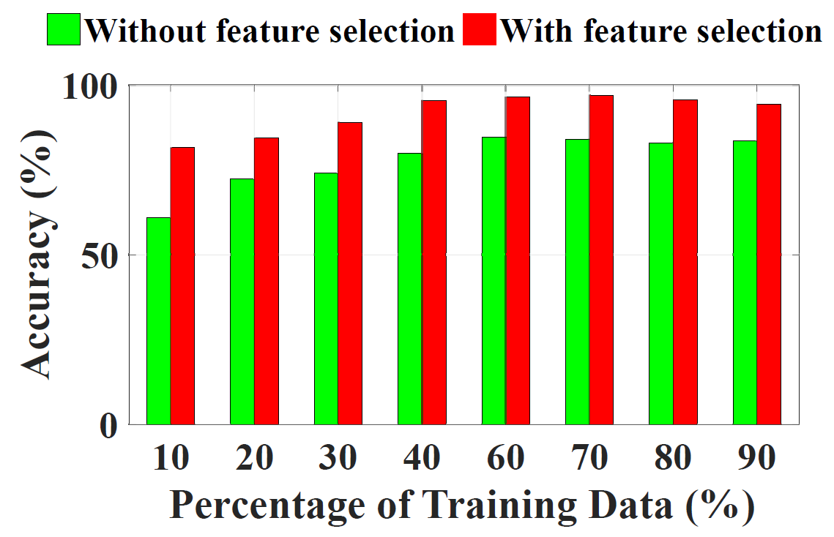
Architecture
Sleep Stage Classification
What is the reason to do feature selection?
The performance of a classification algorithm can degrade when all extracted features are used to determine the sleep stages.
Comment: The figure above is only the result of decision tree and random forest algorithms. Actually a lot of sophisticated classification algorithms could automatically choose the important features related to the output. For example, neural network could reduce the influence of unimportant features with sufficient training. In this case, feature selection may not be necessary.

Slide 24
Architecture
Sleep Stage Classification
How to do feature selection?
Forward Selection (FSP) identifies the most effective combination of features extracted from in-ear signal.
Features are selected sequentially until the addition of a new feature results in no performance improvement in prediction.
A feature is added to the set of selected features if it not only improves the misclassification error but also is less redundant given the features already selected.

Slide 25
Architecture
Sleep Stage Classification
What classification algorithms authors considered?
Neural Network
Reject Reason: Long training time and complexity
SVM
Reject Reason: Long training time and difficulty to understand the learned function
Decision Tree & Random Forest
Easy to implement and interpret
Highest performance
Flexible and work well with catrgorical data

Slide 26
05
EVALUATION

Slide 27
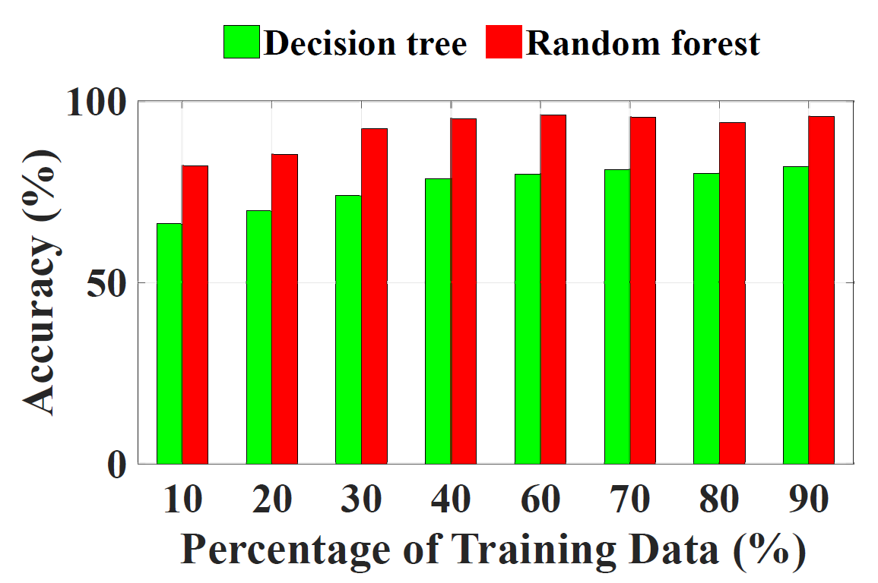
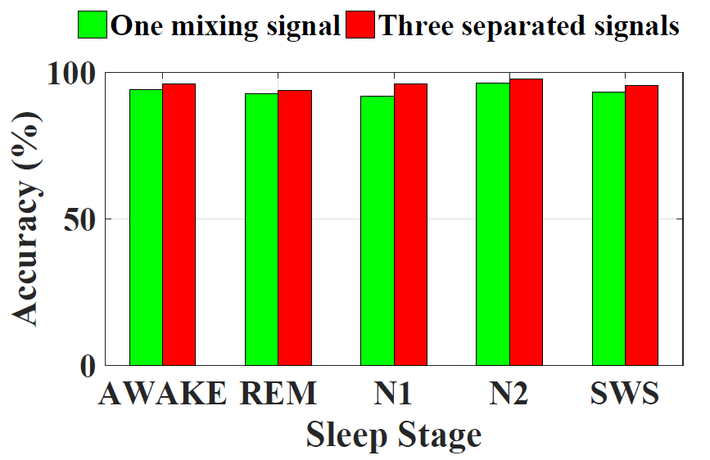
Evaluation
System Performance

Slide 28
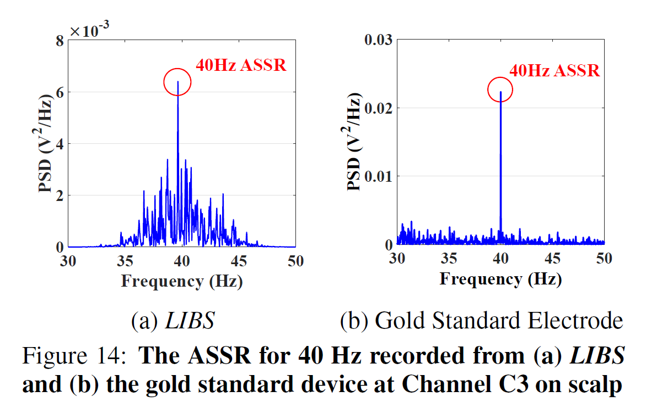
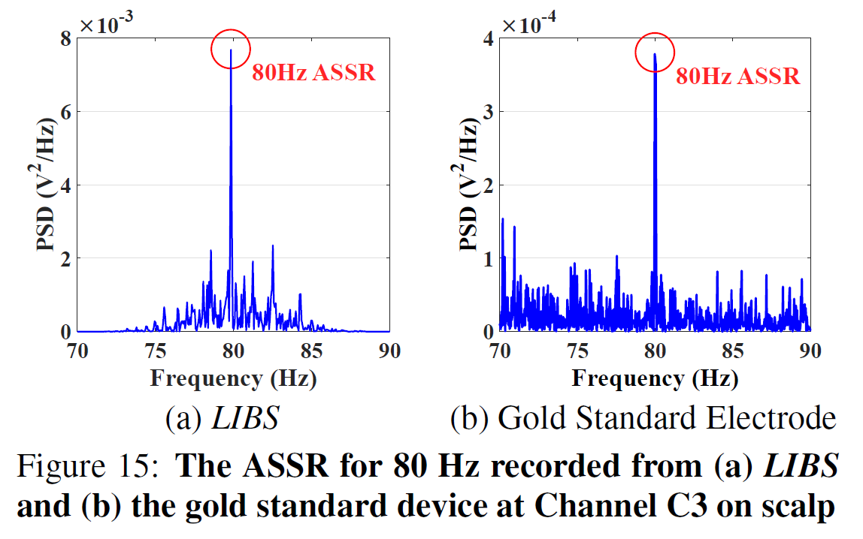
Evaluation
Signal Acquisition

Slide 29
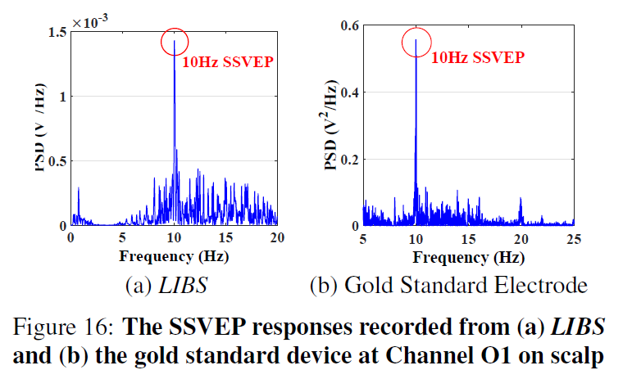
Evaluation
Signal Acquisition

Slide 30
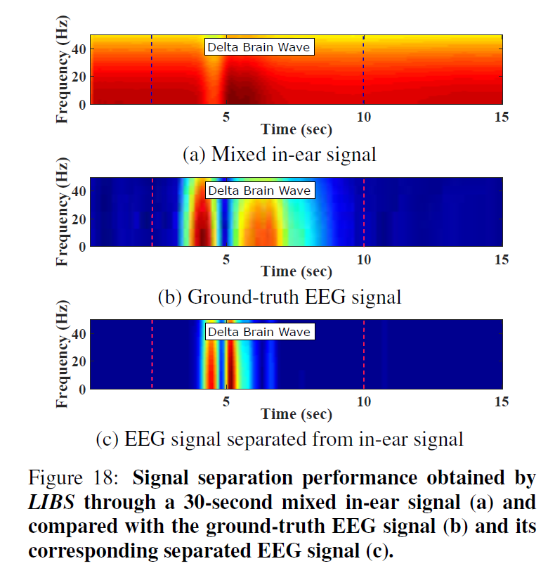
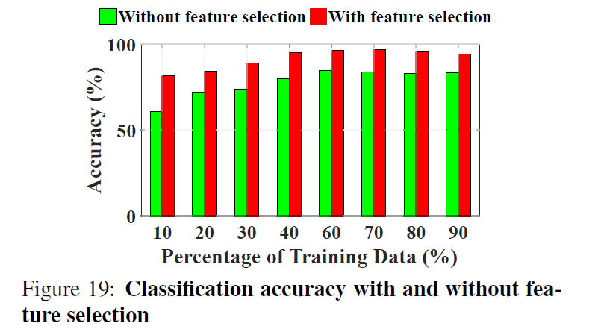
Evaluation
Signal Separation

Slide 31
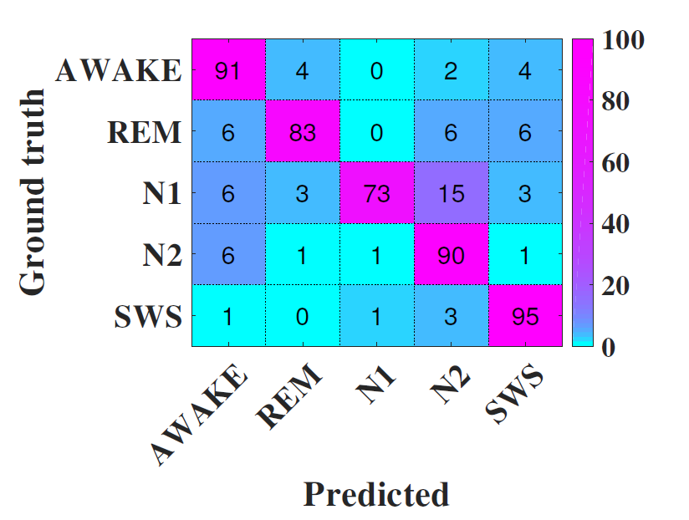
Evaluation
Sleep Stage Classification

Slide 32
06
CONCLUSION

Slide 33
Conclusion
In this paper, the authors presented the desgin, implementation and evaluation of LIBS.
LIBS could achieve similar performance like PSG in terms of sleep stages classification accuracy.
It has the advantages of low cost, easy operation and comfortable wearing during sleep.
It has the potential to become a fundamental sleep monitoring device in the future.

