Slide 1
Lecture 1.2
Sensors and DSP Basics
(Part 2)
CMSC 818W : Spring 2019
Tu-Th 2:00-3:15pm
CSI 2118
Nirupam Roy
Feb. 7th 2019

Slide 2
So far we have learned
Scalar and vector values from sensors
Global and local coordinate system (a.k.a, world and body frame)
Frequency, amplitude, and phase of a sinusoidal signal
a
The concept of the Fourier series
Time domain and Frequency domain
Fourier transform, FFT and IFFT
Frequency band, bandwidth, baseband signal
Spectrogram, moving window FFT
Analog-to-digital conversion
Sampling a signal
Sample rate or sampling frequency
Aliasing
Nyquist frequency
Nyquist rate
$$. sin⁡(2πft)$$
Mapping

Slide 3
The last slide from the previous lecture
Commonly, the maximum frequency in human voice is 4 kHz, what sample rate will you use in your audio recorder?
Is there any limit on the maximum sample rate you can use?

Slide 4
Frequency band
Amplitude
0
2
4
6
0
8
Frequency (kHz)
What should be the sample rate?

Slide 5
Frequency band
Amplitude
Frequency
down-conversion
Amplitude
0
2
4
6
8
0
2
4
6
8
Frequency (kHz)
Frequency (kHz)
What should be the sample rate?
Generally, bandwidth of the signal determines the sample rate.

Slide 6
Aliasing: Finding the aliased frequency
Sampling frequency = 10Hz
Nyquist frequency = 5Hz
Amplitude
0
2
4
6
8
Frequency (Hz)

Slide 7
Aliasing: Finding the aliased frequency
Sampling frequency = 10Hz
Nyquist frequency = 5Hz
Amplitude
Received
signal
Amplitude
0
2
4
6
8
0
2
4
6
8
Frequency (Hz)
Frequency (Hz)

Slide 8
Aliasing: Finding the aliased frequency
Sampling frequency = 10Hz
Nyquist frequency = 5Hz
Amplitude
Received
signal
Amplitude
0
2
4
6
8
0
2
4
6
8
Frequency (Hz)
Frequency (Hz)
f_{s} = Sampling frequency
f = Frequency to record
N = Non-negative integer
f_{a} = Aliased(perceived) frequency
f_{a} = min(abs(N*f_{s} - f))

Slide 9
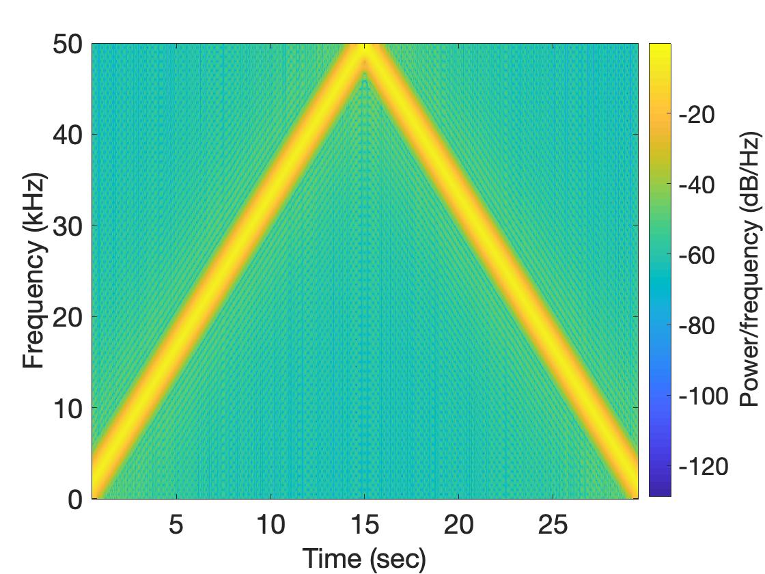
Aliasing: Spectrogram of increasing frequency

Slide 10
Aliasing
Nyquist frequency
Amplitude
10k
20k
30k
40k
50k
60k
70k
80k
90k
100k
Frequency spectrum
Notes:
to amplify the signal power …
Now, this signal typically contains many more frequencies than the sampling system can handle …

Slide 11
Aliasing
Nyquist frequency
Amplitude
10k
20k
30k
40k
50k
60k
70k
80k
90k
100k
Frequency spectrum
Notes:
to amplify the signal power …
Now, this signal typically contains many more frequencies than the sampling system can handle …

Slide 12
Aliasing
Nyquist frequency
Amplitude
10k
20k
30k
40k
50k
60k
70k
80k
90k
100k
Frequency spectrum
We need a “Low-pass filter”
to remove unwanted high frequency signals
Notes:
to amplify the signal power …
Now, this signal typically contains many more frequencies than the sampling system can handle …

Slide 13
Anti-aliasing filter
Nyquist frequency
Amplitude
10k
20k
30k
40k
50k
60k
70k
80k
90k
100k
Frequency spectrum
Sensor
ADC
Anti-aliasing
Filter
Notes:
to amplify the signal power …
Now, this signal typically contains many more frequencies than the sampling system can handle …

Slide 14
Anti-aliasing filter
Nyquist frequency
Amplitude
10k
20k
30k
40k
50k
60k
70k
80k
90k
100k
Frequency spectrum
Sensor
ADC
Anti-aliasing
Filter
Notes:
Hence, a low pass filter…

Slide 15
Anti-aliasing filter
Anti-aliasing
filter
Amplitude
10k
20k
30k
40k
50k
60k
70k
80k
90k
100k
Frequency spectrum
Sensor
ADC
Anti-aliasing
Filter
Notes:
removes the unwanted frequencies above 24 kHz …
And ultimately, this filtered signal is sampled by an ADC to generate digital sound samples

Slide 16
Inertial Measurement Unit (IMU)
Accelerometer
Gyroscope
Magnetometer

Slide 17
Inertial Measurement Unit (IMU)
Accelerometer
Gyroscope
Magnetometer

Slide 18
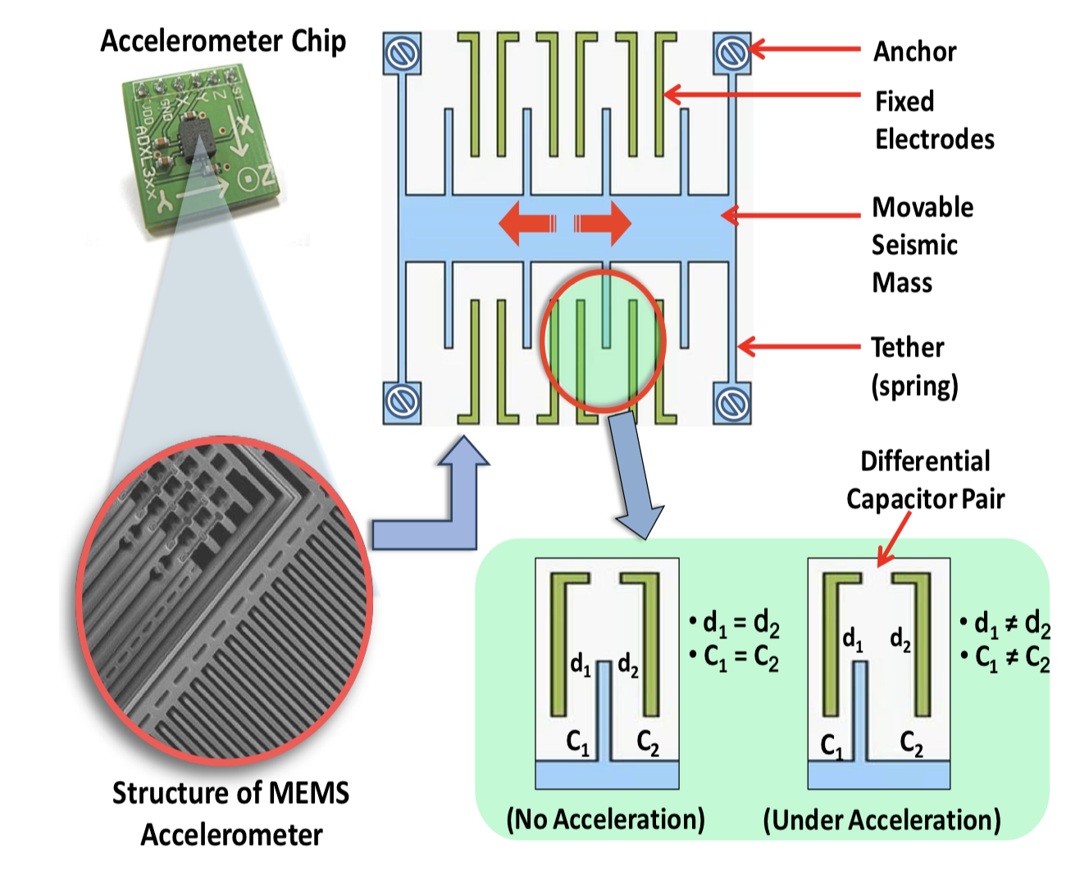
Accelerometer
Measures acceleration, not speed.
Measurements are proportional to the force. Why?

Slide 19
Accelerometer
Notes:
F = m.a = k.d (k= spring constant)
a = k.d/m, transformed the measurement of acceleration to the measurement of displacement

Slide 20
Accelerometer
Z
X
Y

Slide 21
Accelerometer
Gravity = 9.8 m/s²
What reading will you get when the device is in “free-fall”?
Old laptops had accelerometers in them. Why?

Slide 22
Accelerometer
Z
X
-Z
Y
gravity

Slide 23
Accelerometer
Z
linear acceleration
X
-Z
Y
gravity
Output = linear acceleration + gravity

Slide 24
Accelerometer Demo

Slide 25
Accelerometer: Extracting gravity component
Accelerometer output
(any one of the axes)

Slide 26
Accelerometer: Extracting gravity component
Accelerometer output
(any one of the axes)
Low frequency gravity signal
=
+
High frequency linear acceleration

Slide 27
Accelerometer: Extracting gravity component
Accelerometer output
(any one of the axes)
Low-pass filter
Low frequency gravity signal

Slide 28
Accelerometer: Extracting gravity component
Accelerometer output
(any one of the axes)
Low-pass filter
Low frequency gravity signal
X
Y
Z

Slide 29
Accelerometer: Extracting gravity component
Z
X
-Z
Y
gravity

Slide 30
Accelerometer: Extracting gravity component
Z
X
-Z
Y
gravity

Slide 31
Accelerometer:: Extracting gravity component
Z
𝚹
X
Φ
-Z
Y
gravity

Slide 32
Accelerometer: Extracting gravity component
Accelerometer output
(any one of the axes)
Low-pass filter
Low frequency gravity signal
Do you see any problem?

Slide 33
Inertial Measurement Unit (IMU)
Accelerometer
Gyroscope
Magnetometer

Slide 34
Gyroscope
Yaw
Roll
Pitch
Angular velocity around three axes

Slide 35
Gyroscope
Right hand rule

Slide 36
Gyroscope
Coriolis effect

Slide 37
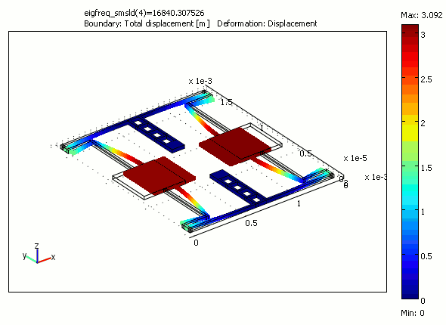
Gyroscope

Slide 38
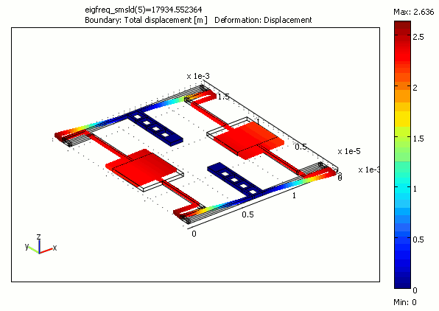
Gyroscope

Slide 39
Gyroscope Demo

Slide 40
Gyroscope: Finding orientation
Gyroscope data = angular velocity (radians or degrees per second)
⍵ = Δ𝚹/Δt
We need angle (𝚹)
Integrate the output,
𝚹 = 𝚹_{prev.} + ⍵. Δt
$\int{cos⁡(2}Πft) = \frac{1}{2Πf} sin$(2 $Πft)$

Slide 41
Gyroscope: Finding orientation
Gyroscope data = angular velocity (radians or degrees per second)
⍵ = Δ𝚹/Δt
Calculated angle drifts over time

Slide 42
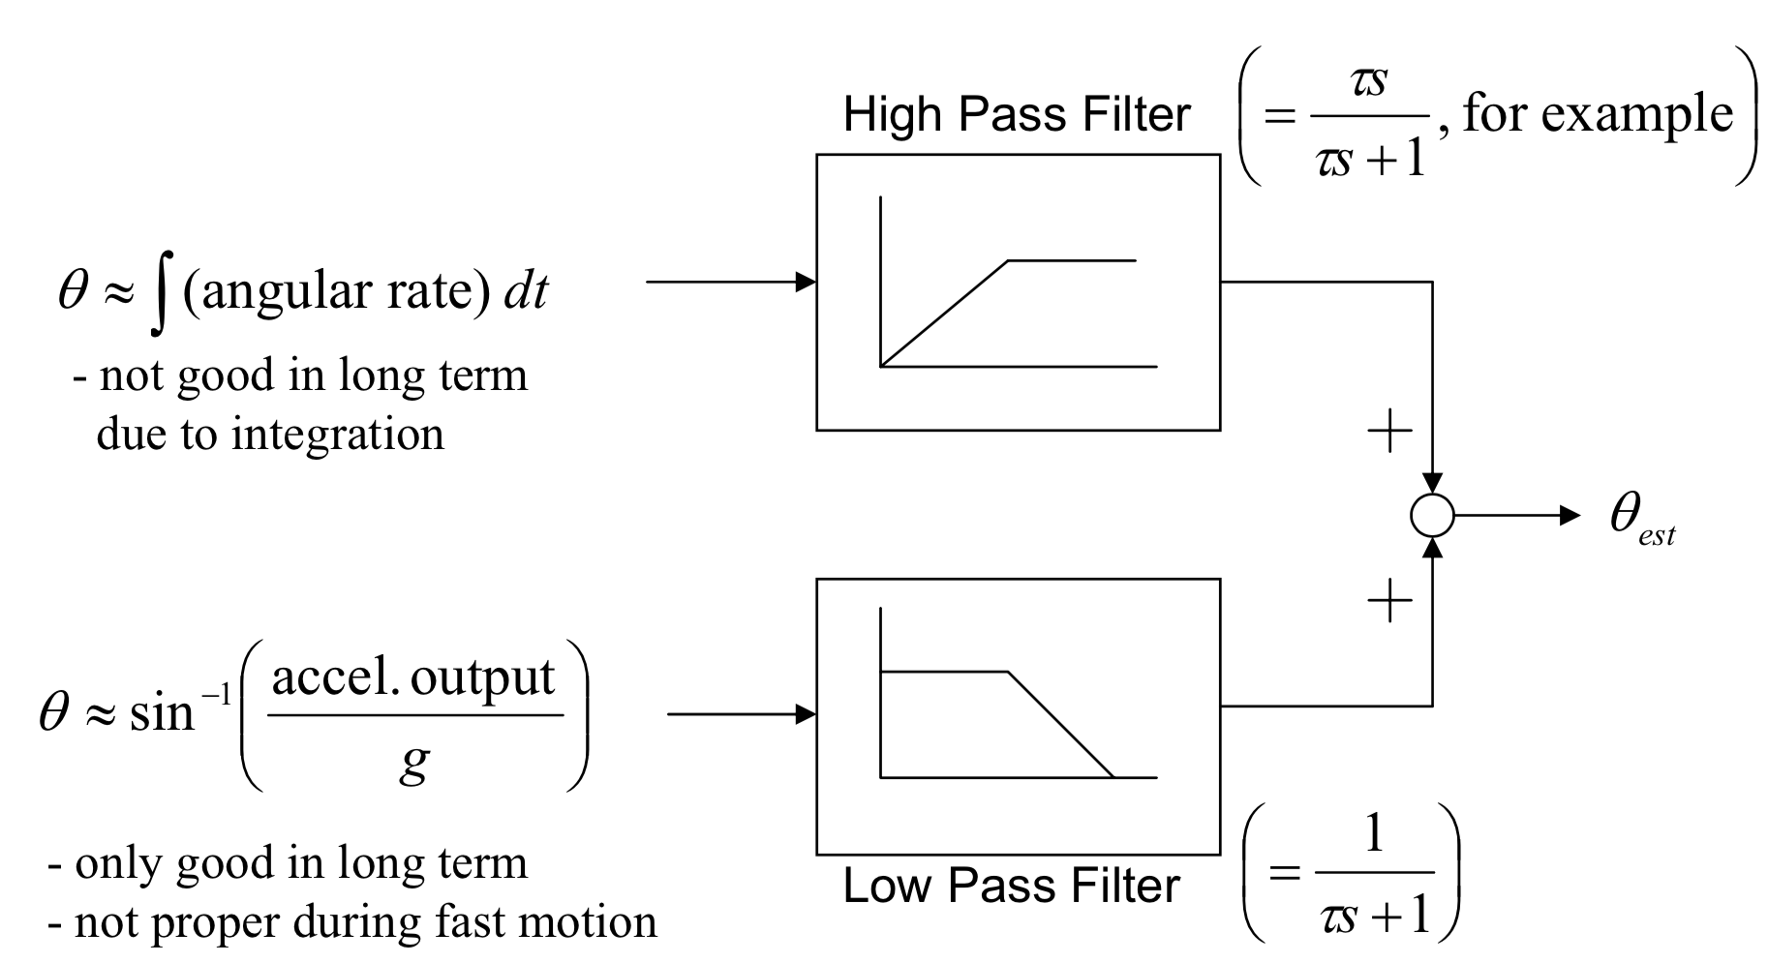
Accelerometer and Gyroscope Fusion
Complementary filter
Angle from gyro.
Angle from accel.
Angle from the gravity
vector

Slide 43
Axes V/S Degrees of freedom

Slide 44
Inertial Measurement Unit (IMU)
Accelerometer
Gyroscope
Magnetometer

Slide 45
Magnetometer (the sensor behind the compass app)

Slide 46
Magnetometer (the sensor behind the compass app)
Z
Magnetic field vector
X
Y
Measures magnetic flux density (unit tesla)

Slide 47
Magnetometer Demo

Slide 48
Magnetometer (the sensor behind the compass app)
Gyroscope
Accelerometer
Tilt correction
Magnetometer
Azimuth angle
(Compass angle)

