Slide 1
Lecture 3.4
Communication Basics
CMSC 818W : Spring 2019
Tu-Th 2:00-3:15pm
CSI 2118
Nirupam Roy
Feb. 26th 2019

Slide 2
What is communication?

Slide 3
What is communication?

Slide 4
What is communication?

Slide 5
Data bits
1
1
0
1
1
0
0
1
0
0
1
0
1
0
1
0
…
Notes:
https://www.tutorialspoint.com/analog_communication/analog_communication_angle_modulation.htm

Slide 6
Data bits
1
1
0
1
1
0
0
1
0
0
1
0
1
0
1
0
…
Baseband signal
Notes:
https://www.tutorialspoint.com/analog_communication/analog_communication_angle_modulation.htm

Slide 7
Baseband vs Passband
Amplitude
Time

Slide 8
Baseband vs Passband
Baseband signal
Amplitude
FFT
Amplitude
Time
Frequency

Slide 9
Baseband vs Passband
Baseband signal
Amplitude
FFT
Amplitude
Frequency
Passband signal
Up-conversion
Carrier
frequency
Amplitude
Frequency

Slide 10
Baseband vs Passband
Baseband signal
Amplitude
FFT
Amplitude
Time
Frequency
Passband signal
Up-conversion
Carrier
frequency
Amplitude
IFFT
Amplitude
2
4
6
8
Frequency (kHz)
Frequency

Slide 11
Baseband vs Passband
Amplitude
Transmit
2
4
6
8
Frequency (kHz)

Slide 12
Baseband vs Passband
Amplitude
Transmit
Receive
2
4
6
8
Frequency (kHz)

Slide 13
Baseband vs Passband
Amplitude
Transmit
Receive
Down-conversion
2
4
6
8
Frequency (kHz)
Amplitude
Time

Slide 14
Baseband vs Passband
Amplitude
Transmit
Receive
Down-conversion
Why do we need passband signal?
2
4
6
8
Frequency (kHz)
Amplitude
Time

Slide 15
Baseband vs Passband
Spectrum sharing for multiple simultaneous communication
Amplitude

Slide 16
Baseband vs Passband
Spectrum sharing for multiple simultaneous communication
Antenna size ∝ wavelength
Higher frequency requires smaller antenna
Amplitude
Amplitude

Slide 17
Communication flow
Data bits
Data bits
Map to some baseband signal pattern
Map the baseband signal to bits
Modulate
Demodulate
Transmit
Channel
Receive
Notes:
https://www.tutorialspoint.com/analog_communication/analog_communication_angle_modulation.htm

Slide 18
Communication flow
We are here
Notes:
https://www.tutorialspoint.com/analog_communication/analog_communication_angle_modulation.htm

Slide 19
Data bits
1
1
0
1
1
0
0
1
0
0
1
0
1
0
1
0
…
Notes:
https://www.tutorialspoint.com/analog_communication/analog_communication_angle_modulation.htm

Slide 20
Data bits
1
1
0
1
1
0
0
1
0
0
1
0
1
0
1
0
…
Baseband signal
Notes:
https://www.tutorialspoint.com/analog_communication/analog_communication_angle_modulation.htm

Slide 21
Data bits
1
1
0
1
1
0
0
1
0
0
1
0
1
0
1
0
…
Baseband signal
Notes:
https://www.tutorialspoint.com/analog_communication/analog_communication_angle_modulation.htm

Slide 22
Data bits
1
1
0
1
1
0
0
1
0
0
1
0
1
0
1
0
…
Baseband signal
Carrier signal
Notes:
https://www.tutorialspoint.com/analog_communication/analog_communication_angle_modulation.htm

Slide 23
Data bits
1
1
0
1
1
0
0
1
0
0
1
0
1
0
1
0
…
Baseband signal
Carrier signal
Transmit signal
Notes:
https://www.tutorialspoint.com/analog_communication/analog_communication_angle_modulation.htm

Slide 24
How to embed information in
a high frequency signal (carrier)?

Slide 25
Modulation

Slide 26
Depth imaging
…
SONAR
(detection)
Gesture
Finding distance using waves
(Ranging)
Speed
Amplitude
Frequency
Phase

Slide 27
Modulation
Speed
Amplitude
Frequency
Phase
(AM)
(FM)
(PM)

Slide 28
Modulation
Speed
Amplitude
Frequency
Phase
(AM)
(FM)
(PM)

Slide 29
Amplitude Modulation
Notes:
https://www.tutorialspoint.com/analog_communication/analog_communication_angle_modulation.htm

Slide 30
Amplitude Modulation
Notes:
https://www.tutorialspoint.com/analog_communication/analog_communication_angle_modulation.htm

Slide 31
Amplitude Modulation
Notes:
https://www.tutorialspoint.com/analog_communication/analog_communication_angle_modulation.htm

Slide 32
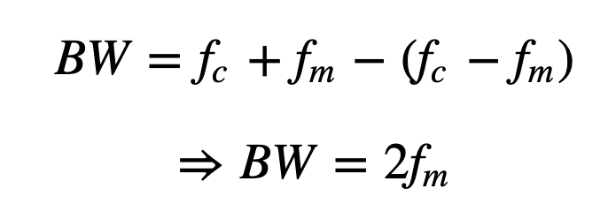
Amplitude Modulation: Bandwidth

Slide 33
Amplitude Modulation: Bandwidth
Carrier
frequency
Amplitude
Amplitude

Slide 34
Modulation
Speed
Amplitude
Frequency
Phase
(AM)
(FM)
(PM)

Slide 35
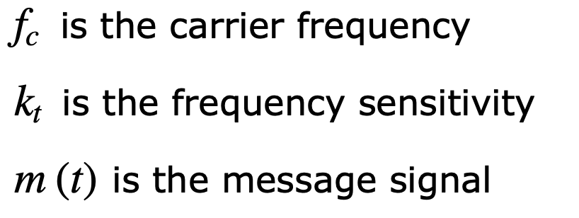
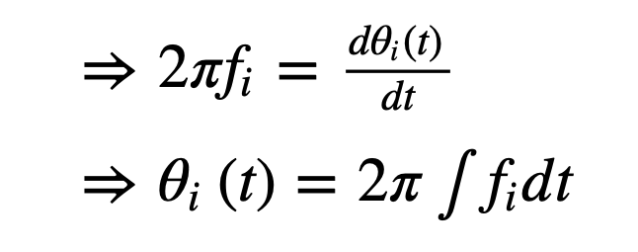
Frequency Modulation

Slide 36
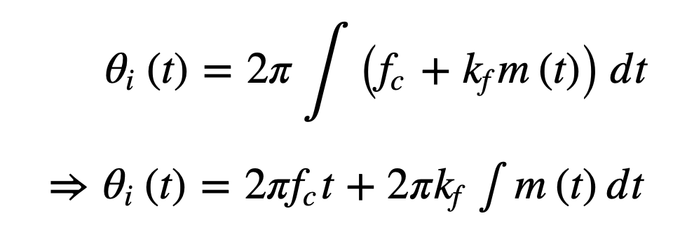

Slide 37
Modulation
Speed
Amplitude
Frequency
Phase
(AM)
(FM)
(PM)

Slide 38
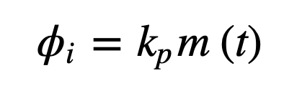
Phase Modulation

Slide 39
Phase Modulation

Slide 40
Phase Modulation

Slide 41
Constellation
Symbols

Slide 42
Constellation
Constellation diagram
Symbols

Slide 43
Constellation
Constellation diagram
Symbols
A
ϕ

Slide 44
Constellation
Constellation diagram
Symbols
Bit=0
Bit=1

Slide 45
Constellation
Constellation diagram
Symbols
10
01
11
00

Slide 46
Constellation
QPSK or 4-PSK
(Phase Shift Keying)
10
01
11
00
16-PSK
(Phase Shift Keying)
…
Higher bit-rate
0001
0000
Lower margin for error

Slide 47
Constellation
16-PSK
(Phase Shift Keying)
…
0001
0000
Lower margin for error
16-QAM
(Quadrature amplitude modulation)
More separation between symbols, i.e., higher margin for error
i.e., lower error probability

Slide 48
Quadrature Amplitude Modulation
Amplitude + phase modulation
OR
amplitude of the sin and cos components are modulated independently

Slide 49
Quadrature Amplitude Modulation
Quadrature
A
ϕ
In-phase

Slide 50
Quadrature Amplitude Modulation
Quadrature
A
ϕ
In-phase

Slide 51
Quadrature Amplitude Modulation
Quadrature
A
ϕ
In-phase

Slide 52
Quadrature Amplitude Modulation
Quadrature
A
ϕ
In-phase
This trigonometric identity shows phased can be added to the carrier by amplitude modulating sine and cosine of the carrier frequency

Slide 53
Quadrature Amplitude Modulation
Quadrature
A
ϕ
In-phase

Slide 54
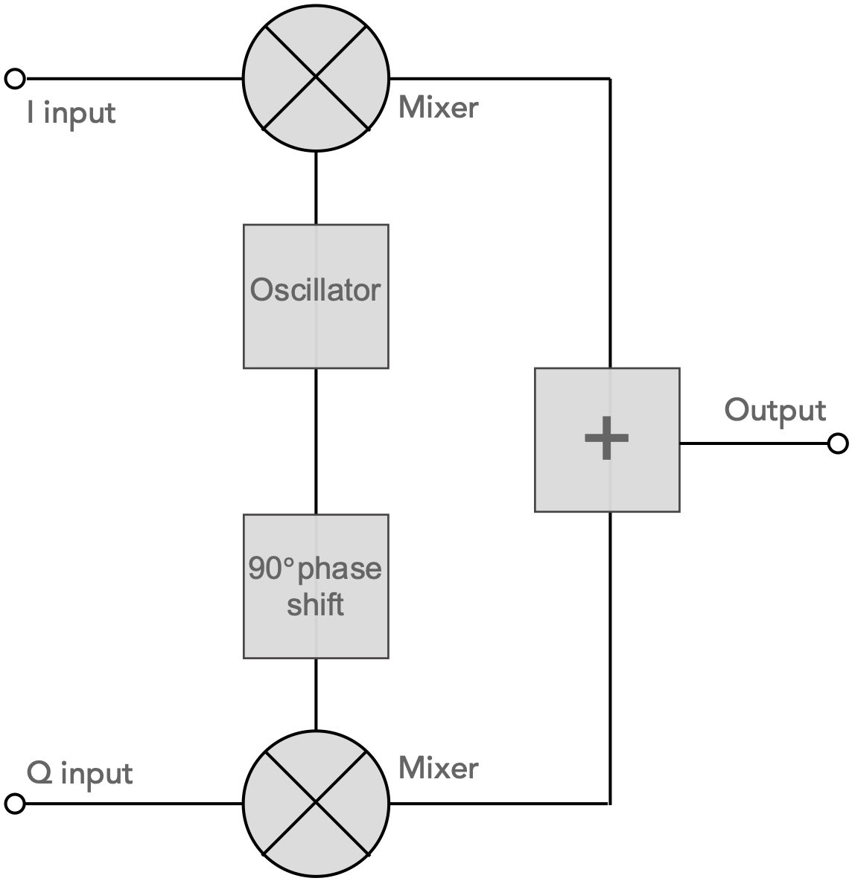
Quadrature Amplitude Modulation
Modulation

Slide 55
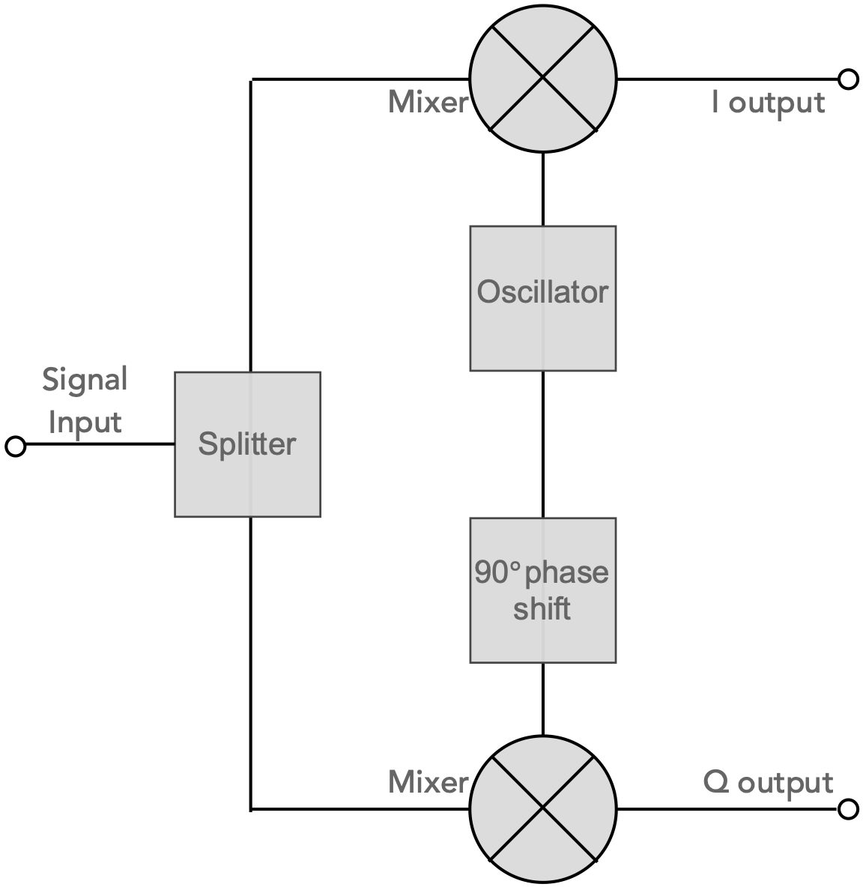
Quadrature Amplitude Modulation
Demodulation

Slide 57
Channel error
Quadrature
10
01
In-phase
11
00

Slide 58
Channel error
Quadrature
Received symbol
10
01
In-phase
11
00

Slide 59
Channel error
Quadrature
Received symbol
Magnitude error
10
01
In-phase
11
00
Phase error

Slide 60
Channel error
Quadrature
10
01
In-phase
11
00

Slide 61
Channel error
Quadrature
Carrier phase offset
10
01
In-phase
11
00

Slide 62
Channel error
Quadrature
Carrier phase and magnitude error
10
01
In-phase
11
00

Slide 63
Channel error
Input
(Transmit symbol)
Linear System
(Channel)
Output
(Receive symbol)

Slide 64
Channel error
Input
(Transmit symbol)
Linear System
(Channel)
Output
(Receive symbol)
Tx signal
Tx signal
Channel
*
Channel Impulse Response (CIR)

Slide 65
Channel error
Known bits sequence
Data bits
Low error modulation
modulation
Preamble
Tx signal

Slide 66
Channel error
Tx Preamble
Tx signal
Channel
Rx Preamble
Rx signal
(Rx preamble) = (Tx Preamble) * (CIR)

Slide 67
Channel error
Tx Preamble
Tx signal
Channel
Rx Preamble
Rx signal
(Rx preamble) = (Tx Preamble) * (CIR)
CIR = deconv (Rx preamble, Tx Preamble )

Slide 68
Channel error
Tx Preamble
Tx signal
Channel
Rx Preamble
Rx signal
(Rx preamble) = (Tx Preamble) * (CIR)
(CIR) = deconv (Rx preamble, Tx Preamble )
(Rx signal) = (Tx signal) * (CIR)
Tx signal = deconv (Rx signal, CIR)

Slide 69
Channel error
Tx Preamble
Tx signal
Channel
Rx Preamble
Rx signal
(Rx preamble) = (Tx Preamble) * (CIR)
(CIR) = deconv (Rx preamble, Tx Preamble )
(Rx signal) = (Tx signal) * (CIR)
Tx signal = deconv (Rx signal, CIR)
Channel equalization

Slide 70
10
01
11
00

Slide 71
10
01
11
00
Channel equalization
10
01
11
00

Slide 72
Multiple Access

Slide 73
Multicarrier modulation
Carrier
frequency
Amplitude
Frequency
Bandwidth

Slide 74
Multicarrier modulation
Carriers
1
2
3
Amplitude
Frequency

Slide 75
Multicarrier modulation
Carriers
1
2
3
Amplitude
Frequency
Bandpass filter
and
demodulate

Slide 76
Multicarrier modulation
1
2
Amplitude
Frequency

Slide 77
Multicarrier modulation
1
Amplitude
Frequency

Slide 78
Multicarrier modulation
1
2
Amplitude
Frequency

Slide 79
Multicarrier modulation
Orthogonal carriers frequencies
1
2
Amplitude
Frequency

Slide 80
OFDM (Orthogonal Frequency-Division Multiplexing)

Slide 81
OFDM (Orthogonal Frequency-Division Multiplexing)
subcarriers

Slide 82
Frequency Division Multiple Access

Slide 83
Time Division Multiple Access
Frequency Division Multiple Access

Slide 84
Time Division Multiple Access
Frequency Division Multiple Access
Code Division Multiple Access

Slide 85
Code Division Multiple Access

Slide 86
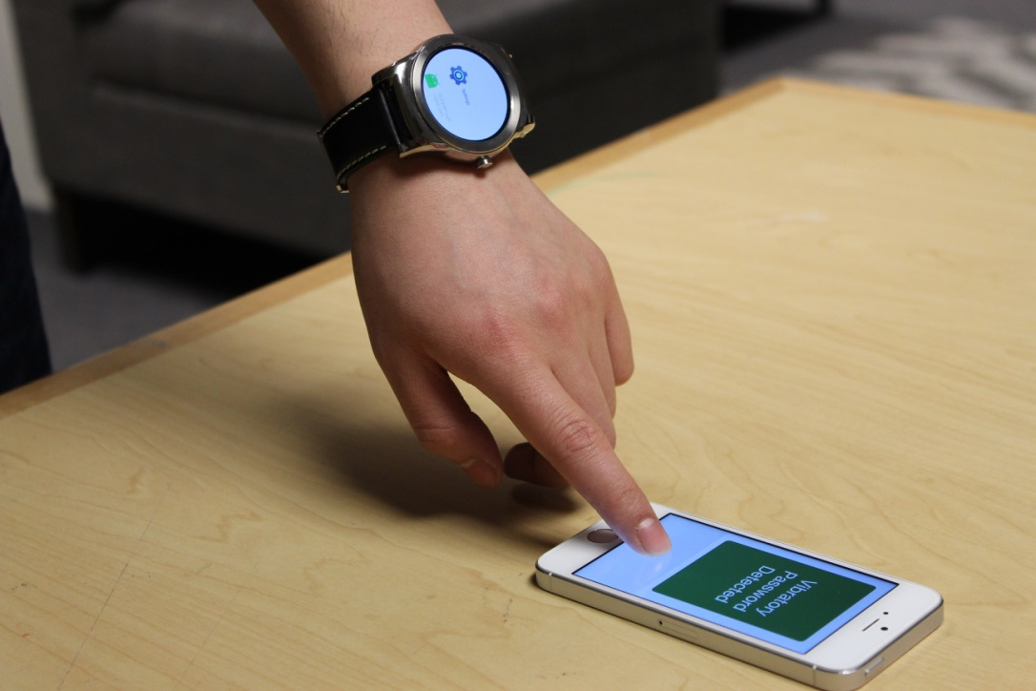
Case study
Ripple: Communicating through Physical Vibrations
NSDI 2015

Slide 87
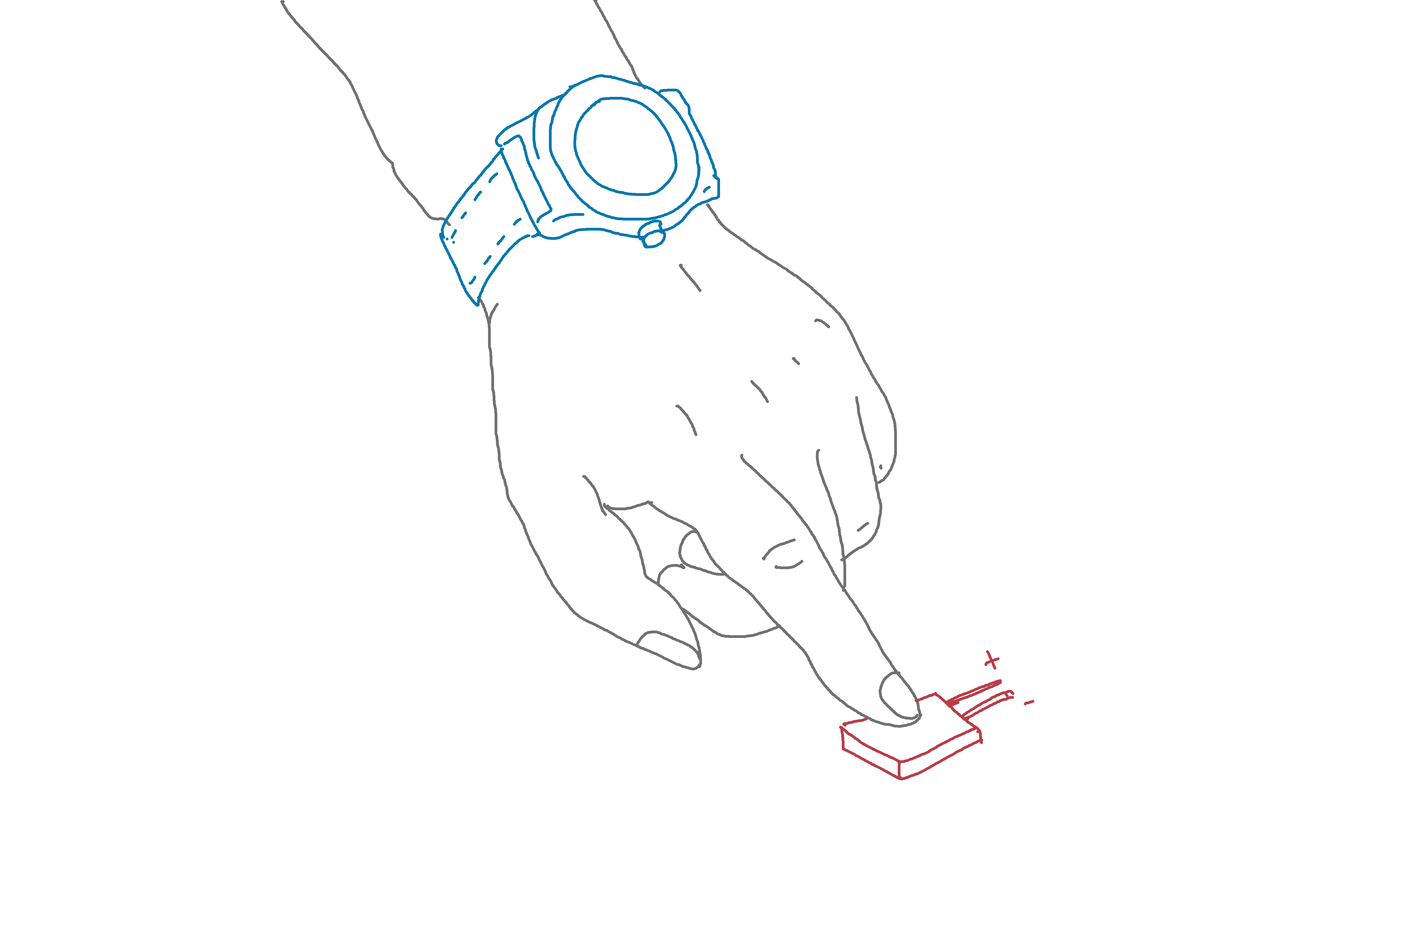

Slide 88
Vibration Motor

Slide 89
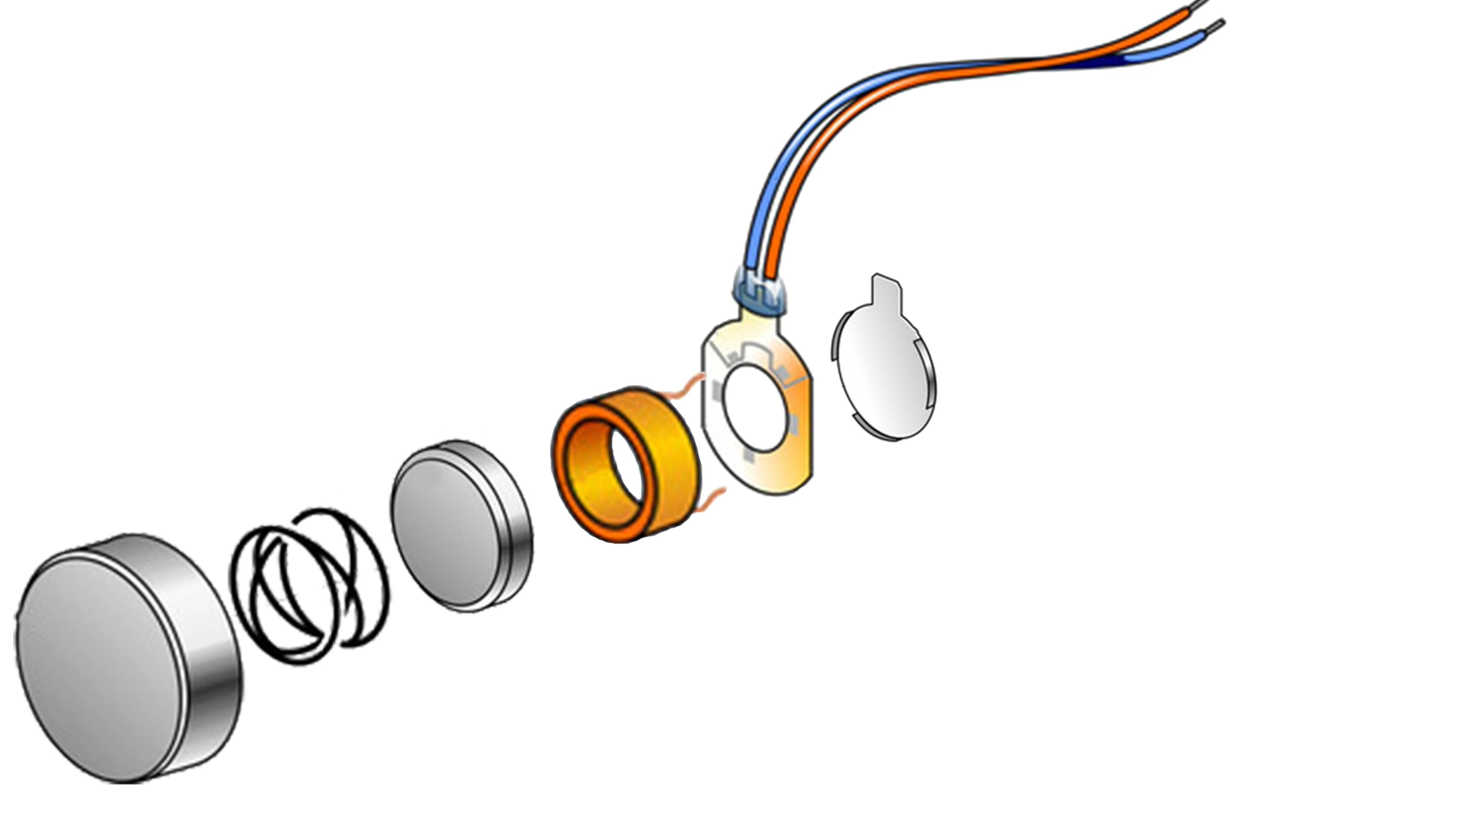
AC current
Coil
Magnetic mass
Notes:
You will see that there is essentially a small magnetic mass … suspended inside a coil.
When we apply an AC current in the coil

Slide 90
AC current
Coil
Magnetic mass
Notes:
… the current creates an alternating magnetic field … which then moves the mass back and forth.
Now … by controlling the frequency and intensity of the AC current … we can PROGRAMMATICALLY control the vibration of the vibration motor.
This gives us the seed opportunity to create a data “TRANSMITTER" out of vibrations …

Slide 91
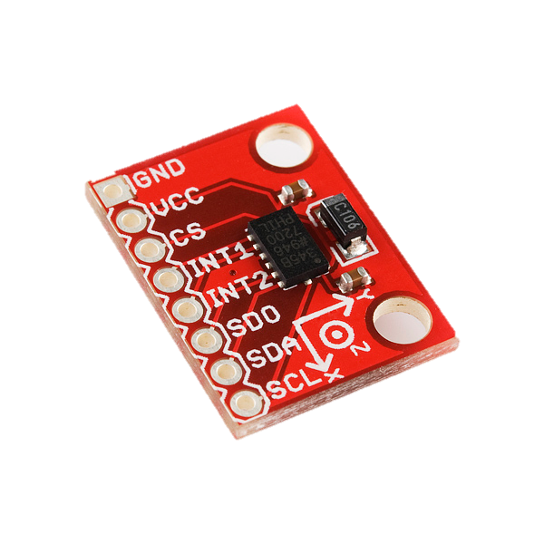
Vibration motor
Motion sensor
(accelerometer)
Notes:
Now, what could be the “RECEIVER” for such vibrations?
Observe that almost all mobile devices today have a motion sensor called … ACCELEROMETERS

Slide 92
Vibration motor
Motion sensor
(accelerometer)
Notes:
Thus, if the vibrating transmitter comes in CONTACT with the accelerometer … by literally TOUCHING the accelerometer … then the accelerometer can SENSE the vibrations and DECODE the data bits from it.
We have built such vibratory transmitters inside smartwatches and finger rings.
When the human finger touches the accelerometer … the vibration flows the the finger bone … and the data is transferred.
Of course, the human does not feel anything at all …

Slide 93
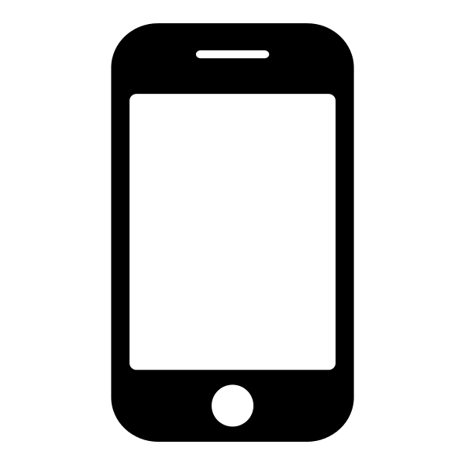
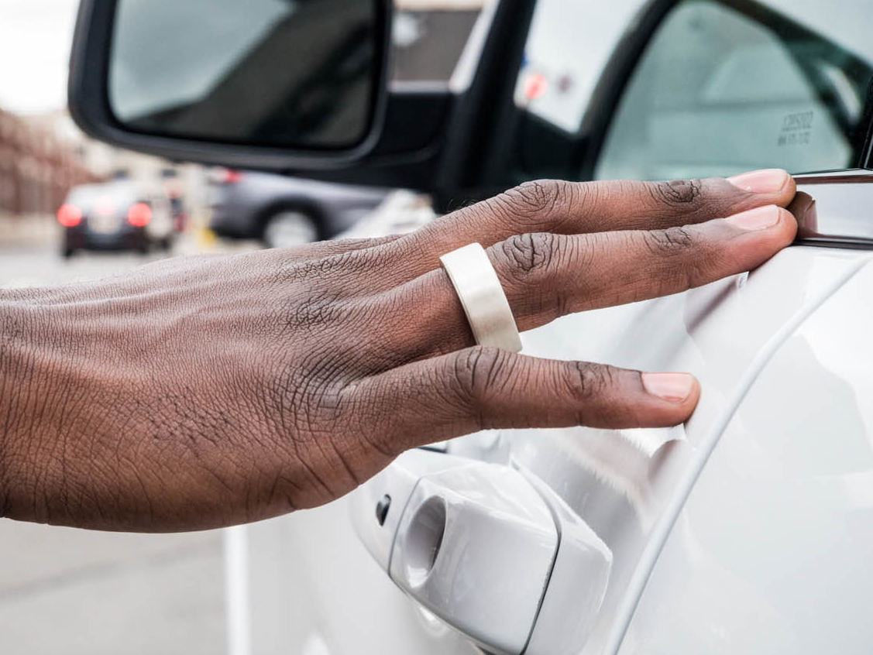
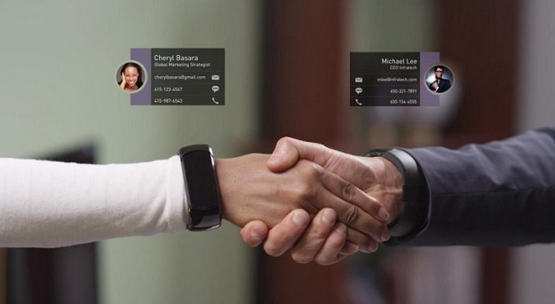
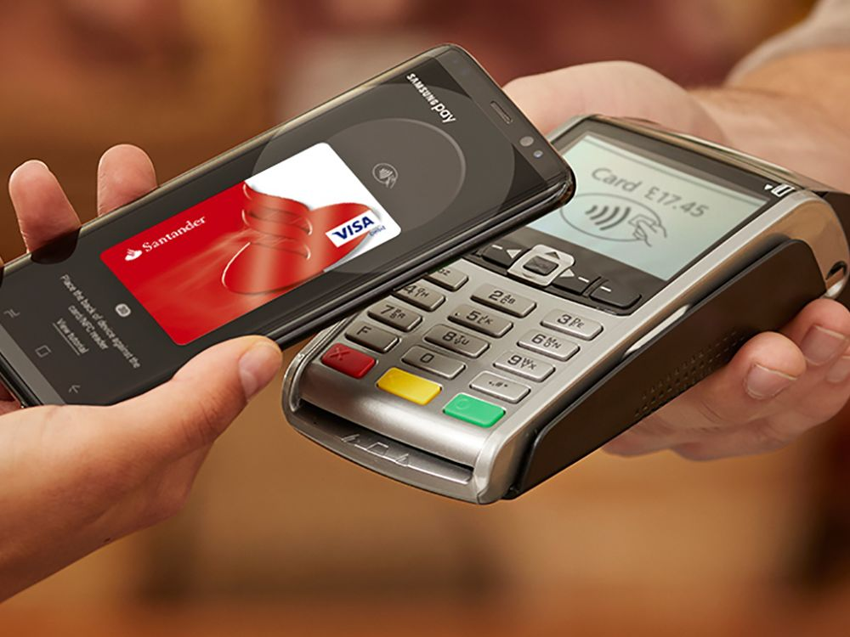

Slide 94
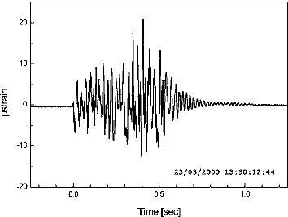
On
On
On
Off
Vibration Motor
Pulse-based communication
Accelerometer
10 bits/sec
> 25 kbps
Notes:
In designing this vibratory system, probably the easiest form of communication will be MORSE code … that is, to turn the vibration motor ON and OFF.
However, due to INERTIA of the MOVING MASS … we cannot change its state fast enough …. which fundamentally limits the data rate to around 10 BITS per second. <CLICK>
Clearly … any real application will need at least 25 kbps.

Slide 95
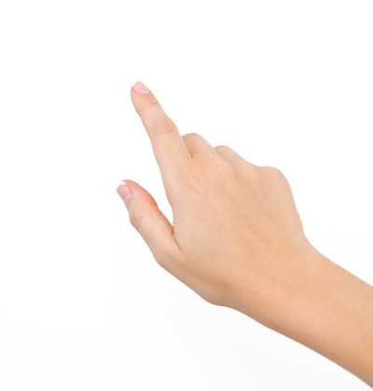
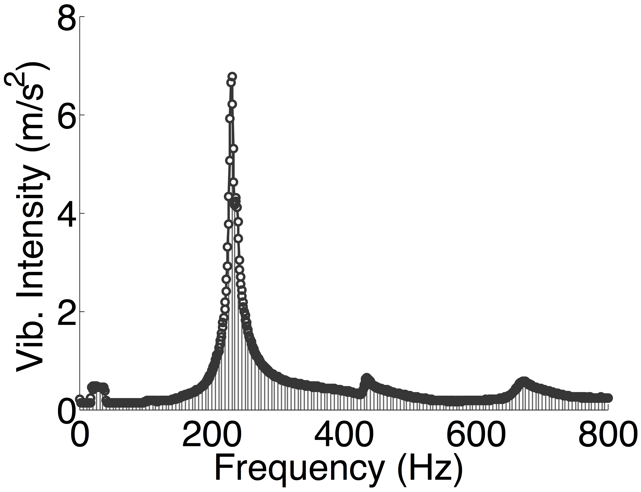
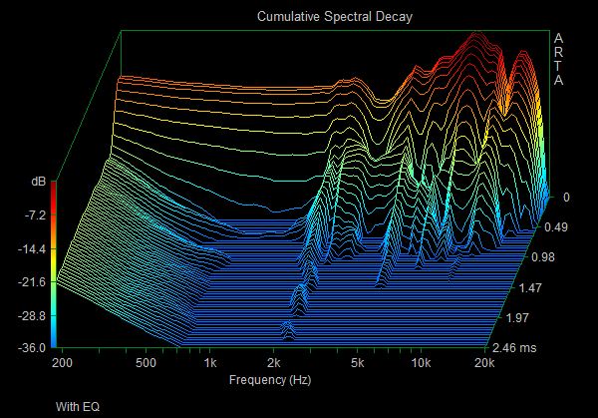
Vibration Motor
Medium
Accelerometer
Limited bandwidth
High freq. absorption
ACK-free link protocol
Driver latency
32kbps Orthogonal Frequency
Division Multiplexing (OFDM)
Amplitude
Frequency
Notes:
However, attempts to achieve high data rate revealed various challenges …
The vibration motor presents a non-linear frequency response … the attenuation from human bone conduction is time varying … the accelerometer is low bandwidth … and numerous more.
We addressed these challenges to ultimately develop an OFDM based transmitter receiver … where OFDM is the scheme used in WiFi today … and ultimately achieved 32 kbps through vibrations.
Let me briefly tell you about one of these problems around receiver design.

Slide 96
Microphone as Vibration Receiver
Microphone
Accelerometer
(24 kHz bandwidth)
Low bandwidth
(200 Hz)
Air
vibration
Signal
Diaphragm
Notes:
The first bottleneck we faced is with accelerometers.
Since it samples at a maximum of 200 Hz, we have a very limited bandwidth … FUNDAMENTALLY limiting the data rate we can achieve.
So … while searching for a better vibration sensor … we again landed up with MICROPHONES …
Recall that microphones have a diaphragm to vibrate to air-vibrations from sound …

Slide 97
Vibratory communication stack
OFDM modulation
OFDM de-modulation
Physical
Layer
Power waterfilling
Interference
cancellation
Channel pre-coding
Vibra-motor Driver
Microphone Driver
Hardware
Notes:
That is the sketch of our receiver design at the vibratory PHY layer.

Slide 98
Vibratory communication stack
Channel coding
MAC
Layer
Proactive symbol retransmission
Channel sensing and prediction
OFDM modulation
OFDM de-modulation
Physical
Layer
Power waterfilling
Interference
cancellation
Channel pre-coding
Vibra-motor Driver
Microphone Driver
Hardware
Notes:
We have also built a MAC layer on top to cope with data packet errors, rate control, and retransmission strategies …

Slide 99
Vibratory communication stack
Applications
Wearables
(watch, ring)
Surface
communication
Smartphone
Device-device
Channel coding
MAC
Layer
Proactive symbol retransmission
Channel sensing and prediction
OFDM modulation
OFDM de-modulation
Physical
Layer
Power waterfilling
Interference
cancellation
Channel pre-coding
Vibra-motor Driver
Microphone Driver
Hardware
Notes:
And have finally developed an application layer that can transmit data from a phone, watch, or a ring, to any other device that has 2 microphones.

Slide 100
Morse-code
Single-Carrier
Multi-Carrier
Multi-dimension
Phy-Security
Physical Layer Security
Notes:
As the vibration does not broadcast signal in the air, security might be an application area for Ripple. However, there are some side channels

Slide 101
Morse-code
Single-Carrier
Multi-Carrier
Multi-dimension
Phy-Security
N
S
1 0 1
Correlated
Notes:
Along with the vibration, the moving mass of the motor generates<CLICK> sound while vibrating at a very high speed. And this sound <CLICK>
…is correlated with the data it transmit. Therefore, even if the vibratory signal is not accessible, an attacker can listen to this sound of vibration and decode the data.
One obvious solution is to use jamming signal. Lets see how it works.

Slide 102
Morse-code
Single-Carrier
Multi-Carrier
Multi-dimension
Phy-Security
Vibration sound
Speaker sound
Notes:
<CLICK> When device transmits data it generates vibration sound.
<CLICK> a built-in, co-located speaker can simultaneously generate a jamming sound.
<CLICK> The combination makes it difficult for the attacker to recover the data.

Slide 103
Morse-code
Single-Carrier
Multi-Carrier
Multi-dimension
Phy-Security
Vibration sound
Speaker sound
Notes:
However, for various reasons jamming is not the ideal solution. Instead we attempt to cancel the sound of vibration by generating anti-sound through the speaker.
<CLICK> The anti sound is actually the same waveform as the vibration sound, but..
<CLICK> reverse in amplitude.
<CLICK> When this two waveforms combine, they completely cancel each other.

Slide 104
Morse-code
Single-Carrier
Multi-Carrier
Multi-dimension
Phy-Security
Vibration sound
Speaker sound
Notes:
Is to exactly match the phases of these two sounds.
<CLICK> If the there is any phase mismatch
<CLICK> we can end up amplifying the sound, instead of cancelling this. To perform this phase alignment we need a real-time control over the audio processing system. Unfortunately, none of the mobile devices offers such control.

Slide 105
Morse-code
Single-Carrier
Multi-Carrier
Multi-dimension
Phy-Security
S6 S5 S4 S3 S2 S1 S0
Audio Sample Buffer
Audio Clock
Notes:
Here is a simplified version of the audio-processing system.
To play the waveform it first <CLICK> loads the samples in a buffer.
<CLICK> then at every tick of audio clock <CLICK> it sends the sample to the speaker.
Loading the samples and starting the sound introduces random delay of tens of milli-second which is sufficient to have significant phase mismatch.
We don’t have precise control on them, BUT… <NEXT>

Slide 106
Morse-code
Single-Carrier
Multi-Carrier
Multi-dimension
Phy-Security
S6 S5 S4 S3 S2 S1 S0
Audio Sample Buffer
Audio Clock
Notes:
We can change the frequency of the clock at real-time and it changes the frequency of the ongoing sound. So we have control over only one parameter, the frequency of the anti-sound and here is how we use it for phase alignment.

Slide 107
Morse-code
Single-Carrier
Multi-Carrier
Multi-dimension
Phy-Security
Vibration sound
Speaker sound
Notes:
Going back to the same setting, the vibration sound is in the air…we have to play the anti-sound. But instead of playing it with the correct frequency..we first increase the frequency a little <CLICK>.
<CLICK>Now when these two waveforms combine, they don’t cancel rather <CLICK> shows periodic cancellation and amplification.
<CLICK> and we get a wavy envelope of the signal.

Slide 108
Morse-code
Single-Carrier
Multi-Carrier
Multi-dimension
Phy-Security
Vibration sound
Speaker sound
Notes:
The device listened to this waveform and <CLICK> follows the envelope. When the envelope comes to a minimum we know that the phase of the sounds are at match…then we change the frequency back to actual value…<CLICK> It locks the phase difference and we get constant destruction after that.

Slide 109
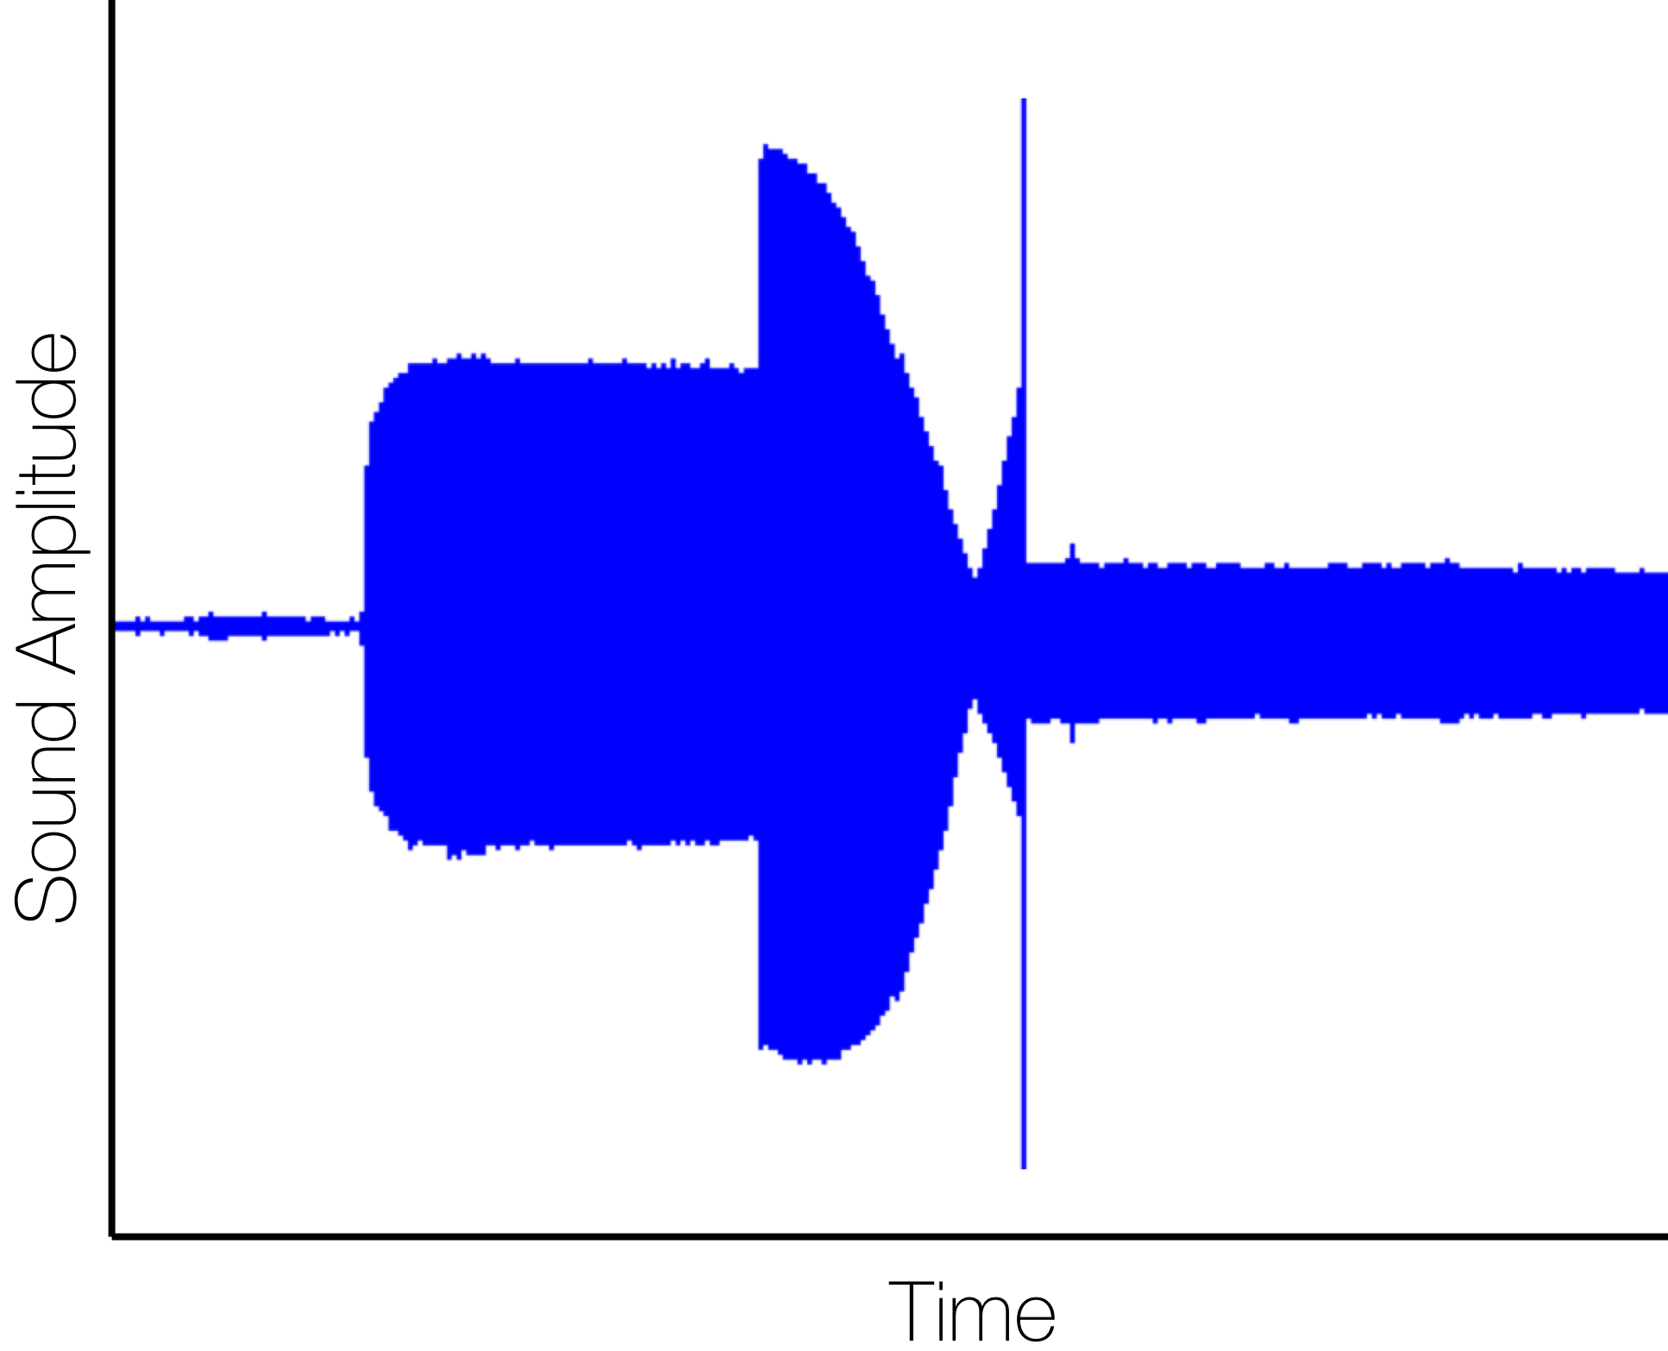
Morse-code
Single-Carrier
Multi-Carrier
Multi-dimension
Phy-Security
Anti-sound start
Frequency switch
Vibration start
Notes:
This plot shows how this technique works in reality.
At this point the vibration starts and after some time we start the anti-sound with increased frequency. We can see the varying envelope. When it observes a minimum value, it switches the frequency and we have a constant reduction in sound after that point.
However, as the system could not identify the minimum value of the envelope, it leaves some residual sound, which we can camouflage with a faint jamming signal.

Slide 110
Demo
Notes:
Here is a demo of our vibratory ring … which contains an image that needs to be transmitted to the receiver …
==========
We use an image to demonstrate the 10 kbps bandwidth achieved …
Of course, in general the data could be credit card information … or authentication passwords … that would take MUCH LESS TIME for transmission.

Slide 111
Demo
Notes:
Here is a demo of our vibratory ring … which contains an image that needs to be transmitted to the receiver …
==========
We use an image to demonstrate the 10 kbps bandwidth achieved …
Of course, in general the data could be credit card information … or authentication passwords … that would take MUCH LESS TIME for transmission.

