Slide 1
Smart Homes that Monitor Breathing and Heart Rate
Fadel Adib, Hongzi Mao, Zach Kabelac, Dina Katabi, Rob Miller
CHI 2015
Presenter: Gang Liao and Dunbang He

Slide 2




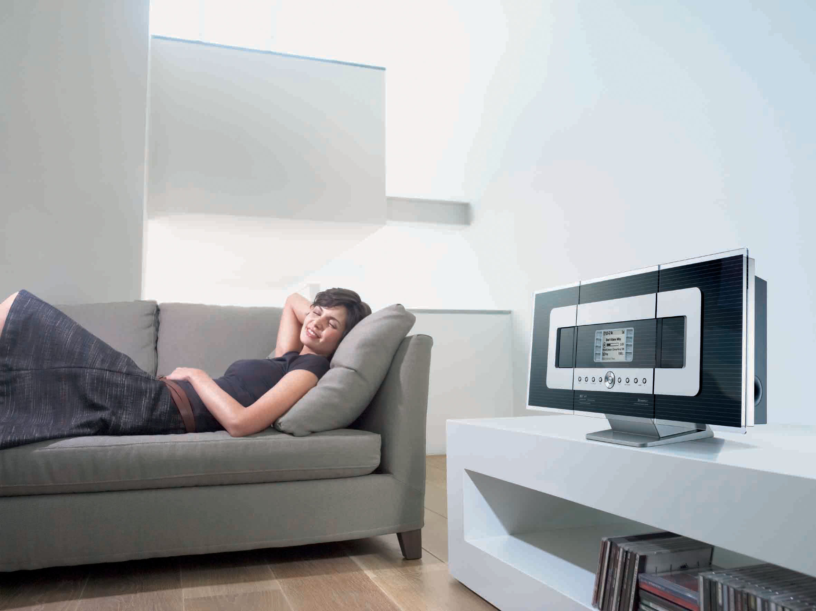
Can smart homes monitor and adapt to our breathing and heart rates?
Personal Health
Baby Sleep
Elderly Health
Adapt Lighting and Music to Mood
Notes:
Over the past few years, we've started seeing more and more sensors that can be placed in the smart home. In fact, there already exist smart homes sensors that can monitor temperature and air quality and use this information to improve our health and comfort. In this talk, we want to ask; Whether smart homes can also monitor our breathing and heart rate similar to how they monitor air quality or temperature.
Now you might be wondering: why would I want a smart home to remotely monitor breathing and heart rate?
Well, if it could, I can start asking my smart home interesting questions like: Do my breathing and heart rates reflect a healthy lifestyle?
Or: Does my child breathe normally during sleep?
Or even: Does my elderly parent experience irregular heartbeats? [pause]
In fact, if my smart home can monitor breathing and heart rate, then it could also use them to infer our emotional and stress levels and automatically adapt lighting and music to our daily moods.
[pause]
So, how can we allow smart homes to monitor our breathing and heart rates? [pause] Well, one option is for us to wear a bunch of sensors that can monitor vital signs. Unfortunately and clearly, that would become highly cumbersome.

Slide 3
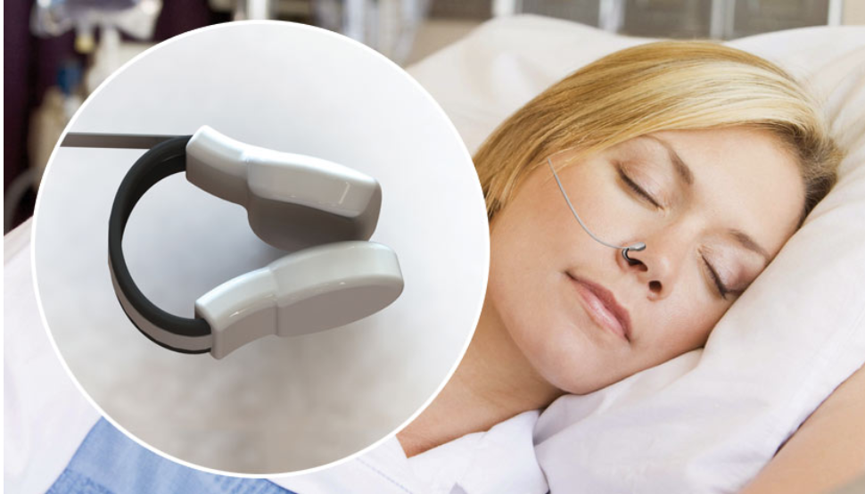
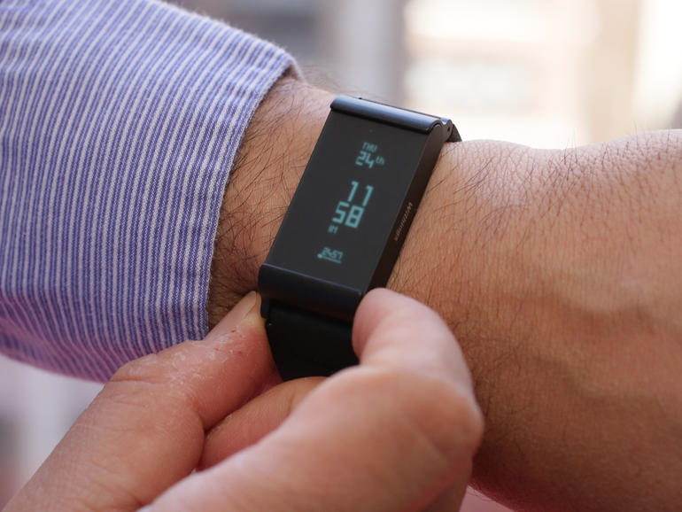
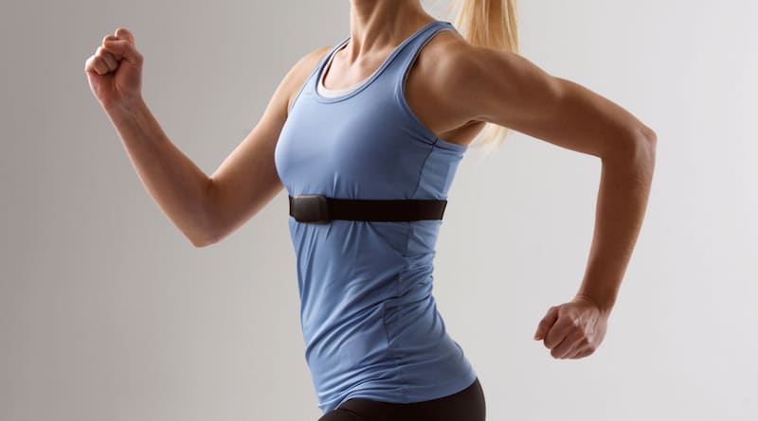
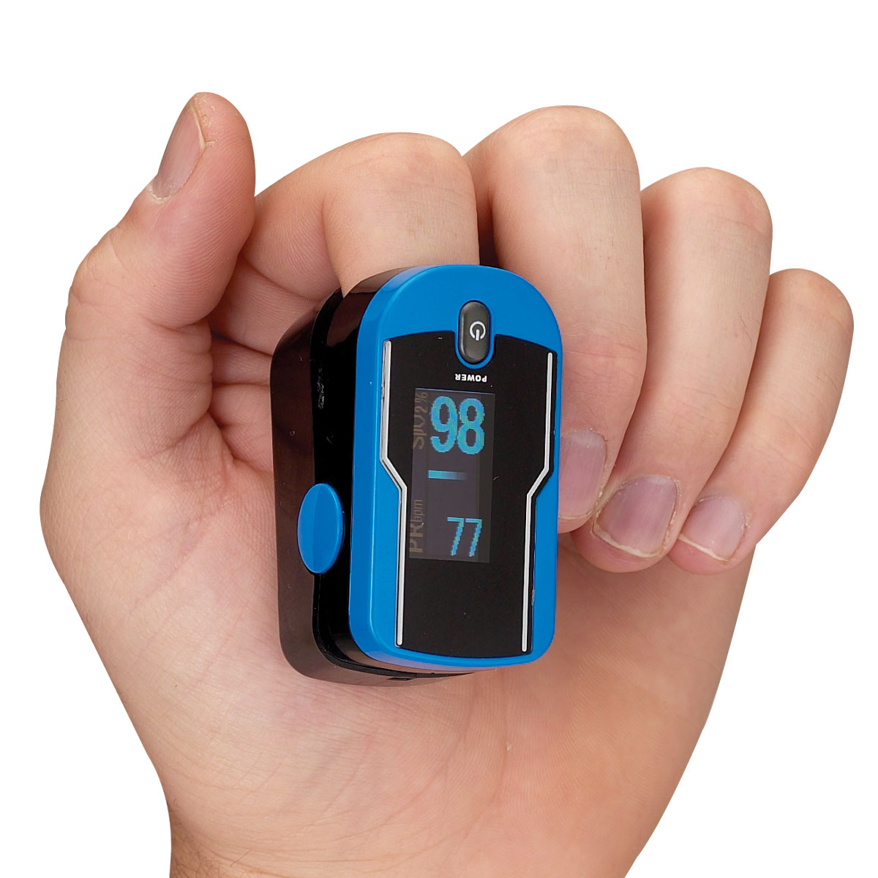
Today’s monitor technologies are cumbersome
Breath Monitoring
Heart Rate Monitoring
Notes:
Imagine yourself wearing a nasal probe or a chest band throughout the day, walking around in the comfort of your home. [animate]
And, on top of that, you need to wear a pulse oximeter or wristband that would monitor your heartrate, and take it off every day to charge it.
--
And even if you and I were willing to do this, these wearables are not suitable for certain sections of the population like the elderly and babies who are completely uncomfortable wearing them.
So, can we take these vital sign sensors off our bodies and just let them dissolve into the environment? Then, they would remotely track our vital signs, without us even being aware of them, and adapt our environments accordingly.

Slide 4
Can we monitor breathing and heart rate remotely?
Notes:
In other words, Can we monitor breathing and heart rate from a distance? What do you guys think? [pause]
The answer is yes. [Pause]

Slide 5
Challenges
No physical contact with the body
Monitor multiple users simultaneously
No awareness of system’s presence
Any motion affects the signal and interferes with tracking breathing or heartbeats
Notes:
Without requiring any physical contact with our bodies.
does not require the user to face the device or be aware of its presence. sleeping, watching TV, typing on her laptop, or checking her phone

Slide 6
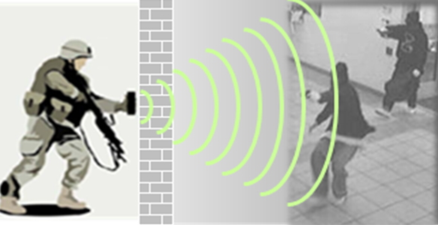
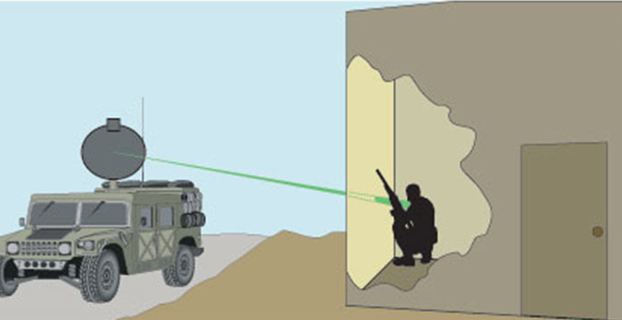
Existing Solution I - Military
Typical transmit at excessive power and use military-reserved spectrum bands which is not feasible for consumer devices.
Notes:
building radars that can detect human presence through walls or under rubble by relying on the fact that breathing impacts wireless signals. they could be used to sense the chest movements of a trapped victim through rubble.

Slide 7
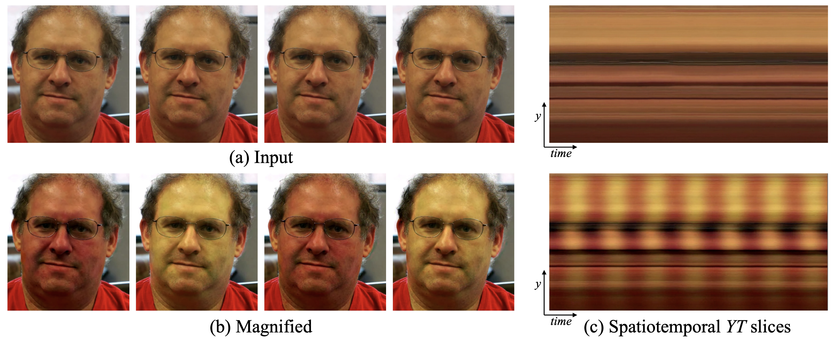
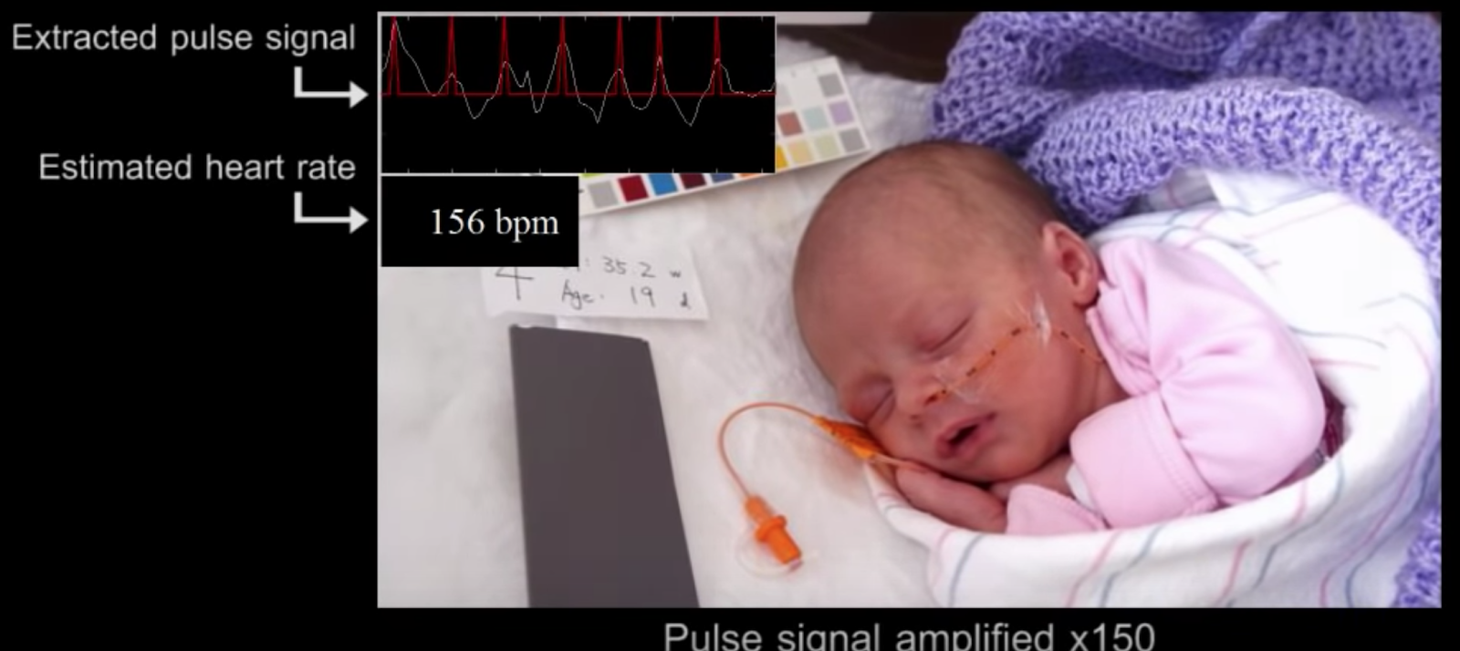
Existing Solution II - Vision-based Techniques
Take video as input
For each pixel, analyze the variation over time and amplify it
Use FFT to get the frequency of this variation and extract the heart rate
Problem: It requires the user to face the camera and do not work when he/she turns around or is outside the camera’s field of view.

Slide 8
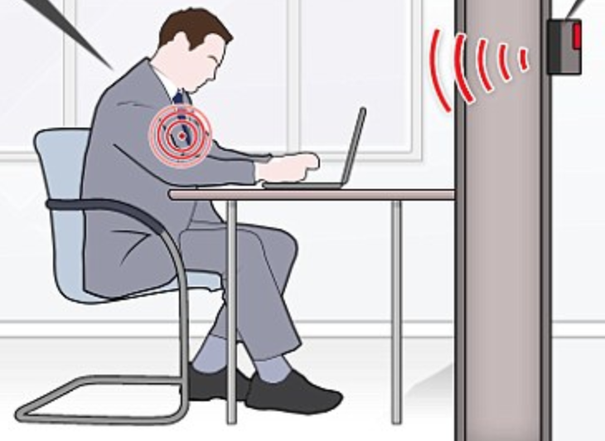
The Existing Solution III - Wireless Signals
Using wireless signals to extract vital signs.
Past Solution: only one person lies still in close proximity to the device.
The key challenge is that any motion affects signal.
Breathing and heartbeats can be easily masked by interference from any movement.
Signal might be affected by the combination of vital signs from multi-users.
Notes:
Since breathing and heartbeats are minute movements, only one source of motion

Slide 9
Vital-Radio
Technology that monitors breathing and heart rate remotely with 97% accuracy
Can monitor multiple users simultaneously
Operates through walls and can cover multiple rooms
Does not require the user to face the device or be aware of its presence
Notes:
In this talk, I will be describing Vital-Radio, a technology that allows us to monitor breathing and heart rate remotely and with very high accuracy.
For example, you can take the device, place it in your home, and it can monitor multiple users’ vital signs simultaneously. And it operates even if the user is behind the wall, so it can cover multiple rooms at the same time.
So, what is the basic idea that allows us to monitor human vital signs remotely? [pause]

Slide 10
Idea: Use wireless reflections off the human body
Notes:
Our idea for doing this is that we will use wireless reflections of the human body to monitor breathing and heart rate.

Slide 11
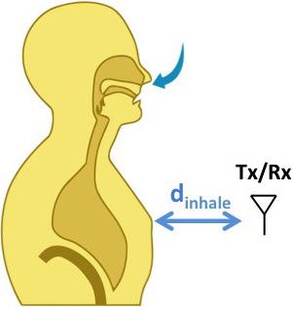
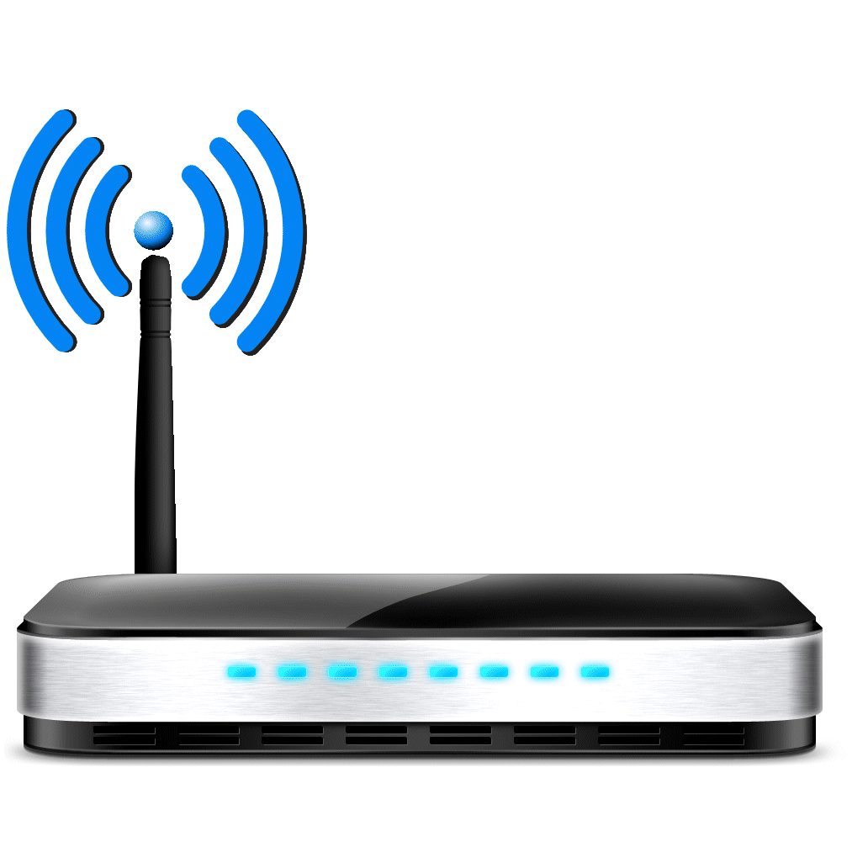

Idea: Use wireless reflections off the human body
Device analyzes the wireless reflections to compute distance to the body
Wireless device
d_{exhale}
d_{inhale}
Chest Motion changes distance
Heartbeats also change distance
distance
Wireless wave has a phase:
φ = 2π
wavelength
Notes:
Let me explain to you what I mean by that. When we have a wireless device and a person standing next to it. The device shines a wireless signal, which reaches the person’s body, reflects off his body, and then comes back to the device. The device captures this wireless reflection.
The device is going to use the wireless reflections to compute the distance to the human body.
Let me show you why the distance is important to measure the breathing motion. Over here, the person is first fully exhaled so his chest is at some distance from the device, Dexhale. Now, I want you to focus on the person’s chest to see what happens when he inhales. As you can see, the person’s chest expanded and is now closer to the device so the new distance is shorter than before, Dinhale. By monitoring the distance between the device and the human, we can monitor the person’s breathing.
Without getting into a lot of details with wireless signals, the key idea is that wireless signals travel as waves, which means they have a phase. And we can express this phase using this mathematical formula which shows a linear relationship between the phase and the distance. So if we can monitor the phase of the wireless signal, we can use it to measure the user’s distance and infer from it the person’s breathing.
Similarly, human heartbeats also lead to changes in distance, and the reason is that when the heart beats, it pumps blood throughout your body, which creates a force on your limbs, like your arms and head due to the momentum of the blood flow. The blood flow causes them to jitter. These movements lead to variations in the wireless reflection, which the device can use to extract our vital signs.
To summarize, breathing and heartbeats cause distance variations that can be captured from a wireless signals’ phase.

Slide 12
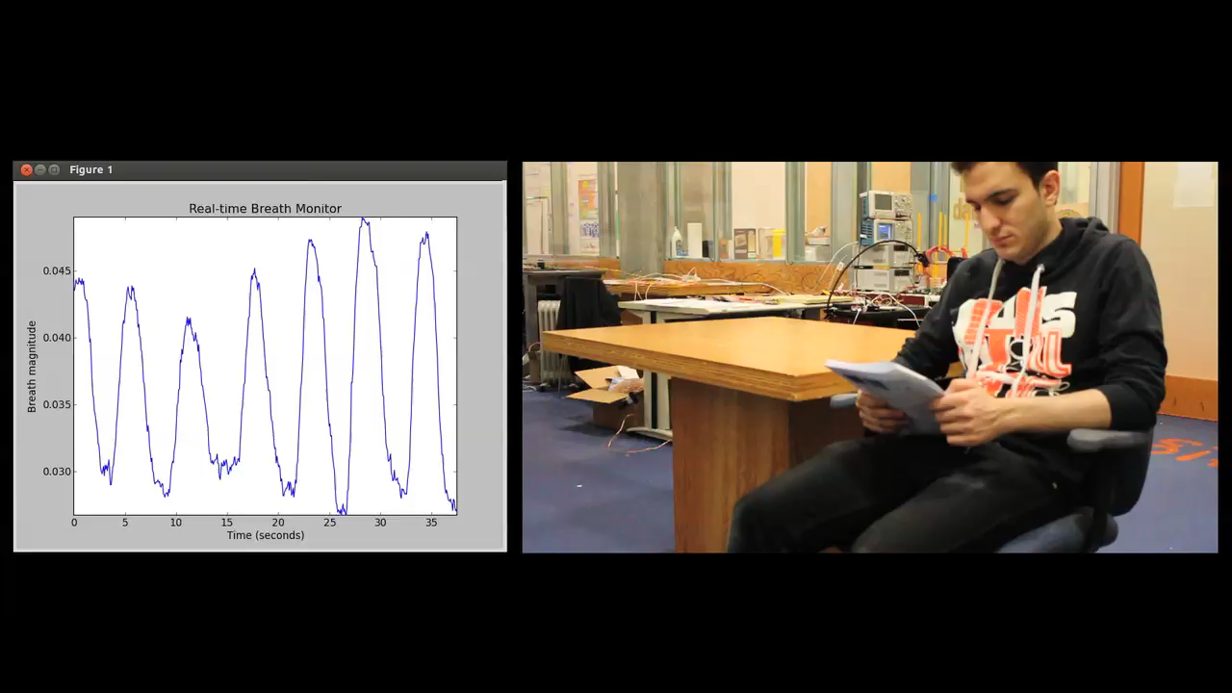
Notes:
So, let’s see what this translates to by looking at a video. [animate]
The sensor in this video is placed behind the camera.
As you can see, as the person inhales and exhales, the phase of the wireless signal varies to reflect the breathing motion. To make sure that this is indeed due to breathing, we ask the person to hold his breath.
And, when he holds his breath, like here, we stop seeing variations.
Actually, we do still see minor variations over here, but I’ll back to them in a bit.
When the person releases his breath in a bit, we start seeing the variations again.
Now, I want to repeat the same video, but at 5 times the speed, and I want you to try to focus on the chest movements and map them to the phase signal…
Okay, so now that we’ve seen this video,

Slide 13
Let’s zoom in on these signals
Notes:
let’s zoom in on these signals to understand them in more details

Slide 14
Heartbeats
Exhale
Inhale
Notes:
So, the figure here plots the reflected signal over time. As you can see, the phase variations in time indicate the human breathing motion.
[animate] The valleys in the signal correspond to the inhale, because the person’s chest is closest to the antenna.
[animate] And the peaks correspond to the exhale.
Now, I want to take this portion here and zoom in on it. [animate]
If we look at this, we see tiny periodic variations. These are the tiny jitters due to the heartbeats that I told you about earlier in the talk [animate]

Slide 15
But in reality…

Slide 16
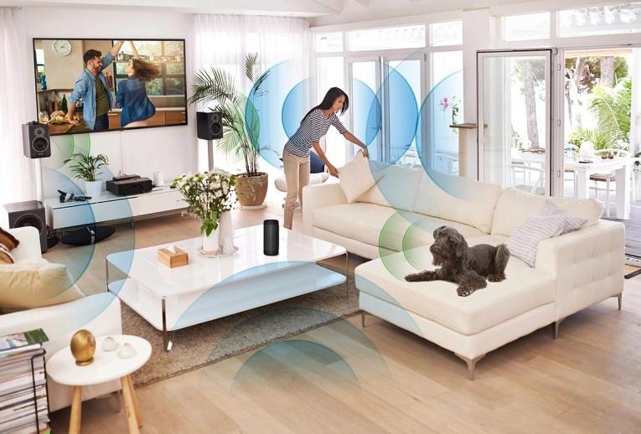
But in reality…
Natural environments:
Walls and furniture
Multiple users and animals
All of them will reflect the wireless signal.

Slide 17



Reflections from different objects collide
Problem: Phase becomes meaningless!
Reflection 1
Reflection 2
Notes:
Well, what’s going to happen is that the reflections from all the different users are going to collide with each other.
Let’s say we have the device and two people in the scene. The first person will reflect the signal back. and the second person will also reflect a signal.
and if we add a table, the table will also reflect back a signal.
All of the reflections will interfere and the phase that gave us breathing and heart rate before becomes completely meaningless.
So, how to deal with all these reflections

Slide 18
Reflections from different objects collide
Idea: Wireless positioning can be used to locate various devices
Problem: Phase becomes meaningless!
Reflection 1
Reflection 2
Notes:
Ideally, we would be able to isolate each person’s reflection.
Wireless positioning is used here. the wireless signals emitted from different devices can be used to find their position.

Slide 19
Solution: Use wireless positioning as a filter to isolate reflections from different positions
Reflection 1
Reflection 2
Notes:
By separating these reflections, we can start analyzing each of them independently to extract breathing and heart rate.

Slide 20
Solution: Use wireless positioning as a filter to isolate reflections from different positions
Reflection 1
Reflection 2
Bucket1
Bucket2
Bucket3
Notes:
By separating these reflections, we can start analyzing each of them independently to extract breathing and heart rate.

Slide 21
Solution: Use wireless positioning as a filter to isolate reflections from different positions
Reflection 1
Reflection 2
Bucket1
Bucket2
Bucket3
Analyze reflections in each bucket to obtain breathing and heart rate
Notes:
By separating these reflections, we can start analyzing each of them independently to extract breathing and heart rate.

Slide 22
Frequency Modulated Carrier Waves (FMCW)
FMCW enables separating the reﬂections from different objects into buckets based on their reﬂection times
Reflections from two objects that are separated by at least 8 cm would fall into different buckets
Vital-Radio eliminates reflections off static objects like walls and furniture
Notes:
Specifically, FMCW can isolate the signals reflected from each of these entities into different buckets.
Since static objects don’t move and their reflections won’t change over time, these reflections can be eliminated by subtracting consecutive time measurements.

Slide 23
What happens when a person moves his limb?
Notes:
But, what if a person moves around or waves his arm?
Here is an example.

Slide 24
What happens when a person moves his limb?
Breathing
Limb Motion
Band-pass filter the cleaned signals to extract breathing and heart rate
Use periodicity test to eliminate variations that are not due to breathing/heartbeats
Periodic
Not periodic
Notes:
In this figure, the person is first fairly static and so we see the breathing signal going up and down, but then he moves his arm right before the 1 minute mark, which results in these random variations in the signal.
To deal with this, Vital-Radio exploits that motion due to vital signs is periodic, while body or limb motion is aperiodic.
So, we can perform a test to identify intervals of time where a user’s whole body moves or where he performs large limb movements.
and discard them, so that they do not create errors in estimating vital signs.

Slide 25
Put Them Together
Step 1: Transmit a wireless signal and capture its reflections
Step 2: Isolate reflections from different objects based on their positions and eliminate reﬂections off furniture and static objects
Step 3: Zoom in on each object’s reflection to obtain phase variations due to vital signs
Notes:
So In order for us to capture breathing and heart rate remotely,
We will first transmit a wireless signal and capture its reflection off the human body
Then, we will isolate reflections from different objects based on their locations
And finally, we will zoom in on each object’s reflection to extract their vital signs.

Slide 26
Extracting Breathing and Heart Rate
Notes:
Next, we show how Vital-Radio extracts breathing and heart rate

Slide 27
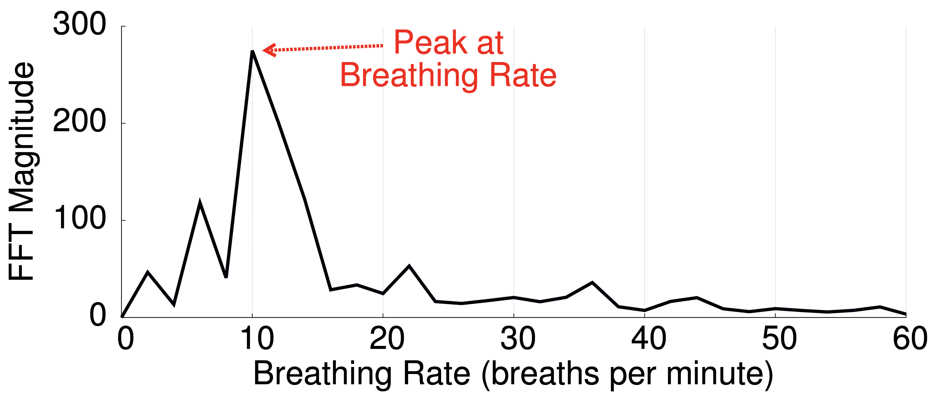
Extracting Breathing and Heart Rate
Breathing Rate Extraction
Coarse estimate: Perform an FFT. The peak at the output corresponds to the breathing rate.
Notes:
Because breathing is a periodic motion, we can extract the frequency (rate) of breathing by performing a Fourier transform (an FFT). The peak at the output of the FFT will correspond to the dominant frequency, which in our case is the breathing rate.
However, simply taking the peak of the FFT does not provide an accurate estimate of breathing rate. For a window size of 30 seconds, the resolution of our breath rate estimate is 2 breaths/minute, is less capable of tracking changes in breathing rate.

Slide 28
Extracting Breathing and Heart Rate
Breathing Rate Extraction
Optimization: ﬁlter the output of the FFT, keeping only the peak and its two adjacent bins to eliminate noise caused by extraneous and nonperiodic movements.
Perform an inverse FFT to obtain a complex time-domain signal s’(t). The phase of s’(t) will be linear and its slope will correspond to the breathing rate.
Notes:
To obtain a more precise measurement, we first…
Also, exploit a well-known property in signal processing
if the signal contains a single dominant frequency, then that frequency can be accurately measured by performing a linear regression on the phase of the complex time-domain signal

Slide 29
Extracting Breathing and Heart Rate
Heart Rate Extraction
Problem: the breathing signal is stronger than the heartbeat, which would leak into other frequencies and could mask a weaker signal at a nearby frequency.
Filter the frequency domain signal around [40-200] beats per minute. The local maximum provides a coarse estimate of the heart rate.
Notes:
When it comes to heart rate, it is mostly similar but
To mitigate this leakage
this allows us to filter out breathing, which is typically between 8 and 16 breaths per minute as well as high frequency noise (which is higher than 200 beats per minute)

Slide 30
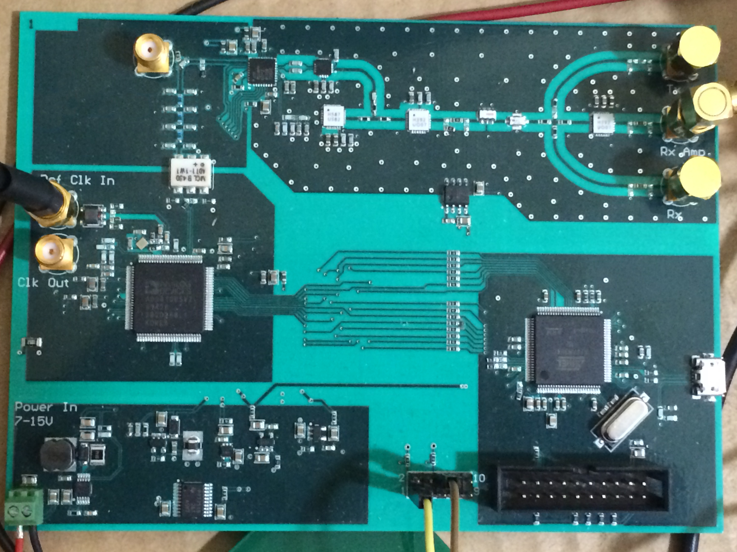
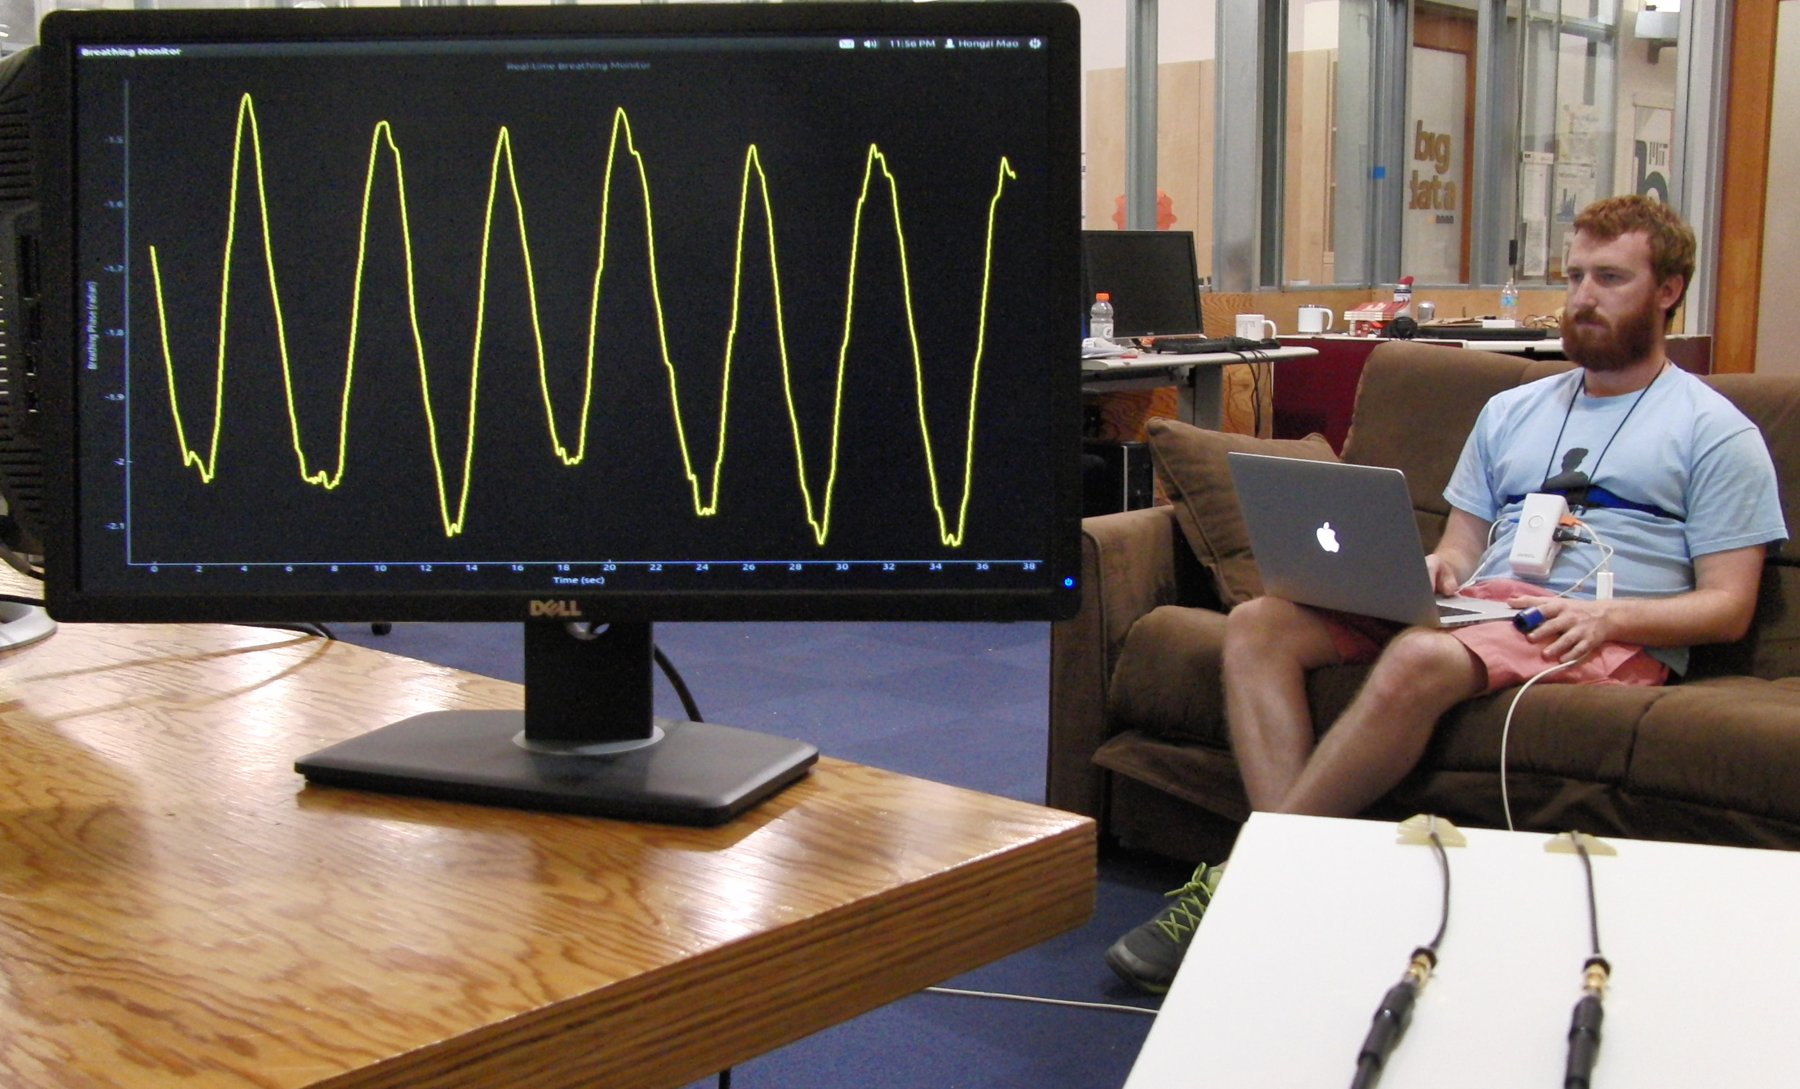
Vital-Radio Implementation
Wireless positioning device to transmits and receives wireless signals
  10,000x lower power than cellphones
  1 transmit & 1 receive antenna
Signal is analyzed in software to extract vital signs
3.4cm
3cm
Notes:
And we do this using our implementation of Vital-Radio which consists of this wireless positioning circuit here [show circuit, animate]. The circuit transmits and receives wireless signals that are 10,000x lower power than cellphones. [animate]
And we connect this board to two small antennas for transmitting and receiving.

Slide 31
Vital-Radio Implementation
Vital-Radio’s antennas
Notes:
In our setup, the antennas are placed somewhere on a desk, while a person sits away from them, and so they shine wireless signals, that reflect off his body, and come back. And the output over here shows us the phase of the reflection in real-time.

Slide 32
Vital-Radio Evaluation
Baseline:
FDA-approved breathing and heart rate monitor
Chest Strap
Experiments:
200 experiments
14 participants
1 million measurements
Pulse
Oximiter
Vital-Radio’s antennas
Notes:
In order to measure the accuracy of the device, the paper used FDA-approved breathing and heart rate monitors.
They asked users to wear a chest strap for monitoring breathing and a pulse oximeter to obtain the heart rate.
They ran over 200 experiments with 14 subjects of different heights and builds, and collected over 1 million measurements.

Slide 33



Accuracy vs Orientation
User is 4m from device, with different orientations
Forward
Right
Backward
Left
Notes:
what happens when the person is facing different directions with respect to the device?
The results show that the accuracy remains above 96% for all cases, with the scenario where the person is facing away to be lowest.
The reason is that the chest expands in all directions when a person breathes, not just forward, but the direction of maximum expansion is forwards.
The system also operates correctly even if the user is behind the wall. In that case, the wireless signal traverses the wall, reflects off his body, and comes back.
and results show that the heart rate accuracy decreases to about 90% in this scenario because the signal is much weaker.

Slide 34

Accuracy for Multi-User Scenario
Multiple users sit at different distances
Nearest (at 2m)
Middle (at 4m)
Furthest (at 6m)
Notes:
The device also works in the presence of multiple users at different distances. However, the accuracy for the nearest user is typically higher than that of further away users, although the accuracy remains above 97% for all of them.
And they also tested the device’s ability to eliminate extraneous movements. So, they asked users to use their smartphones and laptops while the device tracks their vital signs. And they found that the accuracy remains above 99% for these cases.
So, in general, Vital-Radio operates correctly in natural settings across various orientations, through walls, and with multiple users.

Slide 35
Accuracy for Tracking Heart Rate
Measure user’s heart rate after exercising
Vital-Radio accurately tracks changes in vital signs
Notes:
The last result shows the accuracy for tracking changes in heart rate. In this experiment, they asked a user to exercise and then sit down after exercising, and they measured the user’s heart rate and we track it as a function of time.
And this is the result of Vital-Radio and FDA approved baseline. Vital-Radio is able to very accurately track changes in the heart rate and it was able to track changes by as much as 20 beats over a small interval of 20 seconds.

Slide 36
Vital-Radio Limitations
Minimum separation between users: 1-2m
Monitoring range: 8m
Collects measurements when users are quasi-static
Notes:
But of course, this technology still has some limitations.
it requires a minimum separation between users of at least 1-2 meters in order to properly isolate reflections. The reason is that the wireless positioning technology has this level of resolution.
It also has a monitoring range that is limited to 8 meters because of its low power, remember that it’s 10,000x lower than cellphones
and it requires the users to be mostly static and cannot get their heart rates as they are jumping or moving around the room. On the other hand, when we have small movements like you guys in this room using your cellphones or typing on your laptops, we can get the breathing and heart rate.

