Slide 1
LiGaze
Ultra-Low Power Gaze Tracking for Virtual Reality
Alex Rowden and Noel Warford

Slide 2
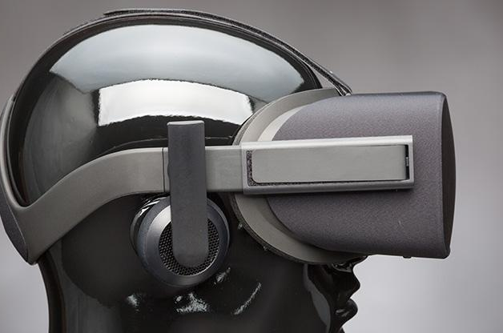
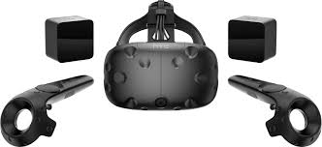
Background
Virtual Reality (VR) is considered by some to be the wave of the future.
VR is computationally expensive
Double the render calls.
Potentially wider Field of View
Energy costs
Interaction in VR requires external sensors.
VR headsets are difficult or impossible to use with glasses.
Notes:
Alex
VR has many benefits in gaming immersion, education, culture, etc.
It still has many flaws
External sensors - premodeled room environments, wands/controllers
High rendering costs - can lead to high monetary costs (specifically for production)
VR headsets pose security risks (verifying users is difficult without reliable interaction)

Slide 3
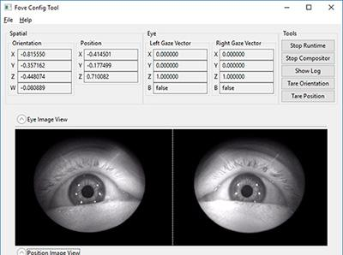
Eye Tracking and Its Benefits
Foveated rendering
Eye-based interaction
Varifocal displays
user verification
increased social avatar immersion
health monitoring
user intent prediction.
Notes:
Alex
Eye tracking is the process of followinng the user’s pupil
Currently implemented in the FOVE and proposed for the upcoming HTC Vive Pro Eye
Reduce number of samples/pixel size in the periphery
Adjust headset for the user (potentially eliminate the need for glasses in headset)

Slide 4
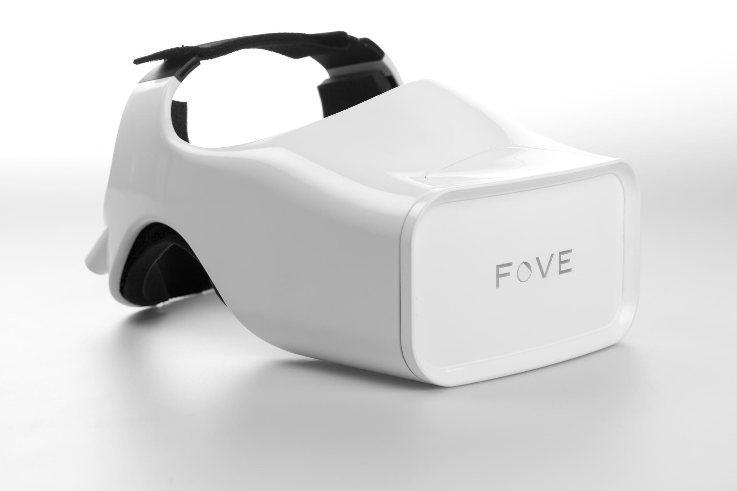
Motivation
Eye tracking is expensive or inaccessible (FOVE is currently developer only)
Eye tracking is power hungry
Eye tracking isn’t built in
Currently only specialized headsets.
Notes:
Alex
State-of-the-art uses IR emitters and IR cameras to track pupil position with computer vision. Emitters drain power and cameras are relatively expensive.

Slide 5
LiGaze
A model for introducing eye tracking to any headset, cheaply and without consuming too much power.
Uses photosensors to take advantage of reflected light from the display and the absorption properties of the pupil.
Key advantage: photosensors are relatively cheap and energy-inexpensive
Eliminates the need for internal cameras (expensive) and active IR LEDs (energy inefficient)
Notes:
Alex

Slide 6
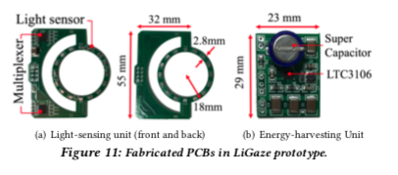
Hardware
Printed circuit board with 32 photodiodes
Microcontroller - 2 4-channel multiplexers
Photodiodes divided into eight groups
Each group transmits data serially
Solar cell at the top for ambient energy - only 4V required
Notes:
Noel

Slide 7
Experimental Design
30 participants (19 males, 11 females)
Divided based on skin color
Tested within-user and cross-user accuracy
Tested across various scenes
Compared LiGaze to FOVE as a source of ground-truth
Notes:
Noel - within-user used own data to train inference model, cross user is half trained on participant’s data and half uses other participants

Slide 8
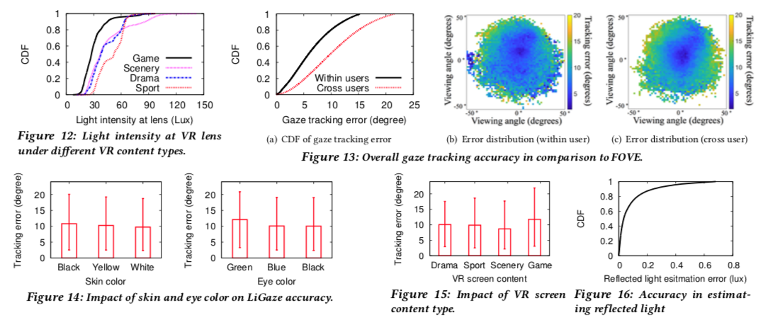
Results
Notes:
(Noel) From top left:
light intensity - has an impact on LiGaze performance
error (within users, trained on you. Cross users, trained on others, two models based on skin color),
error distros - further out towards the edges because of training set focusing on center,
average accuracy same across skin colors,
green slightly worse because of few people with green eyes (within-users much better), representative eye colors essential
Content: games tend to be darker and eyes move rapidly
Reflected: mean error is 0.9 lux

Slide 9
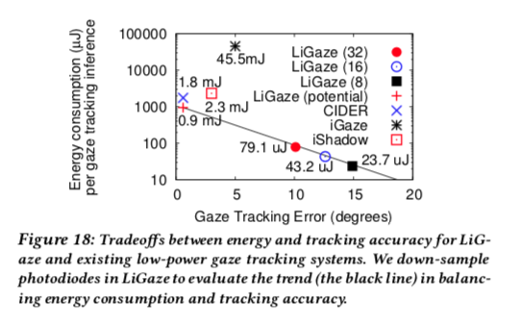
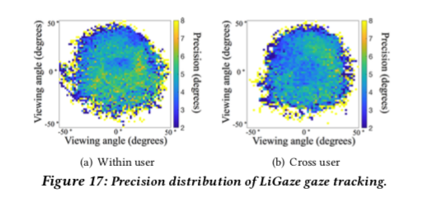
Results
Notes:
(Noel)
Precision: similarly difficult at edge of FoV, indicates reproducibility during calibration;
Energy versus error, including potential - LiGaze entries based on downsampling from 32 to 16 to 8 diodes, others are examples

Slide 10
Results
Notes:
(Noel)
Consumption: 791 microwatts;
good conversion;
pretty good blink detection (affects reflection) - could test with higher sampling rates, black skin reflects less;
Latency is 7.8 milliseconds (could support higher sampling rates)

Slide 11
Discussion
Data quality of ground truth
Improving tracking accuracy
Prior knowledge of VR content
Scenarios beyond VR
Notes:
Noel
Questionable results in the field from FOVE beyond reported error margins
More data! And low sampling rate from the ADC
Could potentially integrate (or manipulate, like in our project)
Could be used for AR, combined with other eye tracking tech

Slide 12
Conclusion
Lower cost than SoTA
Low energy than SoTA
Performs better with more light in the headset
Works better for specific users
Can be fitted to most modern headsets (VR not AR)
Notes:
Alex
Lower energy and cost allows you to port it to new devices (also can be added into the design of new headsets).
AR would allow external light into the headset (if the light is not constant this will through off LiGaze’s tracking).

