Slide 1
Computer Networks
CMSC 417 : Spring 2020
Topic: Internetworking
(Textbook chapter 3)
Nirupam Roy
Tu-Th 2:00-3:15pm
CSI 1115

Slide 2
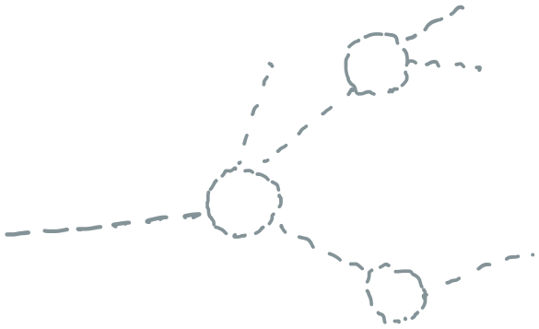
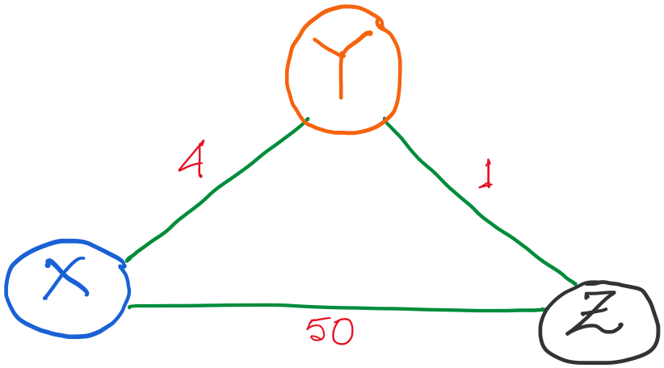
Distance vector routing: Revisited
Routing table entries:

Slide 3
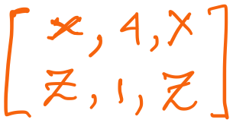
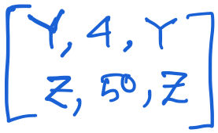
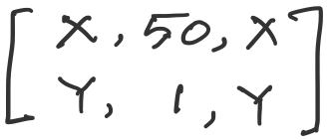
Distance vector routing: Revisited
Routing table entries:

Slide 4
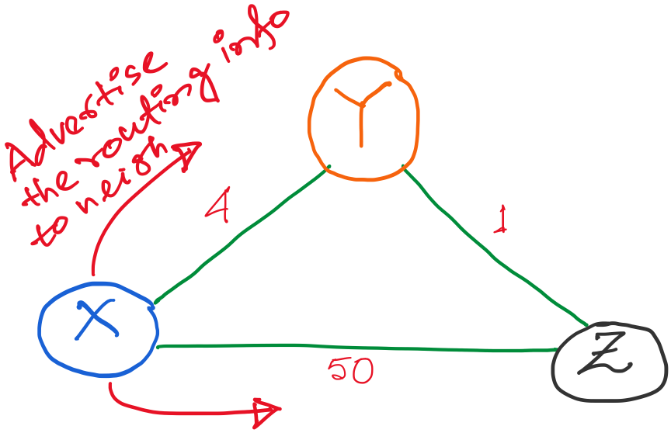
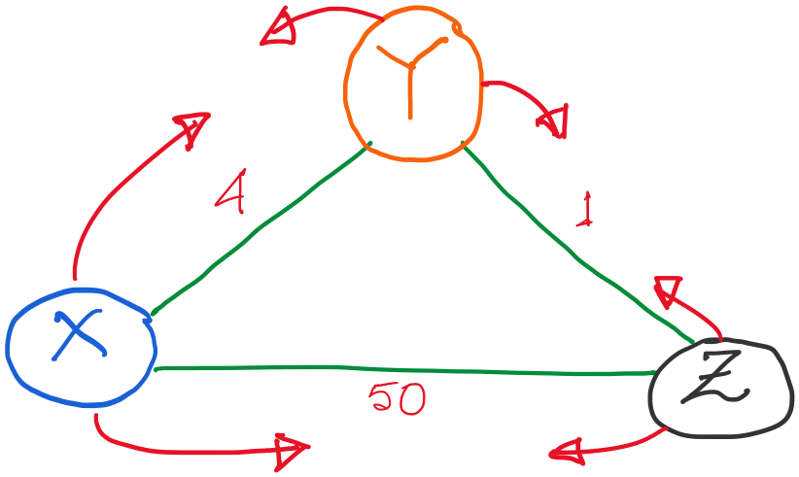

Slide 5
Alternate route to Z,
with lower cost (1+4)
So, update.
Alternate route to Y,
But higher cost (1+50)
No update.

Slide 6
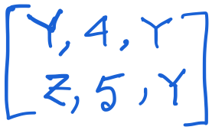
X’s updated table.

Slide 7
X’s updated table.
Alternate route to X,
with lower cost (4+1)
So, update.

Slide 8
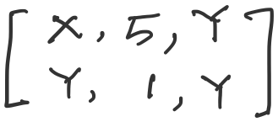
X’s updated table.

Slide 9
All tables are updated.
Advertisement messages will trigger as routing table is updates.

Slide 10
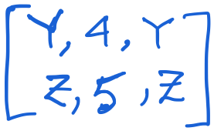
Let’s take a look at the node Y only.
An (false) alternate route to X,
with higher cost (5+1)
So, (fortunately) no update.

Slide 11
No update at any node. The routing algorithm converges.

Slide 12
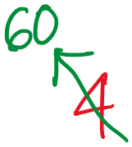
Distance vector: link cost increases (recap)

Slide 13
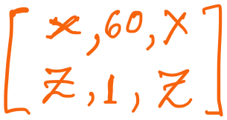
Distance vector: link cost increases (recap)
Y updates its table.

Slide 14
Distance vector: link cost increases (recap)
Y updates its table.
But imagine if Z advertises its old information to Y

Slide 15
Distance vector: link cost increases (recap)
An (false) alternate route to X,
with lower cost (5+1)
So, (unfortunately) it will update.
But imagine if Z advertises its old information to Y, before reading Y’s message.

Slide 16
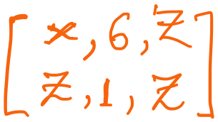
Distance vector: link cost increases (recap)
Y updates its table.

Slide 17
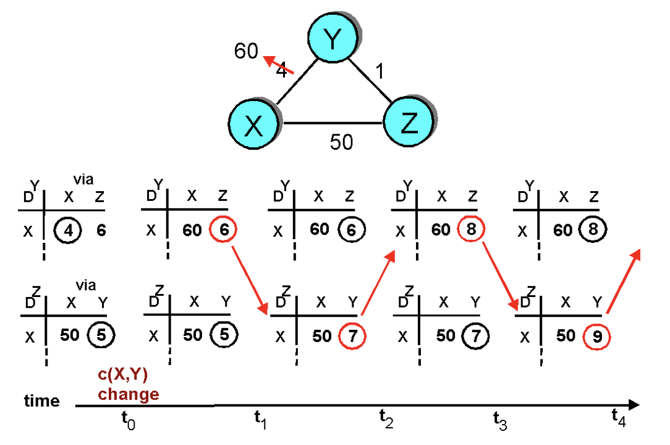
Distance vector: link cost increases (recap)
“Count to infinity” problem

Slide 18
Count-to-infinity Problem
Use some relatively small number as an approximation of infinity
For example, the maximum number of hops to get across a certain network is never going to be more than 16
One technique to improve the time to stabilize routing is called
split horizon
When a node sends a routing update to its neighbors, it does not send those routes it learned from each neighbor back to that neighbor
For example, if B has the route (E, 2, A) in its table, then it knows it must have learned this route from A, and so whenever B sends a routing update to A, it does not include the route (E, 2) in that update

Slide 19
Count-to-infinity Problem
In a stronger version of split horizon, called split horizon with poison reverse
B actually sends that back route to A, but it puts negative information in the route to ensure that A will not eventually use B to get to E
For example, B sends the route (E, ∞) to A

Slide 20
Distance vector: Poisoned reverse
Does poison reverse solve the general count-to-infinity problem?
It does not. It may be possible that loops involving three or more nodes (rather than simply two immediately neighboring nodes, as we shown in last example) will not be detected by the poison reverse technique.

Slide 21
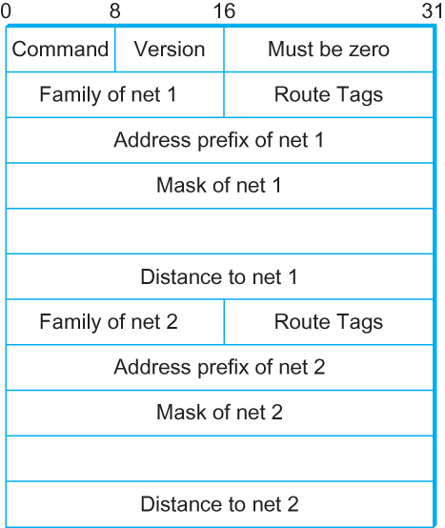
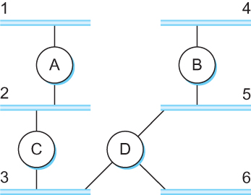
DV Implementation: Routing Information Protocol (RIP)
Example Network
running RIP RIPv2 Packet Format

Slide 22
Link State Routing

Slide 23
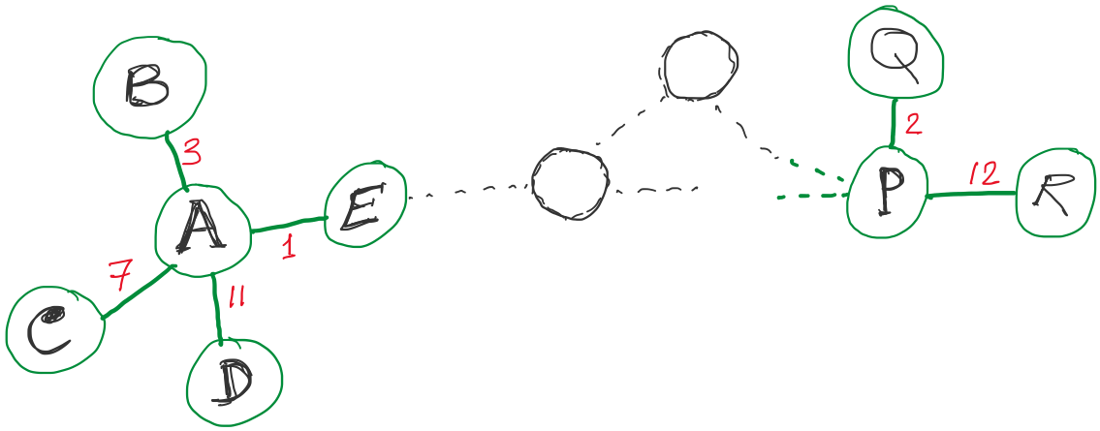
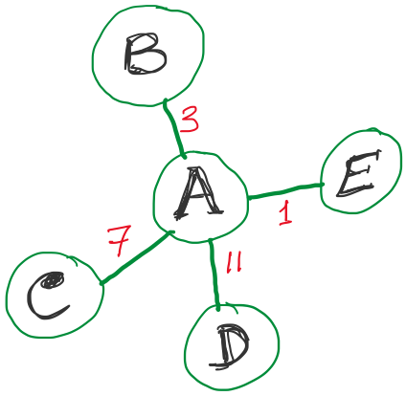
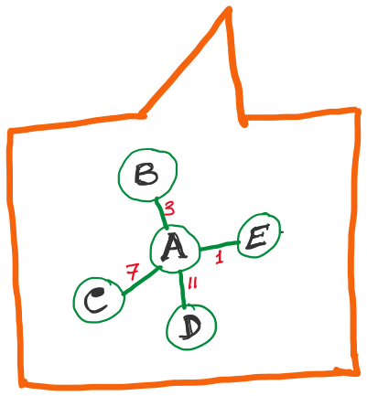
Link State Routing
Strategy:
Send to all nodes (not just neighbors) information about neighbors (not entire routing table).
All nodes will know the link-state information of all other nodes

Slide 24
Link State Routing
Strategy:
Send to all nodes (not just neighbors) information about neighbors (not entire routing table).
Link State Packet (LSP):
The ID of the node that created the LSP
(2) Costs of links to each directly connected neighbor
(3) A sequence number (SEQNO)
[To distinguish a newer LSP from the old ones]
[Smaller number == older LSP]
(4) A Time-To-Live (TTL) for this packet
[To make sure old information is eventually removed
from the network]

Slide 25
Link State Routing
(1) Reliable flooding
[Makes sure all nodes in the network get a copy of LSP from all other nodes]
(2) Route calculation
(Dijkstra’s shortest path algorithm)
[Calculates the shortest path from each node to all other nodes and the corresponding next-hop]

Slide 26
Link State Routing: Reliable flooding
Store most recent LSP from each node
Forward LSP to all nodes but one that sent it
Generate new LSP periodically; increment SEQNO
Start SEQNO at 0 when reboot
Decrement TTL before flooding it to neighbors.
Also age the stored LSP (decrement TTL)
Discard when TTL=0.
Goals:
Flood in minimum time
Minimize total routing traffic

Slide 27
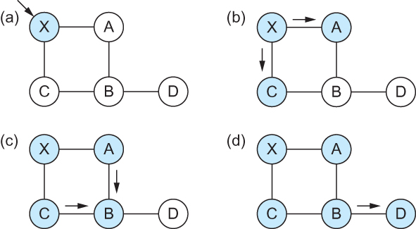
Link State
Gets two identical copies of LSP.
Accepts the one arrived first
Reliable Flooding
Flooding of link-state packets. (a) LSP arrives at node X; (b) X floods LSP to A and C; (c) A and C flood LSP to B (but not X); (d) flooding is complete

Slide 28
Consider this network:
B
D
19
4
A
11
13
15
7
5
C
E
After flooding every node will have the following information:
Each node has complete knowledge of the network topology
B
B
D
19
A
11
15
B
D
4
7
C
C
5
E
13
E
D
B
D
19
4
13
A
C
5
E

Slide 29
Shortest Path Routing
Dijkstra’s Algorithm - Assume non-negative link weights
N: set of nodes in the graph
l((i, j): the non-negative cost associated with the edge between nodes i, j ∈N and l(i, j) = ∝ if no edge connects i and j
Let s ∈N be the starting node which executes the algorithm to find shortest paths to all other nodes in N
Two variables used by the algorithm
M: set of nodes incorporated so far by the algorithm
C(n) : the cost of the path from s to each node n
The algorithm
M = {s}
For each n in N – {s}
C(n) = l(s, n)
while ( N ≠ M)
M = M ∪ {w} such that C(w) is the minimum
for all w in (N-M)
For each n in (N-M)
C(n) = MIN (C(n), C(w) + l(w, n))

Slide 30
Shortest Path Routing
In practice, each switch computes its routing table directly from the LSP’s it has collected using a realization of Dijkstra’s algorithm called the forward search algorithm
Specifically each switch maintains two lists, known as Tentative and Confirmed
Each of these lists contains a set of entries of the form (Destination, Cost, NextHop)

Slide 31
Shortest Path Routing
Dijkstra’s Algorithm
M = {s}
For each n in N – {s}
C(n) = l(s, n)
while ( N ≠ M)
M = M ∪ {w} such that C(w) is the minimum
for all w in (N-M)
For each n in (N-M)
C(n) = MIN (C(n), C(w) + l(w, n))
Confirmed list
Newly added member to the confirmed list
Tentative list

Slide 32
Shortest Path Routing
The algorithm
Initialize the Confirmed list with an entry for myself; this entry has a cost of 0
For the node just added to the Confirmed list in the previous step, call it node Next, select its LSP
For each neighbor (Neighbor) of Next, calculate the cost (Cost) to reach this Neighbor as the sum of the cost from myself to Next and from Next to Neighbor
If Neighbor is currently on neither the Confirmed nor the Tentative list, then add (Neighbor, Cost, Nexthop) to the Tentative list, where Nexthop is the direction I go to reach Next
If Neighbor is currently on the Tentative list, and the Cost is less than the currently listed cost for the Neighbor, then replace the current entry with (Neighbor, Cost, Nexthop) where Nexthop is the direction I go to reach Next
If the Tentative list is empty, stop. Otherwise, pick the entry from the Tentative list with the lowest cost, move it to the Confirmed list, and return to Step 2.

Slide 33
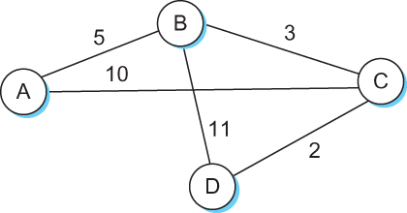
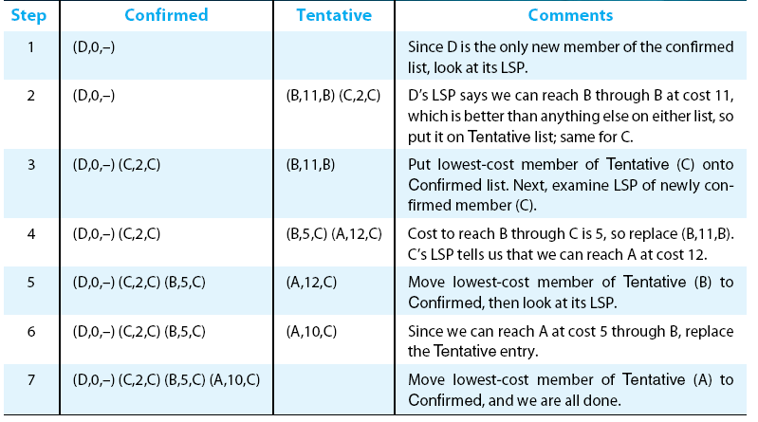
Shortest Path Routing

Slide 34
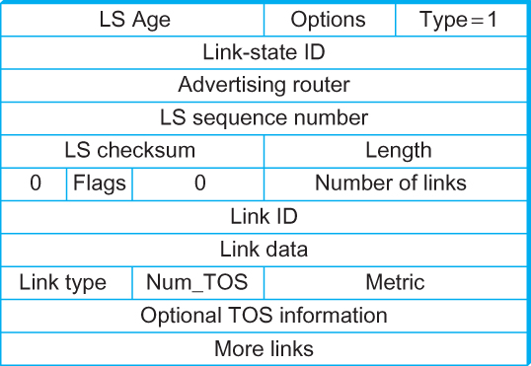
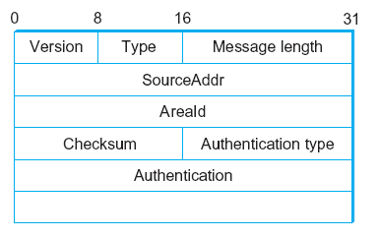
Open Shortest Path First (OSPF)
OSPF Header Format OSPF Link State Advertisement

Slide 35
Comparison of LS and DV algorithms
message complexity
LS: with n nodes, E links, O(nE) msgs sent
DV: exchange between neighbors only
convergence time varies
speed of convergence
LS: O(n²) algorithm requires O(nE) msgs
may have oscillations
DV: convergence time varies
may be routing loops
count-to-infinity problem
robustness: what happens if router malfunctions?
LS:
node can advertise incorrect link cost
each node computes only its own table
DV:
DV node can advertise incorrect path cost
each node’s table used by others
error propagate thru network

