Slide 1
Computer Networks
CMSC 417 : Spring 2020
Topic: Internetworking: Subnet/CIDR example, Private Address Space, NAT protocol
(Textbook chapter 3)
Nirupam Roy
Tu-Th 2:00-3:15pm
CSI 1115

Slide 2
Revisiting Subnets and CIDR
Subnets “toy” example

Slide 3
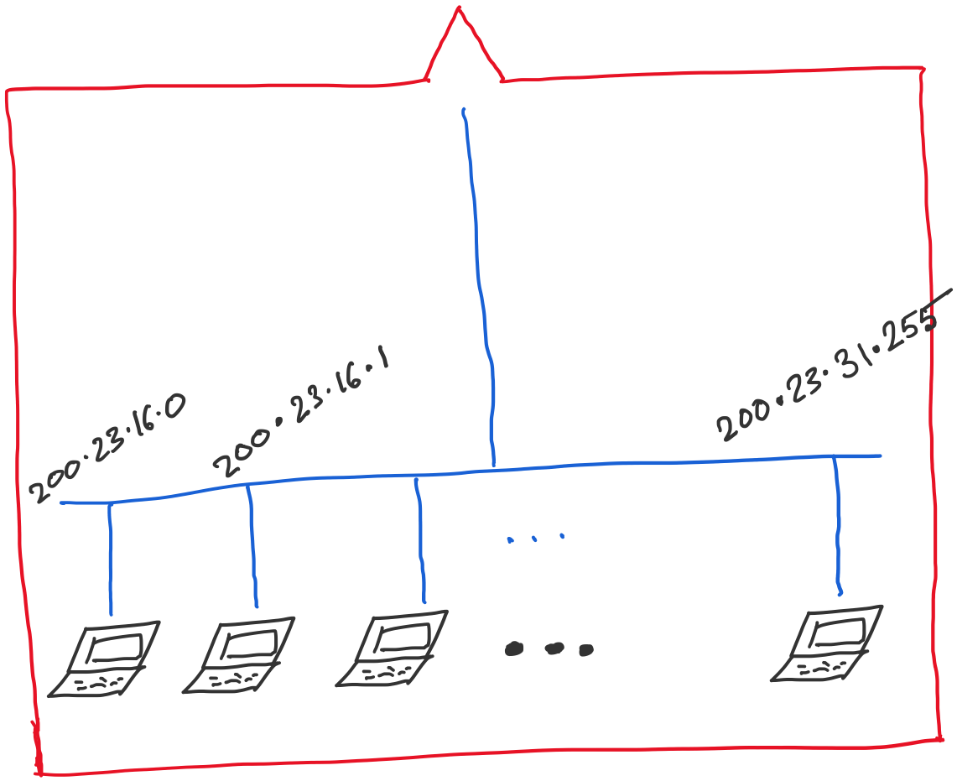
Address space assigned to you:

Slide 4
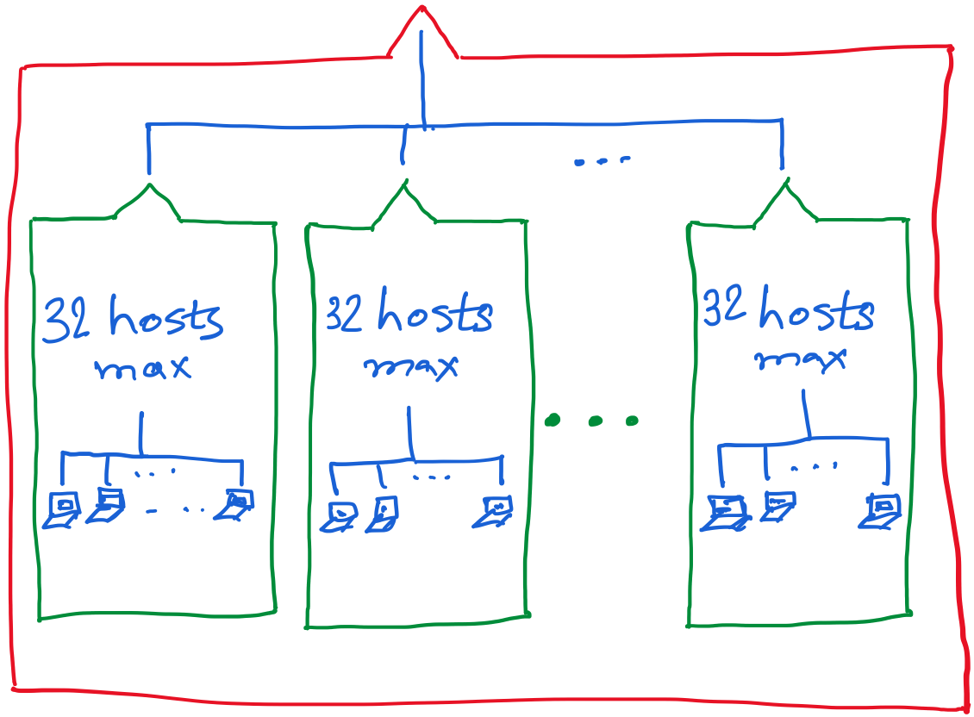

Slide 7
Let’s check our IP addresses
(ifconfig on my Mac terminal)

Slide 8
Private Address Space

Slide 9
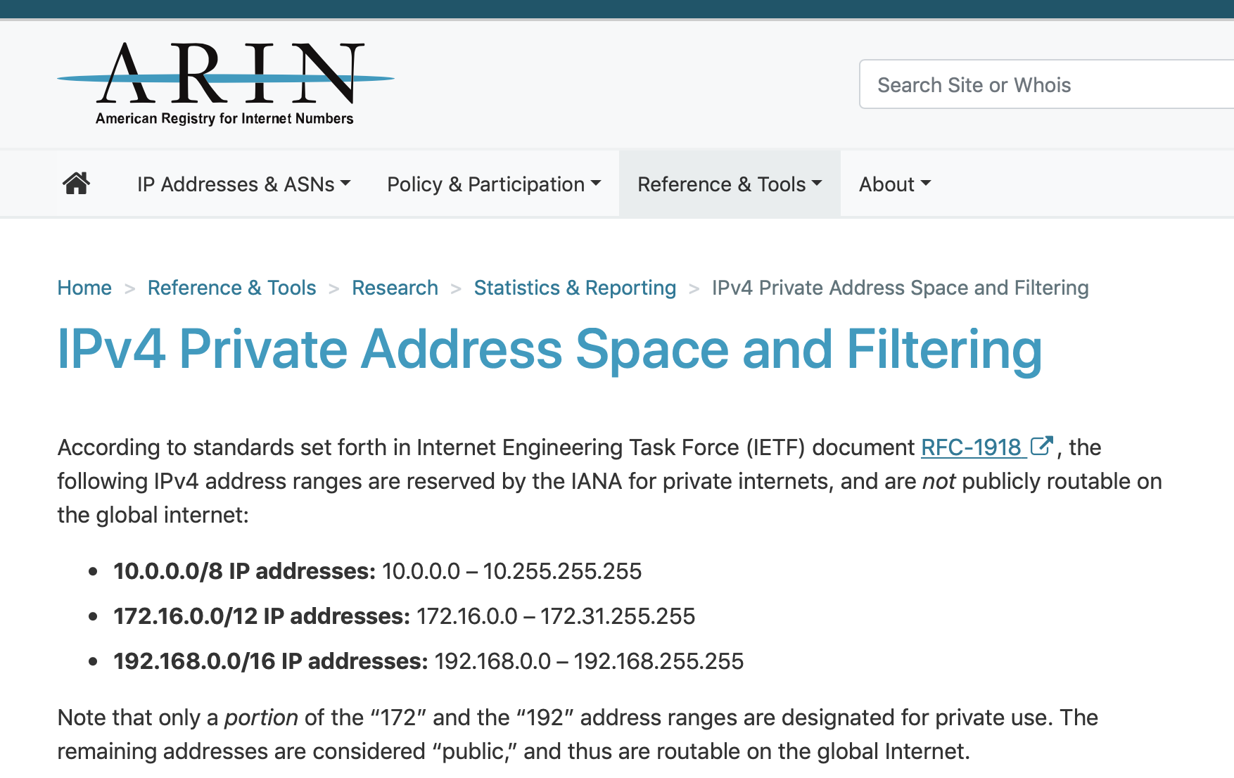

Slide 10
NAT: network address translation
rest of
Internet
local network
(e.g., home network)
10.0.0/24
10.0.0.1
10.0.0.4
10.0.0.2
138.76.29.7
10.0.0.3
all datagrams leaving local
network have same single source NAT IP address: 138.76.29.7,different source port numbers
datagrams with source or
destination in this network
have 10.0.0/24 address for
source, destination (as usual)

Slide 11
NAT: network address translation
NAT translation table
WAN side addr LAN side addr
2: NAT router
changes datagram
source addr from
10.0.0.1, 3345 to
138.76.29.7, 5001,
updates table
1: host 10.0.0.1
sends datagram to
128.119.40.186, 80
138.76.29.7, 5001 10.0.0.1, 3345
…… ……
S: 10.0.0.1, 3345
D: 128.119.40.186, 80
10.0.0.1
1
2
S: 138.76.29.7, 5001
D: 128.119.40.186, 80
10.0.0.4
10.0.0.2
138.76.29.7
S: 128.119.40.186, 80
D: 10.0.0.1, 3345
4
S: 128.119.40.186, 80
D: 138.76.29.7, 5001
3
10.0.0.3
4: NAT router
changes datagram
dest addr from
138.76.29.7, 5001 to 10.0.0.1, 3345
3: reply arrives
dest. address:
138.76.29.7, 5001

Slide 12
NAT: network address translation
motivation: local network uses just one IP address as far as outside world is concerned:
range of addresses not needed from ISP: just one IP address for all devices
can change addresses of devices in local network without notifying outside world
can change ISP without changing addresses of devices in local network
devices inside local net not explicitly addressable, visible by outside world (a security plus)

Slide 13
NAT: network address translation
implementation: NAT router must:
outgoing datagrams: replace (source IP address, port #) of every outgoing datagram to (NAT IP address, new port #)
. . . remote clients/servers will respond using (NAT IP address, new port #) as destination addr
remember (in NAT translation table) every (source IP address, port #) to (NAT IP address, new port #) translation pair
incoming datagrams: replace (NAT IP address, new port #) in dest fields of every incoming datagram with corresponding (source IP address, port #) stored in NAT table

Slide 14
NAT: network address translation
16-bit port-number field:
60,000 simultaneous connections with a single LAN-side address!
NAT challenges:
violates end-to-end argument
NAT possibility must be taken into account by app designers, e.g., P2P applications
NAT traversal: what if client wants to connect to server behind NAT?

