Slide 1

Computer Networks
CMSC 417 : Spring 2020
Topic: Third-term review and discussion
Nirupam Roy
Tu-Th 2:00-3:15pm
CSI 1115

Slide 4
What have we learned so far…
Routing protocols
IP Datagram forwarding, service models etc.
IP addresses, Subnets, CIDR
DHCP, ARP, ICMP

Slide 5
What have we learned so far…
Potpourri
Definition and short answer type questions
Routing protocols
IP Datagram forwarding, service models etc.
IP addresses, Subnets, CIDR
Bonus
DHCP, ARP, ICMP
May be from the outside of the textbook.

Slide 6
Bonus rule:
Your earned score will be capped by
the total score possible.
i.e., your bonus scores will be useful only if you have scored less than 100% in exam.

Slide 7
Today we will revisit some of the topics.
Not necessarily important for the exam.

Slide 8
Routing Protocols

Slide 9
Routing
  For a simple network, we can calculate all shortest paths and load them into some nonvolatile storage on each node.
  Such a static approach has several shortcomings
    It does not deal with node or link failures
    It does not consider the addition of new nodes or links
    It implies that edge costs cannot change
  What is the solution?
    Need a distributed and dynamic protocol
    Two main classes of protocols
      Distance Vector
      Link State

Slide 10

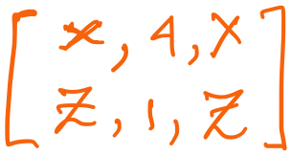
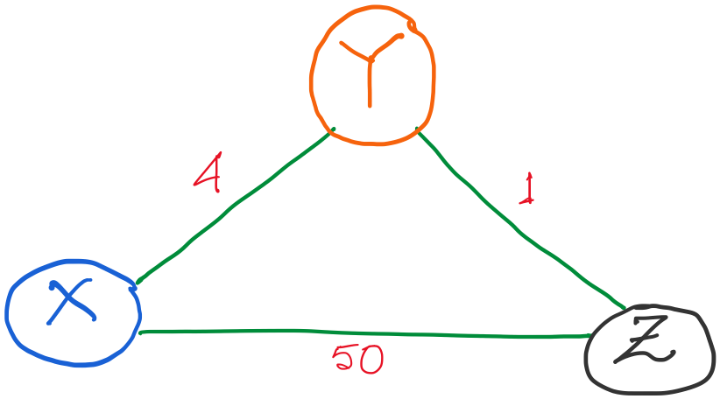
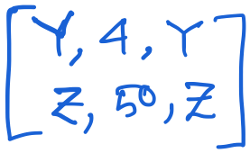
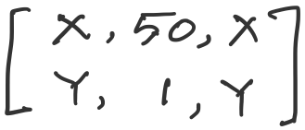
Distance vector routing: Revisited
Routing table entries:

Slide 11
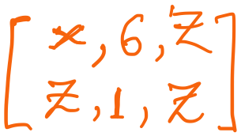

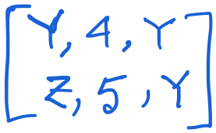
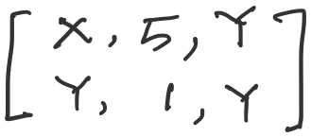
Distance vector: link cost increases (recap)
Y updates its table.

Slide 12
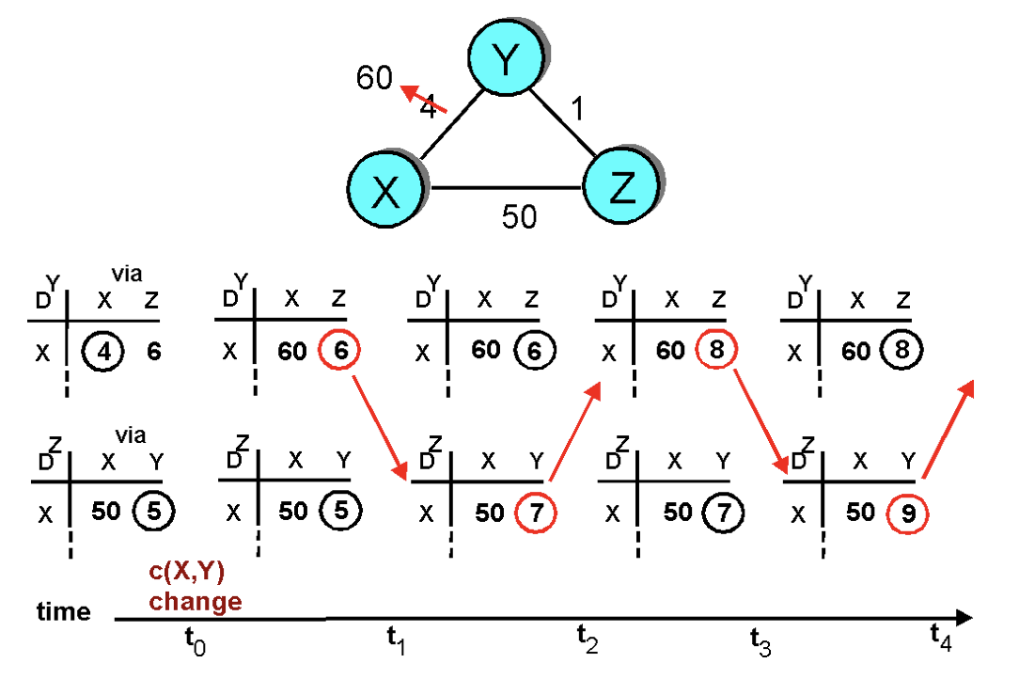
Distance vector: link cost increases (recap)
“Count to infinity” problem

Slide 13
Count-to-infinity Problem
Use some relatively small number as an approximation of infinity
For example, the maximum number of hops to get across a certain network is never going to be more than 16
One technique to improve the time to stabilize routing is called
split horizon
  When a node sends a routing update to its neighbors, it does not send those routes it learned from each neighbor back to that neighbor
  For example, if B has the route (E, 2, A) in its table, then it knows it must have learned this route from A, and so whenever B sends a routing update to A, it does not include the route (E, 2) in that update

Slide 14
Count-to-infinity Problem
In a stronger version of split horizon, called split horizon with poison reverse
  B actually sends that back route to A, but it puts negative information in the route to ensure that A will not eventually use B to get to E
  For example, B sends the route (E, ∞) to A

Slide 15
Distance vector: Poisoned reverse
Does poison reverse solve the general count-to-infinity problem?
It does not. It may be possible that loops involving three or more nodes (rather than simply two immediately neighboring nodes, as we shown in last example) will not be detected by the poison reverse technique.

Slide 16
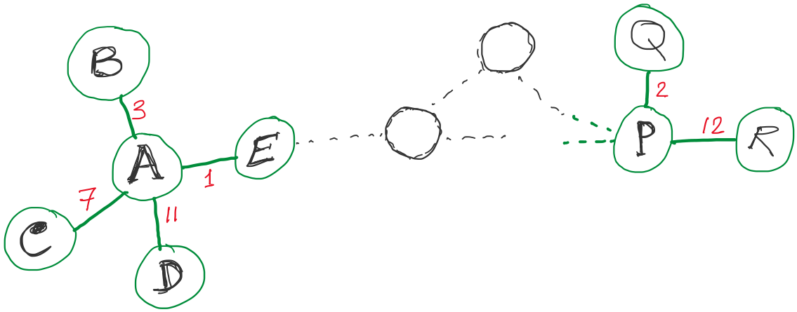
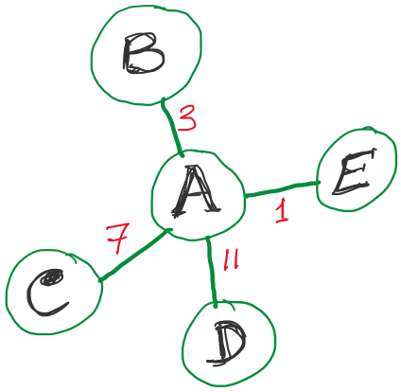
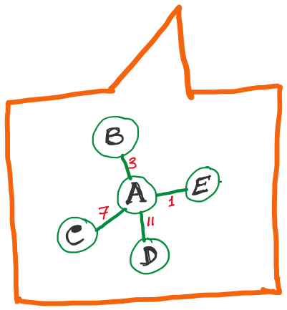
Link State Routing
Strategy:
Send to all nodes (not just neighbors) information about neighbors (not entire routing table).
All nodes will know the link-state information of all other nodes

Slide 17
Link State Routing
Strategy:
Send to all nodes (not just neighbors) information about neighbors (not entire routing table).
Link State Packet (LSP):
  The ID of the node that created the LSP
  (2) Costs of links to each directly connected neighbor
  (3) A sequence number (SEQNO)
  [To distinguish a newer LSP from the old ones]
  [Smaller number == older LSP]
  (4) A Time-To-Live (TTL) for this packet
  [To make sure old information is eventually removed
  from the network]

Slide 18
Link State Routing
(1) Reliable flooding
[Makes sure all nodes in the network get a copy of LSP from all other nodes]
(2) Route calculation
(Dijkstra’s shortest path algorithm)
[Calculates the shortest path from each node to all other nodes and the corresponding next-hop]

Slide 19
Link State Routing: Reliable flooding
  Store most recent LSP from each node
  Forward LSP to all nodes but one that sent it
  Generate new LSP periodically; increment SEQNO
  Start SEQNO at 0 when reboot
  Decrement TTL before flooding it to neighbors.
  Also age the stored LSP (decrement TTL)
  Discard when TTL=0.
Goals:
Flood in minimum time
Minimize total routing traffic

Slide 20
A Comparison of LS and DV Routing Algorithms
The DV and LS algorithms take complementary approaches toward computing routing.
In the DV algorithm, each node talks to only its directly connected neighbors, but it provides its neighbors with least-cost estimates from itself to all the nodes (that it knows about) in the network.
The LS algorithm requires global information.
1. Message complexity.
We have seen that LS requires each node to know the cost of each link in the network.
This requires O(|N| |E|) messages to be sent.
(N is the set of nodes (routers) and E is the set of edges (links). )
Also, whenever a link cost changes, the new link cost must be sent to all nodes.
The DV algorithm requires message exchanges between directly connected neighbors at each iteration. Convergence can depend on many factors. When link costs change, the DV algorithm will propagate the results of the changed link cost only if the new link cost results in a changed least-cost path for one of the nodes attached to that link.
Speed of convergence. We have seen that our implementation of LS is an O(|N|2) algorithm requiring O(|N| |E|)) messages. The DV algorithm can converge slowly and can have routing loops while the algorithm is converging. DV also suffers from the count-to-infinity problem.
Robustness. What can happen if a router fails, misbehaves, or is sabotaged? Under LS, a router could broadcast an incorrect cost for one of its attached links (but no others).
Route calculations are somewhat separated under LS, providing a degree of robustness.
Under DV, a node can advertise incorrect least-cost paths to any or all destinations. More generally, we note that, at each iteration, a node’s calculation in DV is passed on to its neighbor and then indirectly to its
neighbor’s neighbor on the next iteration. In this sense, an incorrect node calculation can be diffused through the entire network under DV.
In the end, neither algorithm is an obvious winner over the other; indeed, both algorithms are used in the Internet.

Slide 21
A Comparison of LS and DV Routing Algorithms
2. Speed of convergence. We have seen that our implementation of LS is an O(|N|2) algorithm requiring O(|N| |E|)) messages. The DV algorithm can converge slowly and can have routing loops while the algorithm is converging. DV also suffers from the count-to-infinity problem.
3. Robustness. What can happen if a router fails, misbehaves, or is sabotaged? Under LS, a router could broadcast an incorrect cost for one of its attached links (but no others).
Route calculations are somewhat separated under LS, providing a degree of robustness.
Under DV, a node can advertise incorrect least-cost paths to any or all destinations. More generally, we note that, at each iteration, a node’s calculation in DV is passed on to its neighbor and then indirectly to its
neighbor’s neighbor on the next iteration. In this sense, an incorrect node calculation can be diffused through the entire network under DV.
In the end, neither algorithm is an obvious winner over the other; indeed, both algorithms are used in the Internet.

Slide 22
Comparison of LS and DV (Summary)
message complexity
LS: with n nodes, E links, O(nE) msgs sent
DV: exchange between neighbors only
  convergence time varies
speed of convergence
LS: O(n²) algorithm requires O(nE) msgs
  may have oscillations
DV: convergence time varies
  may be routing loops
  count-to-infinity problem
robustness: what happens if router malfunctions?
LS:
  node can advertise incorrect link cost
  each node computes only its own table
DV:
  DV node can advertise incorrect path cost
  each node’s table used by others
    error propagate thru network

Slide 23
IP

Slide 24
IP datagram format
IP protocol version
number
32 bits
total datagram
length (bytes)
header length
(bytes)
head.
len
type of
service
ver
length
for
fragmentation/
reassembly
“type” of data
flgs
fragment
offset
16-bit identifier
max number
remaining hops
(decremented at
each router)
time to
live
upper
layer
header
checksum
32 bit source IP address
upper layer protocol
to deliver payload to
32 bit destination IP address
options (if any)
e.g. timestamp,
record route
taken, specify
list of routers
to visit.
data
(variable length,
typically a TCP
or UDP segment)

Slide 25
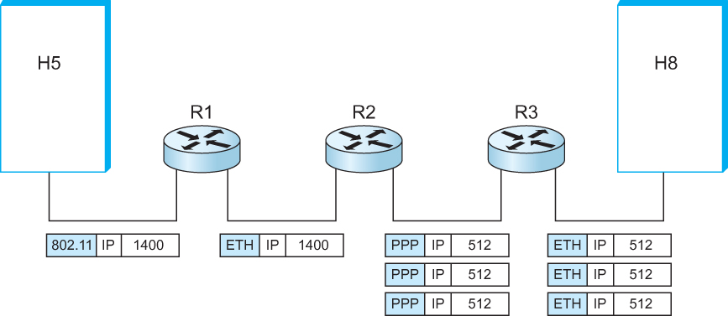
IP Fragmentation and Reassembly
  IP datagrams traversing the sequence of physical networks

Slide 26
IP Fragmentation and Reassembly
Each network has some MTU (Maximum Transmission Unit)
  Ethernet (1500 bytes), FDDI (4500 bytes)
Strategy
  Fragmentation occurs in a router when it receives a datagram that it wants to forward over a network which has (MTU < datagram)
  Reassembly is done at the receiving host
  All the fragments carry the same identifier in the Ident field
  Fragments are self-contained datagrams
  IP does not recover from missing fragments

Slide 27
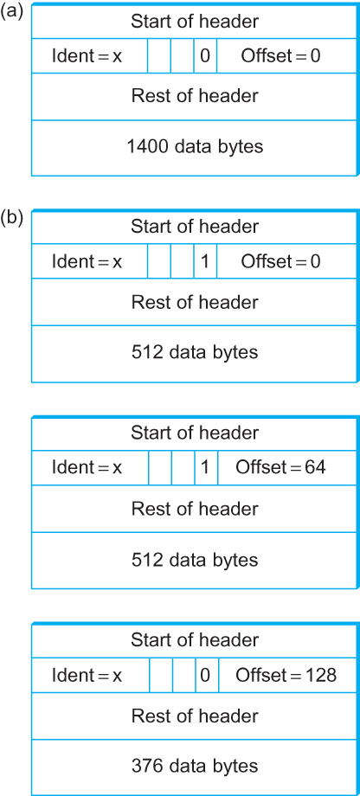
IP Fragmentation and Reassembly
Header fields used in IP fragmentation. (a) Unfragmented packet; (b) fragmented packets.

Slide 28
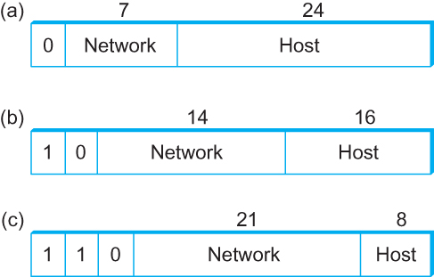
Global Addresses
Properties
  globally unique
  hierarchical: network + host
  4 Billion IP address, half are A type, ¼ is B type, and 1/8 is C type
Format
Dot notation
  10.3.2.4
  128.96.33.81
  192.12.69.77

Slide 29
Let’s assume we have 4-bit address (instead of 32 bit)
0000
0001
0010
0011
0100
0101
0110
0111
1000
1001
1010
1011
1100
1101
1110
1111
Class A (Half of all possible addresses)
Class B (1/4 of all possible addresses)
Class C (1/8 of all possible addresses)

Slide 30
Let’s assume we have 4-bit address (instead of 32 bit)
0000
0001
0010
0011
0100
0101
0110
0111
Class A (Half of all possible addresses)
Say, 1 bit for network part = 2 different networks
Say, 2 bits for host part = 4 hosts per network

Slide 31
IP Datagram Forwarding
Algorithm
if (NetworkNum of destination = NetworkNum of one of my interfaces) then
deliver packet to destination over that interface
else
if (NetworkNum of destination is in my forwarding table) then
deliver packet to NextHop router
else
deliver packet to default router
For a host with only one interface and only a default router in its forwarding table, this simplifies to
if (NetworkNum of destination = my NetworkNum)then
deliver packet to destination directly
else
deliver packet to default router

Slide 32
Subnetting

Slide 33
Problems with the classes of addresses
Wastage of addresses
Bigger tables to look up at routers

Slide 34
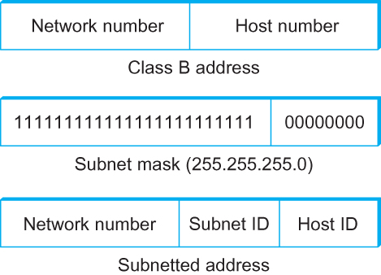
Subnetting
Add another level to address/routing hierarchy: subnet
Subnet masks define variable partition of host part of class A and B addresses
Subnets visible only within site

Slide 35
Revisiting Subnets and CIDR
Subnets “toy” example

Slide 36


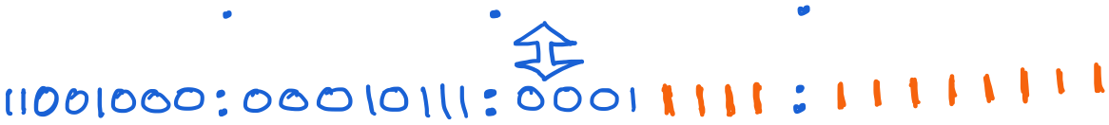
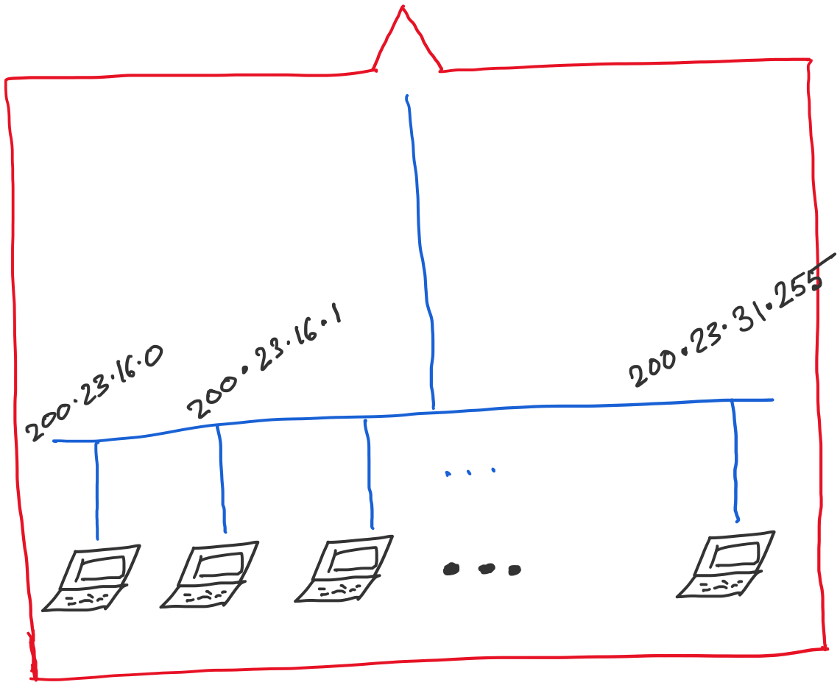
Address space assigned to you:

Slide 37
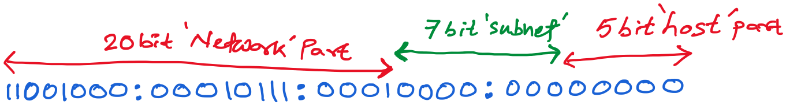
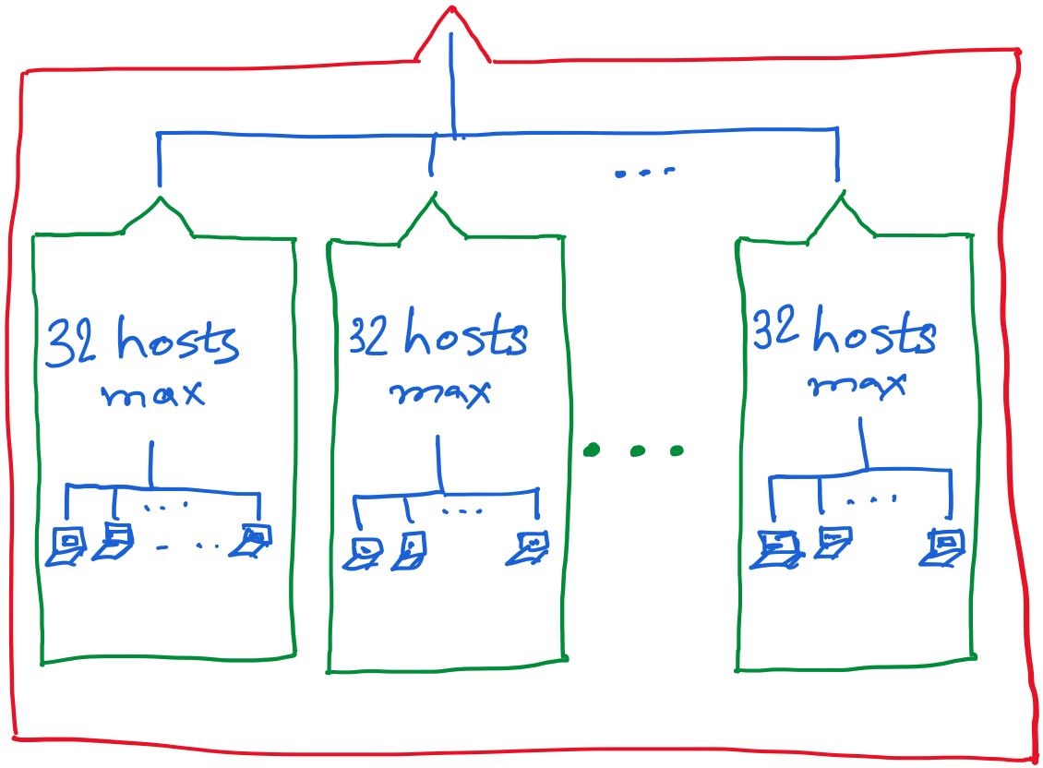

Slide 38
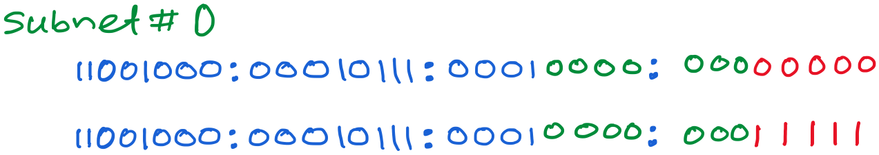
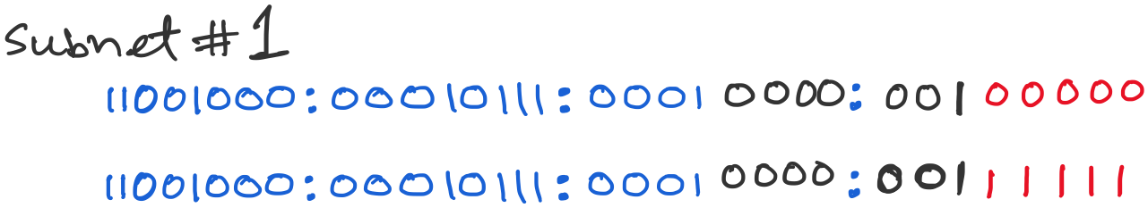
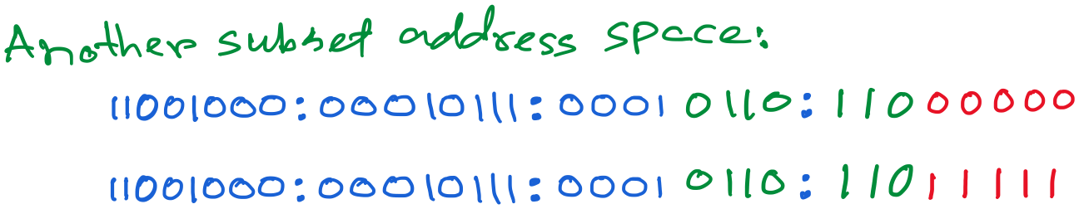

Slide 39
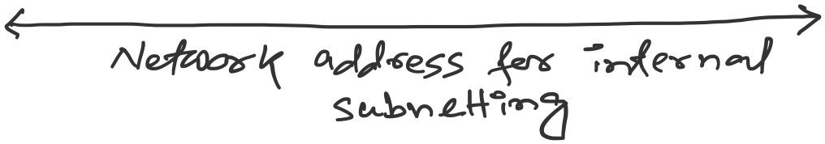
What is a broadcast address?

Slide 40
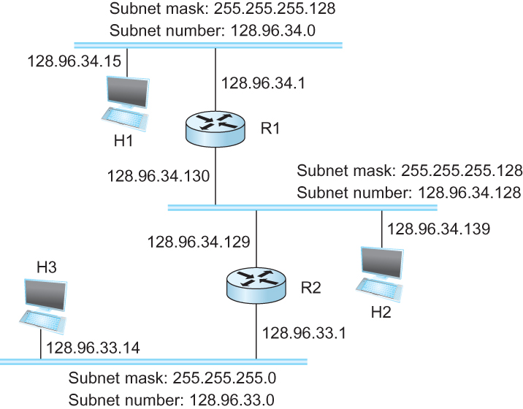
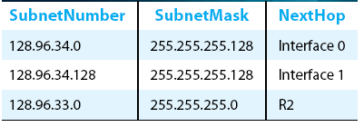
Subnetting
Forwarding Table at Router R1
Forwarding Algorithm
D = destination IP address
for each entry < SubnetNum, SubnetMask, NextHop>
  D1 = SubnetMask & D
  if D1 = SubnetNum
    if NextHop is an interface
    deliver datagram directly to destination
    else
    deliver datagram to NextHop (a router)

Slide 41
Subnetting
Notes
Would use a default router if nothing matches
Not necessary for all ones in subnet mask to be contiguous
Can put multiple subnets on one physical network
Subnets not visible from the rest of the Internet

Slide 42
Class-less addressing: CIDR

Slide 43
IP addressing: CIDR
CIDR: Classless InterDomain Routing
  subnet portion of address of arbitrary length
  address format: a.b.c.d/x, where x is # bits in subnet portion of address
subnet
part
host
part
11001000 00010111 00010000 00000000
200.23.16.0/23
200.23.16.0–200.23.17.255

Slide 44
Classless Inter-Domain Routing (CIDR)
Use two 32-bit numbers to represent a network.
Network number = IP address + Mask
IP Address : 12.4.0.0 IP Mask: 255.254.0.0
Address
00001100
00000100
00000000
00000000
Mask
11111111
11111110
00000000
00000000
Network Prefix
for hosts
Written as 12.4.0.0/15

Slide 45
Hierarchical Address Allocation
Hierarchy is key to scalability
  Address allocated in contiguous chunks (prefixes)
  Today, the Internet has about 400,000 prefixes
12.0.0.0/16
12.1.0.0/16
:
:
:
12.3.0.0/24
12.2.0.0/16
12.3.1.0/24
12.3.0.0/16
:
:
:
:
:
12.0.0.0/8
12.3.254.0/24
12.253.0.0/19
12.253.32.0/19
:
:
12.254.0.0/16
12.253.160.0/19

Slide 46
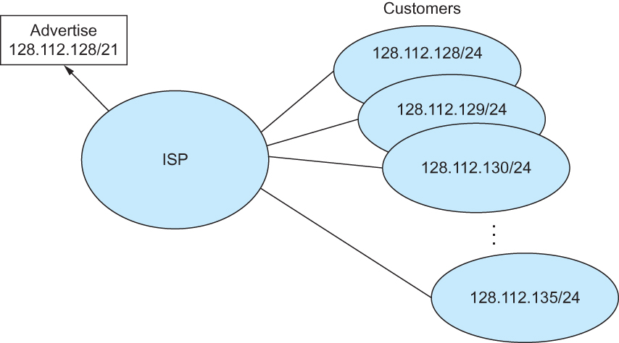
Classless Addressing
Route aggregation with CIDR

Slide 47
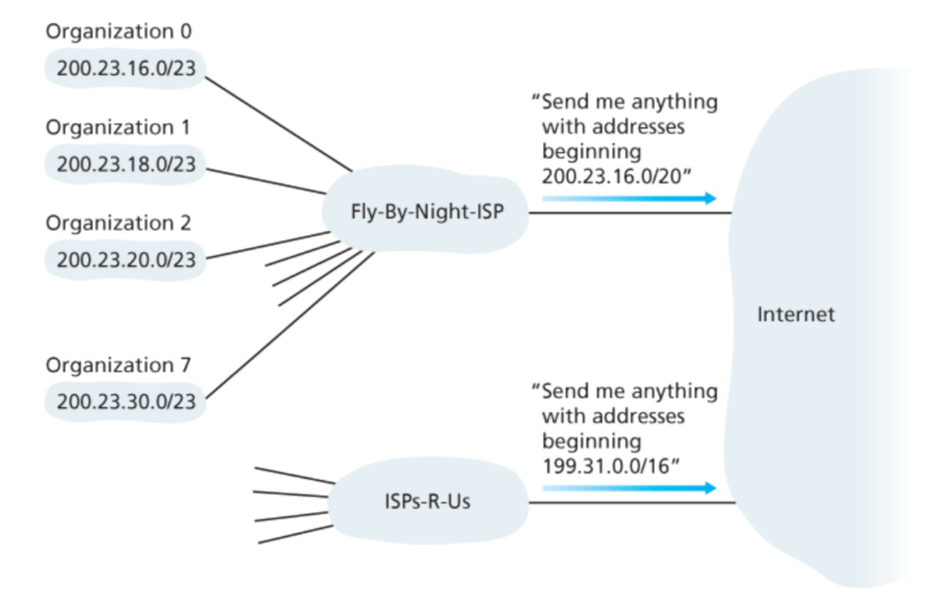
A problem created by CIDR route aggregation

Slide 48
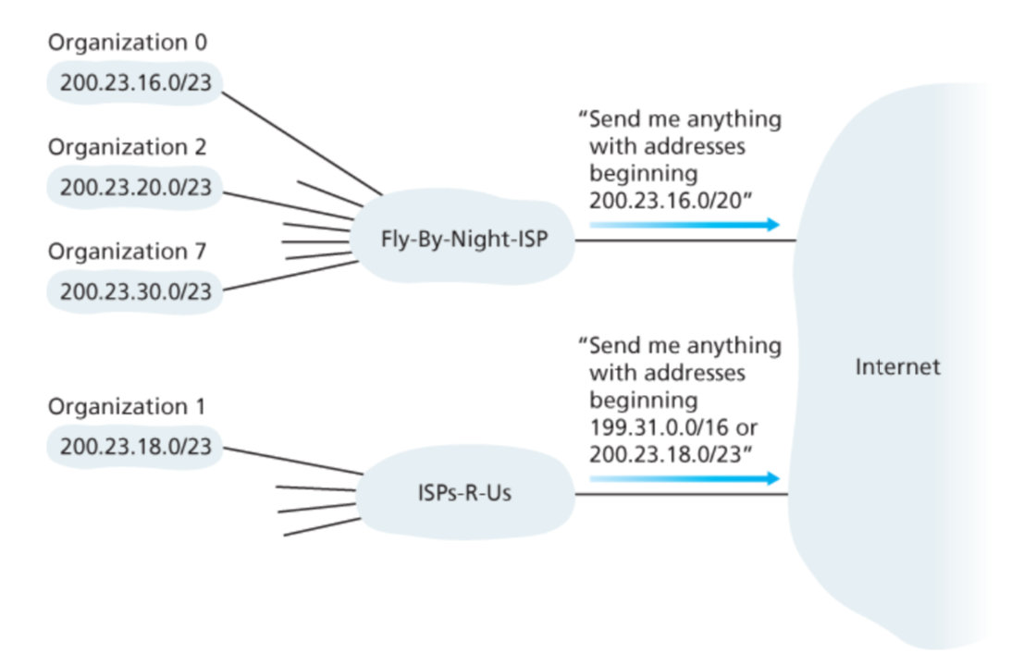
A problem created by CIDR route aggregation
Solution: Longest prefix match forwarding

Slide 49
CIDR Makes Packet Forwarding Harder
Forwarding table may have many matches
  E.g., entries for 201.10.0.0/21 and 201.10.6.0/23
  The IP address 201.10.6.17 would match both!
201.10.0.0/21
Provider 1
Provider 2
201.10.0.0/22
201.10.4.0/24
201.10.5.0/24
201.10.6.0/23

Slide 50
Longest Prefix Match Forwarding
Destination-based forwarding
  Packet has a destination address
  Router identifies longest-matching prefix
  Cute algorithmic problem: very fast lookups
forwarding table
4.0.0.0/8
4.83.128.0/17
201.10.0.0/21
201.10.6.0/23
126.255.103.0/24
destination
201.10.6.17
outgoing link
Serial0/0.1

Slide 51
Getting an IP address: DHCP

Slide 52
IP addresses: how to get one?
Q: How does a host get IP address?
hard-coded by system admin in a file
  Windows: control-panel->network->configuration->tcp/ip->properties
  UNIX: /etc/…
DHCP: Dynamic Host Configuration Protocol: dynamically get address from a server
  “plug-and-play”

Slide 53
DHCP: Dynamic Host Configuration Protocol
DHCP overview:
  host broadcasts “DHCP discover” msg [optional]
  DHCP server responds with “DHCP offer” msg [optional]
  host requests IP address: “DHCP request” msg
  DHCP server sends address: “DHCP ack” msg

Slide 54
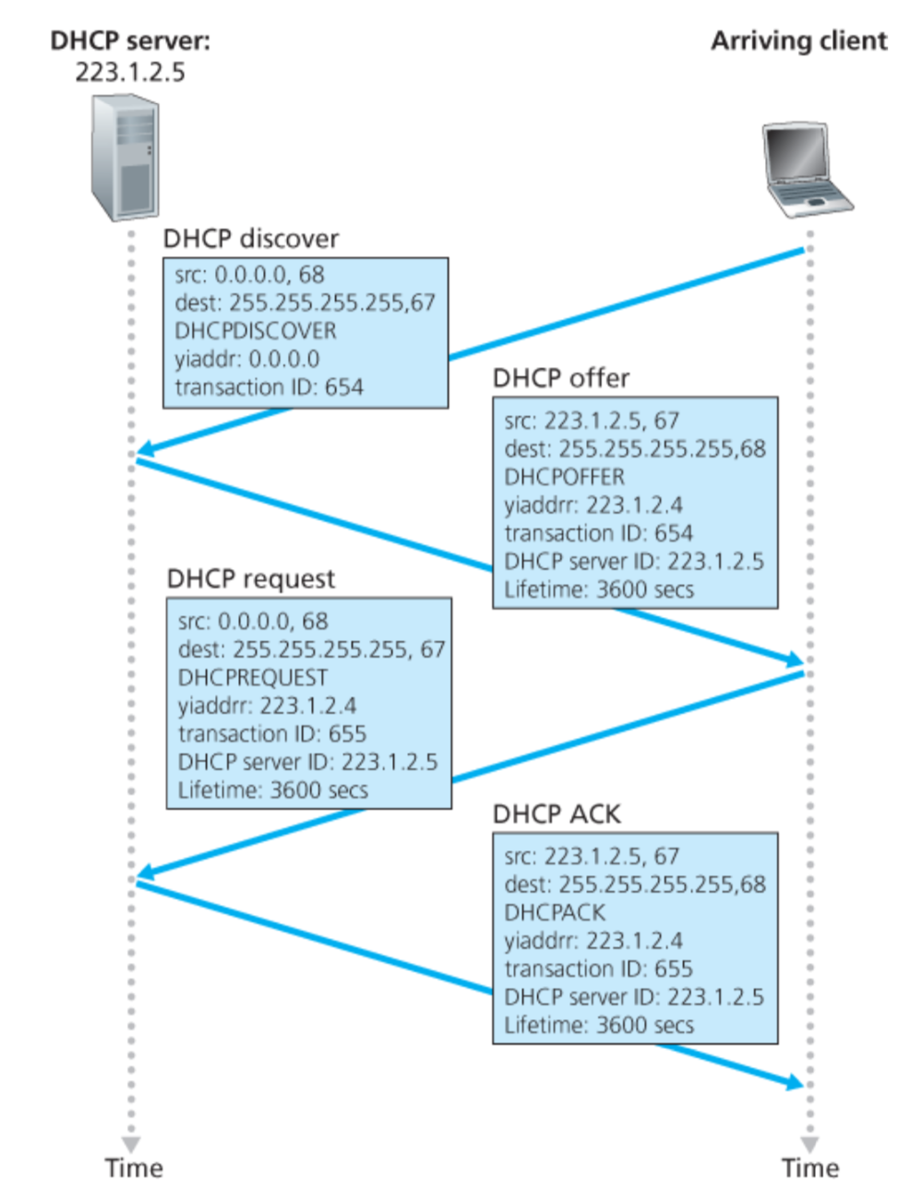
Broadcast: is there a DHCP server out there?
Broadcast: I’m a DHCP server! Here’s an IP address you can use
Broadcast: OK. I’ll take that IP address!
Broadcast: OK. You’ve got that IP address!

Slide 55
DHCP: more than IP addresses
DHCP can return more than just allocated IP address on subnet:
  address of first-hop router for client
  name and IP address of DNS sever
  network mask (indicating network versus host portion of address)

Slide 56
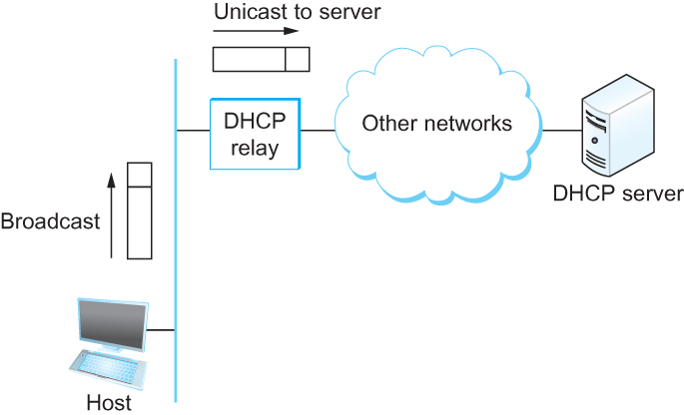
DHCP
Newly booted or attached host sends DHCPDISCOVER message to a special IP address (255.255.255.255)
DHCP relay agent unicasts the message to DHCP server and waits for the response

Slide 57
Internet Control Message Protocol (ICMP)

Slide 58
Internet Control Message Protocol (ICMP)
Defines a collection of error messages that are sent back to the source host whenever a router or host is unable to process an IP datagram successfully
  Destination host unreachable due to link /node failure
  Reassembly process failed
  TTL had reached 0 (so datagrams don't cycle forever)
  IP header checksum failed
ICMP-Redirect
  From router to a source host
  With a better route information

Slide 59
Traceroute : An unintuitive application using ICMP

Slide 60
Traceroute : An unintuitive application

Slide 61
Virtual Networks and Tunnels

Slide 62
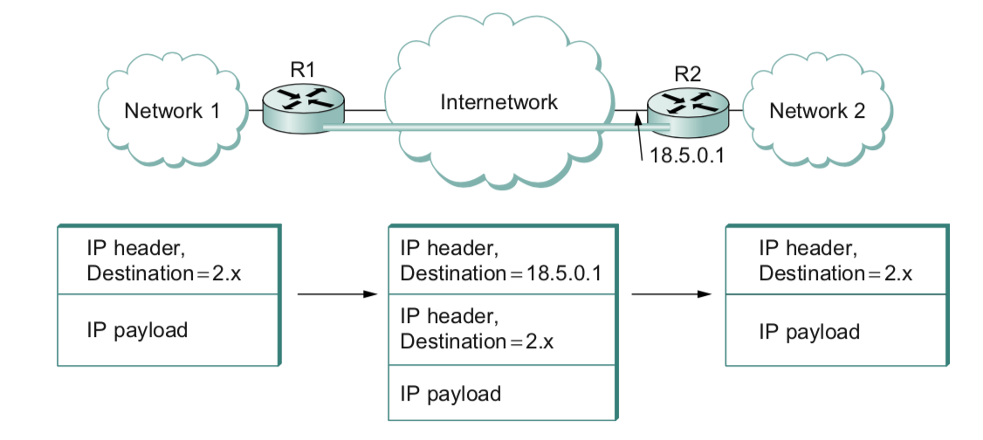

Slide 63
Why do we need virtual networks or tunnels?
1. Security
2. Special capabilities between routers (e.g., multicast)
3. Supporting heterogeneity
Disadvantages:
1. Increases packet length
a) Wastage of bandwidth
b) More processing
c) Fragmentation
2. Increases management cost

Slide 64
Private Address Space

Slide 65
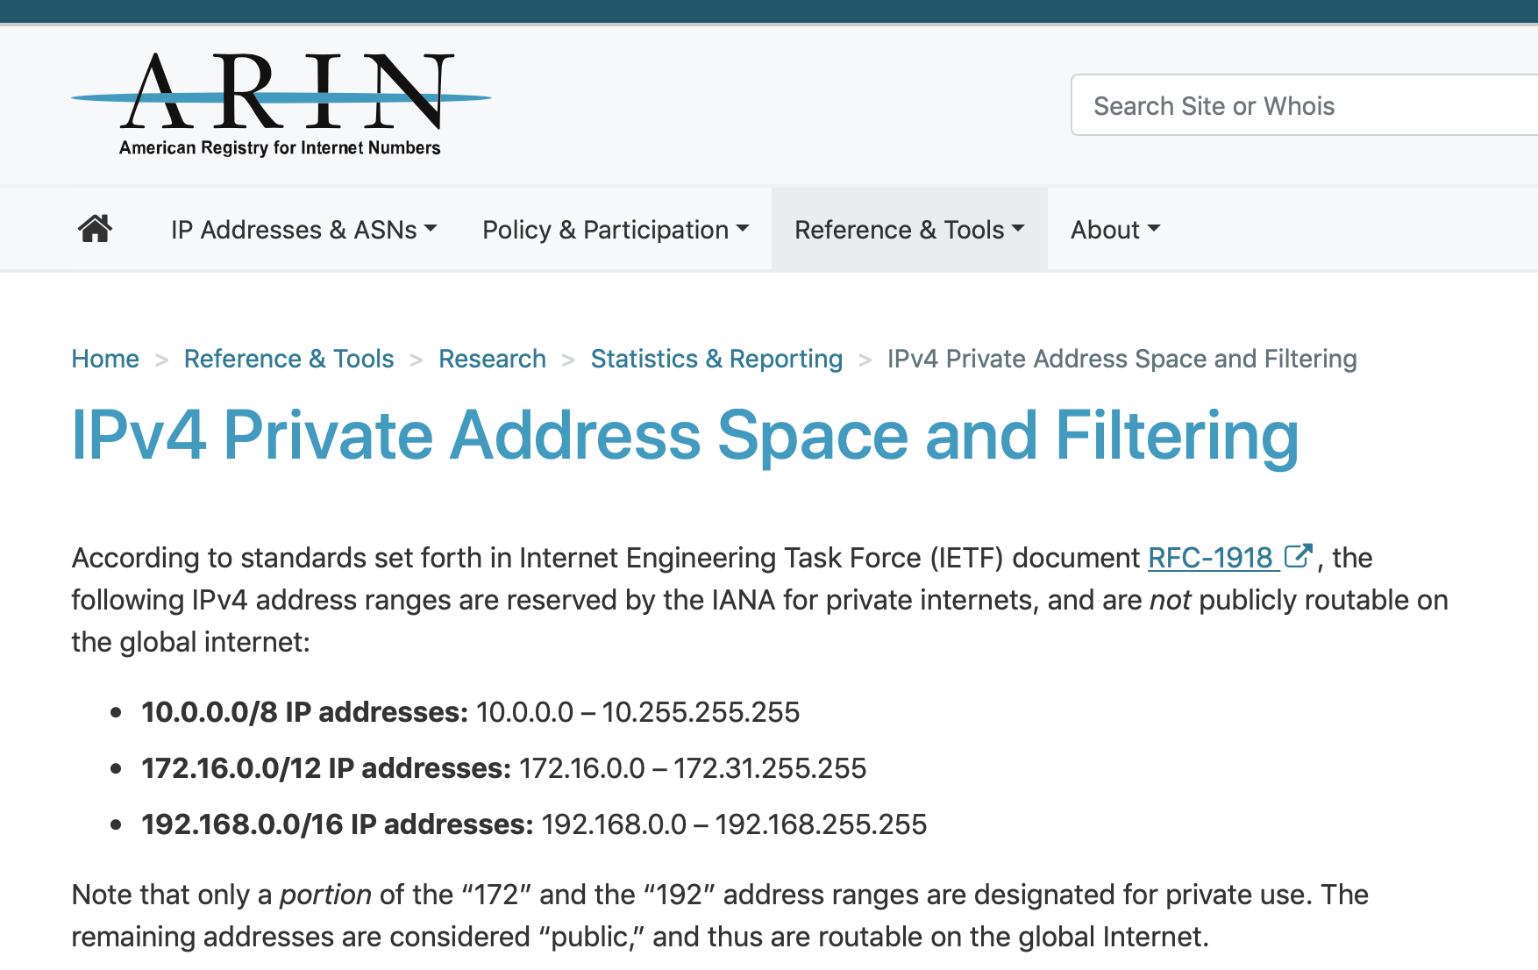

Slide 66

NAT: network address translation
NAT translation table
WAN side addr LAN side addr
2: NAT router
changes datagram
source addr from
10.0.0.1, 3345 to
138.76.29.7, 5001,
updates table
1: host 10.0.0.1
sends datagram to
128.119.40.186, 80
138.76.29.7, 5001 10.0.0.1, 3345
…… ……
S: 10.0.0.1, 3345
D: 128.119.40.186, 80
10.0.0.1
1
2
S: 138.76.29.7, 5001
D: 128.119.40.186, 80
10.0.0.4
10.0.0.2
138.76.29.7
S: 128.119.40.186, 80
D: 10.0.0.1, 3345
4
S: 128.119.40.186, 80
D: 138.76.29.7, 5001
3
10.0.0.3
4: NAT router
changes datagram
dest addr from
138.76.29.7, 5001 to 10.0.0.1, 3345
3: reply arrives
dest. address:
138.76.29.7, 5001

Slide 67
NAT: network address translation
motivation: local network uses just one IP address as far as outside world is concerned:
  range of addresses not needed from ISP: just one IP address for all devices
  can change addresses of devices in local network without notifying outside world
  can change ISP without changing addresses of devices in local network
  devices inside local net not explicitly addressable, visible by outside world (a security plus)

Slide 68
NAT: network address translation
implementation: NAT router must:
  outgoing datagrams: replace (source IP address, port #) of every outgoing datagram to (NAT IP address, new port #)
    . . . remote clients/servers will respond using (NAT IP address, new port #) as destination addr
  remember (in NAT translation table) every (source IP address, port #) to (NAT IP address, new port #) translation pair
  incoming datagrams: replace (NAT IP address, new port #) in dest fields of every incoming datagram with corresponding (source IP address, port #) stored in NAT table

Slide 69
NAT: network address translation
16-bit port-number field:
  60,000 simultaneous connections with a single LAN-side address!
NAT challenges:
  violates end-to-end argument
    NAT possibility must be taken into account by app designers, e.g., P2P applications
  NAT traversal: what if client wants to connect to server behind NAT?

