Slide 1

CMSC 417: Computer Networks
Spring 2024
Topic: Internetworking: IP
(Textbook chapter 3)
Nirupam Roy
Tu-Th 2:00-3:15pm
CSI 2117
Feb 15th, 2024

Slide 2



IP Fragmentation and Reassembly
Fragments
Dgram Len<=532
Dgram Len<=532
Datagram Len=1500
Dgram Len<=532
MTU=1500
(bytes)
MTU=1500
MTU=532
R1
R2
R3
MTU=1500
Datagram Len=1500
Where should reassembly take place?

Slide 3
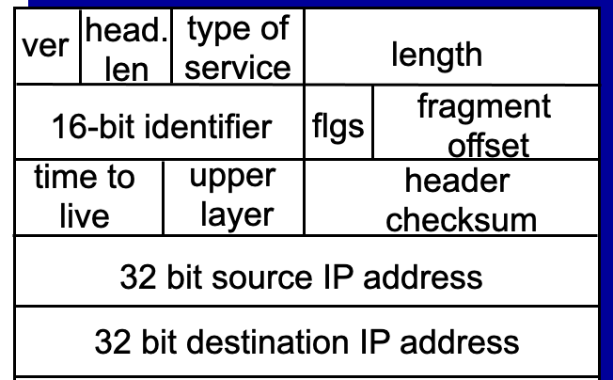
IP Fragmentation and Reassembly
Fragments
Dgram Len<=532
Dgram Len<=532
Datagram Len=1500
Dgram Len<=532
MTU=1500
(bytes)
MTU=1500
MTU=532
R1
R2
R3
MTU=1500
Datagram Len=1500
During assembly,
A. How can the destination identify all fragments of a packet?
Notes:
RFC page 24: https://www.rfc-editor.org/rfc/rfc791
The internet identification field (ID) is used together with the source and destination address, and the protocol fields, to identify datagram fragments for reassembly.
Comments of the limited ID:
https://www.rfc-editor.org/rfc/rfc6864
Introduction
In IPv4, the Identification (ID) field is a 16-bit value that is
unique for every datagram for a given source address, destination
address, and protocol, such that it does not repeat within the
maximum datagram lifetime (MDL) [RFC791] [RFC1122]. As currently
specified, all datagrams between a source and destination of a given
protocol must have unique IPv4 ID values over a period of this MDL,
which is typically interpreted as two minutes and is related to the
recommended reassembly timeout [RFC1122]. This uniqueness is
currently specified as for all datagrams, regardless of fragmentation settings.
Uniqueness of the IPv4 ID is commonly violated by high-speed devices; if strictly enforced, it would limit the speed of a single protocol between two IP endpoints to 6.4 Mbps for typical MTUs of 1500 bytes (assuming a 2-minute MDL, using the analysis presented in [RFC4963]). It is common for a single connection to operate far in excess of these rates, which strongly indicates that the uniqueness of the IPv4 ID as specified is already moot. Further, some sources have been generating non-varying IPv4 IDs for many years (e.g., cellphones), which resulted in support for such in RObust Header Compression (ROHC) [RFC5225].
And
4.1. IPv4 ID Used Only for Fragmentation
Although RFC 1122 suggests that the IPv4 ID field has other uses,
including datagram de-duplication, such uses are already not
interoperable with known implementations of sources that do not vary
their ID. This document thus defines this field's value only for
fragmentation and reassembly:
>> The IPv4 ID field MUST NOT be used for purposes other than fragmentation and reassembly.
Datagram de-duplication can still be accomplished using hash-based duplicate detection for cases where the ID field is absent (IPv6 unfragmented datagrams), which can also be applied to IPv4 atomic datagrams without utilizing the ID field [RFC6621].

Slide 4
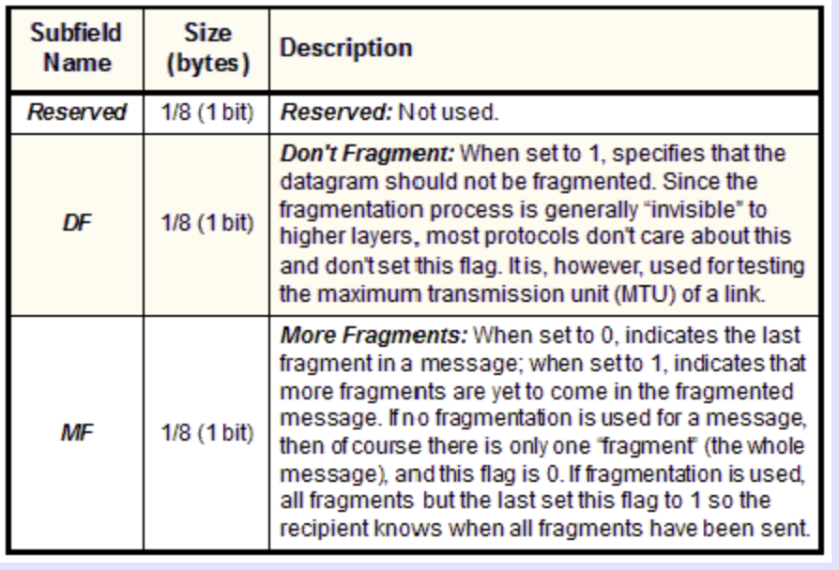
IP Fragmentation and Reassembly
Fragments
Dgram Len<=532
Dgram Len<=532
Datagram Len=1500
Dgram Len<=532
MTU=1500
(bytes)
MTU=1500
MTU=532
R1
R2
R3
MTU=1500
Datagram Len=1500
During assembly,
B. How will the destination know if the last fragment is received?
Notes:
RFC page 24: https://www.rfc-editor.org/rfc/rfc791
The internet identification field (ID) is used together with the source and destination address, and the protocol fields, to identify datagram fragments for reassembly.
If this is a whole datagram (that is both the fragment offset and the more fragments fields are zero), then it concludes that no fragmentation happened.

Slide 5
IP Fragmentation and Reassembly
Identifies the fragment location, relative to the beginning of the unfragmented data.
Fragments are counted in units of 8 octets (i.e., 8-bytes blocks).
Fragments
Dgram Len<=532
Dgram Len<=532
Datagram Len=1500
Dgram Len<=532
MTU=1500
(bytes)
MTU=1500
MTU=532
R1
R2
R3
MTU=1500
Datagram Len=1500
During assembly,
C. How will the destination know how to rearrange the data?
D. How can the destination know if a packet is unfragmented/whole?
Notes:
RFC page 24: https://www.rfc-editor.org/rfc/rfc791
The internet identification field (ID) is used together with the source and destination address, and the protocol fields, to identify datagram fragments for reassembly.
If this is a whole datagram (that is both the fragment offset and the more fragments fields are zero), then it concludes that no fragmentation happened.

Slide 6
Example: IP Fragmentation
Fragments
Dgram Len<=532
Dgram Len<=532
Datagram Len=1500
Dgram Len<=532
MTU=1500
MTU=532
R2
Header field/<info> | Value
P. Identifier | XYZ
More Frag. bit | 0
Frag. offset | 0
Header Len. | 20 (bytes)
<Data Len.> | 1400
Packer Length | 1420
Fields | Val.
P. Id
MF bit
F. off.
H. Len.
<D Len.>
Pkt Len
Frag. Pkt #1
Original Packet

Slide 7
Example: IP Fragmentation
Fragments
Dgram Len<=532
Dgram Len<=532
Datagram Len=1500
Dgram Len<=532
MTU=1500
MTU=532
R2
Header field/<info> | Value
P. Identifier | XYZ
More Frag. bit | 0
Frag. offset | 0
Header Len. | 20 (bytes)
<Data Len.> | 1400
Packer Length | 1420
Fields | Val.
P. Id | XYZ
MF bit | 1
F. off.
H. Len. | 20
<D Len.>
Pkt Len | 532
Max. Data Len. =
Max. Packet Len. – Header Len
In integer multiple of 8-octets (8 bytes block)
Frag. Pkt #1
Original Packet

Slide 8
Example: IP Fragmentation
Fragments
Dgram Len<=532
Dgram Len<=532
Datagram Len=1500
Dgram Len<=532
MTU=1500
MTU=532
R2
Header field/<info> | Value
P. Identifier | XYZ
More Frag. bit | 0
Frag. offset | 0
Header Len. | 20 (bytes)
<Data Len.> | 1400
Packer Length | 1420
Fields | Val.
P. Id | XYZ
MF bit | 1
F. off.
H. Len. | 20
<D Len.> | 512
Pkt Len | 532
Max. Data Len. =
Max. Packet Len. – Header Len
In integer multiple of 8-octets (8 bytes block)
Frag. Pkt #1
(532-20) = 512
Original Packet

Slide 9
Example: IP Fragmentation
Fragments
Dgram Len<=532
Dgram Len<=532
Datagram Len=1500
Dgram Len<=532
MTU=1500
MTU=532
R2
Header field/<info> | Value
P. Identifier | XYZ
More Frag. bit | 0
Frag. offset | 0
Header Len. | 20 (bytes)
<Data Len.> | 1400
Packer Length | 1420
Fields | Val.
P. Id | XYZ
MF bit | 1
F. off.
H. Len. | 20
<D Len.> | 512
Pkt Len | 532
Max. Data Len. =
Max. Packet Len. – Header Len
In integer multiple of 8-octets (8 bytes block)
Frag. Pkt #1
(532-20) = 512
Original Packet

Slide 10
Example: IP Fragmentation
Fragments
Dgram Len<=532
Dgram Len<=532
Datagram Len=1500
Dgram Len<=532
MTU=1500
MTU=532
R2
Header field/<info> | Value
P. Identifier | XYZ
More Frag. bit | 0
Frag. offset | 0
Header Len. | 20 (bytes)
<Data Len.> | 1400
Packer Length | 1420
Fields | Val.
P. Id | XYZ
MF bit | 1
F. off. | 0
H. Len. | 20
<D Len.> | 512
Pkt Len | 532
Starting 8-octet number
Max. Data Len. =
Max. Packet Len. – Header Len
In integer multiple of 8-octets (8 bytes block)
Frag. Pkt #1
(532-20) = 512
Original Packet

Slide 11
Example: IP Fragmentation
Fragments
Dgram Len<=532
Dgram Len<=532
Datagram Len=1500
Dgram Len<=532
MTU=1500
MTU=532
R2
512 bytes/8 =
64 (in 8-octets)
Header field/<info> | Value
P. Identifier | XYZ
More Frag. bit | 0
Frag. offset | 0
Header Len. | 20 (bytes)
<Data Len.> | 1400
Packer Length | 1420
Fields | Val.
P. Id | XYZ
MF bit | 1
F. off. | 0
H. Len. | 20
<D Len.> | 512
Pkt Len | 532
Fields | Val.
P. Id | XYZ
MF bit | 1
F. off. | 64
H. Len. | 20
<D Len.> | 512
Pkt Len | 532
Frag. Pkt #1
Frag. Pkt #2
Original Packet

Slide 12
Example: IP Fragmentation
Fragments
Dgram Len<=532
Dgram Len<=532
Datagram Len=1500
Dgram Len<=532
MTU=1500
MTU=532
R2
Header field/<info> | Value
P. Identifier | XYZ
More Frag. bit | 0
Frag. offset | 0
Header Len. | 20 (bytes)
<Data Len.> | 1400
Packer Length | 1420
Fields | Val.
P. Id | XYZ
MF bit | 1
F. off. | 0
H. Len. | 20
<D Len.> | 512
Pkt Len | 532
Fields | Val.
P. Id | XYZ
MF bit | 1
F. off. | 64
H. Len. | 20
<D Len.> | 512
Pkt Len | 532
Fields | Val.
P. Id | XYZ
MF bit | 0
F. off. | 128
H. Len. | 20
<D Len.> | 376
Pkt Len | 396
Frag. Pkt #1
Frag. Pkt #2
Frag. Pkt #3
Original Packet

Slide 13
Example: IP Reassembly
Fields | Val.
P. Id | XYZ
MF bit | 1
F. off. | 0
H. Len. | 20
<D Len.> | 512
Pkt Len | 532
Fields | Val.
P. Id | XYZ
MF bit | 1
F. off. | 64
H. Len. | 20
<D Len.> | 512
Pkt Len | 532
Fields | Val.
P. Id | XYZ
MF bit | 0
F. off. | 128
H. Len. | 20
<D Len.> | 376
Pkt Len | 396
Header buffer
Data buffer

Slide 14
Example: IP Reassembly
Header from
fgmt 1
(updated later)
Fields | Val.
P. Id | XYZ
MF bit | 1
F. off. | 0
H. Len. | 20
<D Len.> | 512
Pkt Len | 532
Fields | Val.
P. Id | XYZ
MF bit | 1
F. off. | 64
H. Len. | 20
<D Len.> | 512
Pkt Len | 532
Fields | Val.
P. Id | XYZ
MF bit | 0
F. off. | 128
H. Len. | 20
<D Len.> | 376
Pkt Len | 396
Header buffer
Data buffer

Slide 15
Example: IP Reassembly
Header from
fgmt 1
(updated later)
Fields | Val.
P. Id | XYZ
MF bit | 1
F. off. | 0
H. Len. | 20
<D Len.> | 512
Pkt Len | 532
Fields | Val.
P. Id | XYZ
MF bit | 1
F. off. | 64
H. Len. | 20
<D Len.> | 512
Pkt Len | 532
Fields | Val.
P. Id | XYZ
MF bit | 0
F. off. | 128
H. Len. | 20
<D Len.> | 376
Pkt Len | 396
Header buffer
0
Data from fgmt 1
64
Data from fgmt 2
128
Data from fgmt 3
What if assembly is not possible?
Data buffer

Slide 16
Network Addresses

Slide 17
IP Address (IPv4)
A unique 32-bit number
Identifies an interface (on a host, on a router, …)
Represented in dotted-quad notation
12
34
158
5
00001100
00100010
10011110
00000101
12:34:158:5

Slide 18
Grouping Related Hosts
The Internet is an “inter-network”
  Used to connect networks together, not hosts
  Need to address a network (i.e., group of hosts)
host
host
...
host
host
host
...
host
LAN 1
LAN 2
router
router
router
WAN
WAN
LAN = Local Area Network
WAN = Wide Area Network

Slide 19
Scalability Challenge
Suppose hosts had arbitrary addresses
  Then every router would need a lot of information
  …to know how to direct packets toward every host
1.2.3.4
5.6.7.8
2.4.6.8
1.2.3.5
5.6.7.9
2.4.6.9
host
host
...
host
host
host
...
host
LAN 1
LAN 2
router
router
router
WAN
WAN
1.2.3.4
1.2.3.5
forwarding table

Slide 20
Hierarchical Addressing: IP Prefixes
Network and host portions (left and right)
12
34
158
5
00001100
00100010
10011110
00000101
Network (24 bits)
Host (8 bits)
(N bits)
(32-N bits)

Slide 21
Hierarchical Addressing in U.S. Mail
Addressing in the U.S. mail
  Zip code: 08540
  Building: 35 Olden Street
  Room in building: 306
  Name of occupant: Jennifer Rexford
Forwarding the U.S. mail
  Deliver to the post office in the zip code
  Assign to mailman covering the building
  Drop letter into mailbox for building/room
  Give letter to the appropriate person
???

Slide 22
Easy to Add New Hosts
No need to update the routers
  E.g., adding a new host 5.6.7.213 on the right
  Doesn’t require adding a new forwarding-table entry
1.2.3.4
1.2.3.7
1.2.3.156
5.6.7.8
5.6.7.9
5.6.7.212
host
host
...
host
host
host
...
host
LAN 1
LAN 2
router
router
router
host
WAN
WAN
5.6.7.213
1.2.3.0/24
5.6.7.0/24
forwarding table

Slide 23
Hierarchical Addressing: IP Prefixes
Network and host portions (left and right)
12
34
158
5
00001100
00100010
10011110
00000101
Network (24 bits)
Host (8 bits)
(N bits)
(32-N bits)

Slide 24
Hierarchical Addressing: IP Prefixes
Network and host portions (left and right)
12
34
158
5
00001100
00100010
10011110
00000101
Network (24 bits)
Host (8 bits)
(N bits)
(32-N bits)
N = ?

Slide 25
“Classes” of networks
The sizes of networks can be different
1.2.3.4
1.2.3.7
1.2.3.156
5.6.7.8
5.6.7.9
host
host
...
host
host
host
LAN 1
LAN 2
router
router
router
WAN
WAN
Large networks (many hosts)
Fewer such networks exist
Small networks (fewer hosts)
Many such networks exist
1.2.3.0/24
5.6.7.0/24
forwarding table

Slide 26
Class-full addressing

Slide 27
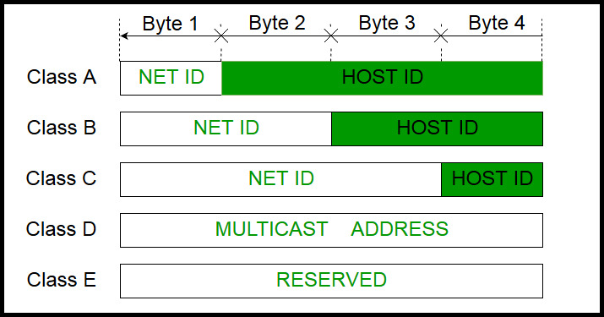
How can you tell network class from the IP address?
Picture courtesy: https://www.geeksforgeeks.org/introduction-of-classful-ip-addressing/

Slide 28
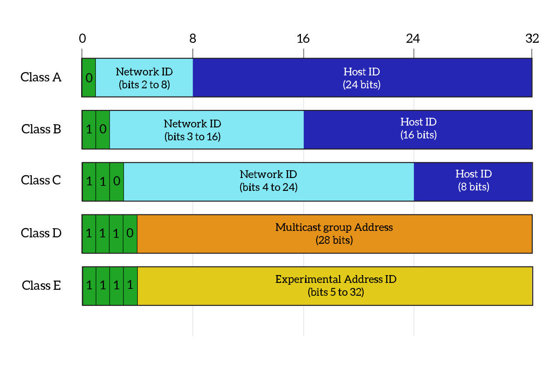
What percentage of addresses and allocated to each class?
Picture courtesy: https://www.ictshore.com/free-ccna-course/network-layer-ipv4-addressing/attachment/1013-05-classful_addressing/

Slide 29
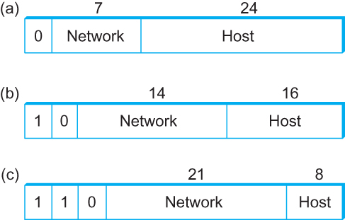
Global Addresses
Properties
  globally unique
  hierarchical: network + host
  4 Billion IP address, half are A type, ¼ is B type, and 1/8 is C type
Format
Dot notation
  10.3.2.4
  128.96.33.81
  192.12.69.77

Slide 30
Let’s assume we have 4-bit address (instead of 32 bit)
0000
0001
0010
0011
0100
0101
0110
0111
1000
1001
1010
1011
1100
1101
1110
1111
Class A (Half of all possible addresses)
Class B (1/4 of all possible addresses)
Class C (1/8 of all possible addresses)

Slide 31
Let’s assume we have 4-bit address (instead of 32 bit)
0000
0001
0010
0011
0100
0101
0110
0111
Class A (Half of all possible addresses)
Say, 1 bit for network part = 2 different networks
Say, 2 bits for host part = 4 hosts per network

Slide 32
Global Addresses
Properties
  globally unique
  hierarchical: network + host
  4 Billion IP address, half are A type, ¼ is B type, and 1/8 is C type
Format
Dot notation
  10.3.2.4
  128.96.33.81
  192.12.69.77

Slide 33
Classful Addressing
In the olden days, only fixed allocation sizes
  Class A: 0*
    Very large /8 blocks (e.g., MIT has 18.0.0.0/8)
    There can be 126 different class A networks (0 and 127 values are reserved) and (2²⁴-2) different hosts (2 values are reserved)
  Class B: 10*
    Large /16 blocks (e.g,. Princeton has 128.112.0.0/16)
  Class C: 110*
    Small /24 blocks (e.g., AT&T Labs has 192.20.225.0/24)
    2²¹ different networks possible, 254 hosts (255 is reserved for broadcast and 0 is reserved)
  Class D: 1110* for multicast groups
  Class E: 11110* reserved for future use
This is why folks use dotted-quad notation!

Slide 34
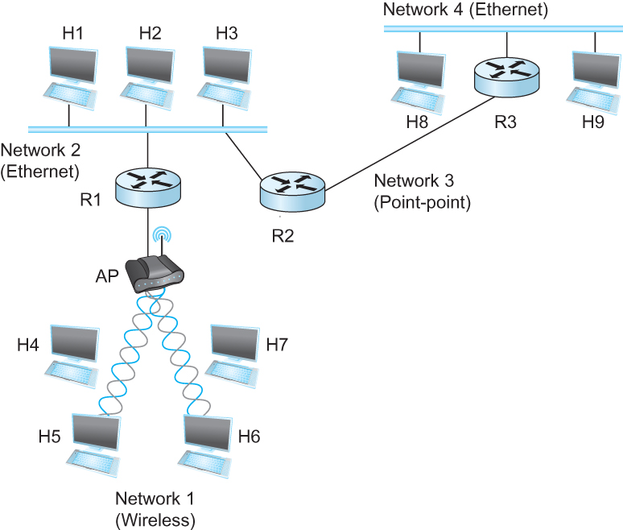
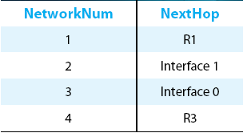
IP Datagram Forwarding
Strategy
  every datagram contains destination's address
  if directly connected to destination network, then forward to host
  if not directly connected to destination network, then forward to some router
  forwarding table maps network number into next hop
  each host has a default router
  each router maintains a forwarding table
Example (router R2)

Slide 35
Thank you

Slide 37
IP Datagram Forwarding
Algorithm
if (NetworkNum of destination = NetworkNum of one of my interfaces) then
deliver packet to destination over that interface
else
if (NetworkNum of destination is in my forwarding table) then
deliver packet to NextHop router
else
deliver packet to default router
First: find the NetworkNum. How?

Slide 38
IP Datagram Forwarding
Algorithm
if (NetworkNum of destination = NetworkNum of one of my interfaces) then
deliver packet to destination over that interface
else
if (NetworkNum of destination is in my forwarding table) then
deliver packet to NextHop router
else
deliver packet to default router
For a host with only one interface and only a default router in its forwarding table, this simplifies to
if (NetworkNum of destination = my NetworkNum)then
deliver packet to destination directly
else
deliver packet to default router

Slide 39
Obtaining a Block of Addresses
Internet Corporation for Assigned Names and Numbers (ICANN)
  Allocates large blocks to Regional Internet Registries
Regional Internet Registries (RIRs)
  E.g., ARIN (American Registry for Internet Numbers)
  Allocates to ISPs and large institutions
Internet Service Providers (ISPs)
  Allocate address blocks to their customers
  Who may, in turn, allocate to their customers…

Slide 40
Obtaining a Block of Addresses
Your organization: XYZ
Maximum # of hosts is estimated to be 10 millions.
What class of IP address will you request for?
Maximum # of hosts is estimated to be 64K ?
Maximum # of hosts is estimated to be 250?
Maximum # of hosts is estimated to be 100?
Maximum # of hosts is estimated to be 20?
Maximum # of hosts is estimated to be 300?
Maximum # of hosts is estimated to be 66K?
Notes:
Class A can have 16 millions (16777214 = 2^24-2)
Class B can have 65K (65534 = 2^16 - 2)
Class C can have 254 (2^8-2)

Slide 41
Problems with the classes of addresses
Wastage of addresses
Bigger tables to look up at routers

Slide 42
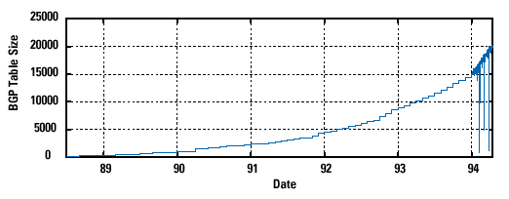
Pre-CIDR (1988-1994): Steep Growth
Growth faster than improvements in equipment capability

Slide 43
Subnetting

Slide 44


The ISP provided the network address space: 223.1.1.X
ISP
Router
223.1.1.1
223.1.1.2
223.1.1.3
223.1.1.4
223.1.1.5
223.1.1.6

Slide 45
The ISP provided the network address space: 223.1.1.X
ISP
223.1.2.X
Router
223.1.3.X
223.1.1.1
223.1.1.2
223.1.1.3
223.1.1.4
223.1.1.5
223.1.1.6

Slide 46
The ISP provided the network address space: 223.1.1.X
Router
Two separate networks are needed. How can we assign addresses to these “sub” networks?

Slide 47
The ISP provided the network address space: 223.1.1.X
Router

Slide 48
The ISP provided the network address space: 223.1.1.X
Router
Use subnetting

Slide 49
The ISP provided the network address space: 223.1.1.X
11011111.00000001.00000001.XXXXXXX
Router
Use part of the host bits to identify separate subnets.

Slide 50
The ISP provided the network address space: 223.1.1.X
11011111.00000001.00000001.XXXXXXX
Router
Use part of the host bits to identify separate subnets.
11011111.00000001.00000001.0XXXXXX
11011111.00000001.00000001.1XXXXXX
Subnet mask = 11111111. 11111111. 11111111.10000000

Slide 51
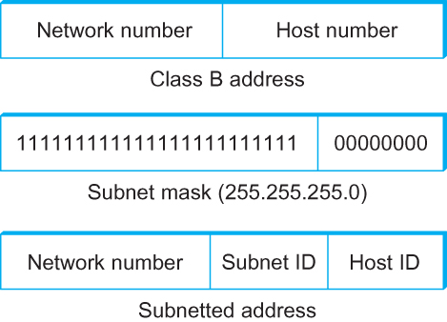
Subnetting
Add another level to address/routing hierarchy: subnet
Subnet masks define variable partition of host part of class A and B addresses
Subnets visible only within site
“Bitwise and”

Slide 52
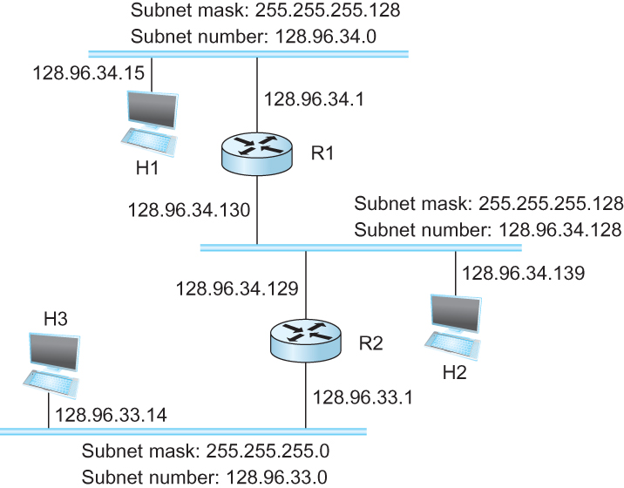
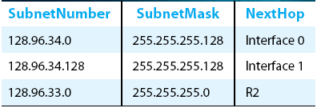
Subnetting
Forwarding Table at Router R1

Slide 53
Subnetting
Forwarding Table at Router R1
Forwarding Algorithm
D = destination IP address
for each entry < SubnetNum, SubnetMask, NextHop>
  D1 = SubnetMask & D
  if D1 = SubnetNum
    if NextHop is an interface
    deliver datagram directly to destination
    else
    deliver datagram to NextHop (a router)

Slide 54
Subnetting
Notes
Would use a default router if nothing matches
Not necessary for all ones in subnet mask to be contiguous
Can put multiple subnets on one physical network
Subnets not visible from the rest of the Internet

Slide 55
Subnets “toy” example

Slide 56



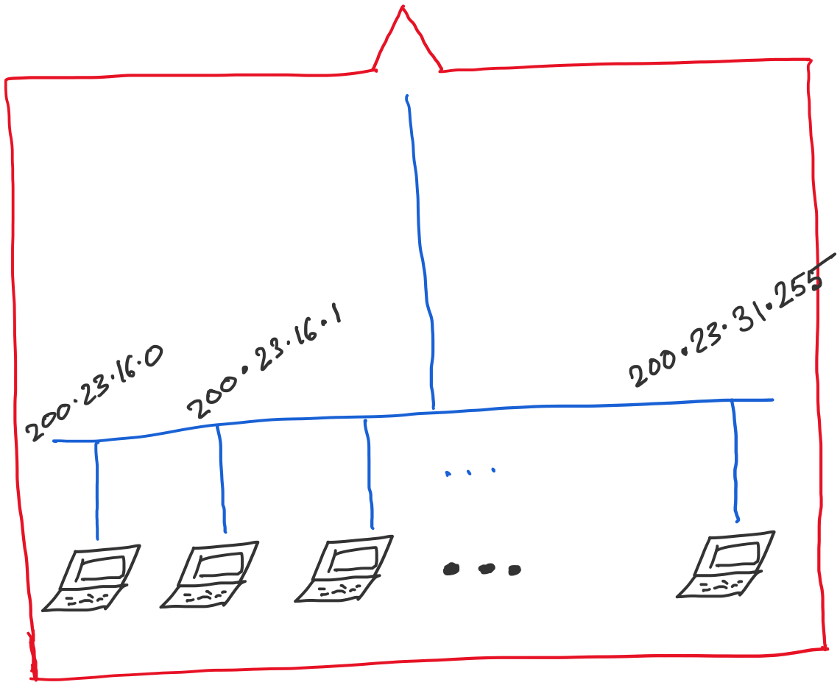
Address space assigned to you:

Slide 57
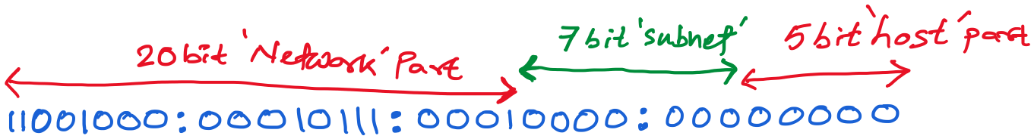
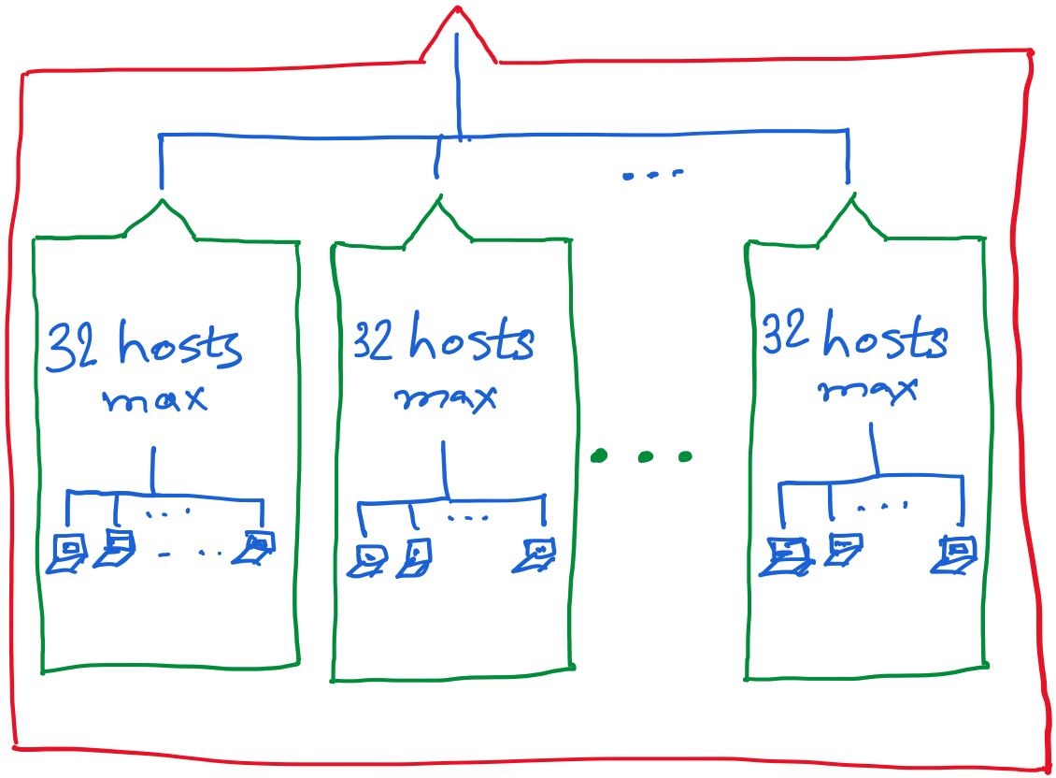
30 hosts max.
22 hosts max.
18 hosts max.

Slide 58
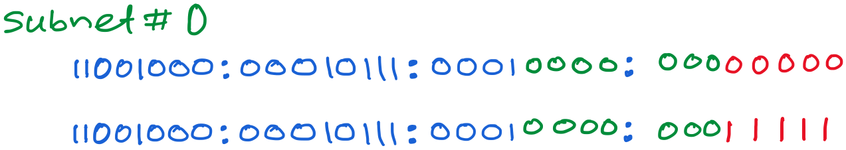
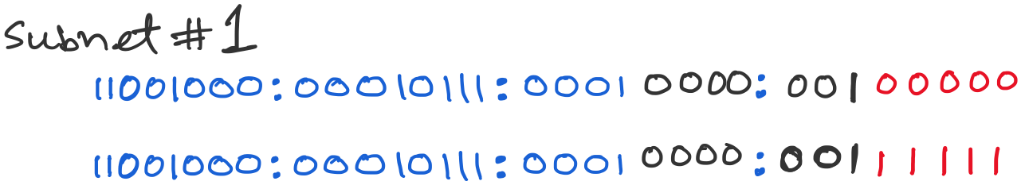
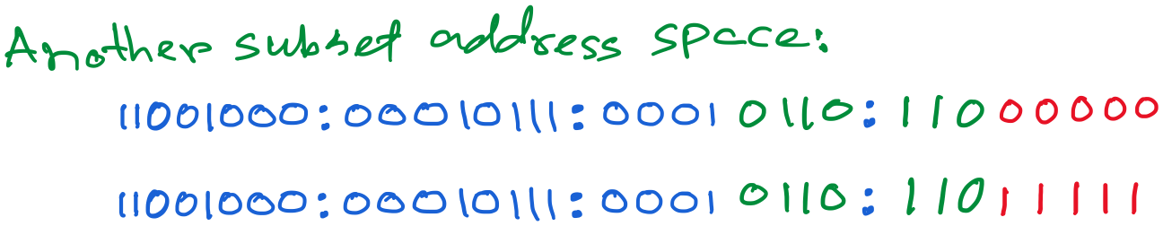

Slide 59
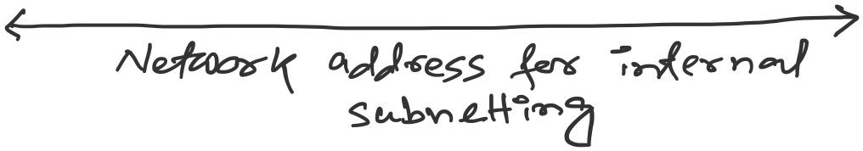

Slide 60
Class-less Interdomain Routing (CIDR)
Generalizes the ideas of subnetting

Slide 61
Lessons learned from subnetting
Forwarding tab.
Forwarding tab.
223.1.1.0
223.1.1.0
223.1.2.0
223.1.2.0
223.1.1.0
223.1.3.0
223.1.3.0
ISP
223.1.2.0
223.1.3.0

Slide 62
Lessons learned from subnetting
Forwarding tab.
Forwarding tab.
223.1.1.0
223.1.1.0
223.1.2.0
223.1.2.0
223.1.1.128
223.1.1.0
223.1.3.0
223.1.3.0
223.1.1.192
ISP
223.1.2.0
223.1.3.0

Slide 63
Lessons learned from subnetting
Forwarding tab.
Forwarding tab.
223.1.1.0
223.1.1.0
223.1.2.0
223.1.2.0
223.1.1.128
223.1.1.0
223.1.3.0
223.1.3.0
223.1.1.192
ISP
Lesson 1:
Address classes are not needed. Mask can define the number of bits for network part.
Lesson 2:
Network hierarchies can be hidden from the outside world.
Network addresses can be aggregated/summarized/combined
223.1.2.0
223.1.3.0

Slide 64
CIDR: Classless address

Slide 65
IP addressing: CIDR
CIDR: Classless InterDomain Routing
  Network portion of address of arbitrary length
  address format: a.b.c.d/x, where x is # bits in subnet portion of address
subnet
part
host
part
11001000 00010111 00010000 00000000
200.23.16.0/23
200.23.16.0–200.23.17.255
This X bit network part is often called Prefix or Network-prefix

Slide 66
IP addressing: CIDR
CIDR: Classless InterDomain Routing
  subnet portion of address of arbitrary length
  address format: a.b.c.d/x, where x is # bits in subnet portion of address
forwarding table
4.0.0.0/8
4.83.128.0/17
201.10.0.0/21
201.10.6.0/23
126.255.103.0/24

Slide 67
CIDR: Super-netting/
Route aggregation

Slide 68
Lessons learned from subnetting
Forwarding tab.
Forwarding tab.
223.1.1.0/24
223.1.1.0/24
223.1.2.0/24
223.1.2.0/24
223.1.1.0
223.1.3.0/24
223.1.3.0/24
ISP
223.1.0.0/16
223.1.2.0
223.1.3.0

Slide 69
Lessons learned from subnetting
Forwarding tab.
Forwarding tab.
223.1.1.0/24
223.1.0.0/16
223.1.2.0/24
223.1.1.0
223.1.3.0/24
ISP
223.1.0.0/16
223.1.2.0
223.1.3.0

Slide 70
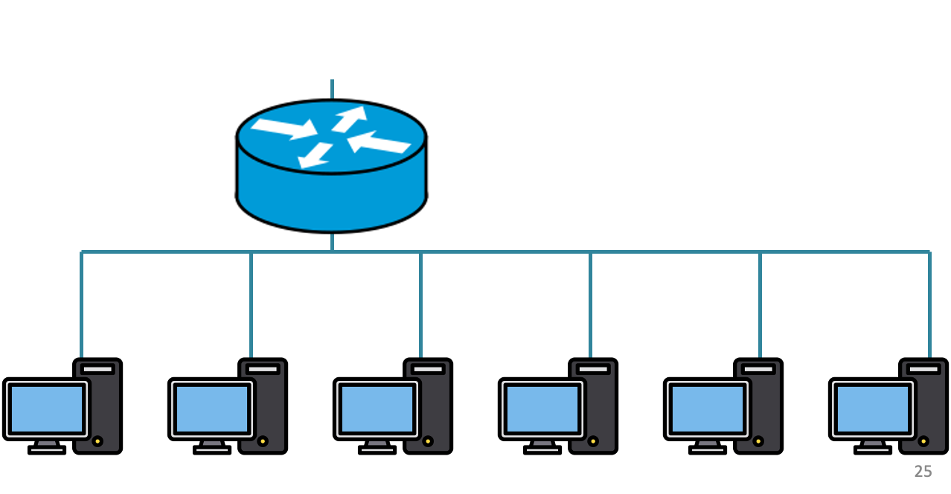
200.20.2.0/24
200.20.3.0/24
200.20.1.0/24

Slide 71
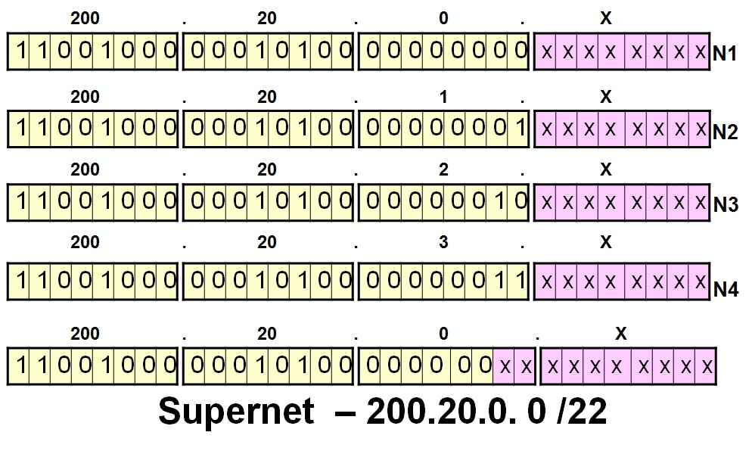
200.20.2.0/24
200.20.3.0/24
200.20.1.0/24

Slide 72
Route aggregation
200.20.2.0/24
200.20.3.0/24
200.20.1.0/24

Slide 73
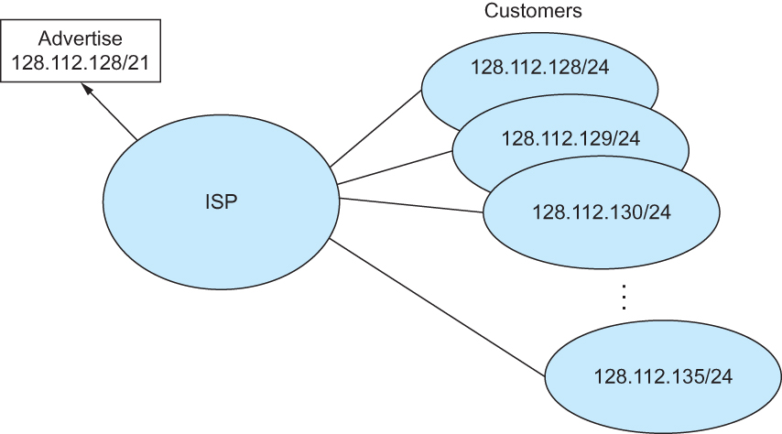
Route aggregation with CIDR

Slide 74
Classless Inter-Domain Routing (CIDR)
Use two 32-bit numbers to represent a network.
Network number = IP address + Mask
IP Address : 12.4.0.0 IP Mask: 255.254.0.0
Address
00001100
00000100
00000000
00000000
Mask
11111111
11111110
00000000
00000000
Network Prefix
for hosts
Written as 12.4.0.0/15

Slide 75
Hierarchical Address Allocation
Hierarchy is key to scalability
  Address allocated in contiguous chunks (prefixes)
  Today, the Internet has about 400,000 prefixes
12.0.0.0/16
12.1.0.0/16
:
:
:
12.3.0.0/24
12.2.0.0/16
12.3.1.0/24
12.3.0.0/16
:
:
:
:
:
12.0.0.0/8
12.3.254.0/24
12.253.0.0/19
12.253.32.0/19
:
:
12.254.0.0/16
12.253.160.0/19

Slide 76
Separate Forwarding Entry Per Prefix
Prefix-based forwarding
  Map the destination address to matching prefix
  Forward to the outgoing interface
1.2.3.4
1.2.3.7
1.2.3.156
5.6.7.8
5.6.7.9
5.6.7.212
host
host
...
host
host
host
...
host
LAN 1
LAN
router
router
router
WAN
WAN
1.2.3.0/24
5.6.7.0/24
forwarding table

Slide 77
CIDR Makes Packet Forwarding Harder
201.10.0.0/21
Provider 1
201.10.0.0/22
201.10.4.0/24
201.10.5.0/24
201.10.6.0/23

Slide 78
CIDR Makes Packet Forwarding Harder
201.10.0.0/21
Provider 1
Provider 2
Multi-homing
201.10.0.0/22
201.10.4.0/24
201.10.5.0/24
201.10.6.0/23

Slide 79
CIDR Makes Packet Forwarding Harder
Forwarding tab.
201.10.0.0/21
Provider 1
Provider 2
Multi-homing
201.10.0.0/22
201.10.4.0/24
201.10.5.0/24
201.10.6.0/23

Slide 80
CIDR Makes Packet Forwarding Harder
Forwarding tab.
201.10.0.0/21
201.10.6.0/23
201.10.0.0/21
Provider 1
Provider 2
Multi-homing
201.10.0.0/22
201.10.4.0/24
201.10.5.0/24
201.10.6.0/23

Slide 81
CIDR Makes Packet Forwarding Harder
Forwarding table
201.10.0.0/21
11001001.00001010.00000000.00000000/21
201.10.6.0/23
11001001.00001010.00000110.00000000/23
A packet with dest. Addr.: 201.10.6.17
11001001.00001010.00000110.00010001

Slide 82
CIDR Makes Packet Forwarding Harder
Forwarding table may have many matches
  E.g., entries for 201.10.0.0/21 and 201.10.6.0/23
  The IP address 201.10.6.17 would match both!
201.10.0.0/21
Provider 1
Provider 2
201.10.0.0/22
201.10.4.0/24
201.10.5.0/24
201.10.6.0/23

Slide 83
Longest Prefix Match Forwarding
Destination-based forwarding
  Packet has a destination address
  Router identifies longest-matching prefix
  Cute algorithmic problem: very fast lookups
forwarding table
4.0.0.0/8
4.83.128.0/17
201.10.0.0/21
201.10.6.0/23
126.255.103.0/24
destination
201.10.6.17
outgoing link

Slide 84
Getting an IP address:
DHCP Protocol

Slide 85
IP addresses: how to get one?
Q: How does a host get IP address?
hard-coded by system admin in a file
  Windows: control-panel->network->configuration->tcp/ip->properties
  UNIX: /etc/…
DHCP: Dynamic Host Configuration Protocol: dynamically get address from a server
  “plug-and-play”

Slide 86
DHCP: Dynamic Host Configuration Protocol
goal: allow host to dynamically obtain its IP address from network server when it joins network
  can renew its lease on address in use
  allows reuse of addresses (only hold address while connected/“on”)
  support for mobile users who want to join network

Slide 87
DHCP: Dynamic Host Configuration Protocol
DHCP overview:
  host broadcasts “DHCP discover” msg
  DHCP server responds with “DHCP offer” msg
  host requests IP address: “DHCP request” msg
  DHCP server sends address: “DHCP ack” msg

Slide 88



DHCP client-server scenario
DHCP
server
223.1.1.0/24
223.1.1.1
223.1.2.1
223.1.1.2
arriving DHCP
client needs
address in this
network
223.1.1.4
223.1.2.9
223.1.3.27
223.1.2.2
223.1.1.3
223.1.2.0/24
223.1.3.1
223.1.3.2
223.1.3.0/24

Slide 89
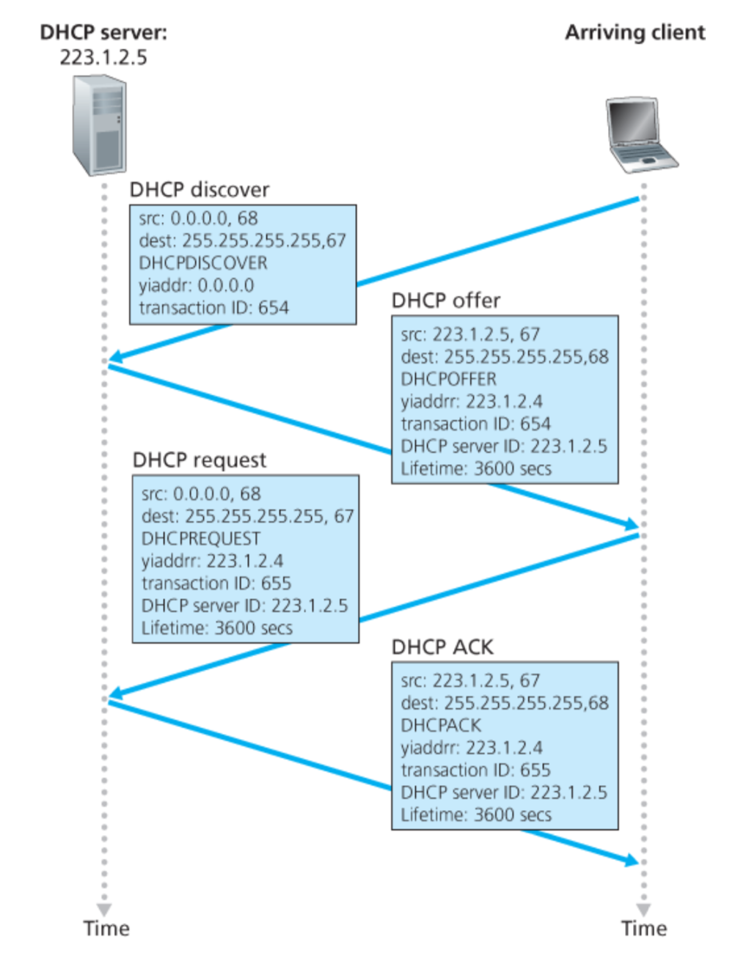
Broadcast: is there a DHCP server out there?

Slide 90
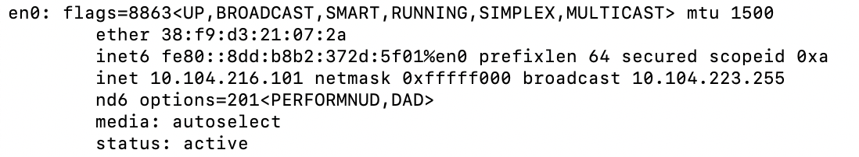
A note on the “broadcast address”

Slide 91
inet 10.104.216.101 ➔ 00001010.01101000.11011000.01100101
netmask ff:ff:f0:00 ➔ 11111111.11111111.11110000.00000000
broadcast 10.104.223.255 ➔
00001010.01101000.11011111.11111111

Slide 92
Broadcast: is there a DHCP server out there?
Broadcast: I’m a DHCP server! Here’s an IP address you can use
Broadcast: OK. I’ll take that IP address!
Broadcast: OK. You’ve got that IP address!

Slide 93
Broadcast: is there a DHCP server out there?
Broadcast: I’m a DHCP server! Here’s an IP address you can use
Broadcast: OK. I’ll take that IP address!
Broadcast: OK. You’ve got that IP address!

Slide 94
Broadcast: is there a DHCP server out there?
Broadcast: I’m a DHCP server! Here’s an IP address you can use
Broadcast: OK. I’ll take that IP address!
Broadcast: OK. You’ve got that IP address!

Slide 95
Broadcast: is there a DHCP server out there?
Broadcast: I’m a DHCP server! Here’s an IP address you can use
Broadcast: OK. I’ll take that IP address!
Broadcast: OK. You’ve got that IP address!

Slide 96
Broadcast: is there a DHCP server out there?
Broadcast: I’m a DHCP server! Here’s an IP address you can use
Broadcast: OK. I’ll take that IP address!
Broadcast: OK. You’ve got that IP address!

Slide 97
Broadcast: is there a DHCP server out there?
Broadcast: I’m a DHCP server! Here’s an IP address you can use
Broadcast: OK. I’ll take that IP address!
Broadcast: OK. You’ve got that IP address!

Slide 98
Broadcast: is there a DHCP server out there?
Broadcast: I’m a DHCP server! Here’s an IP address you can use
Broadcast: OK. I’ll take that IP address!
Broadcast: OK. You’ve got that IP address!

Slide 99
Broadcast: is there a DHCP server out there?
Broadcast: I’m a DHCP server! Here’s an IP address you can use
Broadcast: OK. I’ll take that IP address!
Broadcast: OK. You’ve got that IP address!

Slide 100
Broadcast: is there a DHCP server out there?
Broadcast: I’m a DHCP server! Here’s an IP address you can use
Broadcast: OK. I’ll take that IP address!
Broadcast: OK. You’ve got that IP address!

Slide 101
Broadcast: is there a DHCP server out there?
Broadcast: I’m a DHCP server! Here’s an IP address you can use
Broadcast: OK. I’ll take that IP address!
Broadcast: OK. You’ve got that IP address!

Slide 102
Broadcast: is there a DHCP server out there?
Broadcast: I’m a DHCP server! Here’s an IP address you can use
Broadcast: OK. I’ll take that IP address!
Broadcast: OK. You’ve got that IP address!

Slide 103
Broadcast: is there a DHCP server out there?
Broadcast: I’m a DHCP server! Here’s an IP address you can use
Broadcast: OK. I’ll take that IP address!
Broadcast: OK. You’ve got that IP address!

Slide 104
Broadcast: is there a DHCP server out there?
Broadcast: I’m a DHCP server! Here’s an IP address you can use
Broadcast: OK. I’ll take that IP address!
Broadcast: OK. You’ve got that IP address!

Slide 105
Broadcast: is there a DHCP server out there?
Broadcast: I’m a DHCP server! Here’s an IP address you can use
Broadcast: OK. I’ll take that IP address!
Broadcast: OK. You’ve got that IP address!

Slide 106
Broadcast: is there a DHCP server out there?
Broadcast: I’m a DHCP server! Here’s an IP address you can use
Broadcast: OK. I’ll take that IP address!
Broadcast: OK. You’ve got that IP address!

Slide 107
DHCP: more than IP addresses
DHCP can return more than just allocated IP address on subnet:
  address of first-hop router for client
  name and IP address of DNS sever
  network mask (indicating network versus host portion of address)

Slide 108
Dynamic Host Configuration Protocol (DHCP)
DHCP server is responsible for providing configuration information to hosts
DHCP server maintains a pool of available addresses
There is at least one DHCP server for an administrative domain (a server or a relay agent per subnet)

Slide 109
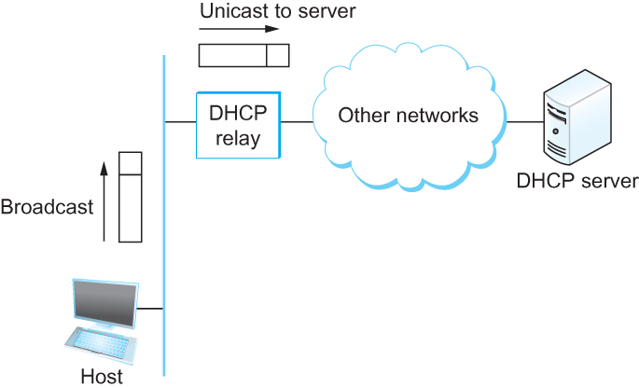
DHCP relay
Newly booted or attached host sends DHCPDISCOVER message to a special IP address (255.255.255.255)
DHCP relay agent unicasts the message to DHCP server and waits for the response

Slide 110
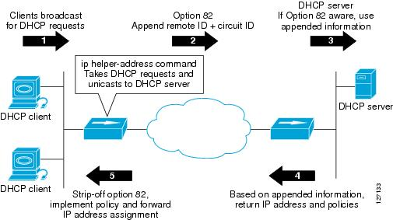
DHCP relay

Slide 111
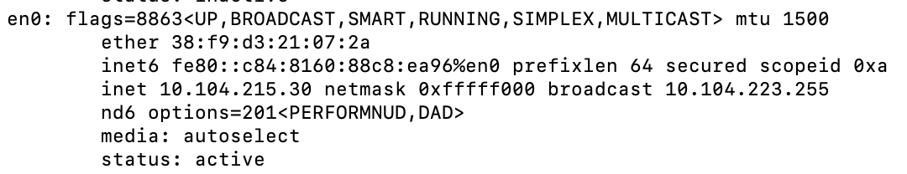
Check our IP addresses
(ifconfig/ipconfig)

Slide 112
Unused slides (ignore)

Slide 115
Class-less addressing: CIDR

Slide 116
IP addressing: CIDR
CIDR: Classless InterDomain Routing
  subnet portion of address of arbitrary length
  address format: a.b.c.d/x, where x is # bits in subnet portion of address
subnet
part
host
part
11001000 00010111 00010000 00000000
200.23.16.0/23
200.23.16.0–200.23.17.255

Slide 117
Classless Inter-Domain Routing (CIDR)
Use two 32-bit numbers to represent a network.
Network number = IP address + Mask
IP Address : 12.4.0.0 IP Mask: 255.254.0.0
Address
00001100
00000100
00000000
00000000
Mask
11111111
11111110
00000000
00000000
Network Prefix
for hosts
Written as 12.4.0.0/15

Slide 118
Hierarchical Address Allocation
Hierarchy is key to scalability
  Address allocated in contiguous chunks (prefixes)
  Today, the Internet has about 400,000 prefixes
12.0.0.0/16
12.1.0.0/16
:
:
:
12.3.0.0/24
12.2.0.0/16
12.3.1.0/24
12.3.0.0/16
:
:
:
:
:
12.0.0.0/8
12.3.254.0/24
12.253.0.0/19
12.253.32.0/19
:
:
12.254.0.0/16
12.253.160.0/19

Slide 119
Classless Addressing
Route aggregation with CIDR

Slide 120
Separate Forwarding Entry Per Prefix
Prefix-based forwarding
  Map the destination address to matching prefix
  Forward to the outgoing interface
1.2.3.4
1.2.3.7
1.2.3.156
5.6.7.8
5.6.7.9
5.6.7.212
host
host
...
host
host
host
...
host
LAN 1
LAN
router
router
router
WAN
WAN
1.2.3.0/24
5.6.7.0/24
forwarding table

Slide 121
CIDR Makes Packet Forwarding Harder
Forwarding table may have many matches
  E.g., entries for 201.10.0.0/21 and 201.10.6.0/23
  The IP address 201.10.6.17 would match both!
201.10.0.0/21
Provider 1
Provider 2
201.10.0.0/22
201.10.4.0/24
201.10.5.0/24
201.10.6.0/23

Slide 122
Longest Prefix Match Forwarding
Destination-based forwarding
  Packet has a destination address
  Router identifies longest-matching prefix
  Cute algorithmic problem: very fast lookups
forwarding table
4.0.0.0/8
4.83.128.0/17
201.10.0.0/21
201.10.6.0/23
126.255.103.0/24
destination
201.10.6.17
outgoing link
Serial0/0.1

Slide 123
Pre-CIDR (1988-1994): Steep Growth
Growth faster than improvements in equipment capability

Slide 124
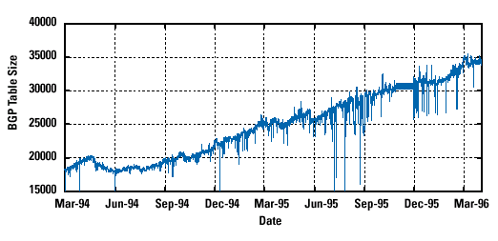
CIDR (1994-1996): Much Flatter
Efforts to aggregate

Slide 125
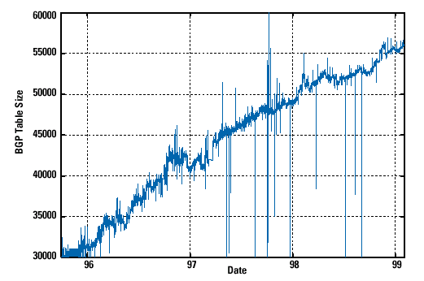
CIDR Growth (1996-1998): Roughly Linear
Good use of aggregation, and peer pressure!

Slide 126
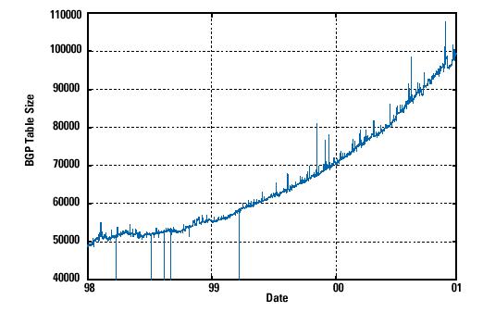
DotCom Boom (1998-2001): Steep Growth
Internet boom and increased multi-homing

Slide 127
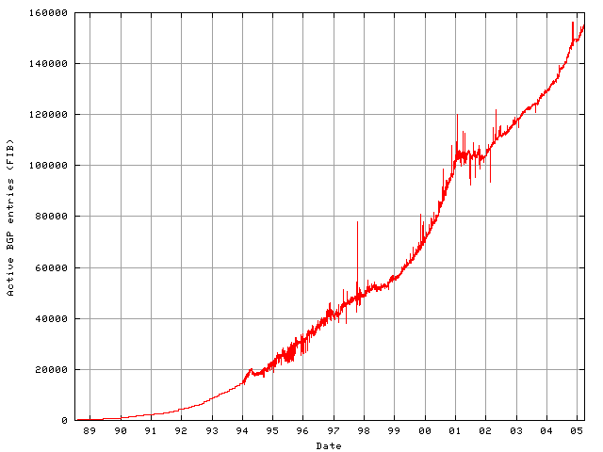
Long Term (1989-2005): Post-Boom
Today we are up to ~400,000 prefixes

Slide 128
Getting an IP address: DHCP

Slide 129
IP addresses: how to get one?
Q: How does a host get IP address?
hard-coded by system admin in a file
  Windows: control-panel->network->configuration->tcp/ip->properties
  UNIX: /etc/…
DHCP: Dynamic Host Configuration Protocol: dynamically get address from a server
  “plug-and-play”

Slide 130
DHCP: Dynamic Host Configuration Protocol
goal: allow host to dynamically obtain its IP address from network server when it joins network
  can renew its lease on address in use
  allows reuse of addresses (only hold address while connected/“on”)
  support for mobile users who want to join network

Slide 131
DHCP: Dynamic Host Configuration Protocol
DHCP overview:
  host broadcasts “DHCP discover” msg [optional]
  DHCP server responds with “DHCP offer” msg
  host requests IP address: “DHCP request” msg
  DHCP server sends address: “DHCP ack” msg

Slide 132
DHCP client-server scenario
DHCP
server
223.1.1.0/24
223.1.1.1
223.1.2.1
223.1.1.2
arriving DHCP
client needs
address in this
network
223.1.1.4
223.1.2.9
223.1.3.27
223.1.2.2
223.1.1.3
223.1.2.0/24
223.1.3.1
223.1.3.2
223.1.3.0/24

Slide 133
Broadcast: is there a DHCP server out there?
Broadcast: I’m a DHCP server! Here’s an IP address you can use
Broadcast: OK. I’ll take that IP address!
Broadcast: OK. You’ve got that IP address!

Slide 134
DHCP: more than IP addresses
DHCP can return more than just allocated IP address on subnet:
  address of first-hop router for client
  name and IP address of DNS sever
  network mask (indicating network versus host portion of address)

Slide 135
Dynamic Host Configuration Protocol (DHCP)
DHCP server is responsible for providing configuration information to hosts
DHCP server maintains a pool of available addresses
There is at least one DHCP server for an administrative domain (a server or a relay agent per subnet)

Slide 136
DHCP
Newly booted or attached host sends DHCPDISCOVER message to a special IP address (255.255.255.255)
DHCP relay agent unicasts the message to DHCP server and waits for the response

Slide 137
Unused slides (ignore)

Slide 138
Example: IP Fragmentation
Fragments
Dgram Len<=532
Dgram Len<=532
Datagram Len=1500
Dgram Len<=532
MTU=1500
MTU=532
R2
Header field/<info> | Value
P. Identifier | XYZ
More Frag. bit | 0
Frag. offset | 0
Header Len. | 20 (bytes)
<Data Len.> | 1400
Packer Length | 1420
Fields | Val.
P. Id | XYZ
MF bit | 1
F. off. | 0
H. Len. | 20
<D Len.> | 512
Pkt Len | 532
Fields | Val.
P. Id | XYZ
MF bit | 1
F. off. | 64
H. Len. | 20
<D Len.> | 512
Pkt Len | 532
Fields | Val.
P. Id | XYZ
MF bit | 0
F. off. | 128
H. Len. | 20
<D Len.> | 376
Pkt Len | 396
Frag. Pkt #1
Frag. Pkt #2
Frag. Pkt #3
Original Packet

Slide 139
Example: IP Reassembly
Fields | Val.
P. Id | XYZ
MF bit | 1
F. off. | 0
H. Len. | 20
<D Len.> | 512
Pkt Len | 532
Fields | Val.
P. Id | XYZ
MF bit | 1
F. off. | 64
H. Len. | 20
<D Len.> | 512
Pkt Len | 532
Fields | Val.
P. Id | XYZ
MF bit | 0
F. off. | 128
H. Len. | 20
<D Len.> | 376
Pkt Len | 396
Header buffer
Data from fgmt 1
Data from fgmt 2
Data from fgmt 3
Data buffer

Slide 140
Example: IP Reassembly
Header from
fgmt 1
(will be updated later)
Fields | Val.
P. Id | XYZ
MF bit | 1
F. off. | 0
H. Len. | 20
<D Len.> | 512
Pkt Len | 532
Fields | Val.
P. Id | XYZ
MF bit | 1
F. off. | 64
H. Len. | 20
<D Len.> | 512
Pkt Len | 532
Fields | Val.
P. Id | XYZ
MF bit | 0
F. off. | 128
H. Len. | 20
<D Len.> | 376
Pkt Len | 396
Header buffer
Data from fgmt 1
Data from fgmt 2
Data from fgmt 3
Data buffer

Slide 141
Example: IP Reassembly
Header from
fgmt 1
(will be updated later)
Fields | Val.
P. Id | XYZ
MF bit | 1
F. off. | 0
H. Len. | 20
<D Len.> | 512
Pkt Len | 532
Fields | Val.
P. Id | XYZ
MF bit | 1
F. off. | 64
H. Len. | 20
<D Len.> | 512
Pkt Len | 532
Fields | Val.
P. Id | XYZ
MF bit | 0
F. off. | 128
H. Len. | 20
<D Len.> | 376
Pkt Len | 396
Header buffer
0
Data from fgmt 1
Data from fgmt 1
Data from fgmt 2
Data from fgmt 3
64
Data from fgmt 2
128
Data from fgmt 3
What if assembly is not possible?
Data buffer

Slide 142
Example: IP Reassembly
32 bits
ver
head.
len
type of
service
length
Header from
fgmt 1
(will be updated later)
Fields | Val.
P. Id | XYZ
MF bit | 1
F. off. | 0
H. Len. | 20
<D Len.> | 512
Pkt Len | 532
Fields | Val.
P. Id | XYZ
MF bit | 1
F. off. | 64
H. Len. | 20
<D Len.> | 512
Pkt Len | 532
Fields | Val.
P. Id | XYZ
MF bit | 0
F. off. | 128
H. Len. | 20
<D Len.> | 376
Pkt Len | 396
flgs
fragment
offset
16-bit identifier
time to
live
upper
layer
header
checksum
32 bit source IP address
Header buffer
32 bit destination IP address
options (if any)
Data from fgmt 1
Data from fgmt 2
Data from fgmt 3
data
(variable length,
typically a TCP
or UDP segment)
Which header fields will be updated
during reassembly?
Data buffer

