Slide 1
CMSC 417: Computer Networks
Spring 2024
Topic: Internetworking: Subnets, CIDR, DHCP
(Textbook chapter 3)
Nirupam Roy
Tu-Th 2:00-3:15pm
CSI 2117
Feb 20th, 2024

Slide 2
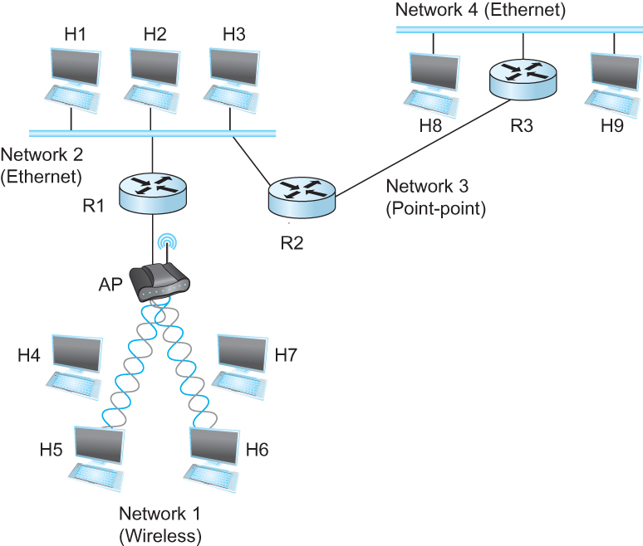
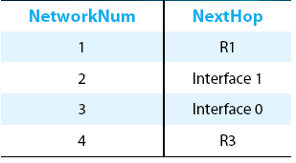
IP Datagram Forwarding
Strategy
every datagram contains destination's address
if directly connected to destination network, then forward to host
if not directly connected to destination network, then forward to some router
forwarding table maps network number into next hop
each host has a default router
each router maintains a forwarding table
Example (router R2)

Slide 3
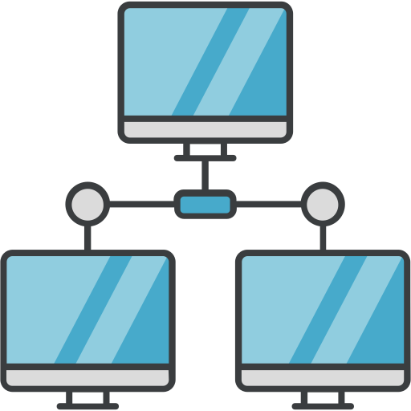
IP Datagram Forwarding
Forwarding table at R2
R2
I-0
I-1
R3
R1

Slide 4
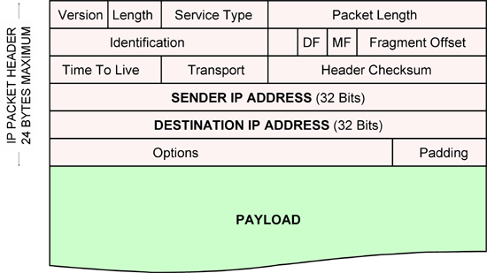
IP Datagram Forwarding
Forwarding table at R2
R2
I-0
I-1
R3
R1
IP data packet (datagram)

Slide 5
IP Datagram Forwarding
Forwarding table at R2
R2
I-0
I-1
R3
R1
Algorithm
if (NetworkNum of destination = NetworkNum of one of my interfaces) then
deliver packet to destination over that interface
else
if (NetworkNum of destination is in my forwarding table) then
deliver packet to NextHop router
else
deliver packet to default router
First: find the NetworkNum. How?

Slide 6
IP Datagram Forwarding
Algorithm
if (NetworkNum of destination = NetworkNum of one of my interfaces) then
deliver packet to destination over that interface
else
if (NetworkNum of destination is in my forwarding table) then
deliver packet to NextHop router
else
deliver packet to default router
For a host with only one interface and only a default router in its forwarding table, this simplifies to
if (NetworkNum of destination = my NetworkNum)then
deliver packet to destination directly
else
deliver packet to default router

Slide 7
Obtaining a Block of Addresses
Internet Corporation for Assigned Names and Numbers (ICANN)
Allocates large blocks to Regional Internet Registries
Regional Internet Registries (RIRs)
E.g., ARIN (American Registry for Internet Numbers)
Allocates to ISPs and large institutions
Internet Service Providers (ISPs)
Allocate address blocks to their customers
Who may, in turn, allocate to their customers…

Slide 8
Obtaining a Block of Addresses
Your organization: XYZ
Maximum # of hosts is estimated to be 10 millions.
What class of IP address will you request for?
Maximum # of hosts is estimated to be 64K ?
Maximum # of hosts is estimated to be 250?
Maximum # of hosts is estimated to be 100?
Maximum # of hosts is estimated to be 20?
Maximum # of hosts is estimated to be 300?
Maximum # of hosts is estimated to be 66K?
Notes:
Class A can have 16 millions (16777214 = 2^24-2)
Class B can have 65K (65534 = 2^16 - 2)
Class C can have 254 (2^8-2)

Slide 9
Problems with the classes of addresses
Wastage of addresses
Bigger tables to look up at routers

Slide 10
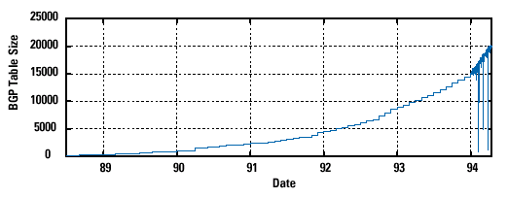
Pre-CIDR (1988-1994): Steep Growth
Growth faster than improvements in equipment capability

Slide 11
Subnetting

Slide 12
The ISP provided the network address space: 223.1.1.X
ISP
Router
223.1.1.1
223.1.1.2
223.1.1.3
223.1.1.4
223.1.1.5
223.1.1.6

Slide 13
The ISP provided the network address space: 223.1.1.X
ISP
223.1.2.X
Router
223.1.3.X
223.1.1.1
223.1.1.2
223.1.1.3
223.1.1.4
223.1.1.5
223.1.1.6

Slide 14
The ISP provided the network address space: 223.1.1.X
Router
Two separate networks are needed. How can we assign addresses to these “sub” networks?

Slide 15
The ISP provided the network address space: 223.1.1.X
Router

Slide 16
The ISP provided the network address space: 223.1.1.X
Router
Use subnetting

Slide 17
The ISP provided the network address space: 223.1.1.X
11011111.00000001.00000001.XXXXXXX
Router
Use part of the host bits to identify separate subnets.

Slide 18
The ISP provided the network address space: 223.1.1.X
11011111.00000001.00000001.XXXXXXX
Router
Use part of the host bits to identify separate subnets.
11011111.00000001.00000001.0XXXXXX
11011111.00000001.00000001.1XXXXXX
Subnet mask = 11111111. 11111111. 11111111.10000000

Slide 19
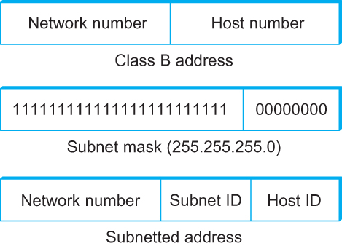
Subnetting
Add another level to address/routing hierarchy: subnet
Subnet masks define variable partition of host part of class A and B addresses
Subnets visible only within site
“Bitwise and”

Slide 20
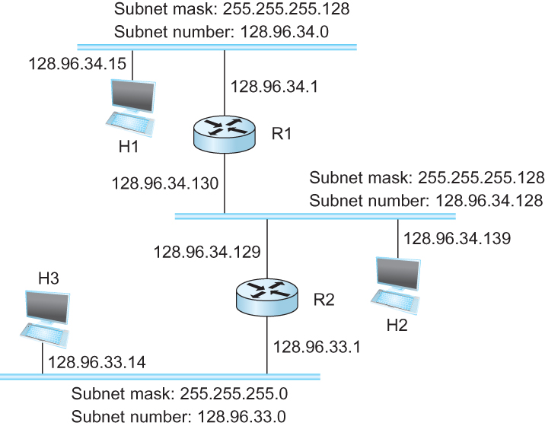
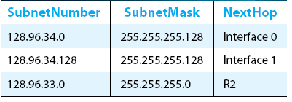
Subnetting
Forwarding Table at Router R1

Slide 21
Subnetting
Forwarding Table at Router R1
Forwarding Algorithm
D = destination IP address
for each entry < SubnetNum, SubnetMask, NextHop>
D1 = SubnetMask & D
if D1 = SubnetNum
if NextHop is an interface
deliver datagram directly to destination
else
deliver datagram to NextHop (a router)

Slide 22
Subnetting
Notes
Would use a default router if nothing matches
Not necessary for all ones in subnet mask to be contiguous
Can put multiple subnets on one physical network
Subnets not visible from the rest of the Internet

Slide 23
Subnets “toy” example

Slide 24
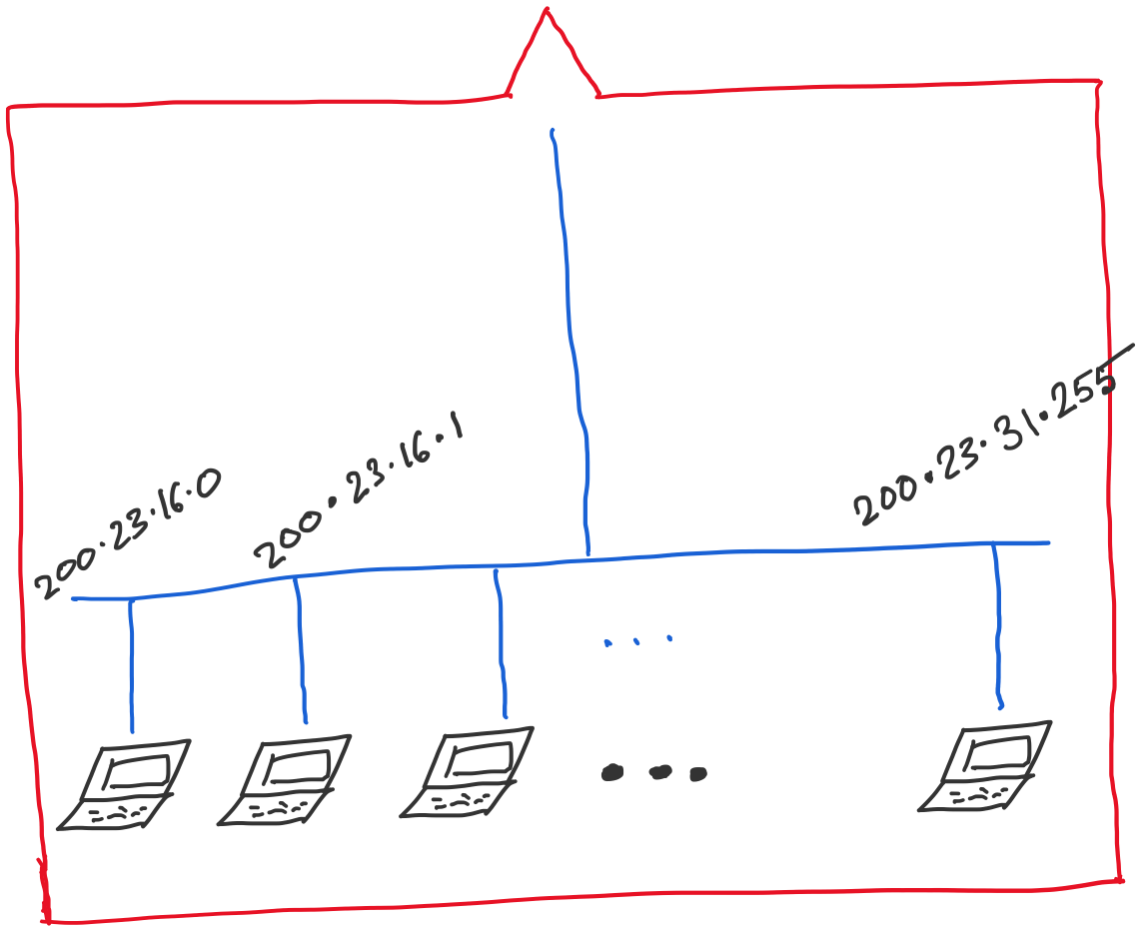
Address space assigned to you:

Slide 25
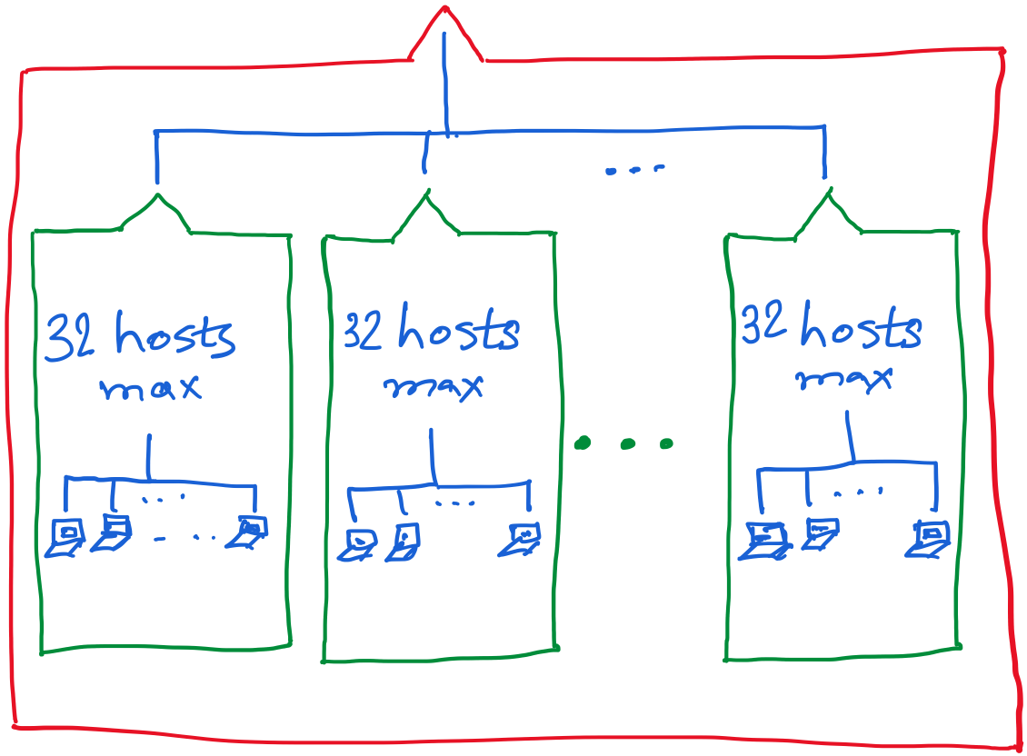
30 hosts max.
22 hosts max.
18 hosts max.

Slide 28
Announcements
In-class Midterm-1 exam: This Thursday. Syllabus is posted.

Slide 29
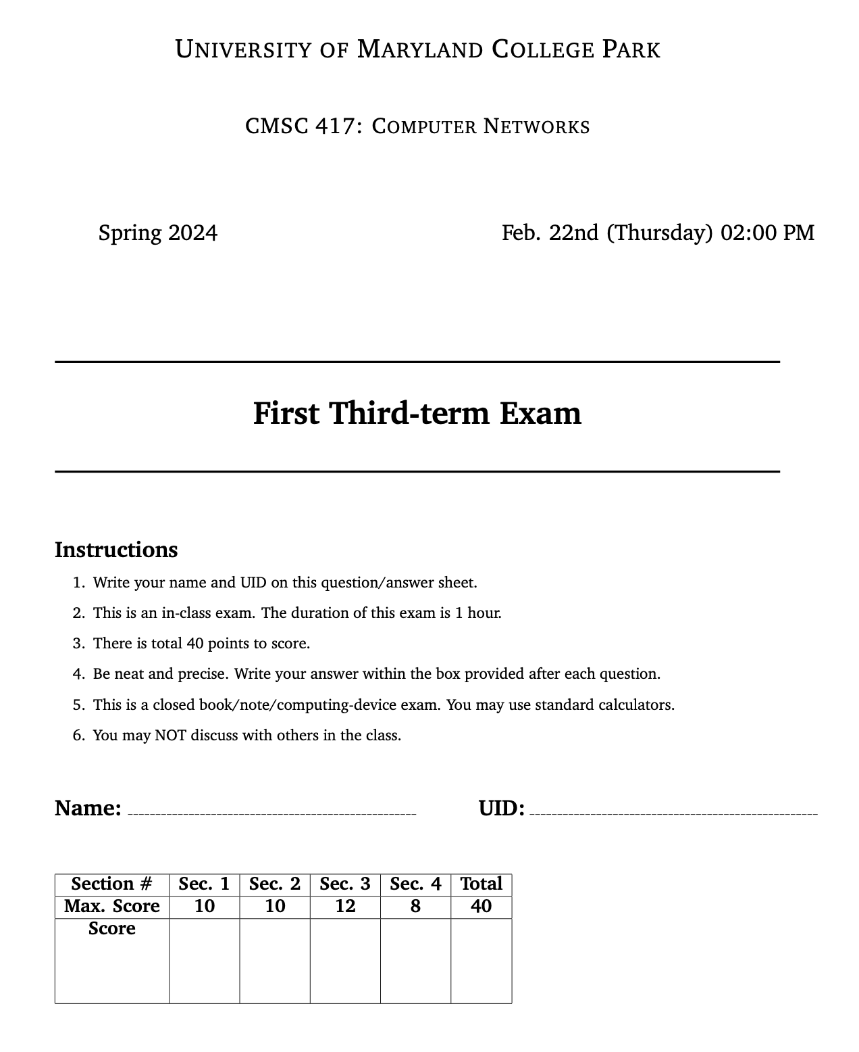

Slide 32
Thank you

Slide 35
Class-less Interdomain Routing (CIDR)
Generalizes the ideas of subnetting

Slide 36
Lessons learned from subnetting
Forwarding tab.
Forwarding tab.
223.1.1.0
223.1.1.0
223.1.2.0
223.1.2.0
223.1.1.0
223.1.3.0
223.1.3.0
ISP
223.1.2.0
223.1.3.0

Slide 37
Lessons learned from subnetting
Forwarding tab.
Forwarding tab.
223.1.1.0
223.1.1.0
223.1.2.0
223.1.2.0
223.1.1.128
223.1.1.0
223.1.3.0
223.1.3.0
223.1.1.192
ISP
223.1.2.0
223.1.3.0

Slide 38
Lessons learned from subnetting
Forwarding tab.
Forwarding tab.
223.1.1.0
223.1.1.0
223.1.2.0
223.1.2.0
223.1.1.128
223.1.1.0
223.1.3.0
223.1.3.0
223.1.1.192
ISP
Lesson 1:
Address classes are not needed. Mask can define the number of bits for network part.
Lesson 2:
Network hierarchies can be hidden from the outside world.
Network addresses can be aggregated/summarized/combined
223.1.2.0
223.1.3.0

Slide 39
CIDR: Classless address

Slide 40
IP addressing: CIDR
CIDR: Classless InterDomain Routing
Network portion of address of arbitrary length
address format: a.b.c.d/x, where x is # bits in subnet portion of address
subnet
part
host
part
11001000 00010111 00010000 00000000
200.23.16.0/23
200.23.16.0–200.23.17.255
This X bit network part is often called Prefix or Network-prefix

Slide 41
IP addressing: CIDR
CIDR: Classless InterDomain Routing
subnet portion of address of arbitrary length
address format: a.b.c.d/x, where x is # bits in subnet portion of address
forwarding table
4.0.0.0/8
4.83.128.0/17
201.10.0.0/21
201.10.6.0/23
126.255.103.0/24

Slide 42
CIDR: Super-netting/ Route aggregation

Slide 43
Lessons learned from subnetting
Forwarding tab.
Forwarding tab.
223.1.1.0/24
223.1.1.0/24
223.1.2.0/24
223.1.2.0/24
223.1.1.0
223.1.3.0/24
223.1.3.0/24
ISP
223.1.0.0/16
223.1.2.0
223.1.3.0

Slide 44
Lessons learned from subnetting
Forwarding tab.
Forwarding tab.
223.1.1.0/24
223.1.0.0/16
223.1.2.0/24
223.1.1.0
223.1.3.0/24
ISP
223.1.0.0/16
223.1.2.0
223.1.3.0

Slide 45
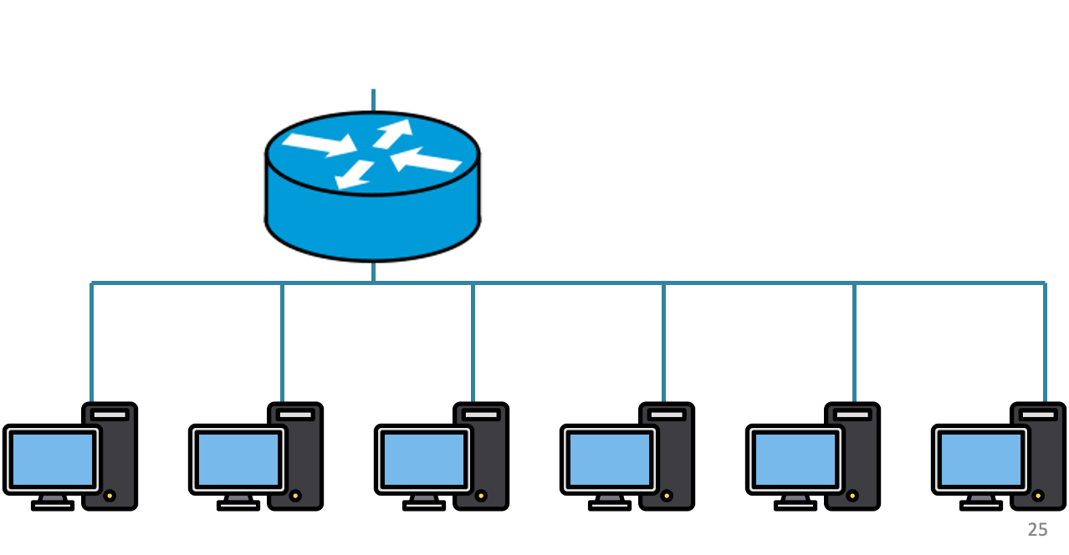
200.20.2.0/24
200.20.3.0/24
200.20.1.0/24

Slide 46
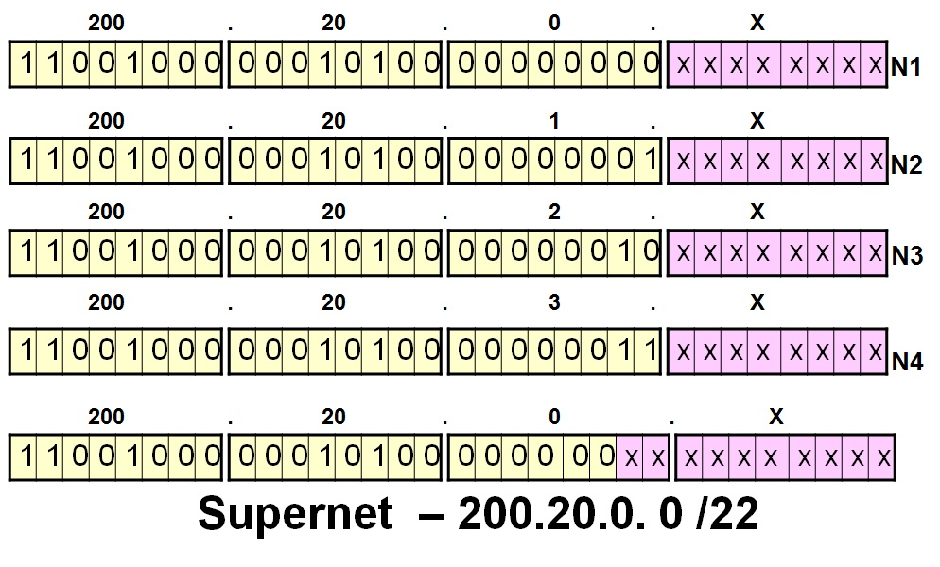
200.20.2.0/24
200.20.3.0/24
200.20.1.0/24

Slide 47
Route aggregation
200.20.2.0/24
200.20.3.0/24
200.20.1.0/24

Slide 48
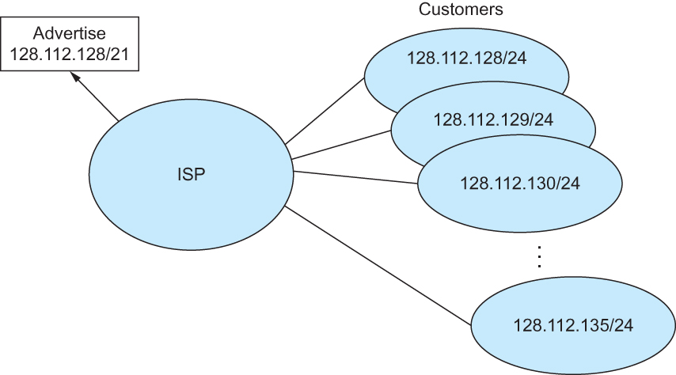
Route aggregation with CIDR

Slide 49
Classless Inter-Domain Routing (CIDR)
Use two 32-bit numbers to represent a network.
Network number = IP address + Mask
IP Address : 12.4.0.0 IP Mask: 255.254.0.0
Address
00001100
00000100
00000000
00000000
Mask
11111111
11111110
00000000
00000000
Network Prefix
for hosts
Written as 12.4.0.0/15

Slide 50
Hierarchical Address Allocation
Hierarchy is key to scalability
Address allocated in contiguous chunks (prefixes)
Today, the Internet has about 400,000 prefixes
12.0.0.0/16
12.1.0.0/16
:
:
:
12.3.0.0/24
12.2.0.0/16
12.3.1.0/24
12.3.0.0/16
:
:
:
:
:
12.0.0.0/8
12.3.254.0/24
12.253.0.0/19
12.253.32.0/19
:
:
12.254.0.0/16
12.253.160.0/19

Slide 51
Separate Forwarding Entry Per Prefix
Prefix-based forwarding
Map the destination address to matching prefix
Forward to the outgoing interface
1.2.3.4
1.2.3.7
1.2.3.156
5.6.7.8
5.6.7.9
5.6.7.212
host
host
...
host
host
host
...
host
LAN 1
LAN
router
router
router
WAN
WAN
1.2.3.0/24
5.6.7.0/24
forwarding table

Slide 52
CIDR Makes Packet Forwarding Harder
201.10.0.0/21
Provider 1
201.10.0.0/22
201.10.4.0/24
201.10.5.0/24
201.10.6.0/23

Slide 53
CIDR Makes Packet Forwarding Harder
201.10.0.0/21
Provider 1
Provider 2
Multi-homing
201.10.0.0/22
201.10.4.0/24
201.10.5.0/24
201.10.6.0/23

Slide 54
CIDR Makes Packet Forwarding Harder
Forwarding tab.
201.10.0.0/21
Provider 1
Provider 2
Multi-homing
201.10.0.0/22
201.10.4.0/24
201.10.5.0/24
201.10.6.0/23

Slide 55
CIDR Makes Packet Forwarding Harder
Forwarding tab.
201.10.0.0/21
201.10.6.0/23
201.10.0.0/21
Provider 1
Provider 2
Multi-homing
201.10.0.0/22
201.10.4.0/24
201.10.5.0/24
201.10.6.0/23

Slide 56
CIDR Makes Packet Forwarding Harder
Forwarding table
201.10.0.0/21
11001001.00001010.00000000.00000000/21
201.10.6.0/23
11001001.00001010.00000110.00000000/23
A packet with dest. Addr.: 201.10.6.17
11001001.00001010.00000110.00010001

Slide 57
CIDR Makes Packet Forwarding Harder
Forwarding table may have many matches
E.g., entries for 201.10.0.0/21 and 201.10.6.0/23
The IP address 201.10.6.17 would match both!
201.10.0.0/21
Provider 1
Provider 2
201.10.0.0/22
201.10.4.0/24
201.10.5.0/24
201.10.6.0/23

Slide 58
Longest Prefix Match Forwarding
Destination-based forwarding
Packet has a destination address
Router identifies longest-matching prefix
Cute algorithmic problem: very fast lookups
forwarding table
4.0.0.0/8
4.83.128.0/17
201.10.0.0/21
201.10.6.0/23
126.255.103.0/24
destination
201.10.6.17
outgoing link

Slide 59
Getting an IP address: DHCP Protocol

Slide 60
IP addresses: how to get one?
Q: How does a host get IP address?
hard-coded by system admin in a file
Windows: control-panel->network->configuration->tcp/ip->properties
UNIX: /etc/…
DHCP: Dynamic Host Configuration Protocol: dynamically get address from a server
“plug-and-play”

Slide 61
DHCP: Dynamic Host Configuration Protocol
goal: allow host to dynamically obtain its IP address from network server when it joins network
can renew its lease on address in use
allows reuse of addresses (only hold address while connected/“on”)
support for mobile users who want to join network

Slide 62
DHCP: Dynamic Host Configuration Protocol
DHCP overview:
host broadcasts “DHCP discover” msg
DHCP server responds with “DHCP offer” msg
host requests IP address: “DHCP request” msg
DHCP server sends address: “DHCP ack” msg

Slide 63
DHCP client-server scenario
DHCP
server
223.1.1.0/24
223.1.1.1
223.1.2.1
223.1.1.2
arriving DHCP
client needs
address in this
network
223.1.1.4
223.1.2.9
223.1.3.27
223.1.2.2
223.1.1.3
223.1.2.0/24
223.1.3.1
223.1.3.2
223.1.3.0/24

Slide 64
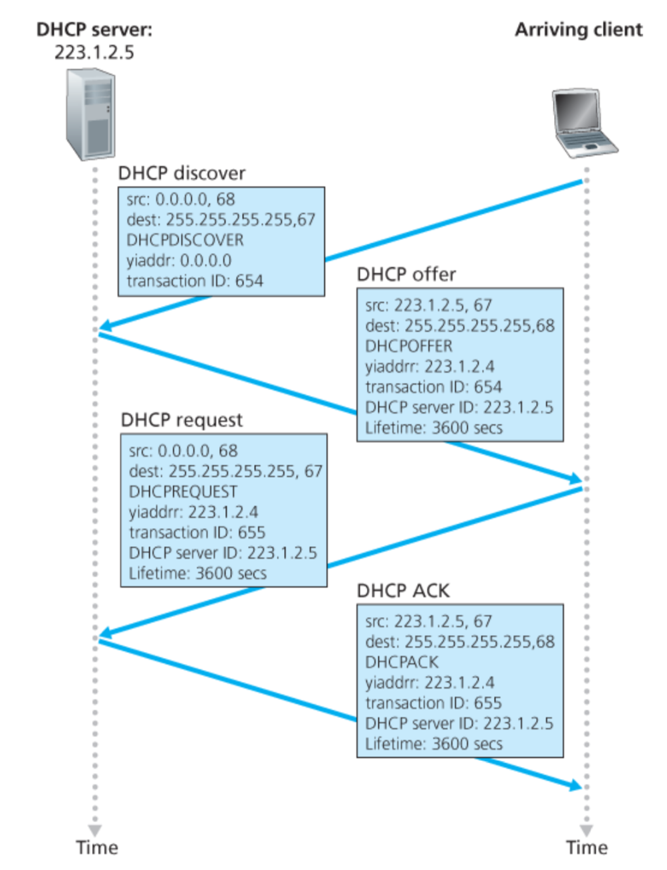
Broadcast: is there a DHCP server out there?

Slide 65
A note on the “broadcast address”

Slide 66
inet 10.104.216.101 ➔ 00001010.01101000.11011000.01100101
netmask ff:ff:f0:00 ➔ 11111111.11111111.11110000.00000000
broadcast 10.104.223.255 ➔
00001010.01101000.11011111.11111111

Slide 67
Broadcast: is there a DHCP server out there?
Broadcast: I’m a DHCP server! Here’s an IP address you can use
Broadcast: OK. I’ll take that IP address!
Broadcast: OK. You’ve got that IP address!

Slide 68
Broadcast: is there a DHCP server out there?
Broadcast: I’m a DHCP server! Here’s an IP address you can use
Broadcast: OK. I’ll take that IP address!
Broadcast: OK. You’ve got that IP address!

Slide 69
Broadcast: is there a DHCP server out there?
Broadcast: I’m a DHCP server! Here’s an IP address you can use
Broadcast: OK. I’ll take that IP address!
Broadcast: OK. You’ve got that IP address!

Slide 70
Broadcast: is there a DHCP server out there?
Broadcast: I’m a DHCP server! Here’s an IP address you can use
Broadcast: OK. I’ll take that IP address!
Broadcast: OK. You’ve got that IP address!

Slide 71
Broadcast: is there a DHCP server out there?
Broadcast: I’m a DHCP server! Here’s an IP address you can use
Broadcast: OK. I’ll take that IP address!
Broadcast: OK. You’ve got that IP address!

Slide 72
Broadcast: is there a DHCP server out there?
Broadcast: I’m a DHCP server! Here’s an IP address you can use
Broadcast: OK. I’ll take that IP address!
Broadcast: OK. You’ve got that IP address!

Slide 73
Broadcast: is there a DHCP server out there?
Broadcast: I’m a DHCP server! Here’s an IP address you can use
Broadcast: OK. I’ll take that IP address!
Broadcast: OK. You’ve got that IP address!

Slide 74
Broadcast: is there a DHCP server out there?
Broadcast: I’m a DHCP server! Here’s an IP address you can use
Broadcast: OK. I’ll take that IP address!
Broadcast: OK. You’ve got that IP address!

Slide 75
Broadcast: is there a DHCP server out there?
Broadcast: I’m a DHCP server! Here’s an IP address you can use
Broadcast: OK. I’ll take that IP address!
Broadcast: OK. You’ve got that IP address!

Slide 76
Broadcast: is there a DHCP server out there?
Broadcast: I’m a DHCP server! Here’s an IP address you can use
Broadcast: OK. I’ll take that IP address!
Broadcast: OK. You’ve got that IP address!

Slide 77
Broadcast: is there a DHCP server out there?
Broadcast: I’m a DHCP server! Here’s an IP address you can use
Broadcast: OK. I’ll take that IP address!
Broadcast: OK. You’ve got that IP address!

Slide 78
Broadcast: is there a DHCP server out there?
Broadcast: I’m a DHCP server! Here’s an IP address you can use
Broadcast: OK. I’ll take that IP address!
Broadcast: OK. You’ve got that IP address!

Slide 79
Broadcast: is there a DHCP server out there?
Broadcast: I’m a DHCP server! Here’s an IP address you can use
Broadcast: OK. I’ll take that IP address!
Broadcast: OK. You’ve got that IP address!

Slide 80
Broadcast: is there a DHCP server out there?
Broadcast: I’m a DHCP server! Here’s an IP address you can use
Broadcast: OK. I’ll take that IP address!
Broadcast: OK. You’ve got that IP address!

Slide 81
Broadcast: is there a DHCP server out there?
Broadcast: I’m a DHCP server! Here’s an IP address you can use
Broadcast: OK. I’ll take that IP address!
Broadcast: OK. You’ve got that IP address!

Slide 82
DHCP: more than IP addresses
DHCP can return more than just allocated IP address on subnet:
address of first-hop router for client
name and IP address of DNS sever
network mask (indicating network versus host portion of address)

Slide 83
Dynamic Host Configuration Protocol (DHCP)
DHCP server is responsible for providing configuration information to hosts
DHCP server maintains a pool of available addresses
There is at least one DHCP server for an administrative domain (a server or a relay agent per subnet)

Slide 84
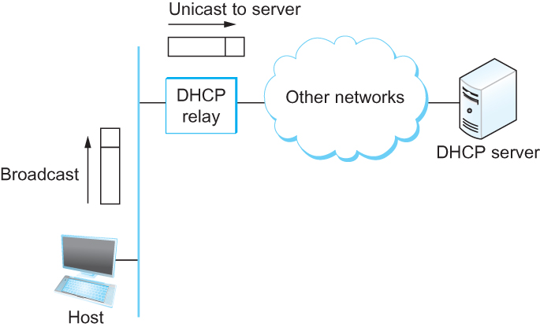
DHCP relay
Newly booted or attached host sends DHCPDISCOVER message to a special IP address (255.255.255.255)
DHCP relay agent unicasts the message to DHCP server and waits for the response

Slide 85
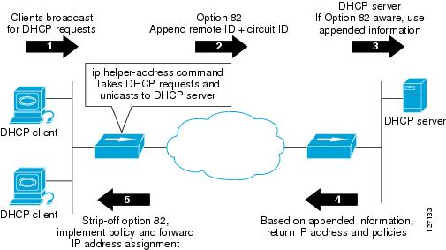
DHCP relay

Slide 86
Check our IP addresses
(ifconfig/ipconfig)

