Slide 1
The End of Denial Architecture and The Rise of Throughput Computing
Bill Dally
Chief Scientist & Sr. VP of Research, NVIDIA
Bell Professor of Engineering, Stanford University
May 21, 2009
University of Maryland
CUDA Center of Excellence

Slide 2
Outline
Performance = Parallelism
Efficiency = Locality
Single-thread processors are in denial about these two facts
We are entering the era of Throughput Computing
Stream Processors
  Parallel arithmetic units
  Exposed storage hierarchy
Stream Programming
  Bulk operations
GPU Computing

Slide 3
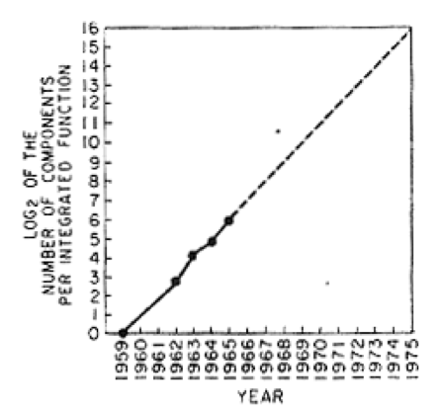
Moore’s Law
In 1965 Gordon Moore predicted the number of transistors on an integrated circuit would double every year.
  Later revised to 18 months
Also predicted L³ power scaling for constant function
No prediction of processor performance
Advanceds in architecture turn device scaling into performance scaling
Moore, Electronics 38(8) April 19, 1965

Slide 4
The Computer Value Chain
Moore’s law gives us more transistors
Architects turn these transistors into more performance
Applications turn this performance into value for the user

Slide 5
Discontinuity 1
The End of ILP Scaling
52%/year
ps/gate 19%
Gates/clock 9%
Clocks/inst 18%
19%/year
Dally et al. The Last Classical Computer, ISAT Study, 2001
Notes:
Over the past 20 years (and in fact since the first microprocessor in 1971), microprocessor performance has been improving at a rate of approximately 52% per year. This exponential increase in performance has come from three sources: (1) improvements in clock rates from innovations in silicon processing technology that have made transistors smaller and faster – 19%/year, (2) improvements in clock rates resulting from deepening pipelines and reducing the number of levels of logic per clock – 9%, and (3) improvements in microarchitectures including multi-instruction issue and out-of-order execution – 18%. Modern designs have nearly exhausted the benefits of pipelining, and conventional architectures are struggling to sustain even one instruction per cycle. Without further innovations, performance improvements will at best only match the rate of improvement due to further process technology innovations, which is projected to continue at 19% per year.
This chart depicts this trend by graphing performance measured in picoseconds/instruction. Thus, improved performance is signified by a lower value in the chart. Note also that the y-axis is on a logarithmic scale.

Slide 6
Future potential of novel architecture is large (1000 vs 30)
52%/year
19%/year
30:1
74%/year
1,000:1
30,000:1
Dally et al. The Last Classical Computer, ISAT Study, 2001
Notes:
While microprocessors have sustained performance improvements of 52%/year, fabrication technology has actually provided a much higher growth rate in potential capability. When accounting for increased transistor counts and faster transistor switching speeds, the capability of microprocessor-scale integrated circuits has been improving at 74%/year. Until now, the differential between the 74% and 52% rates has resulted in only a factor of 30 of untapped performance potential. However, with only 19% per year projected in the future, the differential is expected to increase to a factor of 30,000 by 2020. This quantity represents a tremendous opportunity for novel architectures to help bridge the performance gap and to enable future computer systems to solve increasingly complex and important problems.

Slide 7
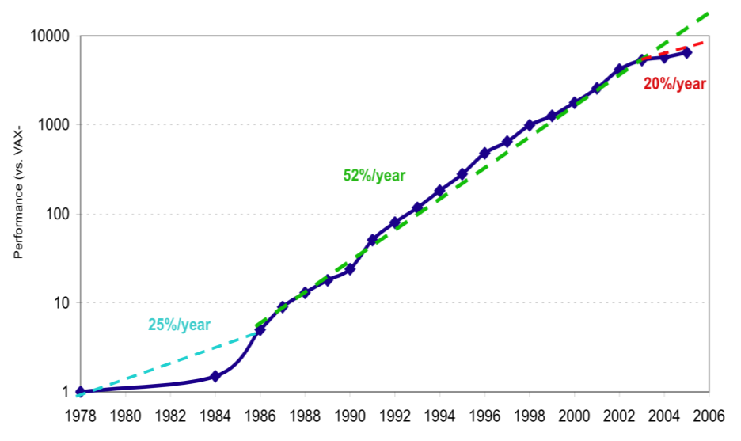
Single-Thread Processor Performance vs Calendar Year
Source: Hennessy & Patterson, CAAQA, 4th Edition

Slide 8
Technology Constraints

Slide 9
CMOS Chip is our Canvas
20mm

Slide 10
4,000 64b FPUs fit on a chip
64b FPU
0.1mm²
50pJ/op
1.5GHz
20mm
Notes:
1000 FPUs
If you run all at 1.4GHz this is 70W and 1.4TOPS

Slide 11
200,000 16b MACs fit on a chip
64b FPU
0.1mm²
50pJ/op
1.5GHz
16b MAC
0.002mm²
1pJ/op
1.5GHz
20mm
.
Notes:
50,000 MACs
At 1.4mW each - still 70W now 70TOPs

Slide 12
Moving a word across die = 124MACs, 10FMAs
Moving a word off chip = 250 MACs, 20FMAs
64b FPU
0.1mm²
50pJ/op
1.5GHz
16b MAC
0.002mm²
1pJ/op
1.5GHz
20mm
.
64b 1mm
Channel
25pJ/word
16b 1mm
Channel
6pJ/word
10mm 250pJ, 4cycles
10mm 62pJ, 4cycles
64b Off-Chip
Channel
1nJ/word
16b Off-Chip
Channel
250pJ/word
64b Floating Point
16b Fixed Point
Notes:
Across die here means 20mm – along one edge – 20mm = 500pJ = 10 FMAs
Corner to corner (32mm) is 16FLOPs
Off chip is 20 FLOPS
Corner to corner is 200 MACs, off chip is 250
Off chip is

Slide 13
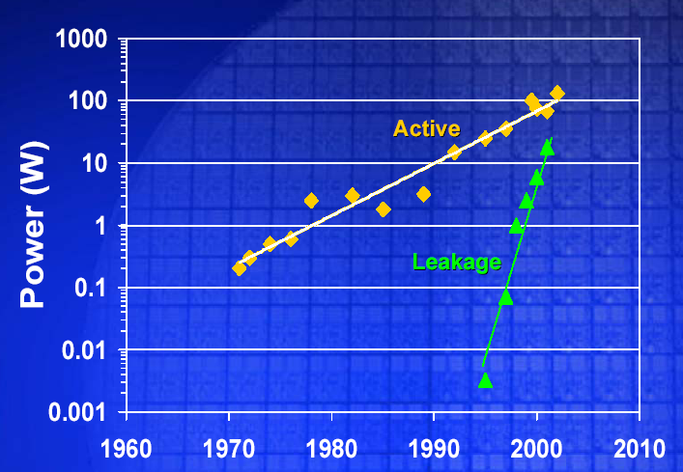
Discontinuity 2
The End of L³ Power Scaling
Gordon Moore, ISSCC 2003

Slide 14
Performance = Parallelism
Efficiency = Locality

Slide 15
The End of Denial Architecture
Single thread processors are in denial about parallelism and locality
They provide two illusions:
Serial execution
  Denies parallelism
  Tries to exploit parallelism with ILP – limited scalability
Flat memory
  Denies locality
  Tries to provide illusion with caches – very inefficient when working set doesn’t fit in the cache

Slide 16
We are entering the era of
Throughput Computing

Slide 17
Throughput computing is what matters now
Latency optimized processors (most CPUs) are improving very slowly
  Little value is being delivered from the evolution of these processors
Throughput optimized processors (like GPUs) are still improving at >70% per year
  This drives new throughput applications that convert this performance to value
Going forward throughput processors matter, not latency processors

Slide 18
Applications

Slide 19
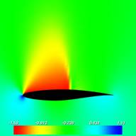

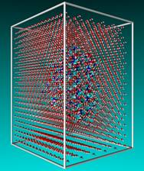
Scientific Applications
Large data sets
  Lots of parallelism
Increasingly irregular (AMR)
  Irregular and dynamic data structures
  Requires efficient gather/scatter
Increasingly complex models
  Lots of locality
Global solution sometimes bandwidth limited
  Less locality in these phases

Slide 20
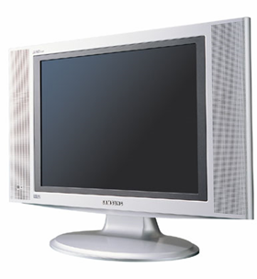
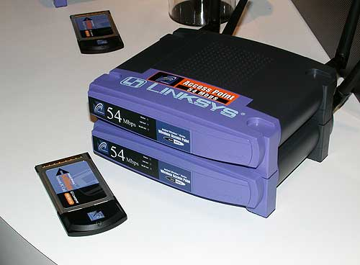

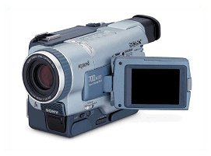

Embedded Applications
Codecs, modems, image processing, etc…
Lots of data (pixels, samples, etc…)
  Lots of parallelism
Increasingly complex
  Lots of parallelism
  Lots of data dependent control
High arithmetic intensity
  Lots of locality

Slide 21
Performance = Parallelism
Efficiency = Locality
Fortunately, most applications have lots of both.
Amdahl’s law doesn’t apply to most future applications.

Slide 22
Stream Processor Architecture

Slide 23
Optimize use of scarce bandwidth
Global Memory
Switch
LM
CM
Switch
RM
RM
RM
Switch
Switch
Switch
R
R
R
R
R
R
R
R
R
A
A
A
A
A
A
A
A
A
Provide rich, exposed storage hierarchy

Slide 24
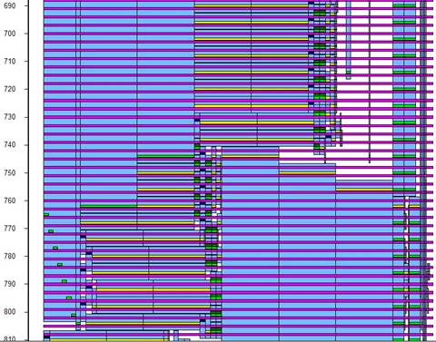
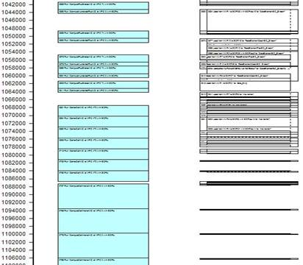
Optimize use of scarce bandwidth
Provide rich, exposed storage hierarchy
Explicitly manage data movement on this hierarchy
  Reduces demand, increases utilization

Slide 25
Predictability enables efficient static scheduling
0
0
10
20
10
30
40
50
20
60
70
30
80
90
100
40
110
120
20
50
30
40
60
50
60
70
70
80
90
100
80
110
120
90
20
30
40
100
50
60
70
110
80
90
100
120
110
120

Slide 26
Summary so far
Arithmetic is cheap, bandwidth is expensive
  Performance = parallelism
  Efficiency = Locality
  And most applications have lots of both
Optimize use of scarce bandwidth
  Rich, exposed storage hierarchy
  Explicit, bulk transfers
  Reduces demand, increases utilization
  Enables more arithmetic and predictable execution

Slide 27
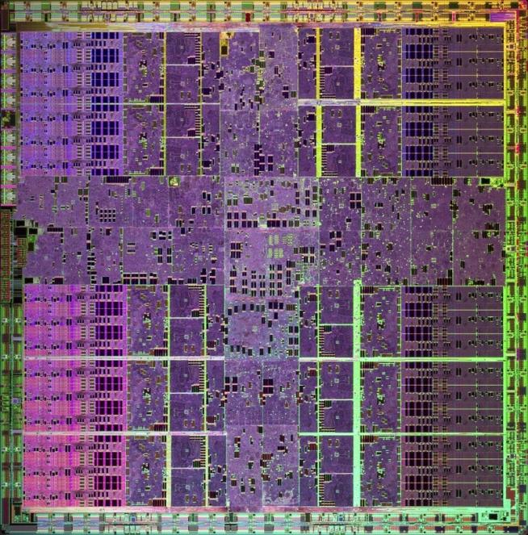
A CUDA-Enabled GPU is
The Ultimate Throughput Computer
GeForce GTX 280 / Tesla T10
240 scalar processors
  30SMs x 8 each
> 1TFLOPS peak
Exposed, hierarchical memory
10-200x performance & efficiency
of a latency-optimized processor

Slide 28
GPU Throughput Computer
GeForce GTX 280 / Tesla T10
Fixed Function Acceleration
Memory & I/O
Communication Fabric

Slide 29
CUDA as a Stream Language
Explicit control of the memory hierarchy with shared memory
  __shared__ float a[SIZE] ;
Also enables communication between threads of a CTA
Transfer data up and down the hierarchy
Operate on data with kernels
But does allow access to arbitrary data within a kernel

Slide 30


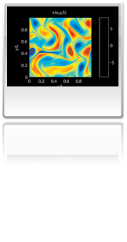

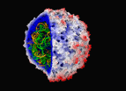
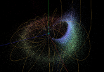
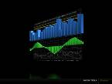
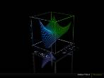



Examples
146X
36X
19X
17X
100X
Interactive visualization of volumetric white matter connectivity
Ionic placement for molecular dynamics simulation on GPU
Transcoding HD video stream to H.264
Fluid mechanics in Matlab using .mex file CUDA function
Astrophysics N-body simulation
149X
47X
20X
24X
30X
Financial simulation of LIBOR model with swaptions
GLAME@lab: an M-script API for GPU linear algebra
Ultrasound medical imaging for cancer diagnostics
Highly optimized object oriented molecular dynamics
Cmatch exact string matching to find similar proteins and gene sequences
Notes:
All results here are speedups reported by non-NVIDIA folks over their own mature optimized CPU codes. In some sense it doesn’t matter whether these speedups are due to better hardware, better programming model (CUDA is easier than SSE), or what kind of CPU is being compared too – this is what external scientists and engineers *experience* when they port their own code to CUDA. The exception is the Matlab plugin, but note that we didn’t modify the code – this is straight off a class web site at U. Washington, accelerated without modification by using Massimiliano’s MEX plugin. In short: these are not NVIDIA demos, coded up by NVIDIA dwarves in our dungeons. I like to say these are ”åreal speedups achieved by real people on real problems”.Clockwise from upper left:
biomedical imaging (MRI) at Utah. Won-Ki Jeong, P. Thomas Fletcher, Ran Tao, and Ross T. Whitaker, University of Utah.
VMD cionize ion placement tool. 240x is the best they’ve observed and 110x is the more conservative number they went with in: J. Stone, J. Phillips, D. Hardy, P. Freddolino, L. Trabuco, K. Schulten. “Accelerating molecular modeling applications with graphics processors,” Journal of Computational Chemistry, Vol. 28, No. 16 , pp 2618 – 2640, 25 Sep 2007. I think this 36x is whole-app performance from the latest and greatest version in a recent paper.
H.264 transcode (think blu-ray to ipod) in the "Badaboom" product by Elemental. This is iTunes on the CPU and badaboom on the GPU. A few different GPU and CPU configs were tested.
Matlab fluid mechanics code – a spectral solver for a vorticity-turbulence simulation I believe – accelerated transparently via M’s MEX plugins that call CUFFT instead of MATLAB’s built-in FFT routines.
nbody astrophysics - “High-Performance Direct Gravitational N-body Simulations on Graphics Processing Units” by E.P.J. van den Heuvel (presentation).
See also e.g. R. G. Belleman, J. Bédorf and S. F. Portegies, “High Performance Direct Gravitational N-body Simulations on Graphics Processing Units II: An implementation in CUDA,” arXiv:0707. 0438v2 [astro-ph], Jul 2007 (Accepted to New Astronomy).
CMATCH gene sequence matching: “Fast Exact String Matching on the GPU”, Michael C. Schatz, Cole Trapnell (presentation)
HOOMD is another major molecular dynamics code (like NAMD/VMD). "General Purpose Molecular Dynamics Simulations Fully Implemented on Graphics Processing Units” by Joshua A. Anderson, Chris D. Lorenz, and A. Travesset.
See http://www.techniscanmedicalsystems.com
GLAME@lab is an extension of the Formal Linear Algebra Methods Environment (FLAME) for MATLAB's M-script language, implemented on top of CUBLAS. GLAME@lab: An M-script API for Linear Algebra Operations on Graphics Processors Sergio Barrachina, Maribel Castillo, Francisco D. Igual, Rafael Mayo, Enrique S. Quintana-Ort´ı . February 2008, Universidad Jaime I, Castellon, Spain.
Computational finance paper by Mike Giles and Su Xiaoke, Oxford.
Not on this slide but I like to show sometimes
Speeding up advanced (non-Cartesian) MRI reconstruction 13x through work at UIUC. Heart = marketing image. Oval images show why you care. Top image is traditional MRI reconstruction of noisy data - 47% error. Bottom is advanced non-Cartesian reconstruction – 16% error. But advanced recon is too slow for clinical use: Quadcore CPU takes 23 minutes. A GPU takes 99 seconds. The 13x faster is whole-application, the 457x is for one of the bottleneck kernels they ported. This is from paper: S. Stone, J. Haldar, S. Tsao, W. Hwu, Z. Liang, B. Sutton. “Accelerating Advanced MRI Reconstructions on GPUs”, ACM Frontiers in Computing, Ischia, Italy, 2008.

Slide 31
Conclusion

Slide 32
The Road Ahead
20x improvement in GPU performance by 2015
<2x improvement in CPU performance by 2015
  Most of the value delivered to end user comes from the GPU, the throughput computer
But not all things scale at the same rate
  Memory bandwidth scales by <5x
  Energy per bit-mm on chip nearly constant
  Energy per op only improves by 5x
  Each of these presents an interesting challenge

Slide 33
Conclusion – Parallelism and Locality for efficient computation
Denial architecture is at an end
We are entering an era of Throughput Computing
  Heterogeneous computers
  Value comes from Throughput Applications running on Throughput Processors (like a GPU)
Performance = parallelism, Efficiency = locality
  Applications have lots of both
Stream processing
  Many ALUs exploit parallelism
  Rich, exposed storage hierarchy enables locality
  Simple control and synchronization reduces overhead
Stream programming - explicit movement, bulk operations
  Enables strategic optimization
  Exposes parallelism and locality
Result: performance and efficiency
  TOPs on a chip
  20-30x efficiency of conventional processors.
  Performance portability
GPUs are the ultimate stream processors

