Slide 1
Visualizing Temporal Evolution of Networks
Jae-wook Ahn, Awalin Sopan,
Catherine Plaisant, Meirav Taieb-maimon, and Ben Shneiderman
{jahn,awalin,plaisant,ben}@cs.umd.edu; meiravta@bgu.ac.il
Human Computer Interaction Lab
University of Maryland

Slide 2
Goals
Visually represent temporal changes of networks
Understand the meaning of the changes
Infer the cause and the results of the phenomena
Support the evaluation of Success
What are the temporal pattern of the changes?
Why does the pattern appear?

Slide 3
What to Visualize?
Nation of Neighbors
Collaboration with a social community service
http://www.nationofneighbors.com
Temporal evolution of social activities
Conversation (Post & Reply network)
Crime report
Invitation network to the service
Additional variables for inferential analysis

Slide 4
NoN Activities Example
Total number of conversations per community (Cumulative)
Killian Pines (FL)
Greater Round Rock West Neighborhood Association (TX)
Duncan St. Neighborhood (CA)
Watch Jefferson County (WV)
Time

Slide 5
How to Visualize?
Highlight temporal changes
Additions & deletions
Network metrics
Three Tools to Show Time Differences
NodeXL
TempoVis
ManyNets

Slide 6
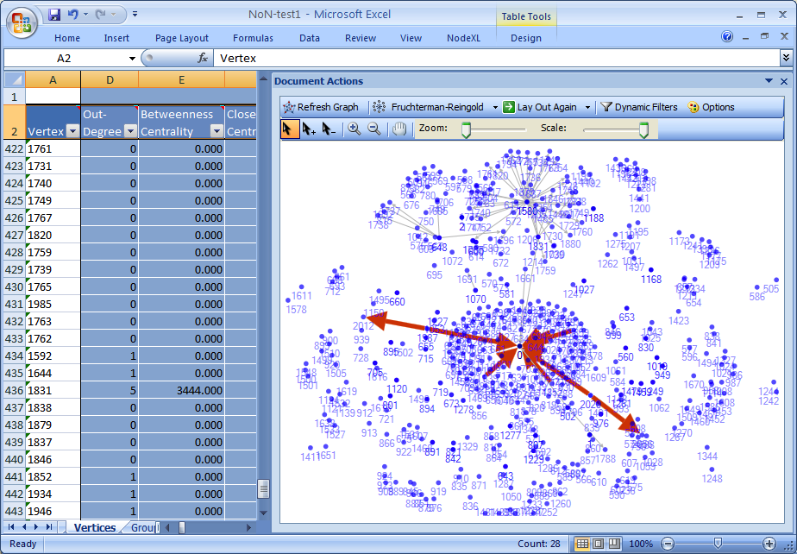
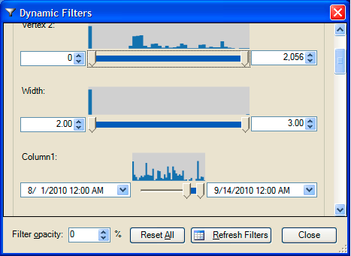
NodeXL www.codeplex.com/nodexl
NoN Invitation Network

Slide 7
TempoVis
Combines node/link diagram + timeline visualizations
Navigation with a “Time Slider”
Marquee-selection of sub-groups
Shows addition and aging of node/links

Slide 8
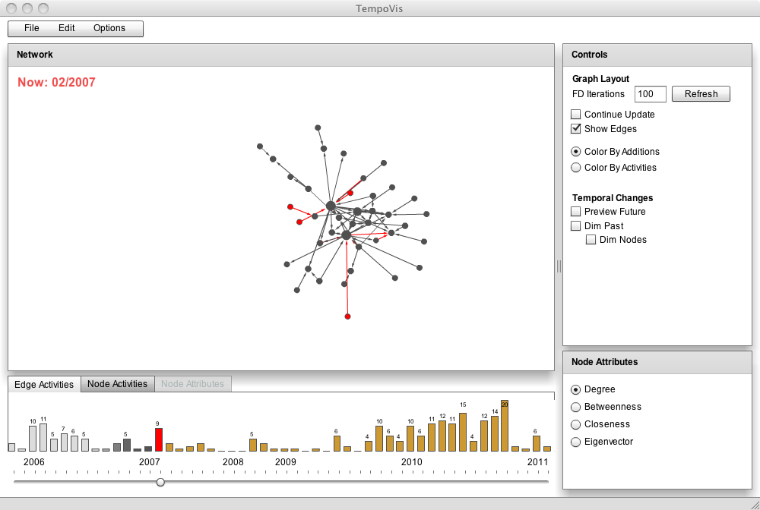

Slide 9
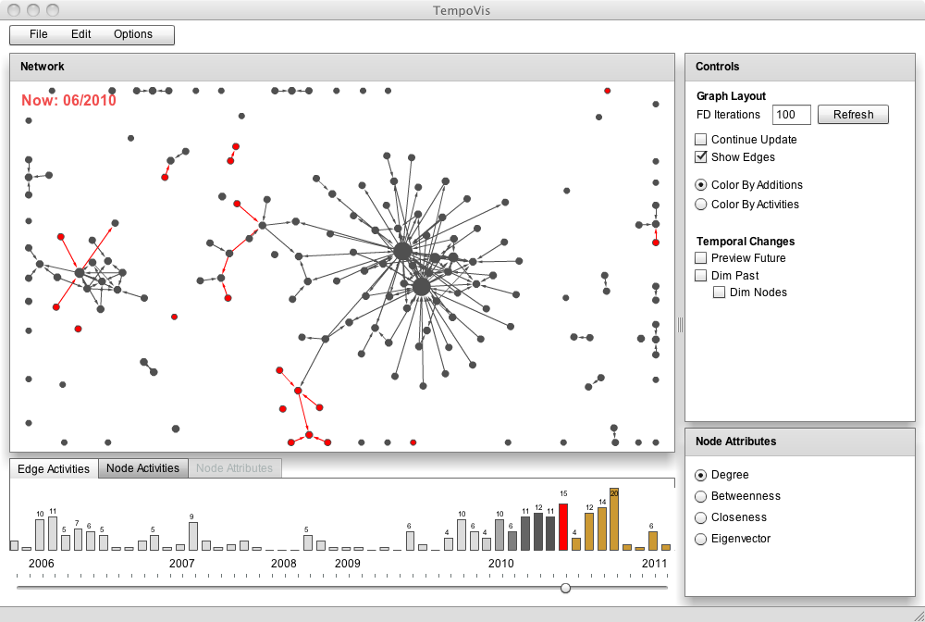

Slide 10
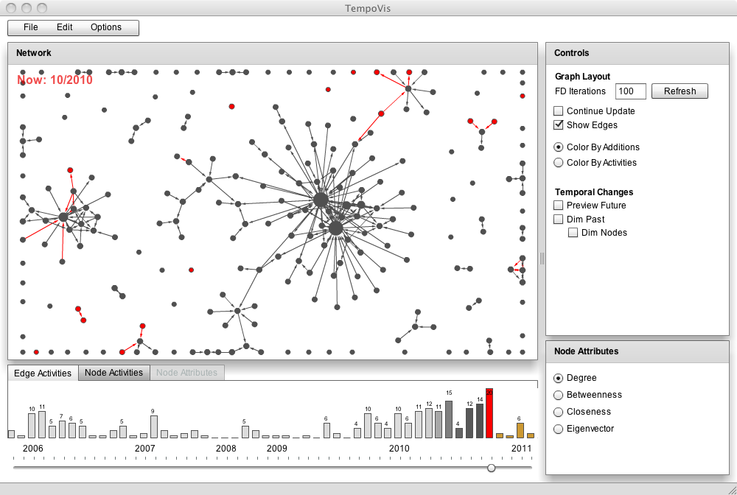

Slide 11
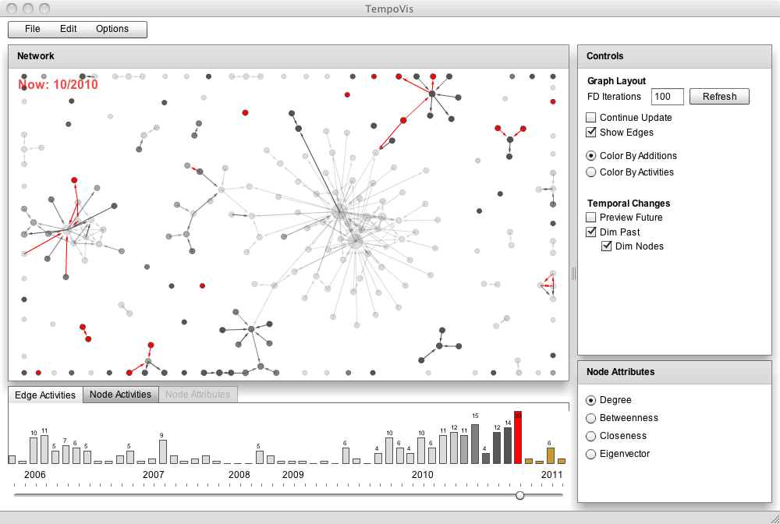

Slide 12
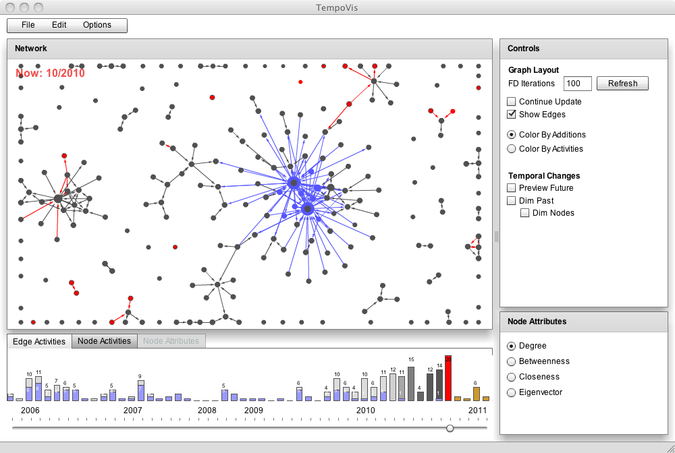

Slide 13
ManyNets
Visualize many networks simultaneously

Slide 14
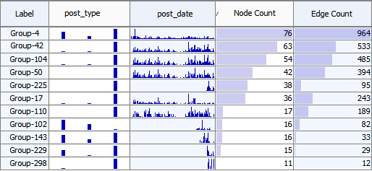
ManyNets
Post Reply Report
Notes:
Tabular visualization of network
Each row represents a network
Columns represent network statistics:
Node count
Edge count
Distribution of values:
Distribution over time: activity date spread over a time span
Distribution over nodes : degree of each node
Distribution of categorical attribute: Types of activity in the network

Slide 15
Overview: Activeness and Growth
Watch-Jefferson County
communities
2005 2011
11 76
Activity over time
Node

Slide 16
Split Network by Time
Post Reply Report
More reports

Slide 17
ManyNets Features
Quick overview of networks
Analyze activity patterns over time
Identify groups and outliers
Identify similar communities

Slide 18
Take Away Message
Temporal network visualization
Social network (e.g. NoN) data
Goals
Visually represent temporal changes of networks
Understand the meaning of the changes
Three visualization tools → Different benefits!
Notes:
Download manynets …

Slide 19
Acknowledgements
ManyNets development
Manuel Freire
NodeXL
Microsoft External Research
Support
National Science Foundation grant IIS0968521
National Science Foundation-Computing Research Association Computing Innovation Fellow
Lockheed Martin
Comments & Feedbacks
Nation of Neighbors team, Art Hanson, Derek Hansen, Mark Smith, Adam Perer, PJ Rey, and Alan Neustadtl
http://www.cs.umd.edu/hcil/NON

