Slide 1
The Promise and Folly of a Unitary Doctoral Curriculum for an Information School
Jeffrey Stanton, Syracuse University

Slide 2
Define Unitary Curriculum
Unitary: Having a quality of oneness; aiming toward unity; having an indivisible nature
Unitary doctoral curriculum: An integrated and coherent course of doctoral study bearing marked similarities across institutions, students, and time

Slide 3
The Promise
Intellectual coherence that would promote sharing and growth (conferences, IP development, publications, mentoring, etc.)
Chaos reduction in recruiting and admissions (for student applicants and faculty evaluators)
Clearer paths from doctoral study to careers
A common brand identity to present to the rest of the university, research and practice communities, funders, and the general public

Slide 4
The Folly
Interdisciplinarity may be diametrically opposed to unification
If there is a “field” of information, it is far too young to support consensus on doctoral education goals
Too many influences, disciplines, backgrounds, perspectives for any normal mortal to absorb them all in 4-5 years
Even “mature” disciplines like sociology have splintering and fractionation in doctoral ed
Individual iSchools may have a stronger interest in brand differentiation than brand coherence

Slide 5
Carnegie Initiative on the Doctorate
Defining doctoral program goals…
“…the task of ‘creating a mission statement with explicit goals’ smacks of recent accountability movements in education that are perceived as efforts to curb academic autonomy”
“One promising strategy… ask faculty and students to… construct an image of a prototypical Ph.D. recipient”

Slide 6
CID Approach at Syracuse I
…would have developed an understanding of the concept of information and have experience in actively probing its cause and effect at some level of reality, be it resource, human, organization, institution, or society
…would conduct multidisciplinary research
…would have insatiable curiosity
…would have professional experience. And, the typical iSchool PhD recipient would rather there were some clarity at the discipline level
…would seamlessly interact with a variety of technical and managerial types and bring tangible value from information processes and systems thus contributing to making the world a better place
…would be able smoothly to build professional skills needed in her workplace and to collaborate with her future colleagues
…would always have one eye focused on the user

Slide 7
CID Approach at Syracuse II
…would be phenomena oriented, drawing to this an educational and experiential background that spans disciplines and draws on two or more distinct perspectives. The best students would be known for deep insight into particular phenomena and be known for their ability to draw on several relevant literatures in ways that enrich science and society's understanding
…would ideally be a master at examining information related phenomena; practically, be a master of his/her domain of research interest; professionally, be competing with MIS students from business schools; emotionally, be drained from the rigors of the program; and wishfully, be optimistic and excited about the future of a blooming field
would be tired but proud of their accomplishment, still passionate about making a difference, excited about the future, and committed to education, research and writing
Notes:
Nothing intrinsically contradictory in these visions, although it is still a long leap to curriculum decisions.

Slide 8
Common Threads
Information as phenomena that “occur” across multiple levels of other constructs/concepts
Scientific research as a practical activity that makes the world a better place
Boundary spanners between science and those who solve problems with information
Collaborators who take action in concert with other professionals

Slide 9
Boulder Conference on Graduate Education (1949)
Core tenets of the scientist-practitioner model
Framing and testing research questions that inform decisions in the information fields
Accessing and integrating scientific findings to inform information-related practices
Building and maintaining effective teamwork with other information professionals that supports the delivery of scientist-practitioner contributions
Research-based training and support to other professions in the delivery of information products and services
Contributing to practice-based research and development to improve the quality and effectiveness of information
Delivering information-related services and products in accordance with scientifically-based knowledge

Slide 10
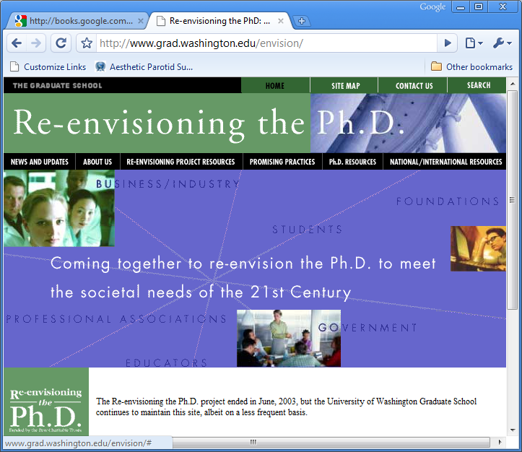

Slide 11
Can We Think of Doctoral Studies…
As training for the leadership of the next generation of information scientist-practitioners, not as replication of the current generation of professors
As an opportunity to address – with the ear of the future generation – the importance, components, and techniques of an evidence-based approach to the science and practice of information
As the primary educational setting where information phenomena receive their most analytical and critical attention in service of solving important problems

Slide 12
A Scientist-Practioner View of Doctoral Studies in the iSchools
Evidence-Based Approach
Application
Information Phenomena

Slide 13
The 3P Curriculum
Post-paradigmatic mixed methods of inquiry
Interpretive and (Post) Positivist methods
Critical and Action methods
Design and Evaluation methods
Problem-based learning with exposure to information problems at multiple levels
Micro (e.g., metadata), Meso (e.g., user behavior), and Macro (e.g., information policy)
Professional skills
E.g., Oral and Written Communication, Group Dynamics, Planning and Strategy, Instruction/Train the trainer

Slide 14
Bibliography
Kathleen Chwalisz (2003). Evidence-Based Practice: A Framework for Twenty-First-Century Scientist-Practitioner Training. The Counseling Psychologist, 31, 497-528.
David Goodstein (1993, February 25-26). Scientific Elites and Scientific Illiterates. Sigma Xi forum on "Ethics, Values, and the Promise of Science.”
Derek J. de Solla Price (1963). Little Science, Big Science. New York: Columbia University Press.

