Slide 1
Designing
Intergenerational
Mobile
Storytelling
Alex Quinn, Ben Bederson, Allison Druin
and the members of our design team
Notes:
Version 5
Updated 5/26/2009 5:08 PM

Slide 2
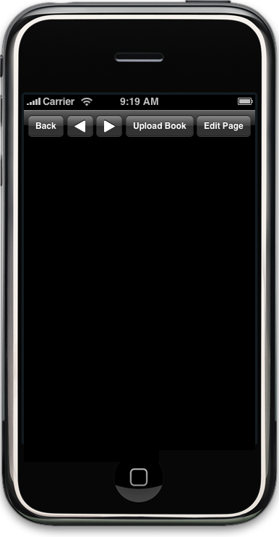

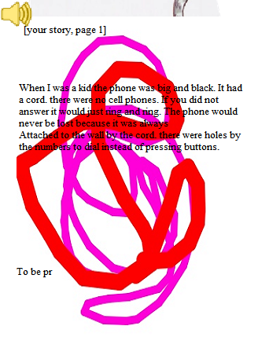
“When I was a kid the phone was big and black. It had a cord. there were no cell phones. If you did not answer it would just ring and ring. The phone would never be lost because it was always
“Attached to the wall by the cord. There were holes by the numbers to dial instead of pressing buttons.”
Notes:
So should I have
examples, demo, motivation
- Examples, motivation, demo,
-
Option A
Examples
Overview
Motivation
Demo
Experience
Lessons
Option B
Examples
Overview
Motivation
Demo
Experience
Lessons
Option C
Examples
Overview
Motivation
Demo
Experience
Lessons

Slide 3
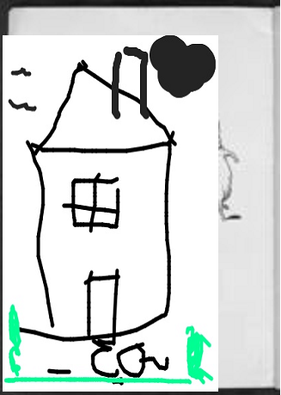
Notes:
So should I have
examples, demo, motivation
- Examples, motivation, demo,
-
Option A
Examples
Overview
Motivation
Demo
Experience
Lessons
Option B
Examples
Overview
Motivation
Demo
Experience
Lessons
Option C
Examples
Overview
Motivation
Demo
Experience
Lessons

Slide 4
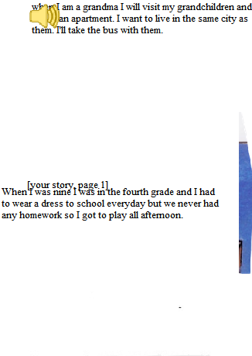
“When I am a grandma I will visit my grandchildren and live in an apartment. I want to live in the same city as them. I'll take the bus with them.
“When I was nine I was in the fourth grade and I had to wear a dress to school everyday but we never had any homework so I got to play all afternoon.”
Notes:
So should I have
examples, demo, motivation
- Examples, motivation, demo,
-
Option A
Examples
Overview
Motivation
Demo
Experience
Lessons
Option B
Examples
Overview
Motivation
Demo
Experience
Lessons
Option C
Examples
Overview
Motivation
Demo
Experience
Lessons

Slide 5
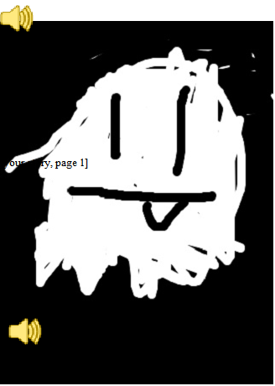
Notes:
So should I have
examples, demo, motivation
- Examples, motivation, demo,
-
Option A
Examples
Overview
Motivation
Demo
Experience
Lessons
Option B
Examples
Overview
Motivation
Demo
Experience
Lessons
Option C
Examples
Overview
Motivation
Demo
Experience
Lessons

Slide 6
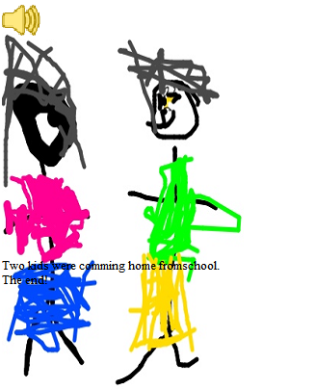
“Two kids were coming home from school.
“The end.”

Slide 7
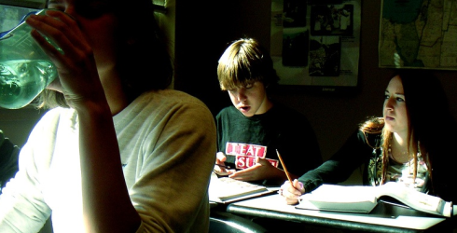
Need For Research
Informal education complements school
Projects with family provide opportunities
Cell phones enable working in new contexts
In time, technology like the iPhone will be available to a broad set of economic levels
Notes:
Photo by lanulop Flickr Creative Commons
Fetched indirectly from http://www.cpbn.org/article/still-subbing

Slide 8
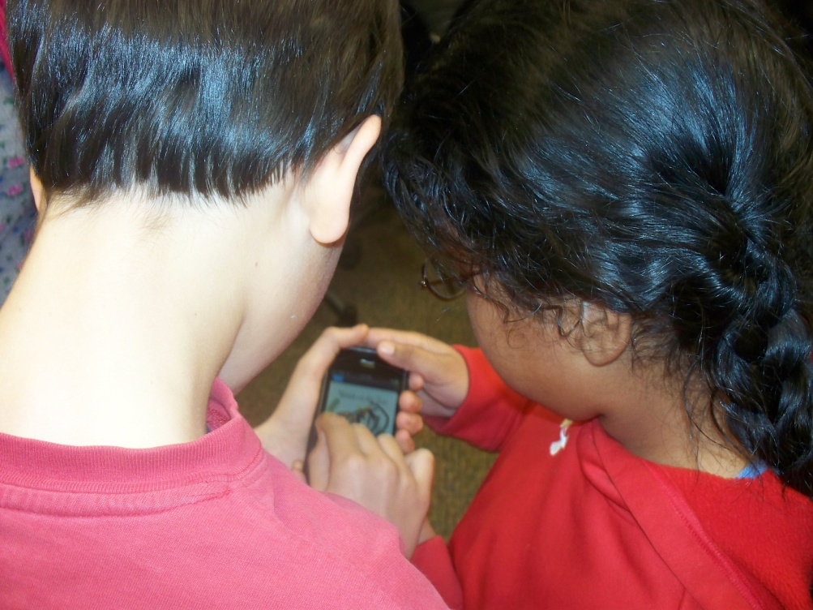
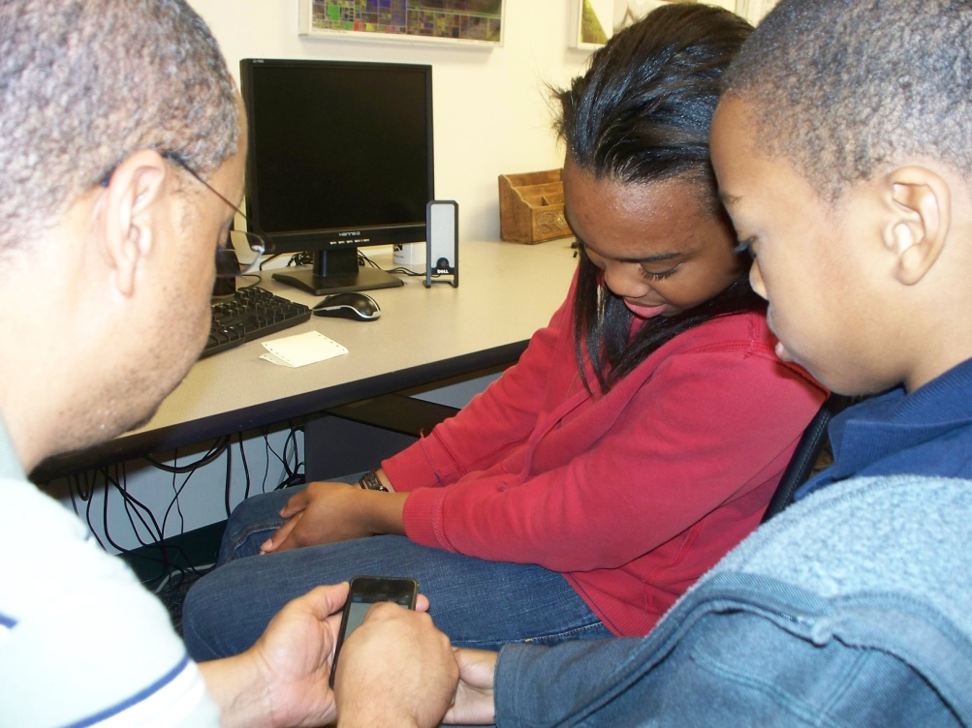
ICDL Story Editor
Modify an existing story from the International Children’s Digital Library (ICDL)
Create a new story
Simple “MMS”-like sharing of creations

Slide 9
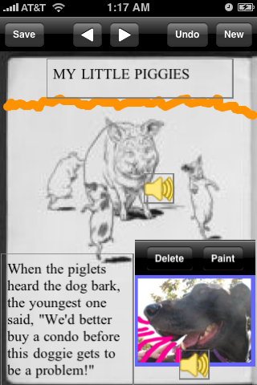
ICDL Story Editor
Work together or apart
Take photographs
Use photographs from the device’s photo album
Paint using a finger
Record sounds
Write text
Arrange page freely

Slide 10
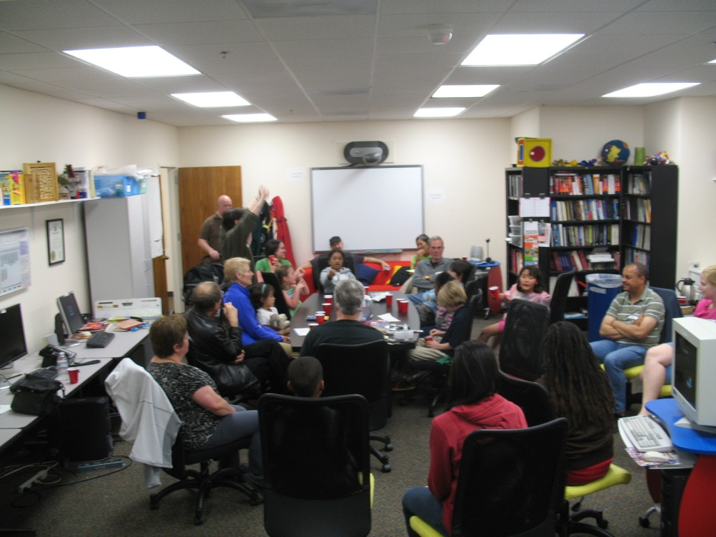
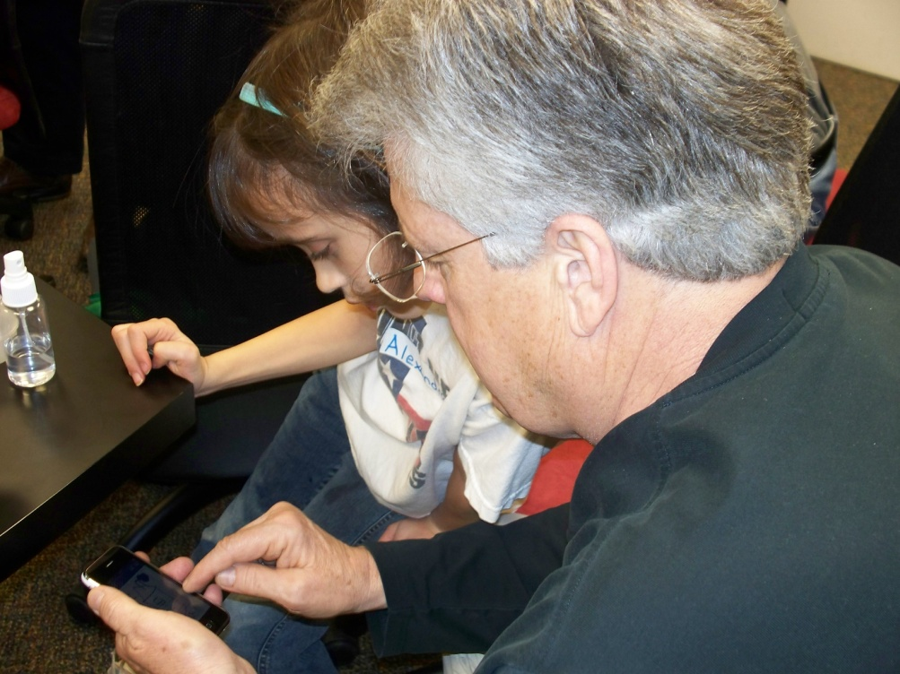
Co-designing With Kids and Elders
Kids brought grandparents or other close elders to the lab
Elders readily adapted to the technology in the context of spending time with the kids

Slide 11
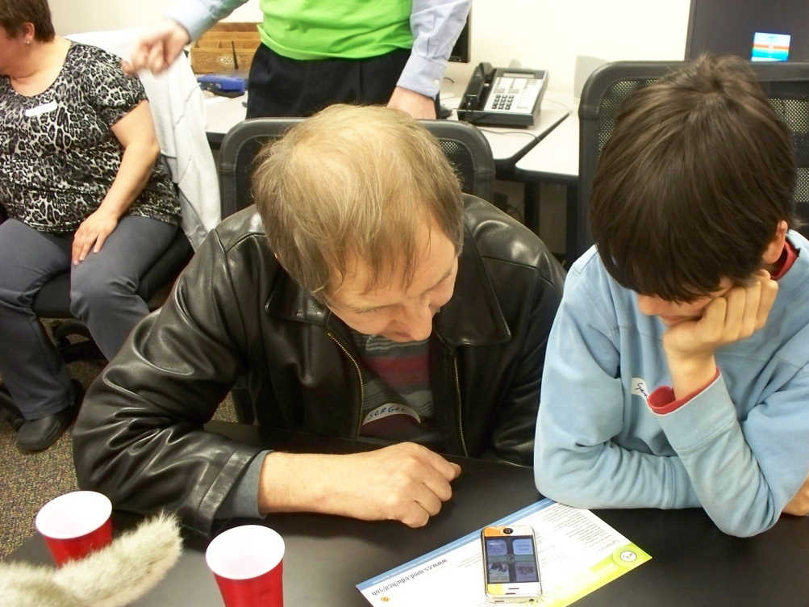
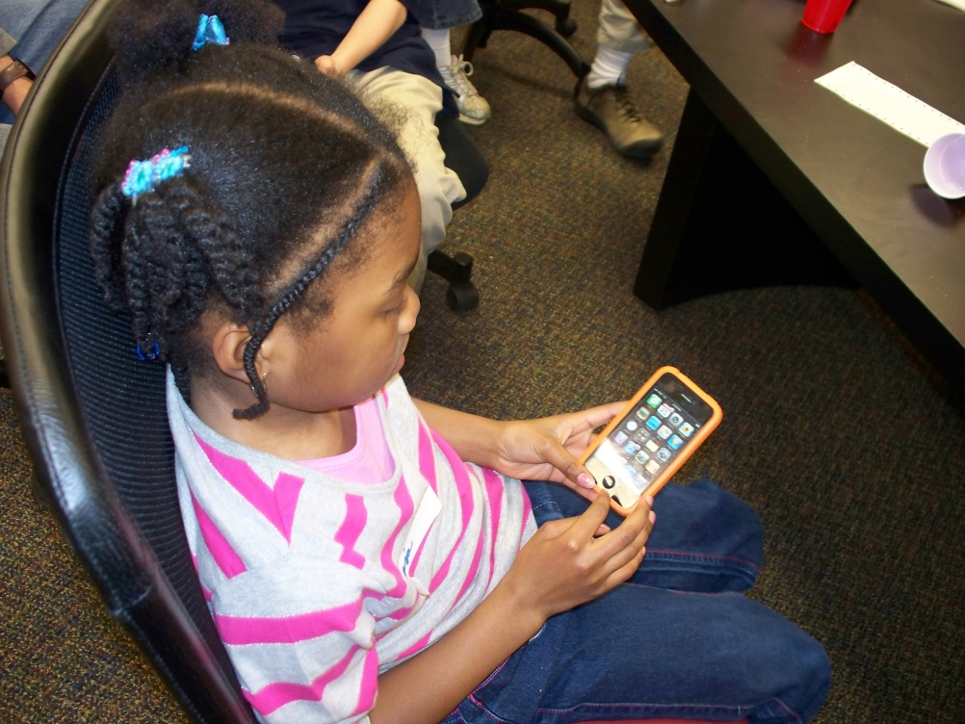
Solitary vs. Pair Work
Need streamlined workflow for pair work
Need detailed control for working alone
Try to design for shared control

Slide 12
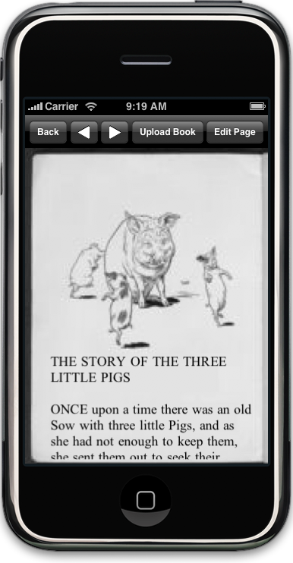
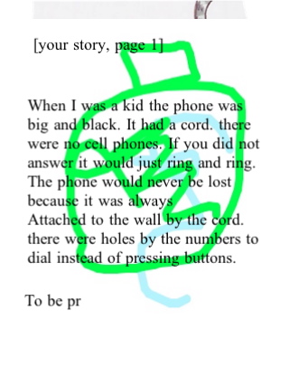
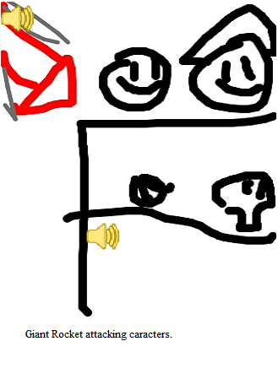
Challenges With Sound
No existing interface model for editing sound on a mobile device
If you were to “undo” a change to a sound, how would the interface show that something happened?
Different ways to use sound:
  Reading the story
  Sound effects
  Dialog

Slide 13
Lessons Learned
Strong human relationships support adaptation to new interfaces
Tailor the interface to the relationship
Pair work interfaces need to be simple
Individuals need more detailed control
Design to ensure shared control
For recording sound, consider the visual representation
Supported by NSF #0839222
Thanks to the children and adults in our design group.
Contact: Alex Quinn aq@cs.umd.edu

